Slide 1
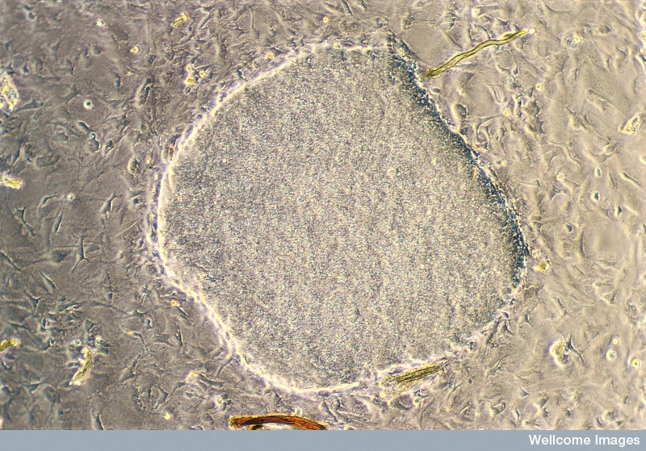
Neural stem cells: therapeutic potential
(Jenny Nichols, Wellcome Images)

Slide 2
Reminder: Types of stem cells
1. Embryonic stem cells (ES)
2. Induced pluripotent stem cells (iPS/iPSCs)
3. Embryonic or adult tissue specific stem cells
Differ in their ‘potency’

Slide 3
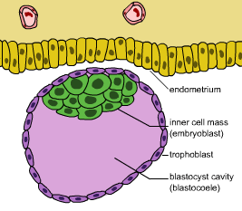
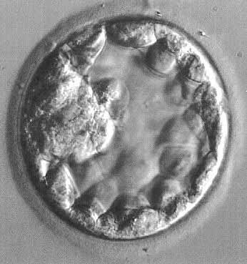
Types of stem cells: 1. Embryonic stem cells (ES)
A preimplantation embryo 4-5 days after fertilisation (‘blastocyst’) = cells that allow implantation into the womb + inner cell mass (‘ICM’)
ES cells come from the ICM
They are pluripotent
NB: cells before 4-5 days post-fertilisation are ‘totipotent’
They have ‘issues’

Slide 4
Huge breakthrough! Takahashi & Yamanaka, Cell 2006
Introduced Oct3/4, Sox2, c-Myc, and Klf4 into mouse embryonic or adult fibroblasts (i.e. differentiated somatic cells)
Resulting cells behaved like ES cells (in many NOT ALL ways)
Called Induced pluripotent stem cells (iPS/iPSCs)
No ethical barriers or immune reactions

Slide 5
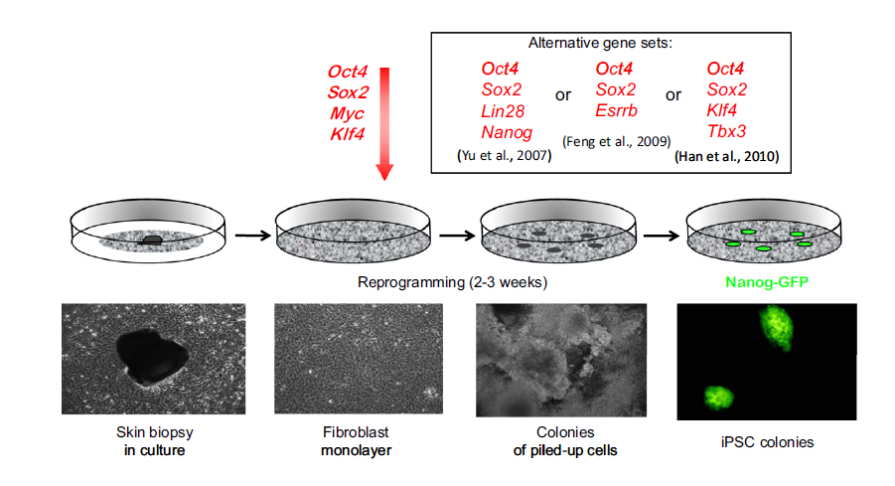
Induced pluripotent stem cells (iPSC)
(Graf, Cell Stem Cell, 2011)

Slide 6
http://www.nobelprize.org/nobel_prizes/medicine/laureates/2012/index.html

Slide 7
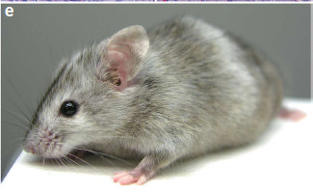
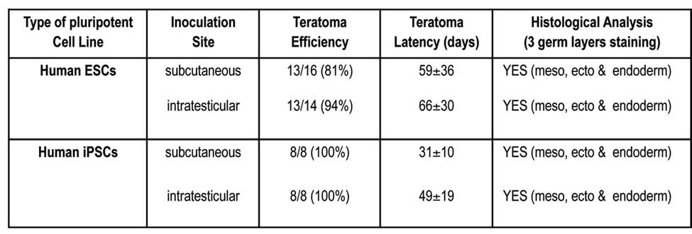
iPS cells: Still to discover (before the clinic)
How the cell of origin can influence iPS behaviour
iPS derived mice are more likely to die of cancer than those made from ES cells. Why?
Why DNA modifications may vary
Chimeric mouse with iPS-derived
grey hair Okita et al., Nature protocols 2010
Gutierrez-Aranda et al., 2010

Slide 8
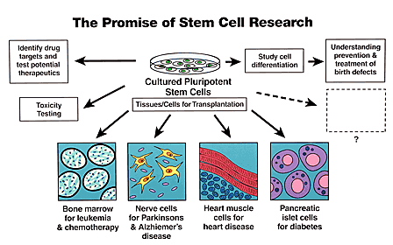
Some ways we can use stem cells in neuroscience research
As tools:
to understand developmental neurobiology
to investigate the cause/s of disease
to test drugs and other therapeutics on
As therapies:
to repair damaged/diseased tissues
to replace diseased/dying cells
(ideally with no immune response)

Slide 9
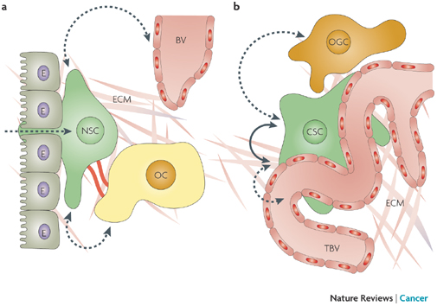
A useful concept: The stem cell ‘niche’
= the environment surrounding the stem cell
Contains the signals that keep it as a stem cell and stop it differentiating (i.e. stops depletion)
Includes signals from support cells, extracellu7lar matrix, other stem cells etc.
Differentiation can be
triggered
by leaving the niche

Slide 10
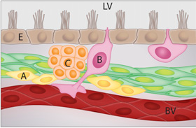
Adult NSC niche includes?
Signals from vascular cells, glial cells, surrounding neurons
PDGF, FGF2, Notch, EGF, Shh…
ECM
Exercise
Enriched environments (rodents at least)
Antidepressants
Stress can reduce SGZ neurogenesis
NSCs will integrate these
(via TFs) to control self-renewal
& differentiation
Usually kept quiescent via BMP signalling
(SVZ)

Slide 11
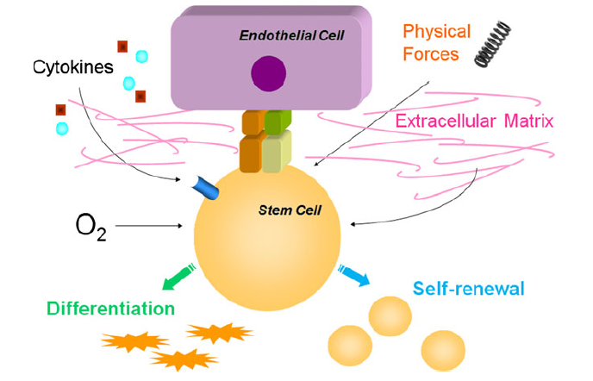
The vascular neural stem cell niche
Often see NSCs clustered near blood vessels

Slide 12
One therapeutic approach: use endogenous neural stem cells (tissue-specific)
Stimulate their division
Drive their differentiation
Studies on ES and IPSCs might help this
Access
Dangers
CNS may resist (niche, surrounding cells)
(little published so far beyond exercise +/- antidepressants)

Slide 13
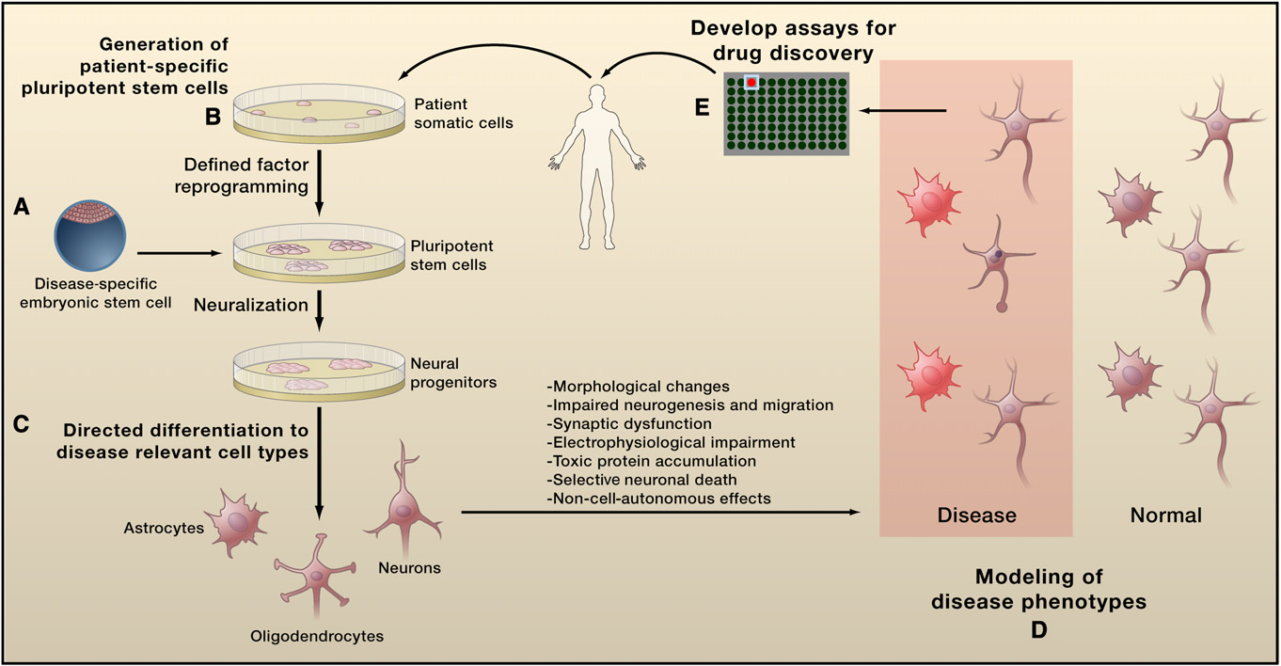
Cf: Uses of iPSC in Neuroscience
(Han et al., Neuron 2011)

Slide 14
E.g. Demos et al., Science, 2008
iPS from an Amyotrophic lateral sclerosis patient (ALS, type of motor neuron disease)
motor neurons in spinal cord and motor cortex die
? Why yet

Slide 15
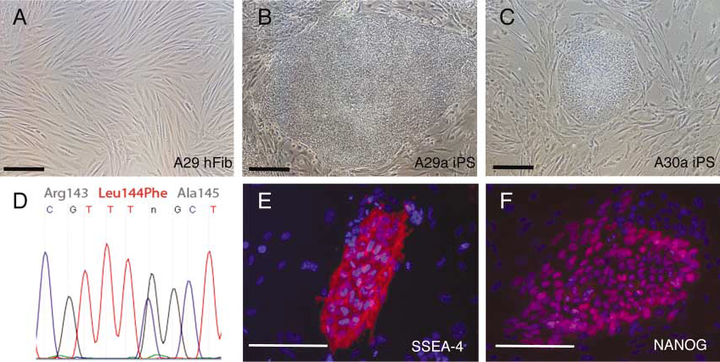
82 yr. old ALS patient: from simple skin biopsy to iPS
D = Sequencing of the iPS cells showing rare L144F
(Leu144 → Phe) dominant allele of the superoxide
dismutase (SOD1): associated with her slowly progressing form of ALS

Slide 16
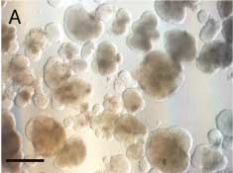
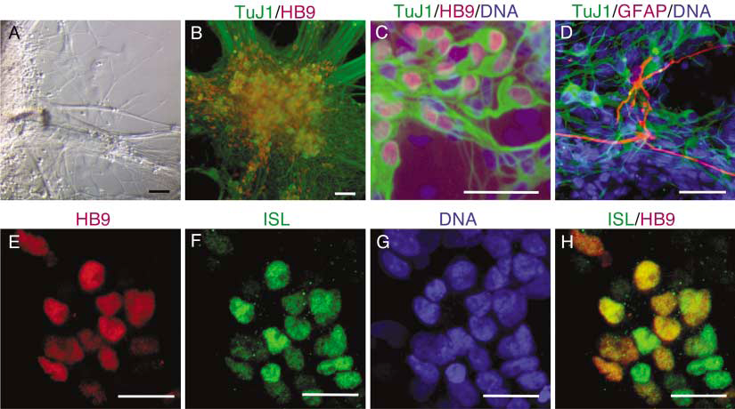
Can differentiate these iPSC into neurons
Take embryoid bodies formed from the iPSC
Treat with a Shh and RA agonist, grow on laminin
The cells differentiated into motor neurons (expressed MN-specific transcription factors:

Slide 17
Another example of patient-specific iPSC in neuroscience
Rett syndrome
Progressive neurological disorder (X-linked gene encoding MeCP2)
Normal development until 18m old, then motor decline, regression, weak muscles, seizures, autistic behaviour
Marchetto et al., Cell, 2010
Developed iPS from Rett patient skin biopsies

Slide 18
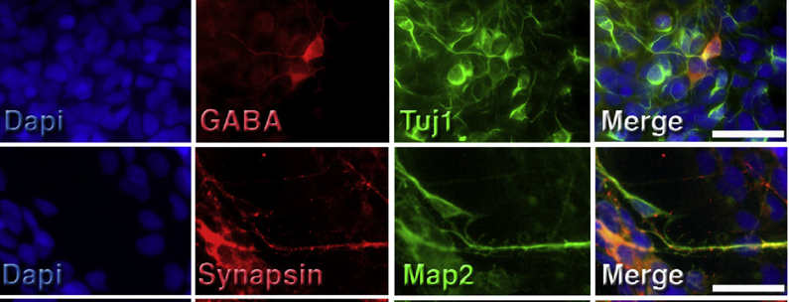
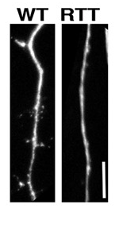
Can differentiate into neurons
Found that Rett iPSC derived neurons have:
Fewer spines and synapses than ‘WT’
Altered calcium signals
Electrophysiology changes

Slide 19
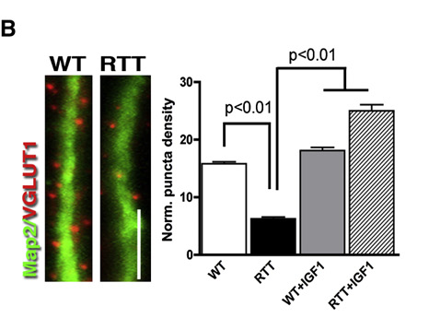
Testing therapies on these iPSC
Could ‘repair’ the gene defect (e.g. with IGF-1 treatment) and see some rescue of normal characteristics:
Can also look at stress resistance, survival, interactions with other cell types,
response to drugs in development

Slide 20
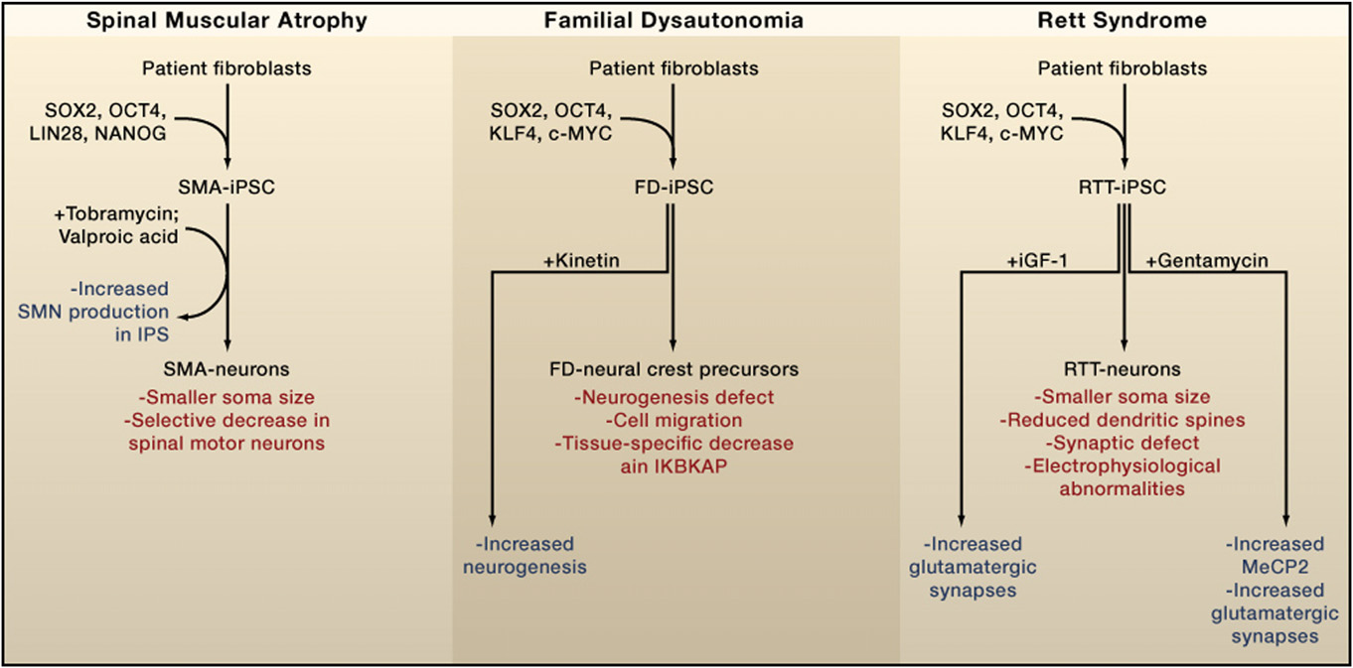
Summary of some neural disease modelling
(Review by Han et al., Neuron 2011)

Slide 21
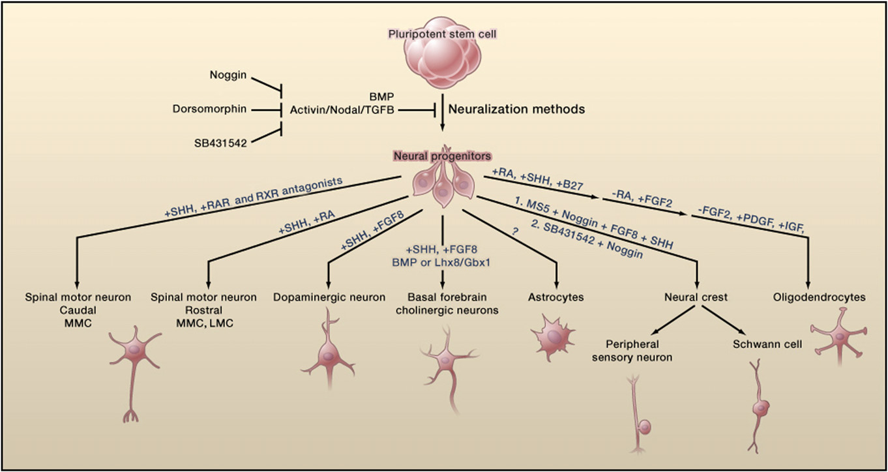
IPSCs can also answer developmental neurobiology questions
(Review by Han et al., Neuron 2011)

Slide 22
15 minute break
Relax
Meet your neighbour
Review your notes
Ask questions

Slide 23
Therapeutic potential of stem cells in the CNS
Huge need: AD, PD, MS, stroke, tumours, spinal cord damage etc
Stem cells can migrate to sites of injury
Are multipotent
Need to reach correct site, integrate, survive, function and not cause tumours and ideally not trigger an immune reaction
Do not want abnormal connections

Slide 24
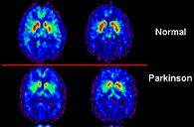
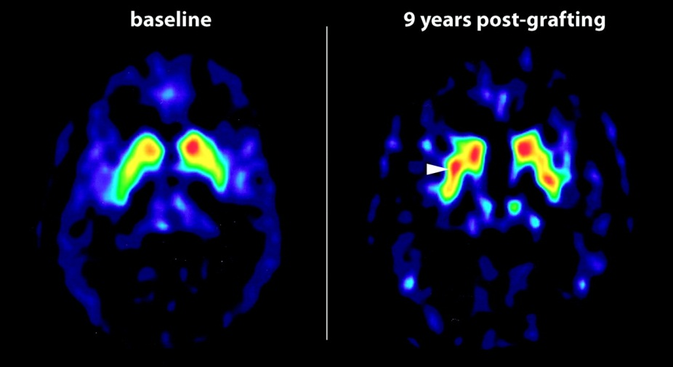
Stem cell derived neural transplants e.g. Parkinson’s disease
PD is… (see Lecture 1 too)
Current treatments
Inc. foetal cell transplants

Slide 25
Strategy: Replace diseased dopaminergic neurons
Use clues from Developmental Biology (previous Lectures)
Nat Biotechnol. 2009 Mar;27(3):275-80. Highly efficient neural conversion of human ES and iPS cells by dual inhibition of SMAD signaling.
Chambers SM, Fasano CA, Papapetrou EP, Tomishima M, Sadelain M, Studer L. (e.g. mimic neural plate inhibition BMP signalling)
Mol Cell Neurosci. 2010 Nov;45(3):258-66. Epub 2010 Jul 24.
Differentiation of human ES and Parkinson's disease iPS cells
into ventral midbrain dopaminergic neurons
requires a high activity form of SHH, FGF8a
and specific regionalization by retinoic acid.
Cooper O, Hargus G, Deleidi M, Blak A, Osborn T,
Marlow E, Lee K, Levy A, Perez-Torres E, Yow A, Isacson O.
Need to push SCs along the lineage you want and then test their characteristics
Currently testing which stage of cells to use

Slide 26
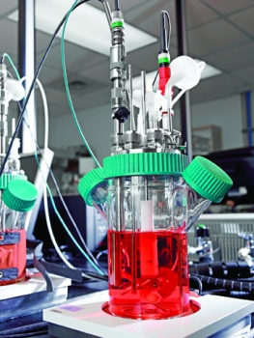
Needs cell culture developments
Scalable
Robust
Cheap
Easy
Cross-disciplinary research: Bioscaffolds, growth factor delivery etc.

Slide 27
Another SC based strategy: neuroprotection (transplant supporting cells)
Again, use knowledge of neurobiology
J Neurosci. 2000 May 1;20(9):3182-90.
Glial cell line-derived neurotrophic factor is essential
for postnatal survival of midbrain dopamine neurons.
Granholm AC, Reyland M, Albeck D, Sanders L, Gerhardt G,
Hoernig G, Shen L, Westphal H, Hoffer B.
J Neurosci. 2001 Oct 15;21(20):8108-18.
Neuroprotection through delivery of glial cell
line-derived neurotrophic factor by neural stem cells
in a mouse model of Parkinson's disease.
Akerud P, Canals JM, Snyder EY, Arenas E.
Eur J Neurosci. 2005 Dec;22(11):2755-64.
Ex vivo gene delivery of GDNF using primary astrocytes
transduced with a lentiviral vector provides neuroprotection
in a rat model of Parkinson's disease.
Ericson C, Georgievska B, Lundberg C.

Slide 28
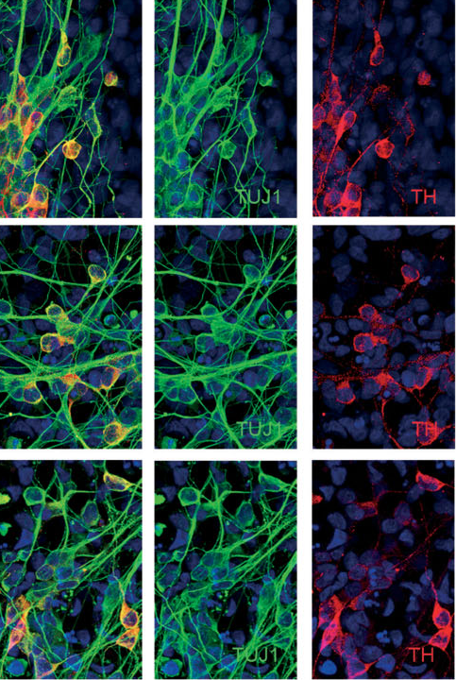
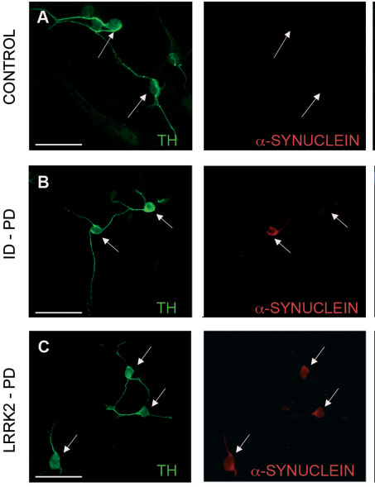
IPSCs might tell us why DNs die in PD
e.g. Sanchez-Danes et al.,
EMBO Molecular Medicine, 2012

Slide 29
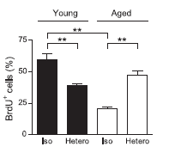
Other possible Stem cell based therapies: anti ageing?
(Last Lecture too: old niches)
Local and/or systemic factors?
Brack et al., Science, 2007
Notes: ‘Parabiosis’ = sharing a circulation
old muscles: stem cells less proliferative and often generate fibrosis generating cells rather than muscle
Parabiosis expt: could ‘rejuvenate’
muscle stem cells
It was due to Wnt inhibition
by the younger serum

Slide 30
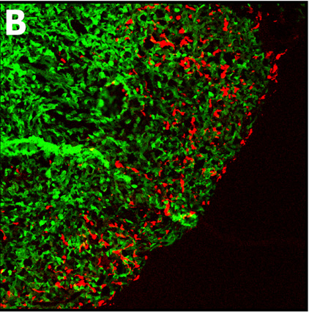
Use stem cells to deliver neural tumour destroyers?
Stem cells e.g. MSCs Can home to signals
Human MSCs moving into
a human glioma
in mouse brain:
(Bexell et al., 2012)

Slide 31
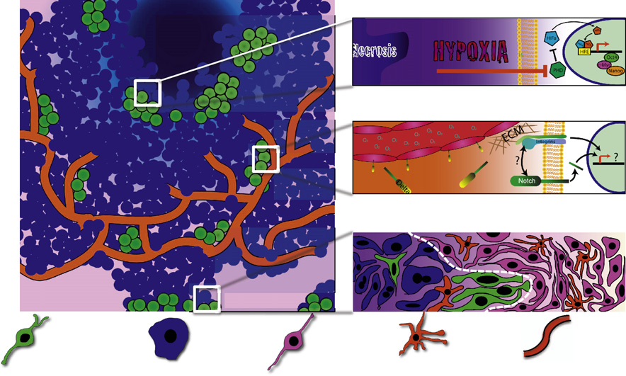
Possible glioma stem cell niches
Hypoxic
Perivascular
Invasive
Glioma SC Glioma Brain stromal Immune cell Blood vessel
(Lathia et al., Review in Cell stem Cell, 2011)

Slide 32
Glia stem cells
Recent finding: Oligodendrocytes are still produced in adulthood
From NG2+ cells
After gliotoxin injury these can also generate Schwann cells and possibly astrocytes (not neurons)
Remyelination possible using these?
(Reviewed in Richardson WD et al., Neuron 2011)

Slide 33
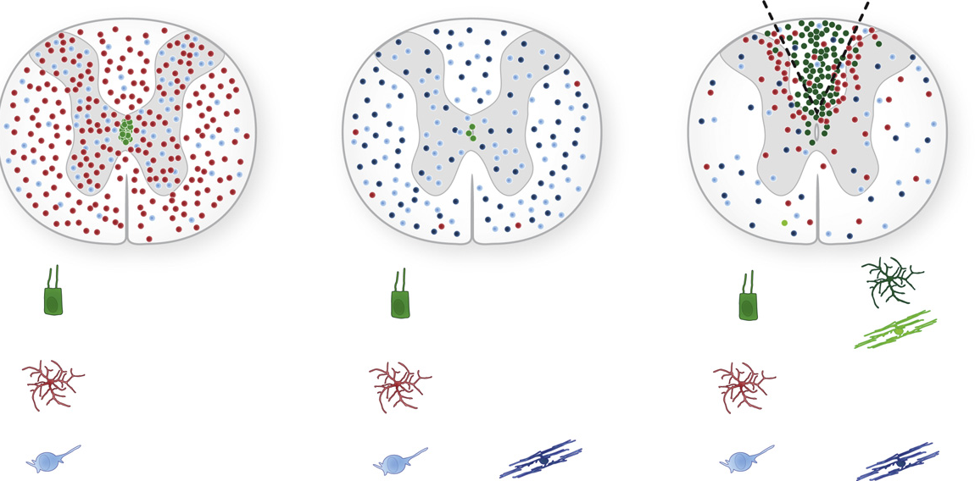
Translating SC studies into medicine
New basic biology of spinal cord injury e.g. Barnabe –Heider et al., Cell Stem cell 2010 :
Normal
Control at 4m
Injured at 4m
ependymal
astrocyte
Oligodendrocyte
progenitor
Ependymal cells can generate astrocyte scar cells (bad) and oligodendrocytes (good)

Slide 34
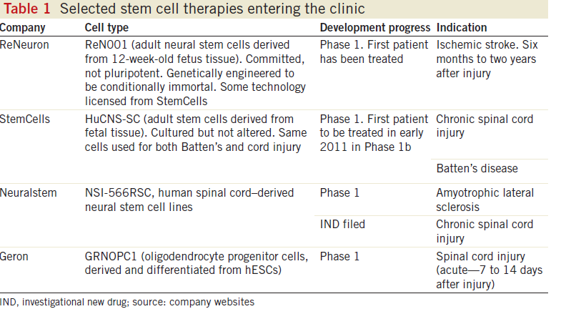
Some are at clinical trial stage already
(See also Review Aboody et al., Neuron, 2011)
(Nat Biotechnol. 2011 Feb;29(2):95-7)

Slide 35
Criticisms/Ethical issues
e.g. of Geron’s trial http://www.youtube.com/watch?v=dYREI7nIMcc&feature=relmfu
‘’including extending the lesion while transplanting the cells or
introducing infection …. understand that patients with
subacute complete SCI are a vulnerable population. Seven to
14 days postinjury, which is the recruitment period for the Geron
trial, is a time during which the patients who will have suffered an
acute traumatic event will be experiencing stress, anxiety, fear,
and depression
…. (1) preventing endogenous
remyelination, (2) promoting teratoma formation, (3) affecting
inflammation, and (4) promoting aberrant neural reorganization. ‘’
(Bretzner et al., Cell Stem Cell 2011)
(‘stem cell tourism’)

Slide 36
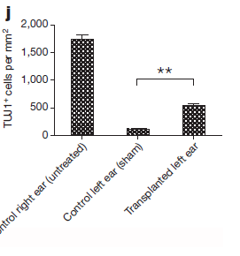
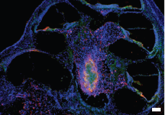
A very recent hope-provoking Neuroscience stem cell paper
‘’Restoration of auditory evoked responses by human ES-cell-derived otic progenitors’’

Slide 37
Learning Outcomes of this Lecture
(What defines a stem cell?)
Different types of stem cells: ES, iPS, Tissue-specific
Potential uses of stem cells in neuroscience research
Neural stem cell-based therapy development inc. cancer, neurodegeneration, genetic disease, ageing (and your own suggestions) and current clinical trials

