Slide 1
Sex hormones and brain development
Imperial College
London
BSc Neuroscience
Glenda Gillies

Slide 2
Aims: To understand the role of sex steroid hormones in sexual differentiation of the brain, the physiological consequences and implications for sex bias in mental health.
Learning objectives
Briefly outline the role of the Sry gene in sexual differentiation of the brain and distinguish between genetic and hormonal influences on sexual differentiation of the embryo.
Describe the developmental changes in circulating levels of the sex steroid hormones, testosterone (T) and oestradiol (E2) in male and female rodents and humans.
List the main processes of neuronal development that are influenced by E2 and T.
Define 'organisational' and 'activational' influences of gonadal steroids in the developing brain.
Describe some neuroanatomical and functional differences between the male and female hypothalamus and discuss the experimental evidence which supports the view that these differences are hormonally mediated.
Explain the evidence, gained primarily from experimental animals, which suggests that, during a critical period of development, the masculinizing effects of testosterone on the hypothalamic centres governing reproductive functions and behaviours are mediated via estrogen receptors after conversion of testosterone to estrogen by central aromatases.
Understand some mechanisms that mediate the mascuinizing/defeminizing actions of testosterone in the POA, Arc and VMN nuclei of the hypothalamus.
Discuss how knowledge of hormonal actions in the developing hypothalamus may have relevance for the rest of the brain.
Consider, briefly, the clinical implications of sex dimorphisms in the brain

Slide 3
Overview
Quick review of the neuroendocrine system
Hormonal control of sexual differentiation of the brain:
- genes versus hormones
- critical periods
- organizational vs activational effects
The hypothalamus as the prototype: neuroregulatory pathways governing reproduction
- why sexual differentiation of the brain is necessary
- underlying mechanisms
When it goes wrong
Sex differences in extra-hypothalamic brain regions and health implications: the midbrain dopaminergic populations
- Parkinson’s disease(experimental & clinical) and sex hormones
A need for sex-specific interventions

Slide 5
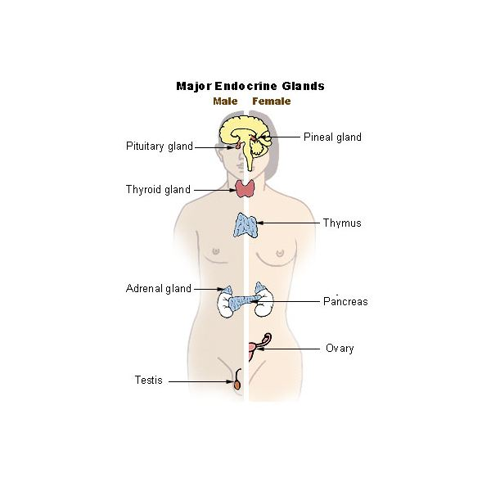
The neuroendocrine system
The Endocrine System
The Nervous System
Hypothalamus
Central
Brain &
Spinal cord
Prl
GH
Pituitary gland
VP
Thyroid gland
Peripheral
TSH
OT
Adrenal gland
ACTH
Ovary
Ovary
LH/FSH
Testis
Brain-body communication
Notes:
As the name suggests, Neuroendocrinology is essentially a study of the interactions between the nervous and endocrine systems that are the major means for communication between the brain and body. The hypothalamus is the region that contains specialised neurones that control the whole of the endocrine system via the pituitary gland.
To remind my students of their neuroanatony, I tell them that if you draw an imaginary line between your ears and from the bridge of your nose to the nape of your neck, the hypothalamus lies where the lines intersect. This is just above the pituitary gland which, in turn, lies above the roof of the mouth. The pituitary gland is aptly described as the conductor of the endocrine orchestra because it send out 8 major hormones into the blood stream that, in turn, control a host of physiologcal processes.
These are thyroid stimulating hormone controls the thyroid gland and metabolic rate; ACTH or corticotrophin that controls cortisol release from the adrenal gland that is critical for survivng stress; luteinizing hormone and follicle stimulating hormone, coleectively called that gonadotrophins because they stimulate the productions of oestrogen and progesterone in the ovaries and testosterone in the testes; growth hormone that targets multiple tissues; prolactin that among other things stimulates lactation; vasopressin that regulates salt and water balance and finally oxytocin that plays roles in parturition and milk ejection.

Slide 6
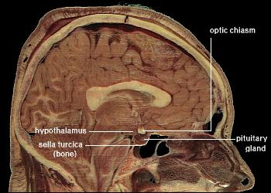

Slide 7
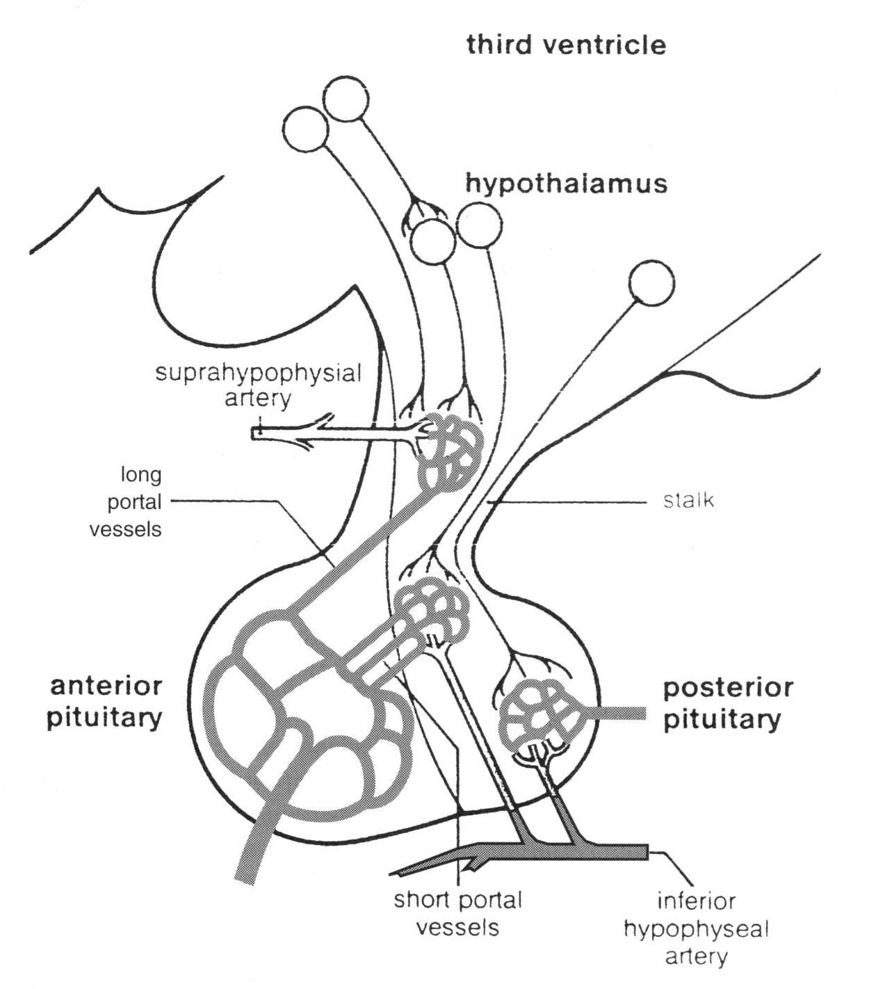
THE HYPOTHALAMO-PITUITARY AXIS
- the classical neuroendocrine system
Hypothalamus
Suprahypophyseal artery
Long portal vessels
Anterior
pituitary
Posterior pituitary
TSH
ACTH
LH/FSH
GH
Prolactin
short portal vessels
Vasopressin
Oxytocin
Notes:
This diagramatic representation of the hypothalamo-pituitary axis explains why VP and OT were in a different colour in my previous slide because these 2 hormones are produced by the posterior pituitary that is formed developmentally by a down-growth of the hypothalamic neurones, so it is part of the brain, whereas the other hormones are produced by the anterior pituitary gland which is an up-growth from the roof of the mouth, so not part of the brains, although it is in the head. For each anterior pituitary hormone there is a separate set of hypothalamic neurones that produce their regulatory factors which the neurones secrete into a tiny portal blood system these factors to the anterior pituitary.
My early research involved characterization of the hypothalamic factors controlling of corticotrophin or ACTH release, and hence the stress resposne and here I would like to acknowledge the huge influence that Phil Lowry had on my career path, because it was with him, as his PhD student and post-doctoral researcher at Barts, that we discovered that some hypothalamic VP neurones had hijacked the role of a CRF. This was a very exciting time and infected me with the research bug, so I THINK I should be thankful for that, although my family may contradict me.

Slide 8
Definitions

Slide 9
Sex
Distinguishes male or female subjects according to the reproductive organs and functions that derive from the chromosomal complement (male XY or female XX sex chromosomes)
Gender
A [human] subject’s self-representation as male or female

Slide 10
Dimorphisms
The occurrence of 2 forms within the same species
Sex dimorphisms occur in regions of human and animal brains important for
-Reproduction (hypothalamus)
-Cognition, memory and affect (hippocampus, amygdala, cortex)
-Sensorimotor control and reward (mesostriatal and mesolimbic pathways)
Cahill 2006; Gillies & McArthur, 2010

Slide 11
Nat Rev Neurosci. 2006 Jun;7(6):477-84 Why sex matters for neuroscience Larry Cahill
Research into sex influences is mandatory to fully
understand a host of brain disorders with sex differences in their incidence and/or nature.
The striking quantity and diversity of sex-related influences on brain function indicate that
the still widespread assumption that sex influences are negligible cannot be justified, and probably retards progress in our field.

Slide 12
Overview
Quick review of the neuroendocrine system
Hormonal control of sexual differentiation of the brain:
- genes versus hormones
- critical periods
- organizational vs activational effects
The hypothalamus as the prototype: neuroregulatory pathways governing reproduction
- why sexual differentiation of the brain is necessary
- underlying mechanisms
When it goes wrong
Sex differences in extra-hypothalamic brain regions and health implications: the midbrain dopaminergic populations
- Parkinson’s disease(experimental & clinical) and sex hormones
A need for sex-specific interventions

Slide 13
Historical perspectives on sex differentiation
460 B.C. Thermal hypothesis (Empedokles of Akras). Conception in a cold uterus - female offspring; in a hot uterus - male
440 B.C. Hypothesis of laterality (Anaxagoras of Clazomenae). Right testis/horn of uterus - male offspring; left - female
384 - 322 B. C. Aristotle of Stagirus. Warm winds from the south during copulation - male offspring; cold winds - female

Slide 14
cf.
frogs - male phenotype if larvae develop at elevated water temperatures.
lizards - incubation of eggs >26ºC - males; <26 ºC - females
certain turtles - incubation of eggs < 26ºC - males; >32 ºC - females

Slide 15
Genetic vs Epigenetic factors governing sexual differentiation
21st Century
The early embryo is essentially female, or at least neutral.
Masculinization of the mammalian gonads is genetically determined by the Sry gene (Sex determining Region of the Y chromosome, previously termed TDF (testes determining factor)
Thereafter, differentiation of other sexual structures (internal and external genitalia) and the brain depends on the imprinting actions of hormones during fetal or neonatal life.

Slide 16
Genetic determination of gender and epigenetic influences on sex differentiation
XY
XX
Y-linked Sry gene

Slide 17
Genetic determination of gender and epigenetic influences on sex differentiation
XY
XX
Y-linked Sry gene
Formation of testis via unknown mechanisms in an embryo with no pre-existing male/female differences
Testosterone
Mullerian duct Inhibitory Factor
prevents development of
internal female genitalia

Slide 18
Genetic determination of gender and epigenetic influences on sex differentiation
XY
XX
Y-linked Sry gene
Formation of testis via unknown mechanisms in an embryo with no pre-existing male/female differences
Testosterone
Mullerian duct Inhibitory Factor
prevents development of
internal female genitalia
5α-reductase
Development and differentiation of the Wolffian duct giving rise to internal genitalia (epididymis, ductus
seminal vesicles)
DHT
Differentiation of external genitalia
(penis, penile urethra, scrotum)

Slide 19
Genetic determination of gender and epigenetic influences on sex differentiation
XY
XX
Y-linked Sry gene
Formation of testis via unknown mechanisms in an embryo with no pre-existing male/female differences
Testosterone
Mullerian duct Inhibitory Factor
prevents development of
internal female genitalia
aromatase
5α-reductase
E2
Masculinization
of brain
Development and differentiation of the Wolffian duct giving rise to internal genitalia (epididymis, ductus
seminal vesicles)
DHT
Differentiation of external genitalia
(penis, penile urethra, scrotum)

Slide 20
Genetic determination of gender and epigenetic influences on sex differentiation
XY
XX
Y-linked Sry gene
Development of Mullerian
duct, giving rise to
internal genitalia
(uterus, oviduct, ovary)
Formation of testis via unknown mechanisms in an embryo with no pre-existing male/female differences
Testosterone
Mullerian duct Inhibitory Factor
prevents development of
internal female genitalia
In absence of testosterone
external genitalia form
(clitoris, labia)
aromatase
5α-reductase
E2
Masculinization
of brain
Development and differentiation of the Wolffian duct giving rise to internal genitalia (epididymis, ductus
seminal vesicles)
DHT
Differentiation of external genitalia
(penis, penile urethra, scrotum)

Slide 21
Summary Testicular differentiation is the primary event in sex determination Sexual differentiation (body and brain) is controlled by gonadal secretions

Slide 22
Patterns of hormone exposure throughout life; a biological basis for sex differences in the brain
Sry gene on Y chromosome directs development of testes
Pubertal hormones activate sexually differentiated brain circuitry
Embryo is not sexually differentiated
conception
birth
puberty
death
rodents
Humans ?
Critical period for hormone-dependent sexual differentiation (organization) of the hypothalamus
Notes:
There is currently some debate as to whether genes on the Y sex chromosome, that is present only in males, contribute directly to brain sex differences, but the overwhelming evidence from basic science studies conclude that sex differentiation of the brain is primarily a hormone-dependent process.
For a short period after conception the is no difference in male and female embryos – in the brain or elsewhere. The Sry gene on Y chromosome then plays a key, indirect role, by directing the development of testes in males, which are transiently activated during development to secrete testosterone. This co-incides with a critical window when the hypothalamic circuitry is susceptible to masculinization or defeminization that persists throughout life. These circuits are, however, not activated until the pubertal rise in testosterone levels.
The experiments can’t be performed to establish if this is the case for humans, but the patterns of hormone exposure suggest that this is likely.

Slide 23
ORGANISTIONAL effects of gonadal steroids in the CNS
At critical developmental stages hormones induce specific neural substrates or circuits to develop differently in males and females such that they react differently at a later stage when they are exposed to the same hormonal environment. eg. the neural regulation of the hypothalamo-pituitary-gonadal (HPG) axis.
These effects are irreversible.

Slide 24
ACTIVATIONAL effects of gonadal steroids in the CNS
In adulthood, the response of a given neural element will differ depending on the hormonal environment e.g. even low dose androgens will make women more assertive and increase libido.
These effects are reversible.

Slide 25
Rats
T exposure in males
Critical
Window for sex differ-entiation
4 day
estrous cycle
LH surge
& ovulation
E2 exposure in females
conception
birth
puberty
death
21 days
35-45 days
Humans
Critical
Window for sex differ-entiation
?
T exposure in males
28 day
menstrual
cycle
E2 exposure in females
1
LH surge
& ovulation
28
conception
birth
puberty
menopause
death
9 months
10-13 years
Notes:
Here you can see that in both rats and humans there are similar patterns of exposure to testosterone, shown in blue, and E2 in pink.
I apologise to those of you who may object to the blue/pink sterotyping. I had thought of breaking away from this convention, but I once attended a symposium where the speaker had used other colours – yellow and green, I think, and many of the audeince found it utterly confusing, so I hope that it serves its purpose.
So, in both cases we see a transient rises in testosterone in early life, that then lies dormant until puberty. In rats the critical period occurs just before and after birth whereas in humans it is likely to occur around or just before mid gestation. Interestingly, the stage of brain development in humans at mid gestation corresponds approximately to birth in the rat, which is a precocious species.
The patterns of E2 exposure are also similar across species, with cyclicity emerging at puberty to trigger the LH surge and ovulation.

Slide 26
sources of sex hormones and their actions in the brain
Steroidogensis in the developing testes is activated earlier in development than ovarian steroidogenesis
The brain develops in a different hormonal environment in males & females
In the developing brain, sex hormones influence
Neurogenesis
Migration
Neurite extension
Synaptogenesis
Growth factor production
Apoptosis
This establishes irreversible sex dimorphisms in specific neural circuits = sexual differentiation of the brain

Slide 27
Overview
Quick review of the neuroendocrine system
Hormonal control of sexual differentiation of the brain:
- genes versus hormones
- critical periods
- organizational vs activational effects
The hypothalamus as the prototype: neuroregulatory pathways governing reproduction
- why sexual differentiation of the brain is necessary
- underlying mechanisms
When it goes wrong
Sex differences in extra-hypothalamic brain regions and health implications: the midbrain dopaminergic populations
- Parkinson’s disease(experimental & clinical) and sex hormones
A need for sex-specific interventions

Slide 28
The sexually differentiated hypothalamo-pituitary-gonadal axis

Slide 29
MALES
HIGHER CENTRES
-ve
HYPOTHALAMUS
-ve
Pulsatile release
GnRH (LHRH)
ANTERIOR PITUITARY GLAND
-ve
FSH
LH (ICSH)
TESTIS
Sertoli cells
Leydig (interstitial) cells
ANDROGENS
Testosterone
DHEA and androstenedione
Spermatogenesis
Secondary sex organs

Slide 30
ovulation
20
80
15
LH (U/l)
FSH (U/l)
10
40
5
0
0
2000
50
1000
25
Oestrogen (pmol/l)
Progesterone (nmol/l)
0
0
0
2
4
6
8
10
12
14
16
18
20
22
24
26
28
Days
Follicular phase
Luteal phase

Slide 31
FEMALE
HIGHER CENTRES
-ve (+ve)
-ve
HYPOTHALAMUS
GnRH
Pulsatile release cyclical changes
-ve
ANTERIOR PITUITARY GLAND
-ve (+ve)
FSH
LH
GF
CL
ovum
OESTROGEN
PROGESTERONE
Ovulation
Falling E & P, menses
Follicular phase (rising oestrogen)
Luteal phase (rising progesterone)
Fertilization, implantation

Slide 32
The Hypothalamo-pituitary gonadal axis – controller of reproduction and the prototype for brain sex differences
Rising levels of E2
Hypothalamus
Gonadotrophin releasing hormone
Pituitary gland
Pituitary
Gonadotrophins
LH/FSH
Thyroid gland
LH surge
Adrenal gland
Oestrogens
Progesterone
Ovary
Ovary
Testis
Testerone
Ovulation
Males have a different hard-wiring of hypothalamic neuronal circuitry
Notes:
But I diverge from sex differences. This summarizes why sex differences in hypothalamic circuitry are important for reproduction and reproductive behaviours.
The hypothalamic neurones governing the hypothalamo pituitary gonadal axis produce gonadotrophin releasing hormone that stimulates release of the gonadotrophins, LH and FSH and, consequently, oestrogens and progesterone from the ovaries or testosterone from the testes. As E2 levels rise over the menstrual cycle, this stimulates the gonadotrophin releasing hormone neurones, which generated an LH surge that is the trigger for ovulation and, in rats, the trigger for sexual receptivity. If you give E2 to males, they cannot mount an LH surge and this is one example that suggests that the hypothalamic hard-wiring is different between the sexes.

Slide 33
What is the experimental evidence that testosterone is the major driving force for masculinisation of the brain?

Slide 34
Sex differences in hypothalamic control of reproductive-associated functions – ESSENTIAL FOR SURVIVAL OF THE SPECIES
Reproductive physiology of HPG axis
cyclicity in the patterns of pulsatile GnRH release, the LH surge & ovulation in females
Reproductive behaviours
eg. lordosis (female); mounting and intromission (male)
Reproductive-associated behaviours
eg. maternal/parenting behaviour, aggressive/territorial behaviour

Slide 35
Plasma testosterone levels in pregnant rats and their offspring
male
female
2400
mother
2000
Testosterone
pg/ml
plasma
1600
1200
800
400
17
19
21
23
31
birth
Days post-fertilisation
modification after Weisz & Ward

Slide 36
Certain actions of testosterone during development and adulthood are mediated via oestradiol (E2) acting at the oestrogen receptor (ER)
Testosterone
aromatase
5-α
reductase
DHT
E2
Brain
masculinization
/defeminization via ERs
Critical period
E17-P10 (rodents)
Third-half way through gestation (humans)?
Development of genitalia via ARs
Brain feminization?
2 weeks later than masculinization?
Notes:
Many of you will know that T acts by binding to intracellular Androgen receptors to produce its effects, and this occurs after it is metabolised to DHT by 5-a reductase enzymes inside the cell. And this is the mechanisms by which T promotes the development of the male genitalia. Perhaps less known is the fact that many tissues in men and other male species express ERs and that some of the actions of T are mediated via the E2 receptor after T is converted to E2 by aromatse enzymes that are present throughout the body, including the brain. So, in rodents it is thought that T enters the developing brain where it masculinizes or defeminizes specific neural circuits only after it is converted to E2.
Perhaps some of you are thinking what about feminization of the brain, and in truth this has received very little attention, largely because it was originally thought that the embryo would develop by default along female lines in the absence of testosterone. However, some recent evidence form rodent studies suggest an active feminization process occurs a little later when the ovaries become activated.

Slide 37
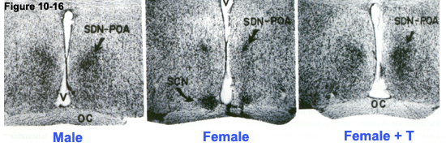
1. Neuroanatomical evidence in the sexually dimorphic nucleus of the preoptic area (SDN-POA) of the hypothalamus (influences copulatory behaviour in adult rats).
neonatal treatment

Slide 38
Development and sexual differentiation of the sexually dimorphic nucleus of the preoptic area (SDN-POA) in female ( ) and male ( ) rats.
600
Volume of SDN
% vs size 3 days
before birth
500
400
300
200
100
-3
-1
1
3
5
7
9
Humans - sex differences in SDN volume appear around
6 years of age when cell numbers decline in the female
modification after Gorski 1984

Slide 39
Influence of perinatal hormone environment on the volume of the SDN-POA
genetic female
genetic male
(* develops female genitalia
** normal genitalia)
100
*
80
Volume
of SDN
%
adult male
60
40
**
20
control
control
Gdx P1
TFM
testicular feminised
male
TP E16-P10
EB P2 100μg
TP P4 1.25mg
DES E16-P10
Gdx P1 + TP P2
Tamoxifen E16-P10
modification after
Gorski 1984

Slide 40
Why doesn’t oestrogen of maternal/placental or foetal origin masculinize the female fetal brain?

Slide 41
Pause

Slide 42
2. Functional evidence for early masculinisation of the neural circuitry regulating the LH surge and, hence, ovulation.
Organisational actions of gonadal steroids imprint a male-type neural circuitry.

Slide 43
I. Experimental paradigm in adult animals: -ovariectomise (Ovx) adult female rats
- administer oestradiol (E2) followed 48h later by progesterone (P) to mimic the natural stimulus for an LH surge and ovulation
measure circulating LH
Follow similar paradigm in castrated (Cx) male rats, which will have the same basal sex hormone status as Ovx female rats

Slide 44
Rats
T exposure in males
4 day
estrous cycle
X
X
E2 exposure in females
LH surge
& ovulation
T or E2
conception
birth
puberty
death
Defeminization of the brain –
‘the loss of capacity to respond to E2”
Notes:
As one example of the experimental hormonal manipulations that can be done to test this concept, administration of either T or E2 to newborn female rats can suppress the ability of E2 to stimulate an LH surge and ovulation in adulthood. Therefore, defeminization of the brain has also been defined as the loss of capacity to respond to E2, which will have relevance for later in my talk.

Slide 45
Hormonal masculinization/defeminization of hypothalamic circuitry regulating LH release
Female: adult Gdx
Male: adult Gdx
Male: neonatal Gdx
Circulating
LH
levels
E₂
P
E₂
P
E₂
P
48h
48h
48h
female: neonatal T
Male: neonatal aromatase inhibition
Circulating
LH
levels
E₂
P
E₂
P
48h
48h

Slide 46
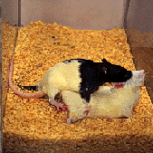
Reproductive behaviours

Slide 47
ER antisense oligonucleotides can reverse the effects of ‘androgenisation’ on sexual receptivity in female rats
Neonatally androgenised female (Neo T)
Neo T
+ vehicle
Neo T
+ antisense
Neo T
+ scrambled oligo
100
80
%
exhibiting
lordosis
60
40
20
adult
+ E&P
+E&P
adult Ovx, E+P
modification after McCarthy et al (1993) Endocrinol 133:433

Slide 48
Summary of hormonal manipulations in experiments designed to to test the hypothesis that testosterone masculinises the brain after aromatisation to estradiol (“aromatization hypothesis”)
Neo Gdx in males +/- T, E2, DHT
Neo GDX in males + neo T
Neo T/DES to females
Neo aromatase inhibitors
Neo anti-estrogens (eg tamoxifen) or ER antisense oligonucleotides
Transgenic models (ERKOs; AR KOs; Aromatase KOs)

Slide 49
Neonatal treatment of male rats castrated at birth (P1) with testosterone (500mg ), but not oil vehicle ( ) suppresses apoptosis (TUNEL stain) in SDN-mPOA, but not the lateral preoptic area
SDN
Lateral preoptic area
1.8
Total cells
undergoing
apoptosis
%
1.5
1.2
0.9
0.6
*
*
*
0.3
6
7
8
10
6
7
8
adapted from Breedlove SM
Days after birth

Slide 50
Is the aromatization hypothesis universally applicable throughout the brain (Morris et al 2004)?

Slide 51
Primates: sexual differentiation of the brain is principally prenatal
Swaab DF 2004 Sexual differentiation of the human brain: relevance for gender identity, transsexualism and sexual orientation. Gynecol Endocrinol. 2004 Dec;19(6):301-12. Review

Slide 52
Overview
Quick review of the neuroendocrine system
Hormonal control of sexual differentiation of the brain:
- genes versus hormones
- critical periods
- organizational vs activational effects
The hypothalamus as the prototype: neuroregulatory pathways governing reproduction
- why sexual differentiation of the brain is necessary
- underlying mechanisms
When it goes wrong
Sex differences in extra-hypothalamic brain regions and health implications: the midbrain dopaminergic populations
- Parkinson’s disease(experimental & clinical) and sex hormones
A need for sex-specific interventions

Slide 53
Clinical syndromes support the concept that the reproductive system, and possibly the brain, is feminine by default and steroid hormone action is necessary for masculine differentiation a role for organisational vs activational actions of sex steroid hormones is unclear

Slide 54
i) Exposure to diethylstilboestrol in utero
supports the view that aspects of brain masculinization may be ER-dependent
[Cooke et al (1998) Frontiers in Neuroendocrinol 19: 323-362]
Daughters of women treated with diethylstilboestrol during pregnancy showed greater evidence of cognitive lateralisation than their non-DES -exposed sisters (listening task and visual search task) ie. a more male-type pattern.

Slide 55
ii) The androgen insensitivity syndrome
supports the view that if testosterone masculinises the human brain it may do so via AR activation [Morris et al; Breedlove et al ]

Slide 56
XY individuals have normal TDF (Sry gene); early development of testes and testosterone synthesis occurs
autosomal gene mutations (i.e. not on the X or Y sex chromosomes) give rise to lack of functional ARs, so external genitalia appear feminine - raised as girls; as adults self-identify as women
MIF acts normally to suppress development of internal female genitalia
the resultant XY ‘women’ have an underdeveloped vagina and no oviduct, uterus or cervix
display feminine spatial learning behaviour and verbal behaviour – lack of AR = deficient masculinization
unclear whether prenatal steroids or social influences determine sex difference in human behaviour

Slide 57
Conclusion (humans):
Testosterone is the major influence for sexual differentiation of the reproductive organs
Because of sex differences in experience and social stimulation, it is less clear whether sexual dimorphisms in the human brain are engendered by the organisational actions of sex steroid hormones, although they clearly exert potent activational effects.
However, some clinical evidence, from DES treated women, supports the view that fetal oestrogens can masculinise the human brain.

Slide 58
Overview
Quick review of the neuroendocrine system
Hormonal control of sexual differentiation of the brain:
- genes versus hormones
- critical periods
- organizational vs activational effects
The hypothalamus as the prototype: neuroregulatory pathways governing reproduction
- why sexual differentiation of the brain is necessary
- underlying mechanisms
When it goes wrong
Sex differences in extra-hypothalamic brain regions and health implications: the midbrain dopaminergic populations
- Parkinson’s disease(experimental & clinical) and sex hormones
A need for sex-specific interventions

Slide 59
What about the rest of the brain?
1990s et seq mounting evidence for sex differences
largely ignored
possibly suppressed
inconvenient truth
Hormonally programmed?
Notes:
As far as we know, the rest of the brain would be exposed to the same male/female differences in the hormonal environment during development. But very few studies have investigated this as a potential source of brain sex differences.
It took several decades for sex differences in the rest of the brain to be identified. - an inconvenient truth that was largely ignored, if not suppressed, for fear of it being misinterpreted and fuelling anti-feminists with knowledge that could be misused.

Slide 60
Human and clinical implications
Do sex differences in the brain provide a basis for sex differences in the prevalence and/or severity of neurological and psychiatric diseases?
e.g. schizophrenia, ADHD, stroke, Parkinson’s disease
(see later - e.g. Schwaab et al 2004; Gillies et al 2010)

Slide 61
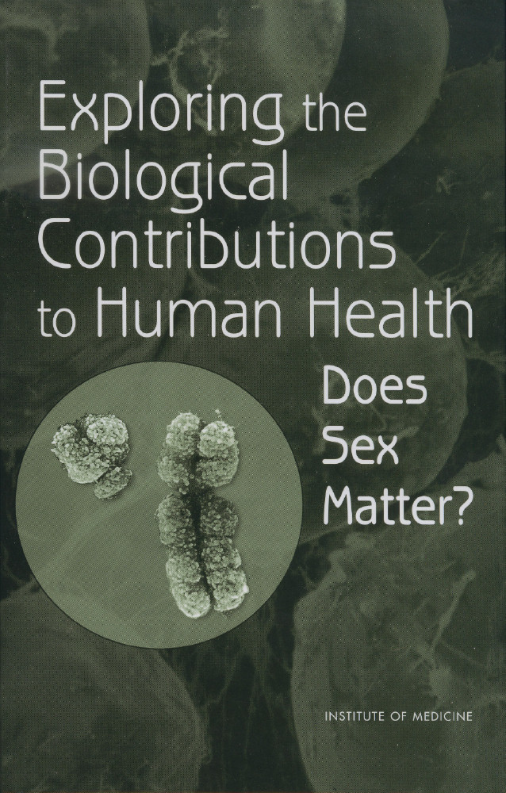
2001 A report of the US National Research Council
It is well-established that one’s sex (being male or female, according to reproductive organs and chromosomes) can influence susceptibility, prevalence, presentation (symptoms) progression, pathology and response to treatments for neurological and psychiatric disorders
Different preventive, diagnostic and treatment approaches may be required for men and women
X
L.Cahill “Why sex matters for neuroscience” Nat Rev Neurosci, 7: 477-84
Evidence abounds for sex differences in brain anatomy, chemistry and function; this demands research into sex influences if we are to understand the host of brain disorders with sex differences in their incidence and nature.
Y
CH3
OH
OH
CH3
T
E2
O
OH
Notes:
By the late 90s, however, the mounting evidence that sex differences pervade most brain regions could not be denied and this book, based on a report of the US National Research Council acknowledged that one’s sex has marked influences on brain disorders and therefore different therapeutic approaches may be required in men and women.
This was followed a few years later by an influential publication that emphasized the importance of understanding the variety of sex brain differences that must contribute to a host of disorders with sex differences in their prevalence and nature.
The National Institute of Mental Health , Bethesda, convened a workshop last year on this topic
here is a growing appreciation that genetic factors, including genes linked to the sex chromosomes, as well as life-style contribute to the sex bias in disease, sex hormones are considered by far to have the greatest influence on brain sex dimorphisms, whether in structure, function or disease susceptibility.
Gender -

Slide 62
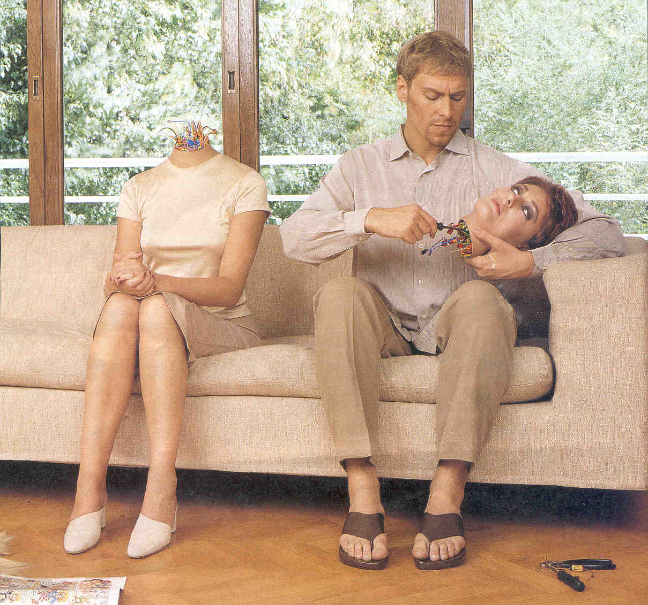
2011 National Institute of Mental Health, Bethesda, workshop on gaps in the study of sex differences in the brain
We know very little about the neural circuitry and mechanisms that provide the neurobiological basis for brain sex differences that underlie the expression of sex differences in mental disorders
The wider neuroscience community is relatively unaware of sex differences in the brain, let alone the differences between the effects of steroid hormones on brain organization and activity
I’m sure these hormones get in there somehow
mechanisms
Genes
Hormones
Environment/
experience
CH3
OH
OH
CH3
T
E2
O
OH
C.Small
Notes:
However, just last year an NIH workshop concluded that we still know very little about .............
Furthermore, the workshop concluded that... So I think we can say that everyone here may now know more than neurosceintists about the hormonal basis for brain sex differences.
So, where does one start?
Although genes linked to the sex chromosomes, as well as one’s environment and experience may contribute to the sex bias in disease, sex hormones are considered by far to have the greatest influence on brain sex dimorphisms, whether in structure, function or disease susceptibility. So I was fortunate enough to collaborate with my colleague, David Dexter, who has expertise in the field of PD, to investigate the role played by sex hormones in the sex difference observed in PD.

Slide 63
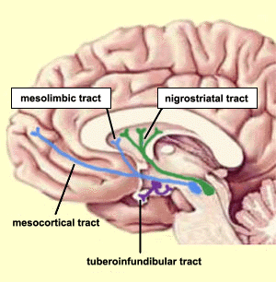
Neural circuitry
nigrostriatal dopaminergic system
Parkinson’s disease
is twice as prevalent in men;
what roles do sex hormones play?
SNc
Mask-like facial expression
Retrospective and observational studies in women suggest that oestrogens are neuroprotective
Pill-rolling tremor
Hormonal fluctuations over the menstrual cycle
Menopause
HRT
Flexion of trunk
Properly controlled and powered prospective studies are lacking
Slow, shuffling movements
Dluzen D, & Horstink M. (2003) Endocrine 21: 67-75
Shulman L. & Bhat V. (2006) Expert Rev Neurother, 6: 407-16
Gillies, GE & McArthur S. (2010) Pharmacol Revs, 62: 155-98
Notes:
PD is a highly prevalent debilitating movement disorder.
The main pathological feature of PD is the loss of DA neurones in the SNc that project to the striatum, forming the NSDA pathway. This controls fine movements
Apart from a few % of cases that have genetic origins, we do not know the cause of PD, but it is a highly prevalent and deblitating movement disorder.
Disease symptoms appear to be less at times when E2 levels are highest
However, there are contradictions in the literature .....
but also in its symptoms, progression and responses to treatment

Slide 64
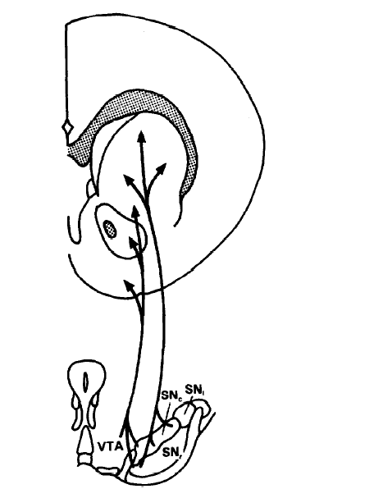
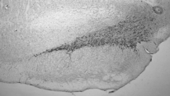
Experimental Parkinson’s disease
Sex differences are seen with mild/moderate lesions
Striatal DA content
% lesioned vs
unlesioned side
DA neurones in SNc
% lesioned vs
unlesioned side
120
DA levels
Striatum
†
†
80
*
*
*
6-OHDA Injection
40
**
SNc
**
**
**
0
Vehicle 1 6
Vehicle 1 6
mg 6-OHDA
Murray et al (2003) Neuroscience 116: 213-222
Notes:
Therefore, we used an experimental model of PD that mimics important aspects of the condition. 6-OHDA is a neurotoxin selective for DA neurones. It is injected into the MFB and
here are recognised familial Model mirrors sex differences in clinical PD

Slide 65
Adult sex hormones influence lesion size in pre-clinical experimental Parkinson’s disease
Females
Males
100
#
DA content
(% lesioned vs
unlesioned striatum)
80
*
*
*
*
60
40
20
0
Intact
Pro
Ovx
Ovx
+ DHT
Ovx
+ E2
intact
Cx
Cx
+ DHT
Cx
+ E2
Physiological levels of gonadal hormones (E2) are neuroprotective in females
... but in males gonadal hormones (T aromatized to E2) may worsen DA loss
Murray et al (2003) Neuroscience 116: 213-222
Datla et al (2003) Neuroreport 14: 47-50
Notes:
In further experiments we

Slide 66
Summary for experimental PD that models early- stage disease (<50% loss of striatal DA)
Detrimental effects of gonadal factors in the male NSDA system as well as protective effects in females contribute to sex differences in susceptibility to striatal injury
E2 has opposite effects on striatal DA loss in males (increased) and females (decreased)
In the absence of sex hormones male and female brains are not identical
Innate sex dimorphisms may be attributable to the established major contribution of the organizational effects of sex hormones
McArthur S. et al (2007) JNeurochem 100: 678-692; Gillies GE & McArthur S. (2010) Horm Behav 57: 23-34 ; Gillies GE & McArthur S.( 2010) Pharm Revs 62: 155-198
Notes:
To summarise, these studies showed that
1
2
From these observations it follows that....3. and, 4. given our prior knowledge, it is reasonable to suggest that

Slide 67
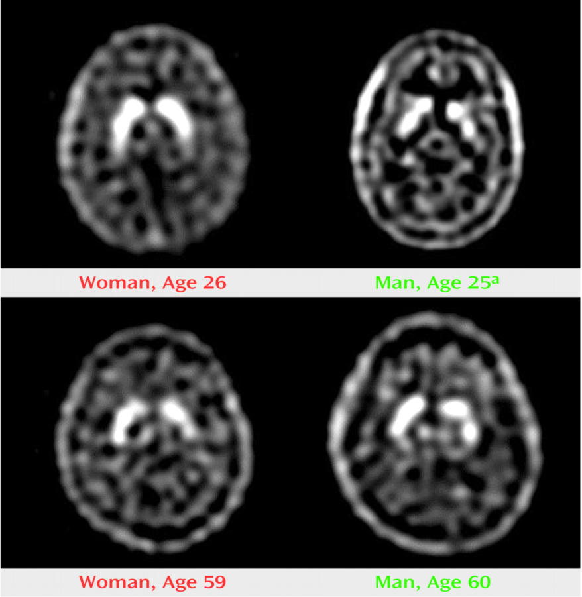
Supporting evidence for innate sex dimorphisms in the NSDA pathway and associated circuitry
Same goal,
different strategies
Similar performance between the sexes does not necessitate the same neural mechanisms and information processing
Woman
(26 years)
Man
(25 years)
Similar extracellular levels of striatal DA levels are achieved by different DA neurone dynamics (balance of uptake and release) in males and females (humans & rodents)
Real-time in vivo neuroimaging
Motor & cognitive functions are differentially regulated by DA in men & women
There are sex differences in the ‘molecular’ signature of the NSDA pathway in normal and PD brains
Mozley L. et al. Am.J.Psychiatry, 2001, 158: 1492
Notes:
And here are some examples from several studies that supports the view that there are innate sex dimorphisms in the nigrostriatal pathway. Here, functional magnetic resonance imaging was used to assess striatal activity in subjects performing tests that largely rely on activation of the NSDA pathway and, although performance was similar in men and women, brain activity and, by implication, information processing, was different... And this is notably a recurring theme for other brain regions.

Slide 68
Translational implications
Is the clinical course of Parkinson’s disease affected by endogenous sex steroid hormones in humans?
In healthy human individuals performance on a striatal-mediated sequential movement task suggests that the effects of sex hormones on NSDA activity may be sexually dimorphic
endogenous E2 promotes activity in females; males unaffected by T or E2 (Siegel et al 2008, Behav Neurosci 122: 955-62; Jennings et al 1988)
The reported clinical benefits of oestrogens in the female sex may not simply translate to the male sex, highlighting the importance of studies in both males and females
Notes:
As it is not possible to perform similar experiments in humans, we cannot be certain of the applicability of these findings to the clinical situations, but ......., suggesting that sex hormone effects on the activity of the healthy nigrostriatal activity appear sexually dimorphic in human as well as rodents. If the same proves true for the degenerating pathway, these studies indicate that..

Slide 69
In experimental PD that models early stage disease (<50% loss of striatal DA)...
Hormonal manipulations that affect DA levels in the injured striatum do not affect DA cell loss in the SNc
DA levels
How can hormonal influences on striatal DA depletion occur independently of effects at the cell body?
Why are the effects of E2 different in males & females?
Striatum
6-OHDA Injection
Endogenous sex hormones target the compensatory mechanisms in the surviving neurones that preserve function rather than neurone survival per se
SNc
These mechanisms are sexually dimorphic
McArthur S. et al 2007 JNeurochem 100: 678-692
Gillies GE & McArthur S. 2010 Horm Behav 57: 23-34 and Pharm Revs 62: 155-198
Notes:
How can hormonal influences on striatal DA depletion occur independently of dopaminergic cell survival? A combination of results from our own and other labs support our hypothesis that

Slide 70
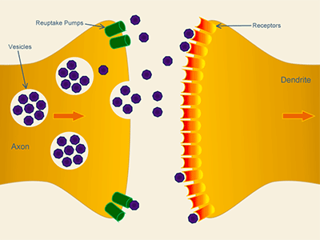
Compensatory mechanisms in surviving neurones in the damaged NSDA system
Adaptations in NSDA-associated circuitry
100
% SNc DA neurones
or striatal DA
Clinical signs & symptoms
50
0
Progression of disease
re-uptake
receptors
synthesis
release
Adaptations in striatal terminal
Notes:
Compensatory mechanisms are complicated and not fully understood. They may involve adaptations in the input pathways that regulate the NSDA pathway, and they also involve adaptations in the striatal nerve terminals

Slide 71
Compensatory mechanisms in striatal terminals of surviving neurones in the damaged NSDA system
Renders females more able to preserve striatal DA levels when lesions are small/moderate
re-uptake
Promoted by physiological levels of E2 in normal females, not males
receptors
synthesis
release
Pre-clinical studies:
sex differences in PD prevail for moderate lesion size
Potential to delay progression or onset of disease –
at least in females
100
% striatal DA
Clinical signs & symptoms
50
0
McArthur S. et al (2007) JNeurochem 100: 678-692
Gillies GE & McArthur S. (2010) Horm Behav 57: 23-34;
Gillies GE & McArthur S. (2010) Pharm Revs 62: 155-98
Progression of disease
Notes:
Together these findings could account for why physiological levels of oestrogens appear neuroprotective at the level of the striatal DA terminals, but not at the cell bodies in the SNc.
A disease modifying drug – at least in females. An important challenge would be to investigate whether the detrimental effects of testicular factors could be prevented

Slide 72
Priorities in Parkinson’s disease research
Meissner WG et al (2011) Nat Rev Drug Discov 10: 377-93
Current therapies rely on dopamine replacement strategies
There is an urgent, unmet need for disease modifying agents
Progress requires an understanding of susceptibility factors that lead to disease
Being male is an important susceptibility factor after age, but was not considered
Sufficient pre-clinical evidence now suggests that sex differences should no longer be ignored

Slide 73
Conclusion: The goal of understanding PD pathogenesis and improving treatments requires a better knowledge of the basis for sex differences in Parkinson’s disease
NIH mandated inclusion of women in human clinical trials in 1993
There is no equvialent mandate for pre-clinical research, where single sex studies of males outnumber those in females by 5.5:1
Yet, because of the potential neuroprotective effects of E2 in PD, most basic science studies begin with ovariectomized females, despite the evidence for greater susceptibility in the male sex (humans and rodents models)
Notes:
Therefore, I hope that you will agree that....
However, changing attitudes is a slow process. Until relatively recently it was not necessary to include women in clinical trials and more than *0% of basic neuroscience research is conducted in males only, but may be relevant for only 50% of the population.

Slide 74
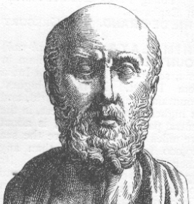
Medieval Cell Theory of localization of the functions of the brain into 3 chambers
“De Origine Catarrhi” Richard Lower,1670
Thank you
Memory
Sensation
Waste products of the reaction
Reason
thought
judgement
Conversion to ANIMAL SPIRITS in the brain
Modern day Neuroendocrinology
estrogens
VITAL SPIRITS generated in the body
RA
androgens
LV
Galen of Pergamum
131-201 AD
corticosteroids
Hippokrates of Kos
circa 460-370 BC
thyroid hormones
Notes:
Thank you, and for my signing off slide I would like to leave you spot some similarites between the ideas of the ancient Greek and medieval philospophers and modern day neuroendocrinolongy

