Slide 1

Pain II
Neuroscience and Mental Health
Module 1: Cellular & Developmental Neuroscience
Kenji OKUSE
22 October 2012
1
Notes:
Today, I’m going to talk about identification of a novel regulatory factor that facilitates the expression of Na_{V}1.8

Slide 2
Key References
J. Physiol. (1999) 516(2): 433-446
Nature (2002) 417: 653-656
J. Neurosci. (2006) 26(41): 10499-10507
Nature (2006) 444: 894-898
Neuron (2006) 52: 767–774
PLoS One (2012) 7(8): e40079
2

Slide 3
Types of pain
Overview of sensory nervous system and pain pathway
Introduction of key molecules in pain pathway
Na⁺ channels and accessory subunits in pain pathway
Pain killers
3

Slide 4
Structure of voltage-gated Na⁺ Channel
S
e
r
β1/3
β2/4
α
4
Notes:
Voltage-gated sodium channels initiate and propagate action potentials in excitable cells.
These sodium channels comprise a large membrane spanning pore-forming alpha-subunits and small accessory beta-subunits.
So far 3 beta-subunits have been discovered, and all of them share common structure which is one transmembrane domain and extracellular Ig loops.

Slide 5
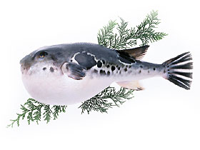
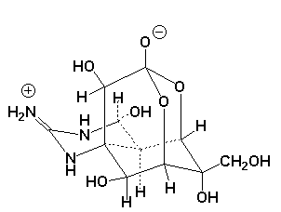
Tetrodotoxin a potent sodium channel blocker
Tetrodotoxin (TTX)
5

Slide 6
Mammalian voltage-gated sodium channel
 subunits
Gene
Primary
Present
TTX
Type
Symbol
Name
Tissue
in DRG
sensitivity
+
+
Na_{V}1.1
SCN1a
type I
CNS, heart
+
+
Na_{V}1.2
SCN2a
type II
CNS
+
+
Na_{V}1.3
SCN3a
type III
fetal brain
-
+
Na_{V}1.4
SCN4a
SkM1 (1)
skeletal muscle
-
-
Na_{V}1.5
SCN5a
SkM2 (1)
heart
+
+
Na_{V}1.6
SCN8a
NaCh6
CNS, glial cells
+
+
Na_{V}1.7
SCN9a
PN1
SCG, CNS
+
-
Na_{V}1.8
SCN10a
SNS (PN3)
DRG
Na_{V}1.9
SCN11a
DRG
+
-
NaN (SNS2)
Na_{X}
SCN7a
sciatic nerve, lung
+
+
(?)
NaG
6
Notes:
So far, 10 distinct alpha-subunits have been identified.
Among them, the expression of the tetrodotoxin-resistant sodium channel Na_{V}1.8 (also known as SNS or PN3) is restricted to damage sencing small diameter C-fiber associated sensory neurons.
Behavioral studies on Na_{V}1.8 knock-out mice have demonstrated a role for Na_{V}1.8 in the detection of noxious thermal, mechanical and inframmatory stimuli.

Slide 7
Expression of neurotrophic factor receptors and Na⁺ channels in DRG neurons
Na_{V}1.8
Myelinated neurons
TrkA
TrkB
TrkC
Unmyelinated neurons
c-ret
GFRa
Na_{V}1.9
Note: This is a simplified chart. Real expression pattern
is overlapped and much more complicated.
7

Slide 8
Recent approaches to study pain mechanisms
Genetic cloning: Subtraction library (Na_{V}1.8, P2X3)
Low-stringency hybridization/RT-PCR (Na_{V}1.9)
Degenerate primers-RT-PCR (Na_{V}1.7)
Expression cloning (TRPV1)
Yeast two-hybrid system (p11)
High-throughput assay: Microarray, 2D gel-Mass spectrometry
Target validation: Antisense oligonucleotides
Transgenic and knockout mouse
- tissue specific knockout using Cre-loxP
RNAi (RNA interference)
8

Slide 9
Mammalian voltage-gated sodium channel α subunits
Primary
Gene
Primary
TTX
Gene
Present
TTX
Present
Tissue
Type
Tissue
Type
Symbol
Symbol
sensitivity
Name
sensitivity
Name
in DRG
in DRG
+
+
+
CNS, heart
+
Na_{V}1.1
CNS, heart
Na_{V}1.1
SCN1a
SCN1a
type I
type I
+
+
+
CNS
+
Na_{V}1.2
CNS
Na_{V}1.2
SCN2a
SCN2a
type II
type II
+
+
+
fetal brain
+
Na_{V}1.3
SCN3a
fetal brain
Na_{V}1.3
SCN3a
type III
type III
+
-
+
skeletal muscle
-
Na_{V}1.4
skeletal muscle
Na_{V}1.4
SCN4a
SCN4a
SkM1 (μ1)
SkM1 (μ1)
-
-
-
heart
-
Na_{V}1.5
heart
Na_{V}1.5
SCN5a
SCN5a
SkM2 (Η1)
SkM2 (Η1)
+
+
+
CNS, glial cells
+
Na_{V}1.6
CNS, glial cells
Na_{V}1.6
SCN8a
SCN8a
NaCh6
NaCh6
+
+
+
SCG, CNS
+
Na_{V}1.7
SCG, CNS
Na_{V}1.7
SCN9a
SCN9a
PN1
PN1
-
+
-
+
DRG
Na_{V}1.8
DRG
Na_{V}1.8
SCN10a
SCN10a
SNS (PN3)
SNS (PN3)
-
+
-
DRG
+
Na_{V}1.9
SCN11a
DRG
Na_{V}1.9
SCN11a
NaN (SNS2)
NaN (SNS2)
+
+
+
sciatic nerve, lung
+
Na_{X}
sciatic nerve, lung
Na_{X}
SCN7a
SCN7a
(?)
NaG
(?)
NaG
9
Notes:
So far, 10 distinct alpha-subunits have been identified.
Among them, the expression of the tetrodotoxin-resistant sodium channel Na_{V}1.8 (also known as SNS or PN3) is restricted to damage sencing small diameter C-fiber associated sensory neurons.
Behavioral studies on Na_{V}1.8 knock-out mice have demonstrated a role for Na_{V}1.8 in the detection of noxious thermal, mechanical and inframmatory stimuli.

Slide 10
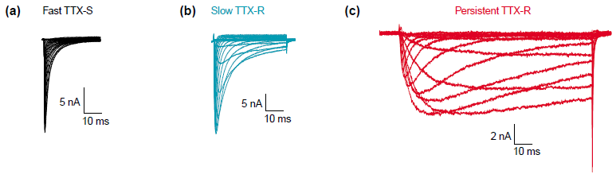
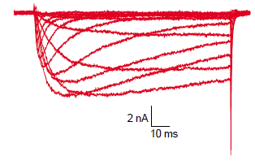
Multiple Na⁺ currents in small neurons in DRG
Na_{V}1.7
Na_{V}1.8
Na_{V}1.9
Dibb-Hajj et al. (2002) TRENDS in Neurosciences, 25(5) 253-259
10

Slide 11
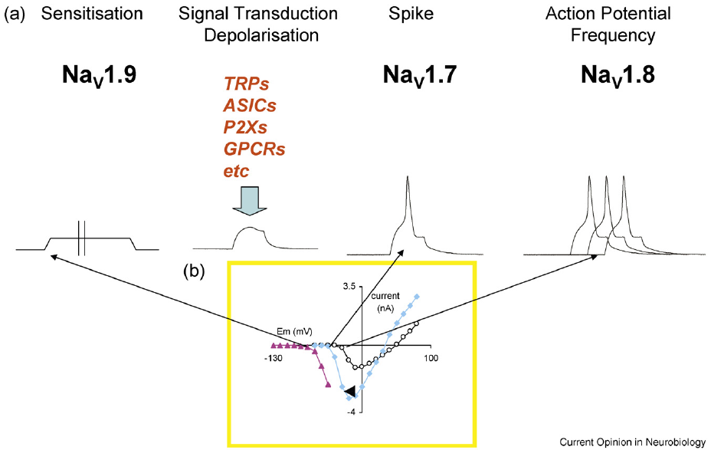
Na_{V}1.9 activates at around -70mV and produces a persistent current that is likely to play a role in setting resting membrane potential
Momin & Wood (2008) Curr Opin Neurobiol., 18(4) 383-388.
11

Slide 12
Na_{V}1.7 inactivates slowly at negative membrane potentials and sets the threshold for generation of action potentials
Momin & Wood (2008) Curr Opin Neurobiol., 18(4) 383-388.
12

Slide 13
Na_{V}1.8 re-primes rapidly and contribute to continuous firing activity during sustained depolarisations
Momin & Wood (2008) Curr Opin Neurobiol., 18(4) 383-388.
13

Slide 14
Na_{V}1.9 KO mice show normal responsiveness to mechanical and thermal stimuli
mechanical stimuli
thermal stimuli
Electrophysiological thresholds
Behavioral response thresholds
Priest et al. (2005) PNAS, 102(26): 9382–9387
14

Slide 15
Na_{V}1.9 KO mice do not exhibit
Inflammatory hyperalgesia
The time spent licking or lifting the injected paw during 2-min
intervals
Withdrawal latencies in response to radiant heating of the paw after injection with inflammatory mediators
Priest et al. (2005) PNAS, 102(26): 9382–9387
15

Slide 16
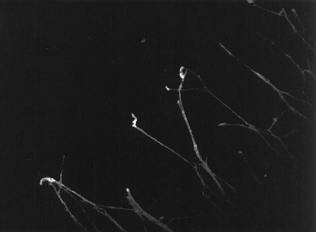
Na_{V}1.7 is localised at growth cones processes of DRG neurons
Toledo-Aral et al. (1997) Proc Natl Acad Sci U S A. 94(4):1527-1532.
16

Slide 17
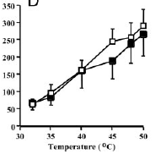
Na_{V}1.7 KO mice show reduced responses to mechanical stimuli, but not to thermal stimuli
mechanical stimuli
thermal stimuli
Electrophysiological responses
Na_{V}1.7 KO
Na_{V}1.7 KO
Na_{V}1.7 KO
Behavioral responses
WT
Nassar et al. PNAS (2004) 101(34): 12706-12711
17

Slide 18
Na_{V}1.7 KO mice do not show thermal hyperalgesia after intraplantar injection of carrageenan
1.5
Na_{V}1.7 KO
1
Test/baseline
0.5
WT
1
2
3
4
Hours
Nassar et al. PNAS (2004) 101(34): 12706-12711
18

Slide 19
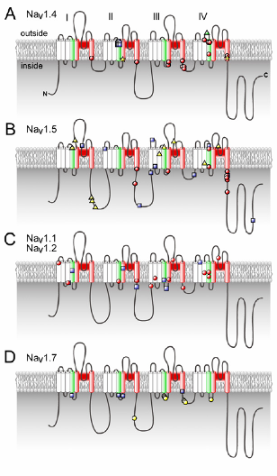
Inherited Human Disease Mutations of
Voltage-Gated Sodium Channels
(A) Mutations of the skeletal muscle sodium channel, Na_{V}1.4.
- Red circles: : mutations linked to paramyotonia congenita,
myotonia congenital,and myotonia fluctuans
- Yellow stars: hyperkalemic periodic paralysis
- Blue squares: normo- and hypokalemic periodic paralysis
- Green triangle: myasthenic syndrome
(B) Mutations of cardiac sodium channel, Na_{V}1.5
- Red circles: long-QT syndrome 3
- Blue squares: Brugada syndrome
- Yellow triangles: sick sinus syndrome, progressive familial heart
block, ventricular fibrillation, or cardiac conduction effect
(C) Mutations of brain sodium channels, Na_{V}1.1 and Na_{V}1.2
- Red circles: generalized epilepsy with febrile seizures plus,
severe myoclonic epilepsy in infancy, intractable childhood
epilepsy with generalized tonic-clonic seizures, familial hemiplegic
migraine, and familial febrile convulsions (Na_{V}1.1)
- Blue squares: benign familial neonatal-infantile seizures and
febrile seizures associated with afebrile seizures (Na_{V}1.2)
19

Slide 20
The locations of the identified human mutations in Na_{V}1.7 which cause the complete inability to sense pain
(loss of function mutation)
2298 T deletion
GCT ATA GGA GC ATA GGA
2691 G A
Ala Ile Gly Ala STOP
TGG TGA
Trp STOP
1376 C G
TCA TGA
Ser STOP
20

Slide 21
The locations of the identified human mutations in Na_{V}1.7 which cause paroxysmal extreme pain disorder
(gain of function mutation)
Paroxysmal extreme pain disorder, previously known as familial rectal pain, is an autosomal dominant paroxysmal disorder of pain and autonomic dysfunction. The distinctive features of this disorder are paroxysmal episodes of burning pain in the rectal, ocular, and mandibular areas accompanied by autonomic manifestations such as skin flushing.
21

Slide 22
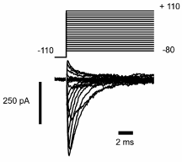
The locations of the identified human mutations in Na_{V}1.7 which cause paroxysmal extreme pain disorder
(gain of function mutation)
WT Na_{V}1.7
mutant Na_{V}1.7
22

Slide 23
Mammalian voltage-gated sodium channel α subunits
Gene
Primary
Present
TTX
Type
Symbol
Name
Tissue
in DRG
sensitivity
+
+
Na_{V}1.1
SCN1a
type I
CNS, heart
+
+
Na_{V}1.2
SCN2a
type II
CNS
+
+
Na_{V}1.3
SCN3a
type III
fetal brain
-
+
Na_{V}1.4
SCN4a
SkM1 (μ1)
skeletal muscle
-
-
Na_{V}1.5
SCN5a
SkM2 (Η1)
heart
+
+
Na_{V}1.6
SCN8a
NaCh6
CNS, glial cells
+
+
Na_{V}1.7
SCN9a
PN1
SCG, CNS
+
-
Na_{V}1.8
SCN10a
SNS (PN3)
DRG
Na_{V}1.9
SCN11a
DRG
+
-
NaN (SNS2)
Na_{X}
SCN7a
sciatic nerve, lung
+
+
(?)
NaG
23
Notes:
So far, 10 distinct alpha-subunits have been identified.
Among them, the expression of the tetrodotoxin-resistant sodium channel Na_{V}1.8 (also known as SNS or PN3) is restricted to damage sencing small diameter C-fiber associated sensory neurons.
Behavioral studies on Na_{V}1.8 knock-out mice have demonstrated a role for Na_{V}1.8 in the detection of noxious thermal, mechanical and inframmatory stimuli.

Slide 24
Na_{V}1.8 is a key molecule in pain pathway because …..
• In vitro, tetrodotoxin (TTX)-resistant Na⁺ current are enhanced by inflammation mediators such as PGE₂
• In vivo, there is an enhancement of TTX-resistant Na⁺ current density after peripheral inflammation
• Na_{V}1.8 is expressed exclusively in nociceptive small diameter C fibre sensory neurons, and TTX-resistant
• Na_{V}1.8 knock-out mice have diminished mechanosensation and delayed inflammatory pain thresholds
24

Slide 25
PGE₂ increases TTX-resistant Na⁺ current and causes a hyperpolarizing shift of its activation curve
2
Command potential (mV)
0
-80
-60
-40
-20
0
20
40
-2
control
1 mM PGE₂
-4
-6
-8
Peak sodium
current (nA)
-10
England et al. (1996) J. Physiol. 495(Pt2): 429-440
25

Slide 26
PGE₂ modulates TTX-resistant Na⁺ current in sensory neurons via protein kinase A cascade
.
100
75
% increase in Na⁺ current
in response to 1 mM PGE₂
50
25
0
control
peptide inhibitor
for PKA
England et al. (1996) J. Physiol. 495(Pt2): 429-440
26

Slide 27
Protein kinase A consensus phosphorylation sites in Na_{V}1.8
Ser
P
P
P
P
P
27
Notes:
Voltage-gated sodium channels initiate and propagate action potentials in excitable cells.
These sodium channels comprise a large membrane spanning pore-forming alpha-subunits and small accessory beta-subunits.
So far 3 beta-subunits have been discovered, and all of them share common structure which is one transmembrane domain and extracellular Ig loops.

Slide 28
Increase of intracellular cAMP level causes Na_{V}1.8 current induction by PKA phosphorylation
100
tissue damage
WT
750
Ser→Ala
50
PGE₂
% change in current amplitude
25
PKA
Na_{V}1.8
Na_{V}1.8
P
0
-25
Dideoxyforskolin
(10 mM)
Forskolin
(10 mM)
8-bromo cAMP
(100 mM)
lower pain thresholds
28

Slide 29
Na_{V}1.8 is a key molecule in pain pathway because …..
• In vitro, tetrodotoxin (TTX)-resistant Na⁺ current are enhanced by inflammation mediators such as PGE₂
• In vivo, there is an enhancement of TTX-resistant Na⁺ current density after peripheral inflammation
• Na_{V}1.8 is expressed exclusively in nociceptive small diameter C fibre sensory neurons, and TTX-resistant
• Na_{V}1.8 knock-out mice have diminished mechanosensation and delayed inflammatory pain thresholds
29

Slide 30
Bradykinin excites tetrodotoxin-resistant primary afferent fibers in a Na⁺ dependent manner
1 mM bradykinin
Dorsal horn
neuron
10 mV
1 min
DRG neruron
TRIS (Na⁺ free)
1 mM bradykinin
Tetrodotoxin
Bath application
of bradykinin
S. Jeftinija (1994) Brain Resarch, 665(1): 69-76
30

Slide 31
Na_{V}1.8 is a key molecule in pain pathway because …..
• In vitro, tetrodotoxin (TTX)-resistant Na⁺ current are enhanced by inflammation mediators such as PGE₂
• In vivo, there is an enhancement of TTX-resistant Na⁺ current density after peripheral inflammation
• Na_{V}1.8 is expressed exclusively in nociceptive small diameter
C fibre sensory neurons, and TTX-resistant
• Na_{V}1.8 knock-out mice have diminished mechanosensation and delayed inflammatory pain thresholds
31

Slide 32
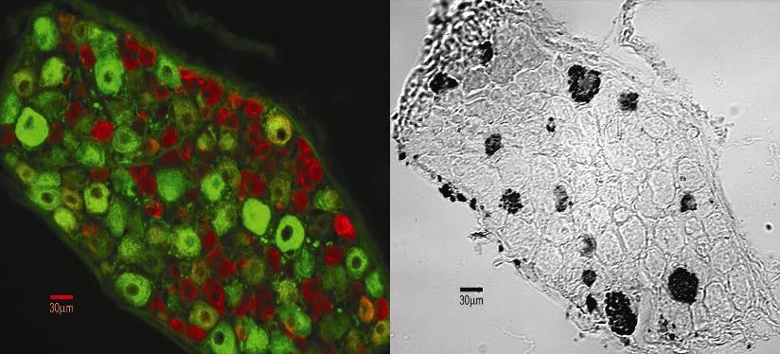
Na_{V}1.8-like immunoreactivity specifically localised in small diameter C-fibre sensory neurons
Na_{V}1.8
NF200 (a marker for large
diameter A-b fibre neurons)
32

Slide 33
Na_{V}1.8 is a key molecule in pain pathway because …..
• In vitro, tetrodotoxin (TTX)-resistant Na⁺ current are enhanced by inflammation mediators such as PGE₂
• In vivo, there is an enhancement of TTX-resistant Na⁺ current density after peripheral inflammation
• Na_{V}1.8 is expressed exclusively in nociceptive small diameter
C fibre sensory neurons, and TTX-resistant
• Na_{V}1.8 knock-out mice have diminished mechanosensation and delayed inflammatory pain thresholds
33

Slide 34
Na_{V}1.8 KO mice show partial analgesia to noxious thermal and mechanical stimulation
Paw flick
Tail pressure
20
25
15
20
Latency (sec)
15
10
Pressure score
10
5
5
0
0
+/+
-/-
+/+
-/-
Thermal stimulation
(hot plate)
Mechanical stimulation
(tail pinch)
34

Slide 35
Carrageenan-induced inflammatory hyperalgesia is delayed in the Na_{V}1.8 KO mice
1.2
1.0
0.8
-/-
Reaction time (test/baseline)
0.6
0.4
+/+
0.2
0
45
90
135
180
24
Minutes
Hours
35

Slide 36
Structure of voltage-gated Na⁺ Channel
S
e
r
β1/3
β2/4
α
36
Notes:
Voltage-gated sodium channels initiate and propagate action potentials in excitable cells.
These sodium channels comprise a large membrane spanning pore-forming alpha-subunits and small accessory beta-subunits.
So far 3 beta-subunits have been discovered, and all of them share common structure which is one transmembrane domain and extracellular Ig loops.

Slide 37
p11, a novel subunit for Na_{V}1.8
• p11 is a member of the family of S-100 related calcium-binding proteins
• Within the cell, p11 is localized at the cytoplasmic surface of the plasma membrane, and p11 plays a role in membrane trafficking events such as exocytosis, endocytosis and cell-cell adhesion
• p11 has been identified as an interactor for Na_{V}1.8 by Yeast two-hybrid screening system. p11 controls the translocation of Na_{V}1.8 to the plasma membrane
37

Slide 38
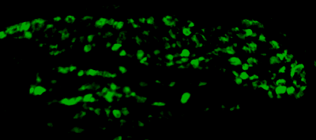
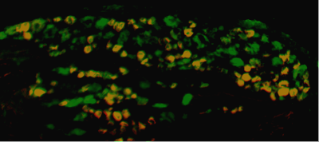
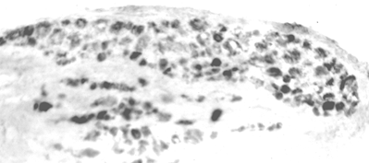
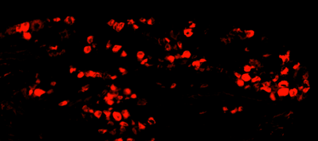
p11 mRNA coexpresses with Na_{V}1.8 in small diameter DRG neurons
in situ hybridization
p11 mRNA
4
4
0
m
0
m
m
m
immunohistochemistry
Na_{V}1.8
4
0
m
m
38

Slide 39
p11 binds 28 aa fragment of N-terminal intracellular loop of Na_{V}1.8
Ser
P
P
p11
P
P
P
39
Notes:
Voltage-gated sodium channels initiate and propagate action potentials in excitable cells.
These sodium channels comprise a large membrane spanning pore-forming alpha-subunits and small accessory beta-subunits.
So far 3 beta-subunits have been discovered, and all of them share common structure which is one transmembrane domain and extracellular Ig loops.

Slide 40
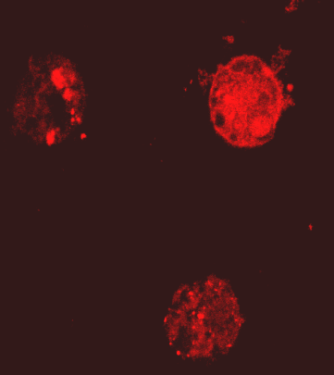
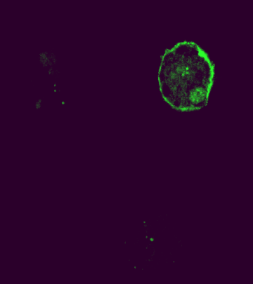
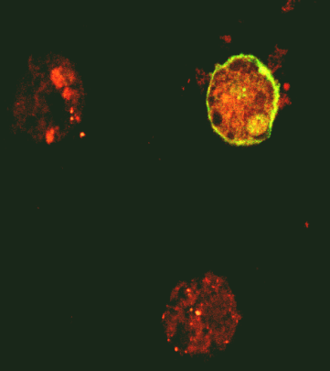
p11 regulates trafficking of Na_{V}1.8 from cytosol to plasma membrane in CHO-SNS22 cells
GFP
p11
anti-Na_{V}1.8 antibody
GFP-p11
merged
40

Slide 41
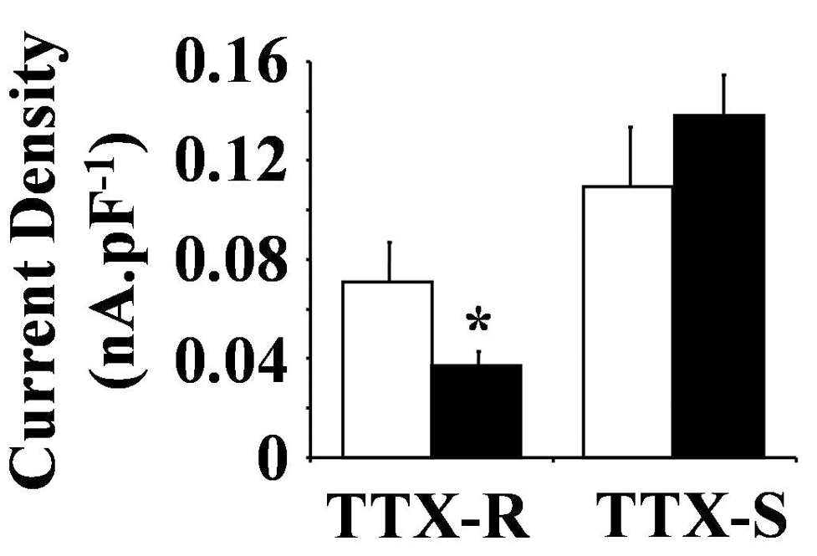
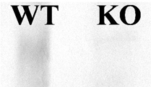
TTX-resistant Na⁺ current is reduced in p11 KO mice
Reduction of membrane-bound
Na_{V}1.8 in p11 KO
40

Slide 42
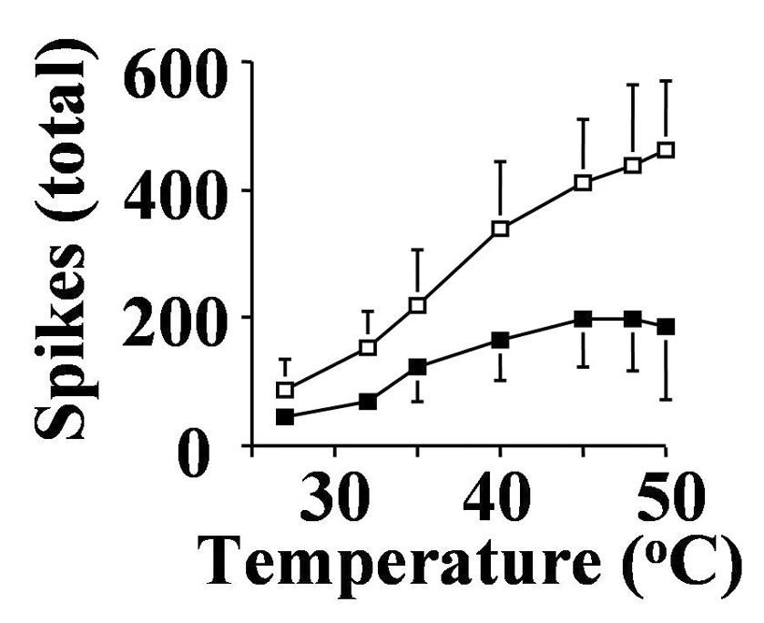
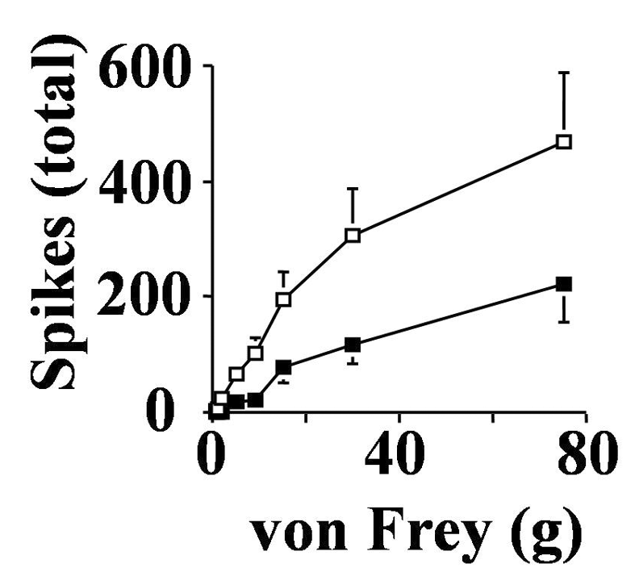
p11 KO mice display marked deficits in mechanically and thermally-evoked spinal cord neuronal activity
mechanical stimuli
thermal stimuli
p11KO
p11KO
42

Slide 43
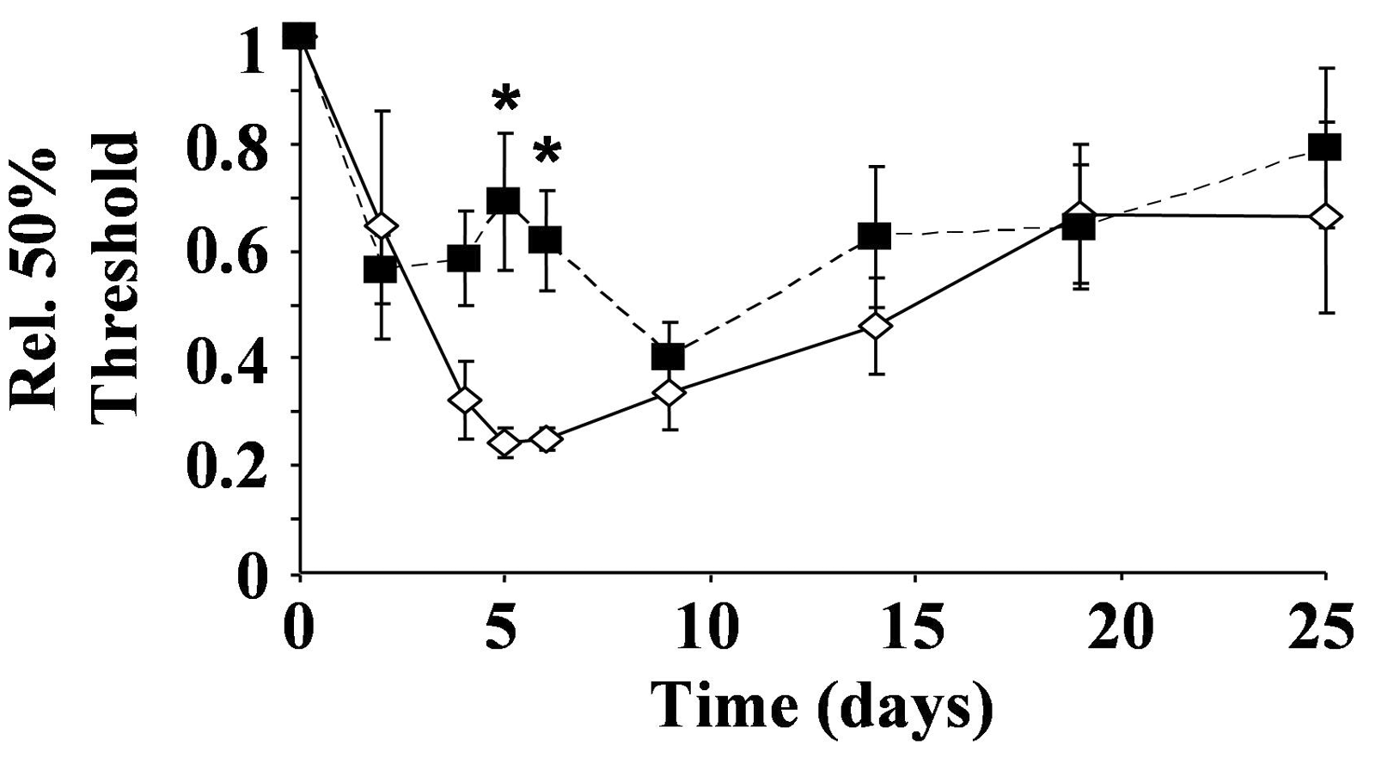
Reduction in mechanical pain behaviour occurs in p11 KO mice
Acute noxious
mechanical pressure
Mechanical allodynia
p11 KO
p11 KO
sciatic nerve injury (neuropathic pain model)
43

Slide 44
p11 specifically binds to Na_{V}1.8 among voltage-gated sodium channels
GST pull down assay
44
Notes:
So far, 10 distinct alpha-subunits have been identified.
Among them, the expression of the tetrodotoxin-resistant sodium channel Na_{V}1.8 (also known as SNS or PN3) is restricted to damage sencing small diameter C-fiber associated sensory neurons.
Behavioral studies on Na_{V}1.8 knock-out mice have demonstrated a role for Na_{V}1.8 in the detection of noxious thermal, mechanical and inframmatory stimuli.

Slide 45
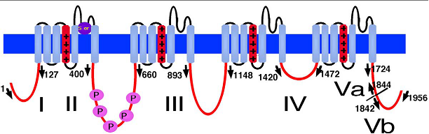
Binding domains in p11 and Na_{V}1.8
p11
Na_{V}1.8
Poon et al. (2004) FEBS Lett. 558(1-3): 114-118
45
Notes:
G

Slide 46
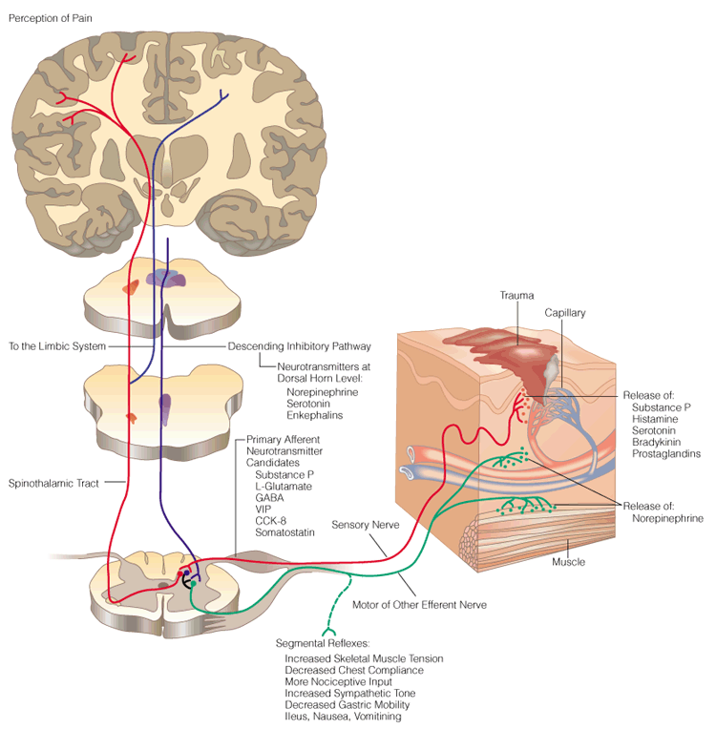
Cerebrum Cortex
Sensory Area
Sensory and Motor
Nervous System
Trauma
Sensory Nerve
Dorsal Root
Ganglia (DRG)
Spinal
Cord
Ventral Root
Motor and Other Efferent Nerve
Neurotransmitter Release
(Glu, Substance P, GABA, Enk)
46

Slide 47
Action Potentials Propagate via Saltatory Conduction in Myelinated Nerves
47

Slide 48
Saltatory Conduction in Myelinated Axons
unmyelinated axon
myelinated axon
++++++++-----++++++++++
+ -- -- ++ +
--------+++++----------
- ++ ++ -- -
--------+++++----------
- -- -- ++ +
++++++++-----++++++++++
+ ++ ++ -- -
48
Notes:
Voltage-gated sodium channels initiate and propagate action potentials in excitable cells.
These sodium channels comprise a large membrane spanning pore-forming alpha-subunits and small accessory beta-subunits.
So far 3 beta-subunits have been discovered, and all of them share common structure which is one transmembrane domain and extracellular Ig loops.

Slide 49
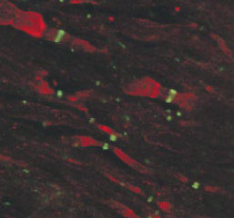
Voltage-gated Na⁺ Channel is Expressed at Node of Ranvier
Node of Ranvier
myelinated axon
+ -- -- ++ +
- ++ ++ -- -
- -- -- ++ +
+ ++ ++ -- -
Immunohistochemistry
Green: Na⁺ channel
Red: K⁺ channel
49
Notes:
Voltage-gated sodium channels initiate and propagate action potentials in excitable cells.
These sodium channels comprise a large membrane spanning pore-forming alpha-subunits and small accessory beta-subunits.
So far 3 beta-subunits have been discovered, and all of them share common structure which is one transmembrane domain and extracellular Ig loops.

Slide 50




Propagation of Action Potential
(unmyelinated axons)
extracellular
Uneven concentrations of ions set up membrane potential.
Intracellular becomes negative (-70mV in neurons) to extracellular.
This is called Resting Potential.
intracellular
Certain stimuli cause cation (mainly Na⁺) influx at the locale.
Intracellular becomes positive (+30~60mV) to extracellular at the area.
This is called Action Potential.
The change of potential causes the local current.
This change triggers opening of the adjacent Na⁺ channel.
Na⁺ influx through the Na⁺ channel leads to further potential change.
And next and next and next ……
Note: Action potential is propagated not by current itself, but by sequential changes of local membrane potential caused by the local current.
50
Notes:
Voltage-gated sodium channels initiate and propagate action potentials in excitable cells.
These sodium channels comprise a large membrane spanning pore-forming alpha-subunits and small accessory beta-subunits.
So far 3 beta-subunits have been discovered, and all of them share common structure which is one transmembrane domain and extracellular Ig loops.

Slide 51
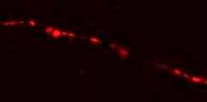

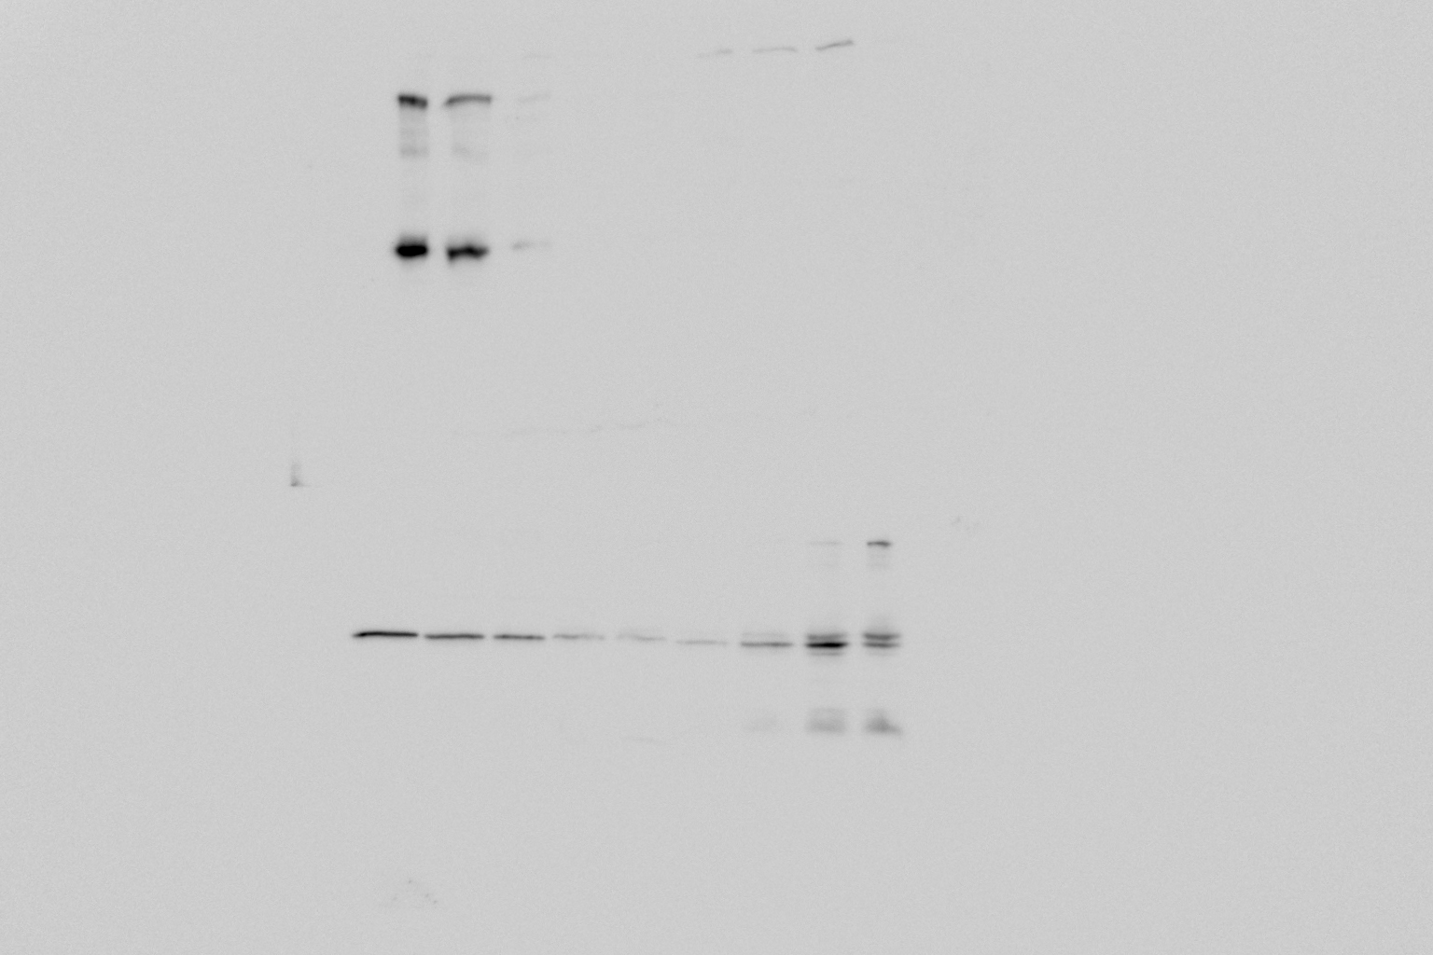


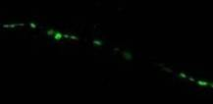

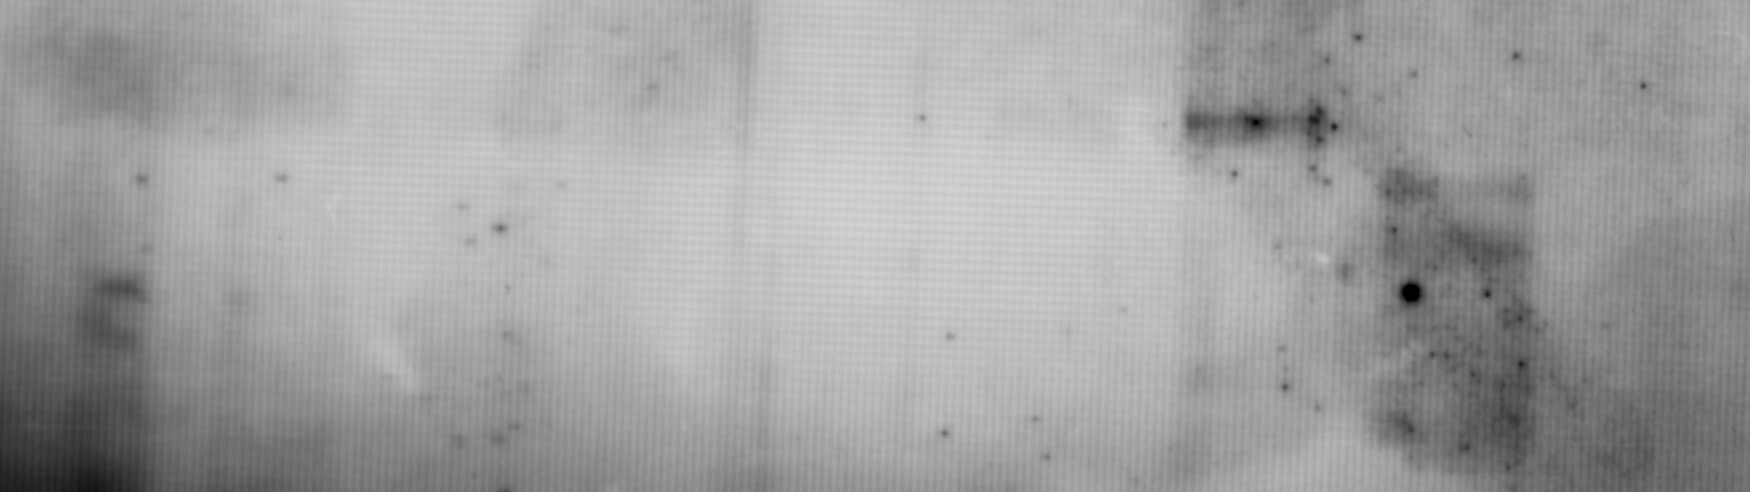
Na_{V}1.8 is localised at discrete positions along the neurites in sensory neurons and colocalises with lipid rafts
Myelinated fibre
NaCh (e.g. Na_{V}1.6)
myelin
Unmyelinated fibre ?
OptiPrep gradient on centrifuge
(Sciatic Nerves)
Na_{V}1.8
40%
30%
0%
Transferrin receptor
Na_{V}1.8-DsRed2
GM1
Lipid raft
Flotillin-1
10 μm
Na_{V}1.8
Lipid raft
51

Slide 52
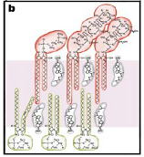
Lipid raft
Glicosphyngolipid
Lipid rafts are cholesterol and sphingolipid
-enriched microdomains of the membrane
Sphingomyelin
Cholesterol
Biological role
- Caveolae and Lipid rafts have been implicated in signal transduction, and endocytosis
- Act as a platform on the membrane where proteins are sorted and functionally localised
Lipid raft in the nervous system
- Proteins involved in cell adhesion and axon guidance
- Proteins involved in synaptic activity (NMDA, AMPA receptor)
- NGF and GDNF receptors
52
Notes:
52

Slide 53
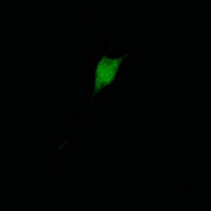
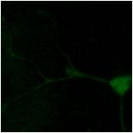


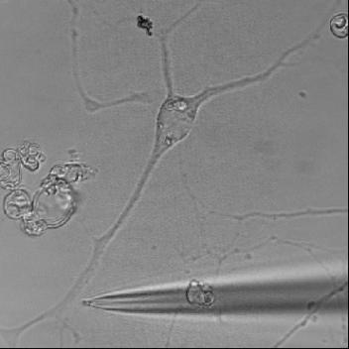
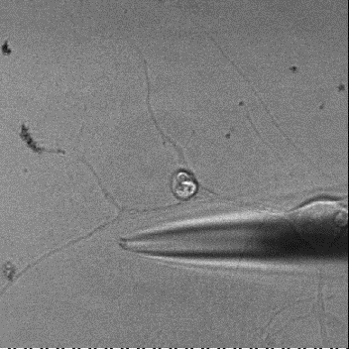
Disruption of lipid rafts in cultured sensory neurons by MβCD resulted in unresponsiveness to mechanical stimuli
with methy-β-cyclodextrin
Flotillin-1
40%
30%
0%
- MβCD
+ MβCD
53

Slide 54
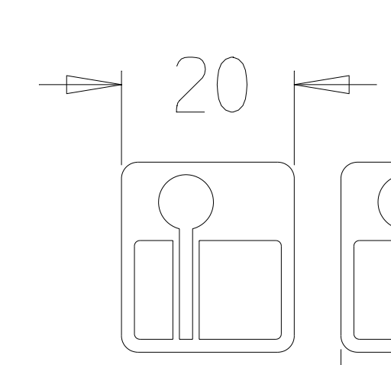
Disruption of lipid rafts in the middle part of axons is
sufficient to block action potential propagation
Time lapse recording of Fluo-4 fluorescence from cell bodies
Stimulation of neurites with chemicals:
Capsaicin 10 μM
Bradykinin 10 μM
ATP 300 μM
Treatments:
CTR, 7KC, MβCD
70
60
50
Fluorescence Intensity (A.U.)
40
30
20
10
0
7-keto
-cholesterol
cholesterol
MβCD
54

Slide 55
Putative conduction mechanism of action potential propagation
in unmyelinated sensory axons
Upon stimulation of the unmyelinated C-fibres by nociceptive signals, Na_{V}1.8 channels at a lipid raft opens and this causes local influx of Na⁺ and action potential initiation. As the depolarisation spreads, the magnitude of membrane depolarisation decreases due to the absence of myelin insulation in unmyelinated fibres. Before the depolarisation is attenuated to sub-threshold level, it reaches the adjacent Na_{V}1.8 cluster and triggers subsequent Na⁺ influx.
threshold
55

Slide 56
TTX-resistant Na⁺ current is essential for transmitting the chemical stimuli to cell soma of culture DRG neurons
Fluo-4 fluorescence from cell bodies
Capsaicin Bradykinin ATP
CTR, Na⁺ free, TTX
56
Notes:
And this action potential propagation was completely abolished when sodium ions are omitted in the middle chamber, but 250nM TTX did not affect the conduction.
This means TTX-resistant sodium current is essential for the action potential propagation in the axons of sensory neurons, which suggests the involvement of Nav1.8.

Slide 57
Types of pain
Overview of sensory nervous system and pain pathway
Introduction of key molecules in pain pathway
Na⁺ channels and accessory subunits in pain pathway
Pain killers
57

Slide 58
Current analgesics
NSAIDs (Non-Steroid Anti Inflamatory Drugs)
Prevent prostaglandin biosynthesis by inhibiting cyclo-oxygenase (COX),
the crucial enzyme in the initial synthesis of prostaglandins
irreversible inactivation of COX
- Aspirin (irreversibly acetylates COX)
reversible competitive inhibition
- Ibuprofen and Mefenamic acid
reversible non-competitive inhibition
- Paracetamol (scavenges hydroperoxides which stimulate COX)
→ no anti-inflammatory effect (i.e. not NSAID)
COX-1: makes prostaglandins vital for protecting the stomach through mucus production, and maintenance of renal blood flow
COX-2: the inducible form that mediates the pain of inflammation by sensitising peripheral nociceptors
58

Slide 59
Current analgesics
NSAIDs (Non-Steroid Anti Inflamatory Drugs)
COX-2 (Cyclo-Oxygenase 2) Inhibitors: Celebrex (released in 1999)
Unlike the other COX inhibitors such as Aspirin, COX-2 specific inhibitors do not block the COX-1 enzyme that protects the stomach lining, thus do not produce the potential stomach problems
Vioxx (Rofecoxib): approved in 1999, withdrawn by Merck in 2004
darbufelone (Pfizer)
CS-502 (Sankyo)
LAS 34475 (Almirall Profesfarma)
LAS 34555 (Almirall Profesfarma)
S-33516 (Servier)
SD 8381 (Pharmacia)
BMS-347070 (Bristol-Myers Squibb)
MK-966 (Merck)
L-783003 (Merck)
T-614 (Toyama)
D-1367 (Chiroscience)
L-748731 (Merck)
CT3 (Atlantic Pharmaceutical)
CGP-28238 (Novartis)
BF-389 (Biofor/Scherer)
GR-253035 (Glaxo Wellcome)
6-dioxo-9H-purin-8-yl-cinnamic acid (Glaxo Wellcome)
S-2474 (Shionogi)
59

Slide 60
Current analgesics
Opiates
Opioids/morphine act by stimulating μ, δ, and κ receptors
Orphan receptor called ORL-1 (for "opiate-like receptor 1")
- 60% sequence homology with the other opiate receptors
- An endogenous ligand (nociceptin/orphanin F2)
Morphine as pain killer
μ and δ receptor activation causes decrease of cyclic AMP production, and hyperpolarisation of membranes by stimulating an inward rectifying potassium channel. This hyperpolarisation decreases the release of neurotransmitters from the nerve cell, as such release depends on opening of voltage-sensitive calcium channels
Opiate receptors are expressed in brain, spinal cord, and peripheral nerves
60

Slide 61
Current analgesics
Opiates
Opium (morphine): an extract of the poppy plant
Why should the brain have receptors for an extract of the opium poppy?
- the brain must have receptors for compounds produced by the body (endogenous
compounds) which happen to share a chemical similarity with morphine
Enkephalins (from the Greek meaning "in the head“)
Tyr-Gly-Gly-Phe-Met
Tyr-Gly-Gly-Phe-Leu
Endorphins (endogenous morphine-like molecule)
α-Endorphin
Tyr-Gly-Gly-Phe-Met-Thr-Ser-Glu-Lys-Ser-Gln-Thr-Pro-Leu-Val-Thr
γ-Endorphin
Tyr-Gly-Gly-Phe-Met-Thr-Ser-Glu-Lys-Ser-Gln-Thr-Pro-Leu-Val-Thr-Leu
β-Endorphin
Tyr-Gly-Gly-Phe-Met-Thr-Ser-Glu-Lys-Ser-Gln-Thr-Pro-Leu-Val-Thr-Leu-Phe-Lys-Asn-Ala-Ile- Ile- Lys-Asn-Ala-Tyr-Lys-Lys-Gly-Glu
HO
HO
O
CH₃
H
N
N
NH₂
HO
O
R
O
morphine
enkephalins/
endorphins
61

Slide 62
Development of analgesics
Sales of analgesics and anti-inflammatories has been estimated as US$18.7 billion worldwide
Current pain killers include NSAIDs (Non-Steroid Anti Inflamatory Drugs) and opiates.
NSAIDs: aspirin, paracetamol, ibuprofen (neurofen)
can cause serious gastrointestinal problems
opiates: morphine
causes unwanted central side effects
Further clinical options are still required and the entire future of pain therapeutics continues to be a major priorty of the pharmaceutical industry
62

Slide 63
Preclinical Testing (6.5 years): Once a new compound has been discovered in a laboratory, a pharmaceutical company conducts studies to show biological activity of the compound against the targeted disease, and the compound is evaluated for safety.
Phase I (1.5 years): involve about 20 to 80 normal, healthy volunteers. The tests study a medication's safety profile, including the safe dosage range. The studies also determine how a medication is absorbed, distributed, metabolized, and excreted, as well as the duration of its action.
Phase II (2 years): controlled trials of approximately 100 to 300 volunteer patients (people with the disease) assess a medication's effectiveness.
Phase III (3.5 years): involves 1,000 to 3,000 patients in clinics and hospitals. Physicians monitor patients closely to confirm efficacy and identify adverse effects.
FDA (Medicines Control Agency (MCA), Department of Health) Review Process and Approval (1.5 years): if the data successfully demonstrate both safety and effectiveness, a company analyzes all of the data and files a New Drug Application (NDA) with the FDA.
The new medicine becomes available for physicians to prescribe.
63

Slide 64
15 years on average - from the lab to patients.
Pharmaceutical companies spend, on average, US$500 million to get one new medicine to the public. Only five in 5,000 compounds that enter preclinical testing make it to human testing.
And only one of those five is approved for sale.
64

Slide 65
Calcium Channel α2δ subunit inhibitor
Gabapentin
Pregabalin (Lyrica): Pfizer
Initially synthesized to mimic GABA, but does not act on GABA receptors
Postulated mechanism is to reduce calcium currents after by binding α2δ subunit of voltage gated calcium channel, and prevent translocation of α1 subunit to the plasma membrane
65

Slide 66
Up-and-coming medications
Sodium Channel Blockers
CNV1014802 (Convergence): Na_{V}1.7 blocker, currently in Phase II
PF-05089771 (Pfizer Neusentis): Na_{V}1.7 blocker, in Phase I
66

Slide 67
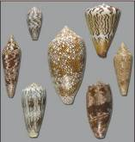
Up-and-coming medications
Calcium Channel Blockers
Ziconotide (Elan): approved by the FDA
Developed from cone snail w-conotoxin
Targets N-type calcium channels
Intrathecal application only
CNV2197944 (Convergence):
Into Phase II
Selective blocker for Cav2.2
67

Slide 68
Up-and-coming medications
NGF antibody
Tanezumab (Pfizer):
Clinical trial halted at Phase III in 2010 due to severe side effect in some patients
In march 2012, the FDA approved for a continuation of the development
68

