Slide 1

Pain I
Neuroscience and Mental Health
Module 1: Cellular & Developmental Neuroscience
Kenji OKUSE
22 October 2012
1
Notes:
Today, I’m going to talk about identification of a novel regulatory factor that facilitates the expression of Na_{V}1.8

Slide 2
Key Reference
Nat. Rev. Drug Discov. (2005) 4(10): 834-844
Int. J. Biochem. & Cell Biol. (2007) 39(3): 490–496
Nature. (2003) 424(6950):778-783
Nature. (2005) 438(7070):1017-1021
Nature. (2006) 444(7121):894-898
Neuron. (2006) 52(5):767-774
2

Slide 3
Types of pain
Overview of sensory nervous system and pain pathway
Introduction of key molecules in pain pathway
Na⁺ channels and accessory subunits in pain pathway
Pain killers
3

Slide 4

Five senses
Audition
(hearing)
Vision
Olfaction
(smell)
Gustation
(taste)
Tactile sense
(touch, pain)
4

Slide 5
Types of Pain
Referred - pain experienced from a site distant from injury
Visceral - originates from organ tissues of the thorax, abdomen or pelvis
(deep, dull and vague sensation)
Somatic - cutaneous, i.e. body surface,
(sharp and burning sensation)
deep tissues, i.e. musculoskeletal tissues,
(dull or aching but localized sensation)
Neuropathic - caused by lesions of the nervous system, resulting in
structural damage to the nervous units, rather than by
receptor stimulation
(burning/stabbing sensation)
Phantom - sensations of burning, tingling felt in absent limb
5

Slide 6
Pain can be caused by wide range of stimuli
Temperature - heat, cold
Mechanical - pressure, friction edema
Chemical - gastric enzymes, histamines, caustic substances
6

Slide 7
Acute Pain vs. Chronic Pain
Acute Pain Chronic Pain
May be sudden or gradual with periods of remission & exacerbation
> 6 months
Usually sudden, self-limiting
< 6 months
Precipitating event
May not be associated with injury
Resolves with treatment
Difficult to treat
Restless, anxious, crying
Depressed, withdrawn
7

Slide 8
Types of pain
Overview of sensory nervous system and pain pathway
Introduction of key molecules in pain pathway
Na⁺ channels and accessory subunits in pain pathway
Pain killers
8

Slide 9
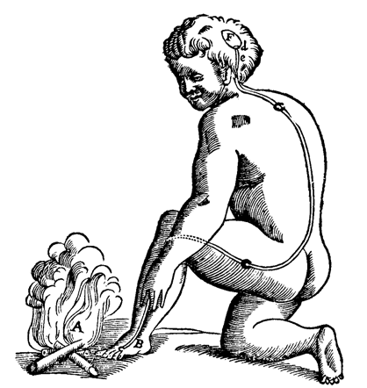
Descartes first described the human body
in terms of a machine
PAIN
“fast moving particles of fire that disturb the filaments in the nerve”
René Descartes
Le Traité de l'Homme (1664)
NOCICEPTION
9

Slide 10
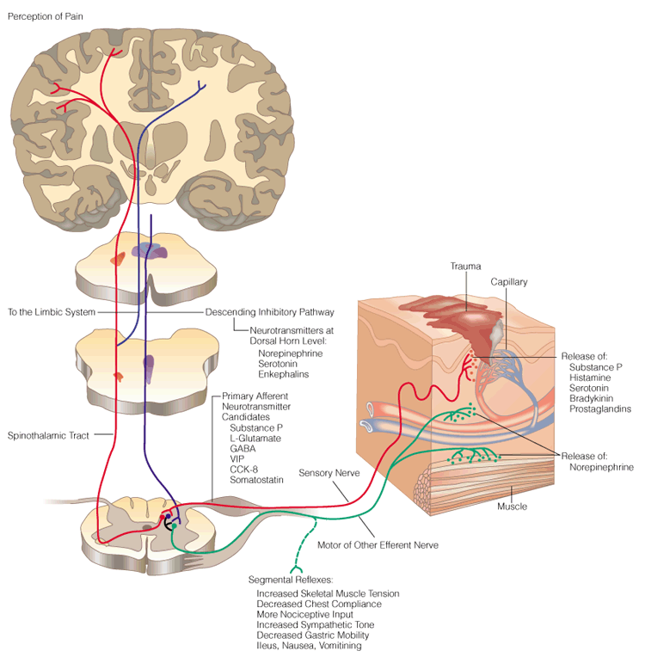
Cerebrum Cortex
Sensory Area
Sensory and Motor
Nervous System
Trauma
Release of:
Substance P
Histamine
Serotonin
Bradykinin
Prostaglandins
NGF
Sensory Nerve
Dorsal Root
Ganglia (DRG)
Spinal
Cord
Ventral Root
Motor and Other Efferent Nerve
Neurotransmitter Release
(Glu, Substance P, GABA, Enk)
10

Slide 11
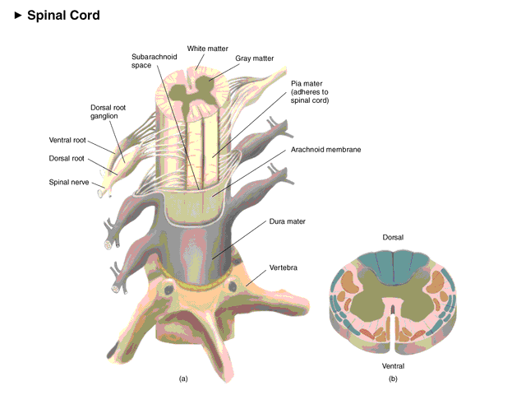
Spinal Cord and Dorsal Root Ganglion
11

Slide 12
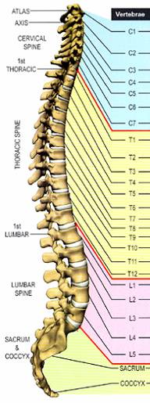
Vertebral subluxation and innervation chart
Cervical
Median nerve (arms, hands)
Thoracic
Gastric nerve (stomach)
Lumbar
Sciatic nerve (legs, foots)
Sacral
12

Slide 13
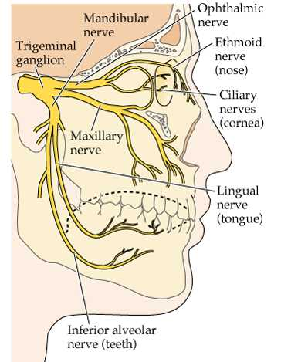
Trigeminal ganglion neurons innervate facial nerves
13

Slide 14
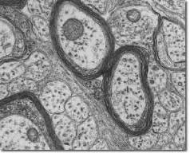
Small diameter sensory neurons
are responsible for nociception
DRG
Spinal Cord
Peripheral
Small diameter, unmyelinated C fibre neuron (chronic pain)
Medium diameter, thinly myelinated A-δ fibre neuron (acute pain)
Large diameter, myelinated A-β fibre neuron (touch)
14

Slide 15
Descartes’ view on pain
The specificity theory of pain
“the intensity of pain is directly related to the amount of associated tissue injury”
This theory is generally accurate, but can not be applied to many chronic pain whose cause is not necessary tissue injury
e.g. Phantom limb - Patients who undergo the amputation of a limb may continue to report sensations or chronic pain that seem to come from the limb that has been amputated.
15

Slide 16
Gate control theory of pain
Developed by Ronald Melzack and Patrick Wall in 1960s
“When the gates are opening, pain messages “get through” more or less easily and pain can be intense. When the gates close, pain messages are prevented from reaching the brain and may not even be experienced.”
Three types of nerve fibers carry the tactile messages to the spinal cord
A-β fibres: touch, 35-75 m/s (240 mph)
A-δ fibres: acute pain, 5-35 m/s (40 mph)
C fibres: chronic pain, 0.5-2 m/s (2 mph)
Activation of A-β fibres can block the signals transmitted by A-δ and C fibres
i.e. A-β fibres send information about pressure and touch that reach the spinal cord and brain to override pain messages carried by A-δ and C-fibres
16

Slide 17
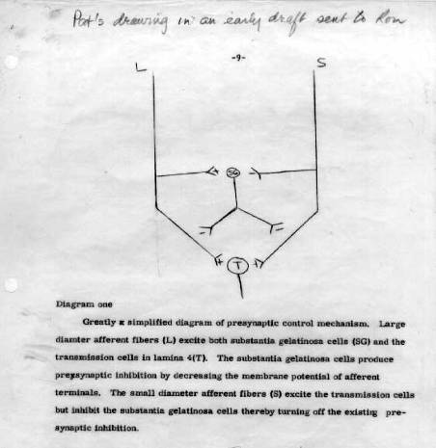
Gate control theory of pain
Brain
A-β fibre
A-δ, C fibre
17

Slide 18
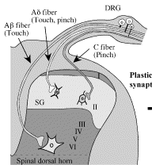
Dorsal horn
The cells of the spinal cord are arranged in layers or laminae, six in the dorsal horn (I-VI), three in the ventral horn (VII-IX) and an additional column of cells clustered around the central canal as Lamina X
C nociceptive afferents terminate mainly in Laminae I and II
A-δ afferents terminate mainly in Laminae I. II and V
A-β afferents terminate mainly in Laminae V, VI
18

Slide 19
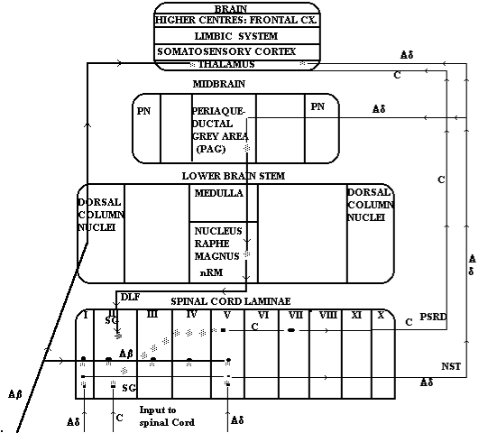
Central pain pathways
Ascending pathways
Neospinothalamic pathway (NST)
- A-δ afferents
Paleo-spino-reticulo-diencephalic pathway (PSRD)
- C afferents
19

Slide 20
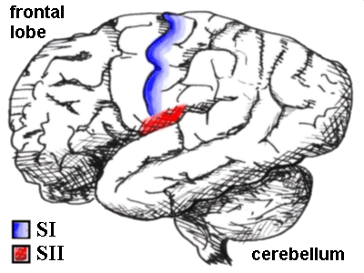
Major brain areas involved in pain pathway
S I: the primary sensory cortex
S II: the secondary sensory cortex
The anterior part of the insula
The cingulate gyrus.
20

Slide 21
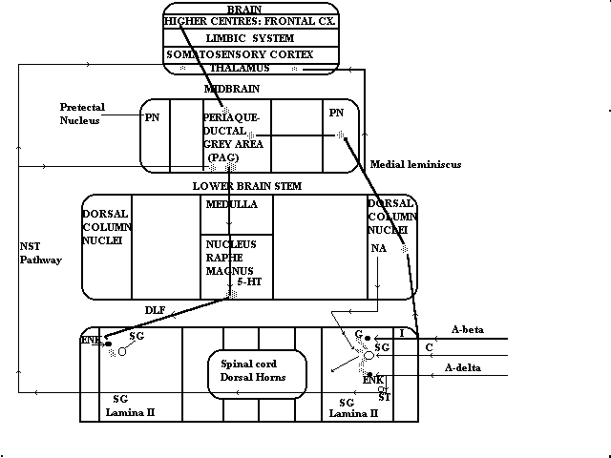
Central pain pathways
Descending pathways
Nociceptive tissue damage information reaches the substantia gelatinosa (SG) of the spinal cord
SG cells can be postsynaptically inhibited by enkephalinergic interneurones (ENK) which are activated either by A-δ fibres or via serotoninergic (5-HT) inhibitory fibres that descend in the Dorsolateral Funiculus (DLF)
21

Slide 22
Types of pain
Overview of sensory nervous system and pain pathway
Introduction of key molecules in pain pathway
Na⁺ channels and accessory subunits in pain pathway
Pain killers
22

Slide 23
Cerebrum Cortex
Sensory Area
Sensory and Motor
Nervous System
Trauma
Release of:
Substance P
Histamine
Serotonin
Bradykinin
Prostaglandins
NGF
Mediators
Receptors
Sensory Nerve
Dorsal Root
Ganglia (DRG)
Spinal
Cord
Ventral Root
Motor and Other Efferent Nerve
Neurotransmitter Release
(Glu, Substance P, GABA, Enk)
23

Slide 24
Pain inducers / Inflammation mediators
Bradykinin
Bradykinin
- polypeptide (Arg-Pro-Gly-Phe-Ser-Pro-Phe-Arg)
- made from Kininogen by proteolysis in blood in response to
tissue damage/blood coagulation
Bradykinin receptors
- B1, B2
- 7-TM G-protein coupled receptors
- linked to Gq and Gi
- Activate phospholipase Cβ (PLCβ) and phospholipase A2 (PLA2) - Activation of PLCβ leads to protein kinaseC (PKC) activation
- Activation of PLA2 causes production of arachidonic acid (AA)
from the cellular phospholipid bilayer
- AA is converted into prostanoids
24

Slide 25
Pain inducers / Inflammation mediators
Prostanoids
Prostaglandins (PGE₂)
- Synthesized/released from Glanulocyte, Macrophage, and Nociceptive Neurons in response to tissue damage
- Binds to EP2 receptor expressed at free nerve endings
Cyclooxygenase: COX is the rate-limiting enzyme of PGE₂ synthesis
COX-2 can be induced by proinflammatory cytokines such as TNFα and IL-Iβ at the site of local inflammation
25

Slide 26
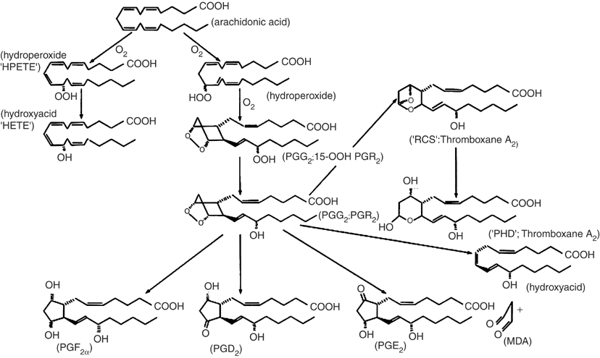
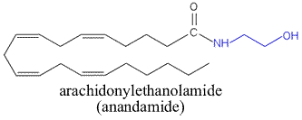
Prostaglandin synthesis pathways
N-acyltransferase
phospholipase D
cyclooxygenase activity
COX
peroxidase activity
COX
(PGH₂)
26

Slide 27
Pain inducers / Inflammation mediators
Prostaglandin receptors
- DP1, DP2
- EP1, EP2, EP3, EP4
- FP
- IP
- 7-TM G-protein coupled receptors
- PGE2 binds to EP2 receptor expressed at free nerve endings
- Activates adenylate cyclase via Gs
- Increases intracellular cAMP
- cAMP leads to protein kinase A (PKA) activation
- Phosphorylates channels, Lower the thresholds of nociceptive neurons
27

Slide 28
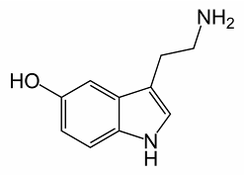
Pain inducers / Inflammation mediators
Serotonin
Serotonin (5-HT)
- Synthesized from Tryptophan
- Released from platelets upon aggregation
Serotonin receptors
- 14 receptors have been identified so far
- 7-TM G-protein coupled receptors
- 5-HT3 receptor is not linked to a G-protein
- forms a ligandgated ion channel
- causes Na⁺ influx and neuronal excitation in response to
ligand binding.
28

Slide 29
Pain inducers / Inflammation mediators
NGF (Nerve Growth Factor)
NGF - Regulate the peripheral sensitivity of nociceptive neurons
- Increased NGF levels lead to mechanical and thermal hyperalgesia
- Increases functional sodium channel expression
TrkA - Single-TM tyrosine kinase receptor for NGF
- Selectively expressed in unmyelinated nociceptive sensory neurons
BDNF (brain-derived neurorophic factor)
NT-4/5
NT-3
TrkB
TrkC
cf. Hyperalgesia: an increased response to a stimulus that is normally painful
Allodynia: pain due to a stimulus that does not normally provoke pain
29

Slide 30
GDNF (Glial cell line-Derived Neurotrophic Factor)
Pain inducers / Inflammation mediators
GDNF - Can reverse the sensory abnormalities found in
neuropathic pain condition
- Controls expression levels of various sodium channels
in sensory neurons
GDNF receptor - Selectively expressed in unmyelinated nociceptive sensory neurons
GFRα - GPI (Glycosyl-Phosphatidyl-Inisotol) anchored
- GDNF binds to GFRa, and this leads to the subsequent
high affinity binding to c-ret
c-ret - single TM tyrosine kinase receptor
- activates MAP kinase pathway
30

Slide 31
Expression of Neurotrophic Factor Receptors in DRG neurons
Myelinated neurons
TrkA
TrkB
TrkC
Unmyelinated neurons
c-ret
GFRα
Note: This is a simplified chart. Real expression pattern
is overlapped and much more complicated.
31

Slide 32
Cerebrum Cortex
Sensory Area
Sensory and Motor
Nervous System
Trauma
Release of:
Substance P
Histamine
Serotonin
Bradykinin
Prostaglandins
NGF
Sensory Nerve
Dorsal Root
Ganglia (DRG)
Spinal
Cord
Neurotransmitters
Ventral Root
Motor and Other Efferent Nerve
Neurotransmitter Release
(Glu, Substance P, GABA, Enk)
32

Slide 33
Neurotransmitters
Excitatory neurotransmitters
Glutamate
tachykinins
(substance P – NK1, neurokinin A – NK2, neurokinin B – NK3)
Other substances that transmit pain impulses from incoming nerves in the dorsal horn including calcitonin gene-related peptide (CGRP), vasoactive intestinal polypeptide (VIP), somatostatin and bombesin
Inhibitory neurotransmitters
γ-amino butyric acid (GABA)
Neurotransmitters involved in Descending Pain Regulation
Noradrenaline, Serotonin
Enkephalins, Endorphins
33

Slide 34
Neurotransmitters
Glutamate
Excitatory neurotransmitter
Released from postsynaptic terminals of sensory neurons at dorsal horn
- Variety of receptors
AMPA
GluR1-4 (GluRα1-α4)
GluR5-7 (GluRβ1-β3)
KA1/2 (GluRγ1/γ2)
GluRδ1/δ2
Kinate
Ionotropic
NA2A-D (GluRε1-ε4)
NR1 (GluRζ)
NR3A/3B (GluRκ1),
NMDA
mGluR group I
mGluR1/5
Gq/G₁₁ – PLCβ (IP3/DAG)
metabotropic
mGluR group II
mGluR2/3
Gi – AC (cAMP↓)
mGluR group III
mGluR6-8
Gi – AC (cAMP↓)
34

Slide 35
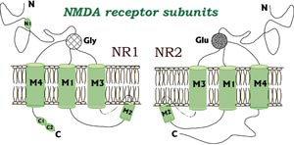
Neurotransmitters
Glutamate
NMDA receptor is inactive without Glutamate as it is physiologically choked by a Mg²⁺ sitting in its ion channel
↓
Glutamate, secreted by sensory neurons at dorsal horn, binds to NMDA receptor
↓
Upon Glutamate binding to the receptor, Mg²⁺ pops off
↓
Stimulated NMDA receptor mediates a host of spinal responses to painful stimulation
↓
Production of c-fos, prostanoids, and nitric oxide.
brain
A-β fibre
A-δ, C fibre
35

Slide 36
Neurotransmitters
Tachykinins
Tachykinins : substance P – NK1
neurokinin A – NK2
neurokinin B – NK3
all tachykinins have consensus C-terminal sequence
i.e. Phe-X-Gly-Leu-Met
tachy = fast brady = slow
expressed in TrkA expressing small diameter neurons
(peptidergic nociceptive neurons)
NK1-3 receptors: 7-TM G-protein coulpled
substance P-saporin
36

Slide 37
Neurotransmitters
Other peptidergic neurotransmitters
CGRP (calcitonin gene-related peptide)
VIP (vasoactive intestinal polypeptide)
Somatostatin
Bombesin
Galanin
Neuropeptide Y
Cholecystokin
PACAP (Pituitary adenyl cyclase activating peptide)
37

Slide 38
Expression of neurotrophic factor receptors and Na⁺ channels in DRG neurons
Na_{V}1.8
Myelinated neurons
Substance P, CGRP
TrkA
TrkB
TrkC
Unmyelinated neurons
c-ret
GFRα
Na_{V}1.9
IB4 +
Note: This is a simplified chart. Real expression pattern
is overlapped and much more complicated.
38

Slide 39
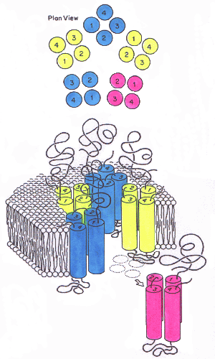
Neurotransmitters
GABA (γ-amino butyric acid)
Interneurones in laminae I, II and III are GABA-rich, and mediate gate control in the dorsal horn by synapsing on neurons that contain Glutamate and substance P
GABA-A receptor: ligand-gated Cl⁻ channel
GABA-B receptor: 7-TM G-protein coupled receptor
brain
A-β fibre
A-δ, C fibre
39

Slide 40
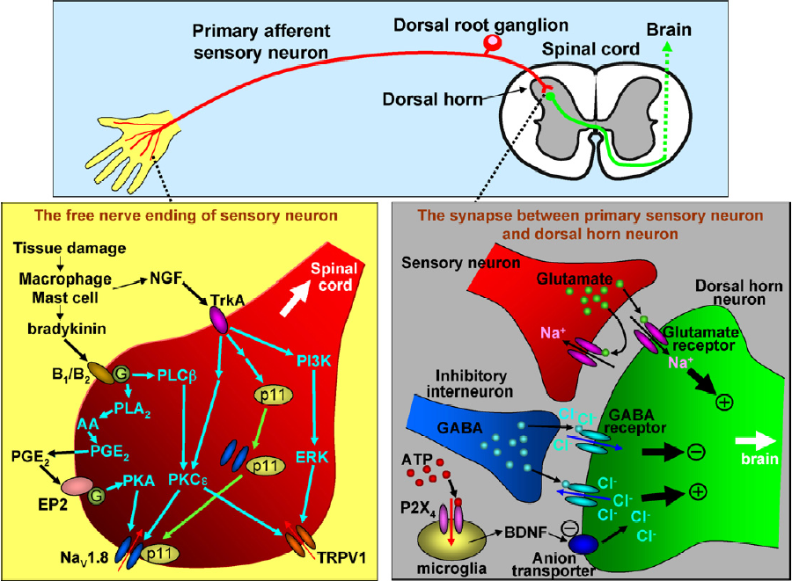
Key molecules in pain pathways at peripheral nerves
40

Slide 41
Cerebrum Cortex
Sensory Area
Sensory and Motor
Nervous System
Trauma
Release of:
Substance P
Histamine
Serotonin
Bradykinin
Prostaglandins
NGF
Sensory Nerve
Dorsal Root
Ganglia (DRG)
Channels
Spinal
Cord
Ventral Root
Motor and Other Efferent Nerve
Neurotransmitter Release
(Glu, Substance P, GABA, Enk)
41

Slide 42
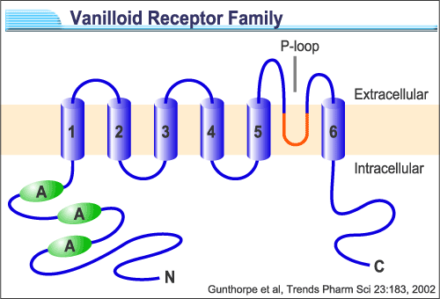

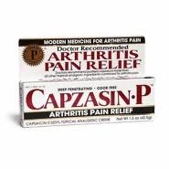

TRP Channels
TRPV1 (VR1): Non-selective cation channel activated by capsaicin which is the main ingredient in 'hot' chilli peppers
Also activated by noxious heat and low pH
Expressed exclusively in nociceptive sensory neruons
TRPV1 knockout mice are impaired in the detection of painful heat stimuli
42

Slide 43
Prostaglandin synthesis pathways
N-acyltransferase
phospholipase D
cyclooxygenase activity
COX
peroxidase activity
COX
(PGH₂)
43

Slide 44
TRP Channels
TRPV1 (VR1): Non-selective cation channel activated by capsaicin which is the main ingredient in 'hot' chilli peppers
Also activated by noxious heat and low pH
Expressed exclusively in nociceptive sensory neruons
TRPV1 knockout mice are impaired in the detection of painful heat stimuli
PKCε sensitises the heat-activated current in DRG neurons
P. Cesare et al. (1999) Neuron
44

Slide 45
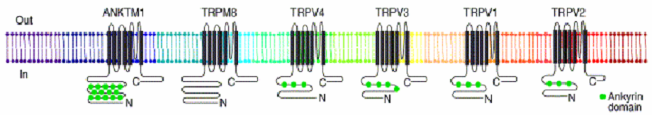
Thermosensitive TRP channels respond to
a wide range of ambient temperatures
Temperature (°C)
0
10
20
30
40
50
60
ANKTM1
TRPM8
TRPV4
TRPV3
TRPV1
TRPV2
Temperature
range
<17°
8-28°
>27°
>31or39°
>43°
>52°
Agonists
Menthol
Capsaicin
45

Slide 46
ATP-gated channel
P2X₃: Non-selective cation channel activated by ATP.
Responsible for ATP-evoked nociceptor activation.
P2X3 knockout mice show deficiency in detection of
some painful stimuli.
P2X₄: ATP activates microglial P2X₄ upon nerve injury.
Microglia releases Brain-Derived Neurotrophic Factor (BDNF).
BDNF acts on neurons to reduce the expression of KCC2 (anion transporter).
Increases of the intracellular Cl⁻.
GABA works as excitatory transmitter
rather than an inhibitory one.
46

Slide 47
Key molecules in pain pathways at peripheral nerves
47

Slide 48
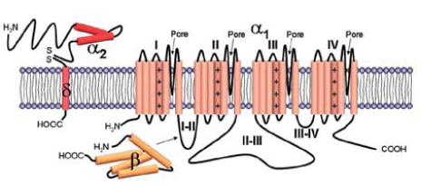
Voltage-gated Ca²⁺ channels
N-type: Blockers for N-type calcium channels prevent
neurotransmitter release, and act as pain killer.
Ca_{V}2.2 knockout mice show reduced response to
inflammatory and neuropathic pain.
Gabapentin: Originally developed for epilepsy
Binds and blocks the α2δ subunit of voltage-gated Ca²⁺ channel
Has analgesic effects in neuropathic pain
48

Slide 49
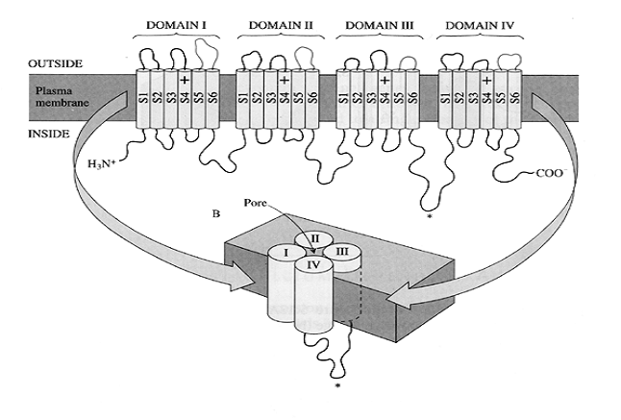
Voltage-gated Na⁺ channels
~250 kDa
6 transmembrane segments X 4 domains (24 transmembrane regions)
Voltage sensors in segment 4 in each domains
9 genes have been identified so far
Expressed mainly in neurons and muscle cells
49
Notes:
Voltage-gated sodium channels initiate and propagate action potentials in excitable cells.
These sodium channels comprise a large membrane spanning pore-forming alpha-subunits and small accessory beta-subunits.
So far 3 beta-subunits have been discovered, and all of them share common structure which is one transmembrane domain and extracellular Ig loops.

