Slide 1
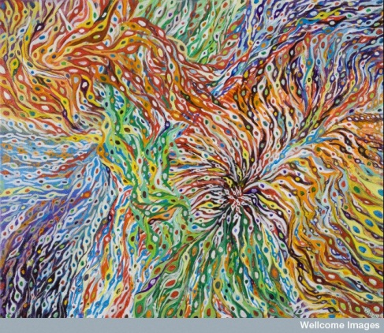
Neuronal migration
(Wellcome Library, London)

Slide 2
Reminder: Outline of CNS development
Part of the embryo ‘designated’ future CNS
Cells divide
Some regionalisation: signalling centres develop
(NB: coordinated with surrounding tissues)
Cell mixing restricted
Neurons start to be generated
Migrate to final positions
Then produce glia and more neurons
Connect and generate synapses
Cull excess
Remodel as required

Slide 3
Several examples of neural migration covered in these talks
Including:
Neurons during cerebral cortex development
Neural crest cells
Dopaminergic neuronal precursors
Cerebellar granule cell neurons

Slide 4
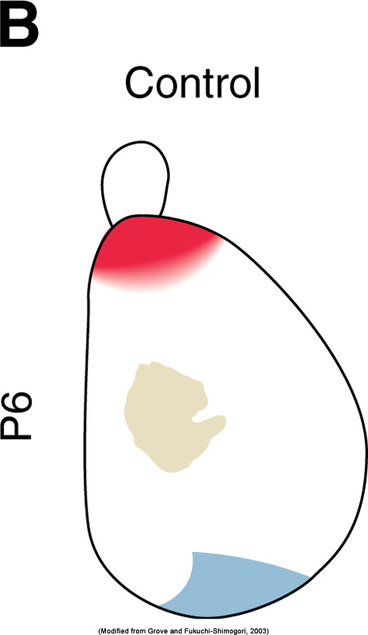
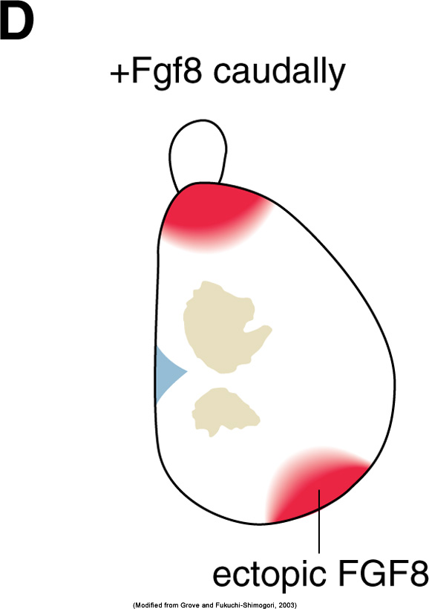
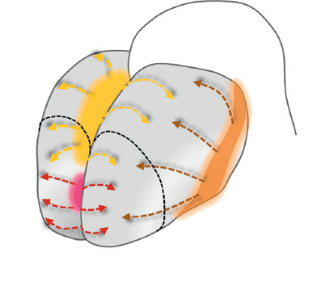
(Reminder) Patterning the forebrain e.g. cerebral cortex: FGF
Yellow= cortical hem (Wnts & BMPs)
Orange = Antihem (Sfrp2, Fgf7, Tgfα)
Pink= Anterior neural ridge (Fgf8, Fgf17, Fgf18)

Slide 5
The development of the cerebral cortex
Neocortex: 6 horizontal layers of neurons
80% = Excitatory projection (pyramidal) neurons (usually glutamatergic), long axon, distant synapses
(e.g. Layer 5 to basal ganglia, diencephalon, midbrain, hindbrain, and spinal cord)
And inhibitory interneurons (GABA), synapse nearby
Local and extrinsic connectivity
(mammalian species-specific)

Slide 6
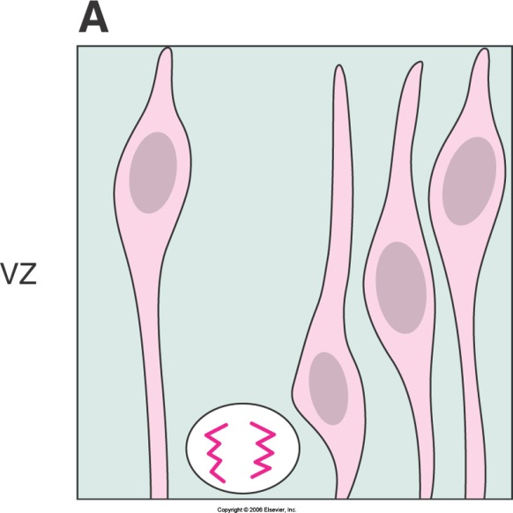
Cell migration during cerebral cortex development
Telencephalic wall
1 cell thick then divisions, symmetrical at first

Slide 7
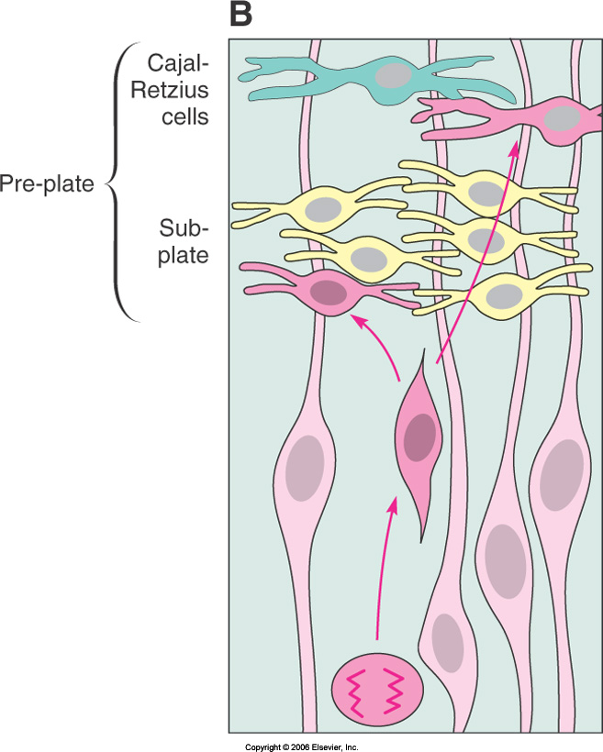
Building the cerebral cortex: outline of cortical projection neuron production
Cortical projection neurons are generated from the neocortical neuroepithelium (ventricular and subventricular zones)
retinoic acid (RA) has a key role (i.e. need to pattern the neuroepithelium)
Asymmetric cell divisions from cortical primary progenitors (radial glia) in the VZ generate either an immature projection neuron, or a secondary progenitor (intermediate progenitor in the SVZ).
Secondary progenitors also generate neurons.
an immature neuron is generated,
it migrates radially towards the pial surface
along radial glial processes (Rakic)
then settles in specific cortical layers
by sensing local molecular cues e.g. reelin

Slide 8
i.e. Cortex develops ‘inside-out’
The first cortical neurons to become post mitotic migrate to the cortical preplate,
which is split into marginal zone (layer 1) and subplate by later arriving neurons

Slide 9
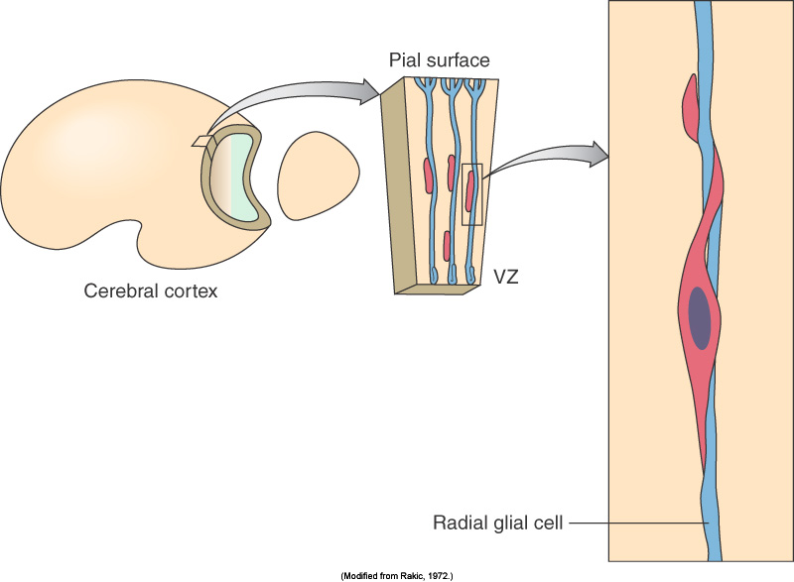
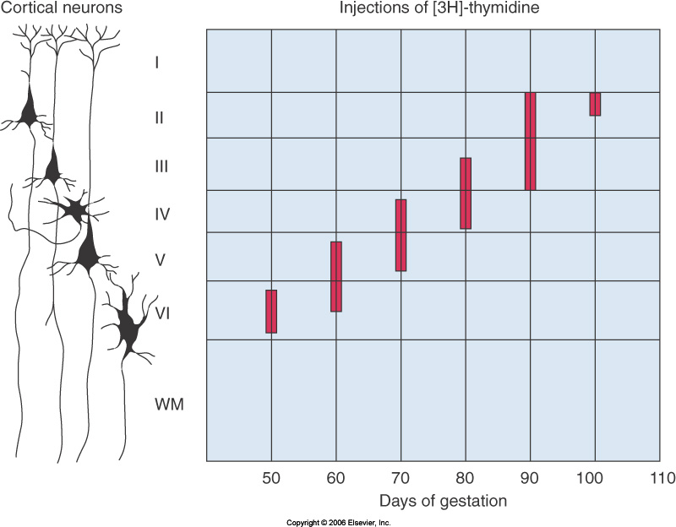
Cortical projection neuron migration
Along radial processes of newly born neurons at first
Later – use radial glia guides
(monkey)

Slide 10
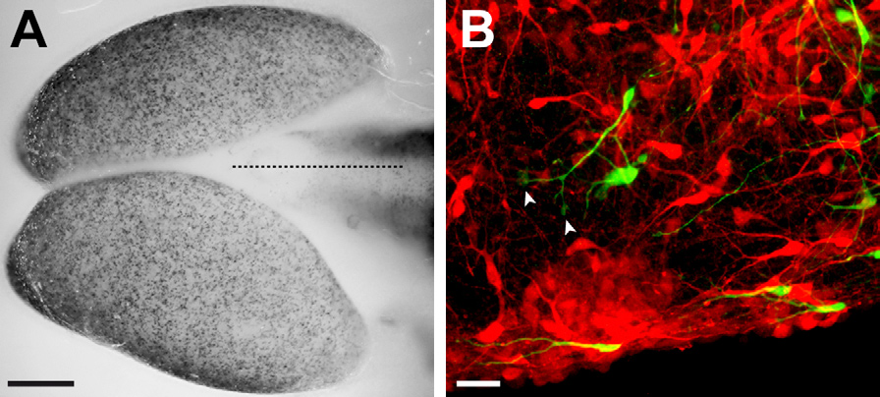
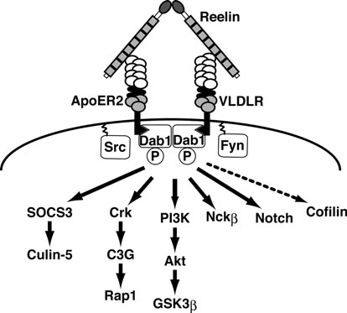
Cajal-Retzius cells
(Villar-Cerviño & Marín, 2012)
Reelin+, glutamate+,
most from cortical hem,
meninges drive migration
subclasses ?
In different regions of the cortex?

Slide 11
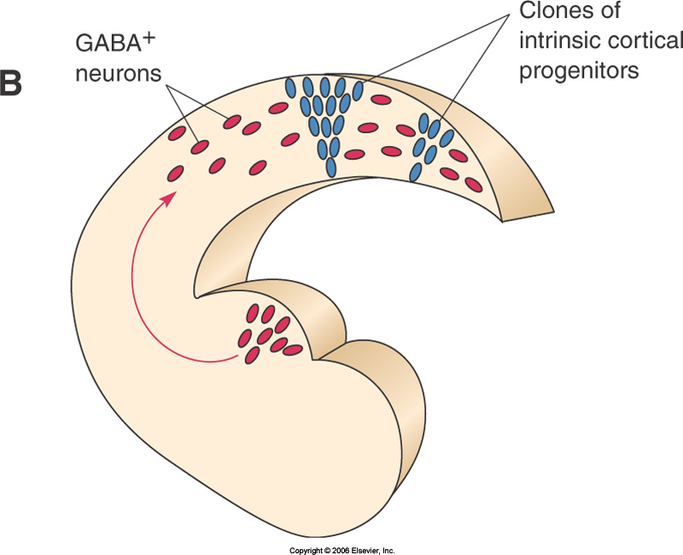
(the radial glia produce the neuronal progenitors too)
(some progenitors migrate tangentially,
some come in from far away e.g. GABA stellate cells come from the lateral ganglionic eminence)

Slide 12
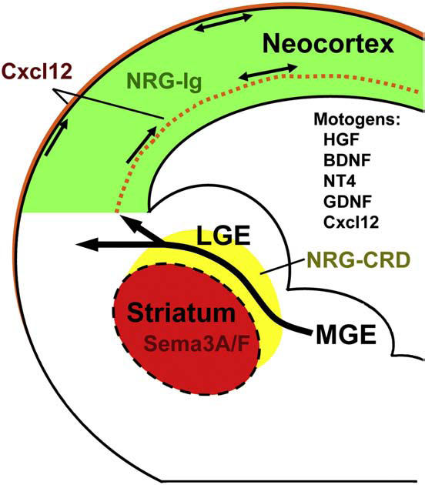
Production of cortical interneurons
Most generated outside of the cortex (humans generate a few in the cortex),
In the primordium of the basal ganglia called the ganglionic eminences.
then tangentially migrate into the immature cortical plate.
some GABAergic
interneurons remain
in the basal ganglia
(e.g. striatal interneurons).

Slide 13
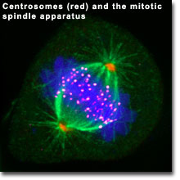
Clinical relevance
medically refractory epilepsy
basis for psychiatric disorders?
Genetic causes of defects often due to cytoskeleton dysregulation
Reelin

Slide 14
Outline of cortical development disorders (3 main types)
Disorders of proliferation (or proliferation/apoptosis): microcephaly
Disorders of migration:
neurons remain at the ventricular surface: periventricular heterotopia
stop in the white matter: subcortical band heterotopia
form a disordered, often thickened, cortical plate - simplified gyral pattern (pachygyria) or a smooth cortical surface (lissencephaly),
sometimes also has overmigration of neurons to pial surface (cobblestone lissencephaly)
Disorders of cortical organization or late migration: polymicrogyrias (multiple small gyri and abnormally thin or thick cortex) may cause clefting between the ventricular and meningeal surface (schizencephaly)

Slide 15
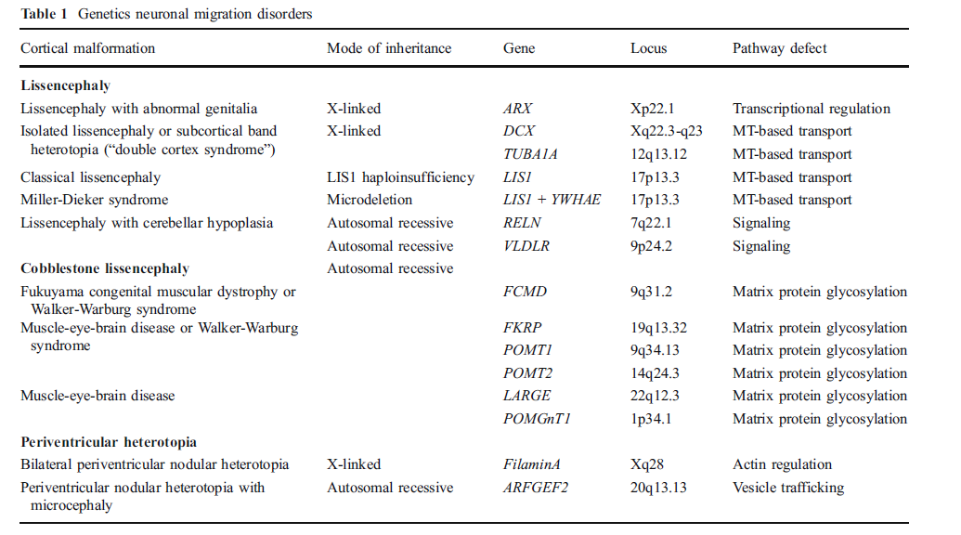
More on the clinical relevance
(reviewed in Lui JS, 2011)

Slide 16
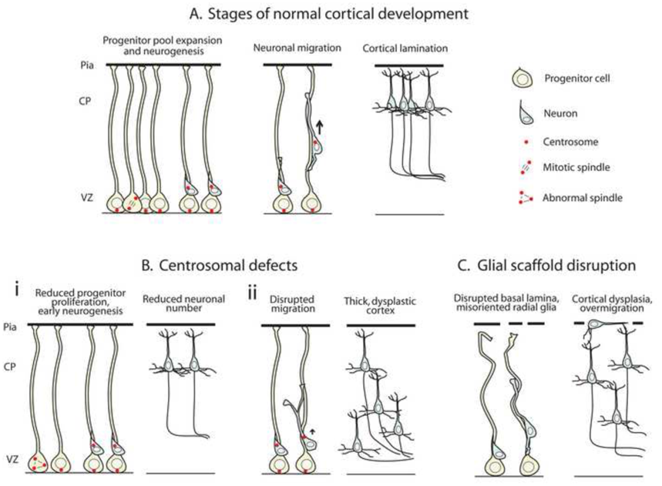
(Manzini and Walsh, 2011)

Slide 17
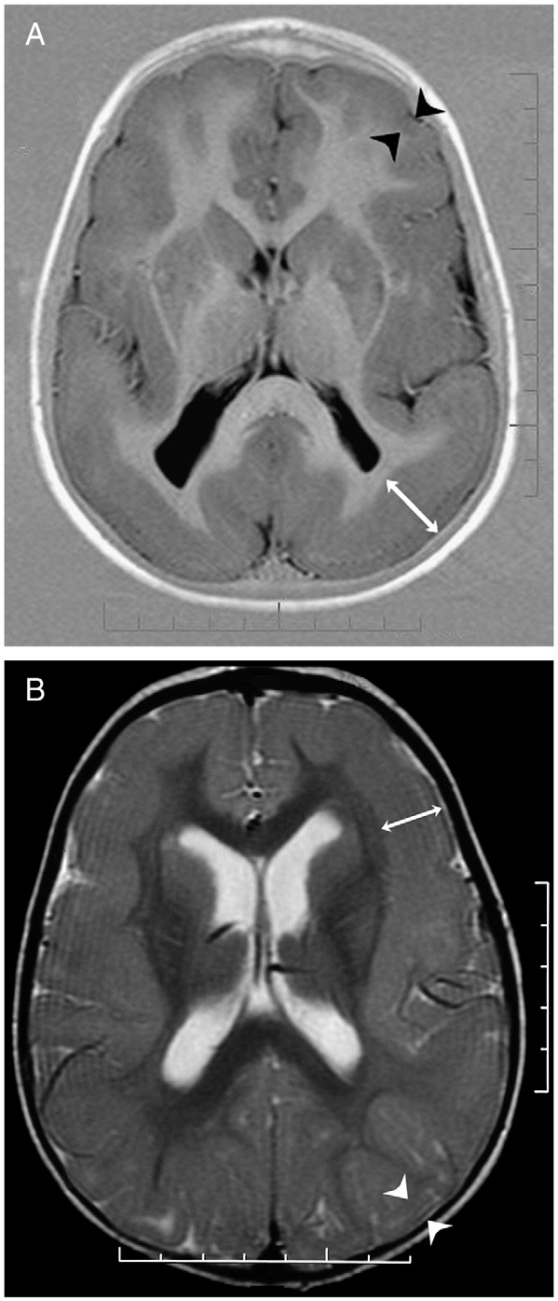
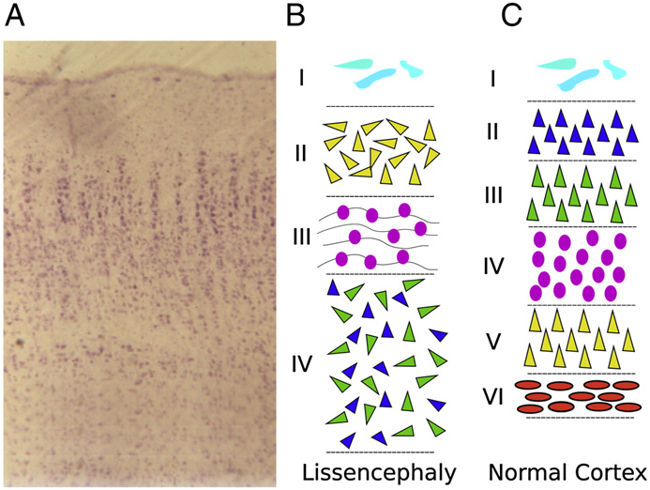
E.g. Lissencephaly (disordered migration)
(Guerrini & Parrini ,2010)

Slide 18
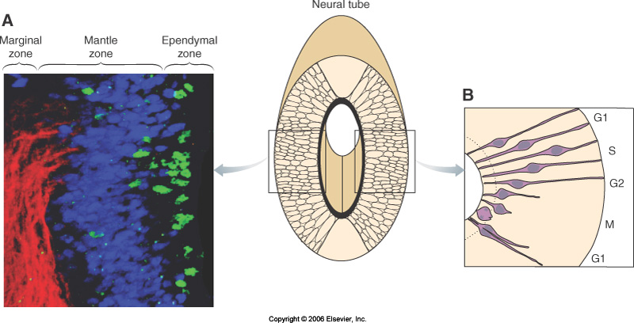
Saw that cell nuclei move during cell cycle (‘interkinetic nuclear migration’)
(ventricular side AKA ‘apical’ and other ‘basal’ i.e. M phase at apical)

Slide 19
Mystery solved
The interkinetic nuclear migration controls the dose of signal the progenitors receive (Notch)
(Zebrafish retina, Del Bene et al., Cell 2008)
High Notch at apical side = keeps progenitors dividing
Lower Notch, they can differentiate into neurons then glia
(Del Bene et al., mutants spent longer at basal than apical – generated early neurons first and lacked later and glia)

Slide 20
15 minutes break
Relax
Meet your neighbours
Ask questions

Slide 21
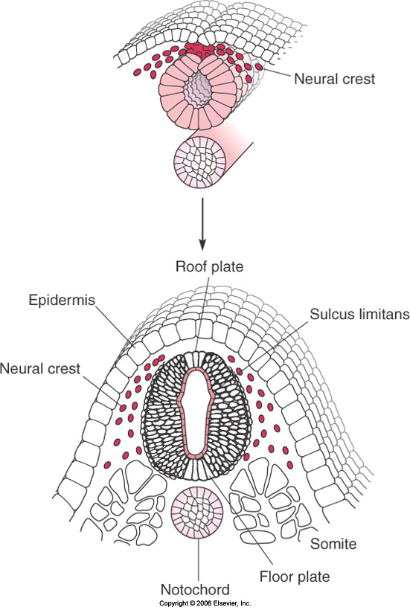
The Neural Crest
Vertebrate stem cell population
Leave dorsal CNS via EMT
(epithelial to mesenchymal transition)
Migrate widely
Diverse fates
(models e.g. Chick: quail chimeras)

Slide 22
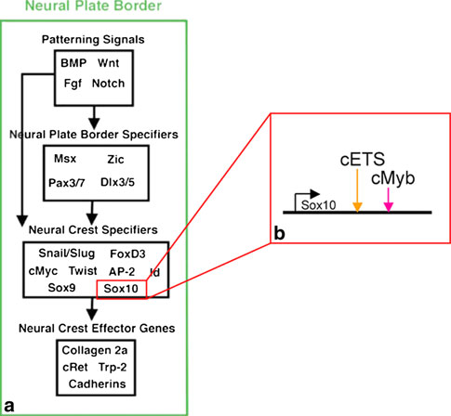
Specifying the neural crest
Induction Wnt, BMP, FGF
Up-regulate ‘neural plate border specifier genes’, inc. Msx1/2, Pax3/7 & Zic.
These broadly define region with ability to form NC cells &
other cell types such as dorsal sensory neurons of the CNS.
Then upregulate NC specifier genes: inc. Snail, FoxD3
Finally, these turn
on genes that make
them migratory and
multipotent.
+epigenetics
(Bronner ME, 2012 Review)

Slide 23
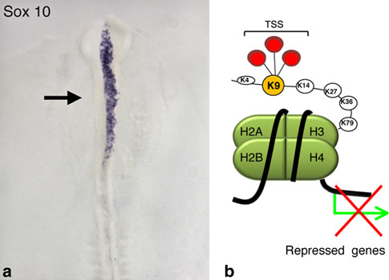
An example of NC Epigenetics
Fig. 5 a Morpholino knock-down of the histone demethylase
JmjD2A causes loss of the neural crest specifier gene Sox10 on the
electroporated (black arrow) side, whereas there is normal expression
on the control, non-electroporated side. b Schematic diagram shows
the repressive state when histone H3 is trimethylated on lysine 9.
JmjD2A specifically removes this repressive mark, thereby allowing
onset of Sox10 transcription at the appropriate stages. (data from Strobl-Mazzulla
et al. 2010)

Slide 24
Level specific NC behaviour
4 different segments of the neuraxis: cranial, cardiac, vagal, and trunk.
Cranial NC produces majority of the bone and cartilage of head and face & nerve ganglia, smooth muscle, connective tissue and pigment cells
Cardiac NC contributes to heart development by forming the aorticopulmonary septum and conotruncal cushions
Vagal NC gives rise to enteric ganglia of the gut
Trunk NC gives rise to neurons and glia, & some PNS, to secretory cells of the endocrine system & to skin pigment cells

Slide 25
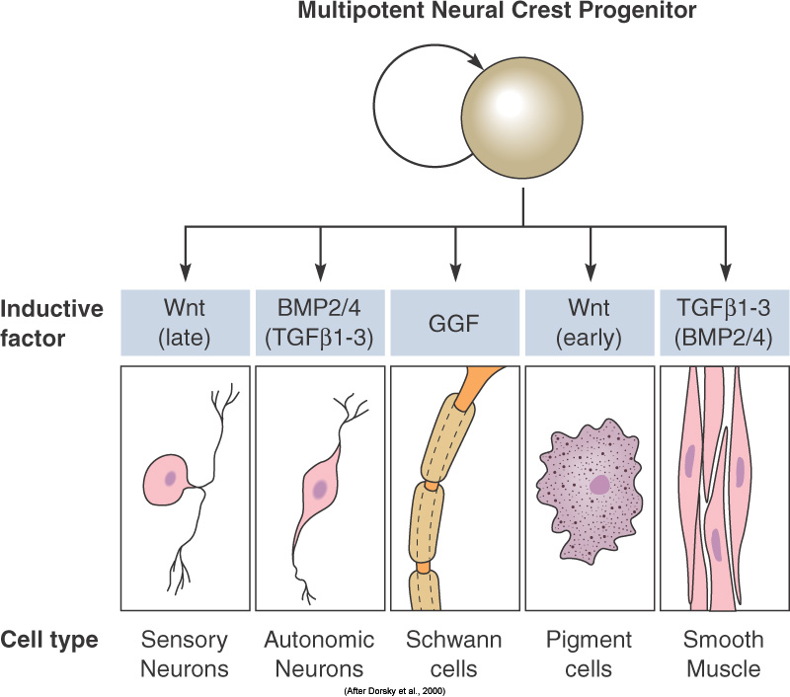
i.e. restricting NC potency
Multipotent progenitors
Fate becomes restricted as migrate
Stop at target, may regroup
Differentiate into a wide range of cell types

Slide 26
NC get moving: Epithelial to mesenchymal transition
Adhesive changes, loss of cell polarity, and cytoskeletal re-arrangements.
Motile and invasive

Slide 27
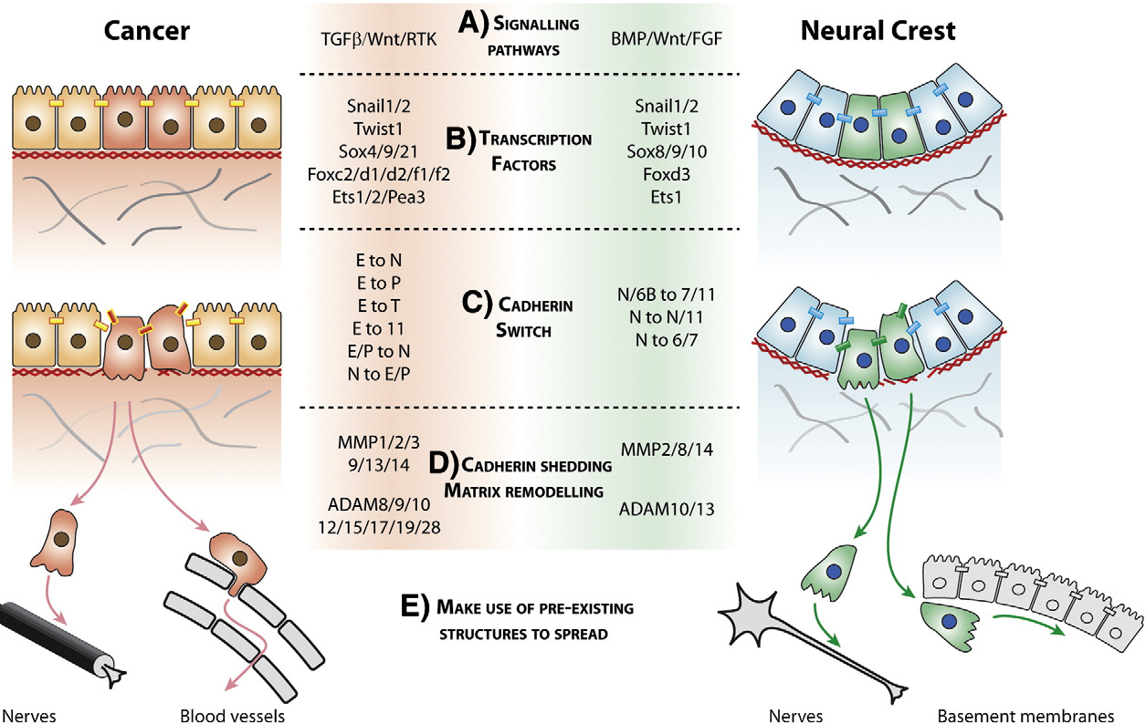
Cancer metastasis and neural crest cell migration show similarities
(Theveneau & Mayor 2012)

Slide 28
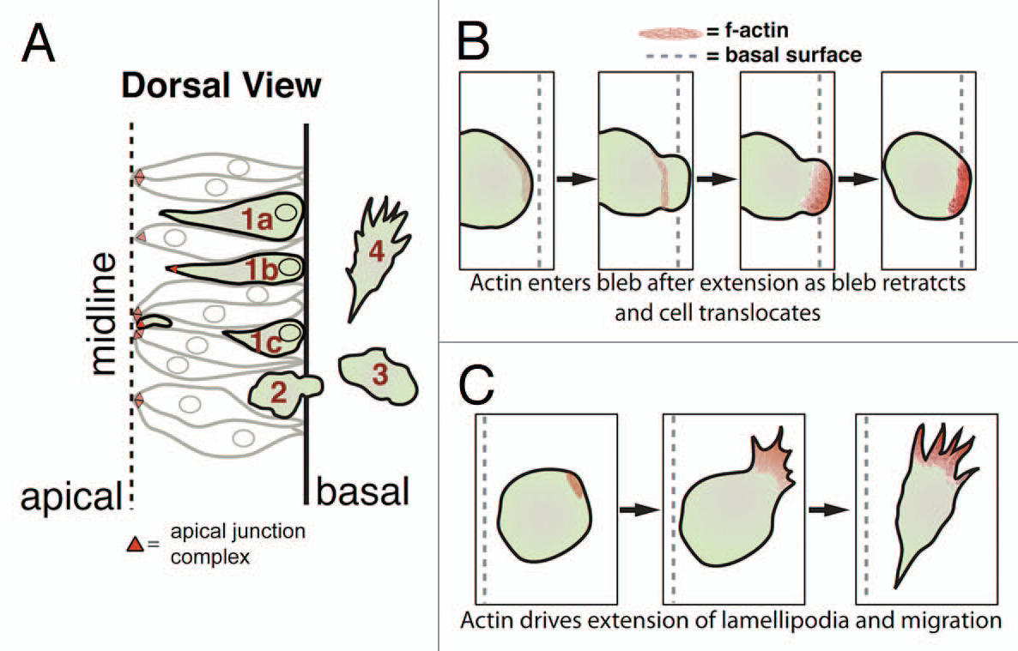
Live imaging of NC migration

Slide 29
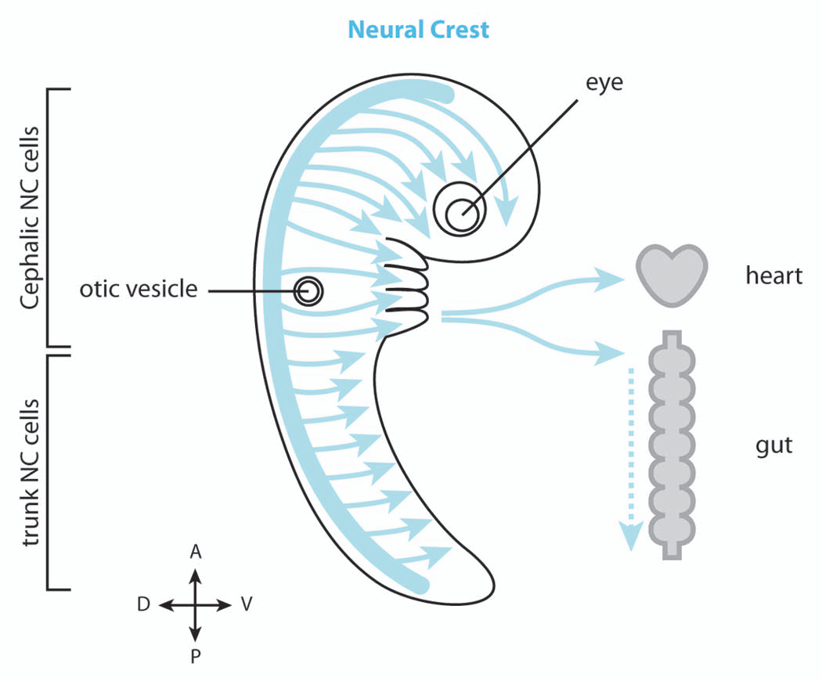
Defining EMT changes
Lose epithelial adhesions
Snail/slug, twist

Slide 30
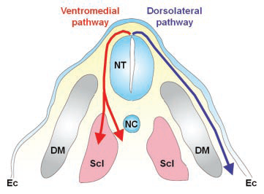
Migrating neural crest: Interactions with the local environment
Migrate along stereotypic
pathways in embryo
a dorsal lateral pathway between the epidermis
and mesoderm and a ventromedial pathway through the somites
Attraction and repulsion
Divide as migrate

Slide 31
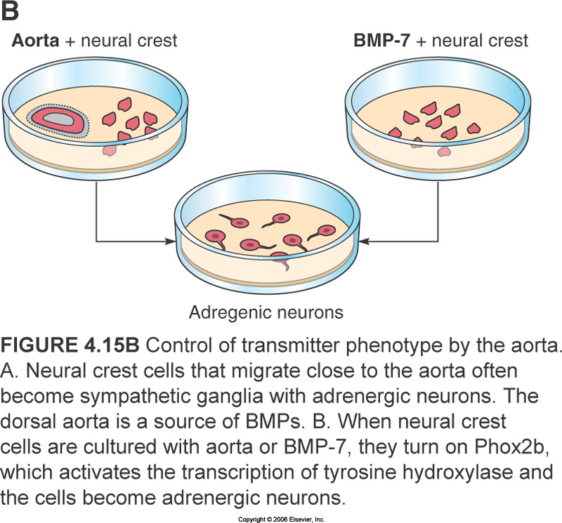
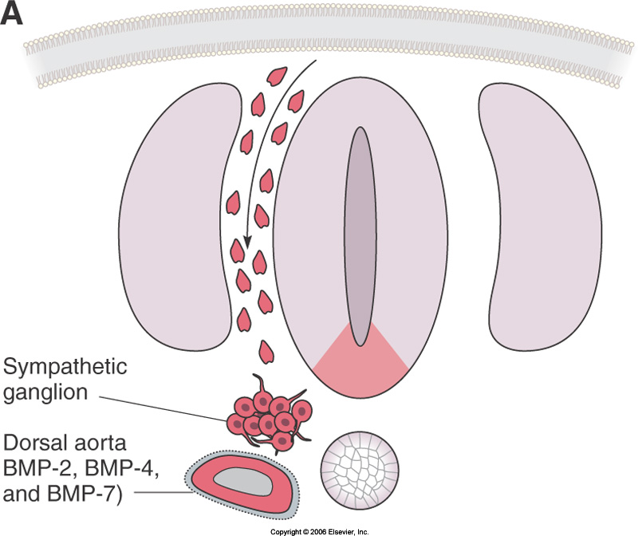
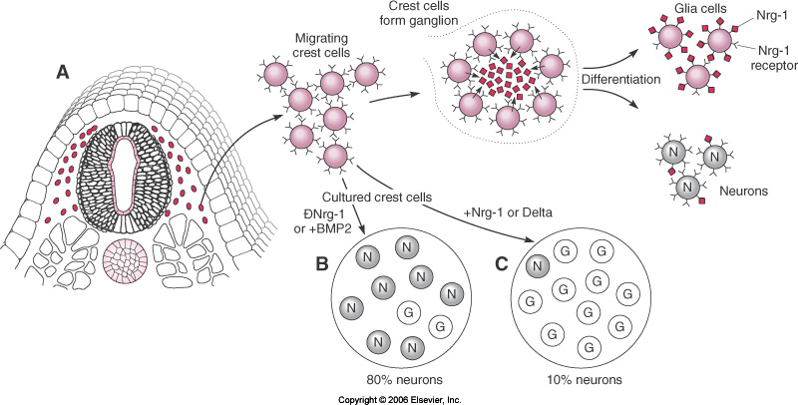
Extracellular signals used
In vitro and in vivo tests

Slide 32
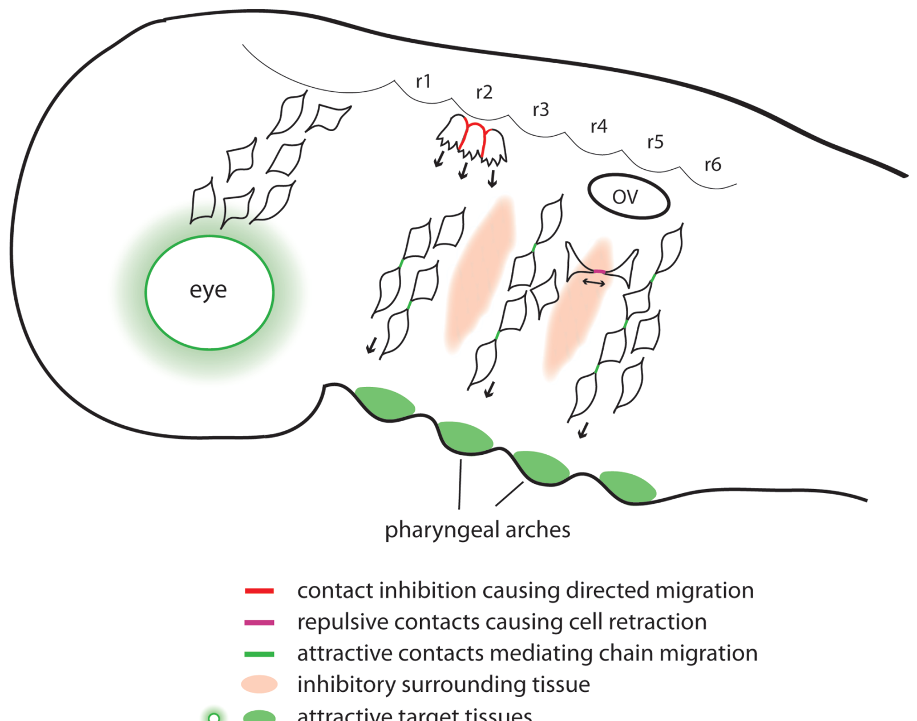
Integrate signals as migrate

Slide 33
Transition from migration to differentiation
Arrive, down regulate migration genes e.g. Snail
Lineage switch genes up

Slide 34
Lineage tracing neural crest cells

Slide 35
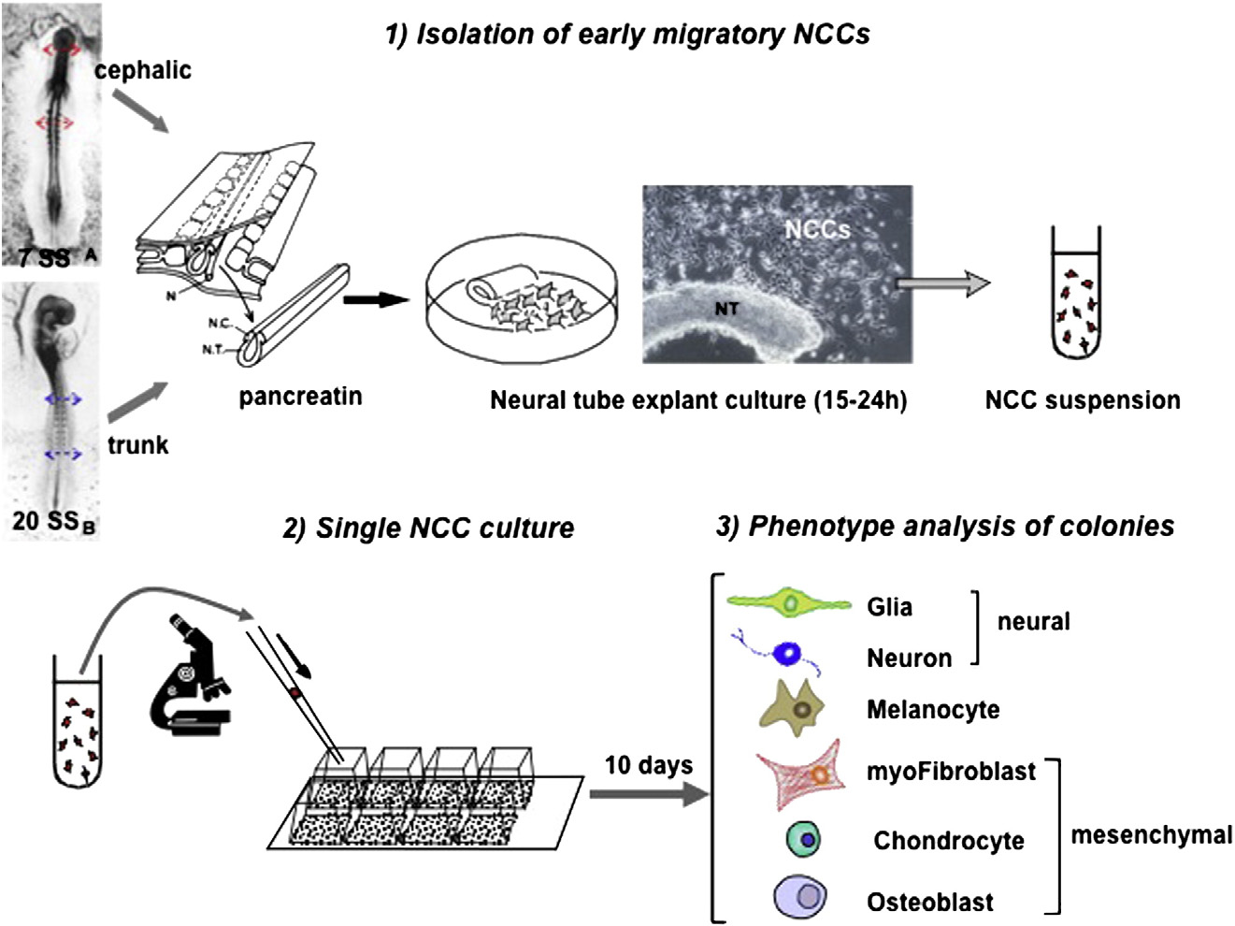
Studying neural crest cells in vitro
(Dupin & Sommer, 2012)

Slide 36
Neural crest: some clinical relevant aspects
Birth defects: cleft palate, septal defects of the heart and outflow tract
Hirschprung’s disease (1/5000 live births, congenital absence of enteric ganglia in distal part of colon)
May retain stem cell properties in adult

Slide 37
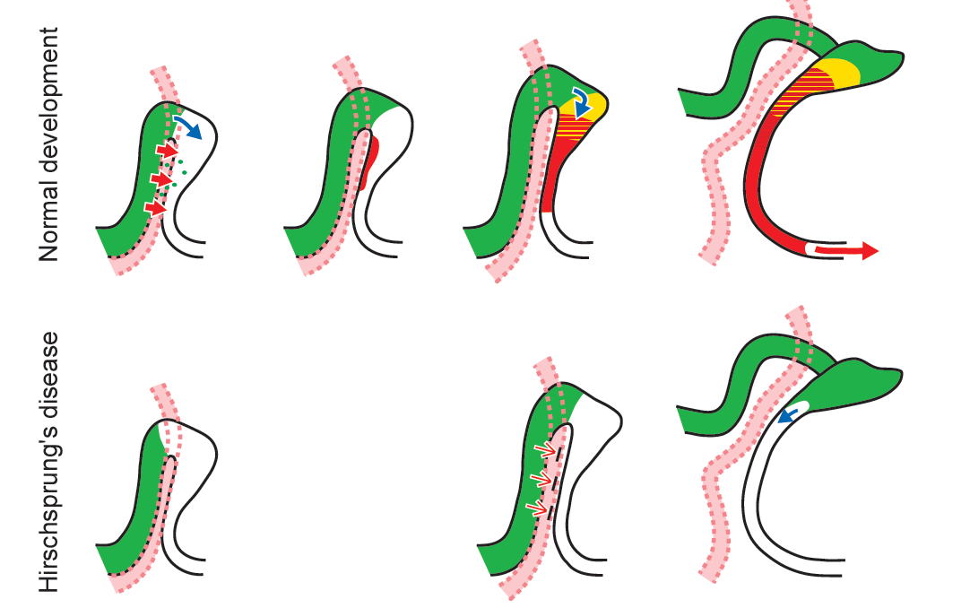
Trans-mesenteric neural crest cells are the principal source of the colonic enteric nervous system
Nishiyama et al., Nature Neuroscience, 2012
The vagal neural crest cells supply the foetal gut (migrate long way) with enteric neurons (many, mixed types)
GDNF signalling
May be able to rescue Hirschprung’s disease

Slide 38
Learning Outcomes
To understand that neural cell migration occurs in many places at many times in the developing CNS
And that defects in neural migration can cause tissue disease and dysfunction
To understand how cell migration contributes to cerebral cortex development and to the production of neural crest derivatives

