Slide 1
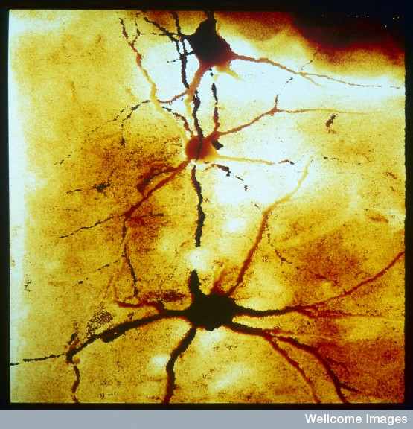
Neurogenesis
(Dr David Becker, Wellcome Images)

Slide 2
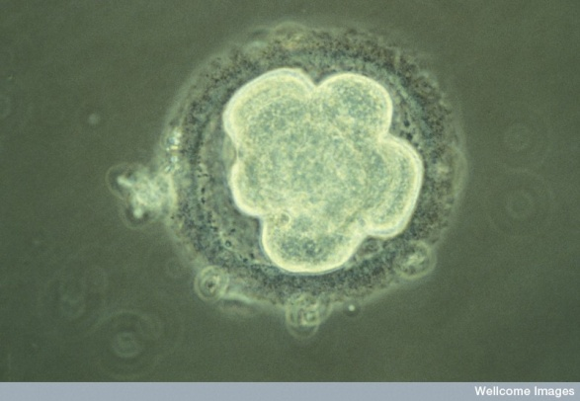
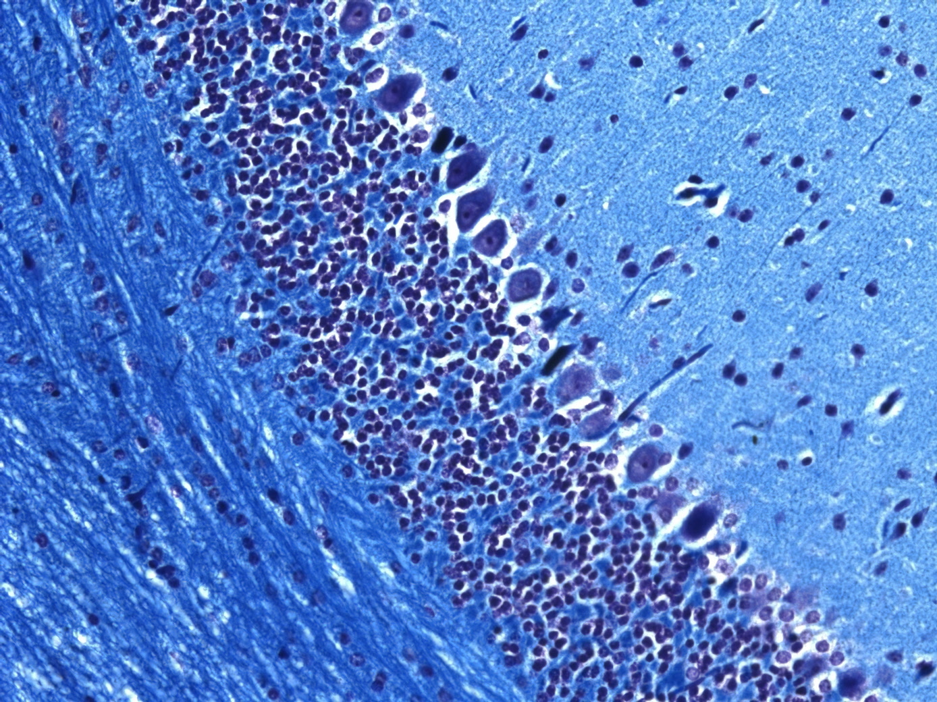
Reminder: some concepts
Cell Signals
Cell to cell interactions!
Position
Cell number control
Cell: cell interactions
Cell shape
Migratory behaviour
Cull excess
Final fate
(model organisms)

Slide 3
Reminder: Outline of CNS development
Part of the embryo ‘designated’ future CNS
Cells divide
Some regionalisation: signalling centres develop
(NB: coordinated with surrounding tissues)
Cell mixing restricted
Neurons start to be generated
Migrate to final positions
Then produce glia and more neurons
Connect and generate synapses
Cull excess
Remodel as required

Slide 4
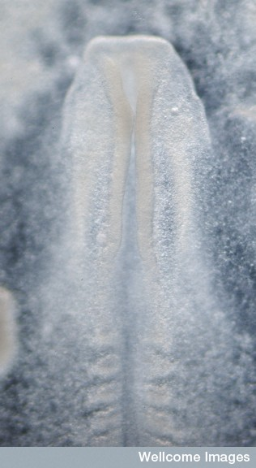
Part 1. Neurogenesis in the embryo - must build CNS from this:
Ventricular zone cells
(Credit Kate Storey, Wellcome Images, Creative commons licence)

Slide 5
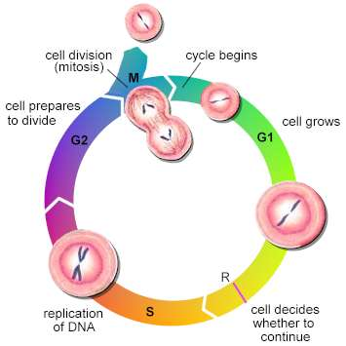
Neurogenesis is regulated
In time and space
number of divisions is controlled
Extrinsic ‘growth factors’/mitogens e.g. FGF, TGF-alpha, EGF, IGF and Shh and Wnt
E.g. Driven to enter S-phase by
cyclin1/Cdk4 phosphorylation of Rb
Driven to exit cell cycle e.g. P27
(mouse mutants)

Slide 6
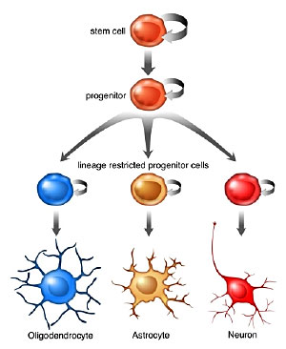
Looking at ventricular zone cells
1.Expansion
(neuroepithelial stem cells
1-2/day, mainly symmetrical )
2. Neurogenic
(NE become RG
and asymmetrically divide)
3. Switch to astrogenic phase
regulated by intrinsic and extrinsic signals e.g. mitogens, mitotic inhibitors, cell death etc (division: differentiation)

Slide 7
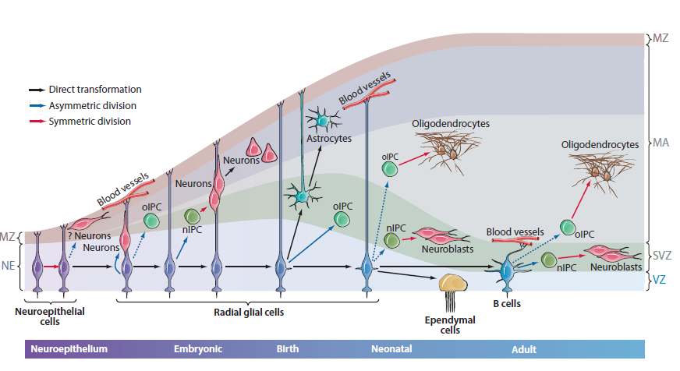
Glial nature of embryonic NSCs
IPC= ‘intermediate progenitor cells
B cells = adult SVZ Type B cells (see next Lecture)
(Kriegstein and Alvarez-Buyalla, 2009)

Slide 10
Defining dopaminergic neurons
(Andersson et al., Cell 2006)
(more in tomorrow’s Lectures)

Slide 11
TF profile and fate
In general: TF profile when exit cell cycle
determines fate
‘Birthdate’ of neural cells

Slide 12
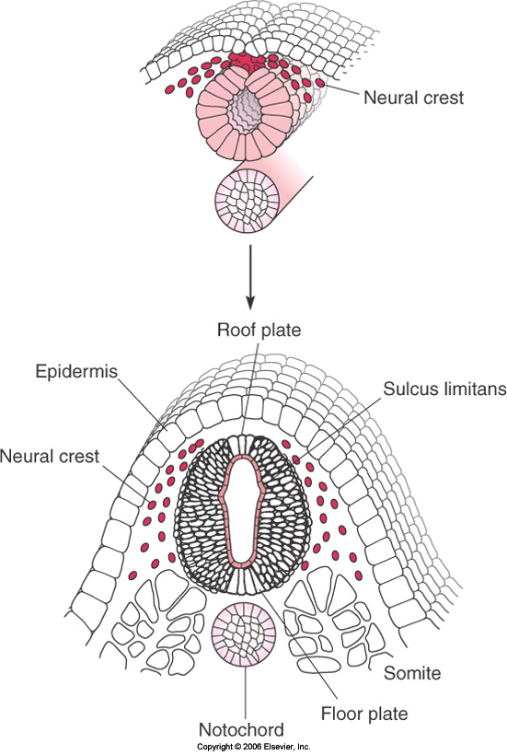
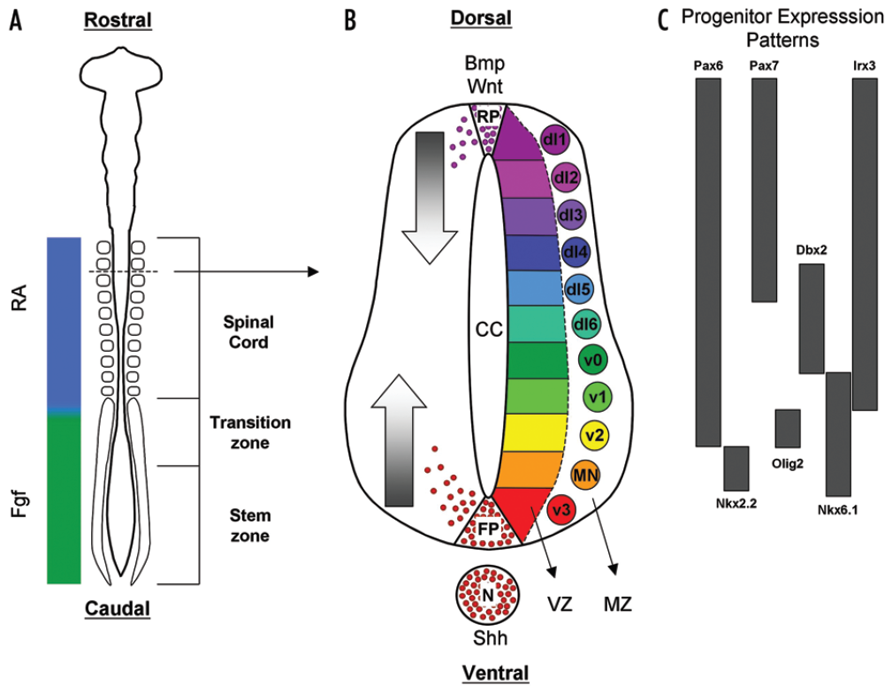
Outline of dorso-ventral spinal cord patterning
(Ulloa and Briscoe, 2007)

Slide 13
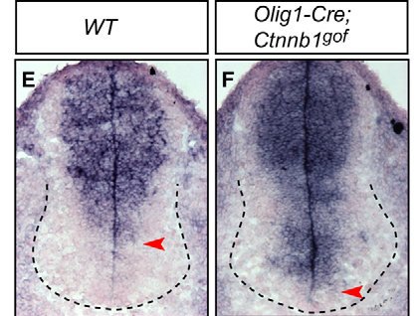
Neural tube patterning and signalling pathway cross-talk
Stabilised β-catenin
Gli3 in situ hybridisation
(mRNA)
(Yu et al., Devpt. 2008)

Slide 14
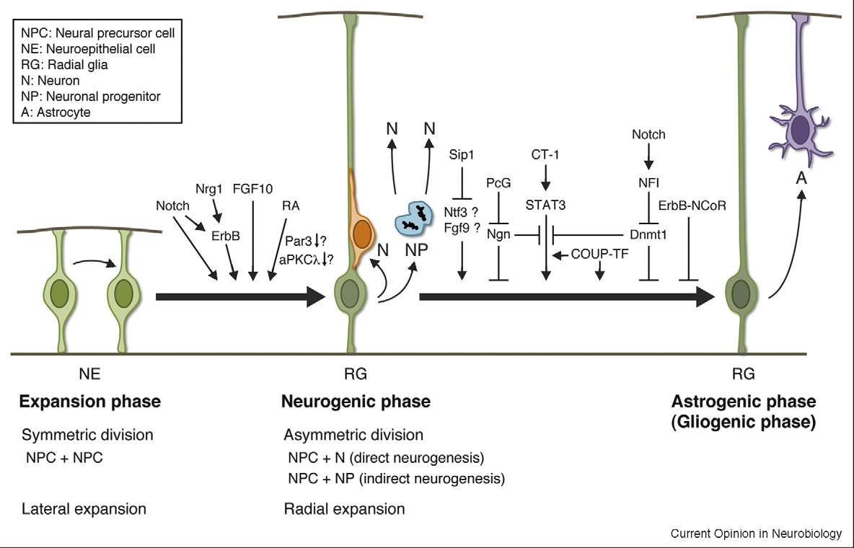
Summary: Regulation of neurogenesis
Organiser centres & patterning molecules from cell commitment to fate
(Miyata et al., 2010)

Slide 15
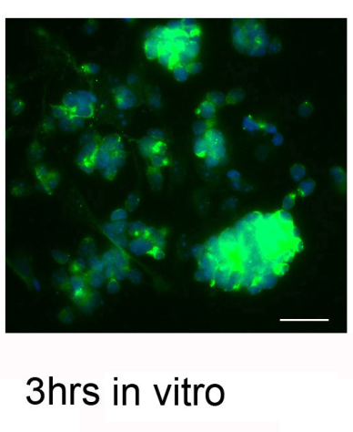
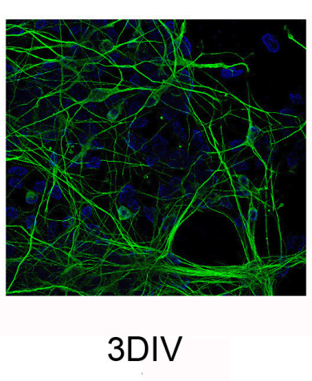
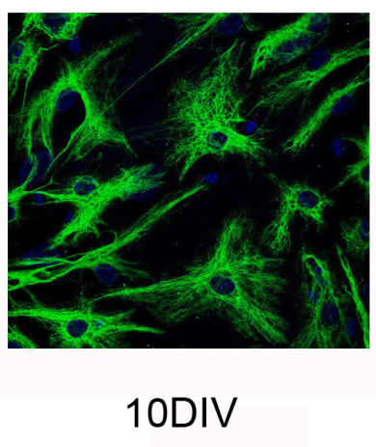
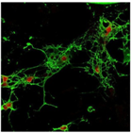
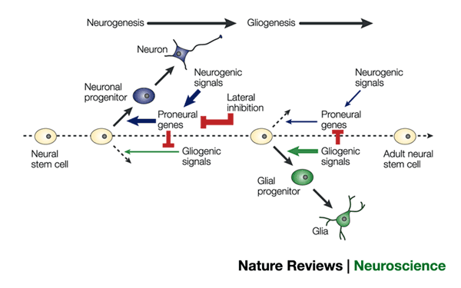
Embryonic NSCs mimic in vivo differentiation in vitro
10 DIV
GFAP+
Astrocytes
O4+
oligodendrocytes
TUJI+
neurons
Nestin +
Precursors
cell-Intrinsic mechanisms
regulate temporal
differentiation

Slide 16
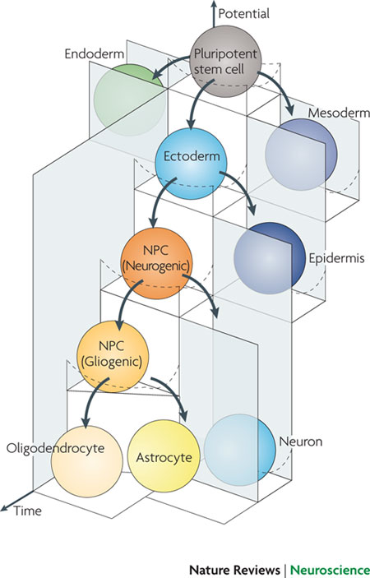
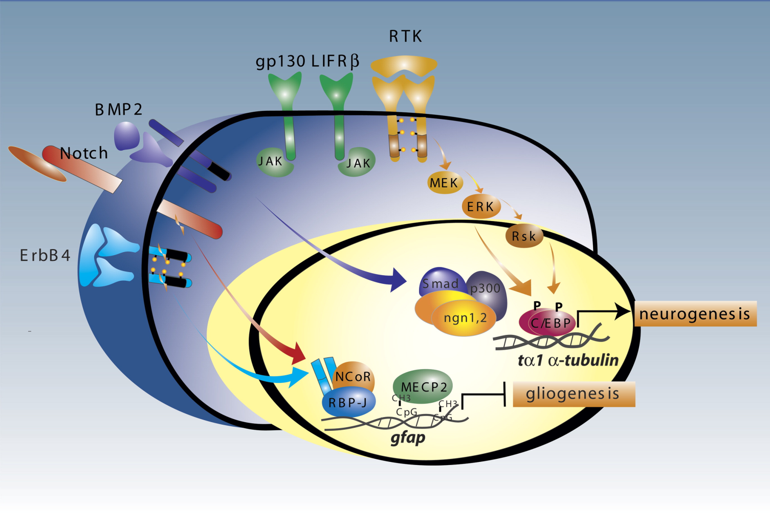
Dissecting the intrinsic and environmental signals to NSCs that regulate neurogenic and gliogenic phases

Slide 17
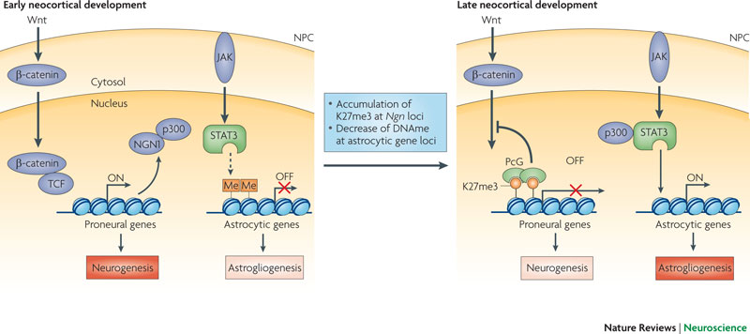
Neuro- to gliogenic switch involves DNA methylation changes

Slide 18
Circuitry issues: Could Devpt explain neuronal/synaptic diversity? Devpt genes in adult – why?

Slide 19
The ‘connectome’
E.g. Blue Brain Project
Do chemospecific mechanisms join up all neurons?
Is there enough information in the genome?
And/or do neurons grow and then happen to overlap?
http://www.rdmag.com/news/2012/09/blue-brain-project-accurately-predicts-connections-between-neurons

Slide 20
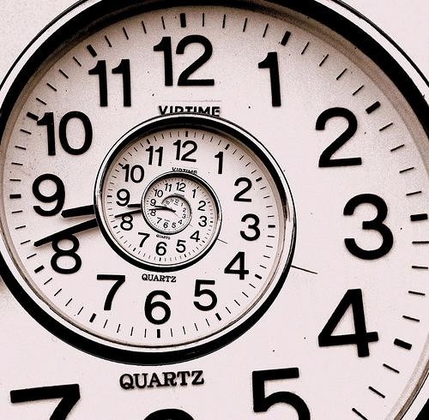
15 minutes break
Relax
Meet your neighbours
Ask questions

Slide 21
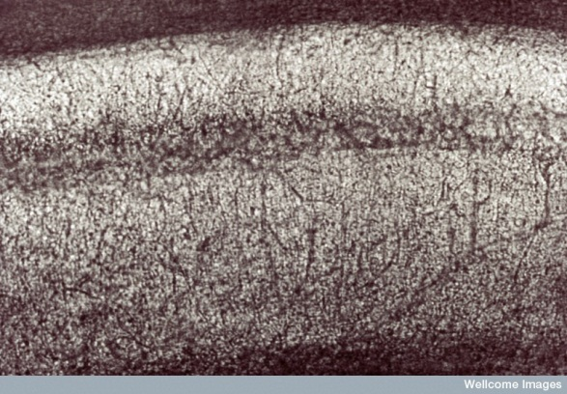
Part2: Neurogenesis in the adult brain

Slide 22
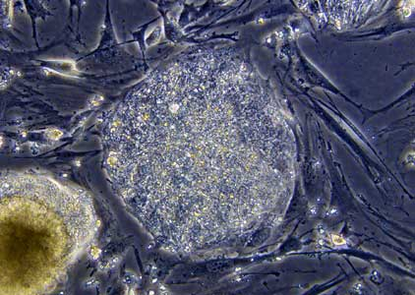
Adult neural stem cells Reminder: What is a stem cell?
A stem cell can self-renew
And is multipotent
Here: tissue-specific stem cells
This Lecture: tissue-specific stem cells
of the brain that generate neurons &
oligodendrocytes

Slide 23
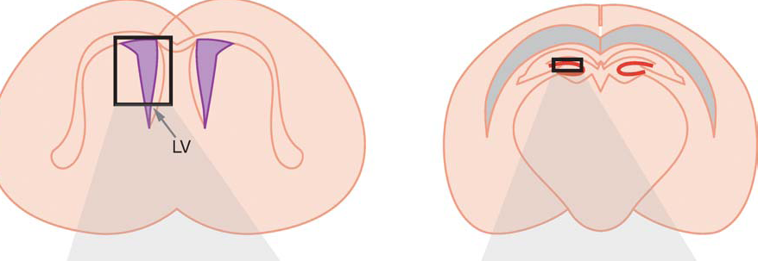
Postnatal and adult mammalian brains can make new neurons
Much more known about rodents than humans
2 main regions: striatal subventricular zone (SVZ) and subgranular zone (SGZ) of the hippocampus:

Slide 24
What are the neural stem cells of the subventricular zone?
Type of astrocyte (GFAP+ and Prominin-1+)
= ‘Type-B1’ cells
Ependymal or subependymal
Quiescent or slowly dividing
Can divide asymmetrically
Produce ‘transit-amplifying cells/progenitors’, Type-C cells, dividing, (EGFrec+)

Slide 25
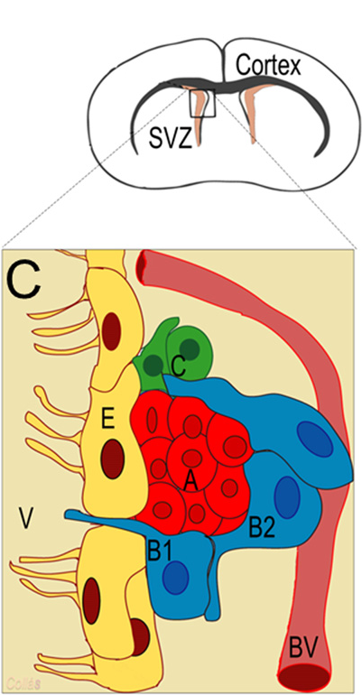
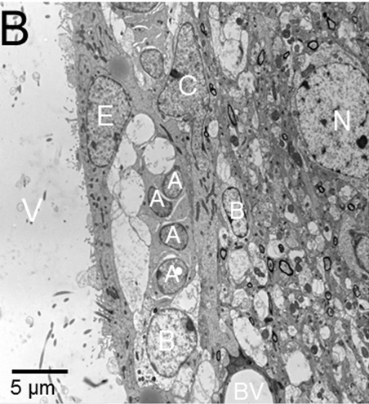
Progeny of the neural stem cells of the SVZ?
Type-C cells divide to give
neuroblasts (type-A cells) PSA-NCAM+
migrate to olfactory bulb via RMS
(also generate
oligodendrocytes
for corpus callosum,
striatum & fimbria)
(Gonzalez-Perez et al., 2012)

Slide 26
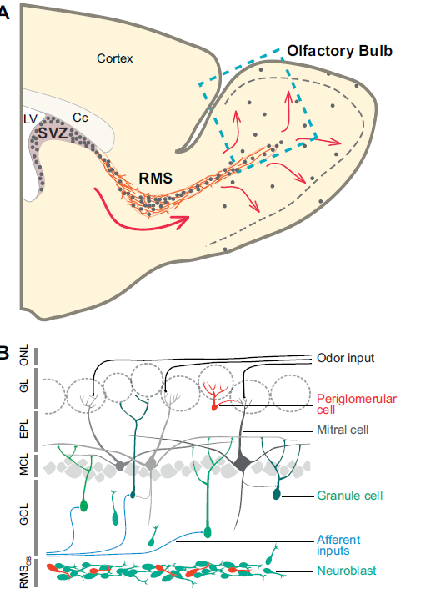
The RMS and final cell fate
GABAergic
& dopaminergic interneurons
granule & periglomerular:
Breton-Provenchera &
ArmenSaghatelyana, 2012

Slide 27
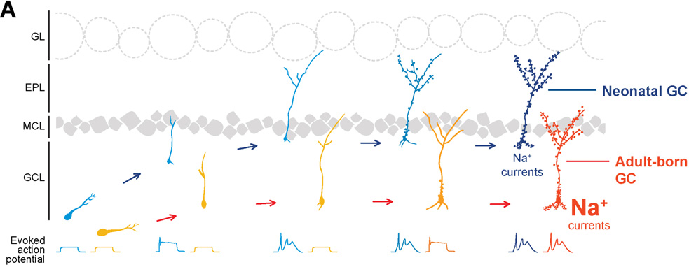
Why have NSCs in the SVZ?
(NB: smell is v important to many mammals)
20-30K per day in rodents, at 12-18m, 50-60% adult born
Adult NSC progeny differ from embryonic and neonatal: deep not superficial layer, delayed firing more excitable)
Olfactory bulb needs to continuous remodel its synapses?

Slide 28
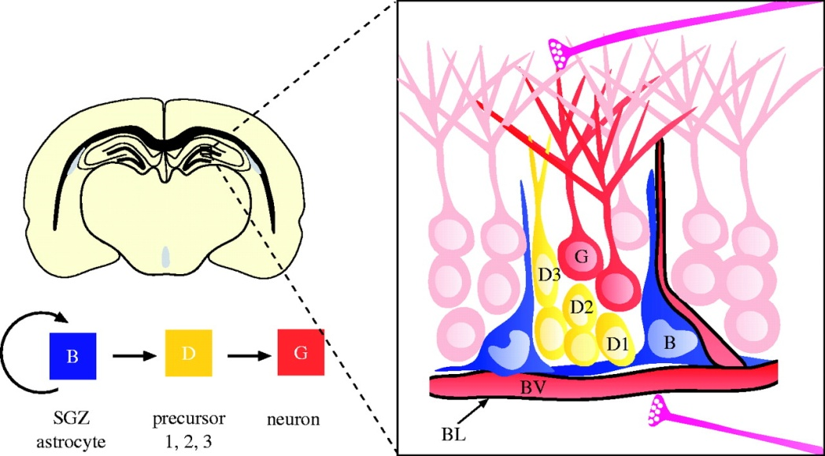
Neural stem cells of the subgranular zone (SGZ) of the dentate gyrus (hc)
A type of astrocyte/radial glia-like cell
(GFAP+, nestin+ and Sox2+)
Quiescent, can self-renew & generate RGLs, neurons (via Nestin and Sox2 + progenitors) and astrocytes (some say subtypes have varying potency)
The neurons formed
are glutamatergic
dentate granule cells
SVZ SGZ

Slide 29
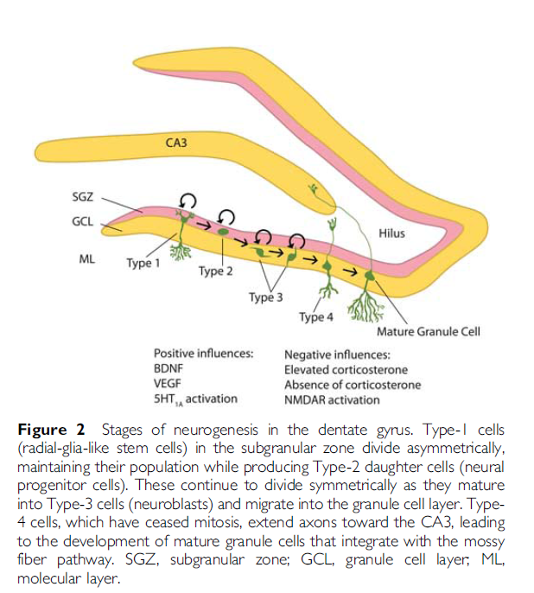
(Ming and Song Review,
Neuron, 2011)
SGZ NSC development
(Hanson et al., 2011)

Slide 30
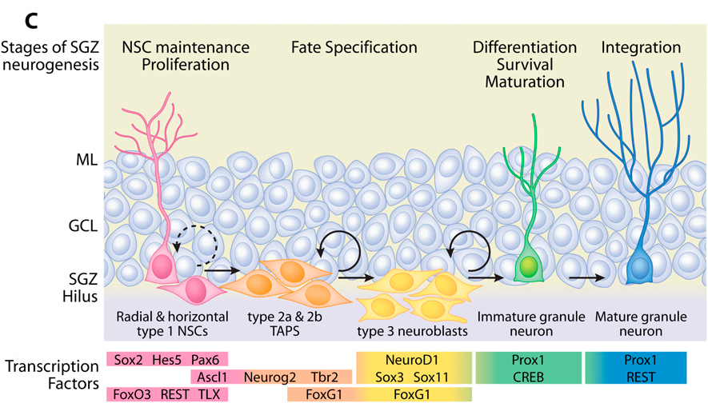
Again, involves sequential expression of TFs
(Hsieh, 2012)

Slide 31
Function of these adult neurons generated from SGZ?
Spatial learning, fear conditioning, clearing ‘memory traces’, navigation and depression
(antidepressant mechanism)

Slide 32
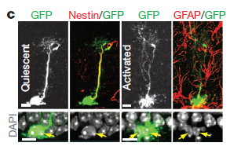
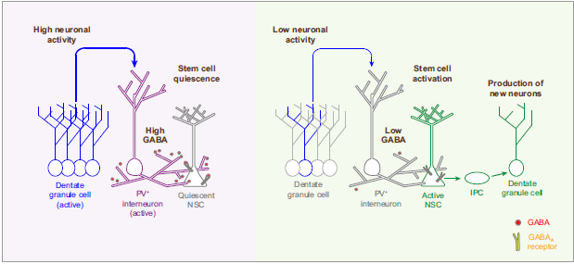
What regulates Adult NSC proliferation? Neuronal activity nearby can stop SGZ NSC proliferation
Via GABA ‘spill-over’ release from interneurons (Song et al., Nature, 2012)

Slide 33
Adult neurogenesis compared to embryonic
Cells generated can differ (e.g. SGZ)
Has to occur in the adult brain
What can development tell us?
On demand?

Slide 34
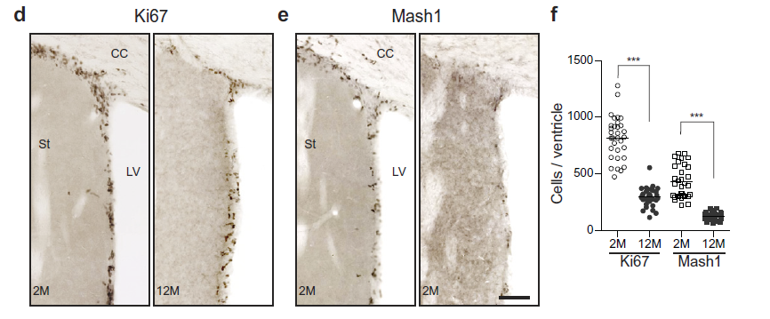
Neurogenesis in aged adult brains
Fewer NSCs
Proliferate less (quiescent)
Fewer neurons survive
Reflected in vitro ‘neurospheres’
Do NSC niches change and cell interactions stop/change?
Hints that NSCs have limited division and self-renewal ability
(old model organisms)
e.g. SVZ of mice:
Ki67+ proliferating cells
Mash1+ progenitors and
neuroblasts
(Bouab et al., 2011)

Slide 35
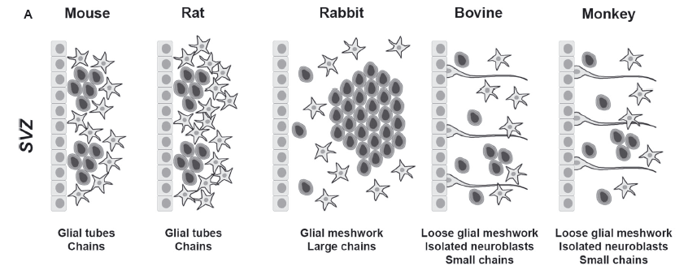
Note: Adult neurogenesis does vary across mammalian species
(Bonfanti & Peretto, 2011)

Slide 36
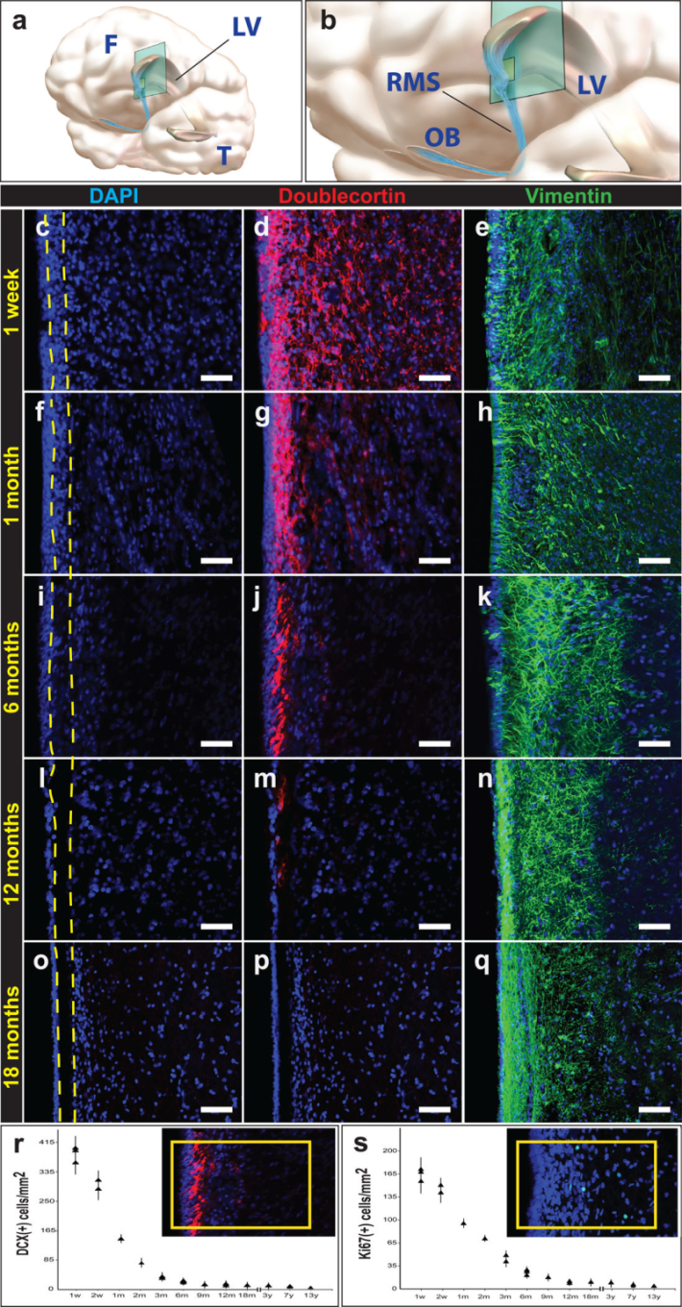
What about us?
until about 18m,
our SVZ produces
many immature neurons –
some go to olfactory bulb
(and some to prefrontal cortex)
BUT after 18m not many at all
(Sanai et al., inc. Arturo Alvarez-Buylla 2011)

Slide 37
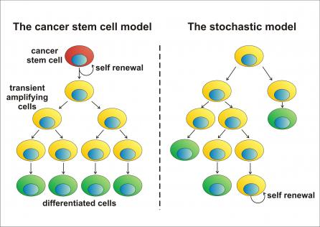
Unwanted adult neurogenesis: Brain tumours
SVZ and the dentate gyrus seem more prone to viral and chemical oncogenesis
Do brain tumours contain/produce cancer stem
cells?

Slide 38
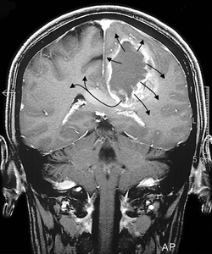
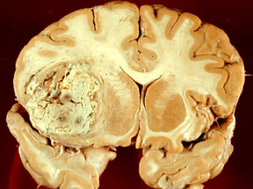
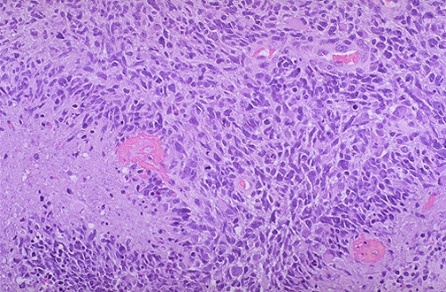
E.g. Glioblastoma Multiforme (GBM)
most common CNS tumour
median survival 14-16m despite optimal surgery, radiation and chemotherapy
profiled whole tumours – seen changes in
e.g. PDGFRec and EGFRec
Current mouse models target many cells
in GBM need to find and target the tumour stem cells?

Slide 39
Learning outcomes
By working at this Lectured material you should be able to:
outline how different types of cells are generated in the CNS. This outline can be focused on how cells with diverse transcription factors profiles are produced. Dopaminergic neurons of the ventral midbrain and motor neurons of the spinal cord could be used as illustrative examples.
To know about the biology of NSCs in the mammalian SVZ and SGZ
To understand that there are differences in NSC biology between embryonic, young, adult and aged brain
To be aware of the possible need to understand NSC and progenitor biology within CNS tumours

