Slide 1
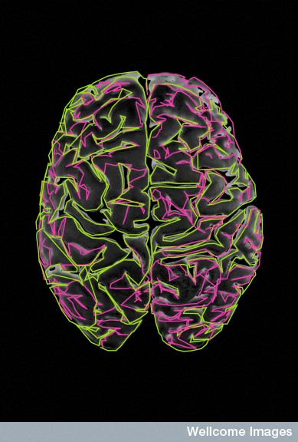
Neural tube development
Dr Anita Hall
anita.hall@imperial.ac.uk

Slide 2
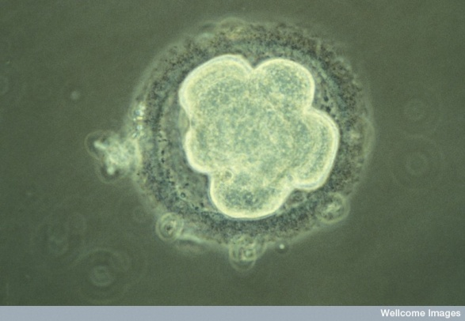
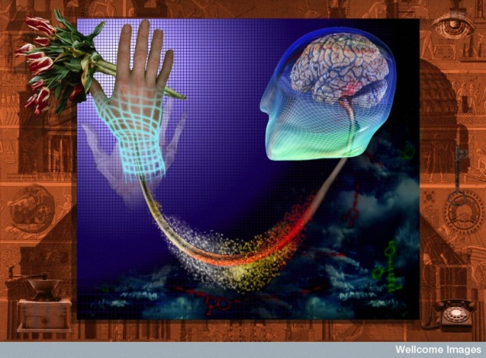
This talk: general aims
To introduce some of the main concepts and experimental approaches in developmental neurobiology
To show how these concepts help explain how your nervous system develops from
Many links to e.g. synapse formation, networks generation, plasticity, psychiatric disorders
(Credit M. Johnson, Wellcome Images)
Ian Spreadbury, Wellcome Images

Slide 3
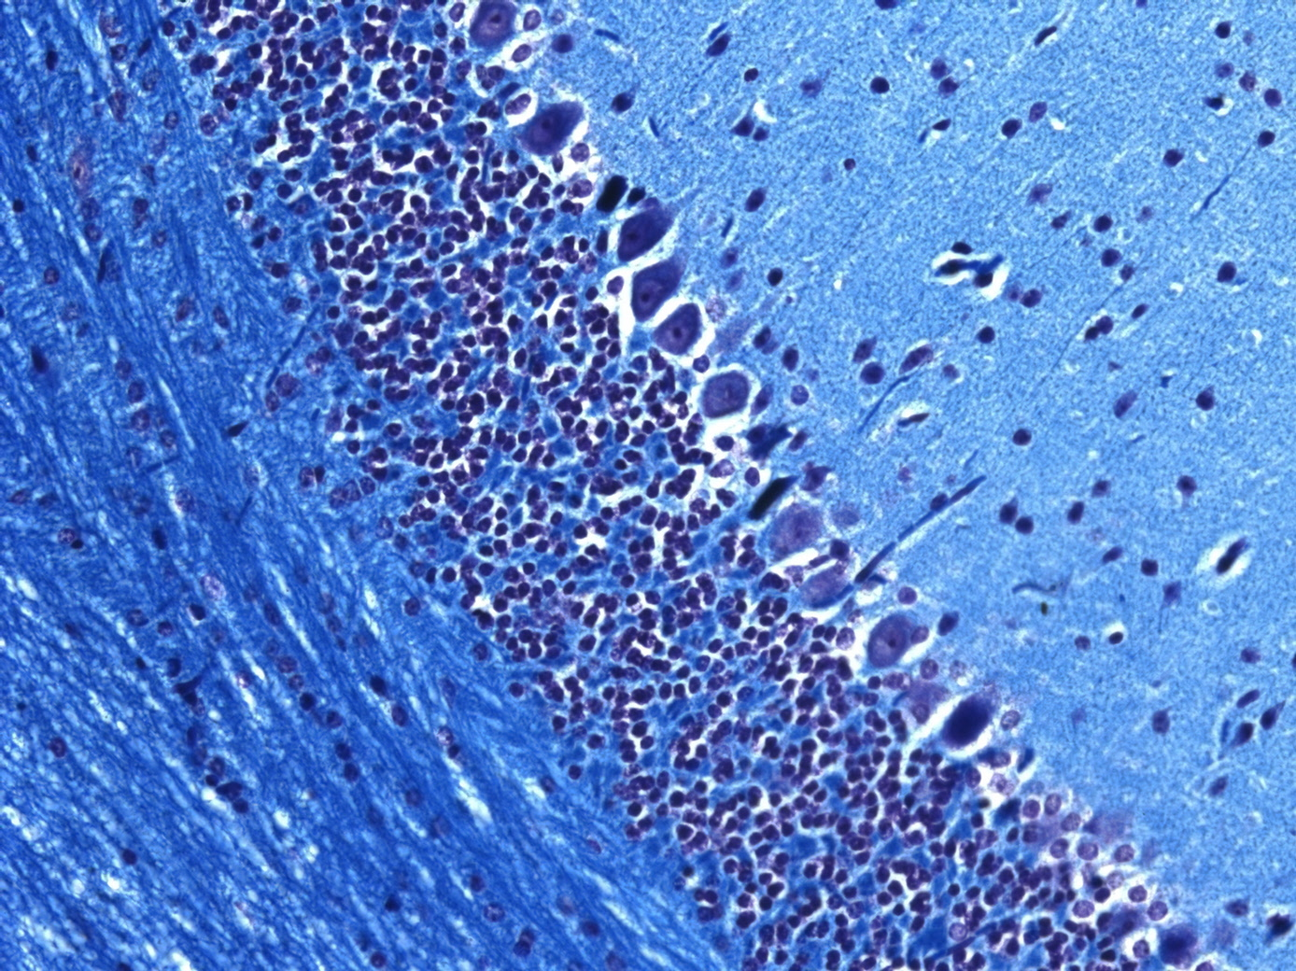
Development: some concepts
Cell Signals
Cell to cell interactions!
Position
Cell number control
Cell: cell interactions
Cell shape
Migratory behaviour
Cull excess
Final fate
(model organisms)

Slide 4
Outline of CNS development
Part of the embryo ‘designated’ future CNS
Cells divide
Some regionalisation: signalling centres develop
(NB: coordinated with surrounding tissues)
Cell mixing restricted
Neurons start to be generated
Migrate to final positions
Then produce glia and more neurons
Connect and generate synapses
Cull excess
Remodel as required

Slide 5
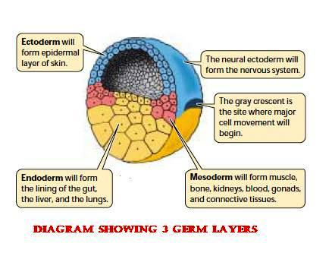
The start of CNS development: helps to know about the 3 germ layers
Endoderm
Mesoderm
Ectoderm
(inc neural ectoderm)

Slide 6
One theme: cell movement
http://www.youtube.com/watch?v=IxFwenTA-gQ

Slide 7
The start of CNS development: neurulation

Slide 8
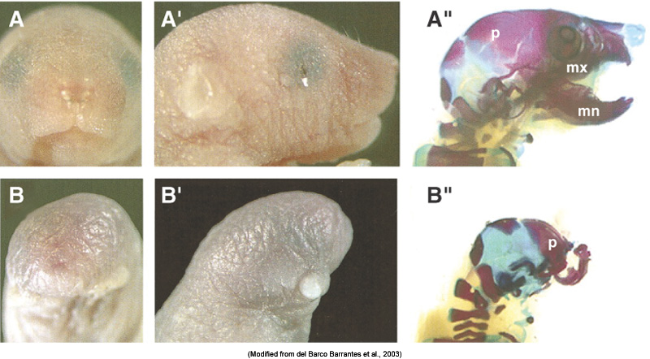
How does the notochord induce a neural plate?
x must be:
Expressed in correct place
Can have neural-inducing activity
BMP4 is anti-neuralising in ectoderm and pro- epidermis development
Must block BMP signalling with e.g. Cerberus, chordin, noggin and follistatin to get neural tissue:
Head: need to inhibit BMP and Wnt signalling
(A: wild-type, B: with deleted Dkk1 and noggin)

Slide 9
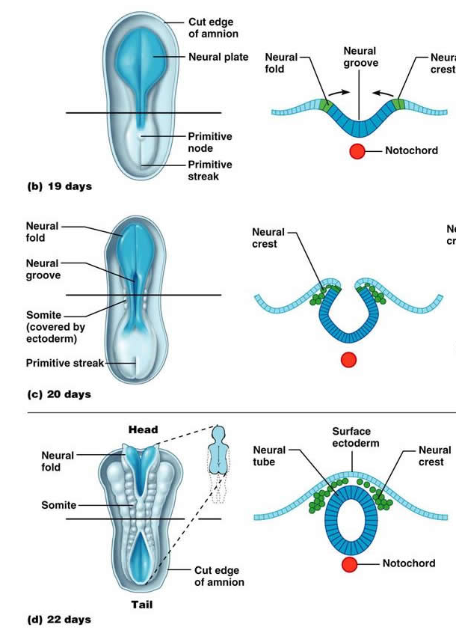
Now form and close the neural tube
(Neural crest produces
most neurons &
glia of the PNS)
Cell shape, behaviour and death
necessary for tube to form

Slide 10
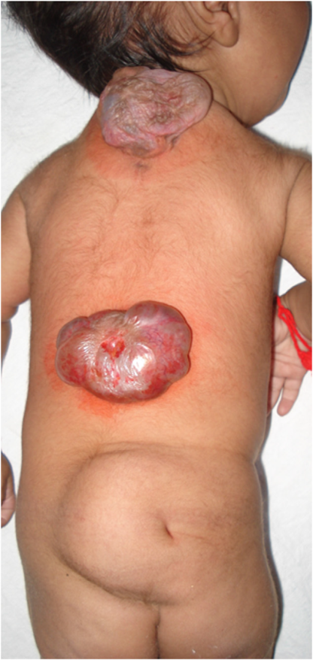
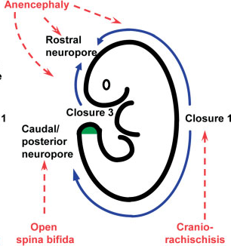
Human Neural tube defects
Some of commonest and most severe disorders of the foetus & newborn (1-2/1000 live births)
Different regions of the neural tube fail to close
Planar cell polarity signalling: initiation of closure.
Sonic hedgehog (Shh) signalling overactivation probably via prevention of dorsolateral hinge points
Bone morphogenetic proteins
Notch signalling, via regulation of neurogenesis.
Retinoid signalling, ?why
Inositol metabolism with protein phosphorylation via protein kinase C
(Review: Copp and Greene, J Pathol., 2010)
(Mahalik SK et al., 2011)

Slide 11
Next step to a nervous system
So neural induction is a reversal of neural inhibition
Now have a ‘neurogenic region’
Must now specify neural progenitors
(i.e. reducing potency)

Slide 12
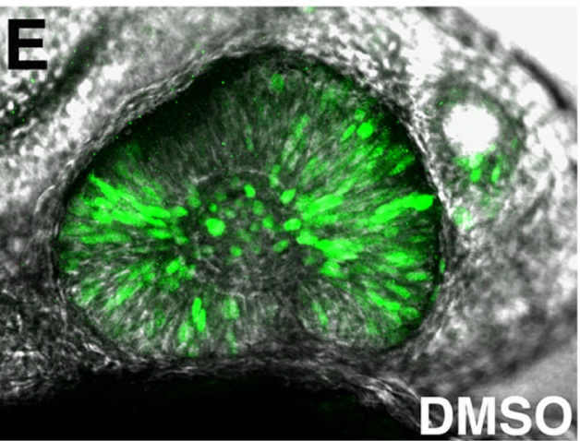
Proneural genes
20+ in vertebrates bHLH transcription factors
Some in all brain and SC e.g. Neurogenin
Some in specific parts: bHLH Ath5 in retina
Willardsen et al., 2009: hunting down what regulates
Ath5 in early retinal progenitors
(Pax6 and FGF on different enhancer elements)

Slide 13
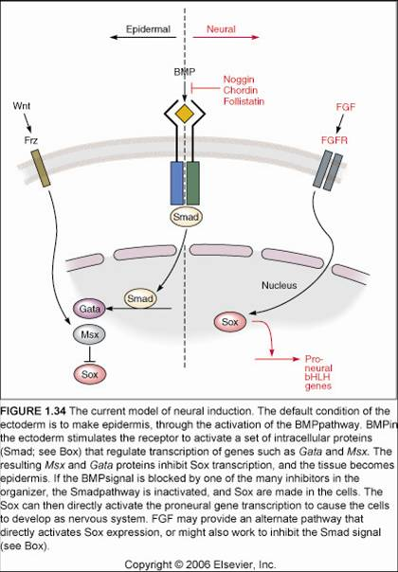
Proneural experiments
Over express ectopically in Xenopus: induce neurons e.g. NeuroD1 in side develop neurons not epidermis
Knockout in mice:
see redundancy
and compensation

Slide 14
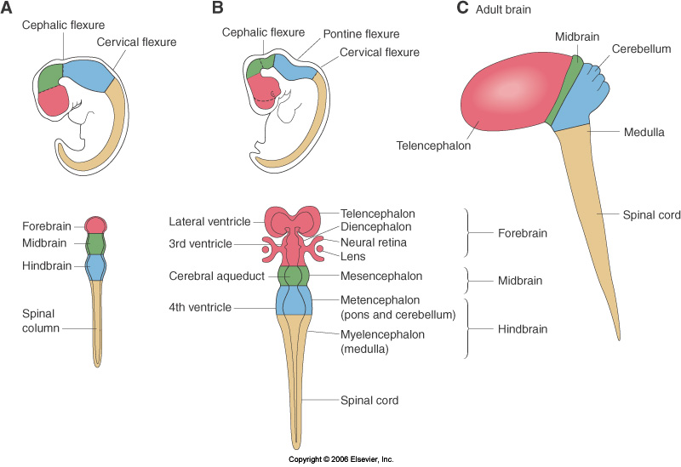
Now start to produce brain and spinal cord regions
Human brain development:
(proliferation and patterning)

Slide 15
Morphogens e.g. Retinoic acid
RA made in mesoderm next to the neural tube
High at posterior, low at anterior
Posterior: repress anterior Hox genes and induce posterior Hox genes

Slide 16
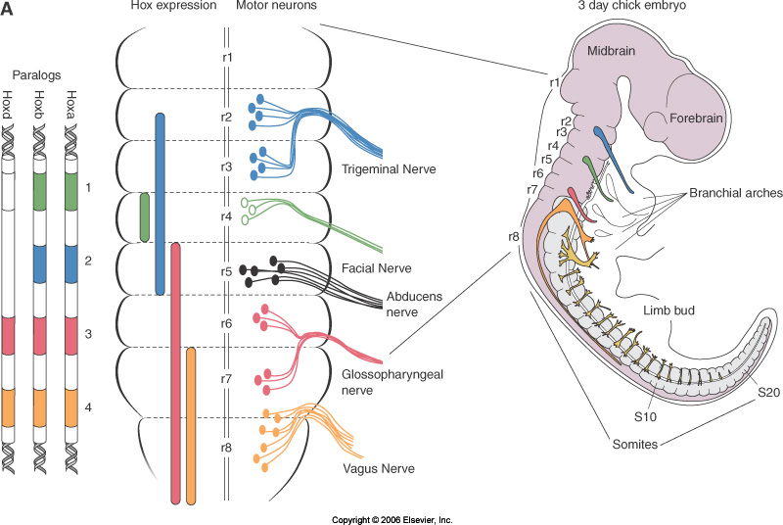
Morphogens & positional identity
Hox gene code, in metencephalon and spinal cord default is rhombomere 1

Slide 17
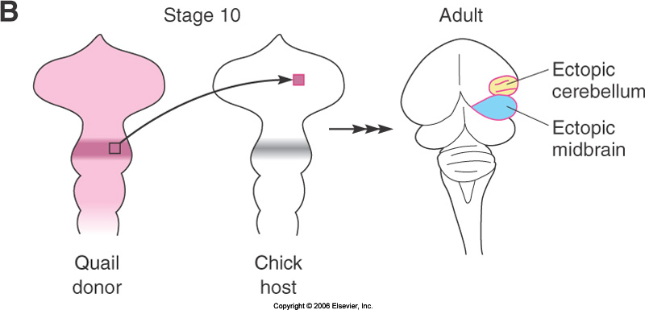
Morphogens and neural tube organising centres
E.g. Midbrain/hindbrain border
The transplanted tissue ‘repatterned’ the surrounding tissue

Slide 18
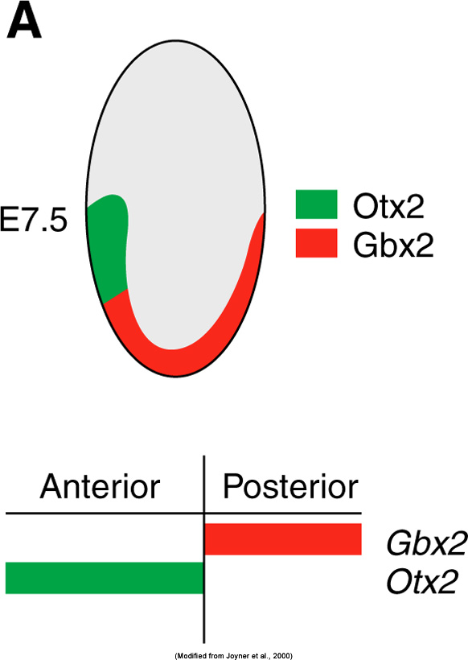
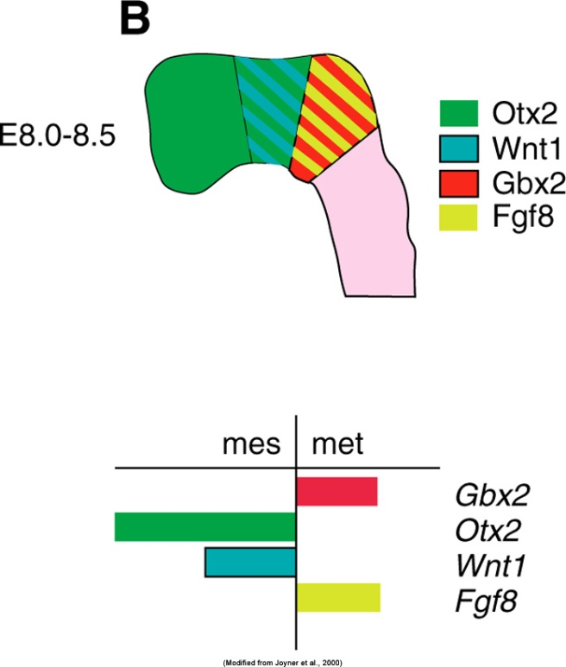
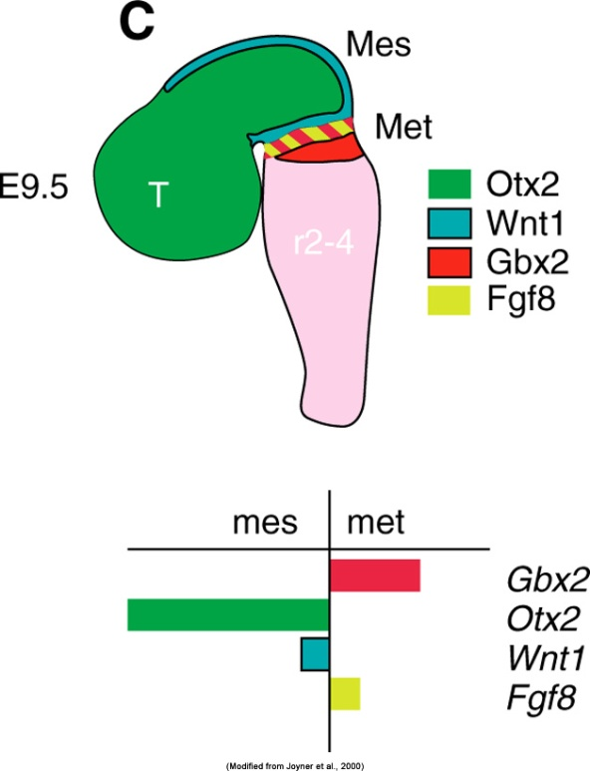
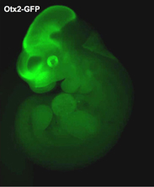
MB/HB organiser/Isthmus
Pattern the expanding neural progenitors
Lineage tracing and fate labelling
e.g. Lamonerie lab:

Slide 19
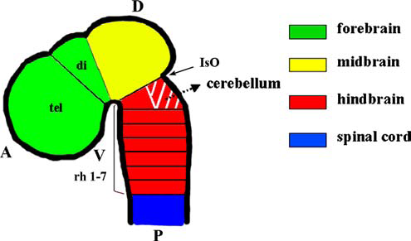
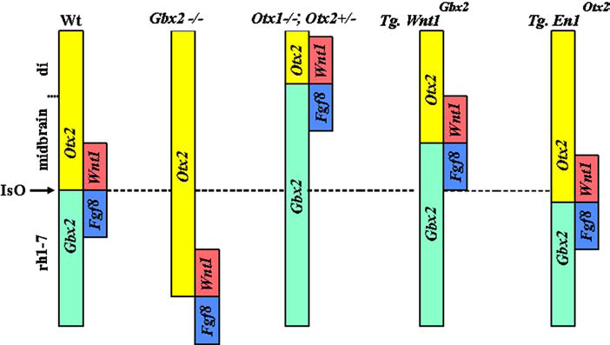
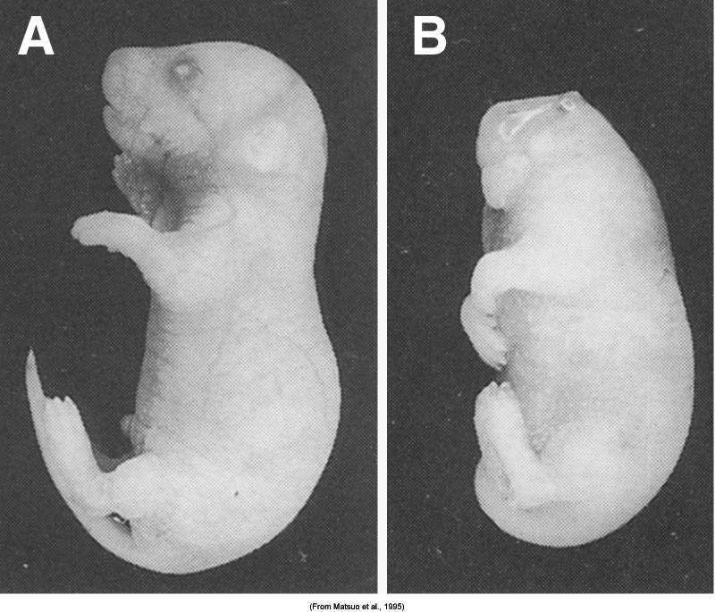
What each region is and what it isn’t
E.g. Otx2 null mice lack brain anterior to rhombomere 3:

Slide 20
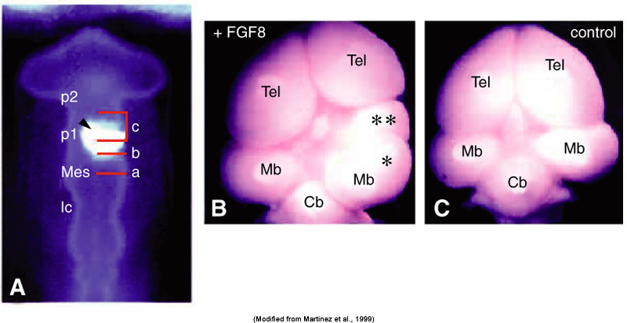
MB/HB organiser/Isthmus
Wnt1 and FGF8
Fate-mapping, lineage tracing, transplantation, beads....

Slide 22
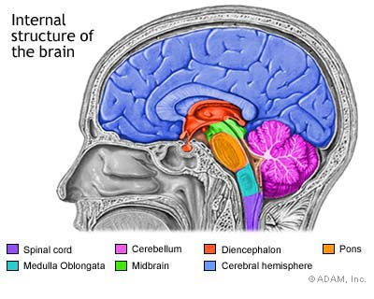

Slide 23
15 minutes break
Relax
Meet your neighbours
Ask questions

Slide 24
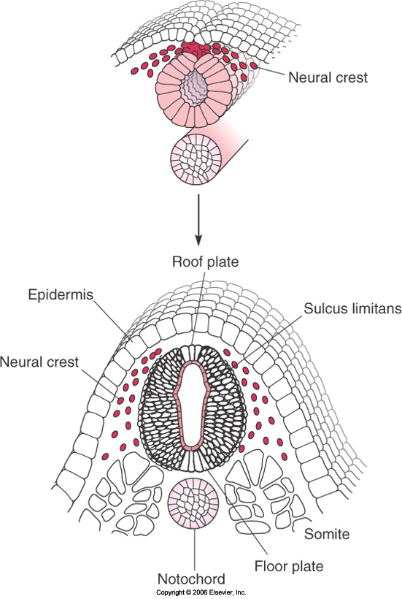
Patterning the dorsal and ventral neural tube e.g. spinal cord
Neural crest between tube
and ectoderm produces
most neurons and
glia of the PNS
(Credit Kate Storey, Wellcome Images)

Slide 25
Need to specify top or bottom (dorsal/ventral)
Ventral floor plate
Dorsal roof plate
Sulcus limitans in middle

Slide 26
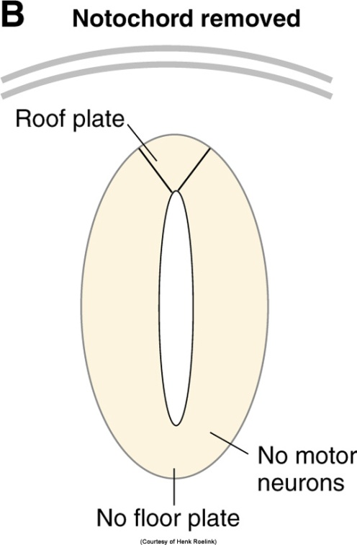
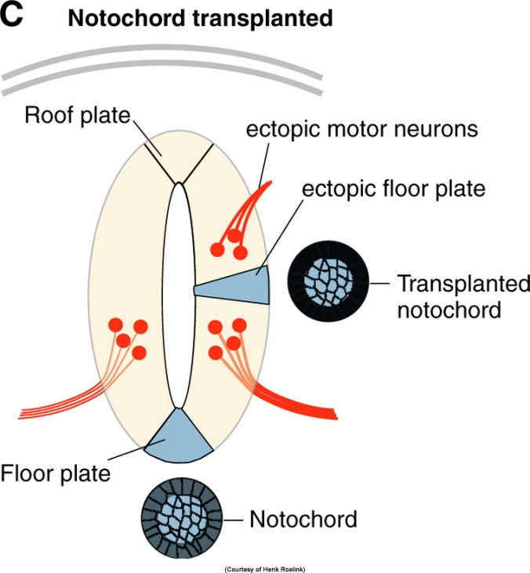
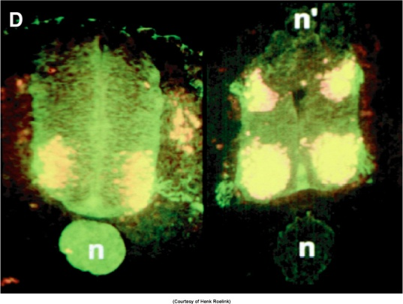
The notochord and floor plate

Slide 27
What is the ventralising signal?
Sonic Hedgehog
(mesodermal Shh also induces forebrain differentiation; cyclopia when Shh not present to divide retinal field in two)
Other signals cooperate

Slide 28
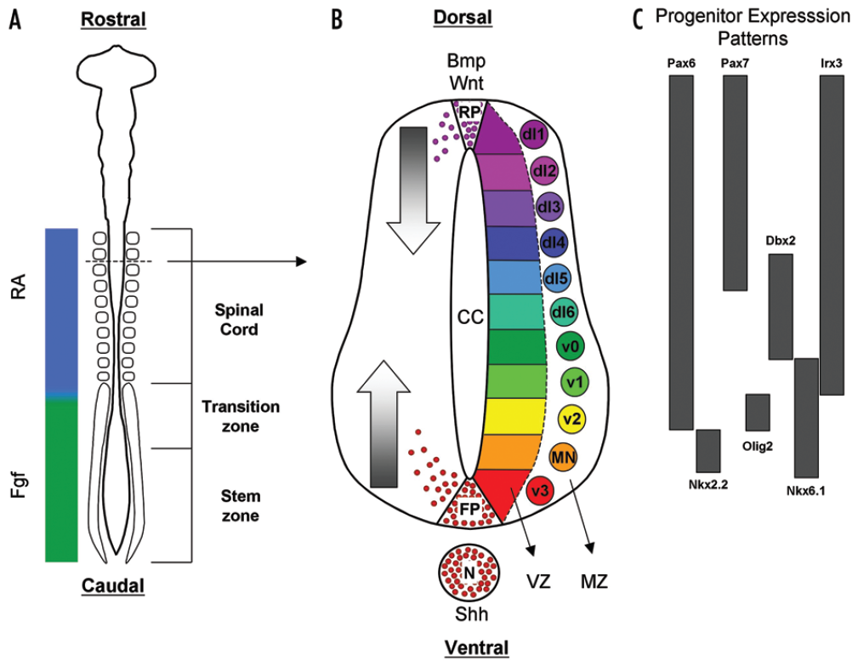
Outline of dorso-ventral spinal cord patterning
(Ulloa and Briscoe, 2007)

Slide 29
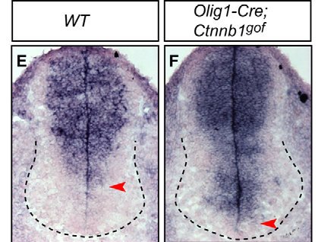
Neural tube patterning and signalling pathway cross-talk
Stabilised β-catenin
Gli3 in situ hybridisation
(mRNA)
(Yu et al., Devpt. 2008)

Slide 30
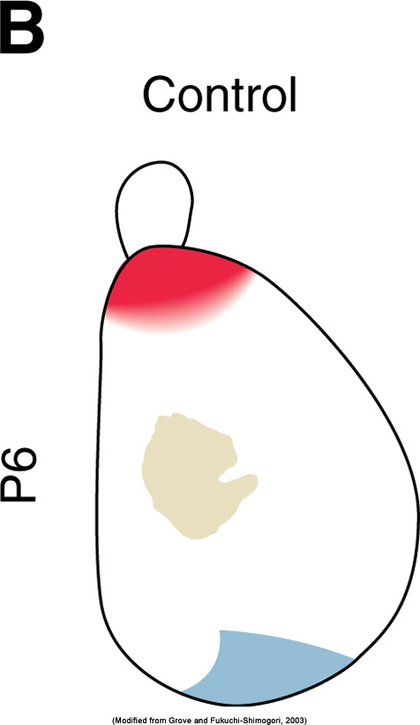
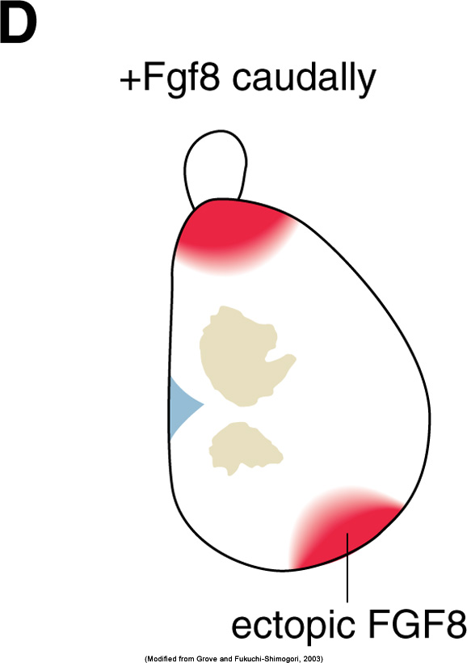
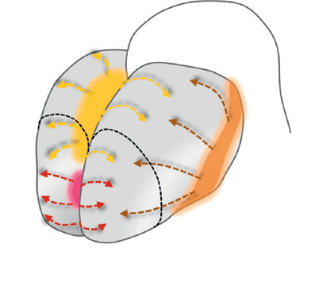
Similar processes pattern the forebrain e.g. cerebral cortex
Yellow= cortical hem (Wnts & BMPs)
Orange = Antihem (Sfrp2, Fgf7, Tgfα)
Pink= Anterior neural ridge (Fgf8, Fgf17, Fgf18)

Slide 31
These gradients set up TF expression patterns and give regional identity

Slide 32
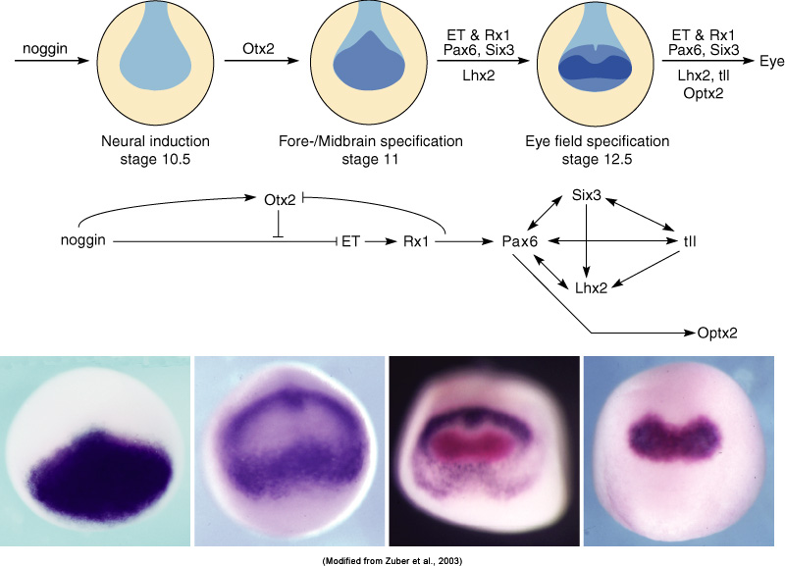
Areas become ‘specified’
Several classes of TFs work together to direct fate
E.g. Pax genes:
pax2 is in
developing human
optic stalk
Pax6 nulls: eyes
fail to develop
Over expression can
induce ectopic eyes

Slide 33
Next steps
Part of the embryo ‘designated’ future CNS
Cells divide
Some regionalisation: signalling centres develop
(NB: coordinated with surrounding tissues)
Cell mixing restricted
Neurons start to be generated
Migrate to final positions
Then produce glia and more neurons
Connect and generate synapses
Cull excess
Remodel as required

Slide 34
Learning outcomes
By working at this Lectured material you should be able to describe how the neural tube is generated and how different regions of it are ‘patterned’ and induced to express specific profiles of transcription factors
NB: There are many links between this Lecture and subsequent Lectures from AH as well as other talks in the NMH course.
Recommended reading:
Nature Reviews in Neuroscience (via PubMed i.e. search "Nat Rev Neurosci"[jour]) your subject)
Sanes DH et al., Development of the Nervous System, Academic Press, 2005 (the Library should have several copies)

