Slide 1
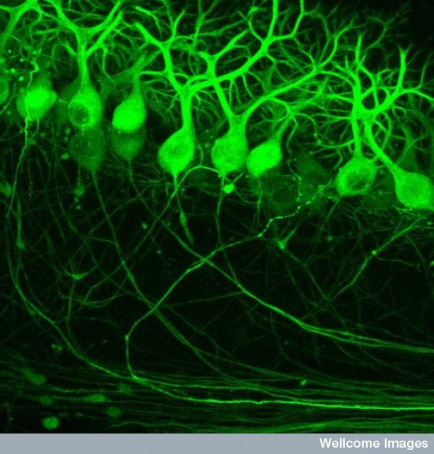
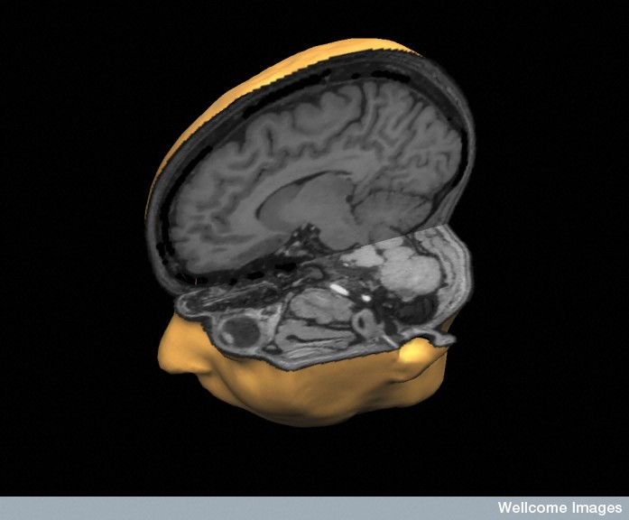
The cerebellum: from cells to circuitry
(Credit Prof. M. Hausser / UCL, Wellcome Images)
(Credit Mark Lythgoe & Chloe Hutton, Wellcome Images)

Slide 2
Learning objectives
By working at this Lectured material you should learn about:
Cerebellum (cortex) structure and function
Cerebellar development
Cerebellum cell types, circuitry and behaviour

Slide 3
150g, more neurons than rest of brain (human)

Slide 4
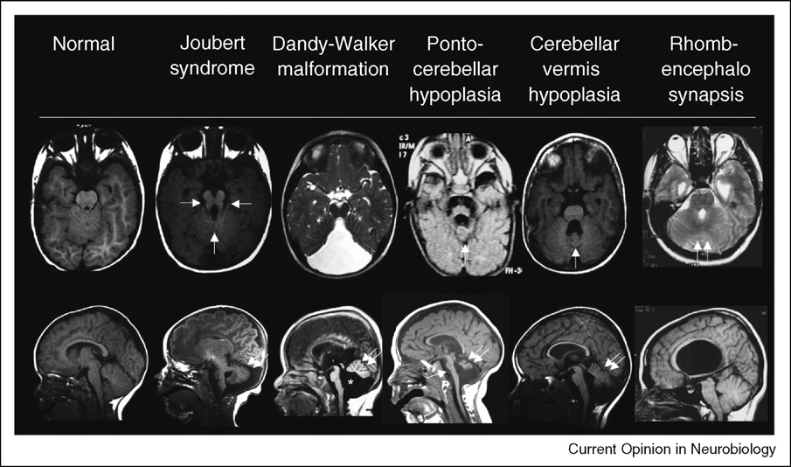
Why study the cerebellum?
Anatomy, cell types, circuitry (cerebellar cortex)
20+ spontaneous mouse mutants
Human Cb develops early emb – first few postnatal years & is vulnerable
Human Cb damage
and disorders:
Ataxias (videos)
tumours (e.g. medulloblastoma)
cognitive defects (?)
Starting to understand functions
of its microcircuits
(Millen and Gleeson, 2008)

Slide 5
What does the cerebellum do?
sensory inputs from cerebral cortex (esp. motor, sensory and visual areas) and spinal cord via pontine nuclei
cerebellum outputs to regions of the thalamus and these project to motor cortex
some go to prefrontal cortical area that controls eye movement
Cb is large in humans and higher primates: why?

Slide 6
What does the Cb do? Cb and motor behaviour
We continuously sense posture, balance & co-ordination
generate pattern of muscle changes etc for movement
need to learn how to move in new situations (inc. timing & sequence)
Summary: Cb Judges error between intended and actual voluntary movement and we learn from this
Rabies tracing work in macaques e.g. Hoshi E et al., 2005, Nat Neurosci.,
shows Cb connects to basal ganglia)

Slide 7
Does the cerebellum have higher cognitive functions?
cerebellar cognitive affective syndrome (CCAS) includes impairments in executive, visual-spatial, & linguistic abilities (sometimes without motor symptoms)
fMRI, PET etc of Cb lesions & non-lesioned
suggest Cb activated in language processing (inc. fluency and word meaning)
(attention, working memory, executive functions)
Does Cb ‘modulate’ aspects of cognition too? Refine models? Timing/sequence?
Autism? Schizophrenia?

Slide 8
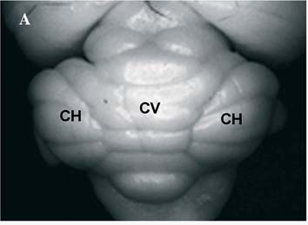
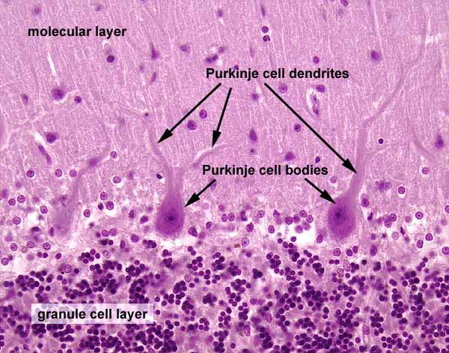
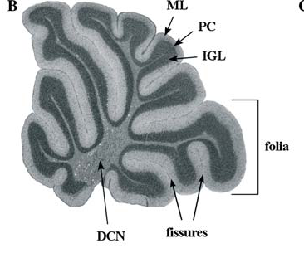
Cerebellum structure
(adult WT mouse)

Slide 9
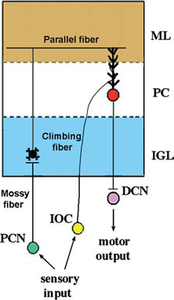
Cerebellar cortex structure in more detail

Slide 10
Cerebellar development
4 steps:
1) establish cerebellar ‘field’ in the hindbrain
2) form two compartments of cell proliferation: produce Purkinje cells & granule cells
3) migration of cells
4) formation of cerebellar circuitry & further differentiation
(20+ spontaneous mouse mutants, tumours etc)

Slide 11
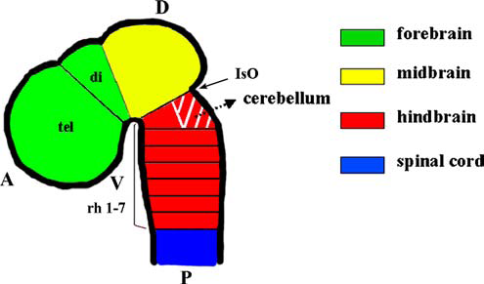
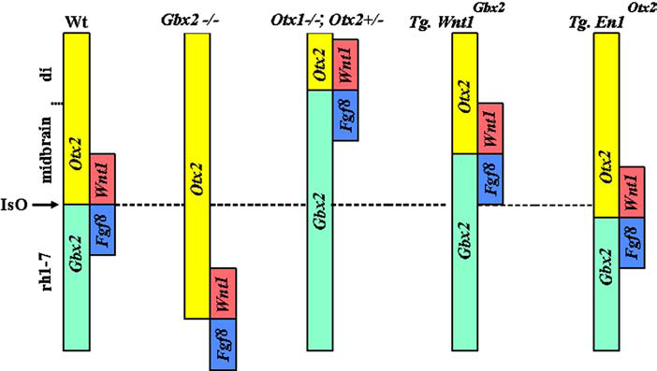
Step 1: Cerebellar field in hindbrain
Mouse E8.5
dorsal
rhombomere 1
Fgf 8/Wnt 1
From isthmus
(Chizhikov and Millen, Review, 2003)

Slide 12
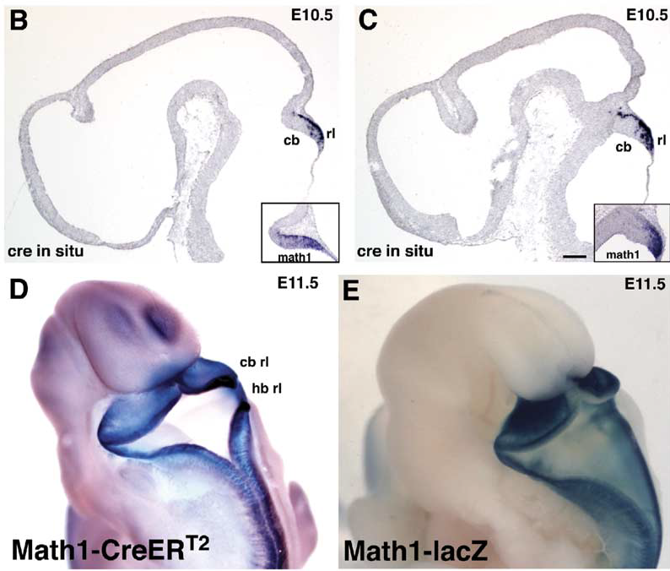
Step2: Form two regions of cell proliferation
1 = rhombic lip, posterior edge of Cb field/’anlage’, Math1+ (a bHLH tf):
(Machold and Fishell, Neuron, 2005)
produces glutamatergic neurons inc. DCN and GCs

Slide 13
BMPs (bone morphogenetic proteins) important for Math1 and GC induction
(Alder et al., Nature, 1999)

Slide 15
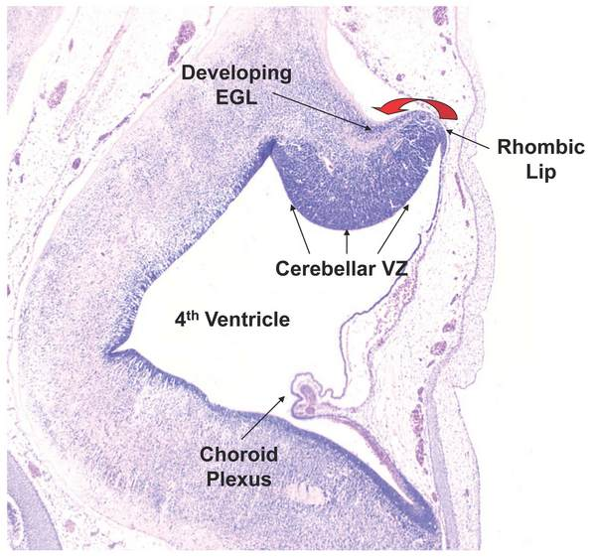
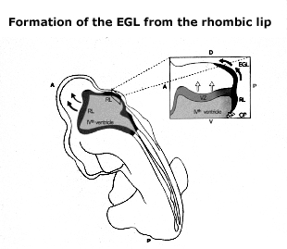
Zone 2: ventricular zone
Lines 4th ventricle, Ptf1A+ Produces GABAergic interneurons, PCs and all Cb glia

Slide 16
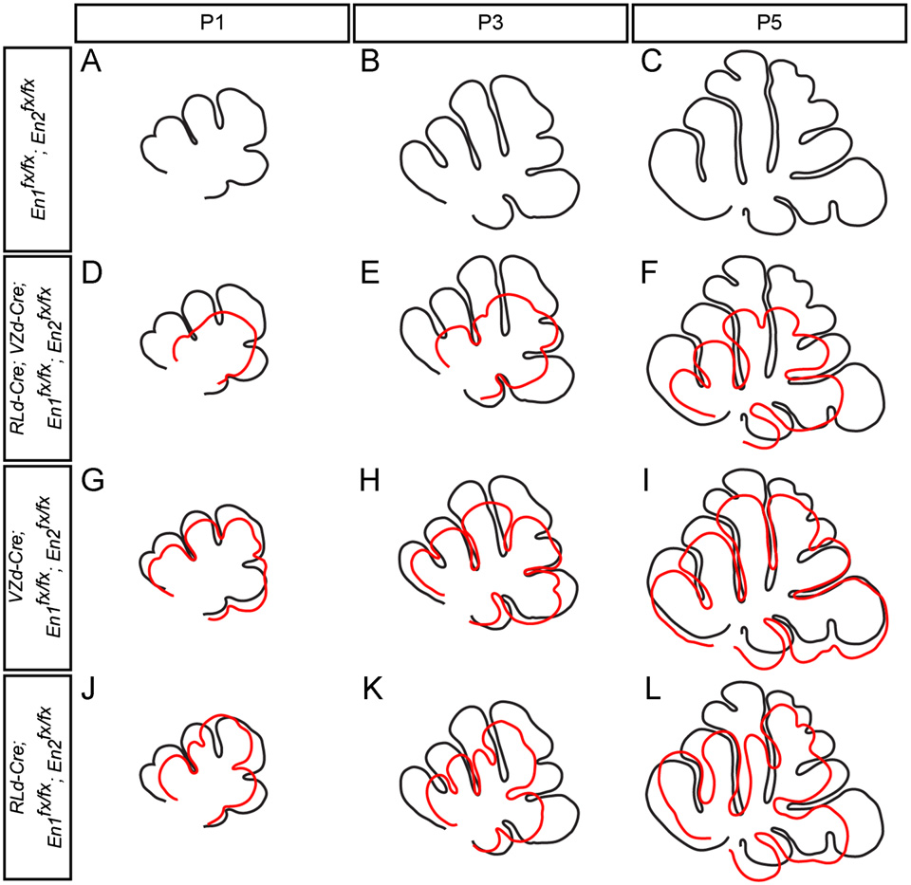
Need En1 & 2 in VZ and RL-derived cells for correct Cb folding
in VZ progeny for timing and site
in RL progeny for growth:
(Orvis GD et al.,
2012)

Slide 17
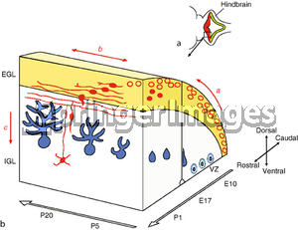
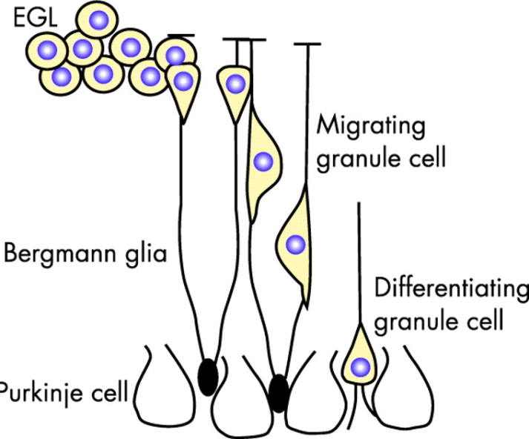
Step 3: Different cell types migrate out of the 2 zones differently
(Post-mitotic) cells from VZ inc Purkinje cells: most migrate radially & stop in layers of the cerebellar cortex
Cells exit RL first migrate over surface and then move inwards.
DCN neurons leave RL first & descend ventrally to form three pairs of nuclei
Granule cell precursors form a proliferative secondary precursor zone = external granule cell layer (EGL)

Slide 18
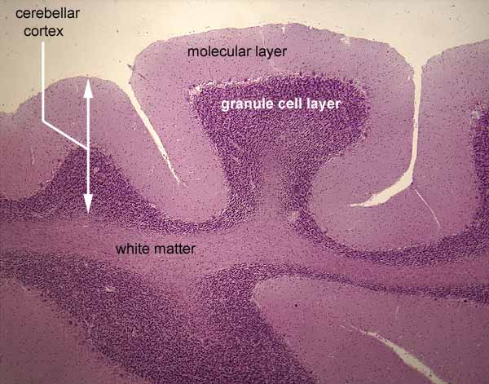
Granule cells leaving the EGL
(Post mitotic) GCs leave the EGL E18.5-P16 and migrate down Bergmann glial past Purkinje cell layer to form the IGL.
The GC axons
(parallel fibres) form
layer above Purkinje cells
= ‘molecular layer’
(Molecular layer also incl 2 major IN types)

Slide 19
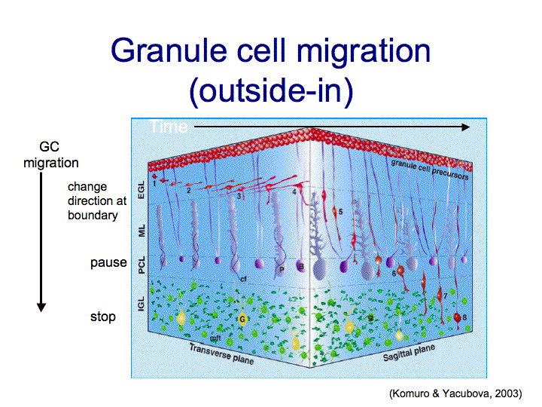
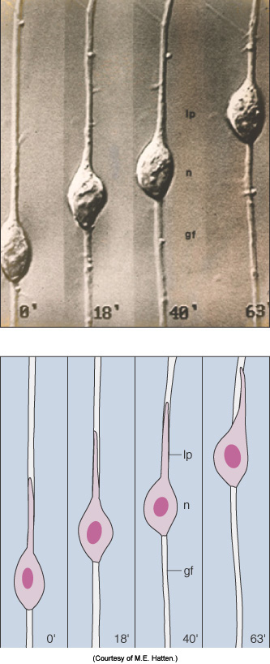
migrating GCs set Cb boundaries
GC migration is guided (through growth cone)
e.g. netrin receptor (UNC5H3) mutant –
GCs migrate into midbrain and brainstem
glial guidance cues (weaver mutant)
adhesive cues
their final destination has ‘stop’ signals
(M.E. Hatten)

Slide 21
extrinsic + intrinsic signals :
pathway selection
adhesive interactions
speed regulation
time-sensing?
cytoskeletal control

Slide 22
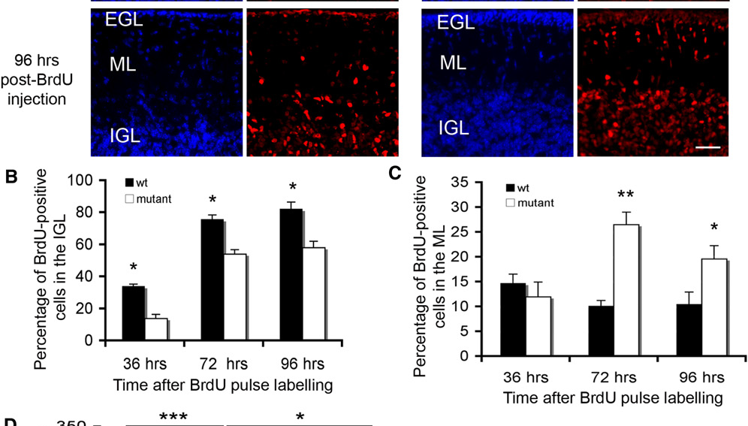
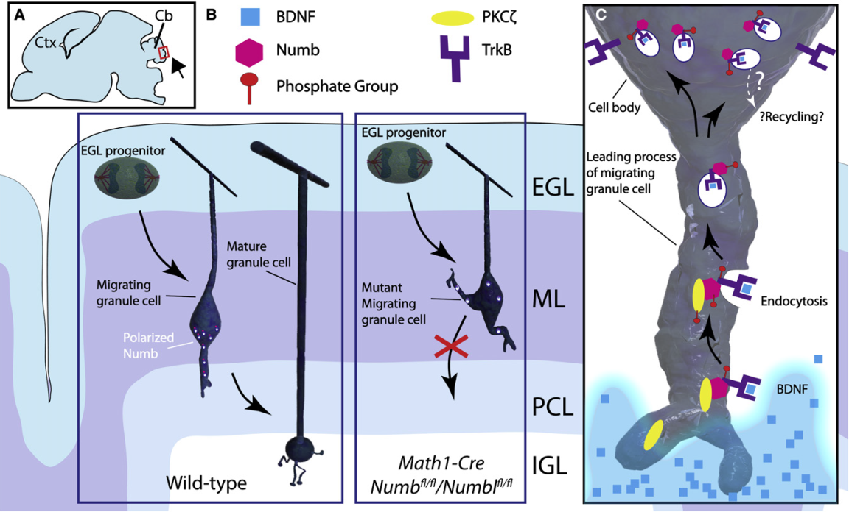
e.g. Endocytic adaptor protein Numb is needed for correct GC migration
(Zhou et al., Dev Cell, 2011
& comment by Breunig and Rakic)

Slide 23
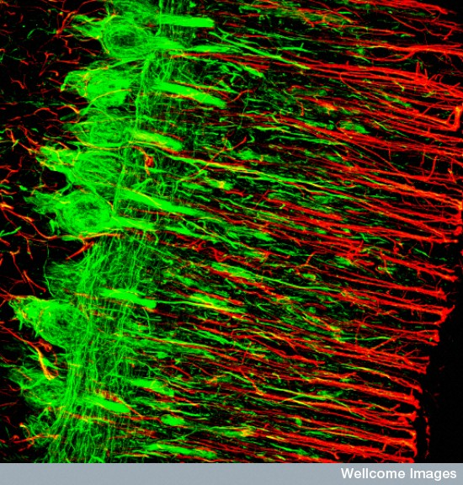
GC and Purkinje cells interact with Bergmann glia
GCs while migrating
later, BG differentiate into unipolar
astrocytes/RG, cell bodies close to
Purkinje cells, radial fibres wrap synapses:
Purkinje cells and Bergmann glia mature
together and presumably ‘talk’ to one another
(Credit MRC Toxicology Unit, Wellcome Images)

Slide 24
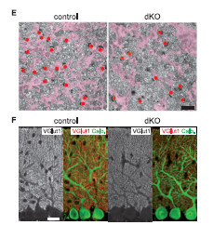
Not just passive: Bergmann glia are required for fine motor coordination
Saab et al., Science 2012
Glutamate from climbing fibres and GC terminals activate AMPArecs subtypes on Bergmann glia
Knock out these recs in young and adult mice
BG retract, fewer PF:PC synapses, don’t clear the glutamate
E: BG processes
Synapses
F: VGlut1 PF synapses
Calb Purkinje cells

Slide 25
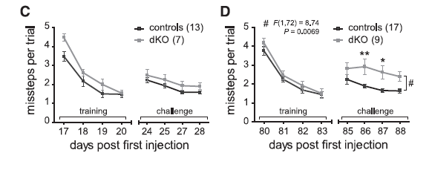
Saab et al., 2012 continued
When Bergmann glia lacked AMPA recs
Eyelid control and ladder stepping declined:

Slide 27
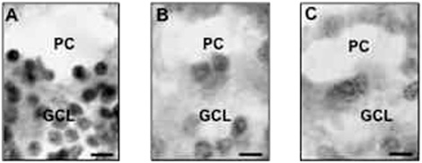
Clinically relevant?
Schizophrenic and bipolar patients have fewer Purkinje cells and less reelin (Maloku et al., PNAS, 2009):
Non-psychiatric
patient
SZ
BPD

Slide 28
15 minute break
Relax
Meet your neighbours
Review your notes
Ask questions

Slide 30
Control of cell number in the cerebellum
tight regulation of proliferation, cell cycle withdrawal, differentiation and cell death (apoptosis)
e.g. Must match Purkinje cell # to GC#
mutants: if reduce # of PCs: # of GCs is
reduced

Slide 31
(while they are in EGL)

Slide 32
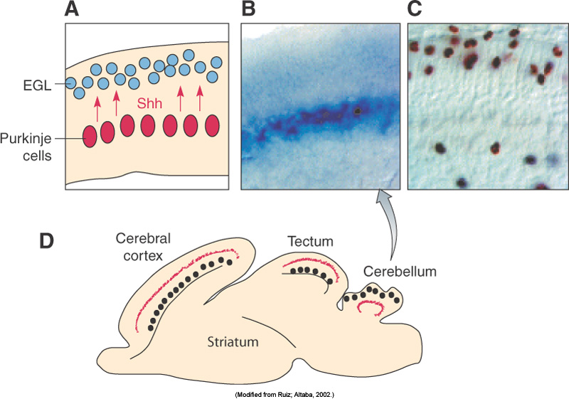
Shh used as a mitogen and ‘number matcher’ in several places
Clinically relevant e.g. medulloblastoma: granule cell divisions unregulated

Slide 33
Returning to Cerebellar circuitry
(1000s of parallel fibres per PC, simple spikes)

Slide 36
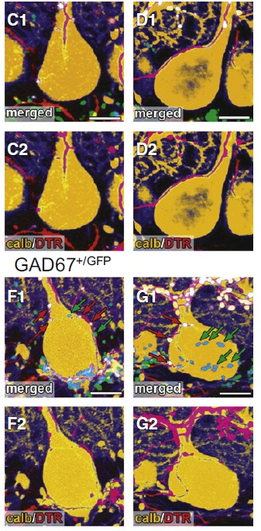
Cb circuitry formation: involves eliminating unwanted synapses
E.g. CF:PC synapses
After birth many CFs:1PC
End of week 3 (mice), 1CF:1PC
(Nakayama H et la., Neuron, 2012)
Strength of GABA signal from other PCs or
Interneurons onto PCs is key to culling excess CF synapses
Weak CFs can’t compete with the signal,
lose PC-derived synapse survival factors and culled
DTR = dextran Texas Red, CF
Calb = Purkinje cell

Slide 37
Cb organised in ‘modules’
Part of inferior olive sends CFs to a zone of Purkinje cells
These PCs then inhibit particular DCN that project back to the same part of the inferior olive
Is it input – adaptive filter – output? (Jury’s out)
Convey ‘output commands and learning signals’
CF input into each zone and the effects seems important to discover (LTP/LTD?)

Slide 38
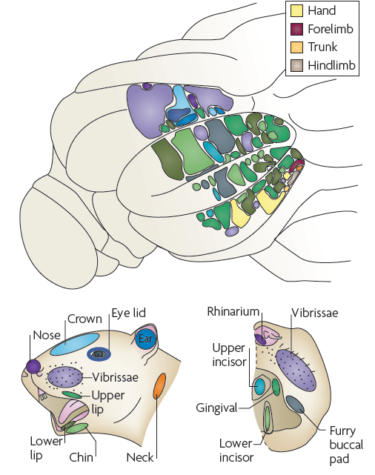
Rat: LHS of Cb – granular responses
To mechanical stimulation of body parts
(Modified from Shambles et al., 1978)

Slide 39
More specific Learning outcomes
Why is it useful to study the cerebellum?
Know the functions of the cerebellum and what damage to it causes
Describe the structure of the cerebellar cortex and the cell types present
Know cerebellar inputs, outputs, synapse location (and effect) and neurotransmitters
Describe the 4 steps of cerebellar development
Appreciate the cerebellum as a good model system for the study of cell migration with reference to Purkinje and granule cells and neural cell number control
(Questions? anita.hall@imperial.ac.uk)

