Slide 1

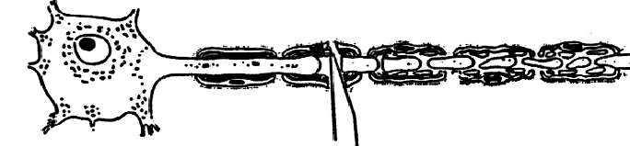
Consequences of axonal damage and regeneration strategies (II)
Neuroscience and Mental Health
Module 1: Cellular & Developmental Neuroscience
Kenji OKUSE
22nd October 2012
1
Notes:
Today, I’m going to talk about identification of a novel regulatory factor that facilitates the expression of Na_{V}1.8

Slide 2
References (original papers)
Huang et al (2007) A combination of intravenous and dietary docosahexaenoic acid significantly improves outcome after spinal cord injury. Brain: 130: 3004-3019.
Keyvan-Fouladi et al (2003) Functional repair of the corticospinal tract by delayed transplantation of OECs in adult rats. J Neurosci 23: 9428-9434.
King et al (2003) Mats made from fibronectin support oriented growth of axons in the damaged spinal cord of the adult rat. Exp Neurol 182: 383-398.
Ramer et al (2000) Functional regeneration of sensory axons into the adult spinal cord. Nature 403: 312-316.
2

Slide 3
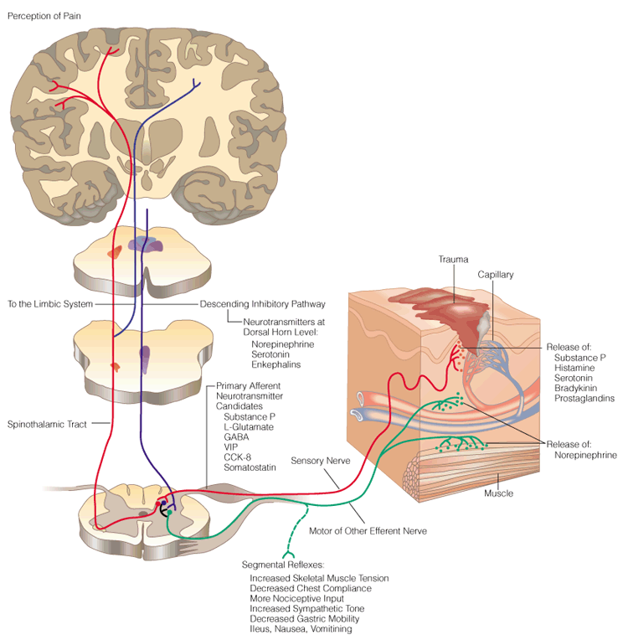
Cerebrum Cortex
Sensory Area
Sensory and Motor
Nervous System
Sensory Nerve
Dorsal Root
Ganglia (DRG)
Spinal
Cord
Ventral Root
Motor and Other Efferent Nerve
Neurotransmitter Release
3

Slide 4
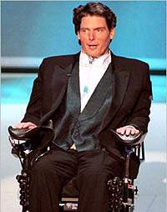
Cerebrum Cortex
Sensory Area
Spinal cord injury has
devastating consequences
Sensory Nerve
Dorsal Root
Ganglia (DRG)
Spinal
Cord
Ventral Root
Motor and Other Efferent Nerve
Neurotransmitter Release
4

Slide 5
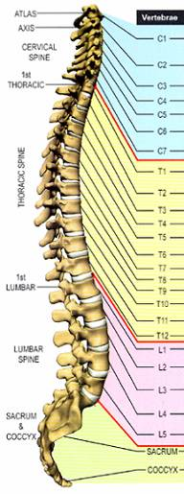
Vertebral subluxation and innervation chart
Cervical
Median nerve (arms, hands)
Thoracic
Gastric nerve (stomach)
Lumbar
Sciatic nerve (legs, foots)
Sacral
5

Slide 6
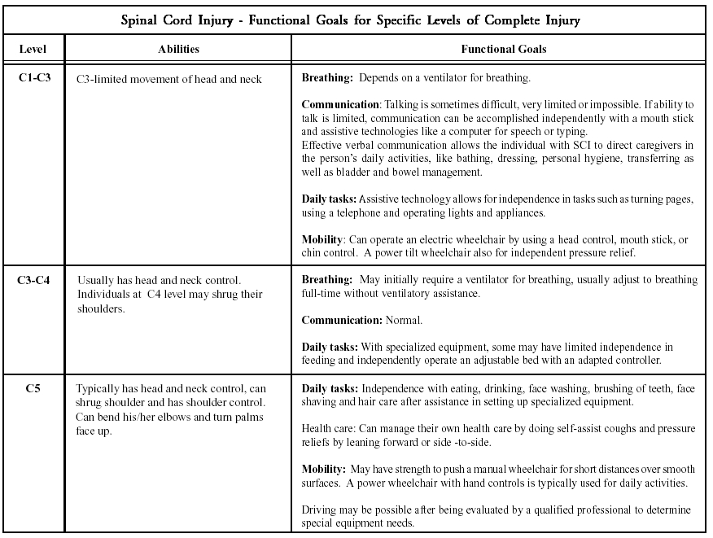
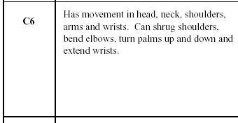
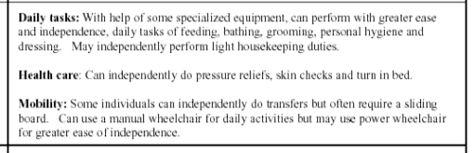


Many patients with spinal cord injury cannot carry out basic daily tasks
6

Slide 7
Current treatment options for spinal cord injury are limited
Acute
Methylprednisolone (a corticosteroid drug) administered
within 3-8 hrs of injury
Chronic
Active Rehabilitation Strategies, such as:
Active physiotherapy, commencing within 2 weeks of injury and maintained for at least 6 months post-injury.
Weight-supported, treadmill training of locomotor patterns.
Constraint use therapy to extend and improve functional limb movements.
Functional electrical stimulation (FES) of:
Phrenic nerves to pace respiration in people with high cervical injury.
Sacral root nerves to maintain continence and assist bladder voiding.
legs to maintain muscle mass and bone density, as well as improved cardiovascular and immune performance.
7

Slide 8
Novel cell-based therapies & pharmaceuticals are already in clinical trial
Phase III 4-aminopyridine (Fampridine-SR, Acorda) and HP-184 (Sanofi-Aventis) to improve conduction along small number of spinal cord fibers that are often spared after SCI. Chronic
Phase II (Proneuron) transplant patient’s own activated macrophages as a neuroprotective and/or regenerative therapy for acute SCI. Trial stopped. Acute
Phase II (Neureva, France) gacyclidine (NMDA antagonist) as a neuroprotective for acute SCI. No neurological improvement. Acute
Phase I (Canada) Minocycline as a neuroprotective therapy for acute SCI. Acute
Phase I (Canada) Rho inhibitor (Cethrin, Alseres Pharmaceuticals), as a neuroprotective and/or regenerative therapy. Acute
Phase I (Europe) NOGO antiserum (ATI355, Novartis), as a regenerative therapy based on overcoming myelin inhibition. Acute
Phase I (Australia) olfactory ensheathing cells (OECs) as a regenerative therapy. Acute
Phase I/II (Iran) Schwann cell transplants as a regenerative therapy based on bridging spinal cord injury sites. Chronic
8

Slide 9
Four different strategies for promoting spinal cord repair
  Neuroprotection: OMEGA-3 polyunsaturated fatty acids
  - Minimise the deleterious effects of early trauma
  Neurotrophic factors
    - Promote axonal regeneration by maximising positive trophic support
  Schwann cells and olfactory ensheathing cells
    - Promote axonal regeneration and guide extended regrowth
  Biomaterial conduits
    - Guide extended regrowth and fill cavities
9

Slide 10
Four different strategies for promoting spinal cord repair
  Neuroprotection: OMEGA-3 polyunsaturated fatty acids
  - Minimise the deleterious effects of early trauma
  Neurotrophic factors
    - Promote axonal regeneration by maximising positive trophic support
  Schwann cells and olfactory ensheathing cells
    - Promote axonal regeneration and guide extended regrowth
  Biomaterial conduits
    - Guide extended regrowth and fill cavities
10

Slide 11

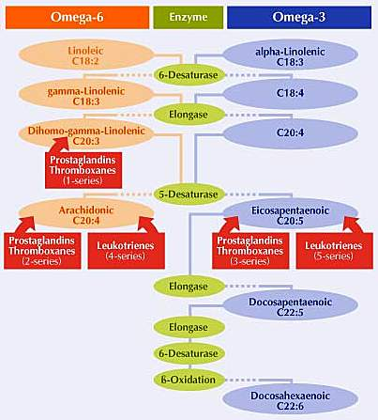
OMEGA-3 and OMEGA-6 polyunsaturated fatty acids
LA/ALA
AA
EPA
prostanoids
DHA
11

Slide 12
OMEGA-3 polyunsaturated fatty acids
Alpha-linolenic acid (LA/ALA)
Eicosapentaenoic acid (EPA)
Docosahexaenoic acid (DHA)
- Present in fish oil and in vegetable oil
- Enriched in CNS: high DHA in retina, brain
- Important structural role but also activate specific cellular targets
- Formation of active metabolites in vivo
- Essential for normal neural development
- Specific symptoms can be corrected by supplementation (e.g. peroxisomal disorders such as Zellweger’s syndrome)
12

Slide 13
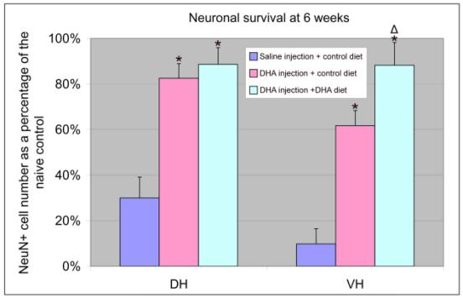
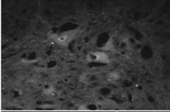
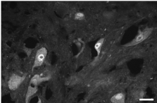
DHA protects neurons after spinal cord compression
30 min after injury, rats received an i.v. injection of DHA.
A separate group received i.v. DHA + DHA enriched diet.
Outcome studied in dorsal and ventral horns at 6 weeks.
Saline
DHA injection + diet
13

Slide 14
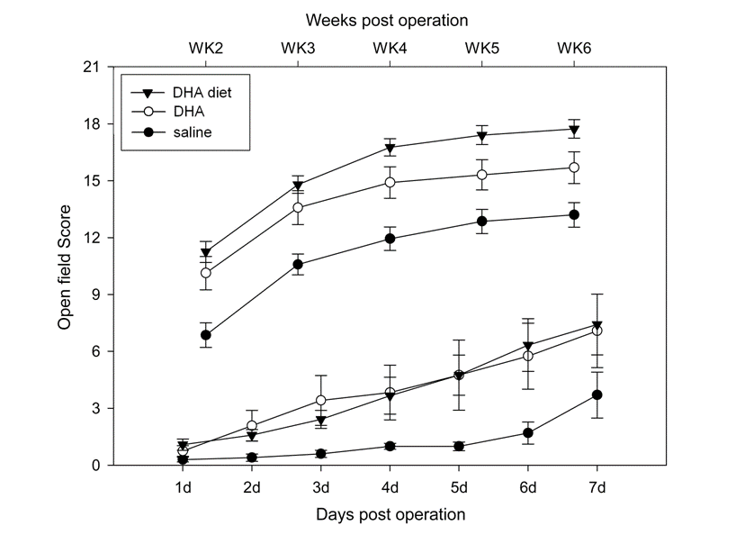
DHA improves the motor score after spinal cord compression
i.v.
14

Slide 15
DHA affects multiple stages in the development of spinal injury
Other cytokines
Inflammation
Macrophage recruitment
COX-2
Prostaglandins
Axonal damage
SCI
Lipid peroxidation
Myelin damage
ROS
Cell membrane damage
Protein, RNA & DNA oxidation
Excitotoxicity
Cell death
Neurological deficit
15

Slide 16
Four different strategies for promoting spinal cord repair
  Neuroprotection: OMEGA-3 polyunsaturated fatty acids
  - Minimise the deleterious effects of early trauma
  Neurotrophic factors
    - Promote axonal regeneration by maximising positive trophic support
  Schwann cells and olfactory ensheathing cells
    - Promote axonal regeneration and guide extended regrowth
  Biomaterial conduits
    - Guide extended regrowth and fill cavities
16

Slide 17
Neurotrophins can be used to promote regeneration
NGF
BDNF
NT-3
NT-4/5
NGF
BDNF
NT-4/5
NT-3
K
K
K
K
K
K
trkA
trkB
trkC
p75
17

Slide 18
Most spinal cord neurons express the neurotrophin receptors trkB and trkC
18

Slide 19
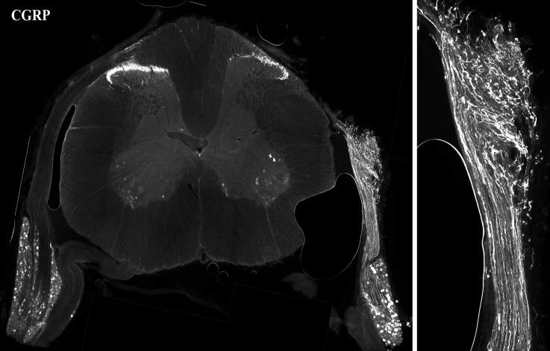
Without neurotrophin treatment,
Injured dorsal root axons start to regenerate,
but fail to reinnervate the spinal cord
19

Slide 20
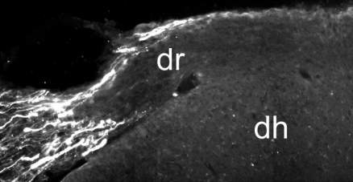
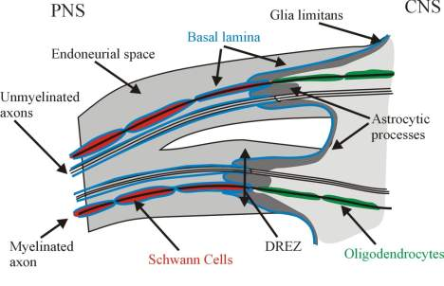
The junction between dorsal roots and the spinal cord - the dorsal root entry zone (DREZ)
20

Slide 21
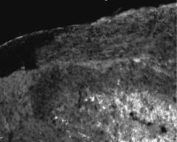
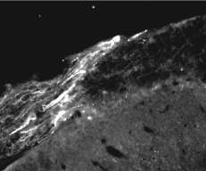
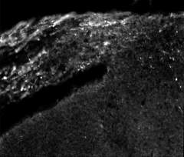
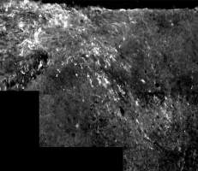
Neurotrophin treatment enables sensory axons to cross the DREZ and reinnervate the spinal cord
Control
Vehicle: 1 wk
NT3: 1 wk
NT3: 2 wk
21

Slide 22
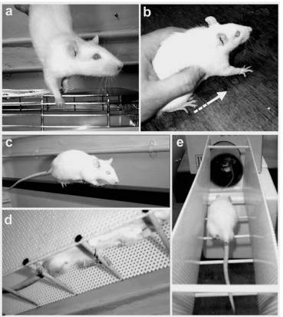
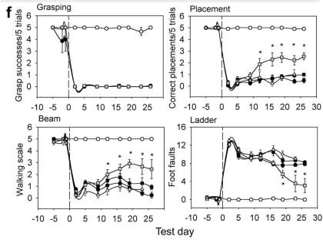
Behavioural analysis indicates that NT-3 helps axonal regeneration and functional connections
Sham
Rhiz/untreated
Rhiz/vehicle
Rhiz/NT3
Rhiz(excision)/NT3
22

Slide 23
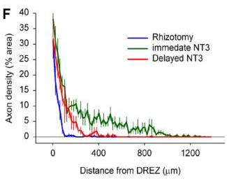
However: delayed NT-3 treatment does not promote regeneration beyond the DREZ
23

Slide 24
Four different strategies for promoting spinal cord repair
  Neuroprotection: OMEGA-3 polyunsaturated fatty acids
  - Minimise the deleterious effects of early trauma
  Neurotrophic factors
    - Promote axonal regeneration by maximising positive trophic support
  Schwann cells and olfactory ensheathing cells
    - Promote axonal regeneration and guide extended regrowth
  Biomaterial conduits
    - Guide extended regrowth and fill cavities
24

Slide 25
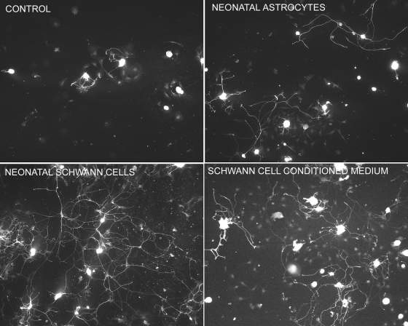
Schwann cells are the key pro-regenerative cell within peripheral nerves and spinal roots
Schwann cells promote neurite outgrowth
and myelinate axons
25

Slide 26
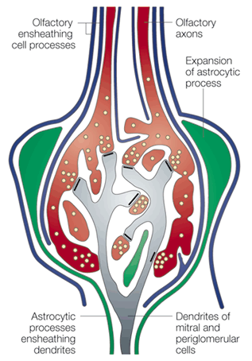
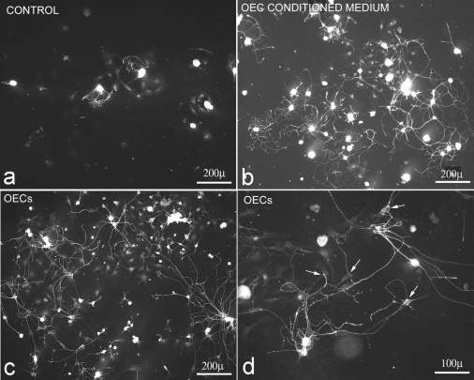
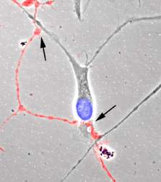
Olfactory ensheathing cells (OEC) promote neurite outgrowth and myelinate axons
26

Slide 27
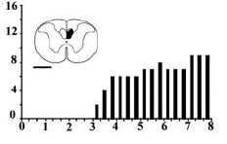
OEC transplants show great promise,
however they are not magic
OEC implanted into a corticospinal tract lesion can promote regeneration and functional recovery
PAW retrieval latency
weeks after transplant
27

Slide 28
Four different strategies for promoting spinal cord repair
  Neuroprotection: OMEGA-3 polyunsaturated fatty acids
  - Minimise the deleterious effects of early trauma
  Neurotrophic factors
    - Promote axonal regeneration by maximising positive trophic support
  Schwann cells and olfactory ensheathing cells
    - Promote axonal regeneration and guide extended regrowth
  Biomaterial conduits
    - Guide extended regrowth and fill cavities
28

Slide 29
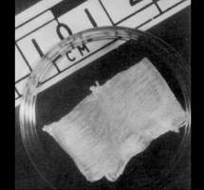
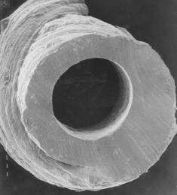
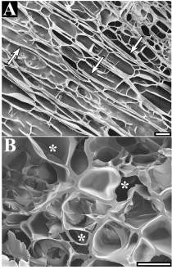
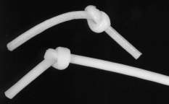
Fibronectin conduits have many properties that suit them for use as implants for supporting spinal cord regeneration
- Made from glycoprotein involved in wound healing
- Have oriented pores 10-200 μ in diameter
- Can act as slow-release depots for growth factors
- Are resorbed over a 2 week period
- Have been used as nerve bridges in the peripheral nervous system
50μm
50μm
29

Slide 30
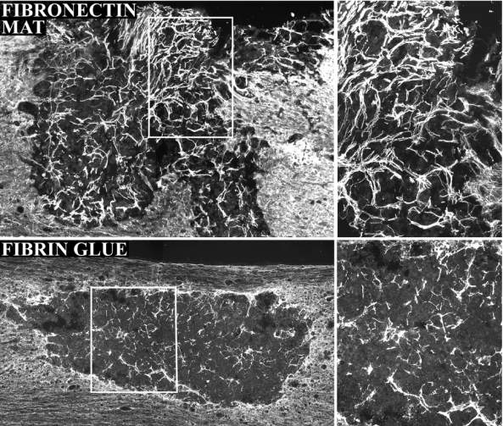
Fibronectin mats support extensive, directional axonal growth
30

Slide 31
Fibronectin mats improve recovery of function after thoracic spinal cord injury
31

Slide 32
Four different strategies for promoting spinal cord repair
  Neuroprotection: OMEGA-3 polyunsaturated fatty acids
  - Minimise the deleterious effects of early trauma
  BUT NOT TRIVIAL TO TRANSLATE TO THE CLINIC
  Neurotrophic factors
    Promote axonal regeneration by maximising positive trophic support
    BUT MAY TRAP AXONS
  Schwann cells and olfactory ensheathing cells
    - Promote axonal regeneration and guide extended regrowth
    BUT TRANSPLANT SITE IS CRUCIAL
  Biomaterial conduits
    Guide extended regrowth and fill cavities
    BUT MAY TRAP AXONS
32

