Slide 1

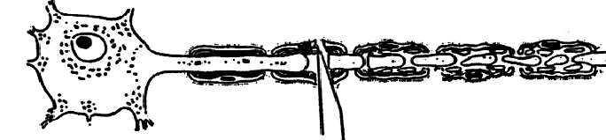
Consequences of axonal damage and regeneration strategies (I)
Neuroscience and Mental Health
Module 1: Cellular & Developmental Neuroscience
Kenji OKUSE
22nd October 2012
1
Notes:
Today, I’m going to talk about identification of a novel regulatory factor that facilitates the expression of Na_{V}1.8

Slide 2
Key References
Brain (2003) 126: 515-530
Advanced Studies in Medicine (2005) 5: S404-S408
Nature Reviews Neuroscience (2005) 6: 889-898
Nature Rev Neurosci (2006) 7: 644-653
2

Slide 3
Causes of axonal damage
Disease (MS, infection, infarction, ischemia etc)
Drug induced
Injury
Pathophysiology and consequences of axonal damage
Degeneration and Regeneration
- Wallerian Degeneration (WD), C57BL/Wld^{s} mouse
- Reinnervation
- CNS vs. PNS
Genetic changes in neurons, glial cells, macrophages
3

Slide 4
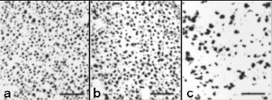
Causes of axonal damage
Multiple Sclerosis
Multiple Sclerosis (MS)
- Is an inflammatory neurodegenerative disease
- Significant axonal loss in normal-appearing white mater
- Molecules secreted by macrophages and activated T cells such as NO and
matrix metalloproteinase lead to axon transections
- Irreversible denervation of target neurons causes functional loss and possibly
downstream effects
Axonal density determined in neurofilament-stained brain white matter sections
control
MS nonlesion
MS lesion
Axon end bulbs following axon injury in MS
- Filled with proteins including APP
- appear in acute lesions, but very few in chronic lesions
4

Slide 5
Axonal varicosities, spheroids and end bulbs
- Focal blockages of axonal transport, which may occur preferentially at nodes of Ranvier, lead to accumulation of organelles and dis-organized cytoskeleton in axonal varicosities
- Amyloid precursor protein (APP) also ac-cumulates in these. The swellings increase in size to form axonal spheroids. The axon re-mains continuous, but as the spheroids grow, axonal transport may become increasingly impaired (APP: consequences or cause?)
- The block of axonal transport is of sufficient magnitude to trigger Wallerian degeneration (WD) of the distal axon. An end bulb remains on the proximal axon stump. End bulbs also form when axons are transected directly
Potent vasoactive peptides, e.g. CGRP, also accumulate in the end bulb
5

Slide 6
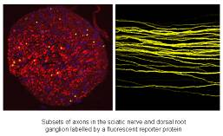
Causes of axonal damage
Infections
Malaria
- Axonal damage is a common finding in patients with severe malaria
- It is not known how malaria parasites, which remain within the vascular space
and do not infect brain cells, influence parenchymal brain function
Brain section from a patient who died with malaria infection shows focal patches of arrays of damaged axonal injury are intensely immunoreactive for APP, and consists of linear arrays of damaged axonal segments that often appear grossly swollen or club-shaped
Healthy axons
HIV
- Neurological disease is a common occurrence in patients with AIDS
- A proportion of neurological disease will be associated with opportunistic
infections as a result of immunodeficiency, meanwhile 20-30% of patients will
develop neurocognitive defects without opportunistic infections
Disseminated and swollen axonal segments in cerebral white matter from a patient who died with HIV encephalitis
6

Slide 7
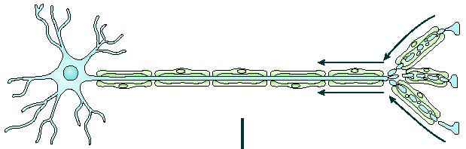
Causes of axonal damage
Drug induced
Taxol
- A microtubule-stabilizing drug used in cancer chemotherapy
- Because of its action on microtubules, side effects of Taxol include peripheral
neuropathy
- Dying back axon degeneration occurs
Degeneration begins at the distal ends of Taxol-challenged axons and spreads retrogradely
- similar dying back processes may underlie the early loss
of synapses that occurs in Alzheimer’s disease
7

Slide 8
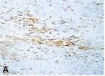
Causes of axonal damage
Injury
Head trauma
- Caused by road-traffic accidents, falls from a height, assaults, sports injuries
- Herniation and brainstem compression caused by haemorrhage, contusion,
haematoma
Brain section from a patient who died with head injury shows waves of diffuse axonal staining
Spinal cord injuries
- Caused by a vertebral fracture, subluxation or dislocation
- 8d to 5w postinjury: the injury site of the spinal cord is characterized by axonal
swelling, fragmentation and increased spacing between axons.
- 7w to 8w postinjury: Wallerian degeneration (WD) is evident in dorsal columns
above the injury and lateral columns below the injury, with debris-laden
phagocytes intermingled with axonal and myelin debris.
8

Slide 9
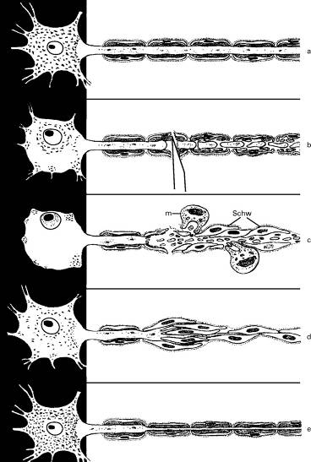
Sequence of cellular events triggered by transection of a myelinated axon
A normal myelinated axon associated with a longitudinal chain of glial cells and enclosed within a continuous basal lamina
Local injury producing dissolution of myelin sheaths and degeneration of axoplasm distally, and sealing of the tip of the proximal stump
The glial cell tube is invaded by macrophages which breach the basal lamina. Glial cells distal to the injury proliferate. Axon sprouts emerge from the proximal stump
macrophage
glial cells
Axon sprouts elongate within the glial tube and associate with the glial cells therein
Daughter glial cells remyelinate the regrowing axon
9

Slide 10
Dying back and focal lesion models of axon degeneration
The focal lesion model proposes that focal lesions can trigger Wallerian degeneration (WD) of distal axons while proximal axons remain intact. The lesion does not necessarily need to transect the axon, as a focal block of axonal transport also trigger WD
10

Slide 11
Wallerian Degeneration (WD)
Process of degeneration of the axon distal to a site of transection (Augustus Waller, 1850)
- Dissociation of myelin sheaths of distal axons
- Removal of the myelin and axonal debris by macrophages
- Removal of myelin-associated molecules, e.g. MAG, which
would otherwise inhibit axonal growth
- During this process, proximal axons remain intact
- Glial cells distal to the injury proliferate
- Glial cells synthesize growth factors
- Secreted growth factors attract axonal sprouts from the
proximal stump
11

Slide 12
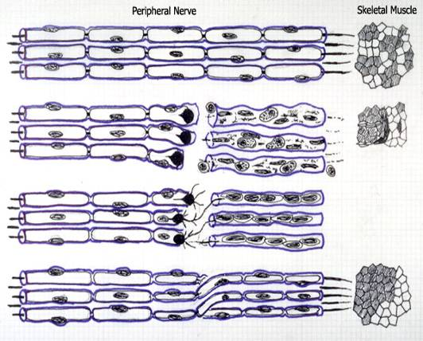
Wallerian Degeneration
CNS vs. PNS
WD happens in both the CNS and the PNS, but the repair process afterwards has quite a few differences
Peripheral motor nerve transection
Normal nerve innervating skeletal muscle
The nerve has been transected and WD has begun. Macrophages clears the Schwann cell debris. There is corresponding atrophy in the muscle
Proximal nerve terminals send sprouts toward the proliferated/reassembled Schwann cell tubes. Misrouting could occur if the two ends are well apart
Some of the sprouts make it into tubes and reinnervate the muscle
12

Slide 13
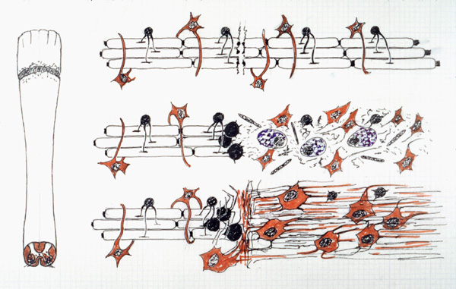
Wallerian Degeneration
CNS vs. PNS
Spinal cord injury
Damage occurs to spinal cord axons
Brain Macrophages (microglia) (purple) enter to clear the debris and astrocytes (orange) begin to enlarge and proliferate
Astrocytes synthesize glial fibrillary acidic protein (GFAP) and a glial scar is formed. Blocking axonal growth
13

Slide 14
Peripheral and central neurons response differently to axonal damage
Wallerian Degeneration (WD) happens in both the PNS and CNS
The repair process afterwards has quite a few differences.
PNS: step 1 - Macrophages clears the Schwann cell debris
step 2 - Corresponding atrophy in the muscle
step 3 - Proximal nerve terminals send sprouts toward the proliferated/reassembled Schwann cell tubes
step 4 - Misrouting could occur if the two ends are well apart
step 5 - Some of the sprouts make it into tubes and re-innervate the muscle
CNS: step 1 - Brain Macrophages (microglia) enter to clear the debris and astrocytes begin to enlarge and proliferate
step 2 - Astrocytes synthesize glial fibrillary acidic protein (GFAP) and a glial scar (consists of reactive astrocyte and microglia) is formed
step 3 - The glial scar blocks axonal growth
14

Slide 15
Wallerian Degeneration
CNS vs. PNS
CNS
PNS
Proliferation of glial cells
2 weeks ~
3-4 days
Invasion by macrophages
~ 2 weeks
2-7 days
Clearance of myelin debris by macrophages
2 weeks ~
~2 weeks
Axonal regeneration
a few days to 4 weeks
Does not occur
15

Slide 16
Why PNS axons can re-grow?
Schwann cells secret neurotrophic factors
Schwann cells form basement membrane to help axonal extension
No inhibitory factors in myelin in PNS.
16

Slide 17
Why CNS axons cannot re-grow?
Low levels of growth factor receptors
- young (upto 2 weeks postnatal) axons can re-
grow, but mature neuron’s axons can not re-enter tissues following damage
Active inhibition
- myelin glycoproteins expressed on the surface of oligodendrocyte activate neuronal Nogo receptor and subsequent Rho kinase pathway
- accumulation of chondroitin sulphate proteoglycan
CNS axons in lower animals (e.g. fish, frog) can re-grow.
17

Slide 18
Is Wallerian degeneration good or bad?
Good - speed up the regeneration process
Bad - over degeneration
18

Slide 19
Slow Wallerian degeneration mutant mouse
C57BL/Wld^{S} mouse
- Shows delayed WD (more than 10-fold)
- Developmentally normal and completely healthy
19

Slide 20
Wld^{S} mouse shows delayed axon degeneration
20

Slide 21
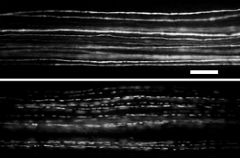
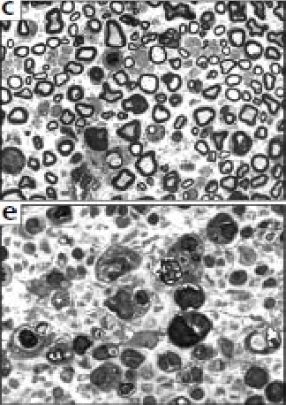
Wld^{S} mouse shows delayed axon degeneration
Complete preservation of distal nerve in Wld^{S} mouse 5 days after nerve lesion (visualized using the YFP-H transgene)
In contrast, no unfragmented axons remained in distal nerve lacking in wild type mouse 3 days after a lesion
Wld^{S} mouse 14 days after transection
Wild type mouse after 12 days
21

Slide 22
Slow Wallerian degeneration mutant mouse
C57BL/Wld^{S} mouse
- Shows delayed WD (more than 10-fold)
- Developmentally normal and completely healthy
- Carries a spontaneous dominant mutation
Wld^{s} gene: encodes fusion protein of the N-terimal 70 amino
acids fragment of ubiquitination factor E4B, the
complete coding region of NAD⁺ synthesizing
enzyme nicotinamid adenylyltransferase 1 (NMNAT1)
and a unique 18 amino acid linking region
- Wld^{S} protein is predominantly located within the nucleus
This suggests other factor(s) mediate the protective effect on the
axon
22

Slide 23
Proteins upregulated in denervated
Schwann cells
p75NTR (low affinity neurotrophin receptor)
NGF, BDNF (growth factors)
GFAP (glial fibrillary acidic protein)
Glial maturation factor-β
c-erbB2, c-erbB3 (neu receptors – responsible for Schwann cell proliferation)
LP (regulates the morphology/adhesion of Schwann cells)
N-CAM, L1 etc (cell adhesion molecules)
netrin-1 (responsible for growth cone and axon guidance)
IL-1α, IL-6, TNF-α, TGF-β1 (cytokines – induce expression of LIF)
Erythropoeitin (a neuroprotective cytokine)
Connexin 46 (a gap-junction protein – facilitates the rapid diffusion of signalling molecules between cells downstream of the site of injury)
MMP-2, MMP-9 (matrix metalloproteinase – remodelling of BNB)
Pax3, c-jun (transcription factors – regulate Schwann cell de- and redifferentiation)
23

Slide 24
Proteins downregulated in denervated
Schwann cells
MAG, MBP, P0, PMP22, periaxin (myelin-associated protein)
Connexin 32, E-cadherin (important for maintaining the complex structural organisation)
Krox-20 (transcription factor – regulates Schwann cell de- and redifferentiation)
24

Slide 25
Proteins upregulated in macrophages
IL-1 (upregulates NGF in Schwann cells)
TNF-α, NO (potential mediators of neuropathic pain, TNF-α activates neuroprotective transcription factor NF-κB)
Cyclooxygenase-2 (may mediate chronic post-traumatic neuropathic pain)
MMP-2, MMP-9 (matrix metalloproteinase – remodelling of BNB)
Erythropoeitin (potentiate division of Schwann cells)
25

Slide 26
Proteins regulated in damaged neurons
Upregulated
c-jun (transcription factor)
GAP-43/B50 (growth associated protein)
peripherin (intermediate filament)
Class II and III β-tubulin
Downregulated
NF-L, NF-M, NF-H (neurofilaments)
26

Slide 27
Axon regeneration in spinal cord is induced by cAMP
The fibres traverse the spinal cord in a tight bundle in un-operated animal
Horizontal section through the lesion site shows majority of fibres stop at the lesion site
Saline-injection does not alter the condition
db-cAMP-injected animals show regenerating fibres.
Many axons regrow into the lesion site. Some grow extensively around and on the walls of a cyst, while others grow toward the surface of the spinal cord
27

