Slide 1
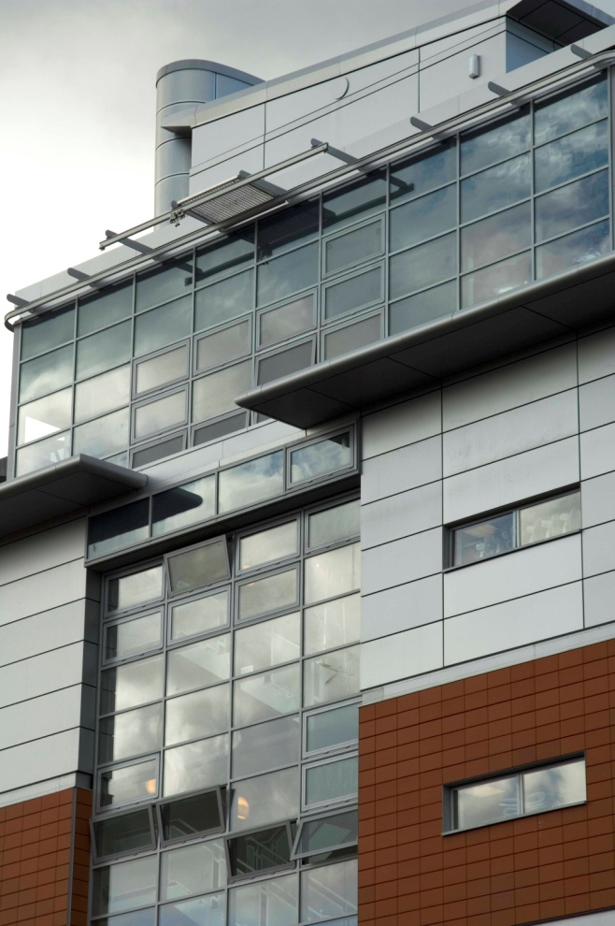
Renal transplantation
Jack Galliford
Consultant Renal and Transplant physician
Hammersmith Hospital, London

Slide 2
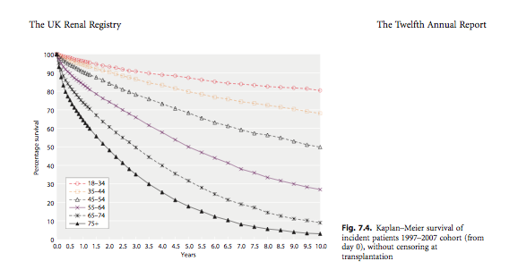
Rationale: Poor survival on dialysis

Slide 3
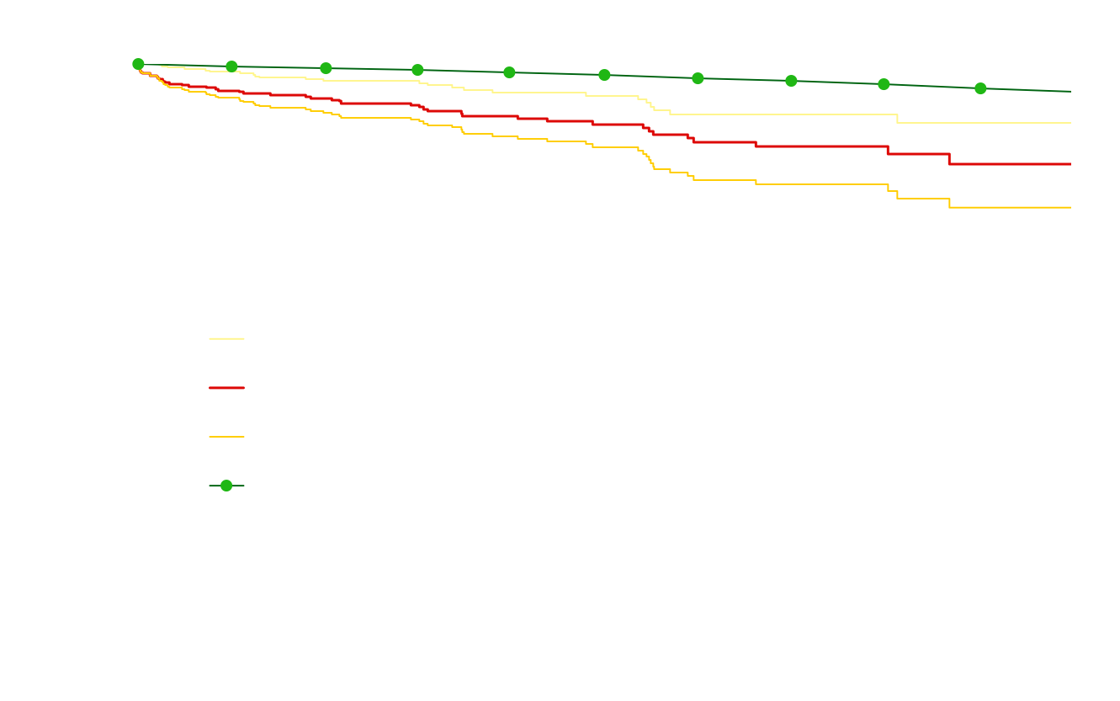
West London patient and graft survival after renal transplantation: 1995-2005

Slide 4
UKT

Slide 5
Economics?

Slide 6
How do we get here?

Slide 7
What gets you the kidney?
Live donor
Deceased Donor
Age
Blood Group
Tissue type/ Matching
Sensitisation
Wait time

Slide 8
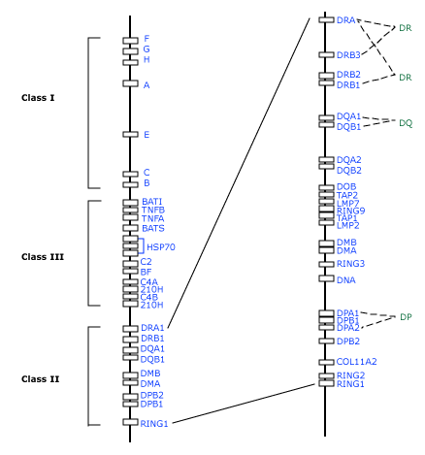
HLA type in transplantation
Define compatibility
Individual HLA type determined by a group of genes
Most kidney transplants are not zero mismatched
Avoid sensitization

Slide 9
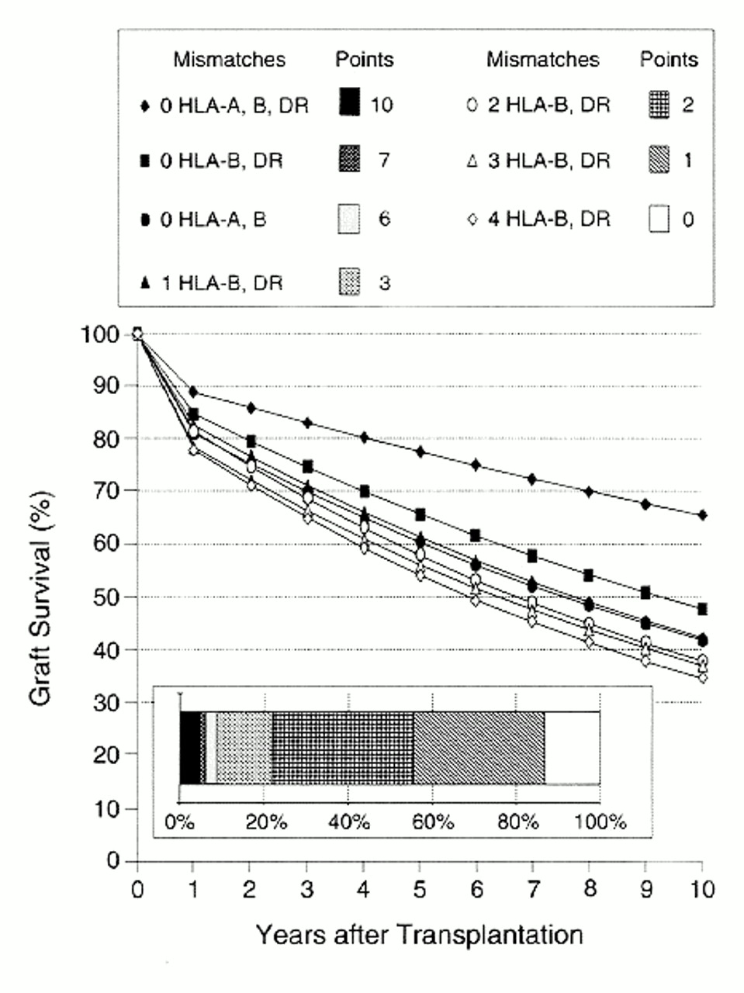
HLA matching
Improved graft survival (cadaveric)
No effect on feasibility of transplantation
No bearing on complement fixation
Kidney transplants are matched to
HLA A, B and DR
Why not to HLA C, DP and DQ?
Takemoto S et al. N Engl J Med 1994;331:760-764

Slide 10
HLA matching
Improved graft survival (cadaveric)
No effect on feasibility of transplantation
No bearing on complement fixation
Kidney transplants are matched to
HLA A, B and DR
Why not to HLA C, DP and DQ?
(Good) survival!
HLA C antibodies are generally not complement fixing
HLA DR shows linkage disequilibration
Takemoto S et al. N Engl J Med 1994;331:760-764

Slide 11
What helps you keep the kidney
Rejection
Drugs [compliance]

Slide 12
Pathogenesis and classification of kidney transplant rejection
Cellular Rejection
Antibody mediated Rejection
They can co-exist

Slide 13
Allograft
Antigen presentation
CD4 T cell
IL2, IL4, IL5
CD8 T cell
B cell
IL2
γIFN etc.
Macrophage
Plasma cell
Antibody
Rejection

Slide 14
Allograft
Antigen presentation
CD4 T cell
IL2, IL4, IL5
CD8 T cell
B cell
IL2
γIFN etc.
Macrophage
Plasma cell
Antibody
Rejection

Slide 15
Acute cellular rejection [ACR]
T cell mediated
Common form of rejection that develops classically 1 – 6 weeks after transplantation
May occur after many years

Slide 16
Features of ACR
Inflammatory infiltrate of mainly lymphocytes and monocytes
Targeting of structural components of the kidney
tubules
interstitium
blood vessels
glomeruli

Slide 17
Treatment
Often responds to bolus steroid treatment and rarely causes graft loss
Pathological features are not pathognomonic of rejection and may occur in drug induced
interstitial nephritis

Slide 18
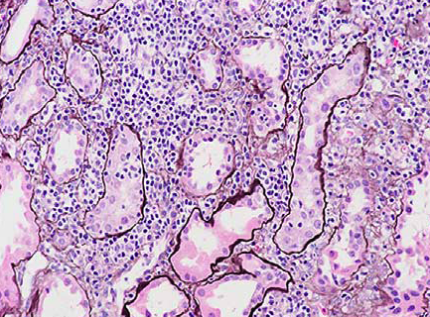

Slide 19
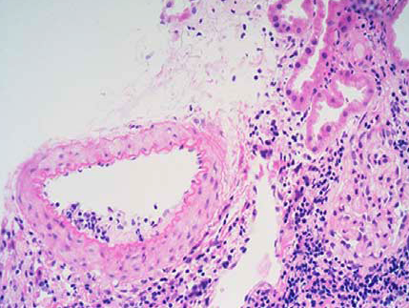
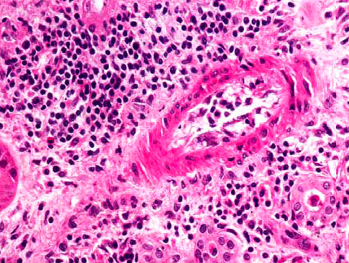
Endarteritis

Slide 20
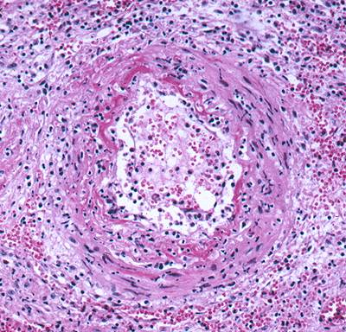
Arterial transmural inflammation
Poor pathogenic feature
Less responsive to steroids
Other T cell based therapies

Slide 21
Glomerular changes
Glomeruli usually spared in acute cellular rejection
May show minor changes with a few infiltrating mononuclear cells
Occasionally show acute allograft glomerulopathy with numerous T cells and macrophages

Slide 22
Allograft
Antigen presentation
CD4 T cell
IL2, IL4, IL5
CD8 T cell
B cell
IL2
γIFN etc.
Macrophage
Plasma cell
Antibody
Rejection

Slide 23
Humoral (antibody-mediated) rejection
AMR
Antibodies against ABO antigens, MHC antigens (class I,II), others (including anti-AT₁ receptor
Primary target - endothelium of arteries and capillaries
Risk factors
  Sensitized, prior transplant, historically positive cross match
  Antibody

Slide 24
AMR
Not responsive to anti-lymphocyte antibodies or drugs
Rates of rejection have decreased [this represents cellular rejection]
AMR rates have not changed
Higher rate of graft loss than cellular rejection
May co-exist with cellular rejection

Slide 25
Classical pathway of complement activation
Antibody-antigen complex
C1
Activated C1
C3
C2
C4b2a
C3 convertase
C4b2a3b
C5 convertase
C4
C4d
Covalent bonds with thio-ester groups on
endothelial cell surfaces and matrix components

Slide 26
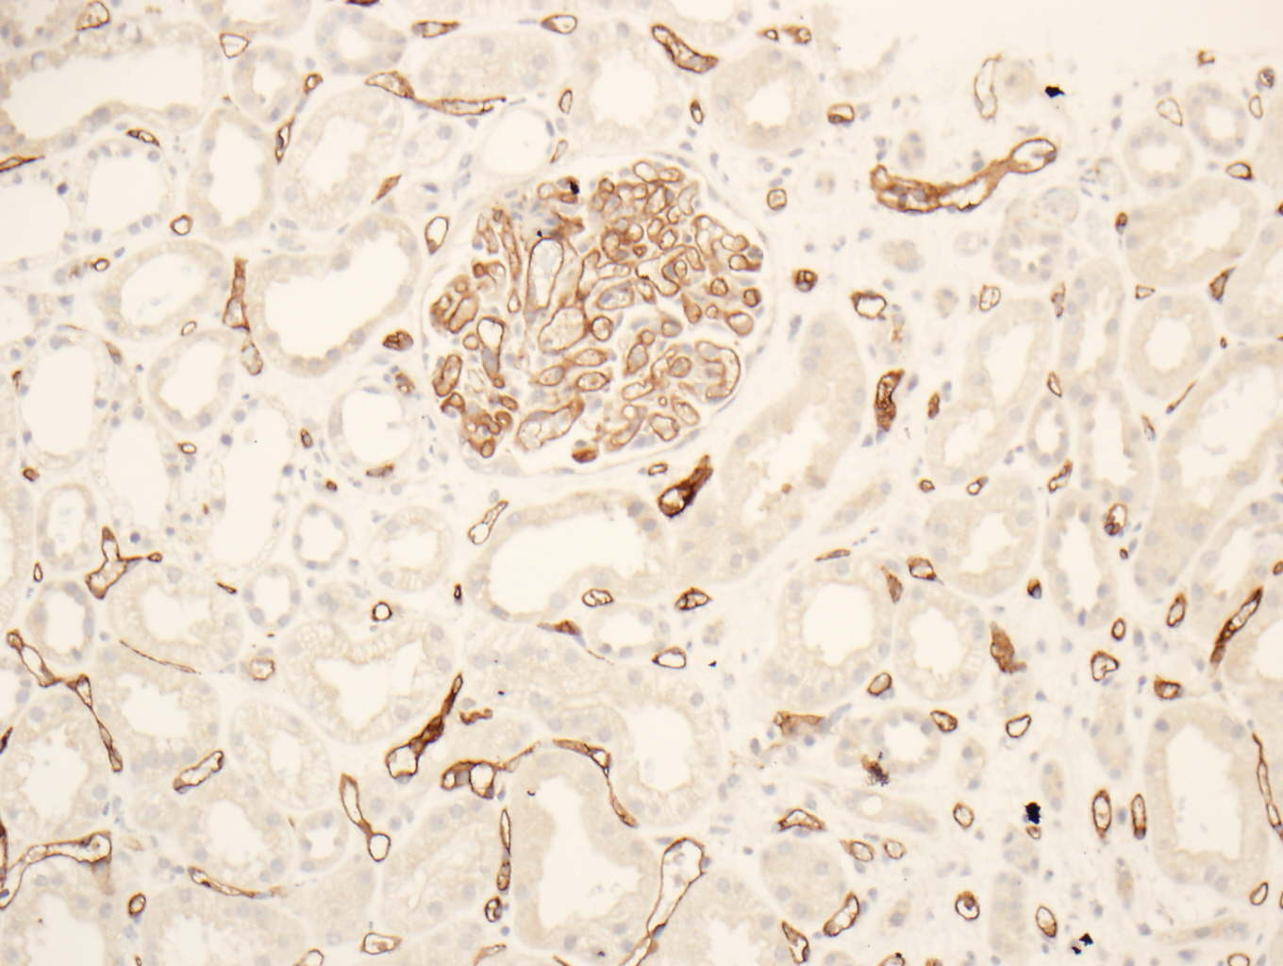

Slide 27
Frequency and Outcome by Acute Rejection Type
Mauiyyedi et al, J. Am. Soc. Nephrol, 13:779,2002
Type Frequency Graft loss
% Bx (n=67) by 1 yr
ACR 1* 48% 3%
ACR 2* 22% 7%
AMR 1 22% 27%
AMR 2 7% 40%
*C4d negative

Slide 28
What helps you keep the kidney
Rejection
Drugs [compliance]

Slide 29
Drugs used in transplantation
Historically have come from other departments!
Mechanism of action found subsequent to use
Balance of toxicity versus effectiveness
[Mostly] Immunosuppression predominantly deals with cellular rejection
The massive improvement in allograft survival is due to the prevention of this
The rates of allografts lost due to antibody mediated rejection has remained constant
Enhanced tissue typing has decreased the proportion of AMR

Slide 30
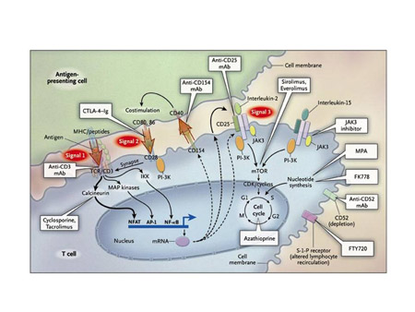

Slide 31
What makes a good drug?

Slide 32
May make a good drug…..?
Efficacious
Well tolerated
Easy to administer/ take
Low side effect profile
Non toxic
Easily available
Cheap

Slide 33
Drugs used in transplantation; Stopping cellular rejection
Calcineurin inhibitors
Entered routine clinical practise in 1980’s
Revolutionised transplantation.
Mainstay of most immunosuppressive protocols
Allograft survival at 1 year raised from 40% to 70-80%
Can be monitored using 12 hour trough levels
Metabolised by CYP3A isoform of Cytochrome P450 – lots of interactions
Nephrotoxic

Slide 34
Calcineurin inhibitors

Slide 35
Ciclosporin/ ciclosporin [CyA]
Binds to cyclophilin
Cyclophilin complex inhibits calcineurin phosphatase
Prevents IL-2 transcription and therefore T cell activation
Emulsion - poorly absorbed
- wide variation in levels
- Sandimmune
Microemulsion
- Neoral

Slide 36
Tacrolimus [FK506]
Mechanism of action very similar to Cyclosporin
More effective at preventing acute rejection
Binds to FK binding proteins, creating similar complex that inhibits IL-2 transcription
Preferable cardiovascular and side effect profile to CyA
Higher incidence of post transplant diabetes [insulin resistance]
Fujisawa/ astellas lost patent [Prograf]
Advagraf
Generics/ bioequivalents available

Slide 37
Antiproliferative Agents
Azathioprine
Derived from 6MP
Came into clinical use with steroids in 1960’s
‘Global’ action
Long term concerns about skin tumours

Slide 38
Azathioprine

Slide 39
Antiproliferative Agents
Mycophenolate Mofetil/ Myfortic
Prodrug of Mycophenolic Acid
Non-competitive and selective antagonist to inosine monophosphate dehydrogenase
Little effect on cell division in other eukaryotic cells as purines can be generated from other
nucleotide breakdown products
Lymphocytes lack this ‘salvage pathway”
MPA specifically inhibits lymphocyte proliferation – little effect on other tissues with high
proliferative activity [skin, bone marrow]
United Kingdom National Institute for Health and Clinical Excellence [NICE] guidelines do not
favour routine use of MMF

Slide 40
Mycophenolic Acid

Slide 41
mTor inhibition
Not nephrotoxic
Binds to FK binding protein
Inhibits cell cycling
May have anti-tumorigenic activity [in vitro]
Not the easiest drug to use
- infection
- rejection
- wound healing problems
- lymphoedema
Especially as a primary immunosuppressive agent [high rates of rejection]

Slide 42
Sirolimus; Evorlimus [mTor Inhibitors]

Slide 43
Induction agents

Slide 44
Daclizumab; Basiliximab [IL-2 receptor (CD25) inhibitors]

Slide 45
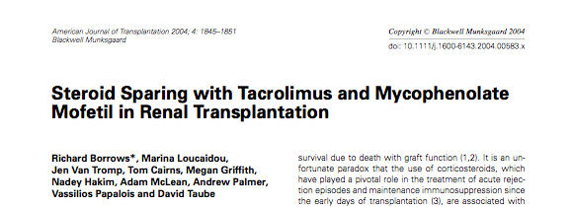
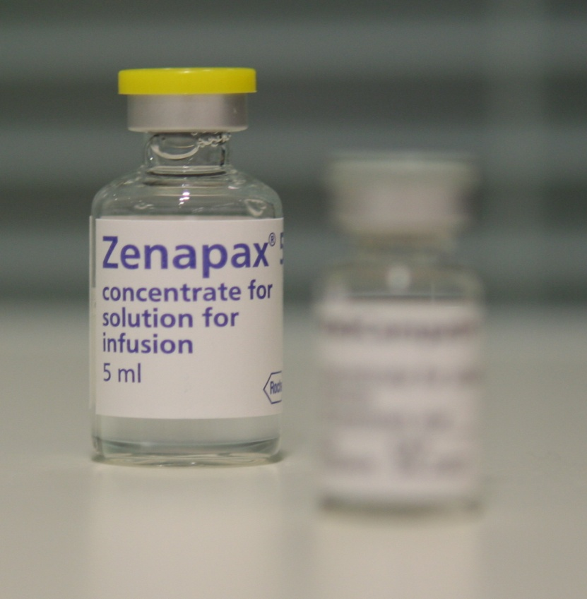
Activated T cells increase IL-2R [CD25] on cell surface
Daclizumab
Tacrolimus
Mycophenolate Mofetil
7 day steroid sparing regime
Notes:
Patients who received our historic immunosupression regime were used as a control. This group consist of patients transplanted from November 2002. These patients all received Daclizumab induction at 2mg/kg on day 0 and day 14. Tacrolimus at 0.15mg/kg/day and aim a higher maintenance level between 8-11 ng/L. This group of patient also received Mycophenolate mofetil for long term and 7 days of steroid.

Slide 46
Alemtuzumab [Campath 1H]

Slide 47
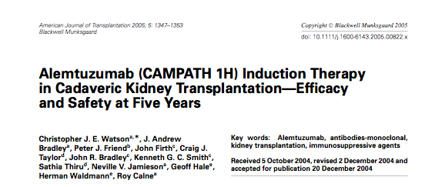
1] Campath 1H [Alemtuzumab] is a humanised rat IgM Mab
2] Directed against a cell surface glycoprotein, CD52 antigen.
3] Few mgs of Campath 1 H can deplete all lymphocytes in circulation within minutes
4] CD4 and CD8 counts remain depressed for years and may never return to normal
5] B cells, NK cells, monocytes, eosinophils reappear earlier and achieve normal levels
- monocytes within 60 – 90 days

Slide 48
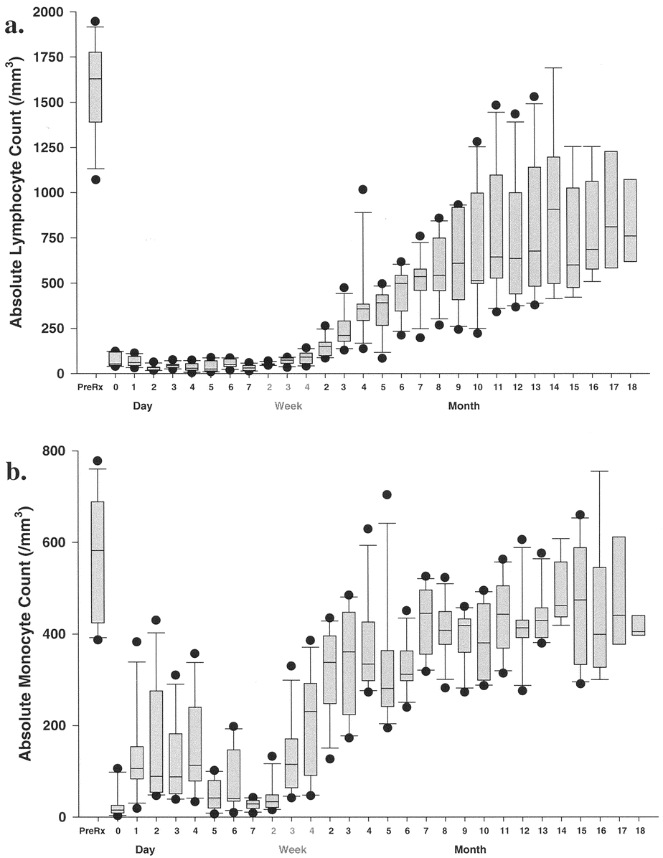
Effect of Campath 1 H on lymphocyte and monocyte counts
From Kirk et al
Transplantation 2003
Notes:
… as shown in this paper published by Kirk et al from NIH. Lymphocytes starts to recover from 2 weeks and return to normal level about 2-3 months.

Slide 49
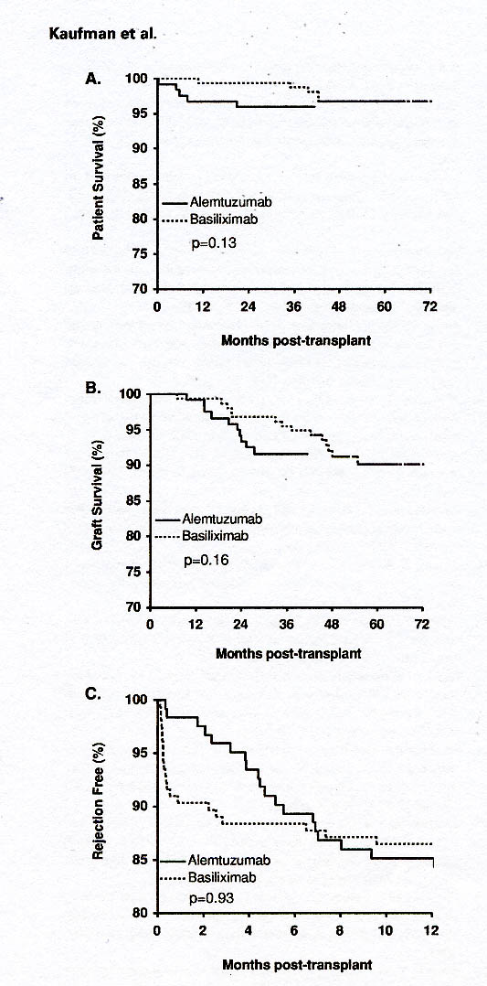
Campath 1H [Alemtuzmab]
1] Favourable experience from Cambridge with Campath and low dose cyclosporin.*
- no steroids
- no MMF
2] Campath is cheap
3] Subsequent studies with Campath and Tacrolimus in the US have shown excellent short term outcomes.**
* Watson CJE et al. Am J Trans. 2005
** Kaufman DB et al. Am J Trans 2005
Notes:
Why campath? Experience from the Cambridge group, with using Campath and low dose cicloporin and no steroid or MMF showed favourable results in medium term. Campath cost £330 per treatment and very effective. Subsequent studies with Campath and Tacrolimus in the US showed excellent outcomes as shown in this Kaplan Meier plot on [patient/allograft survival] when compare with Daclizumab.

Slide 50
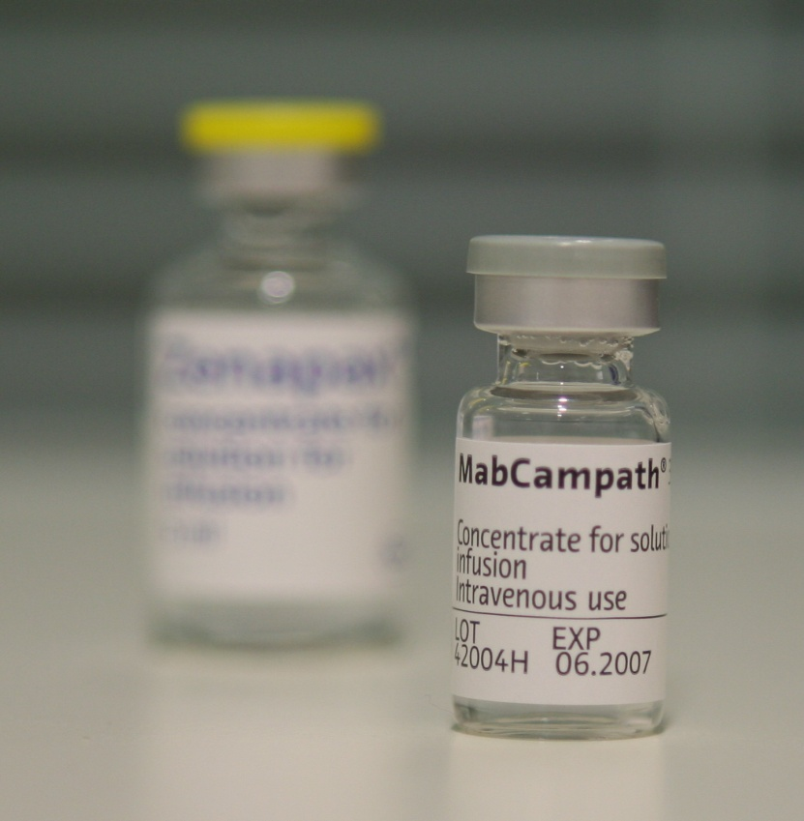
Alemtuzumab induction in West London
2004
Pilot study
-reduce Tacrolimus nephrotoxicity
comply with NICE guidelines [MMF]
reduce costs
steroid sparing
basis of a formal randomised controlled trial
Protocol
Alemtuzumab 30 mgs iv peri operatively
Tacrolimus [0.1mgs/kg/day] monotherapy
Steroid sparing [30mg bd Day 0-4; 30mg od Day 5-7 then stopped]
No MMF
Notes:
In the west London, we have started a pilot using Alemtuzumab induction and tacrolimus monotherapy in 2004. The aim of the pilot was to reduce tacrolimus nephrotoxicity, to comply with NICE guideline and avoid MMF, to reduce cost, spare the use of steroid and use the result to form the basis of a formal randomised control study. Patients received alemtuzumab 30mg iv perioperatively, a medium dose of tacrolimus at 0.1 mg/kg/day with no steroid or MMF

Slide 51
Allograft survival [censored for death with function]
Notes:
Graft sur cen for death with fn overall was over 97% at 1 year and no stat difference

Slide 52
Allograft function [MDRD egfr]
Notes:
This graphs shows allograft fn , as judged using MDRD estimated GFR, was consistently and persistantly better in the alem group and was only stat diffrence at 3 months time point.
are similar between the 2 groups up to 2 years,

Slide 53
Rejection free survival
Notes:
The risk of rejection was less in the alem group at 1 year but not stat different as analysed using the logrank method

Slide 54
Occurrence of Dsabs [Luminex assay]
Notes:
We have also screened for development of Dsab, and Dsab free survival are similar between the 2 groups

Slide 55
Drug costs [mean per patient, per year, using BNF prices]
 |  | 1st year | 2nd year
Alemtuzumab | Induction | £275 | £0
 | Tacrolimus | £3,082 | £3,200
 | MMF | £130 | £25.16
 | Total | £3,488.00 | £3,225
Daclizumab | Induction | £2,505 | £0
 | Tacrolimus | £3,723 | £3,110
 | MMF | £1,293 | £1,342
 | Total | £7,521.00 | £4,452
 | Saving | £4,033.00 | £1,226.84
Notes:
In terms of drug cost, alemtuzumab is significantly cheaper. It achieves a saving of 4000 pounds in the first year and 1300 in the 2nd year. To put this in a bigger picture, assuming a unit perform 120 tx a year. This translates to half million saving in the first year and nearly 150 thousand in the 2nd year

Slide 56
Treatment survival
Notes:
Treatment sur define as MMF and steroid free in the alem group and pred free in the daclizumab group. Tx sur higher in alem group predominately due to lower rejection rate
This KM plot showing treatment survival in the 2 groups. The cumulative survial in the Alemtuzumab group is 90% in the first year and 87.1 % in the 2nd year. While it 79.8% in the first year and 2nd year in the daclizumab group

Slide 57
Summary and conclusions of CamTac study
1] 2 year patient and allograft survival are similar in both groups.
2] Early allograft function is better in the Alemtuzumab group
3] Incidence and nature of rejection are similar in both groups
4] Surveillance biopsies [6 – 12 months] shows the Alemtuzumab group has higher proportion of biopsies with normal features, however not statistically significant
5] Incidence of infection is similar in both groups
6] Alemtuzumab regime is significantly cheaper

Slide 58
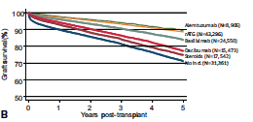
Depletion vs. non-depletion

Slide 59
Others and notable ommissions

Slide 60
JAK3 inhibitors [Tasocitinib]

Slide 61
Janus Kinase Inhibitors
Receptor tyrosine kinase pathway
Very effective immunosuppressive agents
High rates of BK [polyoma] viral nephropathy

Slide 62
Belatacept

Slide 63
Belatacept
CTLA-4 inhibition
Non-calcineurin/ minimal calcineurin based immunosuppression protocols
Increasing use on continent
FDA approval recently achieved
High rates of head and neck lymphoma, especially in EBV negative recipients

Slide 64
ATG
Anti-thymocyte globulin
Immunising horses or rabbits with human lymphoid cells
Harvest and purify [absorbing out toxic antibodies]
Produces profound and prolonged lymphopenia [depletion]
Commonly used in US
Concerns about infection and malignancy
Expensive compared with Campath [owned by the same company]

Slide 65
And finally…….Steroids
Agonists to glucocorticoid receptors at low dose.
Receptor independent at high dose – non-specific
Large side effect profile
Infection
Weight Gain
NODAT
Hypertension
Hyperlipidaemia
Osteopenia

Slide 66
New era of renal transplantation
Transplantation is good
Patient survival is good
Low incidence of rejection < 20% in 1st year post txp
Graft loss from acute rejection is now rare
Multiple immunosuppressive agents and combinations at our disposal
Health economics increasingly a part of medicine
Notes:
We are in a new era of renal transplantation. Incidence of rejection is significantly reduced with the modern immunosuppressants, incidence of rejection is less than 20% in first year post transplantation and graft lost due to rejection is now rare. Multiple immunosuppressive agents and combinations are available. With the improved immunosuppressant regime, steroid is no longer needed as maintenance. Our group showed excellent results with CD25 monoclonal antibody, MMF and Tacrolimus which I am going to share now.

Slide 67
Thank you

