Slide 1
Minor histocompatibility antigens
Professor Julian Dyson
Jan 2013

Slide 2
Minor Histocompatibility Antigens
-What are they?
-What do they do?
-Clinical significance & application.

Slide 3
Minor Histocompatibility Antigens
-What are they?
-What do they do?
-Clinical significance & application.

Slide 4
Definition
-Minor H antigens are responsible for robust, T cell mediated (CD4 and CD8 T cells are both required) graft rejection between MHC matched individuals.
-In human siblings who share identical HLA loci (1/4 siblings)
and
-Mouse strains which have identical H2 regions

Slide 5
Definition
-Minor H antigens are responsible for robust, T cell mediated (CD4 and CD8 T cells are both required) graft rejection between MHC matched individuals.
-In human siblings who share identical HLA loci (1/4 siblings)
and
-Mouse strains which have identical H2 regions

Slide 6
Definition
-Minor H antigens are responsible for robust, T cell mediated (CD4 and CD8 T cells are both required) graft rejection between MHC matched individuals.
-In human siblings who share identical HLA loci (1/4 siblings)
-Mouse strains which have identical H2 regions
?

Slide 7
Definition
-Minor H antigens are responsible for robust, T cell mediated (CD4 and CD8 T cells are both required) graft rejection between MHC matched individuals.
-In human siblings who share identical HLA loci (1/4 siblings)
-Mouse strains which have identical H2 regions
peptides

Slide 8
History
-Minor H antigens were originally defined in mouse strains carrying small congenic regions responsible for the rejection of a skin grafts
-These regions encode proteins encoding polymorphic self-peptides presented by donor MHC class I and II which stimulate recipient CD8 and CD4 T cells.
-Unlike HLA mismatched graft differing at major MHC loci, donor and recipient share the same MHC class I and II molecules. NOT recognition of non-self (allogeneic) MHC molecules as in HLA mis-matched allogeneic tissue grafts.

Slide 9
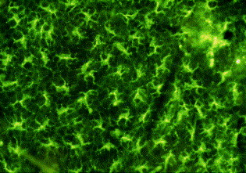
Skin grafts: most common site of tissue damage
Effective immune surveillance.
Skin graft resident DCs contribute to immunity
Removal of DCs from graft
weakens response
Langerhans cell network in skin
Fernandes E, Goold HD, Kissenpfennig A, Malissen B, Dyson J, Bennett CL.Transplantation. 201191:154

Slide 10
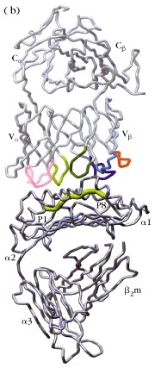
Why are minor H antigens immunogenic?
Individuals have some different peptides bound to MHC class I/II which are recognised by TCRs
Same process as for recognition foreign antigen eg virus

Slide 11
Why are minor H antigens immunogenic?
TCR repertoire tolerised
only to self-peptides
Allelic forms of self- peptides may be immunogenic just as a viral peptide is immunogenic

Slide 12
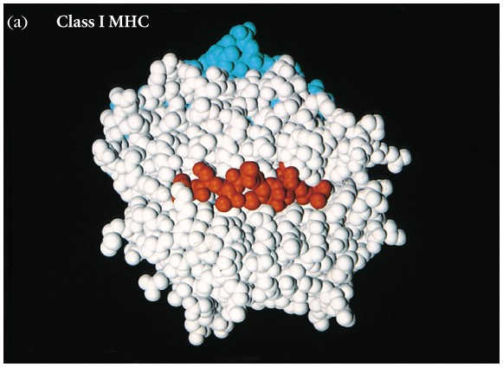
Peptide-binding cleft of
class I molecules
Self-peptide
8 – 10 amino acid residues, most commonly 9

Slide 13
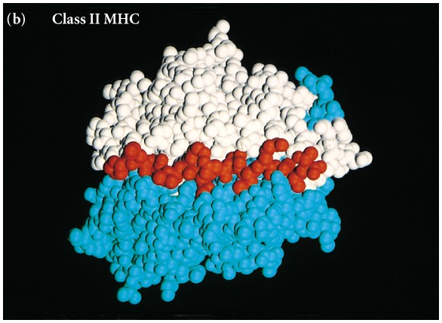
Peptide-binding cleft
of MHC class II molecules
Self-peptide
13 – 18 amino acid residues

Slide 14
Minor H Antigens
-Human. HLA shared by 1 in 4 siblings who inherit same HLA regions from parents.
(AB x CD) = AC, AD, BC, BD
Strong immunity to MHC matched sibling.
-Only identical twins will be matched for major and minor antigens.
-Peptides encoding minor antigens come from
potentially any gene product

Slide 15
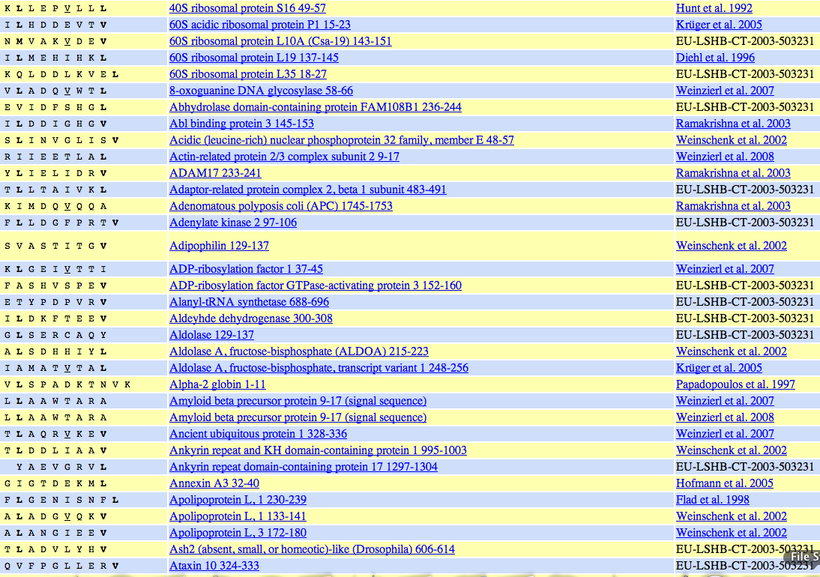
MHC class I/II occupied by
self-peptides
http://www.syfpeithi.de/ or Google SYFPEITHI

Slide 16
Genetic Map of Mouse Minor H Loci
1
2
3
4
5
6
7
8
9
10
11
12
13
14
15
16
17
18
19
X
Y
H22
Hya
H60
(Smcy, Uty)
H24
H39
H33
H51
H8
H2
H (Thy1)
H31
H (lpr)
H46
H55
H32
H54
H47
H30
H43
H21
H52
H (Os)
H50
H15
H27
H1
H29
H53
H3
H16
H7
H40
H (gld)
H25
H13
H37
H20
H (me)
H19
H35
H23
H57
H17
H18
H34
H38
H58
Unmapped H Loci:
H28
H59
H9, H10, H11, H12,
H26, H27, H36, H41
Hxa
H44
Mitochondrial Minor H Loci:
H49
CO1, ND1

Slide 17
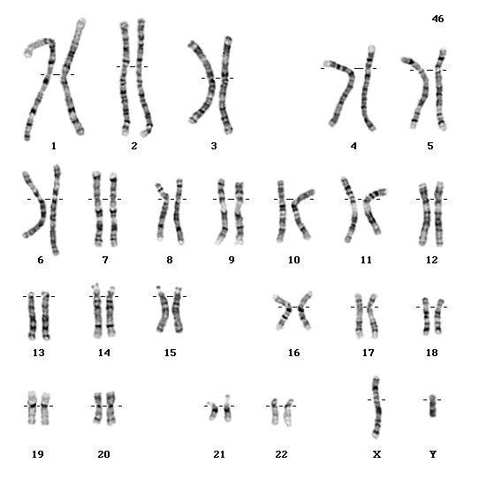
A Genome-level View of Human Histocompatibility Loci – Major and Minor
UGT2B17
SP110
HB-1
HLA
KIAA0020
(NKC)
MYO1G
C22orf18
USP9Y
UTY
DBY
TMSB4Y
RPS4Y
SMCY
BCL2A1
AKAP13
HA-1
MGC13170
(KIR)

Slide 18
How many minor H antigens?
C.C. Little, c.1916
A minimum of 14 “resistance” loci
G.D. Snell, c.1965
Genetically isolated 13 histocompatibility loci
D. Bailey and R. Graph c.1975 >26
Empirical evidence for ~61 H loci
Estimated in hundreds
Underestimated as only detect the dominant ones

Slide 19
How many minor H antigens?
Immunodominance: multiple factors
-Density of MHC/peptide on cell surface
-Expression of APCs
-Features of peptide – immunogenic
-Trigger optimal T cell expansion
-Competition between T cells for access to APC
-T cell repertoire has to recognise the peptide
-Affected by tolerance to allelic forms?

Slide 20
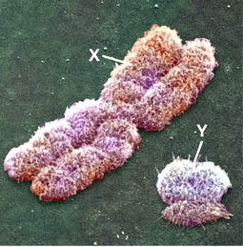
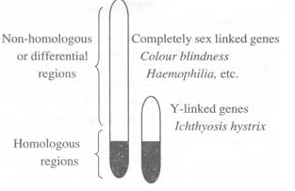
Y chromosome source of minor antigens due to genetic material not present in females
Females reject (MHC matched)
male grafts
Histocompatibility –Y (HY)

Slide 21
Minor Histocompatibility Antigens
-What are they?
-What do they do?
-Clinical significance & application?

Slide 22
Minor Histocompatibility Antigens
Useful models for basic research on T cell immunity:
-Immunodominance
-cross-priming

Slide 23
Rejection of syngeneic male skin grafts
Survival time of primary male grafts is 40-60 days
< 20 days for second graft (memory response)
(MHC mismatch, primary graft ~10 days)
Female graft
Primary male graft
Secondary male graft
Notes:
10

Slide 24
Tetramer and CFSE (7 day) analysis. Immunodominance
HY response
Uty >>
Smcy
1
1
male
naive
female
11
1
memory
(ip male -8
months)
62
0.8
boost
(ip male -8/-2
months)
CFSE
Male/female (iv)
tetramer

Slide 25
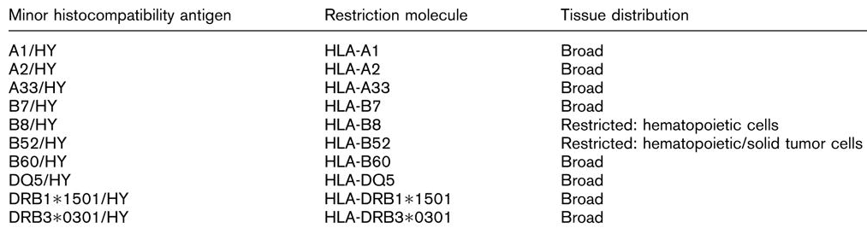
Y chromosome source of minor antigens due genes shared by X and Y quite divergent

Slide 26
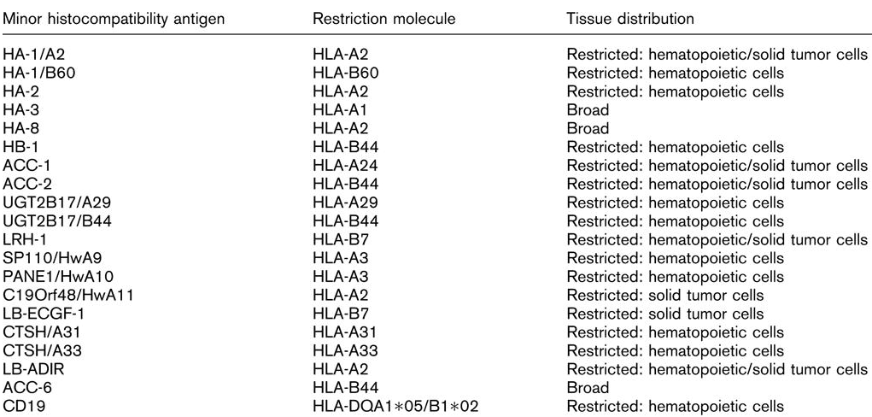
Autosomal minor H antigens

Slide 27
Polymorphism and minor H antigens
Most polymorphism is a result of Simple Sequence Polymorphisms (SNPs)
Many/most known minors are products of coding SNPs
Other forms of genetic variation/processing Y chromosome HY minor H antigen
Gene deletion or non-functional allele ie H60

Slide 28
H60 Becomes a Minor Because of a Genomic Deletion Including H60 Peptide-Encoding Exon 3
129 (H60+)
* - peptide location
1
2
*
6?
1
2
3
4
5
14kb
3
4
5
H60 pseudogene
Functional H60
32kb
B6 (H60-)
1
2
3
4
5
1
2
f
Line1 insertion
6?
H60 pseudogene
B6 ESTs

Slide 29
Defined Mouse Minor H Antigens
Amino Acid Change
  H13 S S V V/I G V W Y L
  H47 S C I L L Y I/F V I
  H3a A/T S P C/R N S T V L
  H4 P/S G I/T R Y I H L
  H7 K A P D N R E/D T L
  HY-Uty W M H H N/T M/V D L I/L
  H46 H A/M F V E A I H A F V E A I P E L Q G H V
Peptide Presence / Absence
  H60 L T F N Y R N L
  H28 I L E N F P R L

Slide 30
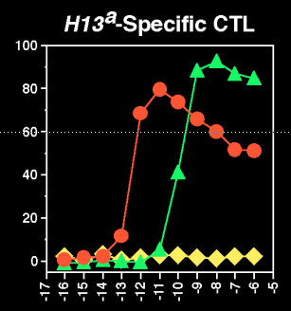
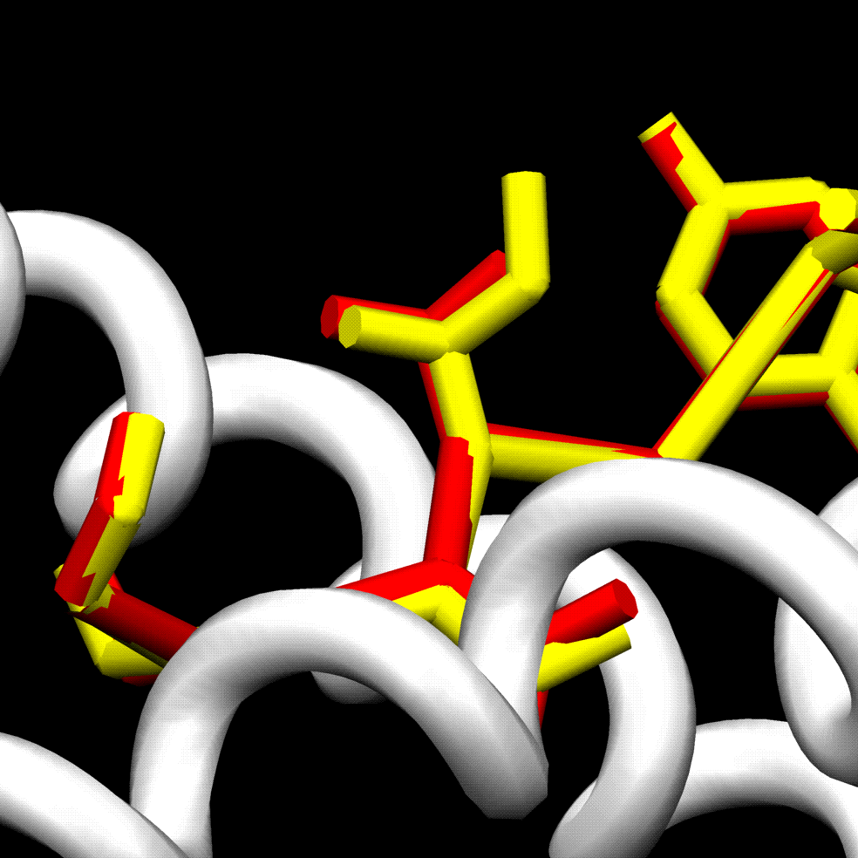

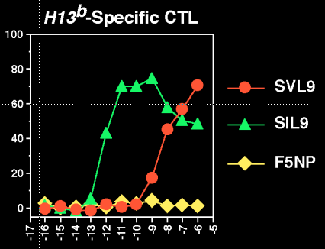
H13 Antigens-the Cusp of Self-Non-Self Discrimination
(V)
α1
P4
(I)
α2
Ostrov DA et al. (2002) J Immunol. 2002 168: 283-9.
Peptide conc

Slide 31
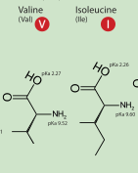
H13 Antigens-the Cusp of Self-Non-Self Discrimination
(V)
(I)
Ostrov DA et al. (2002) J Immunol. 2002 168: 283-9.
Peptide conc

Slide 32
H13 Antigens-the Cusp of Self-Non-Self Discrimination
(V)
α1
P4
(I)
α2
Ostrov DA et al. (2002) J Immunol. 2002 168: 283-9.
Peptide conc

Slide 33
Selecting useful T cells: lessons from the HY response
Identification of minor antigens
Candidate genes: ie Y chromosome genes
-Peptide elution and sequencing
-cDNA library approach
-Localisation by SNP typing is simple fast
Identification of minor H antigens

Slide 34
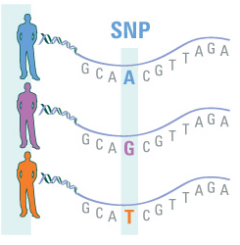
Selecting useful T cells: lessons from the HY response
Identification of minor antigens
SNPs
Identification of minor H antigens

Slide 35
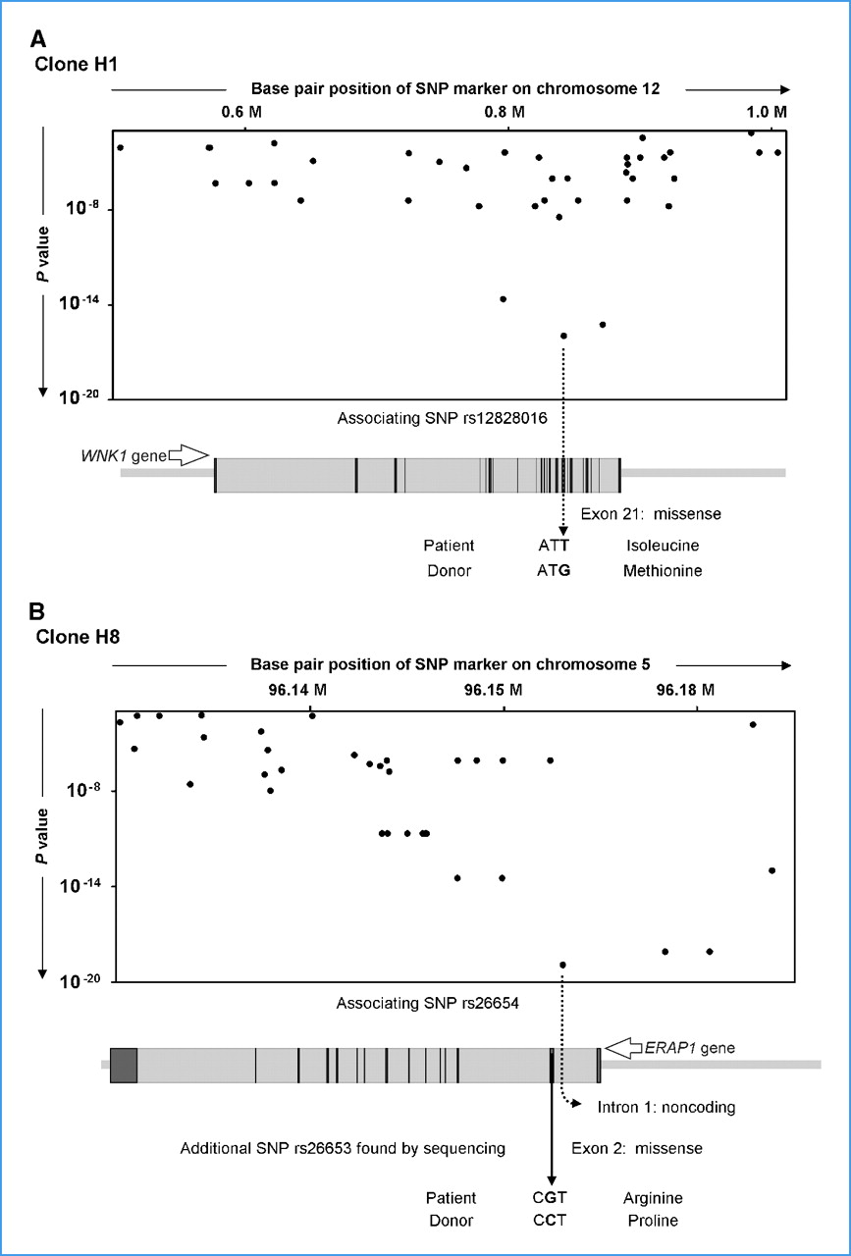

Identification of candidate genes and MiHA-encoding SNPs by WGAs.
Correlation between expression of
minor H antigen (+/-) and whole
genome SNP typing
©2010 by American Association for Cancer Research
Van Bergen C A et al. Cancer Res 2010;70:9073-9083
Notes:
Identification of candidate genes and MiHA-encoding SNPs by WGAs. Association results and selection of candidate MiHA-encoding SNPs are shown for WNK1 (A) and ERAP1 (B) genes as representative examples. Significance of association for each individual array SNP as expressed by P value is depicted. Each dot represents the array SNP relative to its physical position on the genome. The image below each plot shows the gene aligned to the chromosomal position as indicated on the X axis of the plot. Exons and introns are represented by dark and light boxes, respectively. A, for clone H1, the strongest associating SNP is located in exon 21 of the WNK1 gene and encodes an amino acid polymorphism. B, the strongest associating SNP for clone H8 is located in intron 1 of the ERAP1 gene. Sequence analysis revealed a disparate missense SNP in exon 2 of the ERAP1 gene.

Slide 36
Minor Histocompatibility Antigens
-What are they?
-What do they do?
-Clinical significance & application?

Slide 37
Minor H Antigens
-Human. HLA shared by 1 in 4 siblings who inherit same HLA regions from parents.
(AB x CD) = AC, AD, BC, BD
Strong immunity to MHC matched sibling.
-Only identical twins will be matched for major and minor antigens.
-Peptides encoding minor antigens come from
potentially any gene product

Slide 38
Immune response network after allogeneic BM transplantation
for treatment of leukaemia in MHC matched setting
are to minor antigens
DONOR
HvG =
graft rejection
GvH = GvHD
RECIPIENT

Slide 39
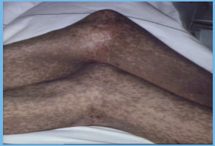
GvHD high mortality
Controlled by immunosuppression
graft versus host disease
Consequence of lack of tolerance to recipient by T cells within donor bone marrow.
Target tissues: skin, GI tract, liver

Slide 40
Immune response network after allogeneic BM transplantation
for treatment of leukaemia in MHC matched setting
are to minor antigens
DONOR
HvG =
graft rejection
GvH = GvHD
GvL
RECIPIENT
Boost GvL
response

Slide 41
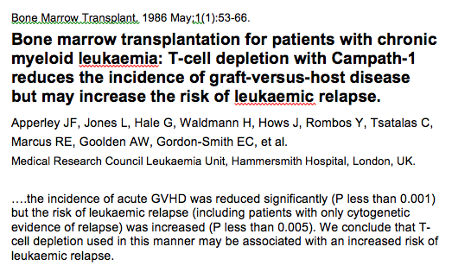
Removing T cells limits anti-leukaemia effect

Slide 42
BM transplant protocols include donor
lymphocyte transfer to boost GvL effect

Slide 43
Immune response network after allogeneic BM transplantation
for treatment of leukaemia in MHC matched setting
are to minor antigens
DONOR
HvG =
graft rejection
GvH = GvHD
GvL
RECIPIENT
Boost GvL
response

Slide 44
Autosomal minor H antigens

Slide 45
Haematopoietic specific minor H antigens:
Promote GvL over GvH

Slide 46
Boosting GvL effect: vaccination?

Slide 47
Boosting GvL effect: TCR gene therapy to target leukaemic cells?

Slide 48



Recent reviews

