Slide 1
BSc in Immunity & Infection
Professor Julian Walters
Gastroenterologist
Hammersmith Hospital
Pathogenesis of gluten sensitive enteropathy
Monday 14 January 2013

Slide 2
Mr. P.M. – CLINICAL COURSE
Presented with mild anaemia
  Family history
Coeliac disease diagnosed
  Typical histology
  Positive antibodies
Started Gluten-free Diet:
  No wheat, barley or rye products
  Prescription of gluten-free products
Response
  Gained 5kg in weight
  Normal Hb & Fe
  Bowels “constipated” every 1-2 days

Slide 3
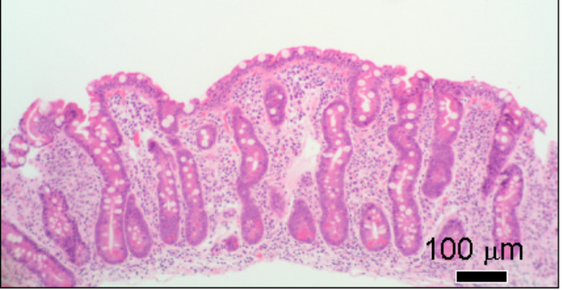
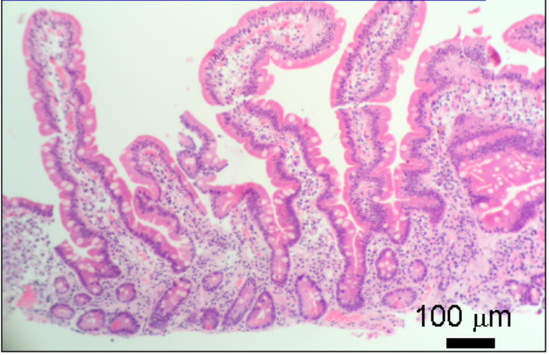
DUODENAL HISTOLOGY
Subtotal villous atrophy with crypt hyperplasia
Normal mucosa

Slide 4
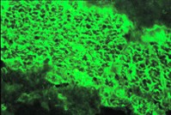
ANTIBODIES IN COELIAC DISEASE
IgA class
Endomysial antibodies
  Detected by indirect immunofluorescence
Tissue transglutaminase (tTG)
  Autoantigen recognized by endomysial antibodies
  tTG cross-links glutamine residues
  Produces neo-antigens from gliadin
  Measured by ELISA
High specificity (>95%) & sensitivity in diagnosis
Useful in monitoring response to treatment

Slide 5
COELIAC DISEASE =
GLUTEN SENSITIVE ENTEROPATHY
GLUTEN
  Fraction of cereals that binds (glues)
  Proteins found in wheat, barley, rye
  A-gliadin (wheat), hordein (barley), secalin (rye)
  Specific polypeptides rich in P and Q
        Shan et al Science 2002
  LQLQPFPQPQLPYPQPQLPYPQPQLPYPQPQPF
  33-mer, residues 57 – 89 of α2-gliadin
  stable in gastric, pancreatic & intestinal proteases
  Q reacts with tTG; deamidated to E
  stimulates HLA- restricted intestinal T cell clones from coeliacs

Slide 6
COELIAC DISEASE =
GLUTEN SENSITIVE ENTEROPATHY
SENSITIVE
  Immunological reaction
    tissue transglutaminases and neo-antigen formation
    activated HLA-restricted T-lymphocytes
  Genetic predisposition to immune response ...

Slide 7
COELIAC DISEASE =
GLUTEN SENSITIVE ENTEROPATHY
ENTEROPATHY
  Inflammatory damage
  Cell death (apoptosis)
  Histological changes
    Enterocyte apoptosis (villous atrophy)
    Stimulated regeneration (hyperplastic crypts)
  Functional changes leading to malabsorption of nutrients

Slide 8
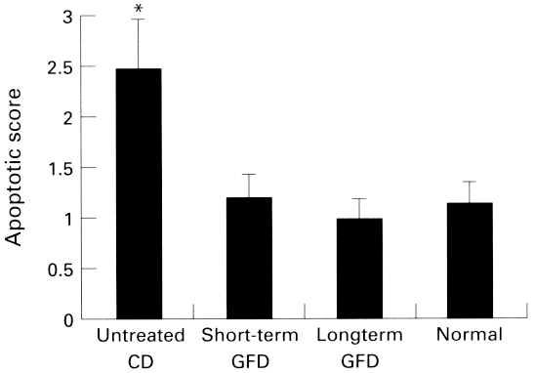
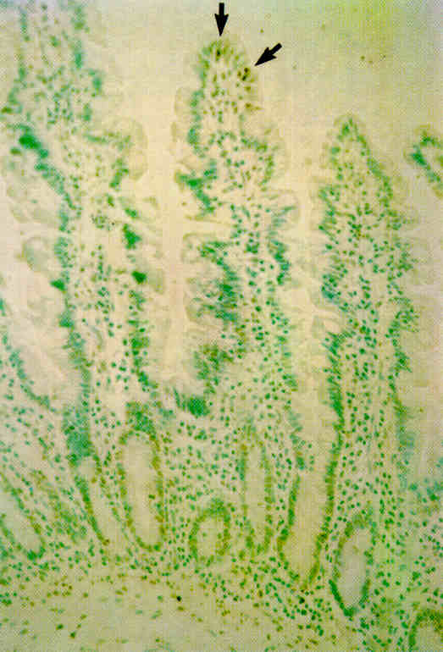
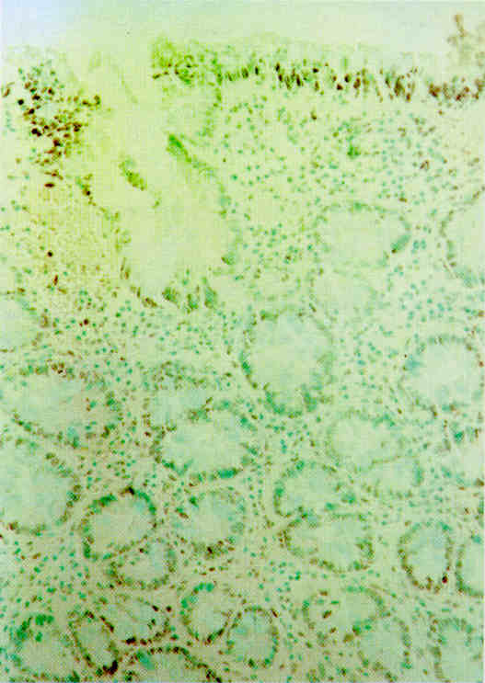
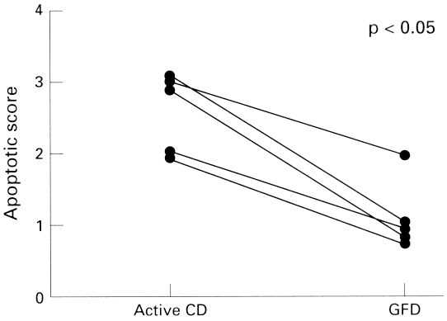
COELIAC DISEASE AND APOPTOSIS
        Moss et al Gut 1996
Normal Coeliac

Slide 9
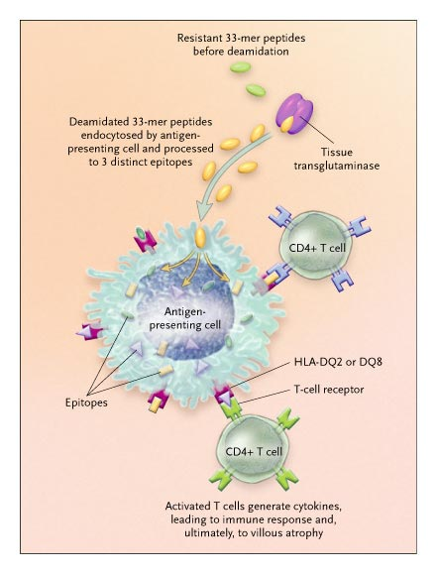

Slide 10
Coeliac references
Sollid LM. Coeliac disease: dissecting a complex inflammatory disorder. Nature Reviews Immunology 2002; 2: 647-655
McManus R, Kelleher D. Celiac disease--the villain unmasked? N Engl J Med. 2003; 348:2573-4. Comment on: N Engl J Med 2003; 348:2517-24.
Green PH, Cellier C. Celiac disease. N Engl J Med. 2007; 357:1731-43.

Slide 11
EVIDENCE FOR A GENETIC PREDISPOSITION
Population prevalence
Family studies
Twin studies

Slide 12
The Coeliac Iceberg
Complicated
Clinically active
Subclinical
Latent / potential
Lymphoma
Nutritional deficiencies
DH
Villous atrophy
Subtle histology
IEL
Antibodies

Slide 13
COELIAC DISEASE:
Evidence for Silent Disease
Family studies
    One in ten of first-degree relatives
Dermatitis Herpetiformis
    >30% have no GI symptoms
Population screening
    Patients with associated disorders
    Asymptomatic
Prevalence of undiagnosed cases is up to 10x that of those previously diagnosed

Slide 14
Coeliac Disease – UK Population Studies
Case finding in GP practices
    30/3000 3%
    (Oxfordshire, Hin et al, 1999)
    12/1200 1%
    (Yorkshire,Sanders et al, 2003)
Cambridge GP health study
    87/7550 1.2%
    (East Anglia, West et al, 2003)
Avon Longitudinal Study of Parents & Children
    54/5470 1.0%
    (7-8 year olds, Bingley et al, 2003)

Slide 15
Coeliac Disease: Screening Populations
        West et al., Gut 2003
Cambridge GP Health Study:
  12 practices 1990-1995
  7550 subjects aged 45-76
87 EMA IgA positive, 77 also TTG abnormal. No biopsy
  Sero-prevalence = 1.2%
  Positive subjects
    Lighter, good/excellent health, less likely to smoke (OR=0.36)
    Lower cholesterol, Hb, corrected Ca
    Increased risk of osteoporosis (OR=3.1) & mild anaemia (OR=4.6)

Slide 16
Coeliac Disease: Screening Children
Undiagnosed coeliac disease at age seven: population based prospective birth cohort study
        Bingley et al., BMJ 2004
Avon Longitudinal Study of Parents and Children
  Children gave blood at age 7.5; 5470 tested
Serology
  54 positive for IgA-EMA
Sero-Prevalence = 1% (95% CI 0.8-1.4%)
    More common in girls (OR 2.12)
    Shorter and weighed less (p<0.0001)
    50% with diarrhoea (OR 1.96)
Comparable prevalence to that found in adults

Slide 17
COELIAC DISEASE: SCREENING POPULATIONS
In general population, prevalence may be ~1%
Groups with prevalence between 1 and 5%:
Diabetes (T1)
Thyroid disease
Addison’s disease
Anaemic blood donors
Irritable Bowel Syndrome
Osteoporosis
Turner’s syndrome
Down’s syndrome

Slide 18
Coeliac Family Studies
Studies of the familial nature of celiac sprue using biopsy of the small intestine.
  Risk in first-degree relatives of ~10%
        MacDonald et al., NEJM 1965
10 further systematic studies
  Risk in first degree relatives ranges from 4-20%
Overall risk to siblings is ~10%

Slide 19
Twin Studies:- Concordant MZ Twins
MZ twins genetically identical
Concordance rate reflects genetic contribution
MZ twins 1st reported in 1923
Idiosyncratic reporting of MZ twins
Only 1 systematic study
MZ concordance ~80%

Slide 20
Evidence for a Genetic Predisposition
Population prevalence 1%
Family studies 10%
Twin studies (MZ) > 80%

Slide 21
COELIAC DISEASE: HLA
HLA associations:
Class I
  HLA - A1
  HLA - B8
Class II
  HLA - DR3
    65 – 95% of N. European patients
    HLA – DR5 / DR7 in Mediterranean patients
  HLA - DQ2
    ~ 90% of N. Europeans

Slide 22
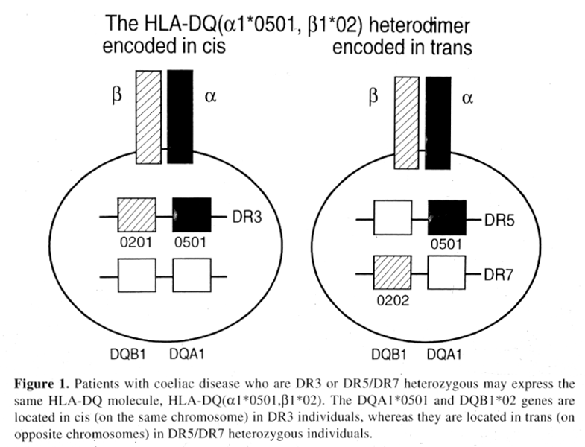
HLA-DQ2

Slide 23
COELIAC DISEASE: HLA
Most coeliacs have DQ2 (DQA1* 05, DQB1*02) in cis or trans
~ 5% are DR4 – DQ8 (DQA1*0301, DQB1*0302)

Slide 24
HLA-DQ in Coeliac Disease
Karell et al., Hum Immunol 2003

Slide 25
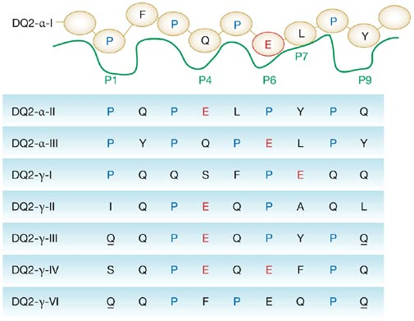

Figure 2 Schematic depiction of the HLA-DQ2 peptide binding site accommodating the deamidated DQ2-α-I epitope
Permission obtained from the American Gastroenterological Association
© Howard L and Ashley C (2003) Gastroenterology 124: 1651–1661.
Jabri B and Sollid LM (2006) Mechanisms of Disease: immunopathogenesis of celiac disease
Nat Clin Pract Gastroenterol Hepatol 3: 516–525 doi:10.1038/ncpgasthep0582

Slide 26
COELIAC DISEASE:
EVIDENCE FOR NON-HLA GENES
HLA - DQ2.5 serology
  DQA1* 05, DQB1*02 alleles
  90% of Northern European coeliac patients
  20% non-coeliac controls
In HLA-matched sibs
  Concordance for coeliac disease ~ 30%
Everyone eats gluten!
  Other gene(s) must contribute to the inheritability ...

Slide 27
STRATEGIES TO MAP NON-HLA GENES
Genome Wide Linkage Studies
Candidate Gene Analyses
Genome Wide Association Studies

Slide 28
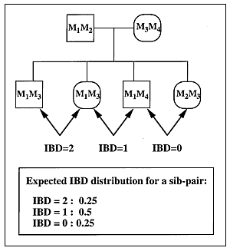
Genome-Wide Linkage Studies:
Principles of Sib-pair Analysis
Sharing by sibs of markers throughout entire genome
Markers in LD with causative genes more frequently shared

Slide 29
COELIAC DISEASE:
GENOME WIDE LINKAGE STUDIES
At least 13 studies:
  Variable findings in different populations
  Often not confirmed
HLA implicated in most studies CELIAC 1
Non-HLA regions with significant linkage in some cohorts:
  2q33 (CD28-CTLA-ICOS region) CELIAC 3
  4p15
  5q31-33 (cytokine cluster) CELIAC 2
  6p23 (distinct from HLA)
  9p21-p13
  11p11
  15q12
  19p13.1 (Myosin 9B) CELIAC 4

Slide 30
COELIAC DISEASE: ASSOCIATION STUDIES
CLASSES OF CANDIDATE NON-HLA GENES
Antigen processing genes
  TGM2 (tissue transglutaminase)
  DPPIV (dipeptidyl peptidase IV)
Antigen recognition genes:
  TCR, HLA genes, co-activation molecule genes
Immune response genes:
  Cytokines, IL12β etc

Slide 31
Regulation of T cell activation
Antigen presenting cell
HLA
Antigen presenting cell
CTLA4 /CD28 binding regulates T-cell activation
(A/G) Polymorphism in CTLA4 exon 1 +49 associated with:
  IDDM (G)
  Graves’(G)
CD80
CD4
Peptide
T cell
T cell receptor
T cell
CTLA4
CD3
CD28
Activated T cell
T-cell
anergy

Slide 32
COELIAC DISEASE:
CHROMOSOME 2q33 STUDIES
Definite linkage across the entire region
Association between marker alleles centromeric to CTLA4 and Coeliac Disease
Other autoimmune diseases associated with this region
Common haplotypes identified in CD
Alleles at 2q33 might predispose to CD, but unlikely that the CTLA4 (+49A/G) polymorphism is implicated
        Hunt, et al., Eur. J. Hum. Genet. 2005

Slide 33
COELIAC DISEASE AND CHROMOSOME 6:
NON-HLA LOCI WITHIN MHC
Strong linkage disequilibrium
  Extended haplotypes (B8/DR3/DQ2)
Most association is due to HLA-DQ2
Studies of TNF, TAP1, TAP2
MICA 5.1 allele
  Spanish and Saharwi cohorts
  Genotype frequency:
    Atypical 91%, Typical 53%, Controls 44%
    OR 8.6 (atypical vs. typical)
    Independent of LD
  ? Involved with NK/CD8+ Tγδ cell binding
        Lopez-Vazquez et al. Gut 2002

Slide 34
COELIAC DISEASE: CHROMOSOME 19p13.1
19p13.1 identified in GWLS in Netherlands population and other pooled European cohort
  Strongest association with SNPs in Myosin 9B
  Homozygous individuals have 2.3x higher risk of CD
  Myosin 9B may have role in actin remodelling
        Monsuur et al., Nat Genetics 2005
Association not confirmed in UK or Italian cohorts
        Van Heel et al., Gut 2006

Slide 35
COELIAC DISEASE
Candidate genes: Summary
HLA class II (DQ2.5)
  Strongly suggestive, much evidence
2q33 (CD28-CTL4-ICOS)
  Suggestive, good evidence
MICA (non-HLA, Chr. 6 region)
  Evidence in some populations)
19p13.1 (Myosin 9B)
  Unclear, some evidence

Slide 36
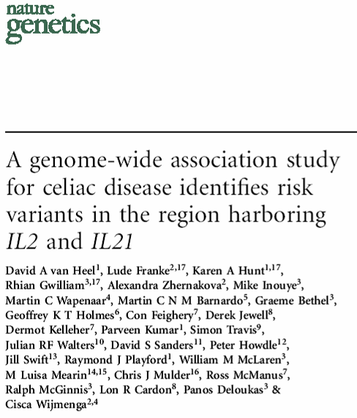
July 2007
Coeliac UK Funded
Multiple UK sites
778 UK coeliacs
1,422 UK population controls

Slide 37
COELIAC DISEASE:
GENOME WIDE ASSOCIATION STUDY
        Nature Genetics 39, 827 - 829 (2007)
Illumina BeadChips
310,605 SNPs (with minor allele frequency >1%)
Overall SNP call rate 99.87%

Slide 38
COELIAC DISEASE:
GENOME WIDE ASSOCIATION STUDY
Association with previously reported genes:
HLA-DQ2.5cis
  inferred by rs2187668 genotype
  89.2% of UK coeliacs vs 25.5% controls
  Chi² = 769.1, P < 10⁻¹⁹
CD28-CTLA4-ICOS region
  rs4675374, P = 0.007
  rs11681040, P = 0.008
No association with MYO9B region

Slide 39
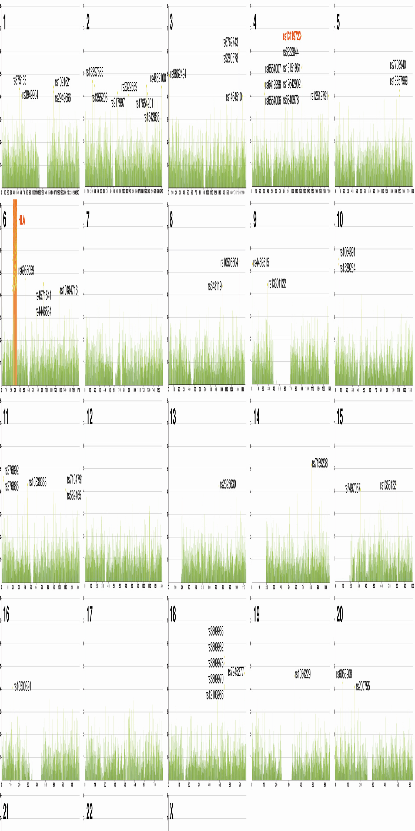

Coeliac Disease: Summary of Genome Wide Association Study p Values

Slide 40
CHROMOSOME 4q27
rs13119723
  P = 2.0 x 10⁻⁷
  Frequency of minor G allele (cases : controls)
  UK 10.1%: 15.8%
  Dutch 11.5% : 16.4%; Irish 12.8% : 16.2%
  Combined OR 0.65; p = 4.8 x 10⁻¹¹
rs 6822844
  Strongest association overall in combined cohorts
  OR 0.63; P = 1.3 x 10⁻¹⁴
  24kb 5’ of IL21

Slide 41
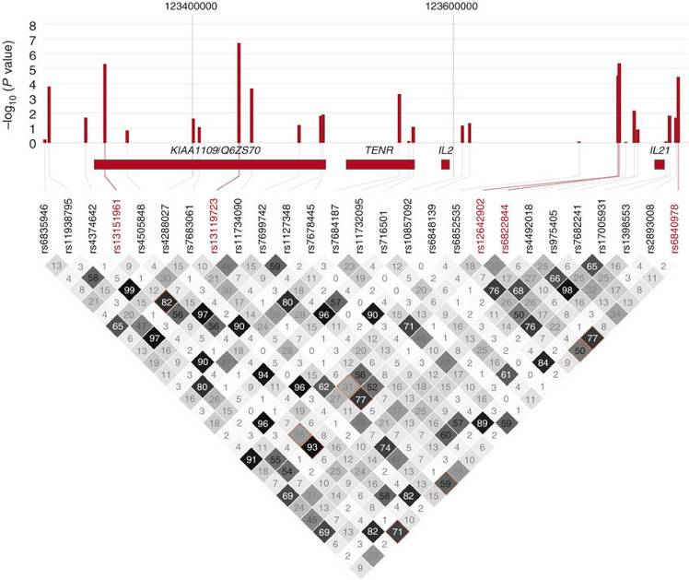
Chromosome 4q27: Linkage Disequilibrium

Slide 42
CHROMOSOME 4q27: GENES
IL21
  Enhances B,T, NK cell proliferation & Interferon-γ production
  Implicated in intestinal inflammation
  Greatly increased expression in untreated Coeliac disease
IL2
  Key cytokine for T-cell activation and proliferation
  Modest reduction in untreated Coeliac disease
  Syntenic region in mouse (Idd3) determines susceptibility to autoimmune diseases in the NOD mouse by influencing IL2 mRNA / protein levels & CD4+ CD25+ regulatory T cell activity
KIAA1109
  Unknown function
  Modest reduction in untreated Coeliac disease
TENR / ADAD1
  Expressed in testes

Slide 43
COELIAC DISEASE GWAS 1
HLA-DQ
Allelic odds ratio = 6.8
IL2/IL21 region
Allelic odds ratio = 1.6

Slide 44
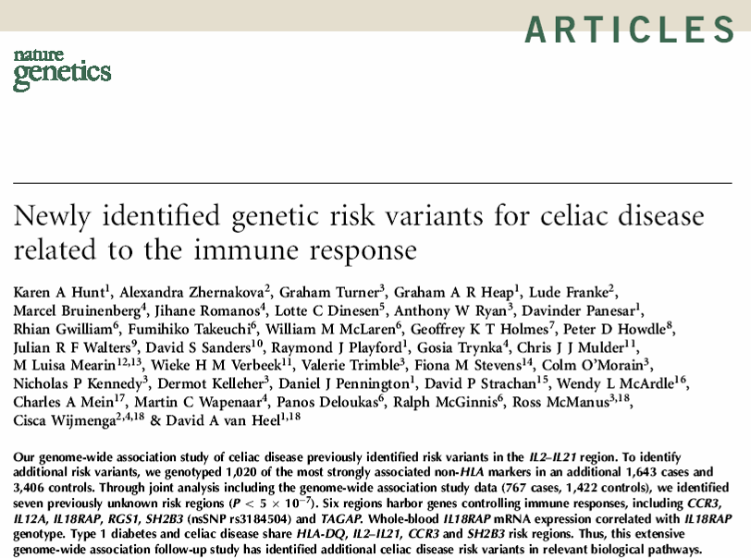
March 2008

Slide 45
Follow-up of Coeliac GWAS Findings
Top 1020 non-HLA SNPs from GWAS (p < 0.00275)
Additional UK2 + Irish + Dutch patients:
1643 cases, 3406 controls
+ GWAS: 767 cases, 1422 controls
totalling 2410 cases, 4828 controls
7 further regions identified
p overall < 5x10⁻⁷ = ‘genome wide significance’

Slide 46
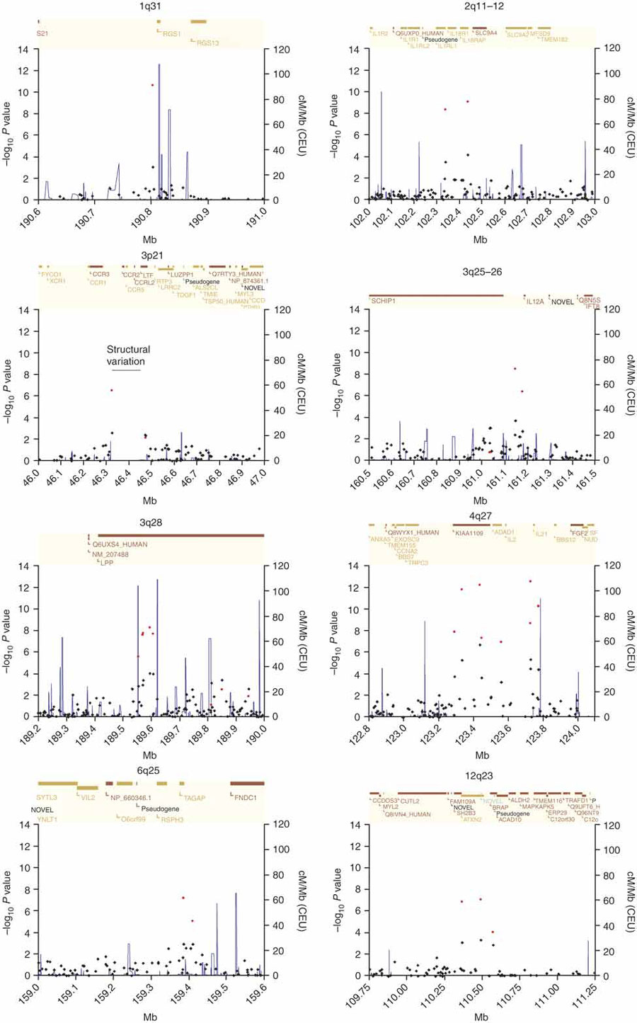
Eight non-HLA Coeliac Disease Associated Regions

Slide 47
Non-HLA Coeliac Disease Associated Regions (1)
4q27 (OR 0.73)
  KIAA1109-ADAD1-IL2-IL21
  Also identified in T1DM, Grave’s disease & Rh. Arthritis
1q31 (OR 0.71)
  RGS1 (regulator of G-protein signalling 1)
  Regulates chemokine receptor signalling
  Involved in B-cell activation
  Strongly expressed in intestinal intra-epithelial lymphocytes

Slide 48
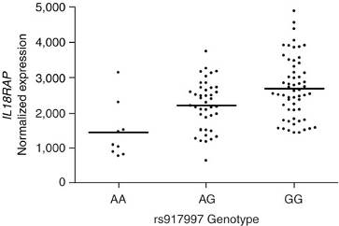
Non-HLA Coeliac Disease Associated Regions (2)
2q11-2q12 (OR 1.27)
  IL18RAP & IL18R1
  IL18 induces T-cells to synthesize Interferon-γ
  IL18 expressed in intestinal mucosa of coeliacs but not healthy controls
    IL18RAP mRNA Expression
    in Blood from Treated Coeliacs

Slide 49
Non-HLA Coeliac Disease Associated Regions (3)
3p21 (OR 1.21)
  Cluster of chemokine receptor genes
  CCR1, CCR2, CCRL2, CCR3, CCR5, XCR1
  Associated with T1DM
3q25-3q26 (OR 1.34)
  IL12A – encodes IL12p35
  Induces Interferon-γ secreting Th1 cells
3q28 (OR 0.82)
  LPP
  Highly expressed in small intestine
  ? Involved in cell shape & motility

Slide 50
Non-HLA Coeliac Disease Associated Regions (4)
6q25 (OR 1.21)
  TAGAP (T-cell activation GTPase activating protein)
  Expressed in activated T-cells
12q24 (OR 1.19)
  SH2B3 (also known as LNK) & ATXN2
  Strong association with T1DM
  Expressed in monocytes & dendritic cells
  Found in small intestine, especially inflamed coeliac tissue

Slide 51
Summary of Variant Genes in Coeliac Disease
DA van Heel 2008

Slide 52
Summary of Coeliac Genetic Studies
HLA-DQ
IL2-IL21
7 more risk variants/regions
Genes from 8 regions involved in immune response
4 of 9 regions overlap with type 1 diabetes

Slide 53
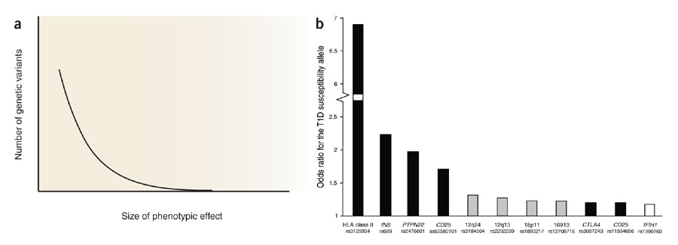
Comparison with findings in Type 1 Diabetes mellitus
(Figure from Todd, J.A. et al., Nat. Genet. 39, 857–864, 2007.)

Slide 54
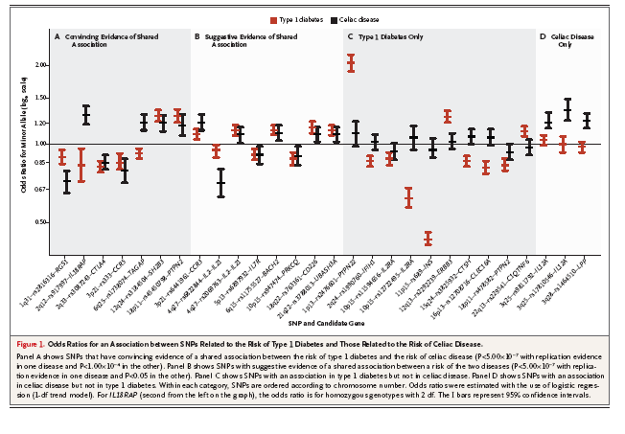
Shared and Distinct Genetic Variants in Type 1 Diabetes and Celiac Disease
        Smyth et al NEJM 2008

Slide 55
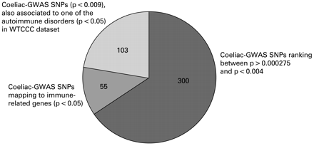
GWAS follow-up
        Trynka et al Gut 2009

Slide 56
GWAS follow-up
        Trynka et al Gut 2009
458 SNPs were assayed in 1682 cases and 3258 controls from three populations (UK, Irish and Dutch).
Results combined with the original GWAS cohort (767 UK cases and 1422 controls);
6 SNPs showed association with p<1 x 10(-04) and were then genotyped in an independent Italian coeliac cohort (538 cases and 593 controls).
2 novel coeliac disease risk regions identified:
  6q23.3 (OLIG3-TNFAIP3)
  2p16.1 (REL)
  genome-wide significance in the combined analysis (2987 cases and 5273 controls) p = 1.3 x 10(-08) & 5.2 x 10(-07)
  Both involved in NFkB pathway

Slide 57
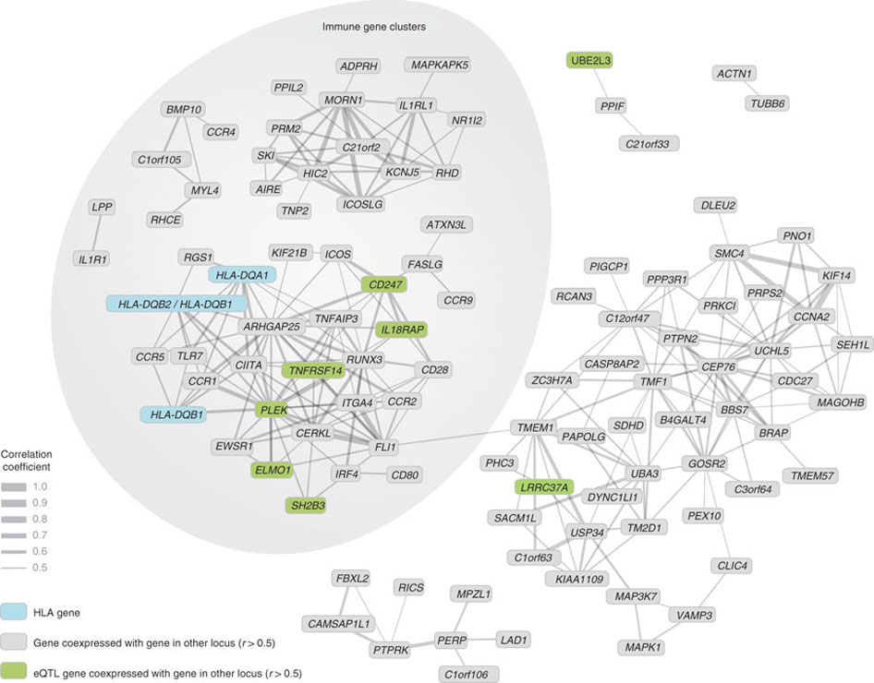
Second Generation GWAS results
Dubois et al. Nat Gen 2010; 42: 295
GWAS in 4,533 celiacs & 10,750 controls; + 4,918 celiacs & 5,684 controls for 113 selected SNPs
Coexpression analysis of genes mapping to 40 genome-wide significant and suggestive celiac disease regions in 33,109 heterogenous human samples from the Gene Expression Omnibus.

Slide 58
Coeliac Genetics - questions
Are there more coeliac genetic risk factors ?
  HLA DQ2/8 may explain ~35% heritability
  8 new variants explain < 5% heritability
  Small individual effects of new genes (OR 1.2-1.3)
How to find them:
  Larger sample SNP GWAS study
  Rare variants
  Structural variants
Which are the causal variants from each region ?
How do variants alter biological function ?

Slide 59
Other Environmental Factors affecting Development of Coeliac Disease
Genetics
Environmental
  Gluten
  Weaning and tolerance
  Influences at time of exposure

Slide 60
Timing of Gluten Introduction & Development of Coeliac Disease Autoimmunity (CDA)
        Norris et al. JAMA 2005; 293:2343
1560 children in Denver (DAISY)
  HLA-DR3-DQ2 or DR4-DQ8, or 1st-degree relative with T1D
  Mean follow-up 4.8y
  CDA = tTG +ve x2 [n=51]; or tTG + Villous atrophy on Biopsy [n=25]
Age of exposure to wheat, barley or rye | CDA +ve | CDA -ve | Hazard ratio of CDA | Biopsy +ve | Biopsy -ve | Hazard ratio of Biopsy +ve
1 – 3 mo | 3 6% | 40 3% | 5.17 [95% CI: 1.44 – 18.57] P = 0.02 | 3 12% | 40 3% | 22.97 [95% CI: 4.55 – 116] P = 0.001
4 – 6 mo | 12 23% | 574 38% | 1 | 3 12% | 583 38% | 1
> 7 mo | 36 71% | 895 59% | 1.87 [95% CI: 0.97 – 3.60] P = 0.07 | 19 76% | 912 59% | 3.98 [95% CI: 1.18 – 13.46] P = 0.04

Slide 61
Rotavirus Infection Frequency and Rick of Celiac Disease Autoimmunity
        Stene et al. Am J Gastro 2006; 101: 2333
1931 children in Denver (DAISY)
  HLA-DR3/DQ2 or DR4, or 1st-degree relative with T1D
  CDA = tTG +ve x2 [n=54]; or tTG + Villous atrophy on Biopsy [n=27]
  Two matched controls for each case
  Rotavirus serology at defined times
Rotavirus infections | Cases | Controls | Risk ratio of CDA
0 | 3 6% | 12 3% | 1
1 | 18 23% | 46 38% | 1.94 [95% CI: 0.39 – 9.56]
>2 | 33 71% | 50 59% | 3.76 [95% CI: 0.76 – 18.7]
Test for trend p = 0.037

Slide 62
GENETICS OF COELIAC DISEASE:
SUMMARY
Gluten-sensitive enteropathy
Strong inheritability
HLA-DQ most important factor
Weak effects from linkage and candidate gene studies
Genome-wide association study identified IL21/IL2
Further genes involved in immune function
Overlap with T1DM (& Grave’s disease)
Only proportion of inheritability explained
… where now?

