Slide 1
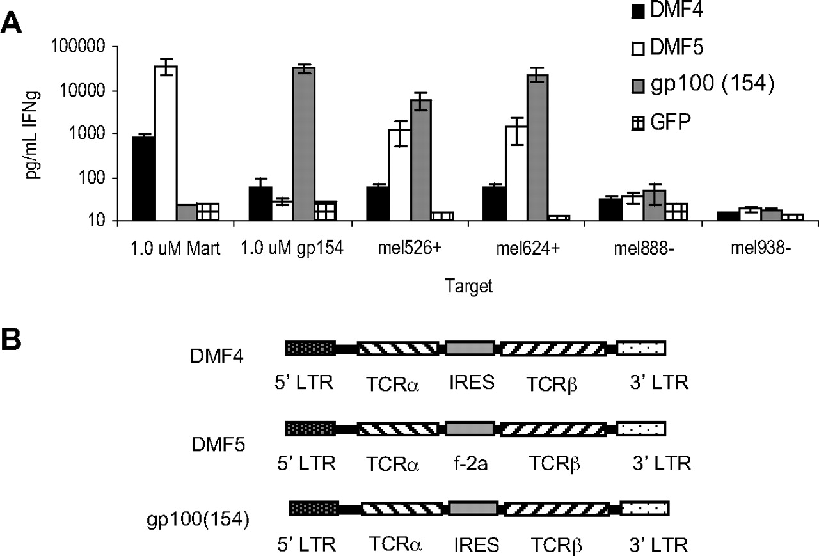
Figure 1 Tumor-reactive DMF5 or gp100(154) alpha and beta TCR chain RNA electroporated into PBLs confer high reactivity to melanoma tumor antigens
All HLA-A*02
restricted
MART-1
MART-1 higher affinity
GP100
Human
Human
Mouse
HLA-A*02 tg
Johnson, L. A. et al. Blood 2009;114:535-546
Copyright ©2009 American Society of Hematology. Copyright restrictions may apply.

Slide 2
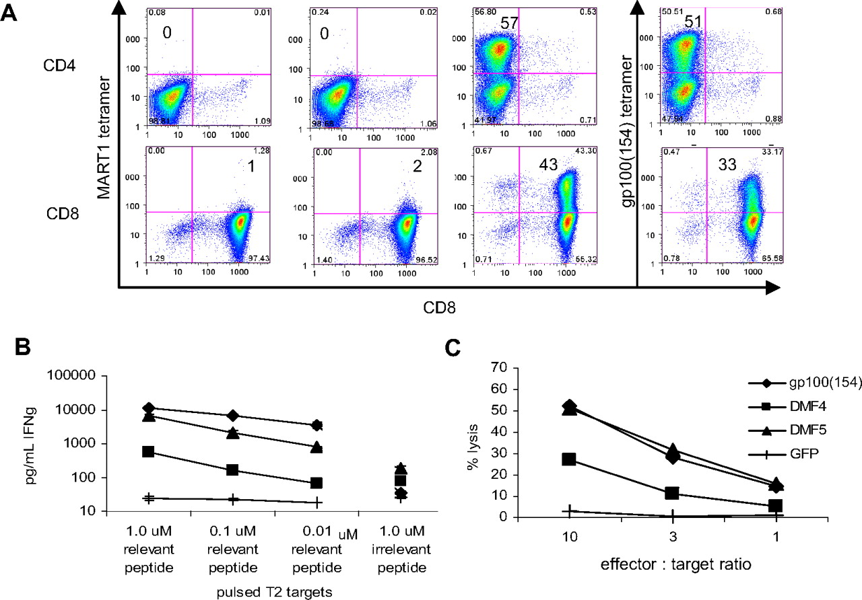
Figure 2 DMF5 and gp100(154) TCR retroviral constructs conferred greater antitumor reactivity to donor PBLs than the original DMF4 receptor
DMF4 DMF5 GP100
Johnson, L. A. et al. Blood 2009;114:535-546
Copyright ©2009 American Society of Hematology. Copyright restrictions may apply.

Slide 3
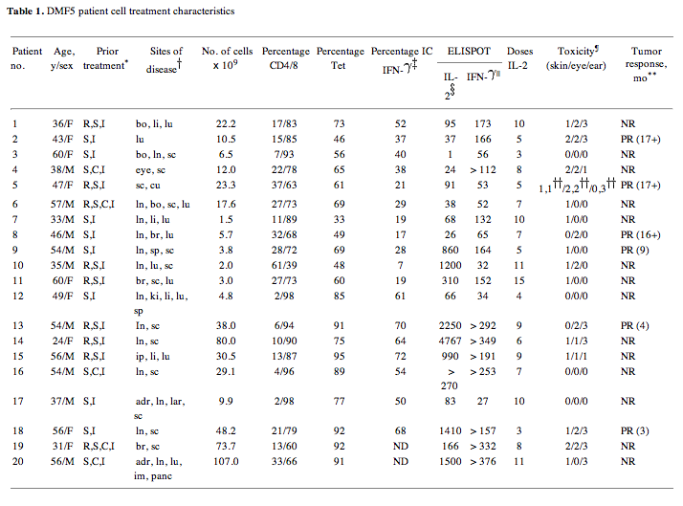

Slide 4
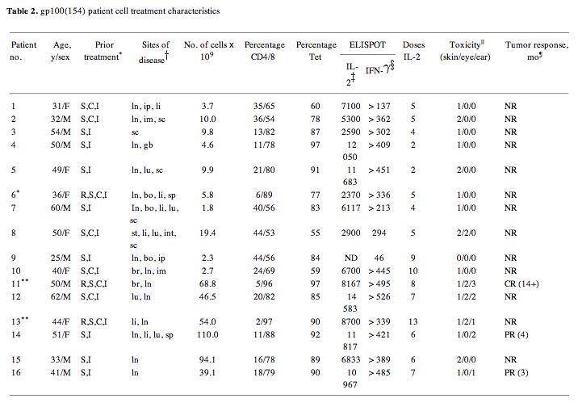

Slide 5
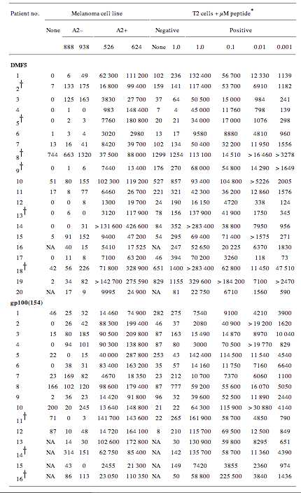

Slide 6
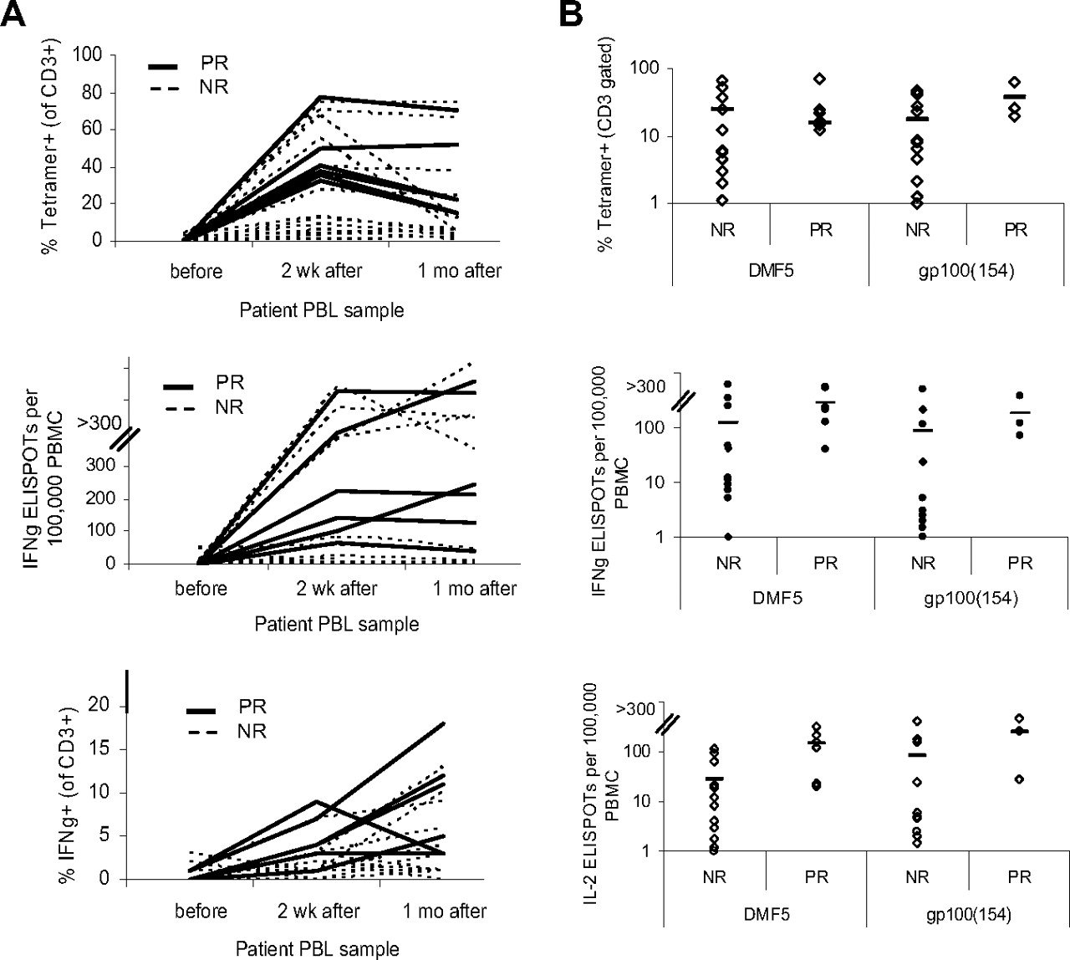
Figure 3 TCR-transduced cells from responding patients persisted and showed antitumor activity ex vivo
Johnson, L. A. et al. Blood 2009;114:535-546
Copyright ©2009 American Society of Hematology. Copyright restrictions may apply.

Slide 7
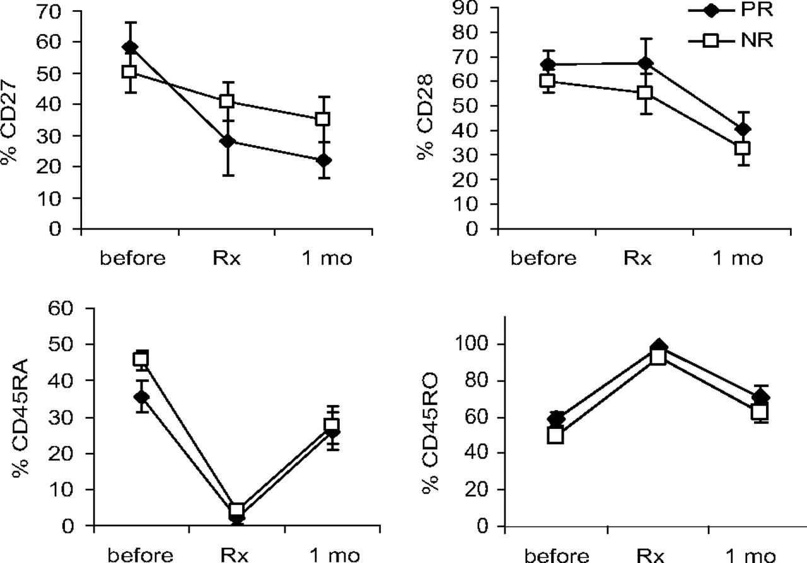
Figure 4 Phenotype of patient treatment cells before and after infusion
Johnson, L. A. et al. Blood 2009;114:535-546
Copyright ©2009 American Society of Hematology. Copyright restrictions may apply.

Slide 8
Figure 5 Patients treated with the highly reactive DMF5 or gp100(154), but not DMF4 TCR, had increased serum IFN-{gamma} levels after treatment
Johnson, L. A. et al. Blood 2009;114:535-546
Copyright ©2009 American Society of Hematology. Copyright restrictions may apply.

Slide 9
Melanin skin, hair
also found in hair, the pigmented tissue underlying the iris of the eye, and the stria vascularis of the inner ear. In the brain, tissues with melanin include the medulla and zona reticularis of the adrenal gland, and pigment-bearing neurons within areas of the brainstem, such as the locus coeruleus and the substantia nigra.

Slide 10
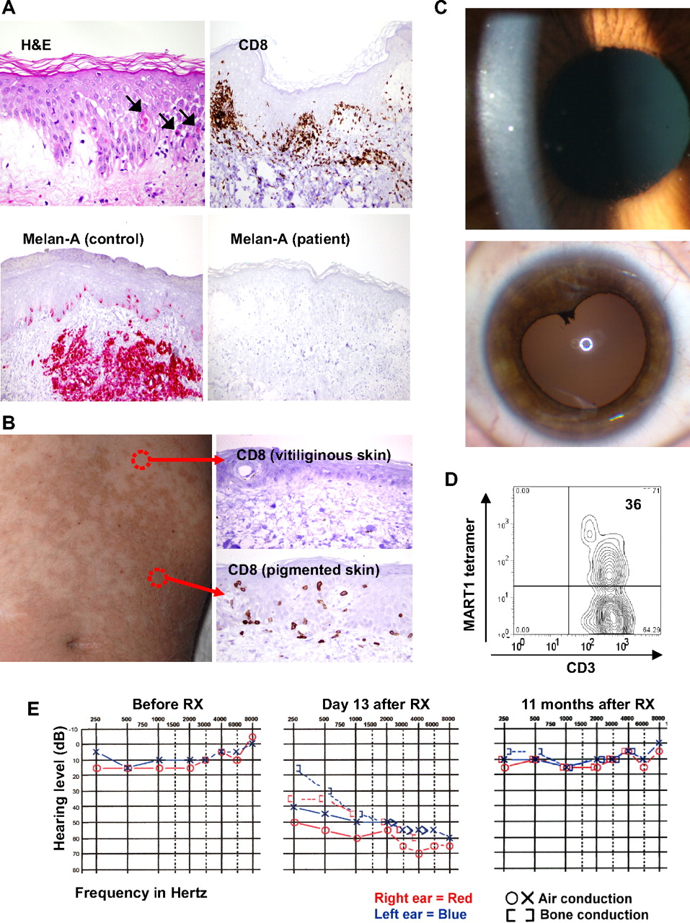
Figure 6 Tissue trafficking and target cell destruction in patients after infusion of TCR-transduced cells
Johnson, L. A. et al. Blood 2009;114:535-546
Copyright ©2009 American Society of Hematology. Copyright restrictions may apply.

Slide 11
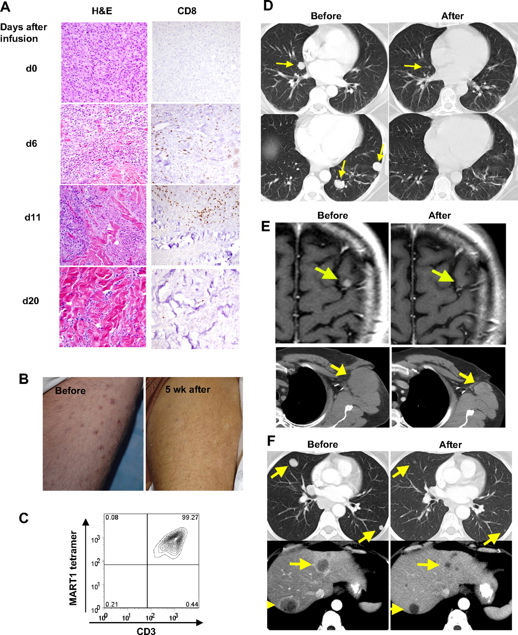
Figure 7 Highly reactive transferred cells traffic to and destroy melanoma tumors in patients
Johnson, L. A. et al. Blood 2009;114:535-546
Copyright ©2009 American Society of Hematology. Copyright restrictions may apply.

Slide 12
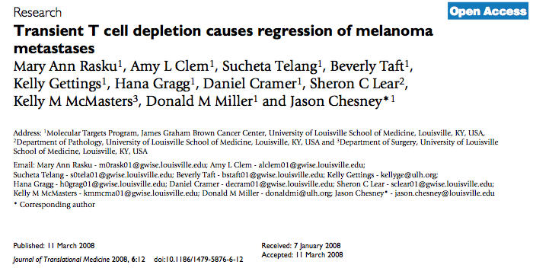

Slide 14
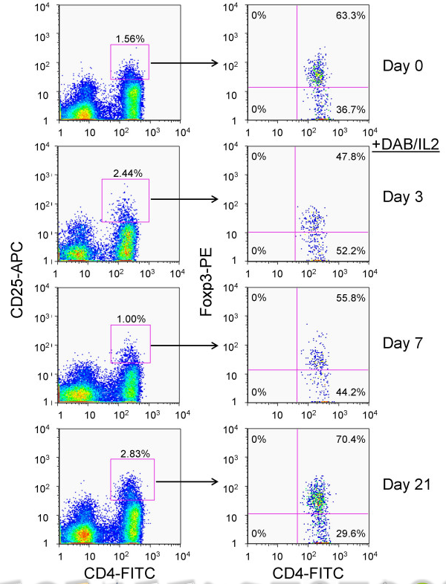

Slide 15
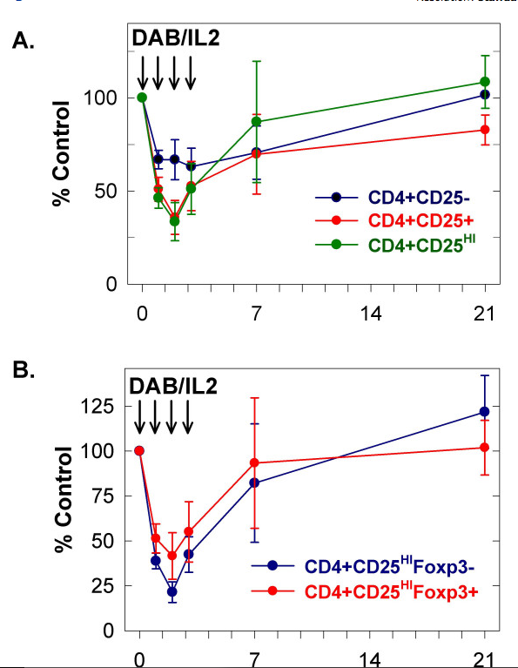

Slide 16
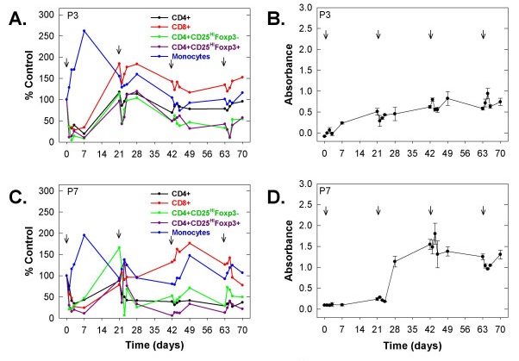

Slide 17
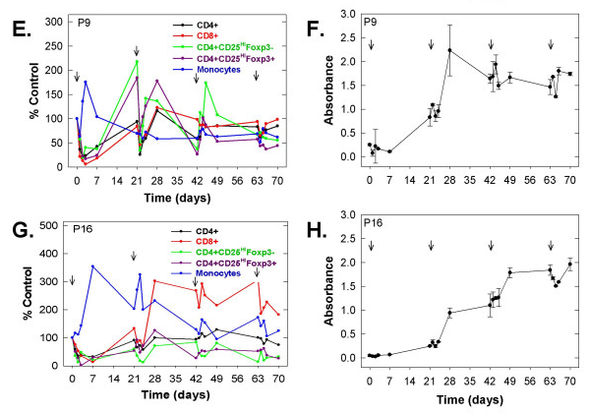

Slide 18
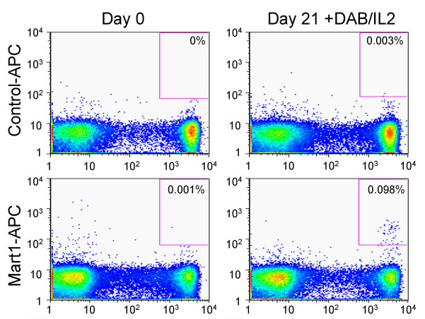

Slide 19
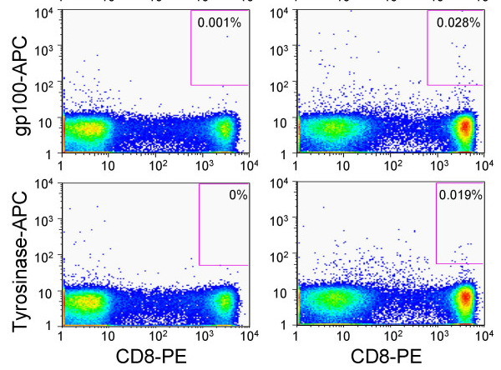

Slide 20
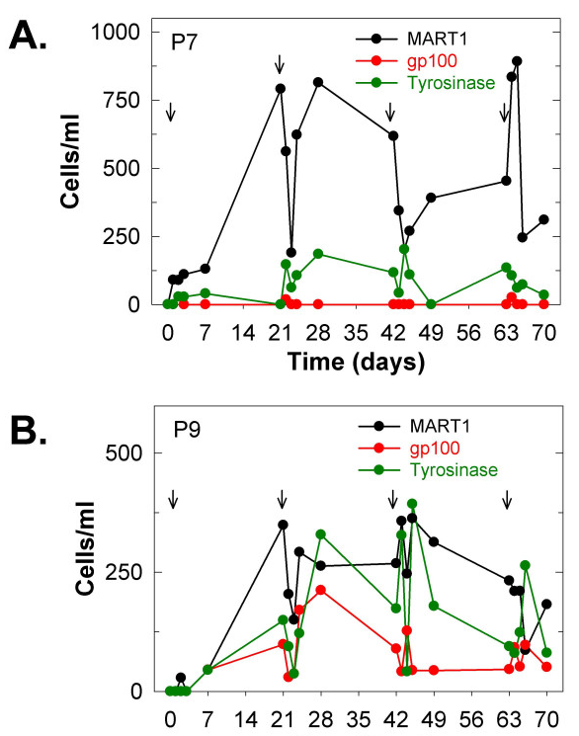

Slide 21
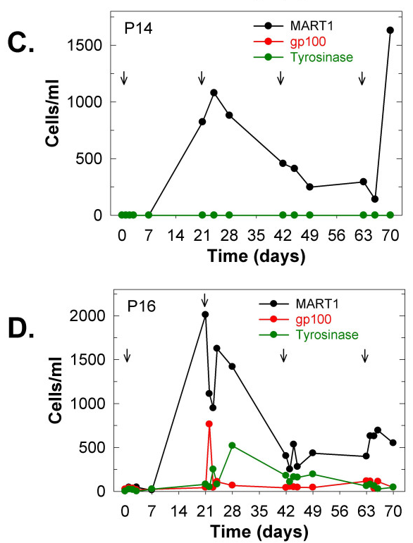

Slide 22
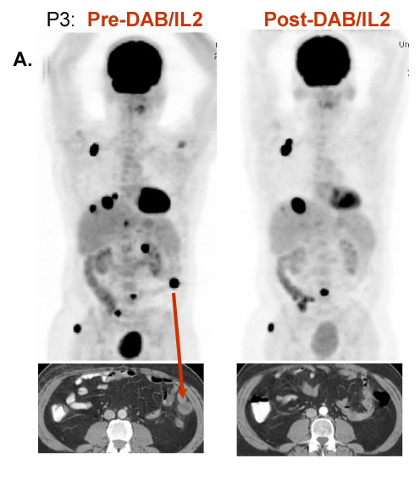

Slide 23
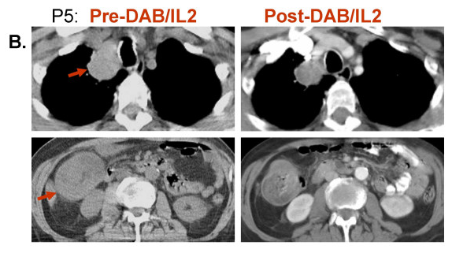

Slide 24
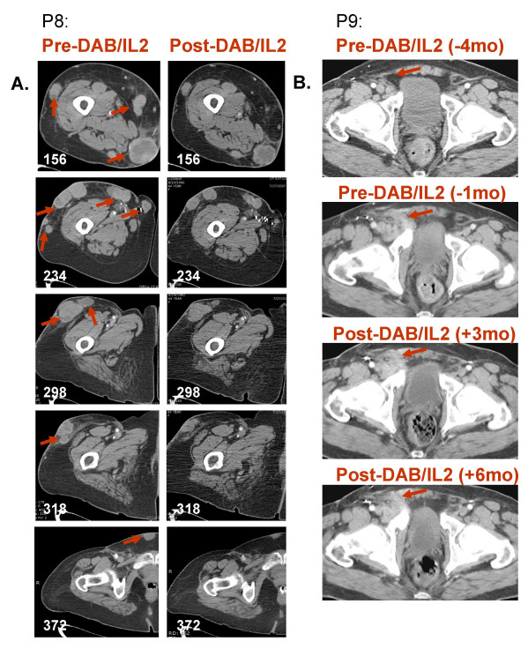

Slide 25
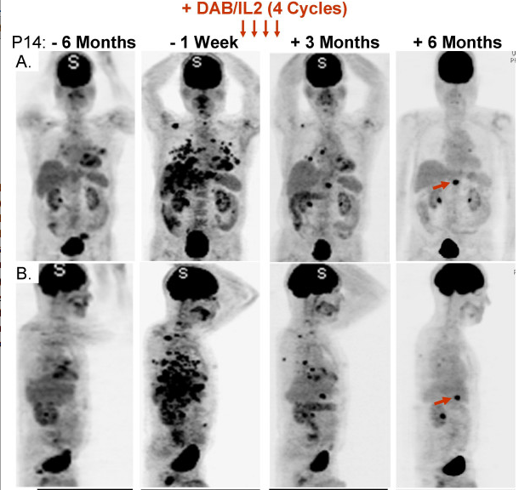

Slide 26
