Slide 1
BSc Course in Immunity & Infection
Autoimmunity in the gut – food intolerance
Tuesday 10th January 2012
Prof Julian Walters
Gastroenterologist
Hammersmith Hospital

Slide 2
Food Intolerance
Most "food allergy" is not allergic
Irritants
  Curry & peppers
  Acidity
Gas
Food poisoning
Biochemical
  Lactose intolerance
  Fructose / Sorbitol malabsorption

Slide 3
Food Allergy: Definition
Food intolerance:
  pharmacological
  metabolic
  toxic reactions to foods
True food allergy is a disorder in which ingestion of a small amount of food elicits an abnormal immunologically mediated clinical response

Slide 4
Classification
IgE-mediated
  Classic, type 1 immediate reaction (mins to 2 hrs)
  Systemic effects (skin, GI, respiratory, cardiovascular)
Cell-mediated
  Delayed onset (1 hr up to 8 hrs)
  Atopic dermatitis, eosinophilic gastroenteropathies
Mixed
  Delayed onset (1 hr up to 8 hrs)
  Dietary protein enterocolitis, dietary protein enteropathy, coeliac disease
Notes:
4

Slide 5
Food Allergy: Epidemiology
Prevalence of IgE-mediated food allergies:
  In adults, estimated to be 1.4%.
  In children, overall rate is 5-7%
The perceived prevalence in adults:
  20.4% of adults reported a food allergy
        Young et al. Lancet 1994;1127-30

Slide 6
Food Allergens
The most common food allergies are:
  Milk allergy
  Egg allergy
  Peanut allergy
  Tree nut allergy
  Seafood allergy
  Shellfish allergy
  Soy allergy
  Wheat allergy
Notes:
6

Slide 7
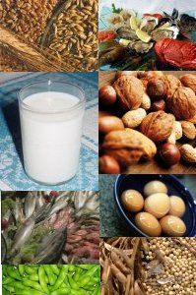
Allergenic Foods
Polar glycoproteins
Acid-resistant
Heat-resistant
Protease-resistant
http://supplementalscience.files.wordpress.com/2007/10/allergens.jpg
Notes:
7

Slide 8
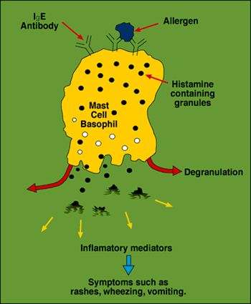
IgE-mediated Hypersensitivity
Notes:
8

Slide 9
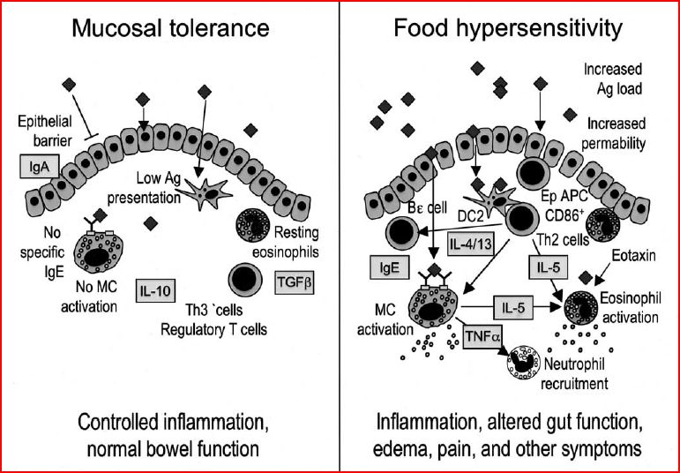
Pathophysiology
Sicherer SH et al. 2009
Notes:
9

Slide 10
Food Allergy: Symptoms and Signs
Itching of the mouth, throat, eyes, skin
Hives
Rhinorrhoea, nasal congestion
Wheezing, scratchy throat, shortness of breath, or difficulty swallowing
Angioedema:
  soft tissue swelling, usually involving the eyelids, face, lips, and tongue.
  severe swelling of the tongue as well as the larynx and trachea results in upper airway obstruction and difficulty breathing.
Anaphylaxis
Nausea, vomiting, diarrhoea, stomach cramps, and/or abdominal pain (gastrointestinal hypersensitivity)

Slide 11
Food Allergy: Diagnosis
Skin prick testing
RAST (RadioAllergoSorbent Test)
  detects the presence of IgE antibodies to a particular allergen
Food challenges:
  double-blind placebo-controlled food challenges are the gold standard for diagnosis
Notes:
11

Slide 12
Atopy: Genetics
Atopic diseases:
  Asthma, hay-fever, food allergy, eczema and atopic dermatitis
If both parents are affected, the risk of the offspring showing allergic disease is high
  58% if the clinical syndrome in the two parents is different
  78% if they have the same clinical disease
HLA class II DR4 and/or DR7 alleles
  42.6% of the patients
  only 2.4% of the healthy subjects.
Notes:
12

Slide 13
Tolerance to Oral Agents
Hygiene Hypothesis:
  Studies showing less allergy in third world countries
  Lack of early exposure to dirt and germs in Western countries
  Loss of tolerance to food proteins
Timing of oral exposure to foods:
  Age at weaning
  Different quantities
  Effect of breastfeeding
What mechanisms induce tolerance and maintain it?
Notes:
13

Slide 14
Prevention
Allergen avoidance
Early allergen exposure
Introduction to solids after
exclusive breastfeeding (4-6 months)
Notes:
Timing and dosage of exposure
14

Slide 15
Food Allergies: Management
Urticaria: anti-histamines
Anaphylactic emergencies: epinephrine
Avoidance of the allergen
Sodium cromglycate
? Desensitization / oral immunotherapy

Slide 16
Management
In anaphylaxis: adrenaline
  Adjuvents: inhaled beta 2 agonists, oxygen, fluid support, antihistamines, steroids, glucagon
In general: avoidance
  Nutritional and social pitfalls
In the future: immunotherapy?
Notes:
16

Slide 17
Reference
  Annu Rev Med. 2009;60:261-77.
  Food allergy: recent advances in pathophysiology and treatment.
  Sicherer SH, Sampson HA.

Slide 18
Food Intolerance
Most "food allergy" is not allergic
Irritants
  Curry & peppers
  Acidity
Gas
Food poisoning
Biochemical
  Lactose intolerance
  Fructose / Sorbitol malabsorption

Slide 19
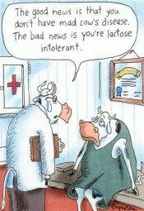

Slide 20
Malabsorption of Sugars – Lactose
Low lactase activity in the small intestinal brush-border membrane (hypolactasia) results in failure to digest lactose
Neonates all have high lactase
  Lactase non-persistence is usual adult human phenotype
  Lactase persistence occurs in most (but not all) Northern Europeans

Slide 21
Malabsorption of Sugars – Lactose
Lactose malabsorption in small intestine gives symptoms when lactose breaks down in colon (H₂, CO₂, SCFA, lactate)
Lactose intolerance diagnosed from history, lactose-H₂ breath test

Slide 22
Lactose-hydrogen Breath Test for Lactase Deficiency
Lactase persistent Deficient
Breath H2:
Low High
Small intestine:
Lactase
Present Not present
Glucose/galactose
Absorbed Not formed
Large intestine:
No lactose Lactose substrate for bacterial action
H2 production
Oral lactose

Slide 23
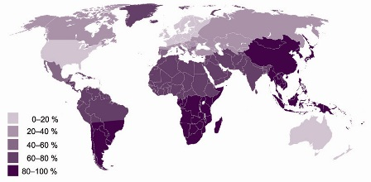
Prevalence of Lactose Malabsorption

Slide 24
Mechanisms of Lactase Persistence / Non-persistence
Genetic basis
Protein active in childhood
Polymorphisms in lactase gene
Heterozygote studies
Factors regulating expression of LPH
Developmental switches
Polymorphism in gene 14kb upstream of start site is associated with persistence/non-persistence in Finnish population
        Enattah Nature 2002

Slide 25
Malabsorption of Sugars (2)
Fructose and Sorbitol:
Abdominal pain and diarrhoea following fruit juices (especially in children) or diet/diabetic drinks
Small intestinal malabsorption of these monosaccharides results in metabolism in colon
Diagnosis from history and from breath H₂ excretion after ingestion of sugar

Slide 26
Sugar Maldigestion / Malabsorption
520 patients with functional dyspepsia
Lactose (25g), fructose (25g), sorbitol (5g)
Breath hydrogen and small bowel transit time measurements
Malabsorption of Lactose
  25% N. Europeans
  65-70% Greeks, Italians, Jews, Arabs
  85% Asians, Africans
Malabsorption of Fructose and Sorbitol
  40-65% overall
        (Mishkin et al. Dig Dis Sci 1997)

Slide 27
Food Allergy
Hypersensitivity
  Peanuts
  Nuts
  Seafood
  Fish
  etc.
Cow’s milk protein allergy
Wheat allergy / Gluten sensitivity / Coeliac disease

Slide 28
Mr. P.M. – HISTORY (1)
54 year old
Urgently referred by GP “<2 week wait, ? Cancer”
  Haemoglobin 10.3 g/l
    (normal >11.5g/l)
  MCV 74
    (normal 82 - 102 )
c/o Tiredness
  Bowel x 2-3/d; no recent change in bowel habit
  No rectal bleeding
  No abdominal pain or weight loss

Slide 29
Mr. P.M. – HISTORY (2)
PMH
  Indigestion treated over 25 years with antacids
FH
  Mother – thyroid disease
  Sister – on special diet for intestinal disease
no bread or cakes
SH
  Building work. Non smoker; little alcohol
On Examination:
  Well nourished, clinically anaemic

Slide 30
INVESTIGATIONS
↓ Hb 10.9, ↓ MCV 74
↓ ↓ Iron 6.0, Transferrin 4.9 , ↓ ↓ transferrin saturation index 5%
Serum B12 & folate normal
Liver function tests & albumin normal
Thyroid function, calcium / phosphate normal
Coeliac IgA abs positive
Upper and lower GI endoscopies
Duodenal biopsy histology

Slide 31
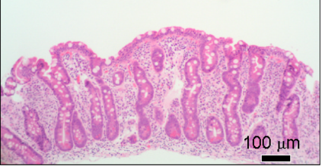
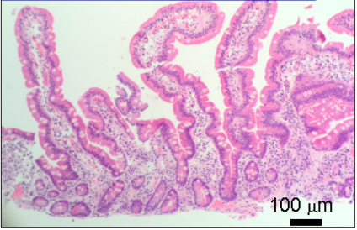
DUODENAL HISTOLOGY
Subtotal villous atrophy with crypt hyperplasia
Normal mucosa

Slide 32
Mr. P.M. – CLINICAL COURSE
Coeliac disease diagnosed
  Typical histology
  Positive antibodies
Started Gluten-free Diet: no wheat, barley or rye products
  Dietetic advice
  Prescription of gluten-free products
  Iron supplements
  Joined Coeliac UK society
Response
  Gained 5kg in weight
  Normal Hb & Fe
  Bowels “constipated” every 1-2 days
NOTE HIS FAMILY HISTORY

Slide 33
COELIAC DISEASE
A chronic small intestinal immune-mediated enteropathy precipitated by exposure to dietary gluten in genetically susceptible individuals
  Oslo definitions for coeliac disease and related terms
    Ludvigsson et al. Gut 2012
= Gluten-sensitive enteropathy
It can present in many ways:
  - Typical disease
  - Atypical disease
  - Silent or asymptomatic disease

Slide 34
  Oslo definitions for coeliac disease and related terms
Ludvigsson et al. Gut 2012
  Classical
  Symptomatic CD
    (Typical disease)
    (Atypical disease)
  Subclinical CD
  Asymptomatic
    (Silent)
  Refractory CD
    Symptoms + villus atrophy on strict GFD >12mnths
  Potential CD
    (Latent)
  Gluten-related disorders (Gluten intolerance)
  Non-coeliac gluten sensitivity

Slide 35
What are the clinical features of Coeliac disease?
Frequent (~50%)
  Malaise
  Fatigue
  Steatorrhoea
  Diarrhoea
  Weight loss
  Anaemia
  Folate
  Fe
Common (>25%)
  Anorexia
  Abdominal pain
  Oral ulcers
  Distension
  Bloating
  Flatulence
  Osteopenia
  Childhood history
  Family history
  B12
  Albumin
  25-OH vit. D
  ↑ PTH
Occasional (<25%)
  Nausea
  Muscle Pains
  Tetany
  Bone pains
  Bruising
  Oedema
  Constipation
  Rashes
  Fractures
  Lymphoma
  ↑ Alk. Phos.
  Ca²⁺
  Mg²⁺
  ↓ Zn²⁺
  ↑ Transaminases
  ↑ PT
Completely asymptomatic

Slide 36
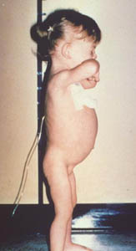
COELIAC DISEASE IN CHILDREN
Classical symptoms such as those described by Gee in 1888
  Diarrhoea
  Steatorrhoea
  Vomiting
  Anorexia
  Abdominal distension
  Abdominal pain
  Weight loss
  Failure to gain weight
  Lassitude
  Irritability
  Respiratory infections

Slide 37
CHANGING EPIDEMIOLOGY OF COELIAC DISEASE
Coeliac disease was once thought to be only a childhood disease
Now well recognised to present at any age and in both sexes
  In 1998 over 85% of newly diagnosed members were adults
        Coeliac UK society
  Between 1975 and 1999, mean age at diagnosis increased from 40 to 51
        West et al BSG 2001

Slide 38
CHANGING PRESENTATION OF COELIAC DISEASE
Average age of diagnosis is now > 50
Less severe disease in children
  Non-specific disease in adults
  Detection in mild anaemia
Diagnosis gold standard still intestinal biopsy
Coeliac serology in identifying cases

Slide 39
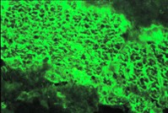
ENDOMYSIAL ANTIBODIES IN COELIAC DISEASE
First described 1983 (Chorzelski et al.)
  Similar to reticulin / jejunal antibodies
Detected by indirect immunofluorescence
  primate oesophagus
  gastric / small bowel muscle
  umbilical cord
IgA class
  IgG in selective IgA deficiency
High specificity (>95%) & sensitivity in diagnosis
Useful in monitoring response to treatment

Slide 40
AUTOANTIBODIES & COELIAC DISEASE
Tissue transglutaminase (TTG)
  Shown to be the autoantigen recognized by endomysial antibodies
  tTG cross-links glutamine residues including those in gliadin
  Produces neo-antigens
  IgA antibodies measured by ELISA
  Now better clinically than Endomysial IgA antibodies
  TTG2 in intestine: other tissues have different TTG isoforms

Slide 41
AUTOANTIBODIES & COELIAC DISEASE
Antigliadin antibodies
  Less specific than endomysial antibodies
Deamidated-gliadin peptide antibodies
  Possible role

Slide 42
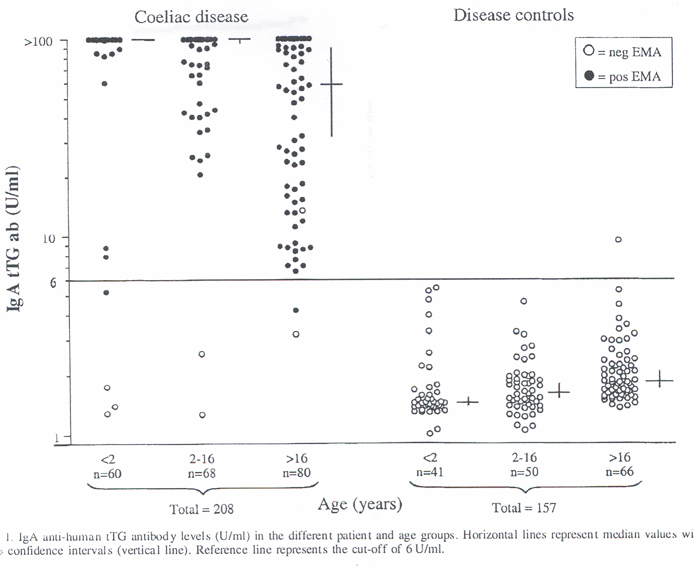
Tissue Transaminase IgA Antibodies in Diagnosis
Burgin-Wolf et al – Sc J Gastro 2002

Slide 43
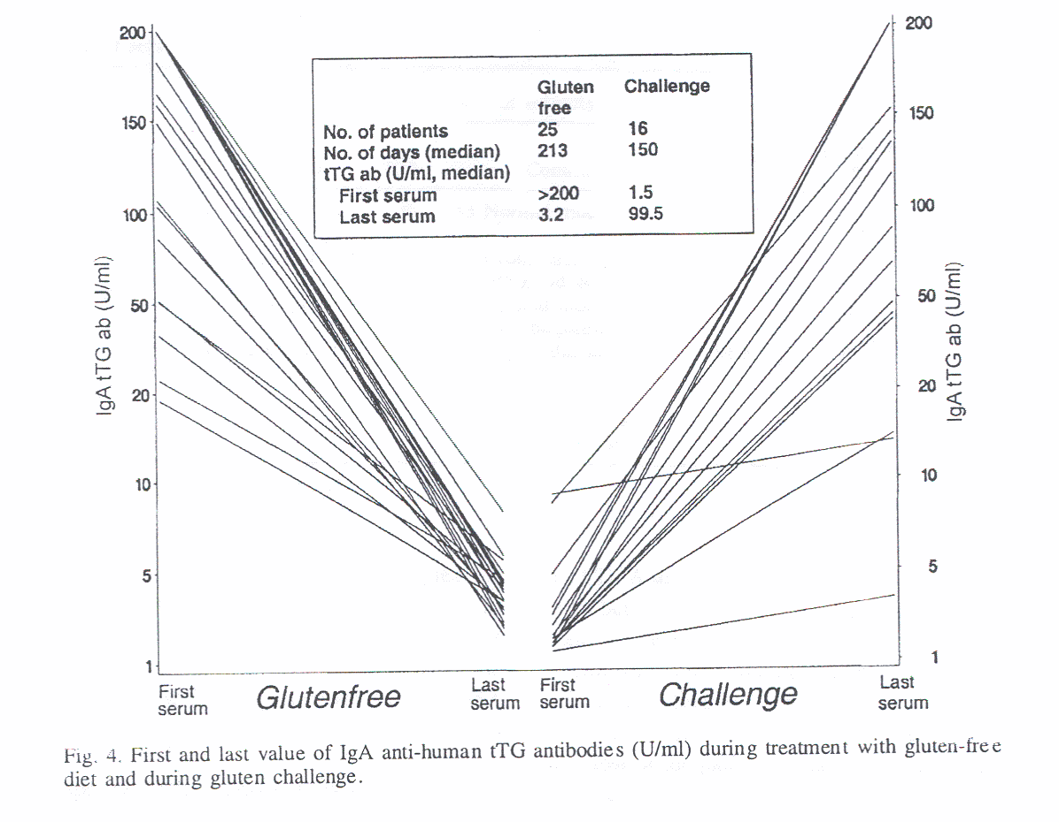
Tissue Transaminase IgA Antibodies in Follow-up
Burgin-Wolf et al – Sc J Gastro 2002

Slide 44
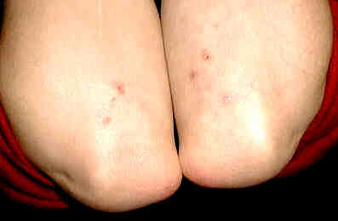
DERMATITIS HERPETIFORMIS
Vesicular rash
  intense pruritus
  blisters rarely present
  esp. arms & shoulders
Skin biopsy
  granular IgA deposits
Associated villous atrophy and gluten-sensitivity

Slide 45
The Coeliac Iceberg
Complicated
Clinically active
Subclinical
Latent / potential
Lymphoma
Nutritional deficiencies
DH
Villous atrophy
Subtle histology
IEL
Antibodies

Slide 46
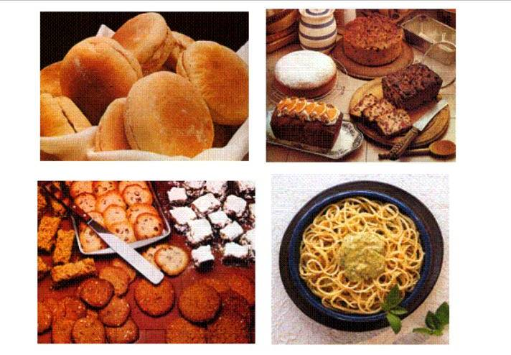
Which could you manage without?

Slide 47
COELIAC DISEASE: PRINCIPLES OF TREATMENT
  !!!! NO WHEAT, BARLEY, RYE !!!!
Gluten-free diet
  (some patients may also be symptomatic with oats)
Maintain adequate nutrition
  Gluten-free products on prescription
  Nutritional supplements
      energy (calories), Fe, Ca, vitamin D, folate, etc.
  Prevent complications
The Coeliac UK society provides patient support
    Advice
    List of gluten-free products – updated regularly

Slide 48
COELIAC DISEASE: COMPLICATIONS
Metabolic:
  Nutrient malabsorption & impaired nutritional status
    (Slow growth, anaemia, neurological disorders, ? infertility)
  Osteoporosis / osteopenia
Neoplastic: Small bowel malignancy
  Lymphoma
    Enteropathy-associated T-cell lymphoma (EATL)
  Adenocarcinoma
    (and ? other cancers)

Slide 49
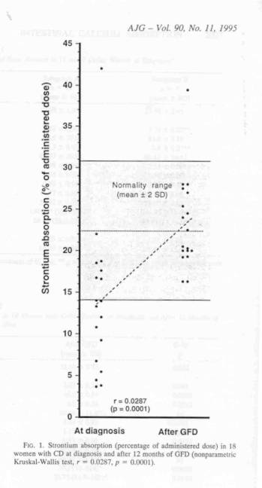
Reduced Calcium Absorption in Untreated Coeliac Disease Returns to Normal with 1 year Gluten-free Diet
18 Females with newly diagnosed coeliac disease and after 12 months of GFD
Molteni et al Am J Gastro 1995

Slide 50
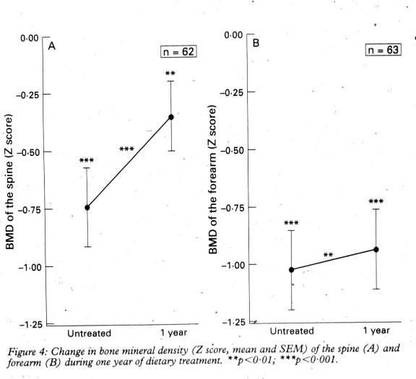
Improvement in BMD in spine and forearm with GFD for one year in new coeliacs
    Valdimarsson et al

Slide 51
Coeliac Disease and Malignancy
Primary small-bowel malignancy in the UK and its association with coeliac disease
        Howdle et al., QJM 2003
    395 cases reported by BSG members 6/1998 – 5/2000
    Total Coeliacs
    Adenocarcinomas 175 23 (13%)
    Lymphomas 107 42 (39%)
    Poor prognosis of lymphoma complicating coeliac disease:
    Survival at 30 months 52% overall
    13% coeliac

Slide 52
COELIAC DISEASE: SUMMARY
Commonest cause of malabsorption
Range of presentations
  Making the Diagnosis
  Specific Antibodies and Biopsies
Treatment
Complications
  Metabolic & Neoplastic
Next talk: the aetiology for this "autoimmune" disease
  Genetic
  Immunological

