Slide 1
Chemokines and cytokines in autoimmunity
Dr Frederick Tam
Reader /Consultant Nephrologist
Renal Section

Slide 2
Learning outcome:
You will understand the important roles of cytokines and chemokines in autoimmune diseases
You will understand potentials for translational development

Slide 3
What are cytokines and chemokines?
Cytokines are small proteins secreted by a variety of cells
Interact with specific receptors
Tends to work in close proximity
  Paracrine
  Autocrine
Chemokines = chemotactic cytokines

Slide 4
How many chemokines are there?
Many
Increasing number

Slide 5
Approaches to study cytokines (1)
Production of cytokines
  mRNA
    Northern blots
    RNAse protection assay
    RT-PCR
    in situ hybridisation
  protein
    immunostaining
    Tissue homogenate (immunoassays)
    Culture of tissues in vitro (immunoassays)

Slide 6
Approaches to study cytokines (2)
Function of cytokines
  Inhibition of synthesis
    Anti-sense
    siRNA
    knockout
  Blockade of receptor interactions
    Specific anti-cytokine antibodies
    Receptor antagonist

Slide 7
What are the functions of chemokines?
Classical functions
  chemotaxis
  Activation of leucocytes
Others
  Stimulation of cytokine production

Slide 8
Recruitment of mononuclear leucocytes in inflammation
Rolling
Activation
Adhesion
integrins
Transmigration
endothelium
selectins
chemokines
cell adhesion
molecules
chemokines

Slide 9
Classification of chemokines

Slide 10
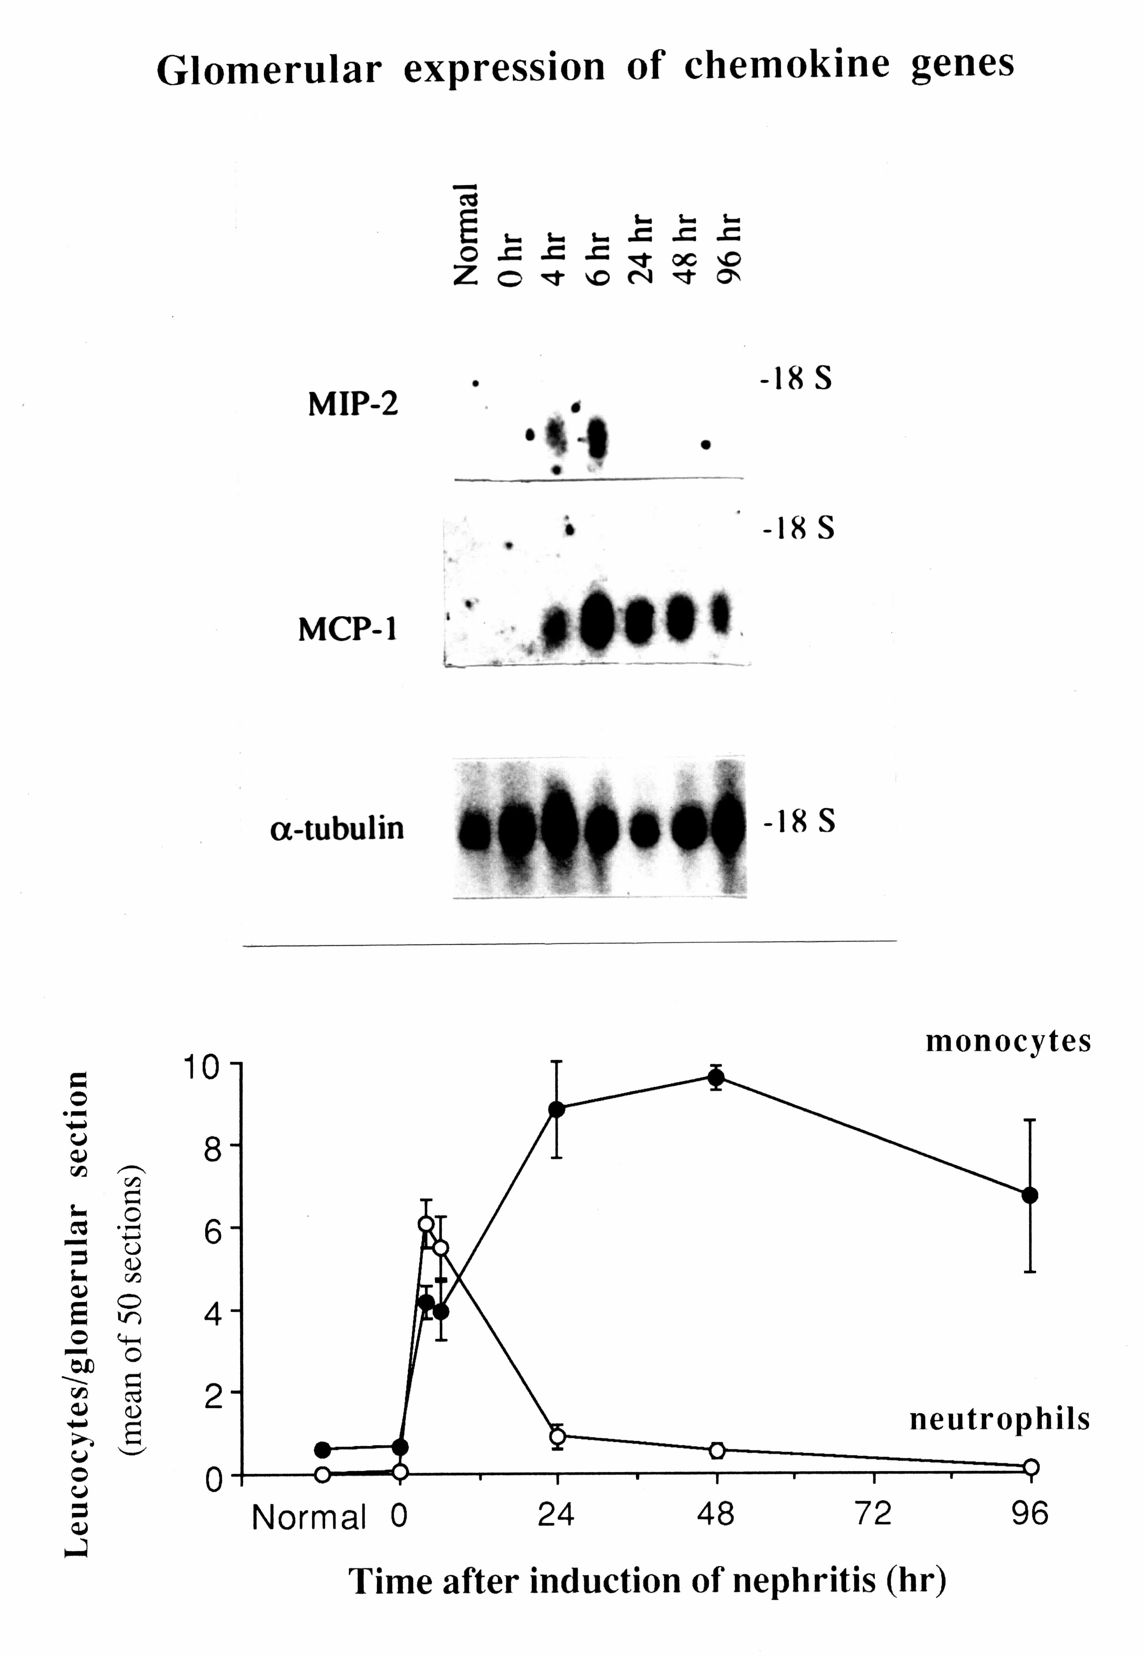
Tam et al (1996) Kidney Int 49:715-721

Slide 11
Monocyte chemoattractant protein-1 (MCP-1)
a CC chemokine (CCL2)
activate monocyte/macrophages
  production of IL-1
  superoxide production
synergise with other inflammatory mediators e.g. PAF
link to next lecture:
monitoring autoimmune disease

Slide 12
MCP-1 in glomeruloephritis
Examples:
  Lupus nephritis
  Renal vasculitis
Upregulation of MCP-1 leads to migration of macrophages and T cells into the glomerulus
link to the next lecture (next 4 slides):
monitoring autoimmune disease

Slide 13
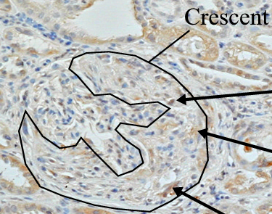
Expression of MCP-1 in patients with renal vasculitis
Tam F. W. K. et al (2004) Nehrol Dial Transplant 19:2761-2768

Slide 14
Correlation between MCP-1 and glomerular macrophage infiltration in renal vasculitis
7.5
5.0
Glomerular macrophages
r=0.63
p<0.05
(cells/glomerular cs)
2.5
0.0
0
1
2
3
Glomerular MCP-1 (score of staining)

Slide 15
Increased urinary MCP-1 in active renal vasculitis
3500
3400
p<0.01
3300
800
600
300
Urinary MCP-1
(ng/mmol creatinine)
200
p<0.05
100
0
600
Serum MCP-1
(pg/ml)
400
200
0
normal
control
inactive
persistent
renal
extra-renal
ACTIVE
Vasculitis
Tam F. W. K. et al (2004) Nehrol Dial Transplant 19:2761-2768

Slide 16
Raised urinary MCP-1 in proliferative lupus nephritis
1050
1025
1000
300
(ng/mmol creatinine)
Urinary MCP-1
200
100
0
Control
Inactive
Active III/IV
Active V
Extra-renal
lupus nephritis
Barhamein M.Y. et al (2003) J Am Soc of Nephrol 14:148A

Slide 17
Blockade of MCP-1
Anti-MCP-1 antibody in experimental glomerulonephritis
Reduce macrophage & T cell infiltration
Crescent formation
Scarring & renal impairment
Wada T et al FASEB J. 10:1418-1425, 1996
Lloyd CM et al J Exp Med. 185:1371-1380, 1997

Slide 18
Clinical development chemokine receptor antagonist
MCP-1 binds to CC chemokine receptor (CCR2)
Successful application of CCR2 antagonist to reduce macrophage influx and tissue injury in
  experimental autoimmune encephalomyelitis (a model of multiple sclerosis)
  experimental inflammatory arthritis.
  Experimental diabetic nephropathy
Brodmerkel CM et al. J Immunol. 2005;15;175:5370-8.
Sayyed SG et al Kidney Int 2011; 80:68-78
Awad AS et al Am J Physiol Renal Physiol 2011; 301:F1758-66
Early clinical trials of CCR2 receptor antagonist in progress

Slide 19
Summary (MCP-1)
Recruit monocytes/macrophages
Increased synthesis in glomerulonephritis
Blockade of MCP-1 reduced injury
Urinary MCP-1 may be used as a non-invasive marker of glomerulonephritis

Slide 20
What are the functions of cytokines?
(1. lymphocytes & immune response)
T cells
  Proliferation/activation
  Maturation and differentiation e.g. T helper cells
  Effector functions
B cells
  Antibody production
  Switching of subclasses of immunoglobulin

Slide 21
What are the functions of cytokines?
(2. inflammatory cells)
Macrophages, neutrophils, esoinophils
  Production of inflammatory mediators (including other cytokines)

Slide 22
Cytokines, inflammatory cells & pathogenesis of disease

Slide 23
What are the functions of cytokines?
(3. ‘intrinsic cells’)
Examples:
Endothelium activation
  Production of cytokines
  upregulation of adhesion molecules
Podocytes, mesangial cells and epithelial cells of kidney

Slide 24
Cytokine network
glomerular mesangial cells

Slide 25
How are the functions of cytokines regulated?
Regulation of synthesis
  Transcription factor (e.g. NF-κB)
  Signal transduction
  (Kinase pathway e.g. p38 MAPK)
Secretion
  e.g. IL-1β is synthesised as a pro-IL-1β
  Role of inflammasome and capase-1 for secretion of active IL-1β and IL-18
Receptor antagonist: IL-1 receptor antagonist (IL-1RA)
Soluble / decoy receptors
Regulatory cytokines

Slide 26
inflammasome
Multimolecular complex e.g. NLRP3
Activates by 2 signals: example
  Signal 1: LPS or TNF
  Signal 2: extracellular ATP stimulate P2X7R
Proteolytic activation of capase-1
Release active IL-1β and IL-18

Slide 27
Signal 1
Signal 2
ATP
Na⁺
Ca²⁺
Na⁺
Ca²⁺
IL18
NMDG
IL1β
TNF
Pannexin-1
LPS
TNF-R
P2X7
Permeants up to 900 Da
Mature IL1β
IL-18 release
K⁺
K⁺
TLR
⬇[K⁺]_{i}
Aggregation
Other membrane pores
Activated caspase-1
Activation
Contextual activation
⬆[Ca²⁺]
Inflammatory gene transcription
Inflammasome
Mitogenic pathways
P2X7
Pro-IL1β
Pro-IL18
accumulation
Cell death
Booth, Tam & Unwin 2012
Notes:
Figure 2. Model of P2X7 receptor participation in inflammatory responses. Release of mature IL1β from macrophages first requires a cellular priming signal, delivered either via toll like receptors in the case of microbial infection, or inflammatory cytokine receptors (eg tumour necrosis factor receptor) in sterile inflammation, leading to inflammatory gene transcription and accumulation of pro-IL1β (‘Signal 1’). Pericellular ATP ligates the P2X7 receptor, leading to inorganic cation transit when double-bound, progressing to pore dilatation and a high conductance state when all three binding sites are occupied. The resultant fall in intracellular potassium is required for assembly of the NLRP3 inflammasome, the central caspase-1 activating platform. Fully-bound P2X7 triggers opening of large diameter membrane pores including the pannexin-1 hemichannel. This event, through uncertain mechanisms, precipitates final activation of caspase-1 on the inflammasome, rapid maturation and release of IL1β and the related cytokine IL-18 and ultimately cell death. (‘Signal 2’). Elevations of cytosolic calcium in the absence of large membrane pore opening, presumably associated with the double ATP-bound state, are hypothesised to underlie apparently paradoxical mitogenic responses to P2X7 activation seen in other contexts (eg tumour growth). LPS, lipopolysaccharide; TNF, tumour necrosis factor, TLR, Toll-like receptor; TNF-R, tumour necrosis factor receptor; NMDG, N-methyl D-glucamine.

Slide 28
Experimental glomerulonephritis
  Induced by intravenous injection of anti-glomerular basement membrane antiserum
    Tam et al Nephrol Dial Transplant 14:1658, 1999
Susceptible strain (WKY) of rats developed severe glomerulonephritis with macrophage infiltration, renal tissue injury proteinuria and renal failure
Resistant strain (LEW) remains healthy

Slide 29
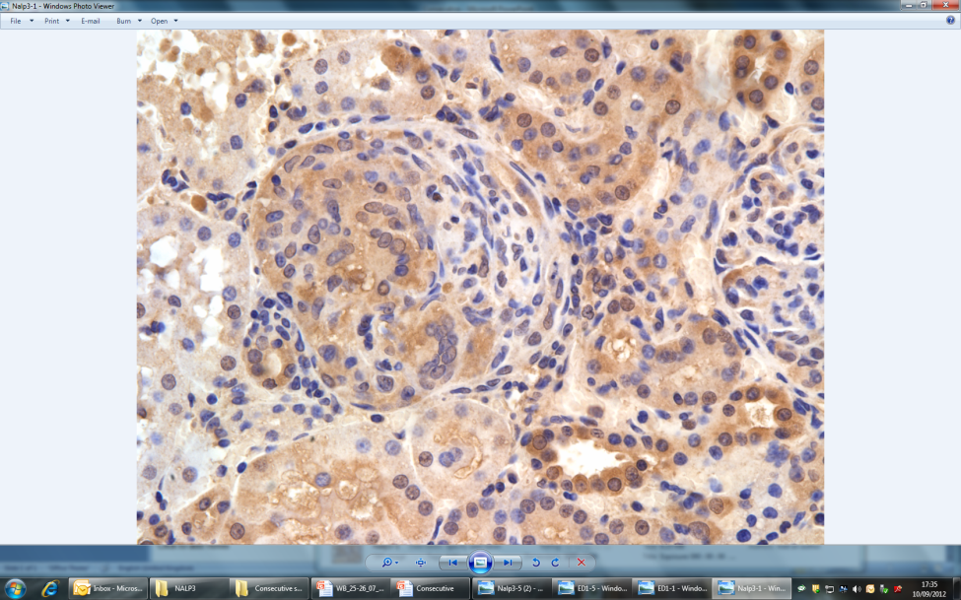
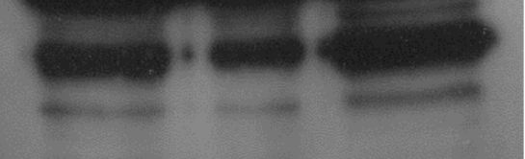


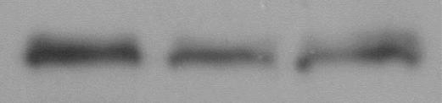

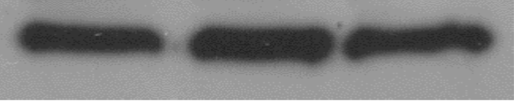
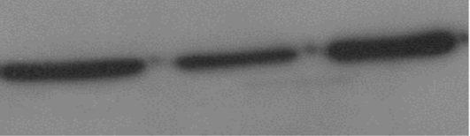
Inflammasome & cytokine in Glomerulonephritis
Increased expression of P2X7 receptor, NLRP3 inflammasome, active capase-1, IL-1β and IL-18 in the glomeruli of WKY rats, but not in LEW rats which are resistant to the disease. (Deplano S et al 2013 J Leuk Biol 93:127-34)
NLRP3
WKY.LCrgn1,2
WKY.LCrgn1,2
B
A
WKY
LEW
KDa
KDa
WKY
LEW
50
pro-caspase-1
KDa
75
P2X7
10
mature
caspase-1
43
β-actin
β-actin
43
C
D
WKY.LCrgn1,2
WKY.LCrgn1,2
LEW
WKY
LEW
KDa
WKY
31
24
pro-IL-18
pro-IL-1β
17
active-IL-1β
18
active IL-18
43
β-actin
43
β-actin

Slide 30
Regulation of the effects of IL‑1β

Slide 31
structure of the cell surface receptors of IL‑1
319
20
213
N
IL-1RtI
C
332
26
29
N
IL-1RtII
C
Ex
T
In

Slide 32
Application of cytokine biology
Use of soluble receptors and anti-cytokine antibodies in treatments
Best examples
  Rheumatoid arthritis
  Renal disease

Slide 33
Anti-cytokine therapy in renal disease
Soluble receptor and receptor antagonist to IL-1 or TNF
  Experimental model
  Clinical studies

Slide 34
Effect of recombinant inhibitors in heterologous phase of NTN (1)
100
5
neutrophils
Chemokine
MIP-2
*
*
75
4
*
*
3
50
Glomerular mRNA
Cells per glomerular section
2
25
1
0
0
control
IL-1ra
sIL-1R
sTNFR
control
IL-1ra
sIL-1R
sTNFR
Treatment
Treatment
Tam et al (1996) Kidney Int 49:715-721

Slide 35
Effect of recombinant inhibitors in the heterologous phase of NTN (2)
60
60
thrombosis
albuminuria
50
50
40
40
Glomeruli (%)
mg/24 h
30
30
20
*
*
*
20
*
*
*
10
10
0
0
control
IL-1ra
sIL-1R
sTNFR
control
IL-1ra
sIL-1R
sTNFR
Treatment
Treatment

Slide 36
Blocking TNF-α prevented crescentic glomerulonephritis (Karkar et al)
200
50
40
150
30
Crescents (%)
Albuminuria (mg/20 h)
100
20
50
10
0
0
Control
sTNFR
Control
sTNFR

Slide 37
Delayed anti-TNF therapy
Khan et al Kidney Int 2004
**
1.2
Anti-TNF
α
1.0
Control
**
0.8
(ml/min)
Creatinine Clearance
0.6
0.4
0.2
0.0
0
7
14
21
28
Day of Nephritis
Delayed anti-TNF therapy
Reduction of urinary MCP-1 and glomerular macrophage number

Slide 38
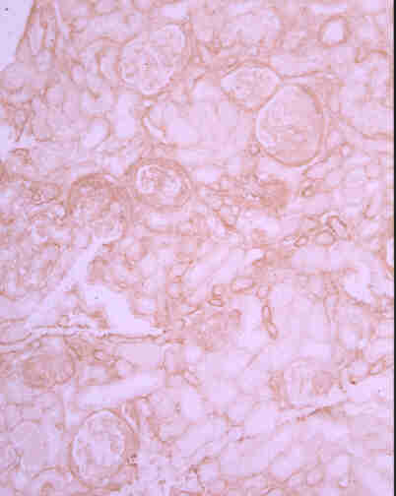

Anti-TNFα Scarring
3
P<0.005
Control
2
Glomerular Scarring
Score
1
0
TNF
α
Control
4
Anti-TNFα
3
P<0.01
Tubulointerstitial
Scarring Score
2
1
0
TNF
α
Control

Slide 39
Clinical trial of anti-TNF therapy Booth A et al (2004) J Am Soc Nephrol 15:717-721
Patients with systemic vasculitis
an open-label multicentre clinical trial
anti-cytokine therapy with infliximab for vasculitis (ACTIVE).
In this clinical trial, patients received 4 doses of infliximab (5 mg/kg body weight) for induction of remission.
Induced remission in 88% of patients
Reduced dose of corticosteroid

Slide 40
Summary (IL-1 & TNF)
Both IL-1 and TNF-α are important in pathogenesis of glomerulonephritis
Blockade of IL-1 and TNF-a may be achieved by antibody therapy, recombinant receptor antagonist and soluble receptors

Slide 41
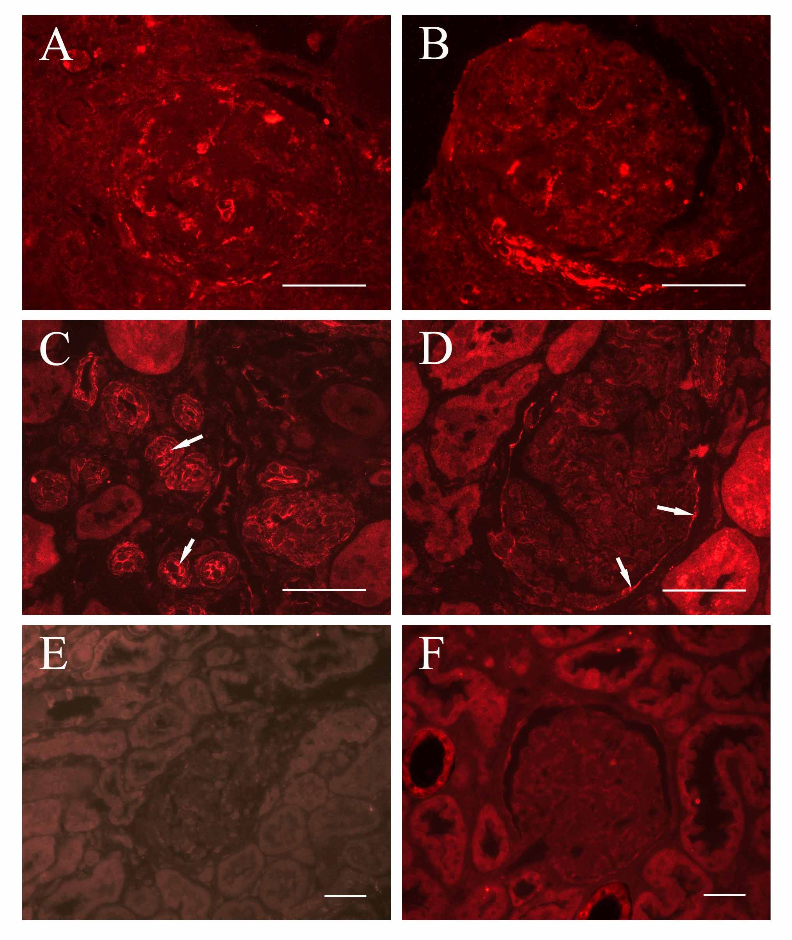
Expression of P2X₇R in human lupus nephritis
Proliferative
Lupus GN
Proliferative
Lupus GN
Membranous
Lupus GN
Membranous
Lupus GN
Negative
Control
Control
Kidney
Turner et al Nephrol Dial Transplant 2006

Slide 42
Expression of P2X₇R in glomerulonephritis
Patients with glomerulonephritis (lupus nephritis)
Experimental glomerulonephritis in WKY rats (coincide with onset of proteinuria)
Experimental glomerulonephritis in mice (both macrophages and intrinsic renal cells)

Slide 43
What is the role P2X₇R in glomerulonephritis?
  Stimulation of P2X7R is known to provide the 2nd signal for NLRP3 inflammasome activation
  Increased expression in susceptible, but not resistant strain of rats (earlier slides)
  Experimental glomerulonephritis
  P2X₇R-/- mice
  P2X₇R antagonist
Taylor et al J Am Soc Nephrol 20: 1275–1281, 2009

Slide 44
P2X₇R KO mice had reduced recruitment of macrophages
Infiltrating macrophages
P<0.001
6
5
4
Macrophages per GCS
3
2
Wildtype
P2X
7
R-/-

Slide 45
Glomerular fibrin deposition

Slide 46
P2X₇R -/- mice are protected from damage
P<0.01
PAS positive
4
3
WT
2
Glomerular thrombosis score
1
0
Wildtype
P2X₇R-/-
-/-

Slide 47
P2X₇R KO mice are protected from damage
Proteinuria
Renal function
P<0.05
P<0.05
20
200
15
150
Serum Creatinine (μmol/L)
10
100
Proteinuria mg/24hr
5
50
0
0
Wildtype
P2X₇R-/-
Wildtype
P2X₇R-/-

Slide 48
Summary 2:
effect of gene knockout
Experimental glomerulonephritis in P2X₇R-/- mice
  Reduced MCP-1 (a chemokine for monocytes/macrophages) production
  Reduced macrophage infiltration
  Reduced fibrin deposition
  Reduced glomerular thrombosis
  Reduced proteinuria and protected renal funciton

Slide 49
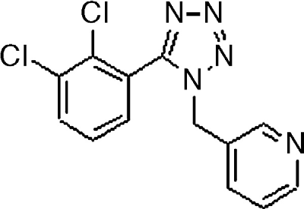
Can we treat glomerulonephritis with
a P2X₇R antagonist?
A438079 is a selective P2X₇R antagonist developed at Abbott Laboratories
A reversible and competitive blocker (McGaraughty et al 2007 Neuroscience 146:1817)
342 kD
Does not cross reactive with
  P2X₁, P2X_{2a}, P2X_{2/4}, P2X₄
  P2Y₁, P2Y₂

Slide 50
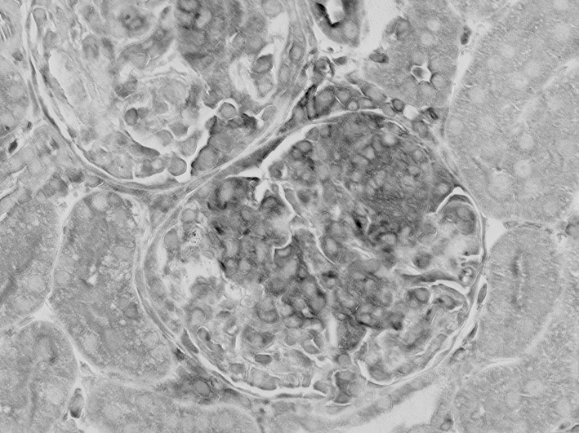
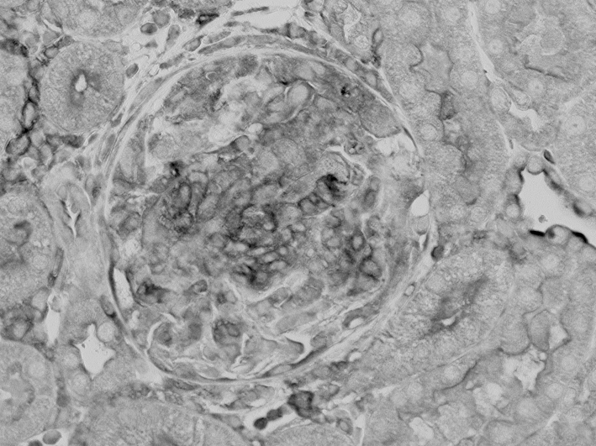
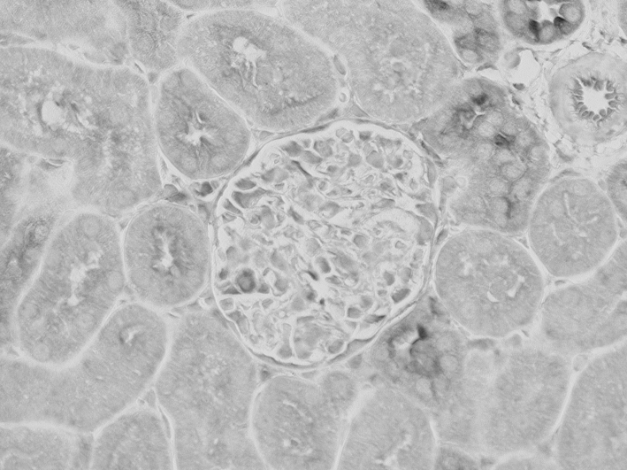
Is MCP-1 production altered by the antagonist
in vivo?
P<0.05
4000
n.s.
3000
Vehicle
Renal MCP-1 (pg/mg protein)
2000
1000
Low dose
100µmol/Kg
0
Vehicle
Low dose
High dose
P2X₇R antagonist
MCP-1 is significantly reduced in the
High dose (300 µmol/Kg group)
High dose
300µmol/Kg

Slide 51
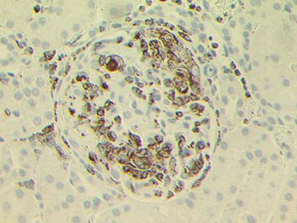
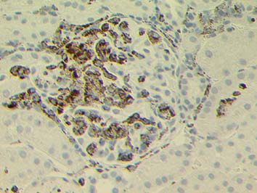
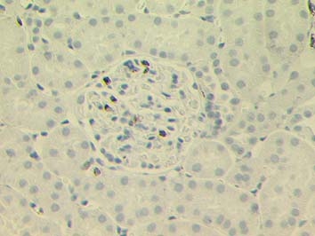
Antagonist treatment reduced number of infiltrating macrophages (ED-1)
P<0.001
n.s.
vehicle
40
30
Low dose
100µmol/Kg
Macrophages / GCS
20
10
0
Vehicle
Low Dose
High Dose
High dose
300µmol/Kg
P2X₇R antagonist

Slide 52
P2X₇R antagonist reduces renal injury
Glomerular fibrinoid necrosis
Proteinuria
P<0.001
P<0.01
n.s.
n.s.
2.5
80
2.0
60
1.5
Proteinuria (mg/24Hr)
Fibrinoid necrosis score
40
1.0
20
0.5
0.0
0
Vehicle
Low Dose
High Dose
Vehicle
Low Dose
High Dose
P2X₇R antagonist
P2X₇R antagonist

Slide 53
Summary 3: effect of a receptor antagonist
A438079, a P2X₇R antagonist
  Reduced macrophage infiltration and MCP-1 production
  Reduced fibrinoid necrosis and proteinuria

Slide 54
Conclusions
Chemokines & cytokines have multiple functions, some examples in this lecture
Chemokines – recruitment of leucocytes
Some cytokines (e.g. IL-4 and IL-12) regulates T cell development
Pro-inflammatory cytokines: e.g. IL-1 & TNF
Tight regulation (including inflammasome) in the production of active cytokines

