Slide 1
The nature of the alloimmune response Antigenicity and Immunogenicity Professor Julian Dyson 15 January 2013

Slide 2
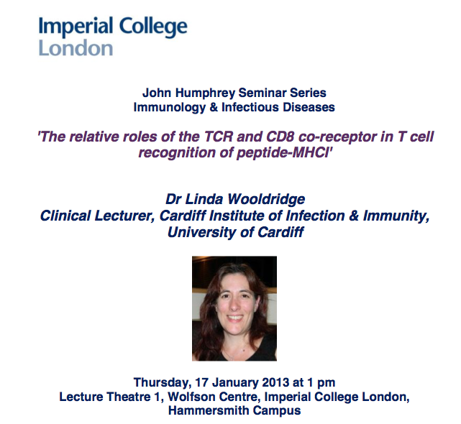

Slide 3
Genetics of the HLA region
Polymorphism of HLA genes
Linkage disequilibrium
HLA and disease associations
Allorecognition

Slide 4
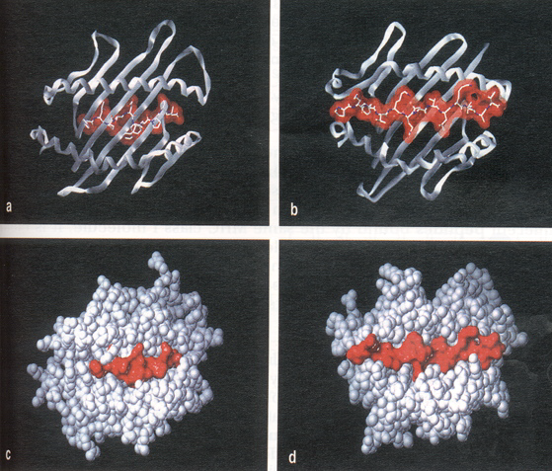
MHC-peptide complex

Slide 5
CD4⁺ T cells
APC
MHC class II
CD4
TCR
CD4⁺ T cell

Slide 6
CD8⁺ T cells
APC
MHC
CD8
TCR
CD8⁺ T cell

Slide 7
MHC in different species
Human HLA (human leucocyte antigen)
Mouse H2 (histocompatibility locus 2)
Pig SLA (swine leucocyte antigen)

Slide 8
Expression of HLA class I molecules:
HLA-A
HLA-B almost all nucleated cells;
HLA-C not on embryonic villous trophoblast
involved in implantation
Foetal tolerance

Slide 9
Expression of HLA class I molecules:
HLA-A
HLA-B almost all nucleated cells;
HLA-C not on embryonic villous trophoblast
involved in implantation.
Instead, HLA-G is expressed.
Ligand for NK cell inhibitory receptor
KIR2DL4

Slide 10
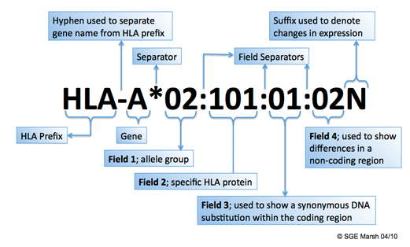
HLA class I nomenclature
eg HLA-A*0201

Slide 11
Expression of HLA class II molecules:
HLA-DR constitutive expression APCs: immunity
HLA-DQ thymic epithelium: T cell development
HLA-DP can be induced on many cell types during inflammation
eg vascular endothelium: IFN gamma

Slide 12
Nomenclature
Serology
HLA-A1
HLA-DR1
Genotypic (DNA seq)
HLA-A*0101
HLA-DRB1*0101

Slide 13
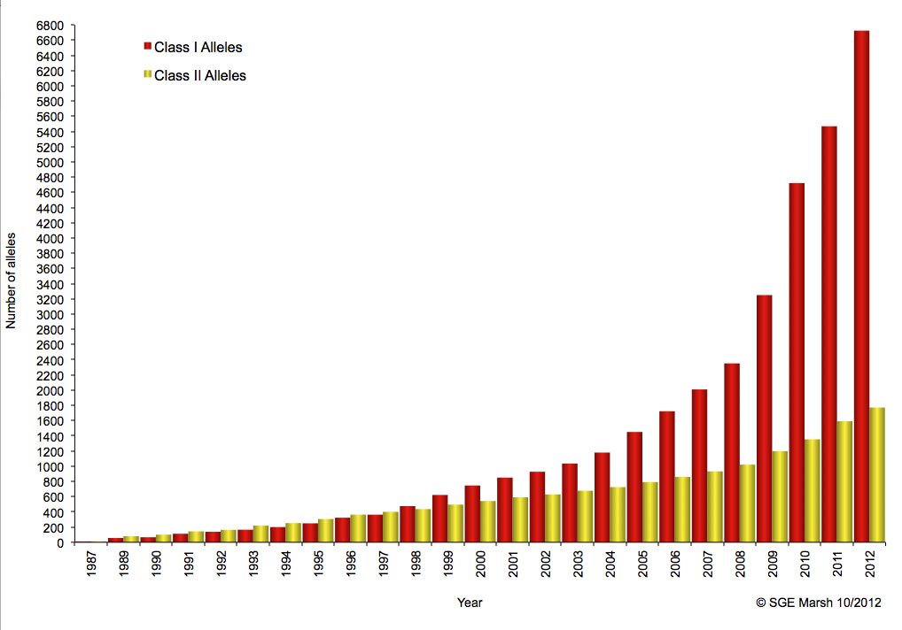
HLA class II nomenclature
http://hla.alleles.org/

Slide 14
HLA class II nomenclature
eg HLA-DRA1*01:01:01
HLA-DRB1*01:01:01

Slide 15
Polymorphism of MHC genes
HLA class I/II genes and Natural killer (NK) receptors,
are the most polymorphic of all mammalian genes

Slide 16
Polymorphism of MHC genes
HLA class I/II genes and Natural killer (NK) receptors,
are the most polymorphic of all mammalian genes
MHC complex also contains polymorphic olfactory receptors.
Basis for discrimination of MHC type in mate choice!

Slide 17
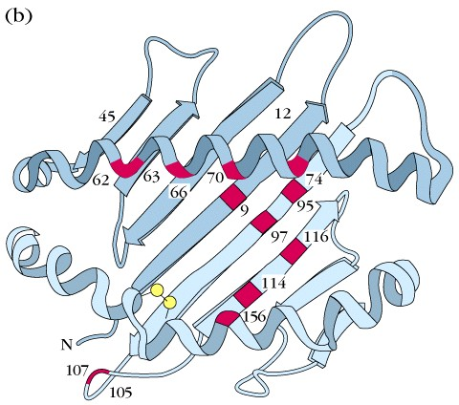
Location of polymorphic amino acid residues
Most polymorphic residues are located in the peptide binding cleft

Slide 18
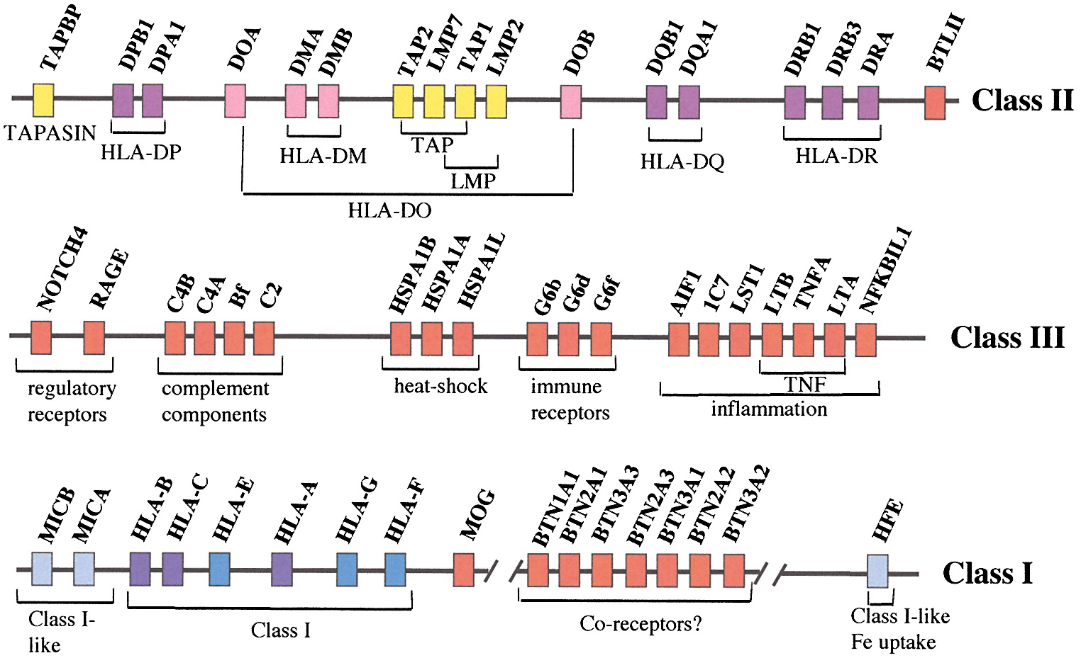
Immunity (2001) Vol. 15, p.363-374

Slide 19
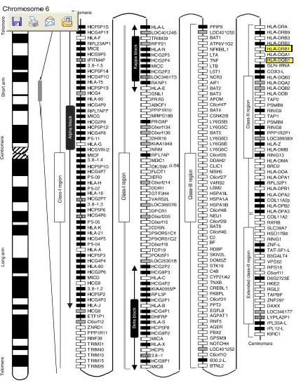

Slide 20
Polymorphism of MHC genes:
http://hla.alleles.org

Slide 21
Why are MHC genes so polymorphic?
An alternative to rapid evolution
Viruses need to be recognised by T cells within hours
after infection
Multiple MHC molecules means the population has many
peptide binding possibilities to evade evolving pathogens

Slide 22
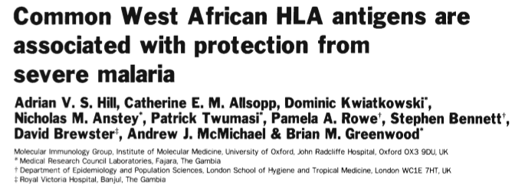
Why are MHC genes so polymorphic?
Nature. 1991 Aug 15;352(6336):595-60

Slide 23
Linkage disequilibrium:
The occurrence together on the same haplotype of
two or more alleles with a frequency greater than
would be predicted by the individual gene frequencies….

Slide 24
Immunity (2001) Vol. 15, p.363-374

Slide 25
In N.European Caucasians:
Frequency of HLA - A1 ~ 10%
B8 ~ 10%
DR3 ~ 10%
Predicted frequency of haplotype carrying A1, B8, DR3 = 0.1%
Actual frequency = 10%
Implications: Different ethnic groups have different HLA patterns
Organ transplantation between races often have poorer outcome

Slide 26
HLA-A201 frequencies by country/racial group

Slide 27
Susceptibility to autoimmune (type 1) diabetes
Susceptibility gene Linked genes Relative risk DQB1*0302 DQA1*0301 8 DRB1*04 DQB1*0201 DQA1*0501 4 DRB1*03
DQB1*04 DQA1*0301 4 DRB1*04

Slide 28
The Thymus
Developing thymocytes are subject to selective pressures in the thymus (+ve and -ve selection)
Bone marrow
progenitor cell
“Ignores the useless
Immature cortical thymocytes (cortex)
Deletes the dangerous
Selects the useful”
Mature medullary thymocytes (medulla)
mature T cells

Slide 29
Generation of diversity
TCR diversity is the results of recombination events that bring together 2 or 3 separate elements, from a pool of genetic segments in order to create maximum diversity
V
V
V
V
J
J
C
1
2
3
x
1
6
α
Rearrangement of DNA segments
V
V
V
J
J
C
1
2
3
5
6
α
V
V
J
C
1
3
5
α
mRNA transcript
protein (T cell receptor)

Slide 30
T lymphocyte selection in the thymus “Central tolerance”
Developing
lymphocyte
Thymus
Moderate affinity “Positive selection”

Slide 31
T lymphocyte selection in the thymus “Central tolerance”
Developing
lymphocyte
Thymus
Moderate affinity “Positive selection”
No affinity Not developed

Slide 32
T lymphocyte selection in the thymus “Central tolerance”
Developing
lymphocyte
Thymus
Moderate affinity “Positive selection”
No affinity Deleted
Not useful
High affinity Potentially autoreactive
Deleted
“Negative selection”

Slide 33
Although positively selected on self-MHC T lymphocytes are ‘alloreactive’ to non-self MHC
Developing
lymphocyte
Thymus
Moderate affinity “Positive selection”

Slide 34
Although positively selected on self-MHC T lymphocytes are ‘alloreactive’ to non-self MHC
Developing
lymphocyte
Repertoire tolerised only to self-MHC peptide complexes
Retains ‘specificity’ for non-self MHC peptide complexes
Thymus
Moderate affinity “Positive selection”

Slide 35
How was allorecognition discovered?
First evidence was provided by the rejection of skin grafts transplanted between different animal strains
MHC A
MHC B
donor
recipient
graft rejected!
% of survival
20
40
60
80
Same as unrelated human kidney, heart transplant

Slide 36
The phenomenon of allorecognition
MHC-incompatible cells induce uniquely strong primary immune responses.
In vivo -> HVG and GVH reaction
In vitro -> MLR mixed lymphocyte reaction
This reflects the high precursor frequencies of T cells with anti-MHC ‘allospecificity’.

Slide 37
Frequency of alloreactive T cells
• Several % of T cells recognise intact allogeneic (non-self) MHC molecules (high frequency)
< 1 in 10,000 are specific for any foreign antigen recognised in the context of self-MHC molecules

Slide 38
Although positively selected on self-MHC T lymphocytes are ‘alloreactive’ to non-self MHC
Developing
lymphocyte
Repertoire tolerised only to self-MHC peptide complexes
Retains ‘specificity’ for non-self MHC peptide complexes
Thymus
Moderate affinity “Positive selection”

Slide 39
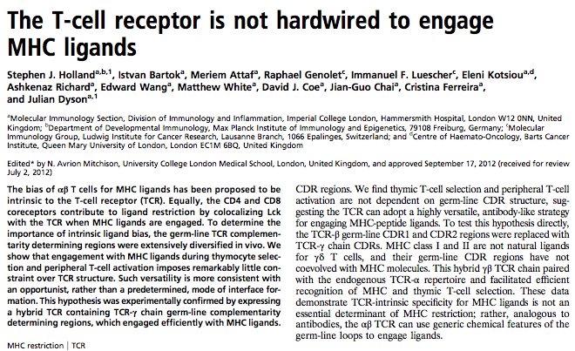
Why does the TCR focus on MHC molecules?
Holland et al Proc Natl Acad Sci U S A. 2012 109:E3111

Slide 40
Why does the TCR focus on MHC molecules?
Van Laethem F et al Immunity. 2007 27:735-5

Slide 41
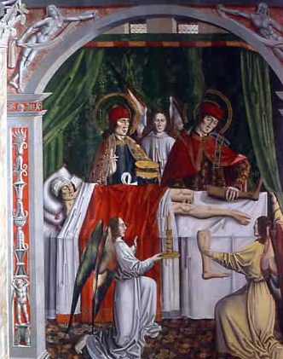
The immunological obstacle to successful
transplantation is the immune response
induced by allogeneic MHC molecules
Saints Cosmas and Damian performing a miraculous leg transplantation. Painting from the early 1500s.

Slide 42
Allorecognition: the two pathways
Indirect allorecognition
CD8
Direct allorecognition
CD4
I
allo APC
CD8
CD4
Shed allogeneic MHC
IL-2
II
IL-2
Taken up and processed by auto APC
I
II
allo APC
Host APC

Slide 43
The indirect pathway of allorecognition
Alternative mechanism of recognition of allogeneic MHC molecules:
allogeneic MHC molecule is processed and presented as a peptide (similar to recognition of foreign peptide/self-MHC complexes);
the complex is recognised on (host) autologous APC;
low frequency;
involved in chronic rejection.

Slide 44
Antigenicity and Immunogenicity

Slide 45
Context of T cell antigen recognition affects outcomes
CD4⁺ T cell
TCR
Accessory
Costimulation
Molecules
MHC
Antigen-presenting cell

Slide 46
Context of T cell antigen recognition affects outcomes
Immunosuppression
A x B
B
Re-transplanted.
The graft was not rejected: the graft was fully antigenic but not immunogenic. Graft associated donor APCs left graft in 1st host
B
no immunosuppression
no rejection
Lechler RI, Batchelor JR. J Exp Med. 1982 155:31

Slide 47
Context of T cell antigen recognition affects outcomes
Immunosuppression
A x B
B
Re-txn.
1/12
Dendritic cells
B
The graft was immediately rejected!

Slide 48
T cell antigen recognition can have several distinct outcomes
CD4⁺ T cell
Full activation
Tolerance
Apoptosis
TCR
Accessory
Costimulation
Molecules
MHC
Antigen-presenting cell

Slide 49
Conclusions
The MHC has the potential to stimulate a very aggressive immune response
This arises out of cross-reactivity of self-restricted T cells
In practice this is controlled with time following transplantation
Deletion, anergy and regulation
What is important is the immunogenicity not the antigenicity of a graft

Slide 50
References
TCR cross-reactivity and allorecognition: new insights into the immunogenetics of allorecognition.
D'Orsogna LJ, Roelen DL, Doxiadis II, Claas FH.
Immunogenetics. 2012 Feb;64(2):77
Alloreactivity: an old puzzle revisited.
Nagy ZA.
Scand J Immunol. 2012 May;75(5):463
The importance of the indirect pathway of allorecognition in clinical transplantation.
Gökmen MR, Lombardi G, Lechler RI.
Curr Opin Immunol. 2008 Oct;20(5):568

