Slide 1
SLE – the role of inherited and acquired complement deficiencies
Marina Botto
Imperial College London

Slide 2
Complement in SLE - objectives
Overview of function, activation and regulation of the complement system
Measurement of complement in SLE –
? helpful
Complement and disease
  inherited and acquired conditions

Slide 3
Complement System
immune complexes
bacteria
‘always on’
classical pathway
lectin pathway
alternative pathway
C1q
C1r
C1s
MBL/Ficolin
MASPs
C3
C4
B
C2
D
C4
P
C2
C3
C5
C9
C8
C7
C6
MAC
Notes:
The biological functions of complement can be divided into three categories.
Firstly, complement has a role in the killing of microorganisms through opsonisation, activation of leucocytes and target cell lysis.
The second activity of complement is as a bridge between the humoral adaptive immune system (antibody) and innate immunity. Many of the effector activities of antibody are mediated by the activation of complement by antibodies bound to antigens (immune complexes). Activation of complement also augments antibody responses and thereby enhances host defense against pathogens.
The third activity of complement is in the resolution of inflammatory responses. It is in this role that complement may prevent the development of systemic lupus erythematosus by promoting the clearance of tissue debris and you will here this discussed in detail in the final talk of the afternoon by Prof. Marina Botto

Slide 4
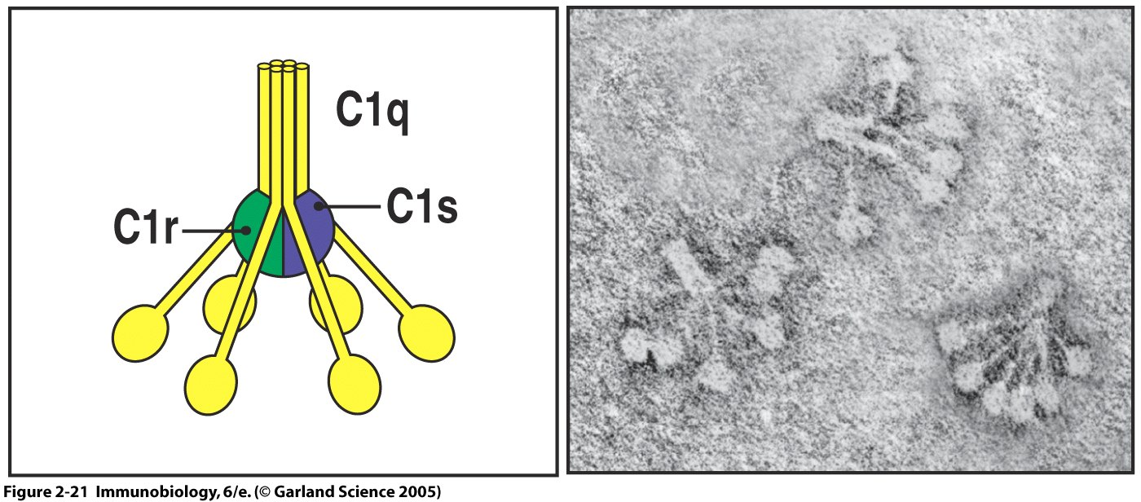
Classical pathway:
-immune complexes
-apoptotic cells
-certain viruses and G- bacteria
-C-reactive protein (e.g. tissue ischaemia, bacteria)
Janeway et al Immunobiology

Slide 5
The complement system - amplification/regulation
classical pathway
lectin pathway
alternative pathway
MBL/Ficolin
MASPs
C1q
C1r
C1s
C3
C4
B
C2
C4
D
P
C1 inhibitor
C2
Factor H
C4bp
C3
CR1
Factor I
DAF
MCP
C5
C9
C8
C7
C6
MAC
CD59
Notes:
This schematic outlines the complement system together with its sophisticated regulatory proteins which at act multiple levels in the activation cascade.
fluid-phase (shown in yellow boxes) and membrane-bound regulatory proteins (shown in the turquoise boxes)

Slide 6
Complement Biology
immune complexes
bacteria
‘always on’
classical pathway
lectin pathway
alternative pathway
C1q
C1r
C1s
MBL/Ficolin
MASPs
C3
C4
B
C2
D
C4
P
‘safe’ disposal of immune complexes and apoptotic debris
C2
C3
opsonin, anaphylatoxin, leucocyte activation
natural adjuvant
anaphylatoxin
C5
C9
C8
C7
C6
MAC
membrane damage or lysis
Notes:
The biological functions of complement can be divided into three categories.
Firstly, complement has a role in the killing of microorganisms through opsonisation, activation of leucocytes and target cell lysis.
The second activity of complement is as a bridge between the humoral adaptive immune system (antibody) and innate immunity. Many of the effector activities of antibody are mediated by the activation of complement by antibodies bound to antigens (immune complexes). Activation of complement also augments antibody responses and thereby enhances host defense against pathogens.
The third activity of complement is in the resolution of inflammatory responses. It is in this role that complement may prevent the development of systemic lupus erythematosus by promoting the clearance of tissue debris and you will here this discussed in detail in the final talk of the afternoon by Prof. Marina Botto

Slide 7
Complement assessment in clinical practice
C3 and C4 levels routinely available
    reliable, antigenic assays
Functional tests of classical (CH50) and alternative (AP50) pathway
    sensitive to sera handling ex vivo, important to repeat ‘absent’ values
    If abnormal please refer to specialised laboratory

Slide 8
What is the CH50?
CH50
  Functional assay that measures total complement haemolytic activity
  Requires
    intact classical pathway
    functional C3
    intact terminal pathway
add antibody
add SERA
quantify lysis
sheep red cells
OPSONISED
sheep red cells

Slide 9
CH50
classical pathway
C1q
C1r
C1s
C4
C2
C3
C5
C9
C8
C7
C6
MAC
Notes:
C may be activated by 3 different pathways which all culminate in the generation of enzyme complexes – termed convertases – that activate C3, a pivitol protein in the C activation pathway.
Following C3 activation, C5 activation occurs which triggers the assembly of a protein complex termed the membrane attack complex – which mediates one of the most important effector functions of C – that of cell lysis
The predominant activators of the classical pathway are aggregated IgG or staple IgM in immune complexes
The lectin pathway is triggered by terminal mannose groups on the surface of certain bacteria
The alternative pathway in contrast to the classical and lectin pathways, is in a constant state of activation due to with the constant generation of activated C3 – this provides a means by which rapid deposition of C3 on foreign surfaces may occur independently of the presence of Ab or mannose
Many of the important functions of C are shown which include…complement has a role in the killing of microorganisms through opsonisation, activation of leucocytes and target cell lysis, resolution of inflammatory responses through the clearance of IC and apoptotic cells and C also acts as a natural adjuvant, augmenting antibody responses.

Slide 10
What is the AP50?
AP50
  Functional assay that measures alternative pathway-mediated haemolytic activity
  Requires
    intact alternative pathway
    functional C3
    intact terminal pathway
add SERA
quantify lysis
Guinea-pig red cells

Slide 11
AP50
alternative pathway
C3
B
D
P
C3
C5
C9
C8
C7
C6
MAC
Notes:
C may be activated by 3 different pathways which all culminate in the generation of enzyme complexes – termed convertases – that activate C3, a pivitol protein in the C activation pathway.
Following C3 activation, C5 activation occurs which triggers the assembly of a protein complex termed the membrane attack complex – which mediates one of the most important effector functions of C – that of cell lysis
The predominant activators of the classical pathway are aggregated IgG or staple IgM in immune complexes
The lectin pathway is triggered by terminal mannose groups on the surface of certain bacteria
The alternative pathway in contrast to the classical and lectin pathways, is in a constant state of activation due to with the constant generation of activated C3 – this provides a means by which rapid deposition of C3 on foreign surfaces may occur independently of the presence of Ab or mannose
Many of the important functions of C are shown which include…complement has a role in the killing of microorganisms through opsonisation, activation of leucocytes and target cell lysis, resolution of inflammatory responses through the clearance of IC and apoptotic cells and C also acts as a natural adjuvant, augmenting antibody responses.

Slide 12
Complement and disease
COMPLEMENT DEFICIENCY
ACTIVATION PROTEIN
inherited
Classical pathway
component
deficiency
and
Systemic
lupus
erythematosus
acquired
Low C4 with
Normal or low C3
e.g.
SLE
MEC
Rheumatoid
Vasculitis
Felty’s syndrome
REGULATORY PROTEIN
inherited
Heterozygous
C1 inhibitor
deficiency
and
Hereditary
angioedema
acquired
Clonal RBC
deficiency of
DAF and CD59
and
Paroxysmal
Nocturmal
Haemoglobinuria

Slide 13
Complement and rheumatic conditions
inherited
Early Classical pathway proteins
SLE

Slide 14
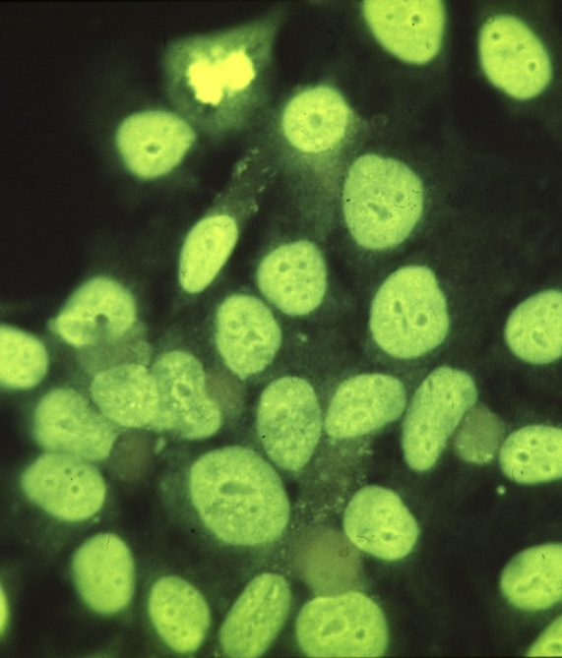
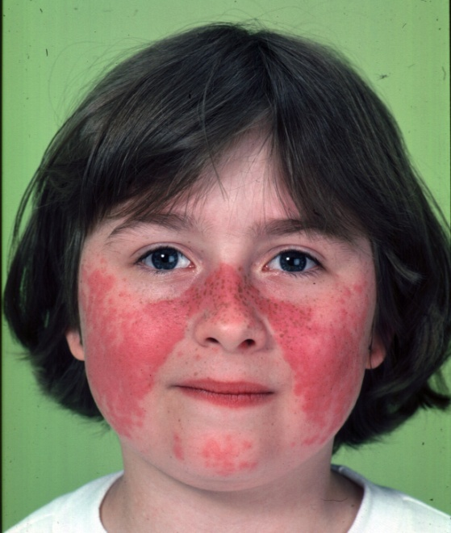
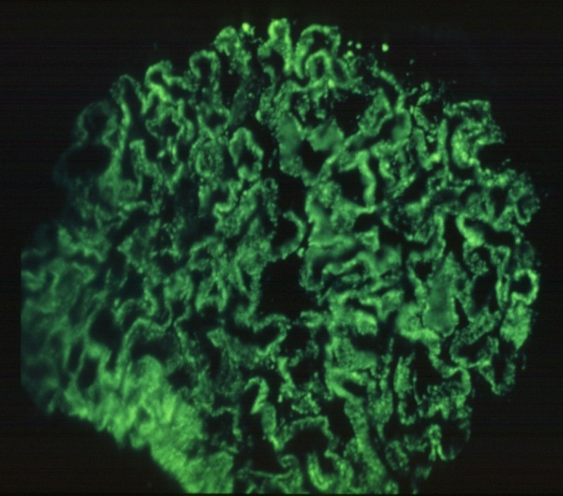
SLE
anti-dsDNA
Butterfly rash
C3 staining

Slide 15
Pathogenesis of inflammation in SLE
The traditional view
Autoantibodies form immune complexes with autoantigens
These fix complement
Complement causes tissue injury
but
The clinical evidence doesn’t quite fit!

Slide 16
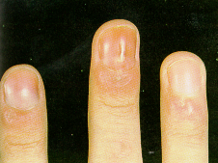
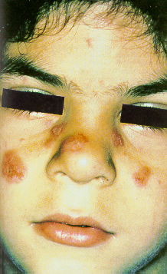
Inherited complement deficiency and rheumatic disease
CASE HISTORY - 1
16 year old Pakistani schoolgirl
aged 6 years:
        facial rash
        photosensitivity
        positive ANA
        normal C3 and C4
        skin biopsy - ‘lupus’
aged 6 - 11 years:
        erythematous rash on dorsum of fingers
        non-scarring alopecia
        Raynaud’s phenomenon
        headaches and seizure
        Recurrent urinary infections
Immunological investigations:
    ANA positive 1/640
    anti-dsDNA antibodies negative
    anti-C1q, -Sm, Ro, -La, RNP antibodies negative
    anticardiolipin antibodies negative

Slide 17
Inherited complement deficiency and rheumatic disease
CASE HISTORY - 2
Complement Profile:
C3 1.28 0.7 – 1.7 g/l
C4 0.64 0.16 – 0.54 g/l
Haemolytic assays:
CH50 0 50 – 125 %NHS
classical pathway
AP50 83 50 – 125 %NHS
alternative pathway
? DIAGNOSIS

Slide 18
Inherited complement deficiency and rheumatic disease
CASE HISTORY - 3
Complement Profile:
C3 1.28 0.7 – 1.7 g/l
C4 0.64 0.16 – 0.54 g/l
Haemolytic assays:
CH50 0 50 – 125 %NHS
AP50 83 50 – 125 %NHS
Measurement of classical pathway components:
C1q 0 50 – 200 μg/ml
SLE SECONDARY TO CONGENITAL DEFICIENCY OF C1q

Slide 19
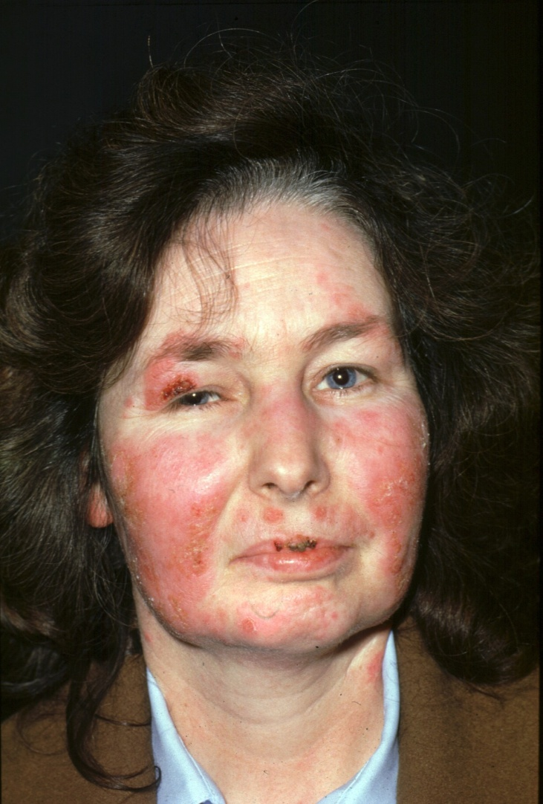
C2 deficiency
commonest classical pathway deficiency
prevalence in Western Europe 1:20,000
SLE in approx. 10%
anti-Ro and anti-La
sex ratio 7 F : 1 M

Slide 20
Screening for inherited complement deficiency
Suspect if:
  frequent infections
  young age at onset
  history of consanguinity
  (severe SLE with normal C3 and C4 levels)
Tests required:
  C3 and C4 levels routinely available
  Functional tests of classical (CH50) and alternative (AP50) pathway
    sensitive to sera handling ex vivo, important to repeat ‘absent’ values

Slide 21
Complement deficiency and SLE
C1q
C1r/C1s
C4
C2
C3
Cases
42
14
24
many
23
SLE
39
8
18
77+
3
SLE
%
93%
57%
75%
10%
13%
Sex (F:M)
1.3
:1
1.7:1
2:
1
7:
1
Sibling
90%
67%
80%
58%
concordance
Strong association between classical pathway deficiency and SLE-like illness

Slide 22
Complement deficiency and SLE
A physiological activity of the early part of the classical pathway of complement protects against the development of SLE

Slide 23
C1q and SLE pathogenesis – different roles
1) C1q and failure of clearing dying
cells
2) C1q and pathological survival of
autoreactive lymphocytes
3) C1q as a regulator of cytokine
expression

Slide 24
Complement and SLE – 2 hypotheses
“Waste-disposal hypothesis”
Complement is involved in the clearance of dying cells
“Tolerance hypothesis”
Complement plays a role in B cell tolerance

Slide 25
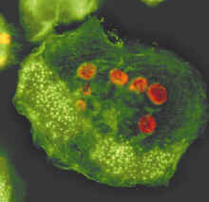
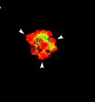
Lupus autoantigens concentrated on the
surface of apoptotic blebs and bodies
Apoptotic bodies: Nucleosomes,
RO, La, Sm, MUMA, PARP etc
Apoptotic blebs:
Ro, Ribosomal P
Calreticulin, Jo-1 etc
Apoptotic blebs recognised by anti-chromatin antibodies

Slide 26
“Waste-disposal hypothesis”
SLE associated with C1q-deficiency may be caused by an impairment of the clearance of dying cells and / or immune complexes which cause inflammation and provide a source of autoantigens

Slide 27
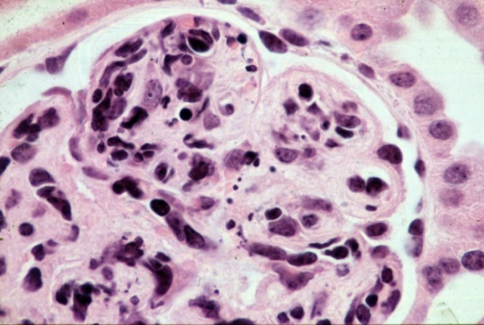
“Waste disposal” hypothesis
Mouse
Human
Kidney from C1q-/- mice
Defective waste disposal
80
Healthy subjects
60
C1q deficient + C1q
AutoAg exposed on apoptotic cells
Botto M et al (1998) Nat Genet 19(1):56-9
40
apoptotic bodies
% of macrophages ingesting
C1q deficient
60
Wild type
20
50
40
0
30
0
30
60
90
120
apoptotic bodies
% of macrophages ingesting
Time (min)
20
10
C1qa -/-
SLE
0
0
30
60
90
120
Time (min)

Slide 28

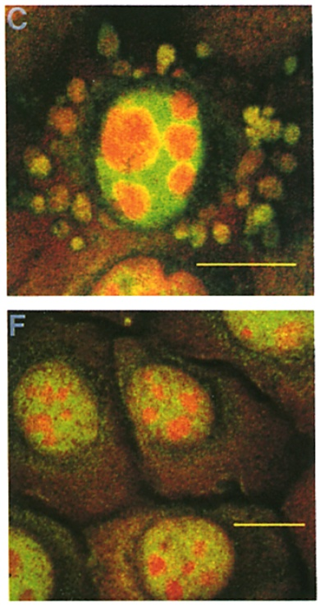
Waste disposal hypothesis
C1q deficiency
Kidney from C1q-/- mice
Defective waste disposal
Botto M et al (1998) Nat Genet 19(1):56-9
AutoAg exposed on apoptotic cells
80
Healthy subjects
60
C1q deficient + C1q
40
apoptotic bodies
% of macrophages ingesting
C1q deficient
20
PI
SLE
Anti-Ro 52kDa
0
Casciola-Rosen et al (1994)
J Exp Med 179(4):1317-30
0
30
60
90
120
Time (min)

Slide 29
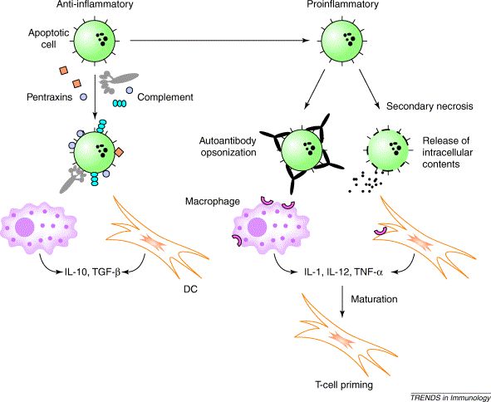
Impaired clearance of apoptotic cells and SLE
Anti-inflammatory
Pro-inflammatory

Slide 30
Complement and SLE – 2 hypotheses
“Waste-disposal hypothesis”
Complement is involved in the clearance of dying cells
“Tolerance hypothesis”
Complement plays a role in B cell tolerance

Slide 31
Does C1q have a direct role in the maintenance of B cell tolerance ?

Slide 32
C1q-deficiency and self tolerance
C1q deficient mice bred with hen egg lysozyme (HEL)-transgenic mice expressing:
a) Ig H and L chains with high affinity for HEL
b) sHEL (10-30ng): sufficient to trigger anergy but not deletion of transgenic B cells

Slide 33
Ig^{HEL} transgenic B cells in presence and absence of HEL
Pre-B cell
Immature B cell
Follicular B cell
Plasma cell
IgM
IgM
IgD
high
B220+
B220+
CD22+
lo-med
B220++
CD21
CD22++
Immature B cells
Mature B cells
Plasma cells
Bone Marrow
Spleen
Mesenteric
Spleen
C1q
Self-
lymph node
Genotype
antigen
<
10
4
10
5
10
6
10
7
<
10
6
10
7
10
8
9
4
5
6
7
<
10
2
10
3
10
4
10
5
10
6
10
<
10
10
10
10
+/-
none
-/-
none
+/-
sHEL
-/-
sHEL
Eur J Immunol. 2001, 31:2087-93

Slide 34
Does C1q have an effect on APC T-cell interactions?

Slide 35
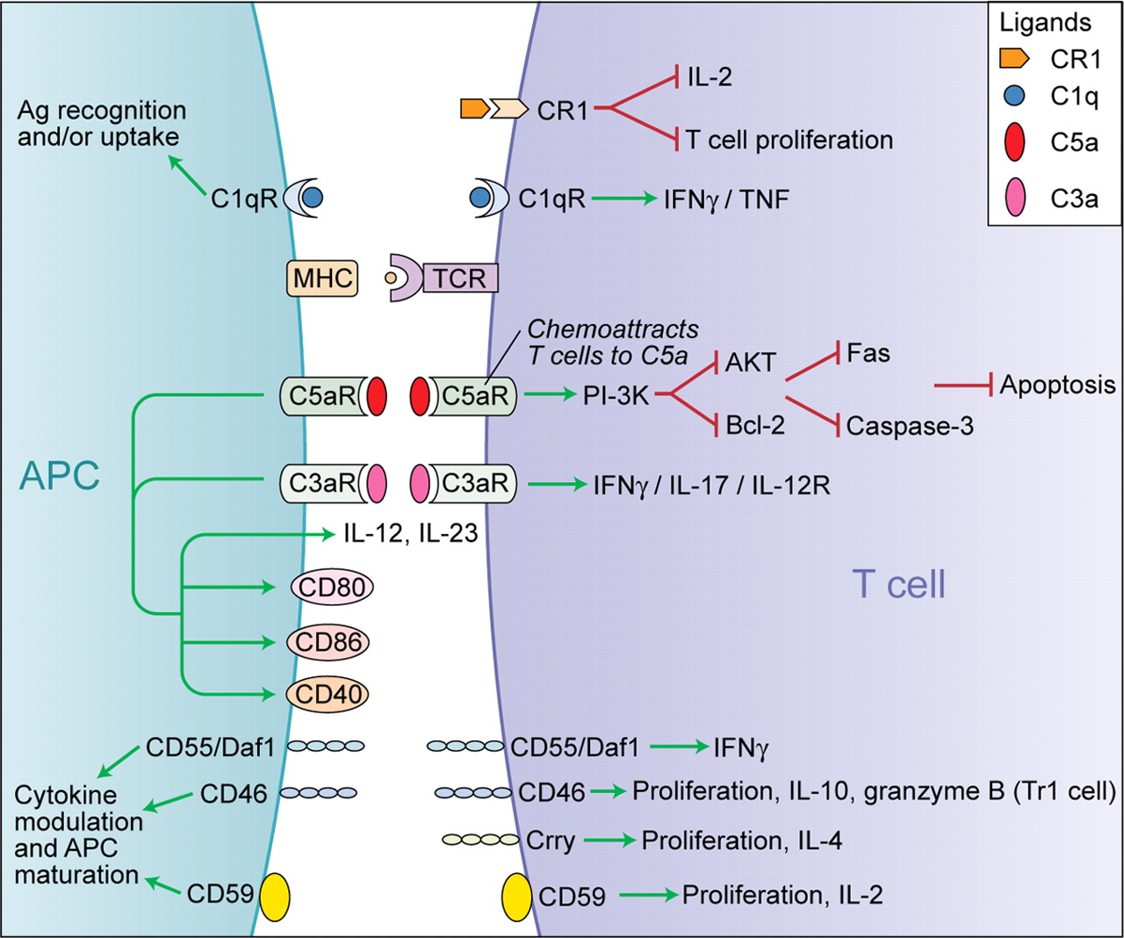
Complement and the adaptive immune system
Ansari, M. J. et al. Blood 2008;112:1551-1552

Slide 36
Impaired IL-12 secretion by DC from C1q-deficient patients in response to CD40 stimulation
800
3000
250
600
200
2000
IL-12p70 (pg/ml)
IL-12p70 (pg/ml)
150
400
IL-10 (pg/ml)
1000
100
200
50
0
w/o
LPS
(0.1µg/ml)
LPS
(1µg/ml)
0
0
w/o
CD40L
1 µg/ml
CD40L
2 µg/ml
w/o
CD40L
1 µg/ml
CD40L
2 µg/ml
C1q-deficient patient
Healthy subject

Slide 37
Complement deficiency and SLE - hypotheses
COMPLEMENT DEFICIENCY
Impaired Waste Disposal Mechanisms e.g. Dying Cells, IC
Abnormal Lymphocyte Activation
Increased levels of circulating DNA/anti-DNA IC
Additional Genetic/ Environmental Factors
SYSTEMIC LUPUS ERYTHEMATOSUS

Slide 38
Complement deficiency
“Tolerance
hypothesis”
“Waste disposal hypothesis”
Failed clearance of immune complexes
Impaired clearance of apoptotic cell debris
Abnormal lymphocyte activation
“Danger signal”
Target organ damage
Excess autoantigens
DC maturation
External danger signals:
- Virus
- IFN-α
Production of autoantibodies
Failure of B cell negative selection
Immune complex formation
SLE
Target organ damage
(including direct damage by complement)

Slide 39
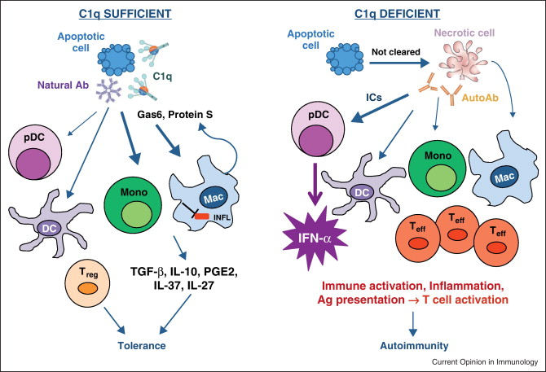
Curr Opin Immunol. 2012 Dec;24(6):665-70

Slide 40
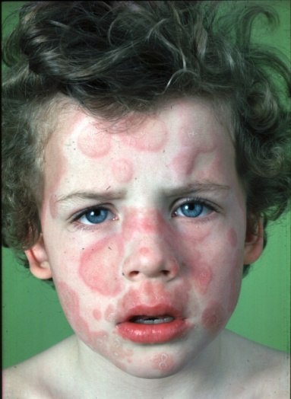
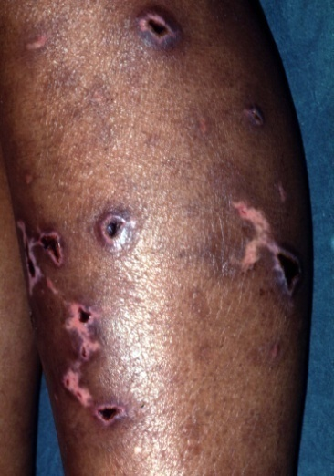
Complement deficiency and disease
Classical pathway
C3
Terminal pathway
SLE
Pyogenic infection
Meningococcal infection
Notes:
There is no doubt that too little complement activation is bad for you as illustrated by the rare but informative individuals with complement deficiency such as CP deficiency and development of SLE illustrated by this C1q-deficient patient, C3 deficiency and pyogenic infection and TP deficiency and neisserial infections

Slide 41
Complement and rheumatic conditions
inherited
Early Classical pathway proteins
SLE
acquired
Consumption: low C4 and C3

Slide 42
Acquired complement deficiency and rheumatic disease
Predominantly classical pathway activation
Mixed essential cryoglobulinaemia
Hypocomplementaemic urticarial vasculitis syndrome
Rheumatoid vasculitis
Chronic infection e.g. infected shunts
Acquired C1 inhibitor deficiency
SLE

Slide 43
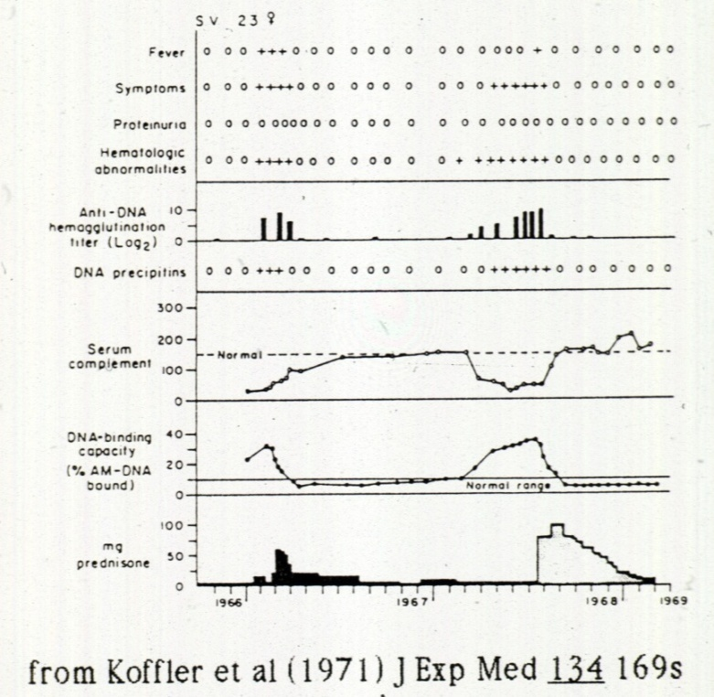
SLE – Complement and disease activity
Hypocomplementaemia frequently seen in active SLE
  may reflect severe disease
  complement levels increase
  following treatment
  tissue biopsies show
  deposits of C3 and C4
  but
  correlation is only approximate

Slide 44
Difficulties in complement assays
Serum levels vary widely among healthy individuals
Complement concentration rises with acute phase response
Local activation may not be reflected in circulating components
Genetic variations may account for low C4 levels

Slide 45
Complement and SLE
Active SLE is associated with hypo-complementaemia:
- low C3 usually associated with severe disease
- normal C3 in active lupus nephritis is unusual
- low C3 more often associated with active disease than
low C4
but
reduction of C3 and C4 levels inconsistently associated with disease flares

Slide 46
‘SLE paradox’
C1q
?
Genetic deficiency of C1q is associated with SLE
Patients with SLE develop antibodies to C1q

Slide 47
Anti-C1q antibodies and SLE
antigen
C1q
C1q
binding of C1q to antibody complexed with antigen
binding of antibodies to C1q

Slide 48
Anti-C1q antibodies - detection
Identified in 1970s - Solid-phase C1q-binding assay to detect IC
They bind to C1q in solid phase and not to circulating C1q - neoepitope when C1q is in its bound form
High affinity - the result of an antigen-driven immune response.
Predominant IgG2 subclass in lupus nephritis – clinical value of IgG subclass levels unclear

Slide 49
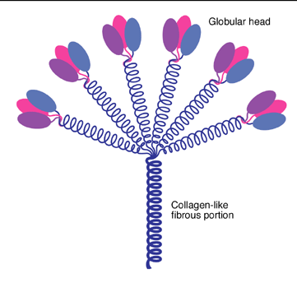
Anti-C1q Abs - what do they recognise?
  React with collagenous part of the C1q molecule
A report of anti-C1q Abs recognising the globular heads of C1q (Tsacheva et al Mol. Immunol, 2007, 44,2147-2151)

Slide 50
Anti-C1q antibodies and SLE
Detected in patients with:
  SLE ~30%
  Hypocomplementaemic urticarial vasculitis syndrome
  Rheumatoid vasculitis, Felty’s syndrome etc
  Healthy individuals or relatives of SLE patients (rare)
In SLE:
  STRONGLY associated with presence of lupus nephritis
    not seen in SLE patients without nephritis
  associated with hypocomplementaemia
    low C3, C4 and C1q
  anti-C1q titres rise prior to lupus nephritis flares

Slide 51
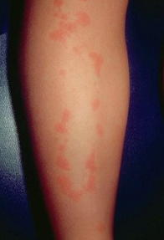
Anti-C1q antibodies and HUVS
Predominantly classical pathway activation
Hypocomplementaemic urticarial vasculitis syndrome
  urticarial vasculitis
  polyarthralgia/arthritis
  renal disease
  low C4 and usually C3
  anti-C1q antibodies positive
  anti-Sm and dsDNA antibodies negative
  low C1q level

Slide 52
The mechanism of development of anti-C1q antibodies in SLE?
Autoantibodies in SLE are to complexes of autoantigens: eg chromatin, Ro/La, anticardiolipin/beta 2 glycoprotein I
Hypothesis - the paradox solved?
C1q binds to dying cells and becomes part of autoantigenic complexes

Slide 53

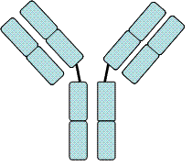
C1q
apoptotic
cell
Genetic
susceptibility
anti-C1q antibody

Slide 54
Anti-C1q antibodies and SLE
Are they epiphenomenon or
truly pathogenic??

Slide 55
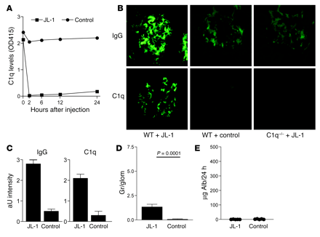
Effects of administration of anti-C1q mAb to naïve mice
PMN influx
Albuminuria
Trouw et al., J Clin Inv 2004 114 679-688

Slide 56
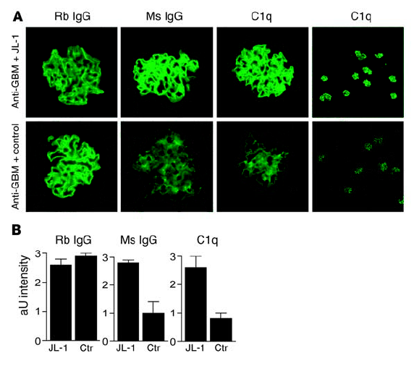
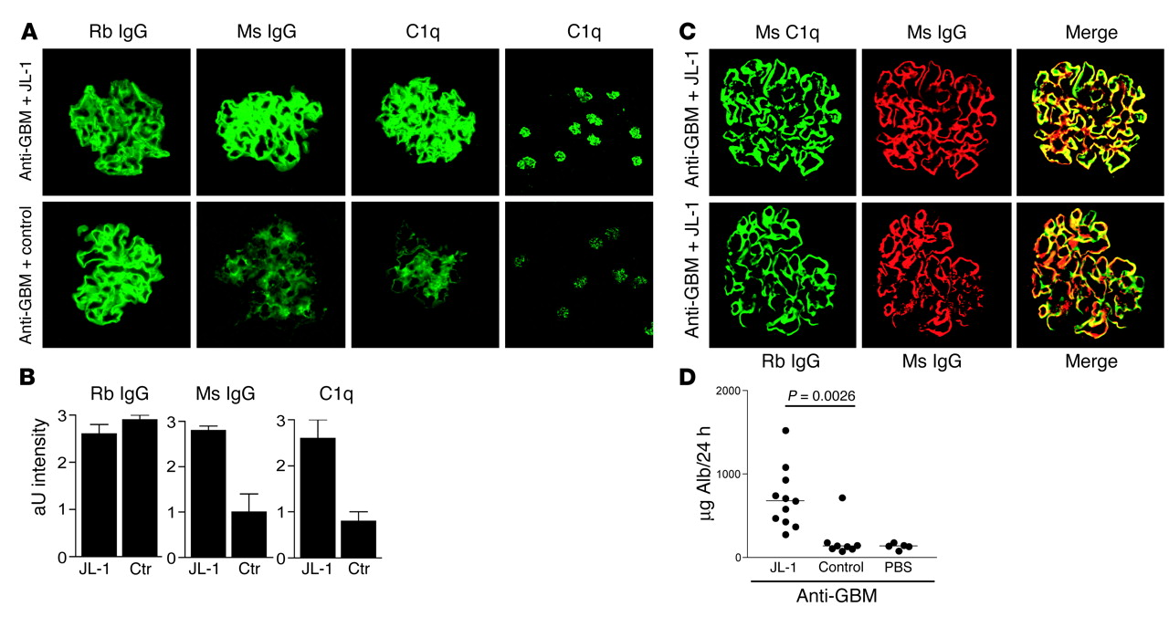
Effects of administration of anti-C1q mAb to anti-GBM pretreated mice
Albuminuria
Trouw et al., J Clin Inv 2004 114 679-688

Slide 57
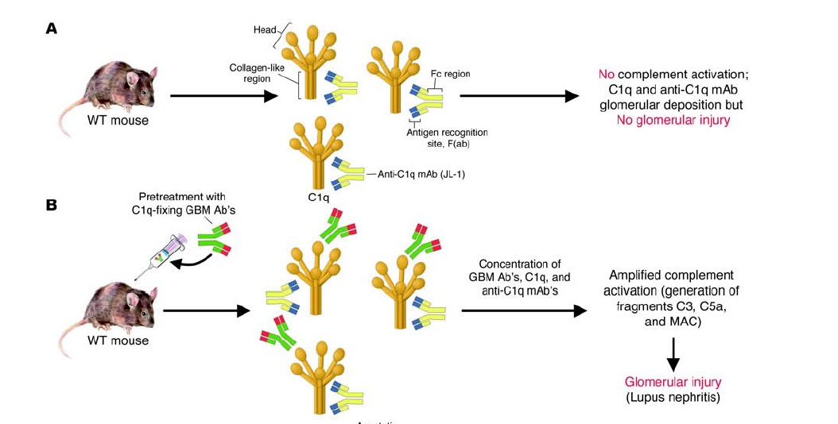
Anti-C1q antibodies and SLE
Holers, J Clin Inv 2004 (114):616-619, Trouw et al, J Clin Inv 2004 (114): 679-688

Slide 58
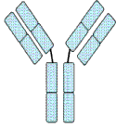


kidney
excessive complement activation → renal inflammation
kidney

Slide 59
Complement and SLE -conclusions
Complement acts at the interface between innate & adaptive immunity
Complement-deficiency results in a defective clearance of apoptotic cells that may explain the association between classical pathway deficiency and SLE
Anti-C1q antibodies can serve as an acquired mechanisms of classical pathway amplification.

Slide 60
Complement and SLE
Waste disposal
Tolerance
Inflammation
Protection
C3/C5
Organ damage
Classical pathway
? Lectin pathway
Alternative pathway
Terminal pathway

Slide 61
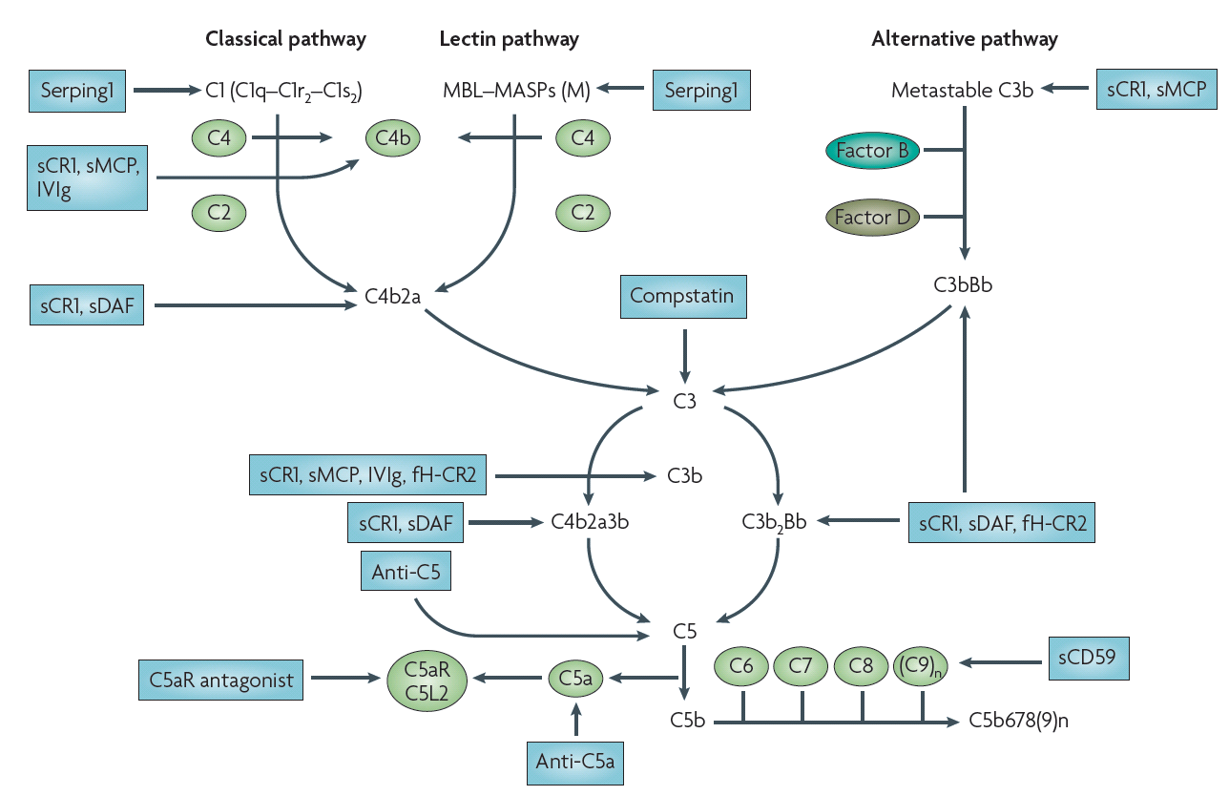
Complement therapeutics
Examples of the many complement inhibitors in development
Eric Wagner and Michael Frank Nature Reviews 2010, vol. 9, 43-56.
Notes:
There is not a shortage of innovative complement inhibitors in development – these are summarised here is a schematic form
Many of these mimick natural regulators for example soluble DAF agents
Some are ingenious linking complement regulators like factor H to complement receptors that allow the therapeutic to target and act only at sites of complement activation rather than causing systemic indiscriminate complement inhibition
In my view the future use of complement inhibition as therapy will be driven by science – in the final slides of my talk I will give you examples of this

Slide 62
The moral
Complement is a double-edged sword in SLE.
It protects against the development of SLE
It plays a direct pathogenic role in disease expression.

Slide 63
Complement - reading
“Complement, apoptosis and SLE” Pickering et al Adv Immunol 76:227-323
“Complement” (part 1 and 2) MJ Walport 2001,
N. Eng J Med. 344: 1058-1066 and 1140-1144

