Slide 1

Concepts of virulence: Animal models of fungal infection
Dr Elaine Bignell
Lecturer In Molecular Mycology
e.bignell@imperial.ac.uk
0207 594 2074
Faculty of Medicine
Division of Investigative Sciences
Department of Microbiology
Section of Microbiology

Slide 2
Overview
Aspects of designing relevant models – and experiments
Definitions of virulence – using models to ask the right question
Signature-tagged mutagenesis
- Candidate gene approach
Modelling of Candida, Aspergillus and Cryptococcus infection
Use of fungal infection modelling to address the host-pathogen
interaction

Slide 3
Learning outcomes
Following study of the taught material and associated reading you will be able to:
Discuss the use of murine models for the study of experimental Aspergillus, Candida and Cryptococcus infections
Distinguish between candidate gene, and global approaches to defining fungal ‘virulence factors’ and provide examples of each
Appreciate the shortcomings associated with the fungal challenge models routinely used to study fungal virulence
Understand the utility of whole animal models of infection compared to ex vivo or in vitro studies

Slide 4
Aspects of designing relevant models of fungal infection
– and good experimental design
Animal models are powerful tools to elucidate the molecular and cellular
pathogenesis of fungal infection
Allow more physiologically relevant examinations of the fungal response to host
stress than ex vivo culture methodologies
Models facilitate the study of precise cause-and-effect longitudinal analysis of
host-pathogen interactions
Compensate for difficulties in obtaining clinical samples in sufficient quantities
Useful for assessment of antifungal therapies
Indispensable for studies of immune modulation and vaccinology

Slide 5
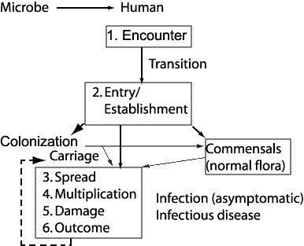
Formation of microbe- human associations
Factors effecting progress of a
pathogen
Circumstantial
Organism-related
Host-related
Virulence factors can be related to the
stage of infection e.g.
1. Entry/establishment
2. Penetration of epithelia
3. Tissue breakdown by enzymes or toxins
4. Entry into bloodstream/lymphatics
5. Dissemination
6. Multiplication
7. Immune evasion
8. Aberrant reaction from the host

Slide 6
Causal relationships between microbes and disease
A rework of Molecular Koch’s postulates (1988)
Identify gene (or gene product) responsible for virulence determinant
Show gene present in microbes that cause the disease
Not present in avirulent strains
Disrupting the gene reduces virulence
Introduction of cloned gene into avirulent strain confers virulence.
The gene is expressed in vivo
Falkow (2004) Molecular Koch's postulates applied to bacterial pathogenicity--a personal recollection 15 years later Nat. Rev. Micro. 2:67-72

Slide 7

Global approach: genome-wide screen
Signature-tagged mutagenesis
Toxin
biosynthesis
A
B
Cell wall protein
C
D
Protease
E
pH sensing
F
Iron uptake
Carbon metabolism
Using an inserting sequence called a transposon, generate library of
random insertion clones
Distinguish insertion clones from each other with
‘molecular barcode’ [A – F]
Hensel et al. (1995) Simultaneous identification of bacterial virulence genes by negative selection Science 269:400 (95)

Slide 8
STM Selection
Pool mutants and inoculate into mice

Slide 9
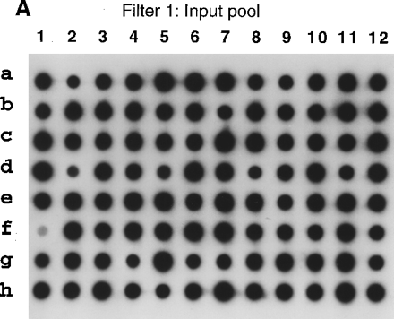
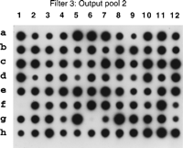
Recover mutants from sacrificed mice
Compare input and output clones
An Adhesin of the Yeast Pathogen Candida glabrata Mediating
Adherence to Human Epithelial Cells
Cormack et. al., (1999) Vol. 285. no. 5427, pp. 578 - 582

Slide 10
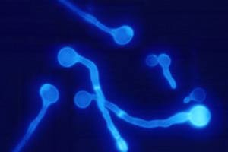
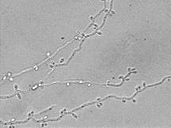
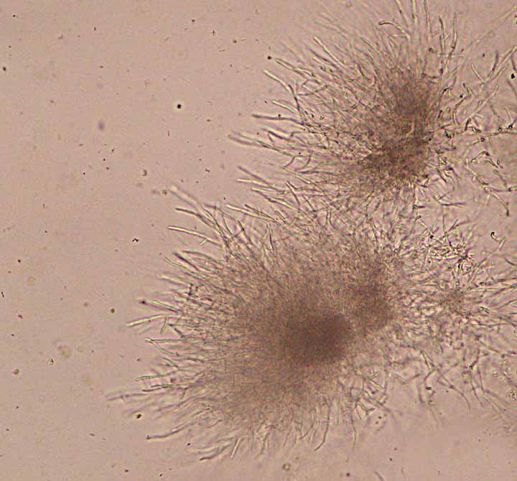
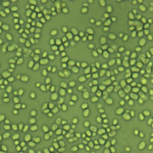
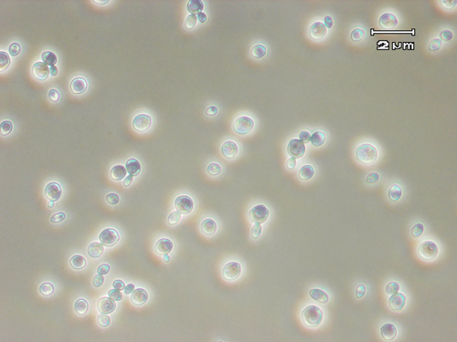
Modelling candidiasis
In immuncompromised hosts saprophytic colonisation often leads to
opportunistic mucosal or life-threatening deep organ infection
Invasion of the human gastrointestinal mucosa by C. albicans and passage
across the bowel wall into the bloodstream is important portal of entry
Haematogenous infection is a frequent complication in the treatment of
patients with acute leukaemia
Oropharyngeal candidiasis occurs in many of HIV infected patients
Vaginal infection occurs in approximately 75% of women
Ability of C. albicans to colonize, penetrate and damage host tissues depends
on imbalances between host immunity and C. albicans virulence factors
Candida albicans
Candida tropicalis
Candida parapsillosis
Candida krusei
C. glabrata

Slide 11
Models of candidiasis: immune suppression
and route of infection
!! MICE ARE NOT NORMALLY COLONISED BY CANDIDA SPECIES !!
Animal models in the analysis of Candida host-pathogen interactions (2004) Current Opinion in Microbiology 7:324-329

Slide 12
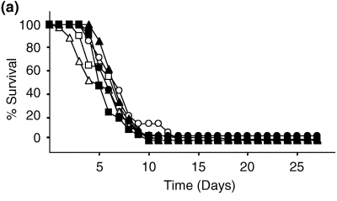
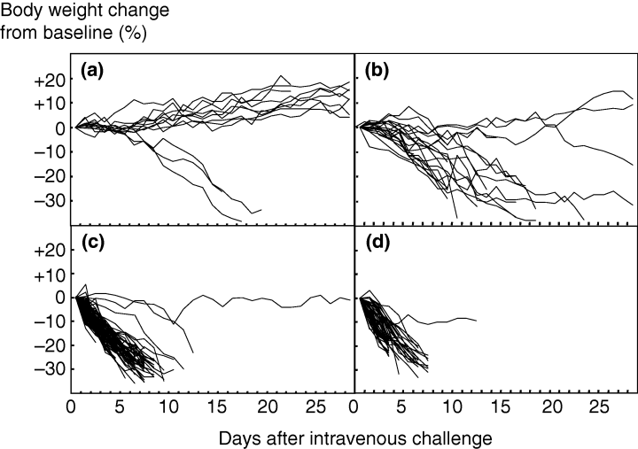
Intravenous (i.v.) Candida albicans challenge
i.v. challenge of mice is the most commonly used
experimental model to assess virulence of
Candida strains.
Mouse strains and sexes differ in their susceptibility
to i.v. C. albicans challenge
BALB/c mice (immunocompetent in-bred) succumb to
tail vein injection of 10⁴-10⁵ C. albicans cells at 2-10 days
post-infection
Body weight from point of infectious challenge falls steadily
and is dose-dependent
a) = 10² – 10³
b) = 10³ – 10⁴
c) = 1 – 3 x 10⁴
d) = 3 x 10⁴ – 1 x 10⁵
MacCallum and Odds (2005) Temporal events in the intravenous challenge model for experimental
C. albicans infections in female mice 48:151-161

Slide 13
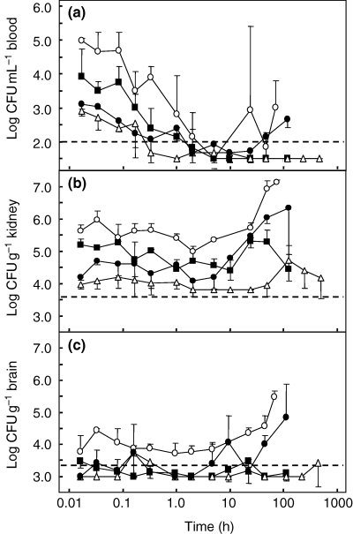
Intravenous (i.v.) Candida albicans challenge
Analysis of post-challenge C. albicans
tissue burdens with time show 3 general patterns
of organ-dependent behaviour
In blood, kidney and brain levels either remain static or fall
during the first 5 hours post-infection, then start to rise again
C. albicans cells are cleared rapidly from the blood with
concentrations lowered by one log₁₀ CFU/ml within
10 minutes of challenge
Kidneys are colonised with C. albicans from earliest time-points
and begin to rise 10 hours post-infection rising 2 orders of
magnitude in the ensuing 40-60h
Brain colonisation can be achieved only with the highest
inocula
In the liver, lungs and heart, fungal burden remain steady until
5-10 hours post-challenge and then fall
5 x 10⁴
8 x 10³
5 x 10²
CFU/g
MacCallum and Odds (2005) Temporal events in the intravenous challenge model for experimental
C. albicans infections in female mice 48:151-161

Slide 14
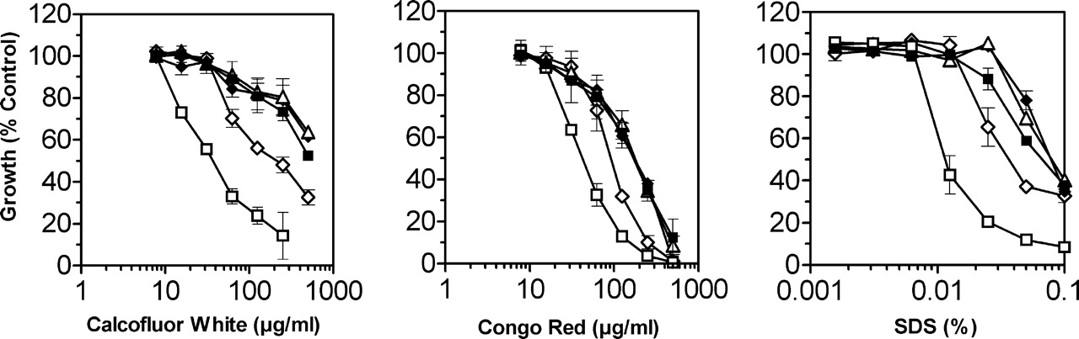
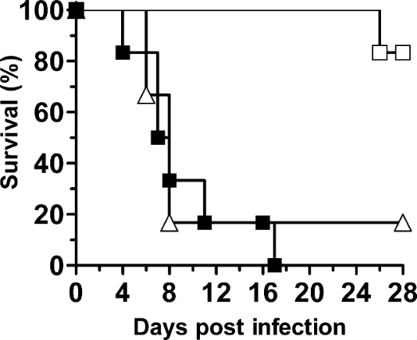
Testing virulence in the i.v. model by the candidate
gene approach
Research Question: The C. albicans cell wall is the immediate point of contact with the host
and is implicated in the host-fungal interaction and virulence. Large gene family of cell-wall associated proteins identified by the sequencing project……………..is the family involved in virulence?
1) Make Iff11 mutant
2) Test phenotype
3) Reconstitute
4) Test virulence
∆iff11 [SBC102]
∆iff11 + IFF11
IFF11
Bates et. al. (2007) Candida albicans Iff11, a secreted protein required for cell wall structure and virulence.

Slide 15
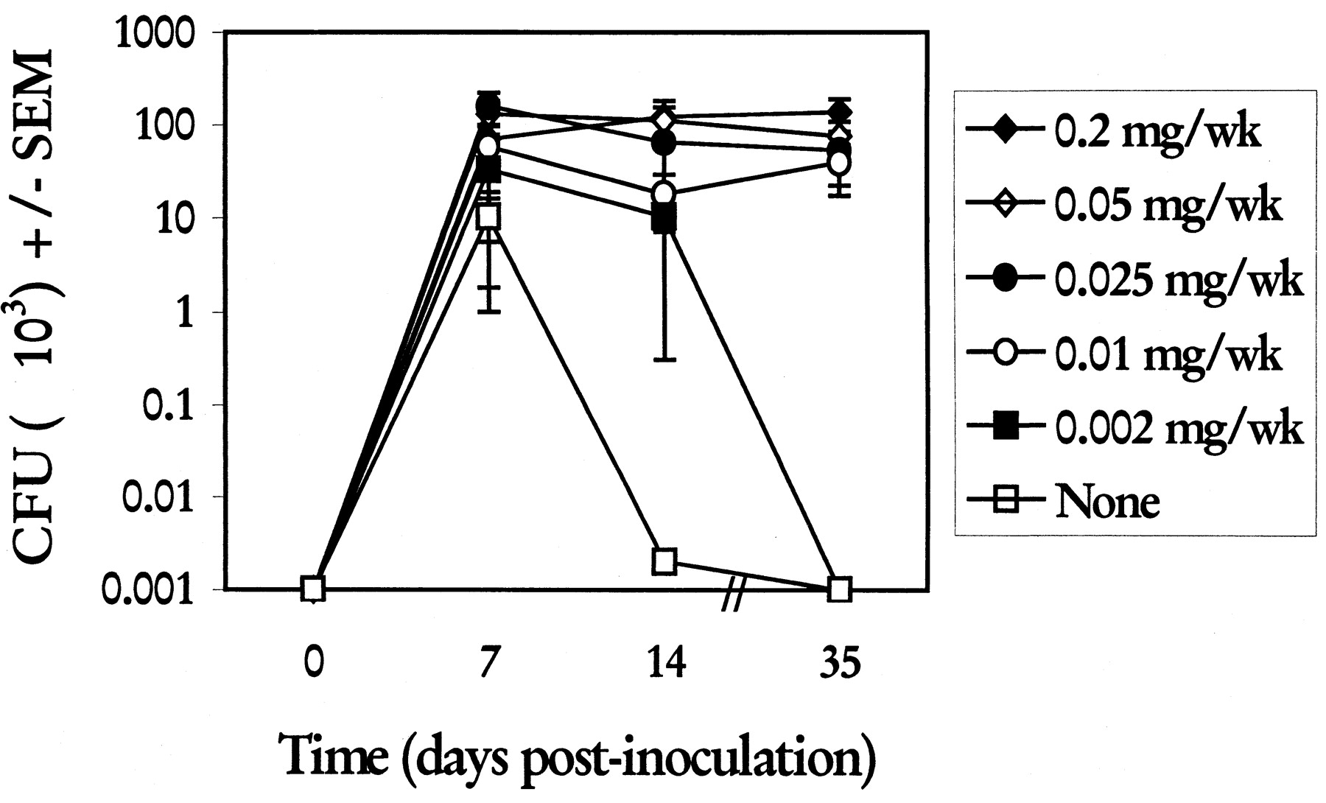
Concurrent murine oral and vaginal Candida albicans
colonization to study epithelial host-pathogen interactions
Improving physiological
relevance:
In women, acute episodes of vulvo-
vaginal candidiasis (VVC) occur
during the luteal phase of the menstrual
cycle when levels of estrogen and
progesterone are elevated
The role of reproductive hormones
and/or their limits in acquisition of
VVC remains unclear
Step 1: Test levels of estrogen required to establish C. albicans colonization
Mice receive weekly i.m or s.c injections of estradiol valerate
Wait 7 days and inoculate orally with 10⁷ C. albicans cells in 100 µl PBS
Inoculate vaginally with 10⁶ C. albicans cells in 25µl using pipette
Rahman et. al. (2007) Murine model of concurrent oral and vaginal C. albicans colonization to study
epithelial host-pathogen interactions Microbes and Infection 9:615-622

Slide 16
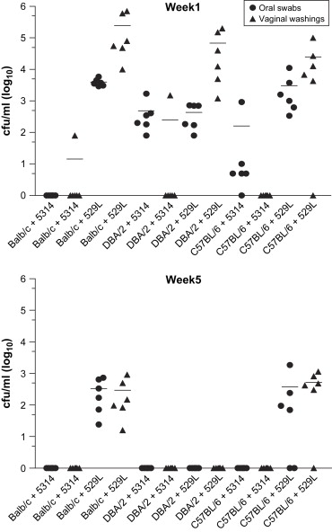
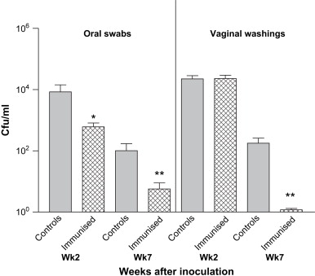
Concurrent murine oral and vaginal Candida albicans
colonization to study epithelial host-pathogen interactions
Authors tested ten different C. albicans strains collecting
oral and vaginal swabs weekly for ten weeks
Persistant concurrent oral and vaginal carriage of C. albicans
was dependent upon both the Candida strain used, and the mouse
strain used
Once establISHED the model can be used for the study of the
host-pathogen interaction within the context of mucosal disease
In this instance the authors tested protection against infection following
vaccination with an i.n. administered C. albicans protease
Rahman et. al. (2007) Murine model of concurrent oral and vaginal C. albicans colonization to study
epithelial host-pathogen interactions Microbes and Infection 9:615-622

Slide 17
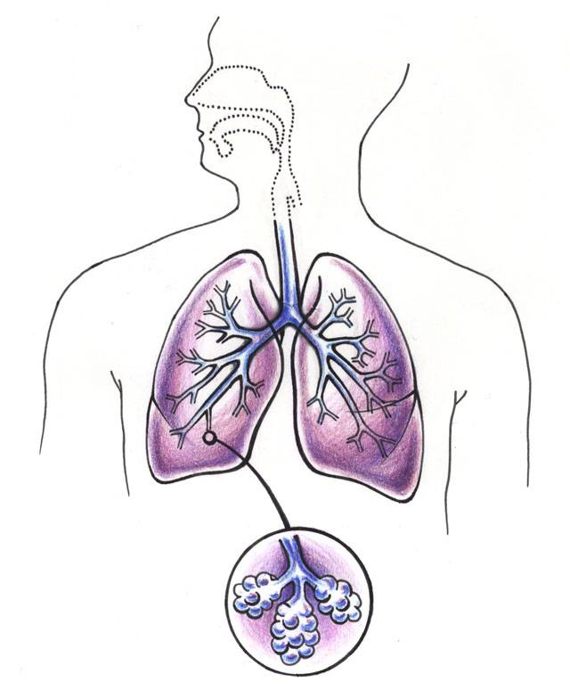
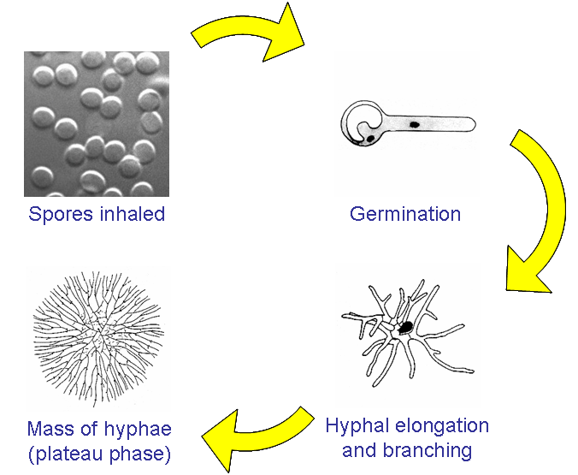
Modelling aspergillosis, in a physiologically
relevant manner

Slide 18
Modelling aspergillosis, in a physiologically
relevant manner
Immunosuppression is
required to establish
invasive pulmonary aspergillosis
The pathogenesis of modelled disease
can be defined by the underlying
immunosuppresion
Pulmonary alveolar macrophages ingest
and kill A. fumigatus spores
Polymorphonuclear leukocytes are
fungicidal to the hyphal forms
Lewis and Wiederhold (2005) Murine model of invasive aspergillosis methods in Molecular Medicine 118: 129 - 142

Slide 19
Modes of immunosuppression
Cyclophosphamide-induced
neutropenia
2) Glucocorticosteroid-mediated
macrophage damage
Dannenberg et. al. The antiinflammatory effects of glucocorticosteroids: A brief review of the literature
Inflammation 3:329-343
Zuluaga et. al., (2006) Neutropenia induced in outbred mice by a simplified low-dose cyclophosphamide regimen:
characterization and applicability to diverse experimental models of infectious diseases BMC Infectious Diseases 6:55

Slide 20
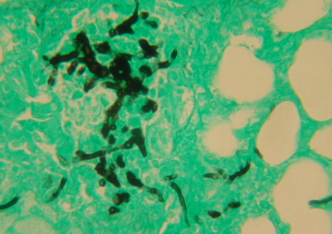
10⁵ A. fumigatus spores
saline/10⁷ cfu
non-immunocomp.
The majority of
laboratories use i.p
cyclophosphamide
every three days from day -3
And one dose of hydrocortisone
acetate s.c. on day -1
Survival
5 X 10⁵ cfu (237)
5 X 10⁵ cfu (D141)
Days post infection
% Original weight
Days post infection
Histology

Slide 21
Aspergillus siderophore biosynthesis and virulence
(A candidate gene approach to evaluating virulence factors)
Most fungi have two mechanisms for high affinity iron uptake
Reductive iron assimilation (RIA) mediated by the plasma membrane permease FtrA
And siderophore mediated iron uptake and sequestration inside the cell, requires sidA functionality
ftrA
sidA
Ferricrocin
L-ornithine
N⁵ hydroxyl ornithine
Schrettl et. al. (2004) Siderophore biosynthesis but not reductive iron assimilation is
essential for A. fumigatus virulence J. Exp. Med. 200:1213-9
TAFC

Slide 22
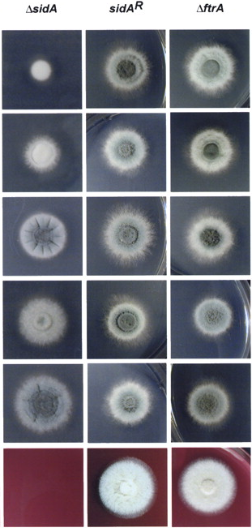
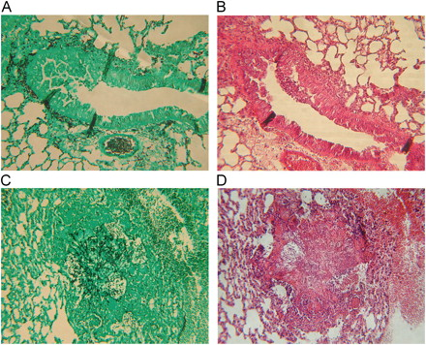
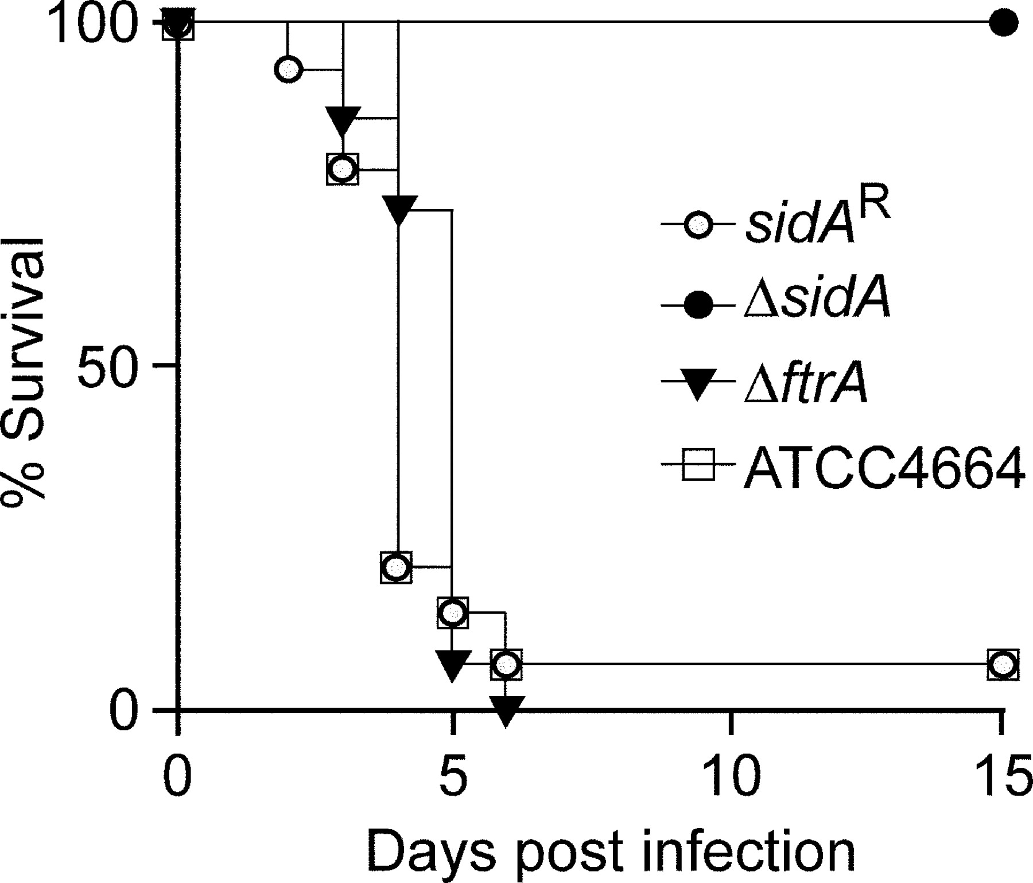
Candidate gene approach : siderophore biosynthesis
in Aspergillus fumigatus
Hypothesize that iron acquisition is required for A. fumigatus virulence
Delete genes participating in the two major iron uptake pathways
Assess phenotype in vitro
Test virulence in murine model
Histological analysis of infected tissue
-Fe
Low
iron
∆sidA
WT
Blood
agar
Schrettl et. al. (2004) Siderophore biosynthesis but not reductive iron assimilation is
essential for A. fumigatus virulence J. Exp. Med. 200:1213-9

Slide 23
A model of fungal allergic airways disease
Hypothesis:Within the context of allergic disease neutrophils have been postulated to promote
more severe airway inflammation by mediating direct tissue injury or by elaborating
proinflammatory mediators: therefore neutrophils contribute to disease severity
How: By examining the consequences of neutrophil depletion and augmented neutrophil chemotaxis
to the airway in a murine model of fungal allergic airway disease.
Sensitization:
1 x i.p. and s.c challenge with A. fumigatus protein extract, day – 35
Intranasal A. fumigatus protein extract -21, -14, -7
Intratracheal inoculation of A. fumigatus conidia Day 0
Park et. al. (2006) Neutrophils regulate airway responses in a model of fungal allergic airways disease J. Immunol. 176:2538-2545

Slide 24
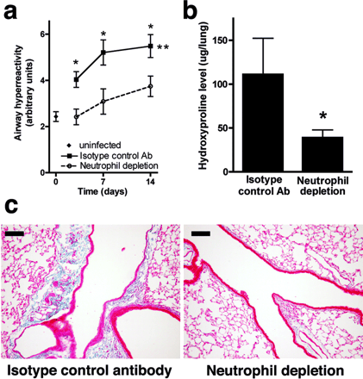
A model of fungal allergic airways disease
Question: How does neutrophil depletion
affect allergic airway responses to
A. fumigatus?
How? Measure
Airway hyperreactivity
[by whole body plethysmography]
b) Hydroxyproline level
[a surrogate marker for lung collagen content]
c) Peribronchial fibrosis
[by histological anlaysis]
In neutrophil-sufficient and –depleted animals
Park et. al. (2006) Neutrophils regulate airway responses in a model of fungal allergic airways disease J. Immunol. 176:2538-2545

Slide 25
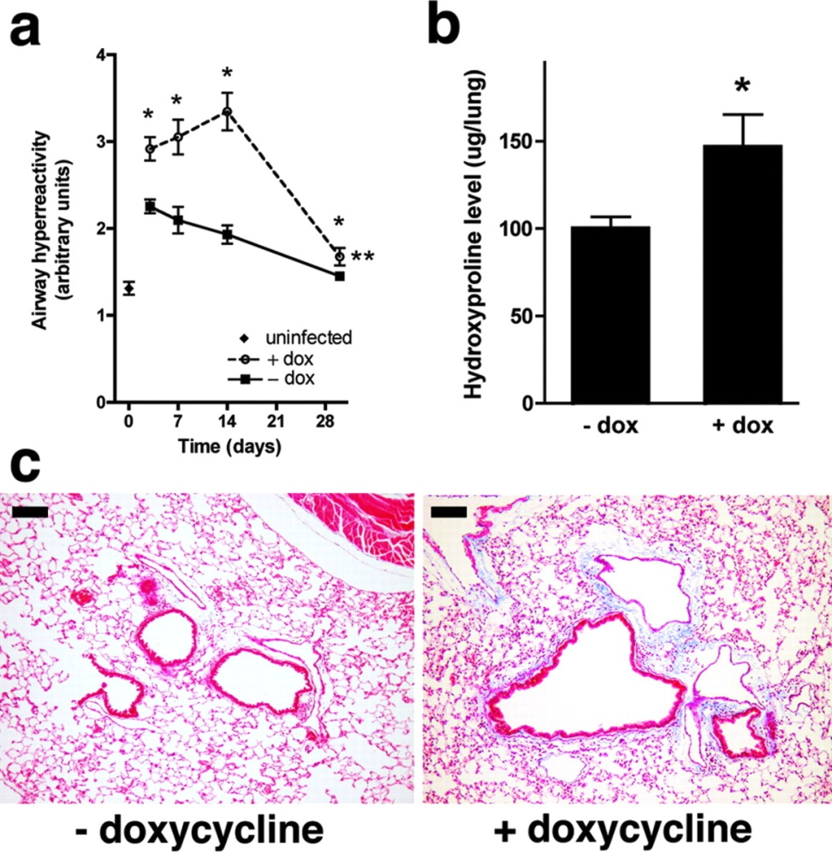
A model of fungal allergic airways disease
And using
Doxycyline-dependent expression
of the neutrophil chemokine attractant
CXCL1………..
…………Effect of augmenting neutrophil
recruitment on allergic airway
responses
Sustained transgenic expression of
CXCL1
Park et. al. (2006) Neutrophils regulate airway responses in a model of fungal allergic airways disease J. Immunol. 176:2538-2545

Slide 26
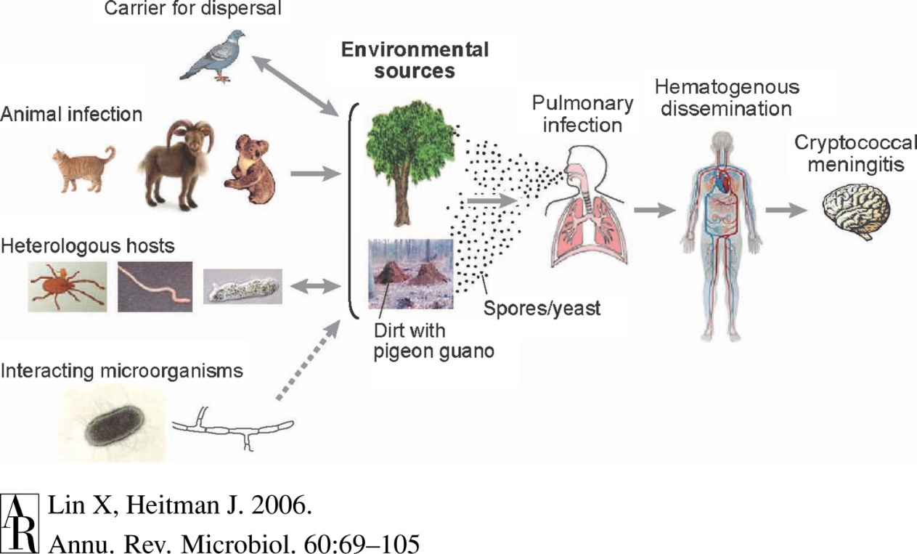
Modelling cryptococcosis
Murine models are less sophisticated than those in existence for the study of candidiasis and aspergillosis
Respiratory infections using mitotic spores are not achievable in a reproducible fashion in mice
Infections are modelled using liquid yeast cultures
Capilla et al., (2006) Experimental systemic infection with Crytpococcus neoformans var. grubii and Cryptococcus gattii in normal
And immunodeficient mice

Slide 27
Cryptococcal virulence: candidate gene approach
HYPOTHESIS: Cryptococcus neoformans
must adapt to the low oxygen concentrations
within the brain to cause CNS infection
Under low oxygen, Sre1p activates genes required
for ergosterol biosynthesis and iron uptake.
Make mutant, test phenotype in vitro, reconstitute, measure survival,
measure fungal burden in the brain.
Chang et. al. (2007) Sre1p, a regulator of oxygen sensing and sterol homeostasis, is required for virulence in
Cryptococcus neoformans Mol Microbiol. 2007 May;64(3):614-29.

Slide 28
Summary and things to have learned (1)
Infection modelling can greatly inform understanding of the host-pathogen interaction
With respect to understanding virulence, infection models enable a causal relationship between
pathogen and disease to be established (and subsequently modulated)
Experimental design varies according to the research question posed
The candidate gene approach addresses the relevance of a nominal pathogen-associated factor
to virulence
The global approach seeks to identify virulence factor-encoding genes by negative selection
in a murine host

Slide 29
Summary and things to have learned (2)
The vast majority of fungal infection modelling has used mice
Murine candidiasis can be established via several infection routes, depending upon the
Infection site of interest, immunosuppression not required
Candida virulence has predominantly been assessed in systemic (i.v.) models of infection
The host-pathogen interaction at mucosal surfaces is better studied in oral/vaginal
models of infection
Major drawback: Mice are not colonised by Candida species
Physologically relevant modelling of A. fumigatus infection is achieveable
Virulence studies and host-pathogen interaction studies both use intranasal inoculations
Immunosuppression is required to establish infection and choice of agent may
influence outcome of infection
Major drawback: Huge numbers of spores required to initiate infection

Slide 30
Summary and things to have learned (3)
Physiologically relevant modelling of Cryptococcus infection is still being optimised
Virulence studies and host-pathogen interaction studies both use intravenous inoculations
Great degree of variability among Cryptococcus isolates
Immunosuppression is not necessary in all instances but does increase susceptibility to
systemic infection

