Slide 1
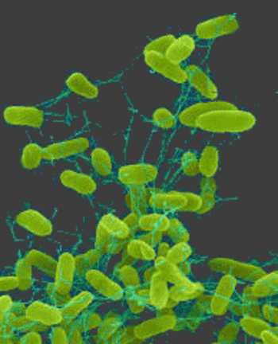
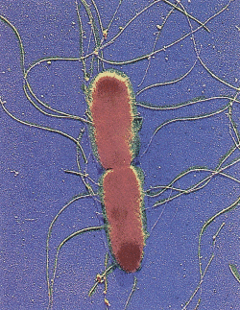
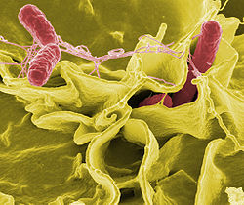
Biology of Salmonella
Dr Sophie Helaine

Slide 2
Salmonella pathogenesis
Human diseases
Typhoid (S. enterica Typhi and S. Paratyphi): 17 million cases and 600,000 deaths/yr - increasing multiple drug resistance – recurrence infection
Non-typhoidal (e.g S. enterica Typhimurium): 1.3 billion cases and 3 million deaths/yr (major problem in sub-Sarahan Africa)

Slide 3
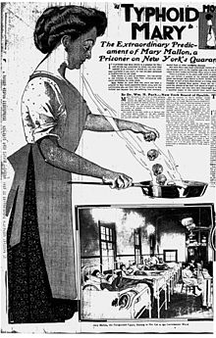
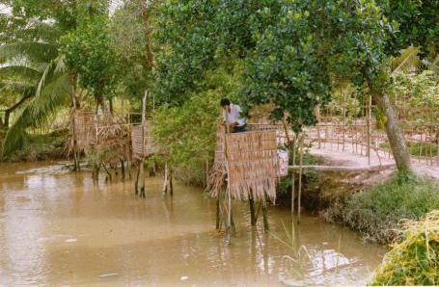
Salmonella Typhi and human typhoid
Transmission (faecal-oral)
Chronic carrier state
Typhoid Mary

Slide 4
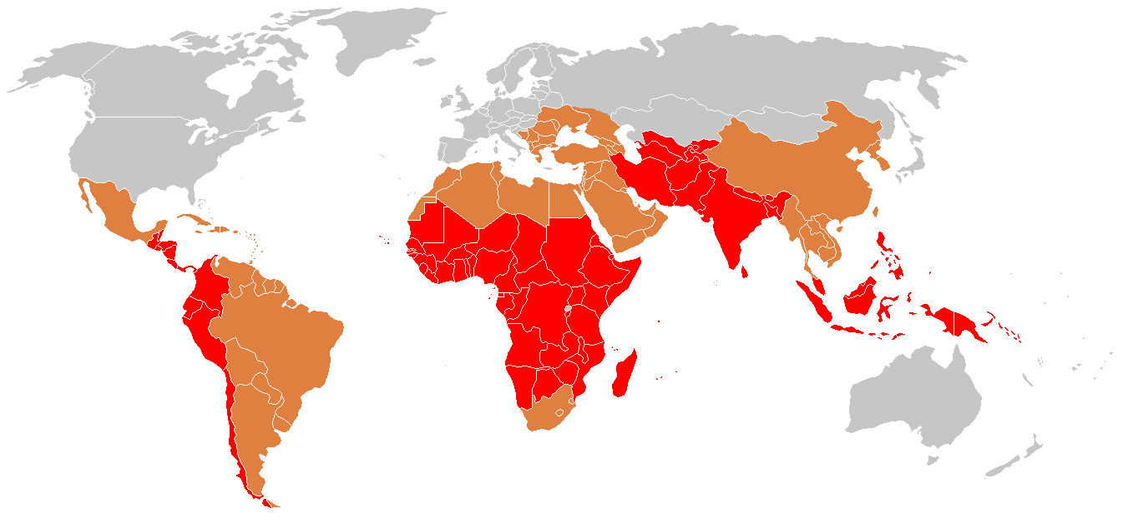
Salmonella Typhi and human typhoid
Typhoid prevalence, 2006

Slide 5
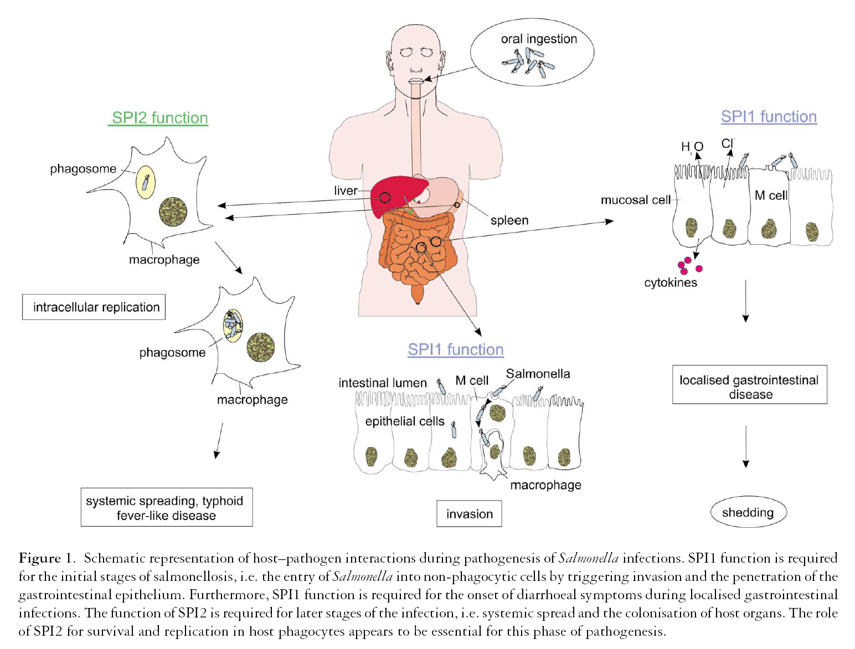
T0
48 h (10 days)
12 days
S. Typhi S. Typhimurium

Slide 6
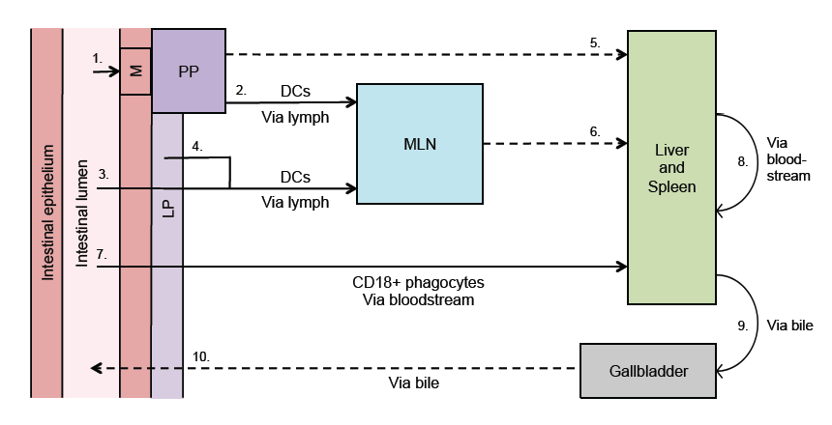
Murine model of Typhoid fever
S. Typhimurium invasion of M cells
and uptake by dendritic cells,
macrophages
Colonisation of Peyer’s Patches, mesenteric lymph nodes
Intracellular replication in spleen and liver
macrophages (up to 10⁹ bacterial cells/organ
implies >30 rounds of cell division)
Fatal bacteraemia

Slide 7
Total number of virulence genes
Estimates suggest approx. of S. Typhimurium genome
required for virulence
S. Typhimurium has 4600 ORFs => approx. virulence genes
Approx. genes identified to date
Most are present on Pathogenicity Islands/islets (> 60)
But, biochemical and physiological functions of many
remain unknown

Slide 8
Different virulence genes act at different stages of S. Typhimurium virulence
stage of environmental response virulence
infection stimulus genes
stomach low pH acid tolerance fur, atr
small osmotic stress motility
intestine anaerobiosis adhesion flg, lpf and pef
epithelium anaerobiosis invasion many (e.g.inv/spa)
penetration cell contact
blood- complement serum resistance rfb, rfc, rck
stream antimicrobial peptide resistance sap, htr
peptides
macrophage low pH, low Mg⁺⁺ complex many
(pag, SPI-2, spv)

Slide 9
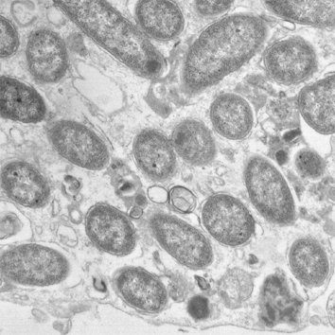
Salmonella an intracellular pathogen
Salmonella-containing vacuoles in spleen cells

Slide 10
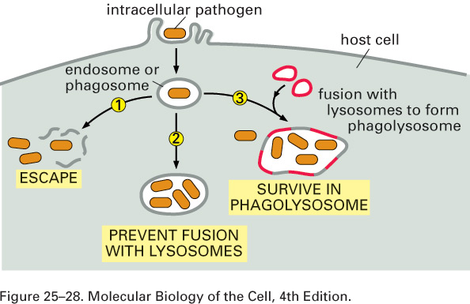
Salmonella an intracellular pathogen
Listeria
Shigella
Salmonella
Mycobacteria
Coxiella

Slide 11
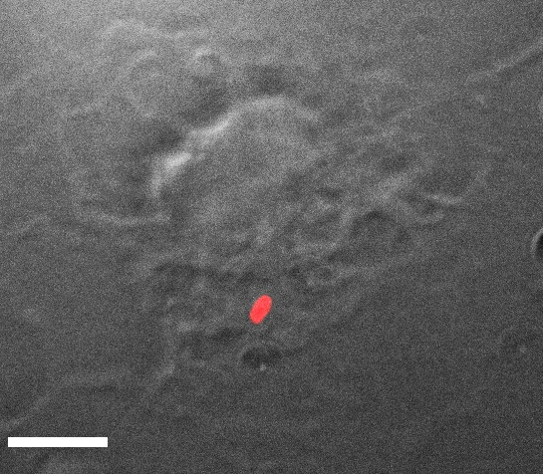
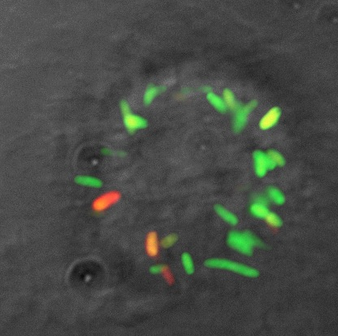
Measuring replication by fluorescence dilution (FD)
18 h
Bone-marrow derived
macrophages
Helaine et al, PNAS 2010

Slide 12
Salmonella an intracellular pathogen
Two T3SS
SPI-1 mediates invasion of host cells and
intestinal secretory and inflammatory responses
SPI-2 is required for bacterial replication and immune modulation

Slide 13
Salmonella an intracellular pathogen
Two T3SS
Adhesion
Invasion
SCV formation
SCV maturation
Replication
SPI-1 T3SS
SPI-2 T3SS
Extracellular
Intracellular

Slide 14
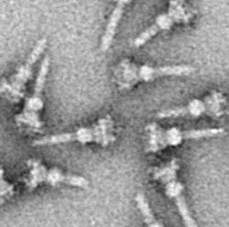
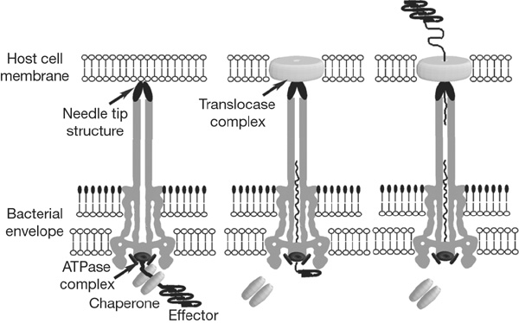
Salmonella invasion of epithelial cells occurs
via the SPI-1 type III secretion system
effectors induce actin polymerisation, membrane ruffling and bacterial internalisation
Effector

Slide 15
Salmonella an intracellular pathogen
Two T3SS
Adhesion
Invasion
SCV formation
SCV maturation
Replication
SPI-1 T3SS
SPI-2 T3SS
Extracellular
Intracellular

Slide 16
SPI-2 Type III
secretion system
effectors (SifA, SseJ, SseG, etc)
translocon
pore (SseC, SseD)
vacuolar membrane
+
H
+
H
+
H
translocon
(SseB)
acidic pH triggers
secretion
H
+
H
+
H
+
H
+
secreton needle
bacterial outer
SsaC
membrane
SsaJ
bacterial inner
SsaV
membrane
SsaM
SpiC
ssaV mutant
is null for
SPI-2 function
SsaL

Slide 17
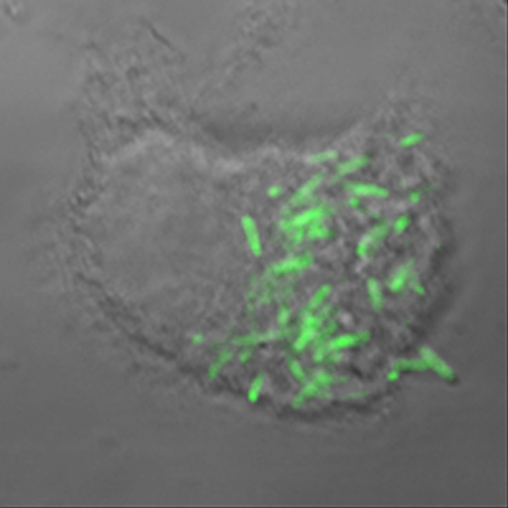
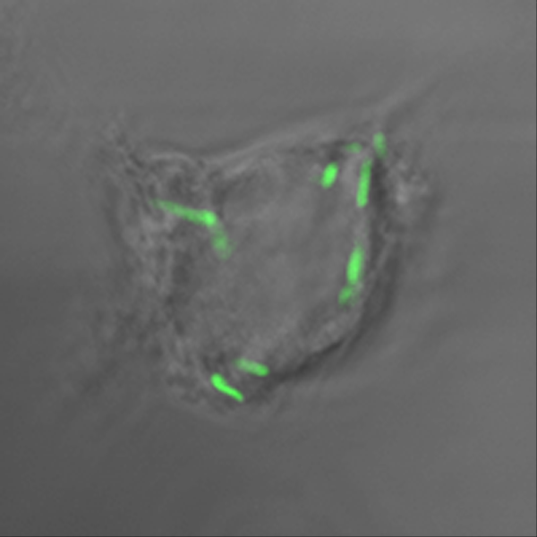
Intracellular replication defect of a SPI-2 null mutant in macrophages (16 h)
wild-type
SPI-2 mutant

Slide 18
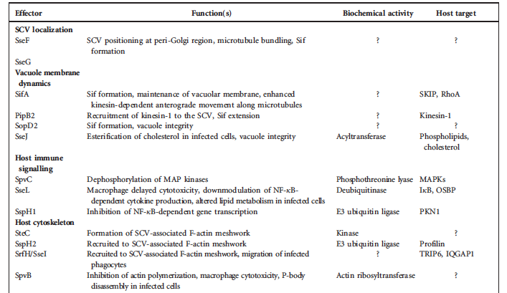
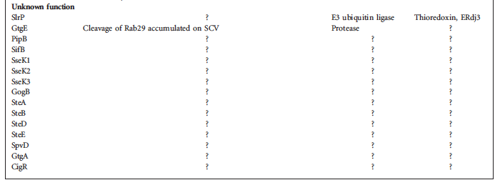
Effectors of the SPI-2 T3SS

Slide 19
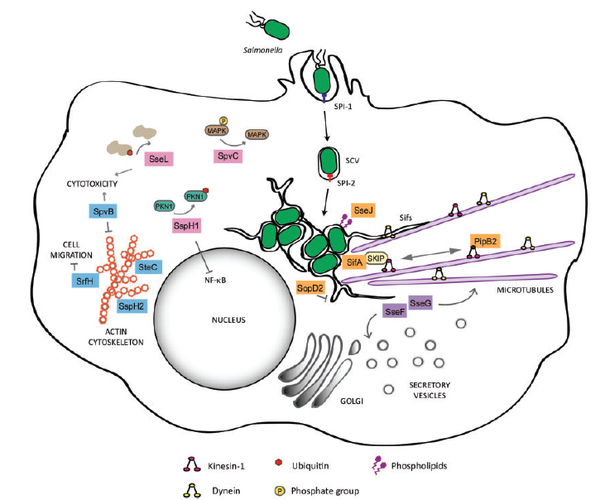
Effectors of the SPI-2 T3SS

Slide 20
Salmonella pathogenesis
Human diseases
Typhoid (S. enterica Typhi and S. Paratyphi): 17 million cases and 600,000 deaths/yr - increasing multiple drug resistance – recurrence infection
Non-typhoidal (e.g S. enterica Typhimurium): 1.3 billion cases and 3 million deaths/yr (major problem in sub-Sarahan Africa)

Slide 21
Nontyphoidal Salmonella in HIV-infected African adults
NTS (S. Typhimurium and Enteritidis):
Predominantly cause self-limiting gastroenteritis
BUT
major cause of invasive disease in Africa, young children and HIV-infected adults
Non specific fever (+/- diarrhea) Bacteremia
Case fatalities (22-45 %)
AB resistance
No vaccine

Slide 22
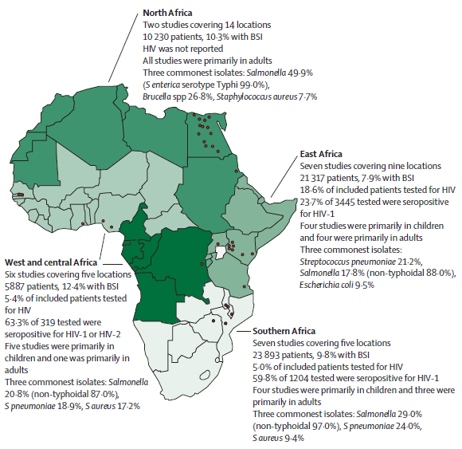
Salmonellae are the commonest cause of bacterial bloodstream infection in Africa
(Reddy EA, et al. Lancet Infect Dis 2010)

Slide 23
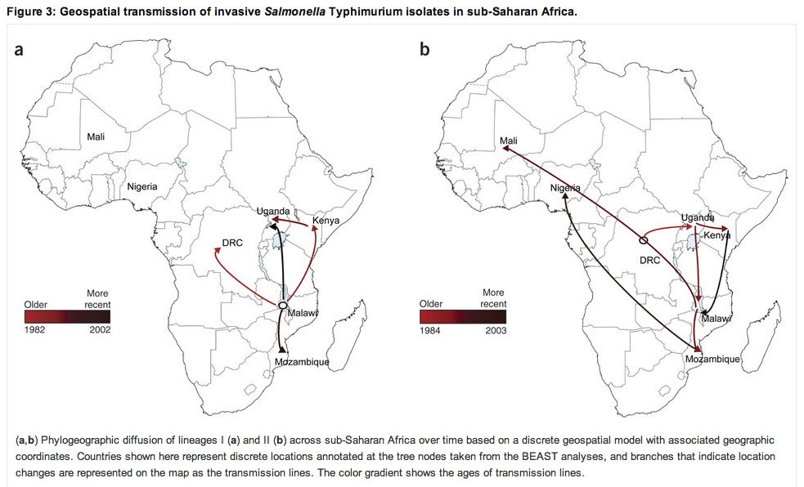
Nontyphoidal Salmonella in HIV-infected African adults
Okoro, et al. Nature Genetics, 2012

Slide 24
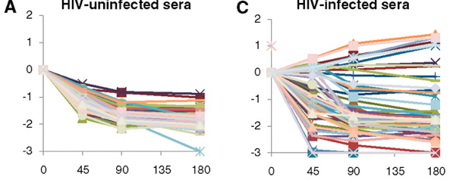
Nontyphoidal Salmonella in HIV-infected African adults
Host resistance to Salmonella relies on:
- cell-mediated immunity (macrophages, PMNs, NK cells)
- complement killing (induced by Antibodies α OMPs)
HIV-uninfected sera
HIV-infected sera
Log10 change in Salmonella (cfu/ml)
Exposure to serum (min)
Lack of AB?
MacLenan, et al. Science, 2010

Slide 25
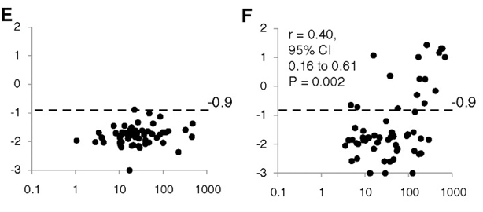
Nontyphoidal Salmonella in HIV-infected African adults
HIV-uninfected sera
HIV-infected sera
Log10 change in Salmonella (cfu/ml)
Total anti- Salmonella IgG titer
MacLenan, et al. Science, 2010

Slide 26
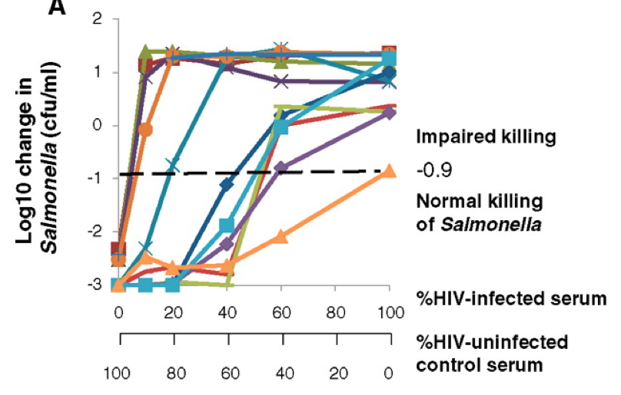
Nontyphoidal Salmonella in HIV-infected African adults
MacLenan, et al. Science, 2010
Inhibitory factor: IgG

Slide 27
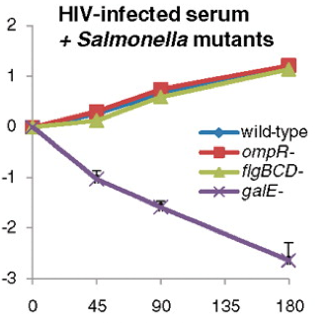
Nontyphoidal Salmonella in HIV-infected African adults
Log10 change in Salmonella (cfu/ml)
Exposure to serum (min)
MacLenan, et al. Science, 2010
Inhibitory factor: LPS IgG
Diverting complement deposition away from OM
Impeding access to OM by cross linking O-antigens

Slide 28
Summary
Salmonella enterica – different diseases, typhoid and non-typhoidal
Replicates in macrophages in membrane-bound vacuoles
Persists – chronic infection, carriers/shedders
SPI-1 and SPI-2 Type III secretion systems are important virulence components: SPI-1 for invasion and SPI-2 for replication

