Slide 1
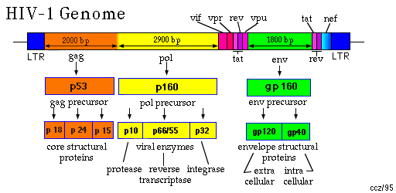

Slide 2
HIV Genes
Structural Genes gag, pol, env
Regulatory Genes tat, rev
Accessory Genes nef, vpu (vpx), vpr, vif

Slide 3
HIV gag
Internal proteins of virion:
matrix
capsid
nucleocapsid

Slide 4
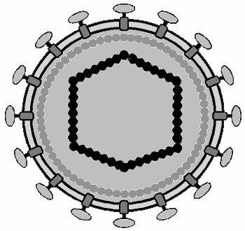
Simplified structure of a virion
Structural
components:
Enzymes:
Targets for
antiviral therapy
Gag proteins
MATRIX
Pro
-
Pol
proteins
CAPSID
REVERSE
TRANSCRIPTASE
NUCLEOCAPSID
INTEGRASE
Env
proteins
SU
PROTEASE
TM
RNA
Lipid envelope
Notes:
Very schematic, simplistic, only intriduction

Slide 5
HIV pol
Enzymes of replication:
Reverse transcriptase
Polymerase
Integrase

Slide 6
Env : Virus phenotype
Virus tropism
Target of humoral response
Viral diversity
Cytopathic effect

Slide 7
HIV genes: structure and function Structural genes- Summary
Gene Proteins Function
gag matrix (p18), sub-envelope, organisation
core (p24), protects genome, enzymes
nucleocapsid (p6...) chaperones RNA
pol reverse transcriptase RNA to DNA
protease maturation of precursors
integrase provirus integration
RNAase eliminates RNA
env surface glycoprotein receptor binding
(gp120)
transmembrane virus-cell membrane
glycoprotein (gp41) fusion

Slide 8
HIV genes: Regulatory genes
Gene Protein Function
tat Tat transactivates transcription
rev Rev regulates splicing

Slide 9
HIV Accessory Genes:
nef, vpu (vpx), vpr, vif

Slide 10
HIV nef
Multifunctional
Down-regulates CD4 & MHC Class1 expression (facilitate immune evasion, enhance replication)
Enhances infectivity (by regulating cholesterol content?)
HIV-1 Nef at the Crossroads, JL Foster & JV Garcia (2008) Retrovirology, 5, 84.

Slide 11
Vpu
Enhances virion release from cell by counteracting tetherin (human cellular protein inhibits virus release, Lassa, Marburg & HIV).

Slide 12
Vpr
Viral Protein R (14kDa)
Regulates import of HIV PIC
Required for infection in non-dividing cells

Slide 13
Vif
Virion Infectivity Factor
Increases virus infectivity
Delta vif virus less infectious
Over-rides APOBEC 3G

Slide 14
Receptor Natural ligand Viruses
CD4 MHC Class II HIV-1, HIV-2 SIV, HHV-7
CCR5 MIP-1α, β, RANTES R5 isolates
CXCR4 SDF-1 X4 isolates

Slide 15
(Gonzalez et al. Science 307: 1434-1440, 2005)
Genetic Variation of Chemokines and their Receptors
HIV-1
CD4
CCR5
CCL3L1 binds to CCR5R
CCR5 expression
CCL3L1 copy no.
Progression to AIDS
low
high
slow
high
low
rapid
none
no infection

Slide 16
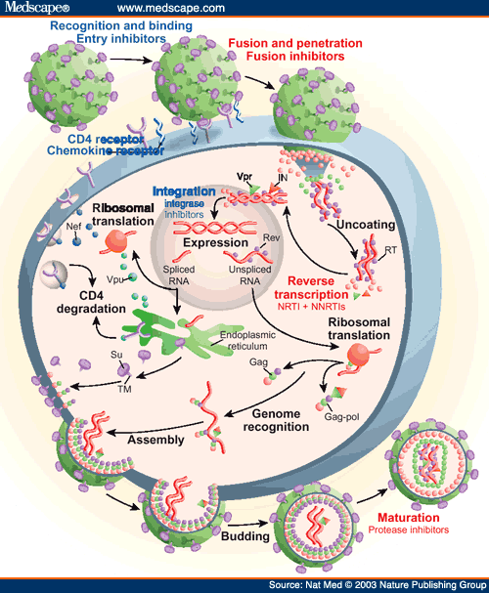

Slide 17
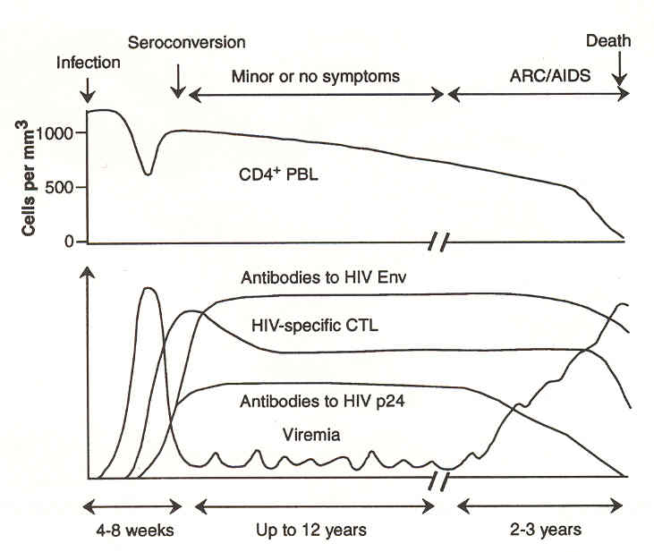

Slide 18
Clinical monitoring of HIV progression
CD4 T helper lymphocyte count:
Normal count 800-1200 CD4 cells μl⁻¹
Still healthy > 400 "
AIDS < 200 "
Plasma virus load by RT-PCR
Proviral load on PCR
Drug resistance by RT-PCR and sequence

Slide 19
2010

Slide 20
What kind of protection in an HIV vaccine?
Prophylactic to protect against infection
• Therapeutic to prevent progression to AIDS
• Altruistic to prevent transmission

Slide 21
Vaccine Approaches for HIV
Humoral immunity (neutralising antibodies)
Cell-mediated immunity (CTL)
Approaches to vaccines:
Clinical trials:
Step AdV trial of gag protein: possible increased risk!
RV144 trial of ALVAC canarypox gag-env + gp120 boost: 16,000 Thai volunteers: possible slight protection
Whole virus, killed
Live, attenuated
Recombinant subunit
Synthetic peptide
DNA vaccines Live vectors:
Pox, Ad5, VEE
New adjuvants (based on TLRs)

