Slide 1
Primary HIV infection The rationale and role of immediate antiretroviral therapy

Slide 2
Outline
Importance of intervening during acute HIV infection in HIV cure
Clinical trials of interventions in acute HIV infection
Designs and outcomes
Viremic control following ART interruption
Determinants for viremic control
RV254/SEARCH 010 study
Examining interventions during acute HIV for functional cure
Role of therapeutic HIV vaccines

Slide 3
Summary of presentation
Definition of Primary HIV infection (PHI)
Identification of PHI
Reasons to intervene in PHI
Delay clinical disease progression
Prevention of transmission

Slide 4
Primary HIV infection
PHI is often defined as the period within the first 6 months of HIV infection
Acute early infection usually refers to the first 3 months after infection

Slide 5
HIV testing
Acute HIV infection is missed by antibody only tests unless a viral PCR or antigen is performed or there is a previous negative test result available
Current tests (3rd generation antibody tests) detect HIV-specific antibody
Point of care tests detect antibody only but give the results back to the patients immediately
Newer combination antigen-antibody (p24) tests detect earlier infection
Detuned/avidity assay HPA detects the recency of the antibody response but is not a validated test

Slide 6
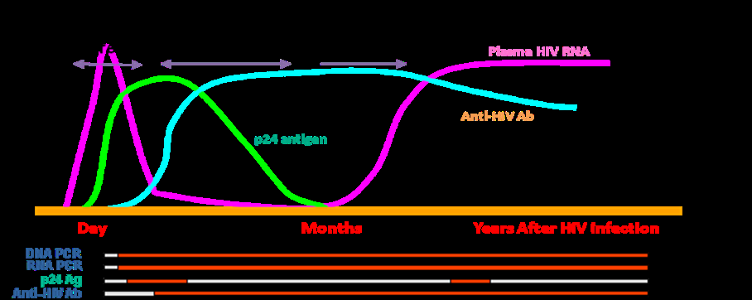
Pre-seroconversion detects virus antigen 0-20 days – RNA or p24
Per-seroconversion detects antibody – 20-45 days
Post seroconversion antibody no antigen (bound up in immune complexes) > day 26
8-17 days
12-26 days
12-26 days
20-45 days

Slide 7
Summary of tests that identify PHI
PCR+ antibody –ve (8 days after infection)
“4th generation” combination antigen-antibody testing
P24 antigen positive antibody –ve (12 -20 days)
P24 positive, antibody positive ( up to 20- 26 days)
3rd generation POCT previous negative to positive within 6 months
Detuned/avidity assay OD < 0.6

Slide 8
So why should PHI be different?
What are we hoping to achieve?

Slide 9
HIV pathogenesis
CD4 T-cell help is required for optimal immune regulation and priming to new antigens (Kalams)
HIV preferentially infects HIV-specific CD4+ T-cells (Doueck)
HIV-specific CD4+ T-cell function is lost early and not recovered despite immune reconstitution with later ART (Autran)

Slide 10
HIV and the gut
Massive (30-60%) selective infection and destruction (within 4 days) of CD4+ memory cell loss from mucosal surface (gut) in acute HIV and SIV (Mattapallil)
>50% depletion of total CD4+ memory in SIV in acute infection
A stable reservoir of HIV infected cells is established very early after PHI and persists despite early ART (Blankson, Siliciano) but treatment could decrease the size of this reservoir (Strain et al 2005 JID) by up to 90% BUT… can’t lead to viral eradication

Slide 11
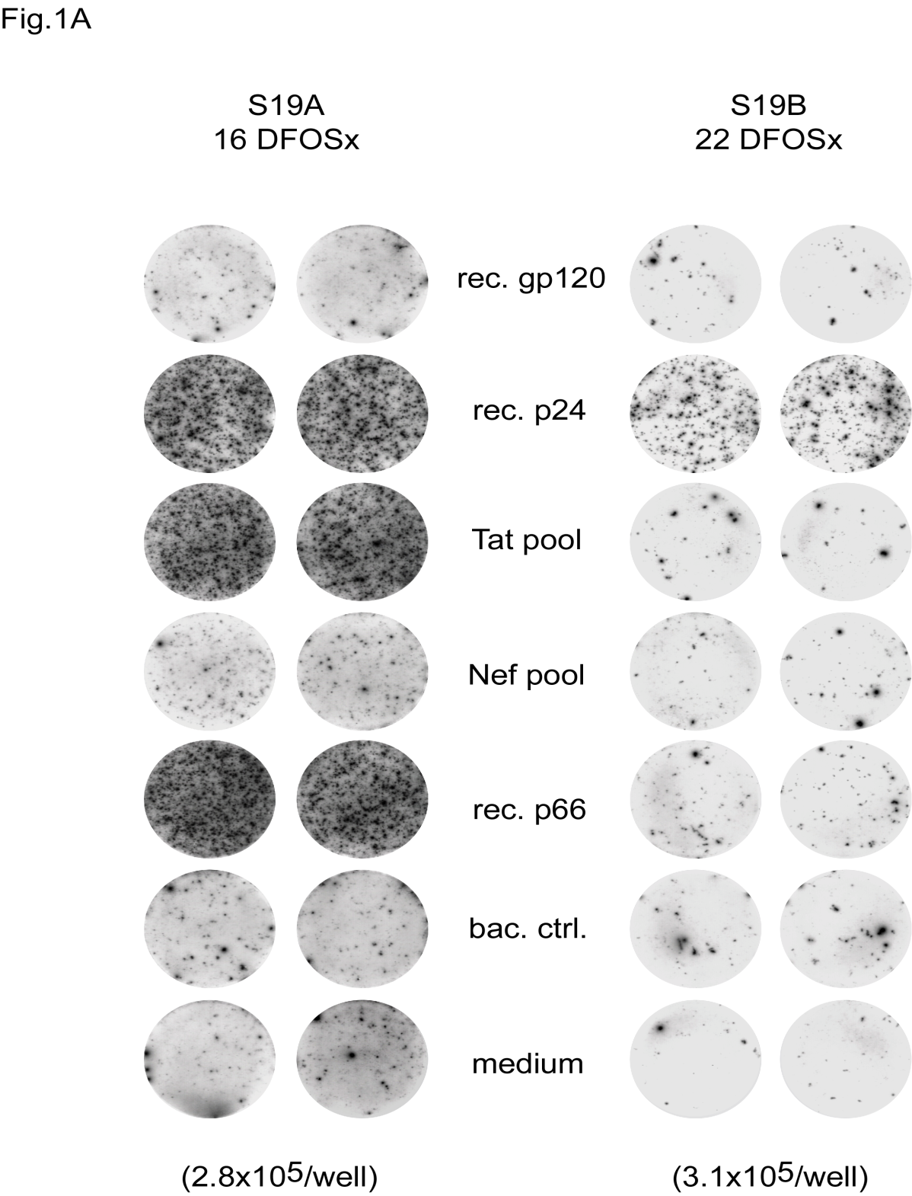
Effect of HIV
On HIV specific
CD4- T helper
responses:

Slide 12
Prognosis in HIV infection Mellors et a l, Ann Int Med 1997;126:946-954

Slide 13
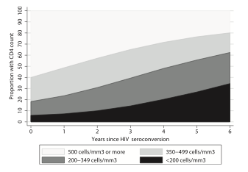
Disease progression
Lodi et al, CID 2011

Slide 14
Disease progression
Susceptible
Acute
2.9 months
58%
23%
16%
3%
>500
350-500
200-350
<200
6.37 years
2.86 years
3.54 years
2.30 years
With thanks to Jeff Eaton.

Slide 15
Can anything prevent/reverse this?
ART intervention in PHI has been shown to induce vigorous HIV-specific CTL and CD4 T-cell responses which initially correlated with enhanced viraemic control and delayed immune destruction (Rosenberg)
BUT… the durability of this immune preservation is uncertain and the magnitude of such responses long-term did not predict viral control (N=14) (Kaufman)

Slide 16
What does ART do?
When should we start treatment?
Risk vs benefit of therapy

Slide 17
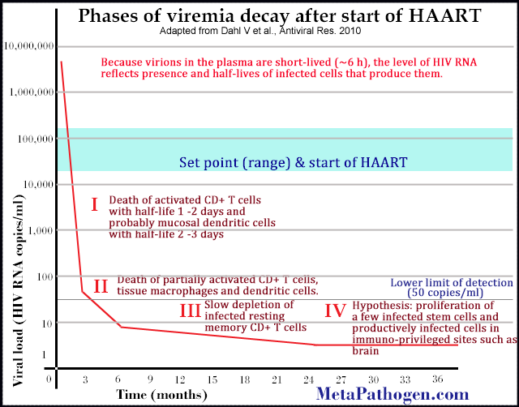

Slide 18
Decay Kinetics of Viral Infected Cells
10⁸
HIV-1
Infected Cells
10⁷
Activated Lymphocyte
10⁶
Longer lived cells Macrophage?
10⁵
Detection limit
Latently infected cells
10⁴
1
14
Longer
Half life of infected cells (days)
Notes:
18
Several somewhat thorny issues Note that this is a semilog plot (CLICK). One pesky issue is that log scales is that they NEVER end, they just keep getting smaller. The size of the post secondary phase remains inherently uncertain and represents a kind of Zeno’s paradox In mathematical terms the value can only get smaller but never reaches zero whereas in physical terms thethe target is always reached. aradoxThus the nature of this curve and its limits bear directly on eradication - there are

Slide 19
No such thing as an “undetectable viral load”
HIV RNA
CD4 count
HIV DNA
50
1
0
1
Years on HAART
Palmer et al., Proc Natl Acad Sci U S A. 2008;105:3879-84 Maldarelli et al., Plos Pathogens 2007; 3:484
Notes:
19
19
HIV DNA is always detectable in infected cells even on suprpessive ART for years
So the major barriers to cure are the persistence of low level viremia and cell associated HIV DNA. The major current question is where is this virus coming from in patients on HAART?

Slide 20
Evidence to support ART for individual benefit
First RCT used AZT vs no therapy led to enhanced outcome of treated group
Addition of vaccine had no enhanced effect on CD4 or viral load outcome (Quest)
Triple ART observational studies only but all ‘encouraging’
3 RCT have shown transient ART started in PHI conferred virological and immunological benefit even after ART stopped

Slide 21
Clinical Trials Designs
Acute/primary HIV infection identified
Vary from Fiebig I to VI
(1 week to 6 months)
ART (new, multi-targeted, intensified) and/or others
(cytokines, HIV vaccines)
Interventions
Immunologic
Virologic outcomes
Compare to elite controllers and those treated
during chronic HIV
Determine HIV RNA control
Varying success rates and criteria for stopping/restarting ART
ART interruption

Slide 22
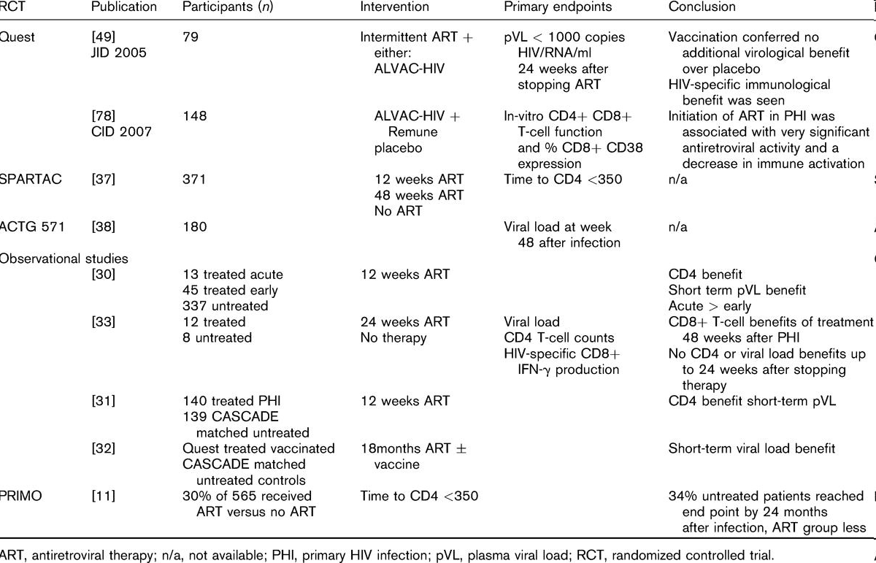
Kinloch
Hoen
Hecht
Streeck
Fidler
Lampe
Goujard
Fidler, Fox, Porter, Weber Current Opinion in Infectious diseases 21 1 4-10 2008

Slide 23
12 weeks ART in early HIV infection delayed the rate of CD4 decline
SMH n = 89 received 12 weeks of ART in early infection
CASCADE n = 179 not treated
Rate CD4 decline
SMH 51 cells/year
CASCADE 77 cells/year
P= 0.011
Fidler S, et al AIDS. 2007 Jun 19;21(10):1283-91.
(Rosenberg 2000, Kaufman 2004, Al-Harthi 2007, Lampe et al 2007, Hecht et al 2006 Streeck
ACTGA57217 )

Slide 24
SPARTAC

Slide 25
Enrolment & Exclusions
SCREENED
429
58 EXCLUDED
15 not PHI
19 protocol exclusions
24 other reasons
RANDOMISED
371
SOC
124
ART-12
123
ART-48
124
5 EXCLUDED
2 not equivocal
1 HIV-neg>8 months
1 remained HIV-neg
1 randomisation error
SOC
124
ART-12
120
ART-48
123
Notes:
58 Not randomised
15 Did not meet PHI definition
6 Last negative HIV test >6 months prior to randomisation
1 No documented negative HIV test available
2 Detuned assay >0.6
1 >2 weeks between equivocal and positive HIV test
5 Did not meet any of the PHI criteria
19 Other protocol exclusion criteria
1 Positive pregnancy test at enrolment visit
14 Participant unlikely to comply with protocol
3 ART clinically indicated at randomisation
1 ART contraindicated
24 Other reason
3 Clinician decision (1 abnormal liver function tests, 1 newly diagnosed diabetic, 1 “good immunovirological situation”)
11 Participant choice
2 Enrolment closed
8 Reason not recorded (all eligible at screening)

Slide 26
Time to primary endpoint
ART48
HR 0.63 (0.45,0.90), p=0.01
1.00
0.75
SOC
0.50
Probability of not reaching
primary endpoint
ART12
HR 0.93 (0.67,1.29), p=0.67
0.25
0.00
0
.5
1
1.5
2
2.5
3
3.5
4
4.5
Time (years)
SOC
123
109
93
82
75
66
59
46
30
18
ART-12
120
110
95
84
79
71
63
49
32
21
ART-48
123
121
117
109
100
88
80
63
41
19
Notes:
This graph compares the actual time difference in weeks to reach primary endpoint between the arms
ART48 delayed time to primary endpoint by 65 weeks compared with SOC. This was however, not significantly longer than time spent on therapy

Slide 27
Duration of infection and time to Primary Endpoint
1.00
ART-48 ≤12 wks
0.75
ART-48 >12 wks
Probability of not reaching
primary endpoint
0.50
SOC ≤12 wks
SOC >12 wks
0.25
ART48 vs SOC < 12 w HR = 0.48 [0.30, 0.78] p = 0.003
0.00
0
.5
1
1.5
2
2.5
3
3.5
4
4.5
Time (years)
SOC >12 wks
53
47
42
41
36
32
29
24
14
8
SOC ≤12 wks
70
62
51
41
39
34
30
22
16
10
ART-48 >12 wks
64
63
60
55
50
42
38
32
20
11
ART-48 ≤12 wks
59
58
57
54
50
46
42
31
21
8
Notes:
A comparison of the time to reach Primary endpoint accounting for duration of infection.
There was a trend to a significant delay in time to reach primary endpoint between individuals infected within 12 weeks receiving ART48 to SOC. Whilst the difference between participants enrolled >12 weeks after infection and SOC was much less.
Of note the time to reach Primary endpoint for individuals in the SOC arm (green) was more rapid for those randomised within 12 weeks than those enrolled later

Slide 28
Conclusions: SPARTAC
Spartac is the largest ever RCT in PHI enrolling men and women in both developed and developing world settings
ART-48 associated with a significant delay in time to CD4 <350 or long-term ART initiation, although the actual delay may not have been any longer than the time spent on treatment
Overall this effect was greater when ART-48 was started closer to the time of HIV infection. (p=0.09)
Compared to standard of Care
ART-48 associated with significant reduction in viral set point of HIV RNA of 0.44 (0.25,0.64) log₁₀ copies/ml sustained to 60 weeks after stopping therapy
ART-48 conferred a higher average CD4 count of 138 cells over 4.5 years
Interruption of ART in PHI had no evidence of harm; development of drug resistance, or CD4 recovery after starting long-term ART
No evidence of a benefit of ART-12

Slide 29
Impact of Antiretroviral Therapy Instituted during Acute HIV Infection
Preservation and restoration of lymph node structure leading to improved survival of naïve CD4+ T cells (Zeng M, PLoS PATHOGENS 2012)
Gut CD4+ T cells immune reconstitution (Ananworanich J, PLoS ONE 2012)
Polyfunctional HIV-specific CD4+ and CD8+ T cells similar to elite controllers
(Cellerai C, PloS ONE 2011)
Restoration of B cell function (Moir S, Blood 2010)
Normalization of immune activation markers (Markowitz M, 2012 IAS HIV Cure Workshop, Abstract 16551)

Slide 30
Have we optimized cART with 3-drug therapy?
Hypothesis
Targeting HIV entry, reverse transcription, integration and particle maturation via inhibition of HIV-1 protease would result in improved virologic and immunologic outcomes when compared to standard 3-drug PI-based ART.

Slide 31
Study design
Subjects with acute and early HIV-1 infection
Negative serology with viremia
Positive serology, viremia, and a non reactive detuned EIA
Documented negative test within 6 months of screening
Susceptible virus to components of the regimen
3-drug ART
(X)
GI biopsy
Leukapheresis
60
96
5-drug ART
(2X)
Weeks

Slide 32
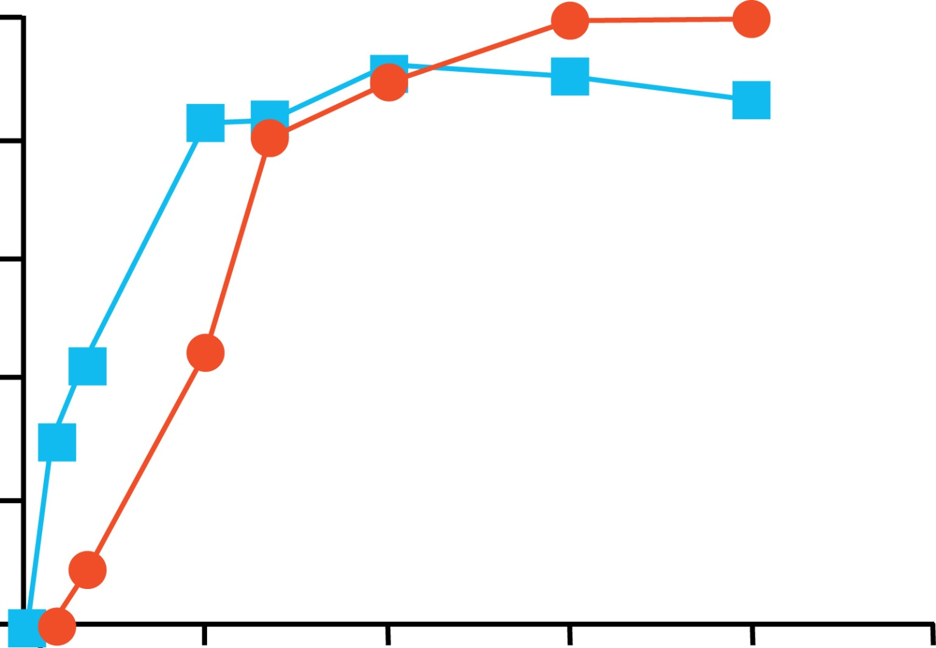
Plasma HIV-1 RNA by standard assay
Week 96
10/10
18/18
p=0.06
p=0.045
100
11/11
20/23
80
60
% of subjects below detection
40
3-drugs
5-drugs
20
0
0
12
24
36
48
60
Weeks of treatment

Slide 33
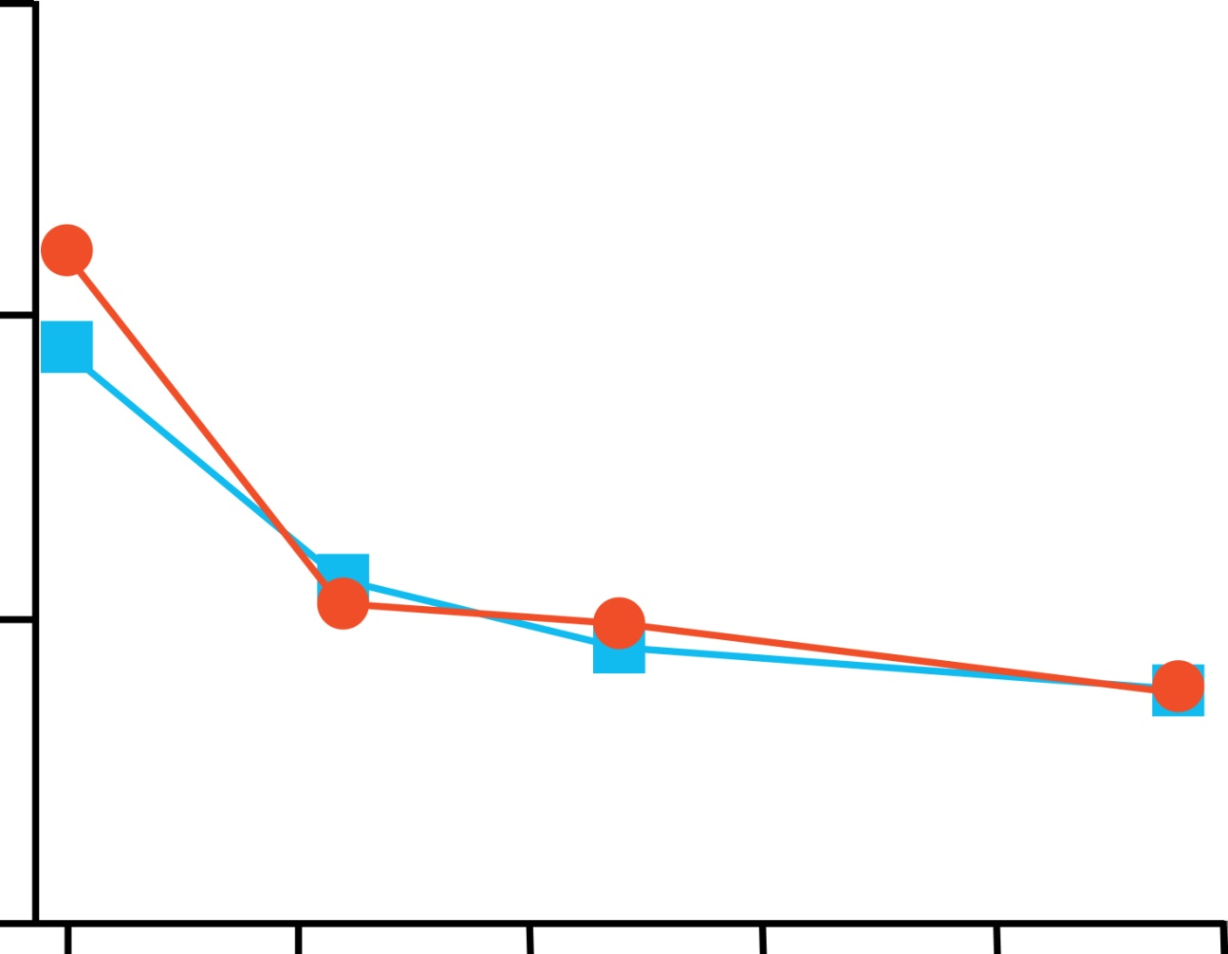
Proviral DNA levels
10⁵
10⁴
3-drugs
5-drugs
Copies of HIV-1 DNA/10⁶ CD4+ T cells
10³
10²
0
10
20
30
40
50
Weeks of therapy

Slide 34
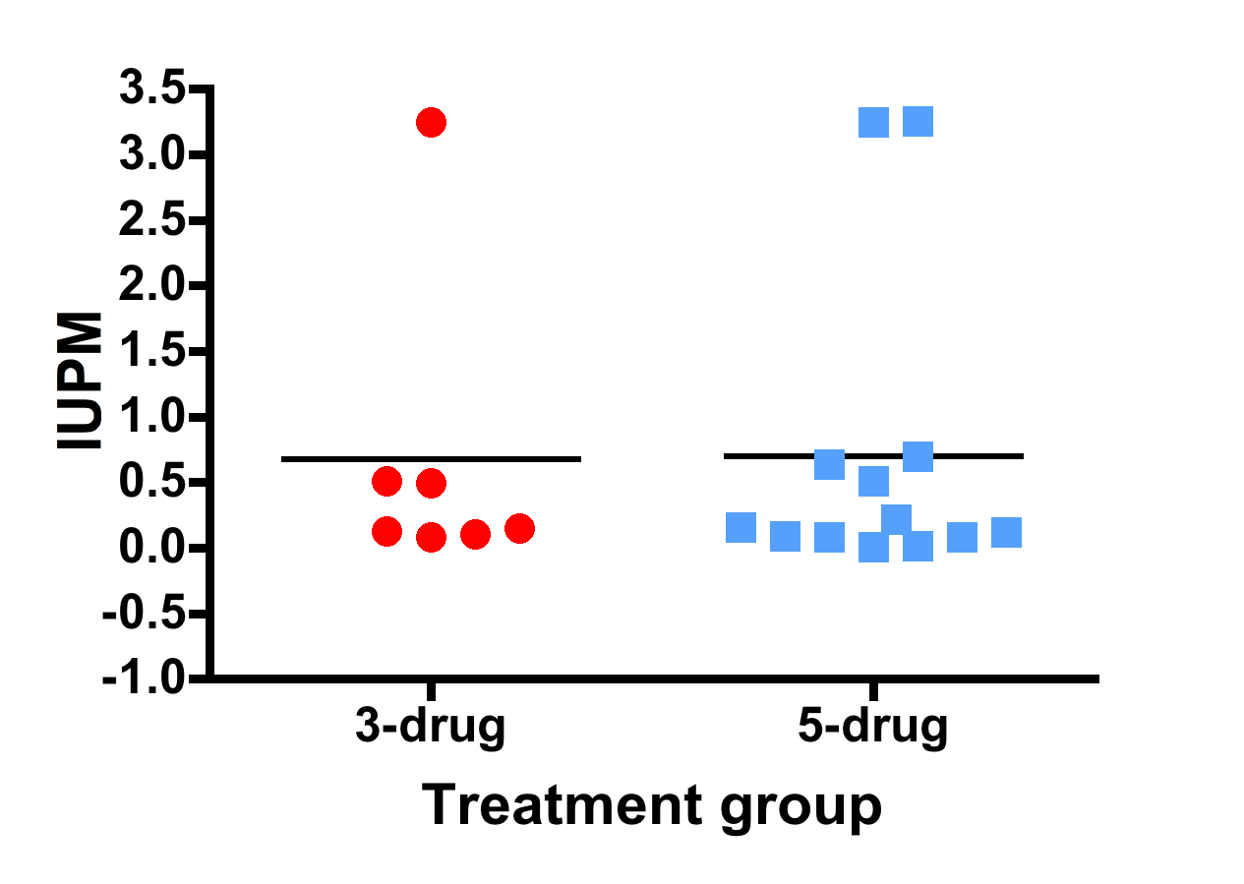
Week 96: Infectious HIV-1 in resting CD4+ T cells (N=21)
P=0.81

Slide 35
Reservoir reduced with early treatment
Chronic infection
(n=135)
Acute infection
(n=22)
Log HIV DNA copies / million cells
Time on HAART (years)
Hocqueloux et al., 16th CROI, Montreal, 2009; abstract #515; Hocqueloux et al., AIDS 2010; 24:1598

Slide 36
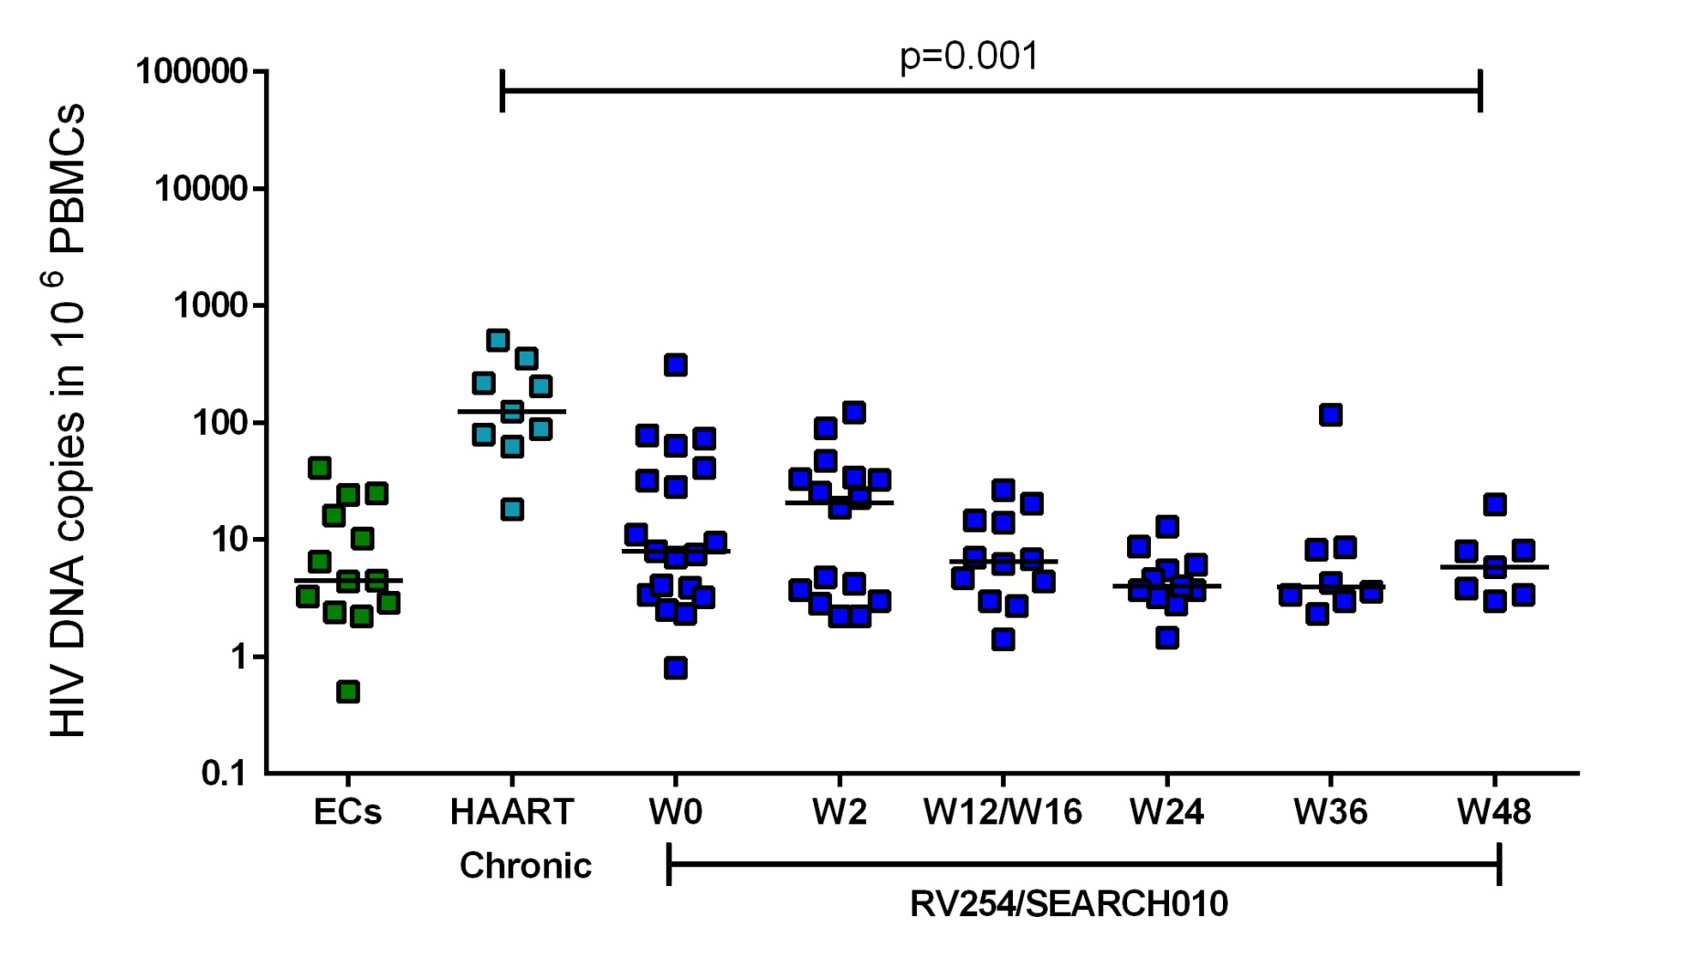
Extremely Low HIV DNA Levels in Fiebig I Subjects
5 yrs
Fiebig I
Updated from Ananworanich J, PLoS ONE 2012
Data provided by Nicolas Chomont, Claire Vandergeeten (VGTI-Florida)

Slide 37
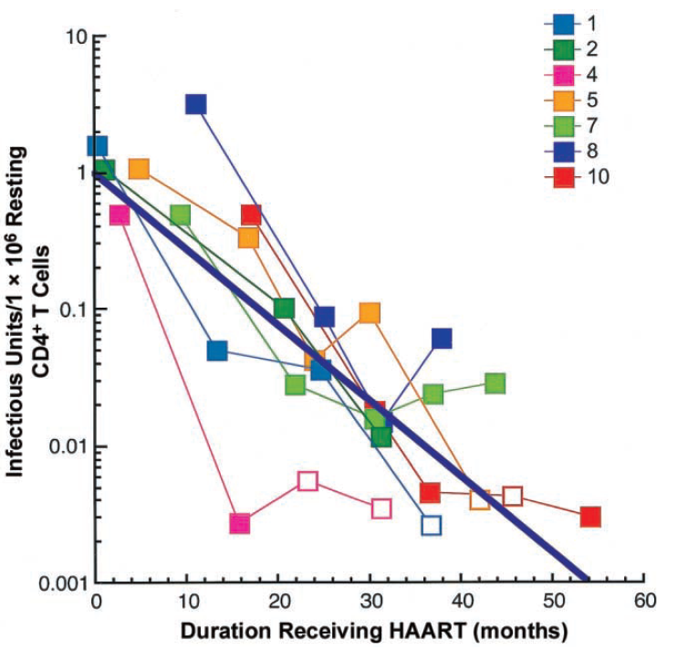
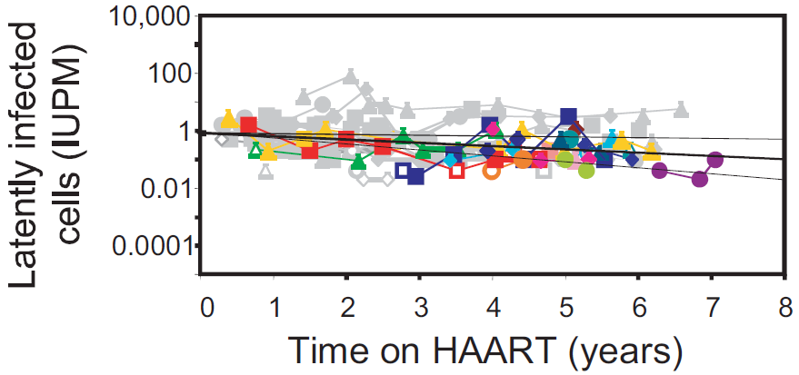
Shorter Latent Reservoir Half-life when ART is Initiated during Primary HIV Infection
Primary HIV
Chronic HIV
Half-life ~ 5 months
Time to eradicate 10⁶ cells ~ 8 years
Half-life ~ 44 months
Time to eradicate 10⁶ cells ~ 73 years
Chun TW, JID 2007
Siliciano JD, Nature Med 2003
Immediate ART restricts HIV infection of resting CD4+ T cells
without accelerating the decay of latent infection (Archin NM, PNAS 2012)

Slide 38
Will ART Initiated during Acute HIV Infection Change the Disease Course? “Viremic Control following ART Interruption”

Slide 39
Clinical Trials of ART during Acute/Primary HIV Infection followed by ART Interruption
Published Studies | Viremic control
VISCONTI (n=32) ART during PHI (Hocqueloux L, AIDS 2010) | 15.6% had VL < 50 for > 6 years
Swiss HIV Cohort Study (n=32) ART during acute vs. Chronic HIV (Gianella S, Antiviral Therapy 2011) | 3 of 32 (9%) had VL < 50 at 1 year
Primo-SHM (n=173) No ART vs. 24 weeks vs. 60 weeks ART (Grijsen ML, PLoS Medicine 2012) | 4 of 79 (5%) in ART arms had VL < 100 at wk 24
ANRS CO6 PRIMO (n=164) ART during PHI (Goujard C, Antiviral Ther 2012) | VL < 50 11% at 1 year, 8.5% at 2 years
CASCADE (n=259) ART during PHI (Lodi S, Arch Intern Med 2012) | VL < 50 8.2% at 1 year and 5.5% at 2 years

Slide 40
Clinical Trials of ART during Acute/Primary HIV Infection followed by ART Interruption
Published Studies | Viremic control
Swiss HIV Cohort Study 2 (n=33) ART vs. untreated PHI (von Wyl V, PLoS ONE 2011) | No report of patients with VL < 50 Lower VL at 1 year compared to untreated
ACTG 371 (n=73) ART during acute vs. recent HIV (Volberding P, AIDS 2009) | No report of patients with VL < 50 40% had VL < 5000 at week 24
ACTG 5187 ART during AHI + DNA vaccine vs. placebo (Rosenberg ES, PLoS ONE 2010) | No report of patients with VL < 50 Lower VL set point compared to historical control
SPARTEC Standard care vs. 12-week vs. 48-week ART (Fidler S, 2011 IAS, Rome) | No report of patients with VL < 50 Lower VL set point in the 48-wk ART arm

Slide 41
Trials | VL < 50 after no ART | AHI stage | Time at ART | ART duration before interruption
VISCONTI (Hocqueloux L, 2010) | 15.6% | Fiebig II to V | 2.2 months from diagnosis | 5 years
Swiss 1 (Gianella S, 2011) | 9% | Fiebig I to VI | ≤ 4 months from infection onset | 1.5 years
Primo-SHM (Grijsen ML, 2012) | 5% | 70% F I to IV 30% F V-VI | 2 months from diagnosis | 0.5 years or 1.5 years
ANRS CO6 PRIMO (Goujard C, 2012) | 11% | Fiebig I to VI | 3.1 months from infection onset | 1.5 years
CASCADE (Lodi S, 2012) | 8.2% | Fiebig I to VI | ≤ 3 months from seroconversion | 1 year
Trials without post-treatment controllers (von Wyl V 2011; Volberding P 2009; Rosenberg ES 2010; Fidler S 2011 ) |  | Fiebig I to VI | 2-3 months from diagnosis | 1+ year

Slide 42
Trials | VL < 50 after no ART | Predictors for Viremic Control
VISCONTI (Hocqueloux L, 2010) | 15.6%
Swiss 1 (Gianella S, 2011) | 9%
Primo-SHM (Grijsen ML, 2012) | 5%
ANRS CO6 PRIMO (Goujard C, 2012) | 11%
CASCADE (Lodi S, 2012) | 8.2%
Ratio ART duration/time before ART initiation 0.88 in controllers vs. 0.42 in non-controllers
Better VL control if ART initiated
within 2 months of infection onset
Better VL control if ART initiated
within 2 weeks of seroconversion
Female, higher CD4+ T cell count, lower HIV RNA,
lower HIV DNA at PHI
were associated with VL control
No predictive factors for VL control but post-treatment controllers had high CD4 off ART

Slide 43
Early ART may Modify HIV Disease Course
Elite controllers
Post-ART controllers
0.5%
HLA B27, B57
overrepresentation
High frequencies of HIV-specific CD8+ T cells
Up to 15.6%
No HLA B27, B57
overrepresentation
Low frequencies of HIV-specific CD8+ T cells
Low HIV DNA
Reservoir distribution in short-lived memory CD4+ T cells
Low immune activation
High CD4+ T cell count
Seng R, JAIDS 2008; Hocqueloux L, AIDS 2010; McMichael AJ, Nat Rev Immunol 2010;
Goujard C, Antiviral 2012, Bacchus C, 2012 IAS HIV Cure workshop

Slide 44
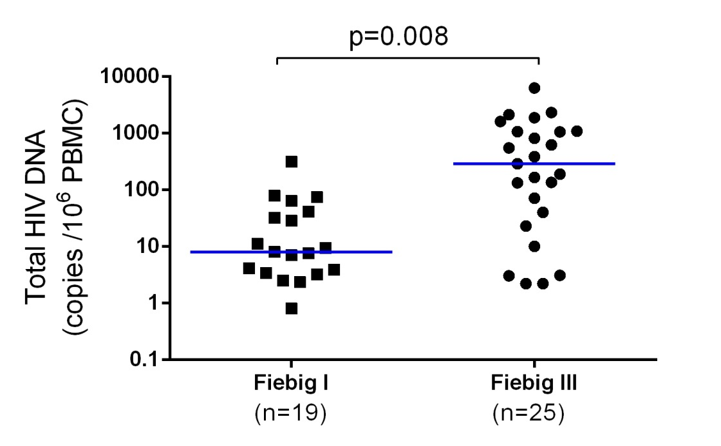
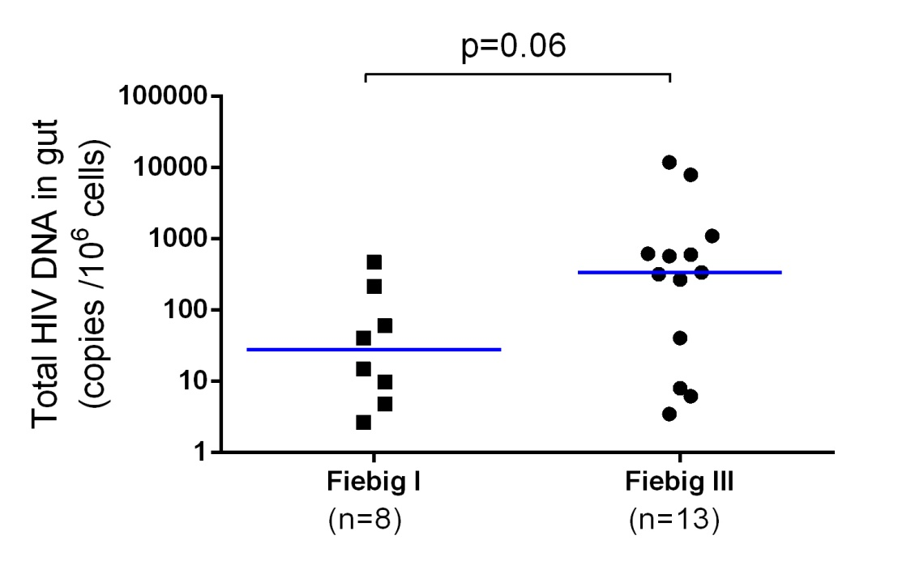
RV254/SEARCH 010 Study:
Smaller Reservoir Size in
Fiebig I compared to Fiebig III Acute HIV Infection
PBMC
Sigmoid
Updated from Ananworanich J, PLoS ONE 2012
Data provided by Nicolas Chomont, Claire Vandergeeten (VGTI-Florida)

Slide 45
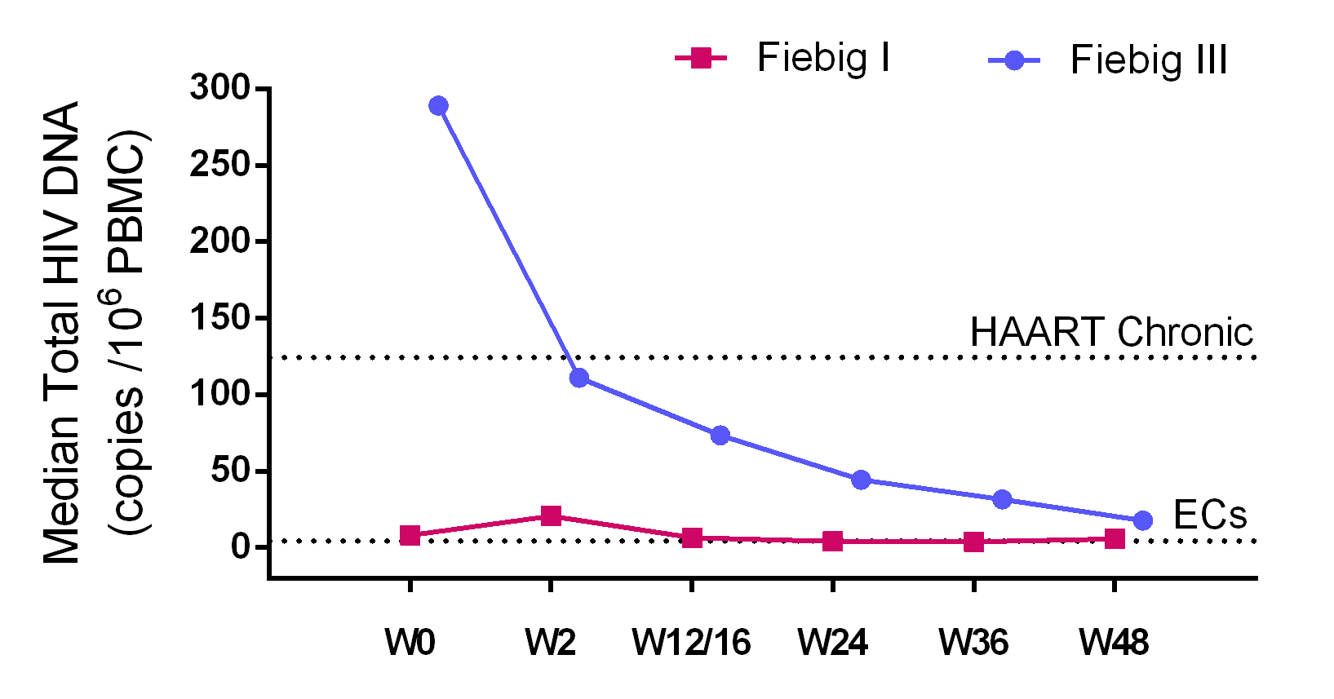
RV254: Total HIV DNA after ART in Early Fiebig AHI
(5 yrs)
Figbig I 19 16 12 11 8 7
Fiebig III 25 23 18 18 16 14
14 post-treatment controllers in ANRS PRIMO/Visconti study
HIV DNA after 20 months on ART was 2.1 log
HIV DNA after 6.5 years off ART was 1.71 log¹
¹Data provided by Christine Rouzioux

Slide 46
Examining interventions during acute HIV for functional cure

Slide 47
Identify acutely HIV-infected persons
Enrollment across
multi-national sites
ART
New drug classes
Drugs with better tissue penetration
Immediate ART leading to
rapid viral suppression
minimize reservoir size
preserve immunity
Reduce ongoing replication
Reduce immune
activation
Reduce latently
Infected cells
HDACi, others
Intervention
vs. no intervention
Enhance
HIV-specific immunity
Therapeutic HIV
vaccine
Other immunotherapy
Make cells
resistant to HIV
Eliminate CCR5
expression
ART
interruption
Passive immunity,
others
Control HIV viremia

Slide 48
Therapeutic HIV Vaccines did not Lower Viral Rebound after ART Interruption in Patients Treated with ART during Primary HIV Infection
VL log
2002
2005
2006
2007
2010
ALVAC/gp160
n=15¹
ALVAC
n=53²
ALVAC
n=49³
ALVAC/Lipo6T/IL2
n=29⁴
VRC DNA
n=20⁵
¹Markowitz M, JID 2002; ²Kinloch-de Loes S, JID 2005; ³Jacobson JM, JID 2006;
⁴Goujard C, AIDS Hum Retro Virus 2007; ⁵Rosenberg ES, PLoS ONE 2010

Slide 49
Why Should there be Renewed Interest in Therapeutic HIV Vaccines in Acute HIV Infection?
Ability to diagnose and intervene in “true” acutely infected patients to limit reservoir size
Possible role of therapeutic HIV vaccine drugs in synergistic with new drug classes
HDACi alone without HIV-specific CD8+ T cell response did not affect reservoir size (Shan L, Immunity 2012)
New and more potent vaccines
Ad26/MVA reduced SIV viral set point by > 2 log in Rhesus monkeys (Baruch DH, Nature 2012)

Slide 50
IAS Recommendation Towards an HIV Cure
Recommendations for future research
Eradication trials specifically designed for acute HIV infection must be implemented, and involve ARVs and other types of interventions
Include strict populations of acutely infected subjects
Large observational study of “post-treatment control” following interventions at acute HIV infection
http://www.iasociety.org/Web/WebContent/File/HIV_Cure_Full_recommendations_July_2012.pdf
Nature Reviews Immunology , August 2012

Slide 51
Conclusions
Nucleic acid testing allows for identification of early Fiebig stage acute HIV infection
ART during acute HIV infection is associated with preserved immunity and small reservoir size, and may alter the HIV disease course
Post-treatment controllers are more common in patients treated during acute HIV infection
Predictors for post-treatment controllers are short interval from HIV onset to ART initiation, long duration of ART, and low HIV DNA and high CD4+ T cell count prior to interruption
Therapeutic HIV vaccines in addition to early ART and possibly new drug classes have an important role in achieving functional cure

Slide 52
Acknowledgements
RV254/SEARCH 010 study participants and investigators
Funding from the US Military HIV Research Program
Antiretrovirals from the Thai Government Pharmaceutical Organization, Gilead, Merck and Pfizer
Data and input for this presentation
MHRP/AFRIMS
Alexandra Schuetz
Mark deSouza
Merlin Robb
Jerome Kim
Nelson Michael
SEARCH/Thai Red Cross
Suteeraporn Pinyakorn (Statistics)
Nitiya Chomchey
James Fletcher
Université Paris Descartes
Chirstine Rouzioux
VGTI-Florida
Claire Vandergeeten
Nicolas Chomont
Royal Free Hospital-London
Sabine Kinloch-de Loes

