Slide 1
Nosocomial infections - with focus on Gram-negative bacteria
Elisabeth Kugelberg
Junior Research fellow

Slide 2
Outline of lecture
History
Prevalence, infections and pathogens
Antibiotic resistance and compensatory evolution
Acinetobacter baumannii – an emerging nosocomial pathogen
Prevention

Slide 3
History of nosocomial infections
Greek: nosos “disease” and komien “to care for”
4th century BC: Hippocrates
18th century AD: Sir John Pringle
Mid 19th century:
1820-1910
1818-1865
“The first requirement of a hospital is that it should do the sick no harm”
Florence Nightingale
Ignaz Semmelweis

Slide 5
Healthcare associated infections (HAI) are a problem worldwide
Prevalence:
Europe: 7.1 per 100 patients
USA: 4.5 per 100 patients
Developing countries: 15.5 per 100 pat.
Studies reporting HAIs in developing countries.
Allegranzi et al, Lancet 2011

Slide 6
The burden of HAIs in the developed world
UK: >100,000 HAIs each year £1 billion/year 5000 deaths per year
USA: >1.7 million HAIs each year $28-45 billion in direct medical costs/year 98,000 deaths per year

Slide 7
Risk factors for nosocomial infections
Patient factors
Debility
Immunosuppressive illness
Extremes of ages
Trauma
Surgical incisions
Intravascular devices
Urinary catheters
Prostheses
Antibiotic use
Anaesthesia and ventilation
Hospital environment
Hospital pathogens
Cross-infection
Lack of hygiene
Overcrowding
Medical and surgical interventions

Slide 8
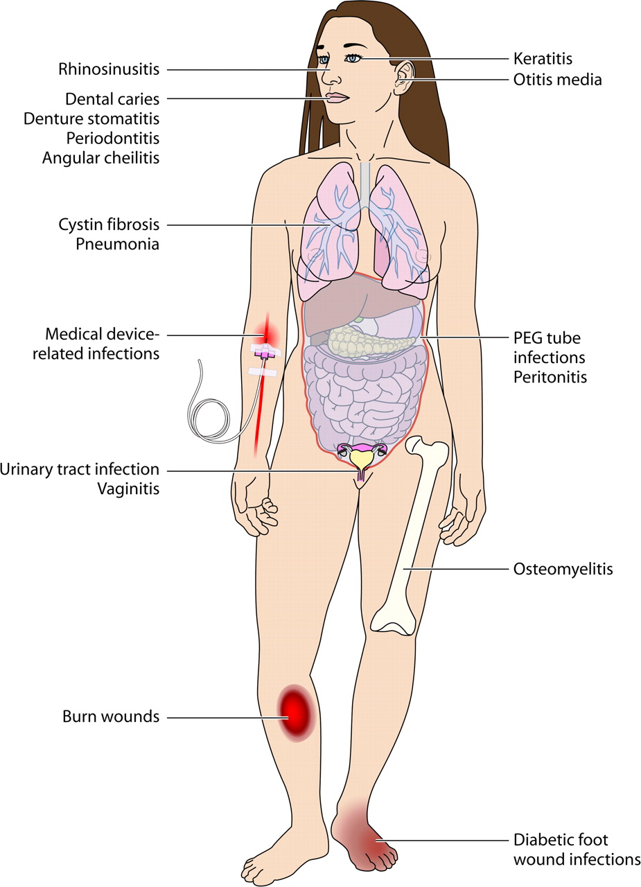
Typical nosocomial infections
Sepsis
Pneumonia
Medical device- related infections
Urinary tract infections
Wound infections

Slide 9
Which organisms are causing the problem?
Gram-positive bacteria:
Staphylococcus aureus: methicillin-resistant (MRSA) methicillin-sensitive (MSSA)
Enterococcus: vancomycin-resistant (VRE)
Clostridium difficile
Enterobacteriaceae: Escherichia coli, Klebsiella
Pseudomonas aeruginosa
Acinetobacter baumannii
Gram-negative bacteria:

Slide 10
MRSA and Clostridium difficile
MRSA bacteraemia 2002-2011 2011: 364 deaths
C. difficile infections 2008-2011 2011: 2,053 deaths

Slide 11
Gram-negative multidrug-resistant bacteria
Cefotaxime resistant E. coli
Pandrug resistance – beginning of a return to the pre-antibiotic era?
Account for 70% of HAIs in intensive care units
Ciprofloxacin resistant E. coli

Slide 12
Use of antibiotics

Slide 13
Use of antibiotics
100,000-200,000 tonnes per year world-wide

Slide 14
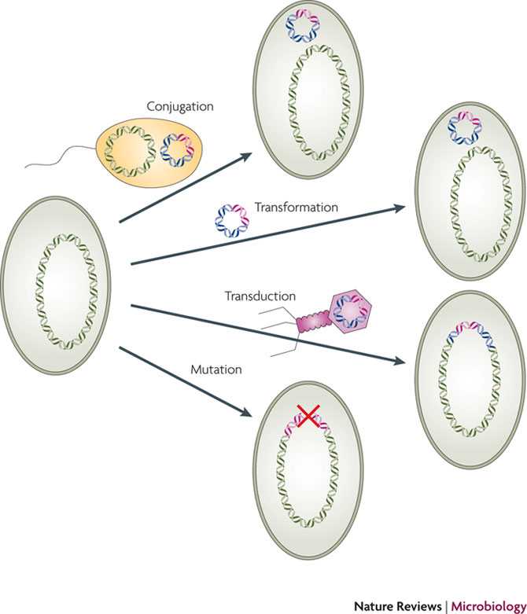
Mechanisms of resistance acquisition
DNA containing an antibiotic resistance gene (pink).
Horizontal gene transfer into a recipient:
Cell-to-cell Conjugation
Transformation by naked DNA
Phage-mediated transduction
Resistance can also arise by de novo mutation
Andersson and Hughes,
Nat Rev Micro 2010

Slide 15
Antibiotic resistance in Gram-negative bacteria
Cell wall synthesis inhibitors
β-lactams (penicillin, carbapenem)
Inhibition of protein synthesis
Aminoglycosides (kanamycin)
Chloramphenicol
Inhibition of nucleic acid synthesis
Quinolones
Rifampicin
Inhibition of folic acid metabolism
Trimethoprim
Alteration of cell membranes
Polymyxins
Peleg and Hooper,
New Eng J Med 2010

Slide 16
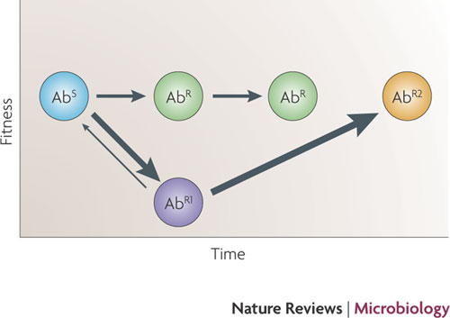
Biological costs of resistance
Sandegren and Andersson,
Nat Rev Micro 2009

Slide 17
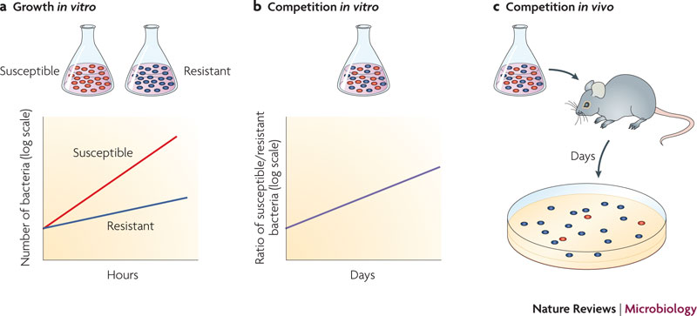
How to determine fitness of bacterial strains

Slide 18
Can we reduce the frequency of resistant bacteria?
Aggravated by:
Cost-free resistance
Compensatory evolution
Co-selection of resistance
Future:
Choose antibiotic targets conferring high fitness cost with low rate of compensation
Use fitness costs for choice and design of novel therapies

Slide 19
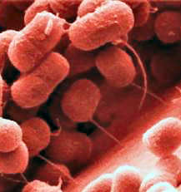
The genus Acinetobacter
Gamma Proteobacteria (Family: Moraxellaceae)
Non-motile Gram-negative, strictly aerobic coccobacilli
33 species – A. baumannii clinically most important

Slide 20
Habitats
Environment: soil, water, sewage (A. calcoaceticus, A. johnsonii, A. baylii)
Food: milk products, meat, poultry, fish (A. johnsonii, A. lwoffii, A. radioresistens)
Human skin (A. johnsonii, A. lwoffii, A. radioresistens)
Hospital environment and infections (A. baumannii, A. sp.3, A. sp.13TU)
A. baumannii is not considered a ubiquitous organism –
natural habitat outside the hospital remains to be defined

Slide 21
Presence of A. baumannii in hospitals
Hospital environmental sources of A. baumannii ( ) during outbreaks: equipment, beds, respiratory tubing, computer keyboards, mobile phones etc

Slide 22
A. baumannii infections
Intensive care units (ICUs): respiratory tract, soft tissue, blood, urinary tract and central nervous system
Survivors of natural disaster and wars: wound
Community-acquired: pneumonia
High mortality rates: 19-54%

Slide 23
The problematic A. baumannii
Persistent – resistant to drying and disinfectants
Antibiotic resistance – increasing numbers of multidrug resistant strains (resistance to carbapenems has increased from <0.5% in 1990 to 24% in 2007 in the UK)
Causes outbreaks

Slide 24
Whole-genome sequencing of eight A. baumannii
Many genomic islands – genes encoding resistance to antibiotics, heavy metals, antiseptics
Type IV and type VI secretion systems
A urease, iron uptake & metabolism, pilus biogenesis
Putative genes for capsule biosynthesis and transport

Slide 25
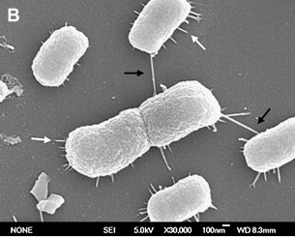
Investigated virulence mechanisms
Quorum-sensing signal molecules
Biofilm formation
Resistance to human serum
Interaction with human epithelial cells
de Breij et al, Res Micro 2009
Choi et al, BMC Microbiol 2008

Slide 26
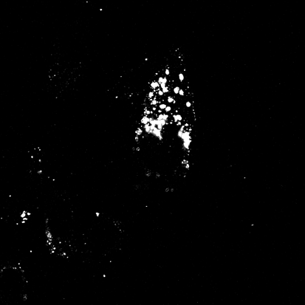
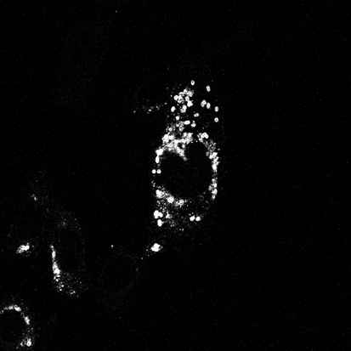
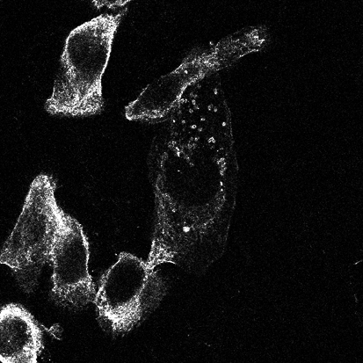
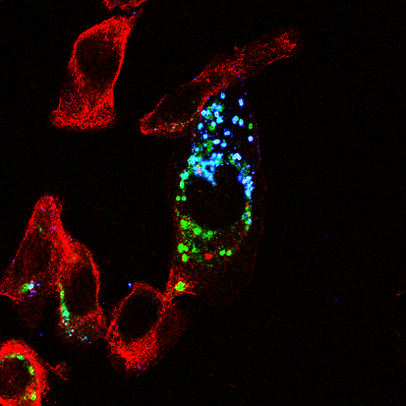
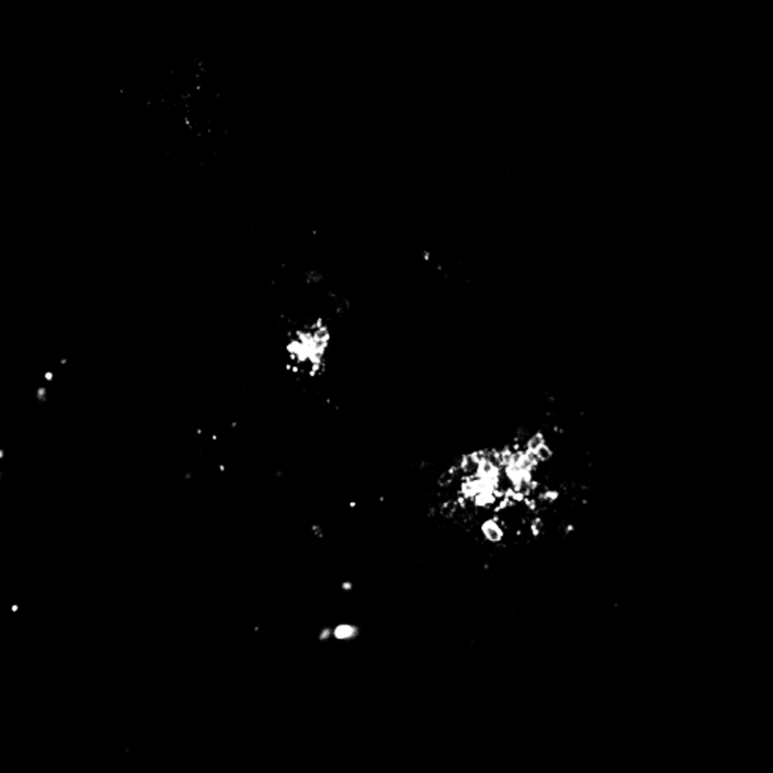
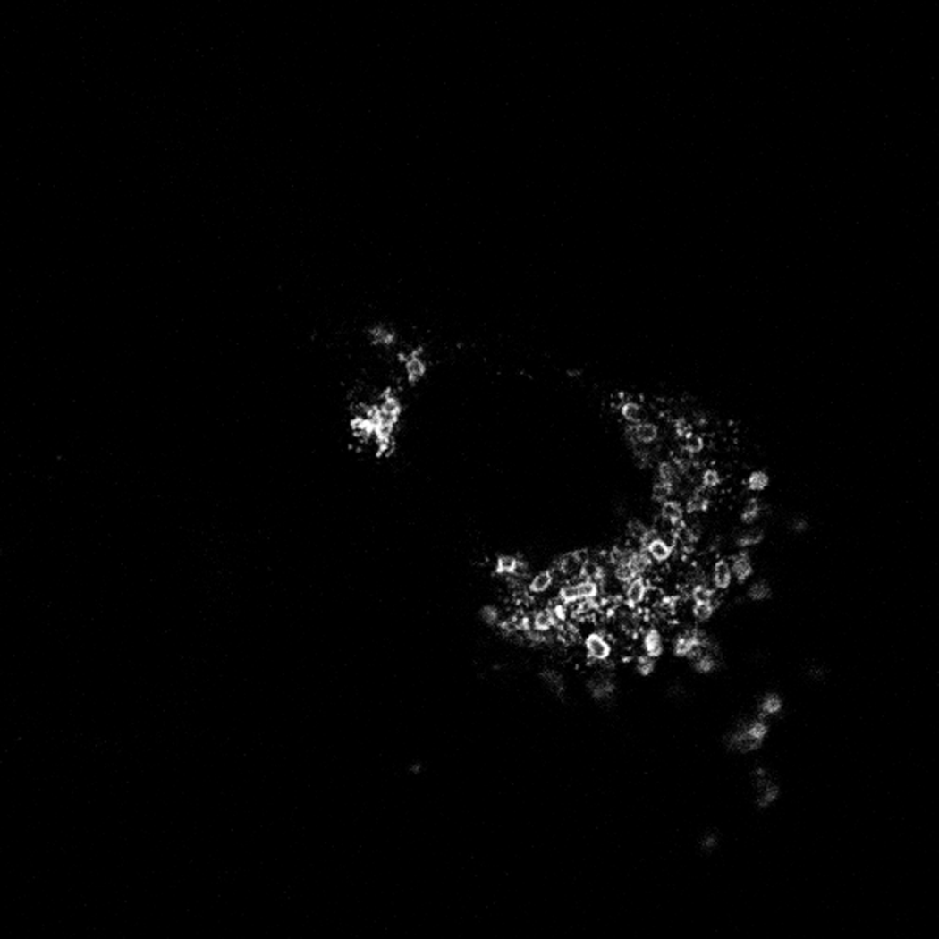
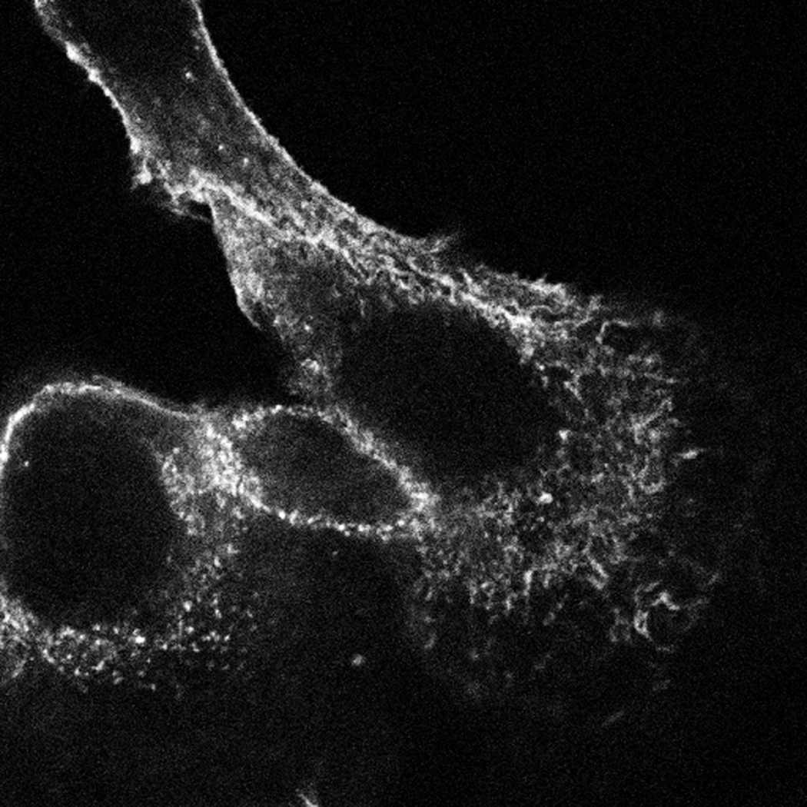
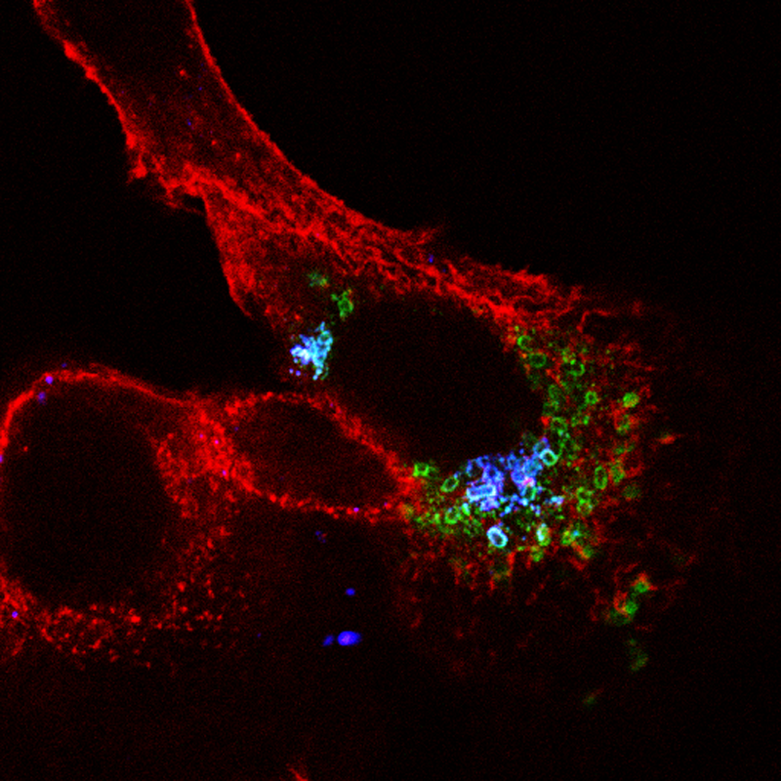
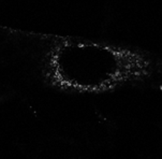
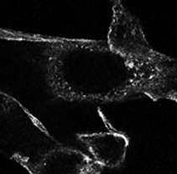
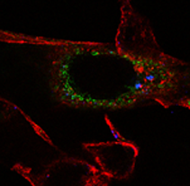
24 hours after infection of COR-L23 with EK1
Extracellular
Total bacteria
Actin
Merged

Slide 27
Current prevention and control strategies of HAIs in Europe
Awareness
Surveillance policies UK mandatory surveillance:
MRSA, C. difficile and since last year MSSA, E. coli
Surgical site infection

Slide 28
Current prevention and control strategies of HAIs in Europe
Awareness
Surveillance policies
Best practice guidelines
Rapid diagnosis and treatment
Rational use of antibiotics

Slide 29
Take home message
HAI is a common public health problem
MRSA and C. difficile infections are decreasing
Emergence of multidrug resistant Gram-negative bacteria (Klebsiella, E. coli, Acinetobacter)
Bacteria can compensate for the biological cost of antibiotic resistance → stabilises the resistant population

Slide 30
Suggested reading
Antibiotic resistance and its cost: is it possible to reverse resistance? Andersson and Hughes, Nature Reviews Microbiology 2010
Crisis in hospital-acquired, healthcare-associated infections Calfee, Annual Review Medicine 2012
Hospital-acquired infections due to Gram-negative bacteria Peleg and Hooper, New Eng J Med 2010

