Slide 1
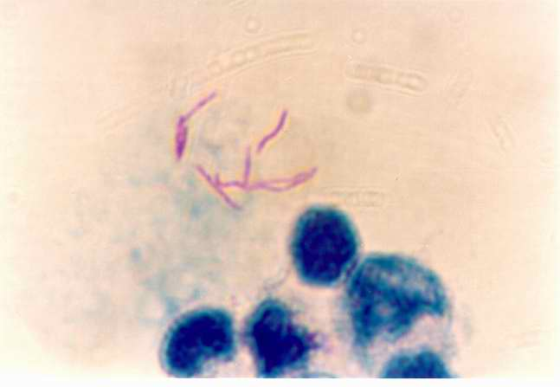
Mtb 3 - Host-pathogen interactions Adaptive Immunity
Dr Brian Robertson
Microbiology, FoM,
MRC CMBI, Flowers building

Slide 2
Different stages of M. tuberculosis infection
adaptive
immunity
Primary
disease
reactivation
disease
Bacterial load
containment
breakdown
innate
immunity
Initial
infection
few weeks
years/decades
time
Notes:
Model for all 3 lectures

Slide 3
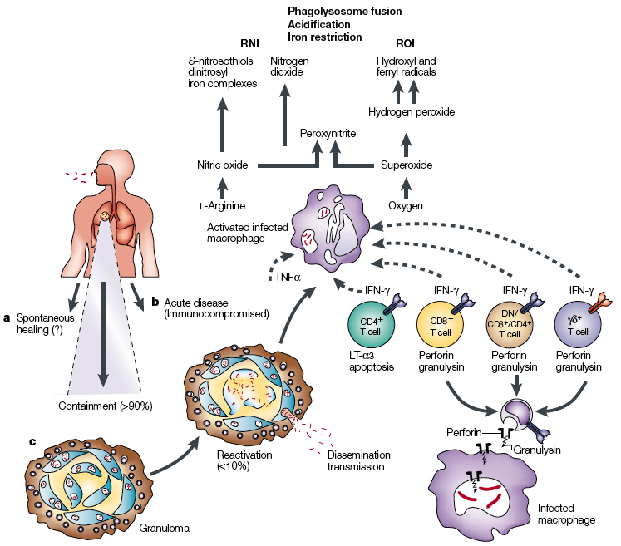
Outline
Main features of tuberculosis: from infection to host defence
Innate response
Adaptive response

Slide 4
Some more innate immunity

Slide 5
Apoptosis
2 different forms of cell death are commonly observed when Mtb-infected macrophages die
Necrosis, cell death defined by cell lysis
Apoptosis, cell death that maintains intact plasma membrane
Necrosis is used by bacteria to exit the macrophage, evade host defences, and spread
Apoptosis associated with diminished pathogen viability
Apoptosis occurs when 2 pathways triggered:
The extrinsic death domain pathway, leading to caspase-8 activation
Mitochondrial outer membrane permeabilization leading to activation of the intrinsic apoptotic pathway
Both pathways lead to caspase-3 activation, which results in apoptosis
Behar et al. Apoptosis is an innate defense function of macrophages against Mycobacterium tuberculosis. Mucosal Immunol (2011) 4, 279-87

Slide 6
Autophagy
Homeostatic process
Cells digest part of cytosol for removal or turnover
Sequestered in double membrane (autophagosome) for lysosomal degradation
Innate and adaptive defense against intracellular pathogens
Induction of autophagy can eliminate intracellular Mtb
Overcomes block in phagosome maturation
PIP3 and SapM
Physiological, chemical, immunological induction
Delivers bacteria to degradative phagolysosome

Slide 7
Immunological induction of autophagy “immunophagy”
IFNγ-mediated activation of macrophages
Oxidative killing
ROI & RNI
Non-oxidative killing
Auotophagy
Induce Immunity Related GTPases (IRG) e.g. LRG-47
Role for ubiquitin
Protective role in vitro against Mtb
Precise mode of action unknown
Deretic V: Autophagy as an innate immunity paradigm: expanding the scope and repertoire of pattern recognition receptors. Curr Opin Immunol 2012, 24:21–31.

Slide 8
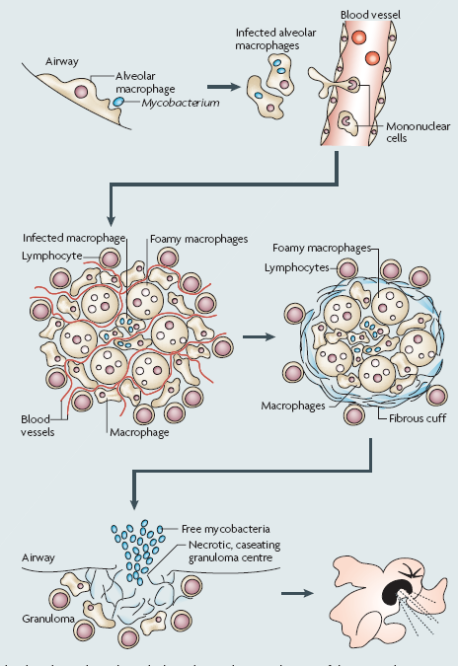
Infection with
M. tuberculosis
Adaptive immunity and maintaining containment

Slide 9
The innate immune response shapes the adaptive response
What T cells?
What effector functions?
How do they interact?
IFNγ
T cell
macrophage or
dendritic cell
cytokines/chemokines
costimulatory molecules
antigens
Notes:
Presentation of antigens released from dead/dying Mtb primes T cells and leads to cycle of activation

Slide 10
Specific or adaptive immunity
Requires specific recognition of foreign antigens
Innate immune response shapes the adaptive response (and vice versa)
IL12 drives T-helper development & IFNγ production
Adaptive response - 2 arms
Cellular - T cell activation and effectors
Humoral - B cells and antibody
Adaptive response to Mtb is primarily cell mediated - Th1 not Th2

Slide 11
Humoral response to Mtb
Probably non-protective, but
Role in opsonization
Blockage at mucosal surfaces
Some use in serological diagnostics
Potential as correlate of protection post vaccination or treatment?

Slide 12
T cell subsets involved in immune response to tuberculosis
CD4⁺ T cells
CD8⁺ T cells
CD1-restricted T cells
γδ T cells

Slide 13
T cell subsets - evidence for involvement
CD4⁺ T cells
Enhanced susceptibility in mice
MHC class II KO and CD4 depleted or KO
Enhanced susceptibility in man
HIV-infection
CD8⁺ T cells
Enhanced susceptibility in mice
CD8 depletion, CD8 KO, β₂m KO, TAP KO

Slide 14
T cell subsets - evidence for involvement
CD1-restricted T cells
No effect seen in mice - but different isotypes
γδ T cells
Enhanced susceptibility in mice
γδ T cell KO increased neutrophils within granulomas

Slide 15
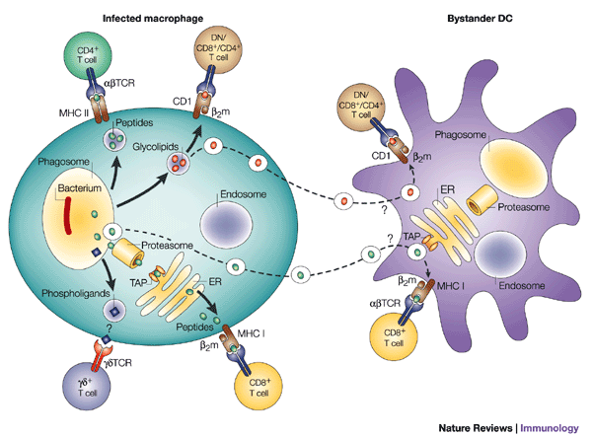
Antigen processing/presentation pathways
and activation of different T-cell subsets
1
3
4
2

Slide 16
Cellular response - (1) CD4+ T cells
Infected DCs in lymph nodes present intra-vacuolar Mtb antigens via MHC class II to CD4 T cells
Develop Th1 phenotype
Production of IFNγ and macrophage activation
Major T cell subset required for protection

Slide 17
Antigen processing/presentation pathways
and activation of different T-cell subsets
2

Slide 18
Cellular response - (2) CD8+ T cells
Presentation of Mtb antigens released into cytoplasm via MHC class I to CD8+ T lymphocytes
Production of IFNγ
macrophage activation
Production of TNFα
Macrophage activation
Granuloma formation and maintenance
NOS2 activation
Perforin, granzymes - lyse infected cells (apoptosis)
Granulysin
Enters infected cells and kills Mtb

Slide 19
Antigen processing/presentation pathways
and activation of different T-cell subsets
3

Slide 20
Cellular response - CD1-restricted T cells
Non-classical presentation of lipid antigens via CD1
cell wall mycolic acids (long chain branched fatty acids)
phosphatidyl inositol mannoside (PIM)
lipoarabinomannan (LAM)
Effector functions (c.f. CD8)
Pro-inflammatory cytokine production (IFNγ)
Cytolytic activity
Granulysin killing of bacteria

Slide 21
Antigen processing/presentation pathways
and activation of different T-cell subsets
4

Slide 22
Cellular response - γδ T cells
Non classical T cells - contribute to innate and adaptive immune response
Activated by low molecular weight phospho-ligands
also peptides?
Accumulate in lungs & lympoid tissue
Seen in granulomas
Cytokine and granzyme B production
Cytotoxic function

Slide 23
Why different T cell subsets?
cell lysis
granulysin
uptake by
activated MΦ
IFNγ
apoptosis
Different effector functions?
Different antigens – antigen processing pathways in different cells?
e.g. professional versus non-professional APCs
inhibition of MHC class II expression in infected macrophages
Different subsets at different times/stages of infection

Slide 24
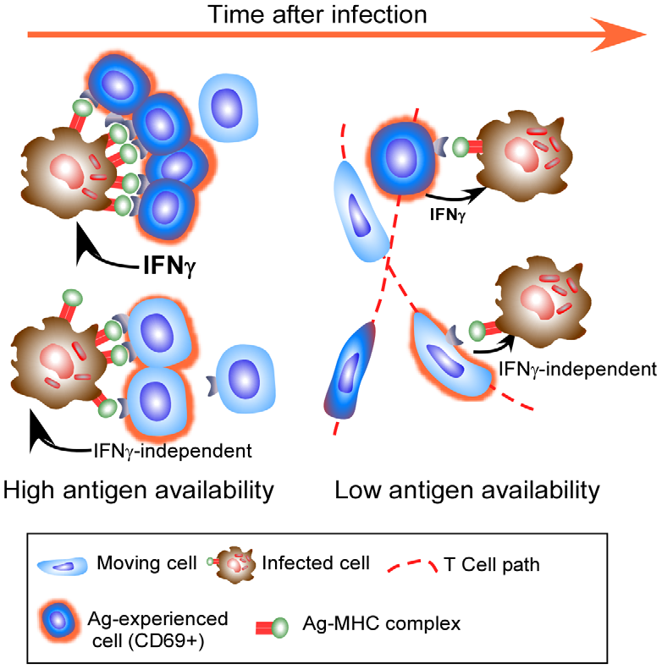
Presence of activated T-cells in the granuloma depends on antigen level
Effector T cells enter the granuloma, only a few stay (dark blue cells) and release of IFNg, ptobably when presented [antigen] is high.
As [antigen] reduced during infection, even fewer cells stay, most cells continue to move throughout the granuloma (light blue motile cells).
Torrado and Cooper.
What Do We Really Know about How CD4 T Cells Control Mycobacterium tuberculosis?
PLoS Pathog (2011) 7, e1002196
Notes:
Effector T cells do not find the granuloma to be a stimulating environment. Effector T cells enter the granuloma and only a few
exhibit significant migration arrest (dark blue cells) and targeted release of IFNc, likely when they encounter a high level of cognate antigen on
infected phagocytes. As their cognate antigen is reduced, even fewer cells undergo migration arrest, with many more cells continuing to move
throughout the granuloma (light blue motile cells). Although these cells do not stop migrating, they do up regulate CD69 in an antigen-specific
manner. Cells entering the granuloma may mediate their effector function without the release of IFNc, and while this activity does require
recognition of antigen, it may not need migration arrest.

Slide 25
Vaccines and Memory T cells
Incomplete understanding of what constitutes a protective memory immune response hampers TB vaccine development
Interferon-γ production by CD4+ T-cells is used as a surrogate post vaccination
What value does it have in predicting protective memory immunity?
Different requirements for interferon-γ mediated protection in the primary response versus the memory recall response.
Do memory CD4+ T-cells need interferon-γ?
Role for other cytokine and T cell subsets?

Slide 26
Summary: TB Adaptive Immunity
Complicated interplay between innate and adaptive immune responses
Apoptosis and Autophagy
Adaptive response is key in maintaining containment
Failure leads to active disease
Limited role for humoral response
Strong T cell response and cytokine production
CD4 and CD8, plus CD1 and γδ T cells
Different roles at different stages
Key role for IFNγ in oxidative and non-oxidative response
ROI, RNI and autophagy
Role as correlate of protection in vaccination is unclear

Slide 27
References
Abebe F: Is interferon-gamma the right marker for bacille Calmette-Guérin-induced immune protection? The missing link in our understanding of tuberculosis immunology. Clin. Exp. Immunol. 2012, 169:213–219.
Bell and Westermann. CD4 memory T cells on trial: immunological memory without a memory T cell. Trends Immunol (2008) 29:405-11
Cooper (2009) Cell-mediated immune responses in tuberculosis. Annu Rev Immunol. 27:393-422.
Cooper AM, Torrado E. (2012) Protection versus pathology in tuberculosis: recent insights. Curr Opin Immunol. 24:431-7
Dorhoi et al. (2011) For better or for worse: the immune response against Mycobacterium tuberculosis balances pathology and protection. Immunol Rev 240:235-51.
Florey O, Overholtzer M: Autophagy proteins in macroendocytic engulfment. Trends Cell Biol 2012, 22:374–380.
Goldsack & Kirman (2007) Half-truths and selective memory: Interferon gamma, CD4+ T cells and protective memory against tuberculosis. Tuberculosis 87:465-73.
Kaufmann SHE: Tuberculosis vaccine development: strength lies in tenacity. Trends Immunol 2012, 33:373–379.
Orme (2004) Adaptive immunity to mycobacteria. Curr Opin Microbiol. 7(1):58-61.
Saunders & Britton (2007) Life and death in the granuloma: immunopathology of tuberculosis. Immunol. Cell. Biol. 85:103-111.
Tischler and McKinney. Contrasting persistence strategies in Salmonella and Mycobacterium. Curr Opin Microbiol (2010) vol. 13 (1) pp. 93-9
Weerdenburg et al. How do mycobacteria activate CD8+ T cells? Trends Microbiol (2010) 18:1-10

Slide 28
Learning objectives
Outline the contribution that humoral immunity makes to Mtb control
Outline the role of the major T cell subsets in adaptive immunity to Mtb
Describe oxidative and non-oxidative killing of Mtb

Slide 29
TED Prize
When James Nachtwey was awarded the TED prize in 2007. He was given $100,000 and one
Wish to change the world. He wished for our help in telling a vital story to the world,
Using powerful photos taken around the globe. This photography project are the result of his wish.
xdrtb.org

