Slide 1
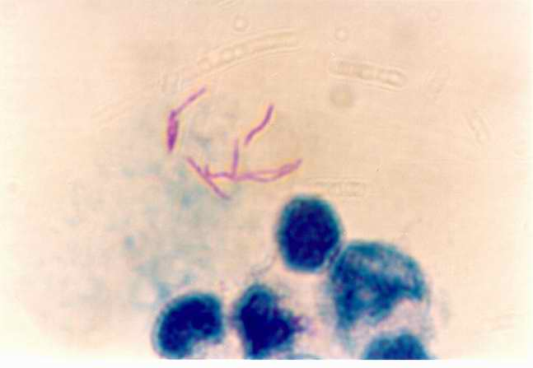
Mtb 2: Host-pathogen interactions Innate Immunity
Dr Brian Robertson
Microbiology, FoM,
MRC CMBI, Flowers building

Slide 2
Different stages of M. tuberculosis infection
adaptive
immunity
Primary
disease
reactivation
disease
Bacterial load
containment
breakdown
innate
immunity
Initial
infection
few weeks
years/decades
time
Notes:
Model for all 3 lectures

Slide 3
Outline
Mtb Interaction with the host
Intracellular life
Phagocytic cells
Interaction with host cells
Innate immunity

Slide 4
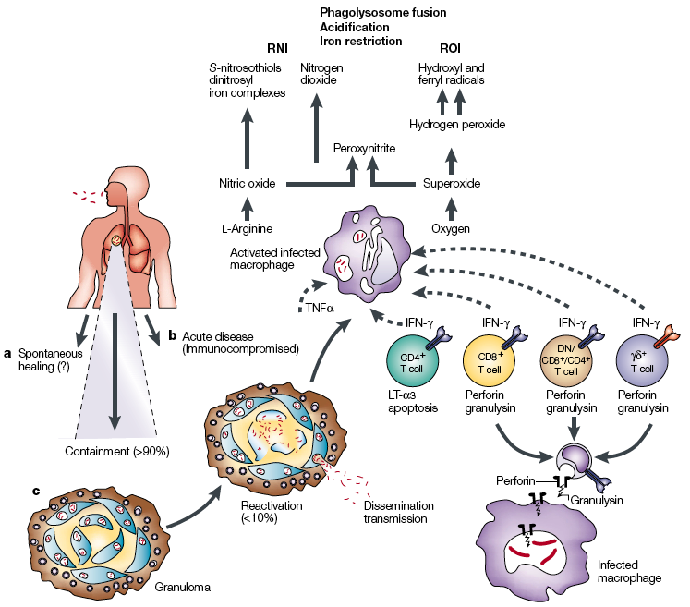
Outline
Main features of tuberculosis: from infection to host defence
Innate response
Adaptive response

Slide 5
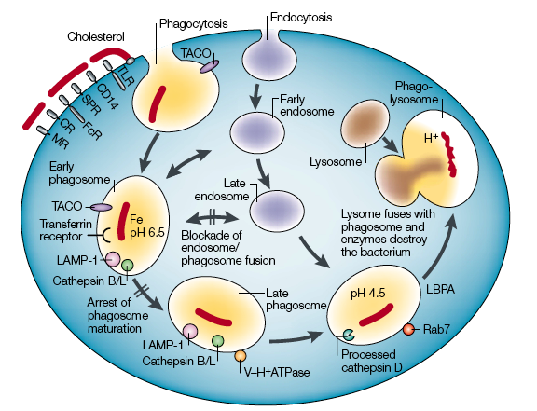
The intracellular lifestyle of M. tuberculosis
2
3
1

Slide 6
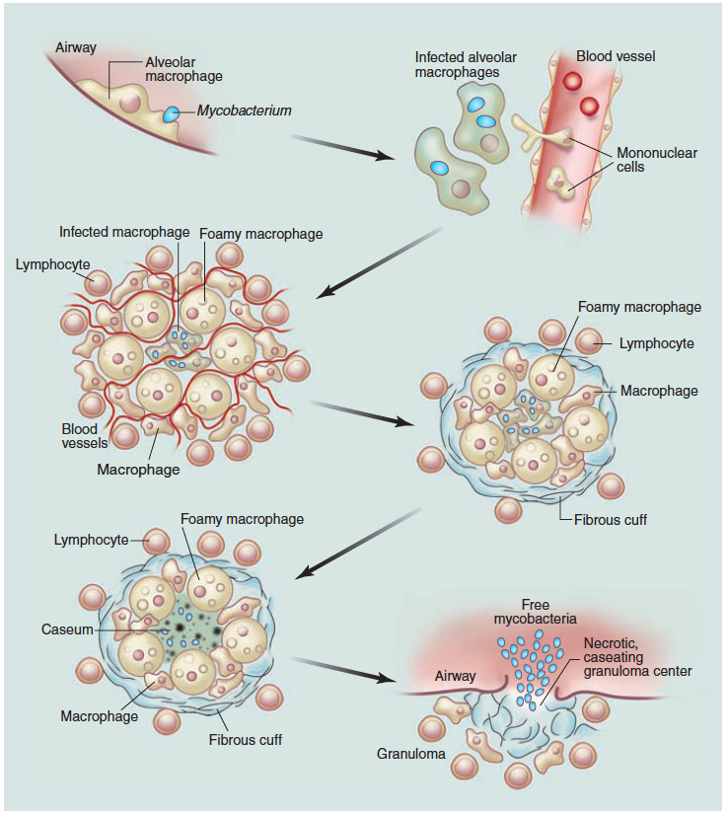
Infection with
M. tuberculosis
Macrophage is pivotal cell in host response and as host cell for Mtb
Russell et al. Tuberculosis: what we don't know can, and does, hurt us. Science (2010) 328:852-6

Slide 7
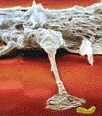
Mycobacteria and Macrophages
elimination
“normal” route
persistence
replication

Slide 8
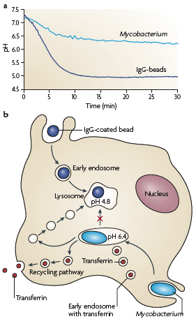
Phagosomes containing live Mycobacteria do not fully acidify
Phagosome acidification kinetics
IgG-beads
M. bovis BCG
IgG bead-phagosomes
acidify < pH 5.0 in 10-12 min
Live BCG phagosomes
limited acidification (pH 6.4)
Reduced V-ATPase
contain early endosome markers
Rab5 & 14
Russell Nature Reviews Microbiology 5, 39–47 (January 2007)

Slide 9
How do mycobacteria arrest phagosome maturation?
3 general strategies:
Interactions with surface receptors?
CR3, Mannose, Fc, TLR, scavenger
Single or multiple?
Modification of phagosomal lumen?
secretion of functional enzyme? SapM, PknG
Modification of phagosomal membrane?
insertion of lipids? LAM, PDIM
Prevention of V-ATPase

Slide 10
Surface receptors on macrophages*
M. tuberculosis
surfactants
SP-A, SP-D
opsonins
CR3
ligand?
LAM
complement
lipoproteins
IgA
Fc
receptor
mannose
receptor
macrophage/DC
TLR1,2,4,6
CR1,3,4
Toll-like receptors
DC-SIGN
scavenger
receptors
complement
receptors
cholesterol (lipid rafts?)
*a selection!
Notes:
c.f. yesterdays invasion lecture. Variety of receptors - differential engagement has consequences for cell and bug.

Slide 11
1. Receptors involved in Mtb uptake
CR3
Bacterial ligand unknown
Prevents respiratory burst
Blocks phagosome maturation
TLR2
19kDa lipoprotein
Lipoarabinnomannan (LAM)
Promotes IL-12 and iNOS

Slide 12
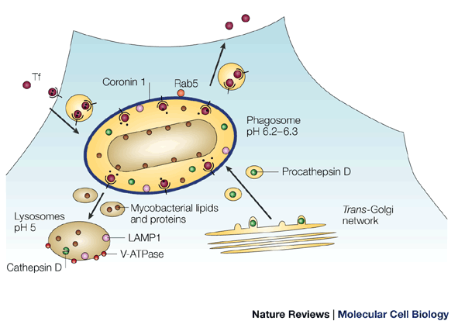
The Mycobacterial Phagosome
inhibition of
Ca²⁺ signalling
Russell DG. 2001. Mycobacterium tuberculosis: here today, and here tomorrow. Nat Rev Mol Cell Biol 2:569-77
Notes:
Dynamic process. Fusion with vesicles containing various biomolecules.

Slide 13
2. Modification of phagosomal lumen
Secreted Acid Phosphatase (SapM)
Cleaves phosphatidylinositol 3-kinase (PI3P)
Blocks phagosome-late endosome fusion
Lipoarabinomannan (LAM)
Inhibits increase in intracellular Ca²⁺

Slide 14
2. Modification of phagosomal lumen
Protein Kinase G (PknG)
Secreted Ser/Thr protein kinase
Blocks delivery of mycobacteria to lysosome
Specific inhibitor identified
New class of drugs?

Slide 15
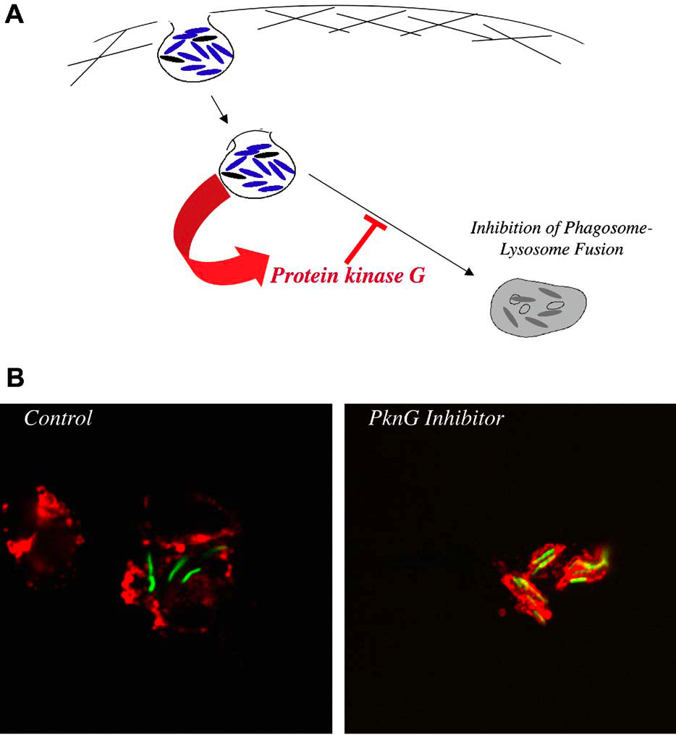
Protein Kinase G from Pathogenic Mycobacteria Promotes Survival Within
Macrophages
Walburger et al (2004)
Science 304:1800-1804

Slide 16
3. Modification of phagosomal membrane
Mycobacterial lipids / proteins traffic out of immature phagosome
Pthiocerol dimycocerasate (PDIM)
Phosphatidylinositol mannosides (PIM)
Modulate phagosome trafficking
Partners unknown

Slide 17
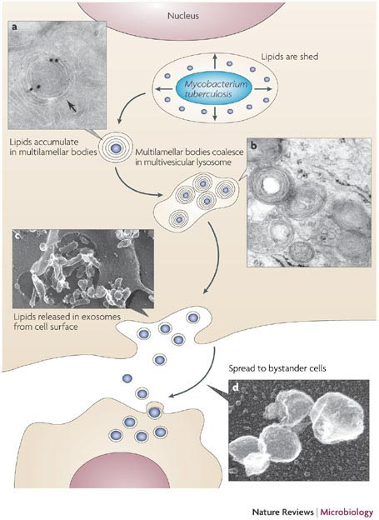
Release and trafficking of bacterial lipids
a
Mtb sheds material into vacuole
Accumulates in multilamellar bodies
Multilamellar bodies coalesce into multivesicular lysosome
Vesicles released by exocytosis
Exosomes internalized by neighbouring cells
*
b
c
d
Russell Nature Reviews Microbiology 5, 39–47

Slide 18
Mtb-infected macrophage
mycobacterial surface sugars/glycolipids tagged with fluorophore prior to phagocytosis
Dave Russell
Cornell University

Slide 19
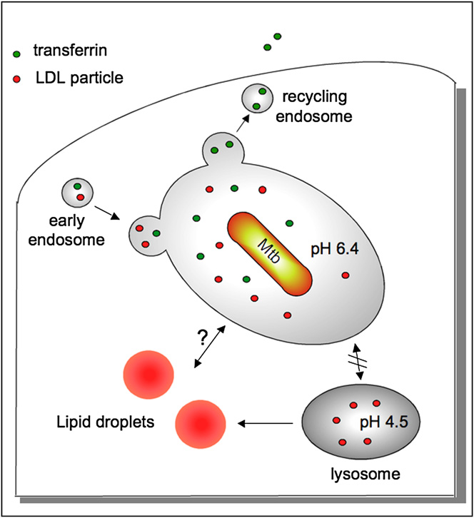

Slide 20
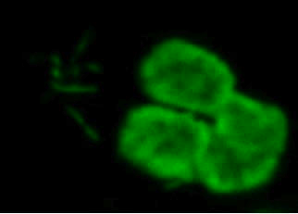
Other innate immunity cells not just macrophages!
Neutrophils can ingest Mtb
Earliest cells recruited to sites of invasion
Well characterised antimicrobial activities
ROI, Neutrophil Extracellular Traps (NETs)
Human purified neutrophils were incubated with Mtb
DNA was stained green with SYTOXTM

Slide 21
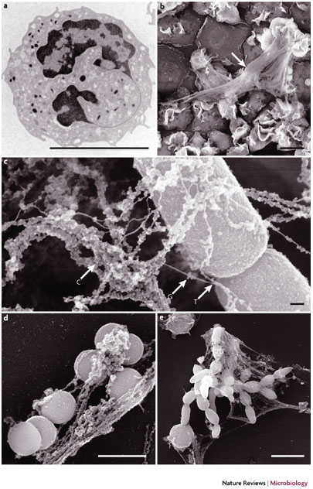
NETs trap Gram– bacteria, Gram+ bacteria & fungi
a
b
Unstimulated human neutrophil
Stimulated neutrophils NETs
NETs trapping
Shigella flexneri
Staph. aureus
Candida albicans
c
d
e
Beneficial suicide: why neutrophils die to make NETs
Brinkmann & Zychlinsky
Nature Reviews Microbiology 5:577-582 (2007)

Slide 22
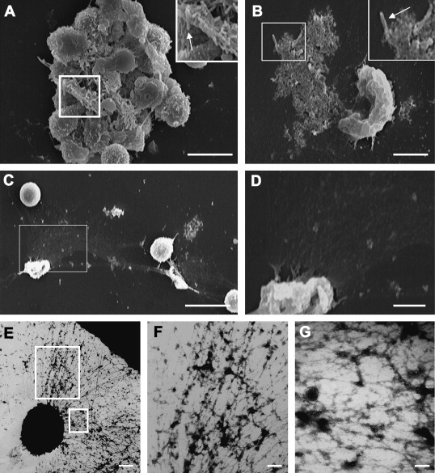
NETs trap mycobacteria, but do not kill them
b
c
d
e
Ramos-Kichik et al. (2009) Neutrophil extracellular traps are induced by Mycobacterium tuberculosis. Tuberculosis. 89:29-37

Slide 23
Innate immunity components
Mast cells
Recruit other cells on the innate system
Natural killer cells
Role unclear, but produce IFNγ
Defensins
Cationic, antimicrobial peptides
30-50 amino acids
Some activity against Mtb - importance unclear
Dendritic cells
Main antigen presenting cells, recruited from blood
Endocytose through C-type lectins (DC-SIGN)
Migrate to peripheral lymph nodes
Mtb-infected DCs do not function optimally
Key in shaping adaptive immunity

Slide 24
The innate immune response
shapes the adaptive response
IFNγ
T cell
macrophage or
dendritic cell
cytokines/chemokines
costimulatory molecules
antigens
Notes:
Presentation of antigens released from dead/dying Mtb primes T cells and leads to cycle of activation

Slide 25
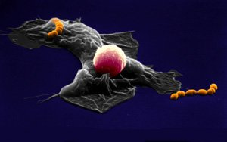
Phagosomal arrest does not occur
in activated macrophages
IFNγ

Slide 26
Macrophage activation
IFNγ
activated macrophage
ROI
RNI
non-activated macrophage
IFNγ-R
T cell
STAT1
mature
phagolysosome
immature
phagosome
LRG-47
V-ATPase
autophagy
MacMicking et al. 2003. Immune control of tuberculosis
by IFNγ-inducible LRG-47. Science 302:654
Notes:
INFgamma overcomes Mtb-mediated phagosomal arrest.

Slide 27
Opsonization promotes phagosome-lysosome fusion
Interaction with Fc-receptor
Increase ROI
Promotes phagosome-lysosome fusion
Bacterial killing
Role for humoral response

Slide 28
Summary: TB host-pathogen interactions
Innate Immunity
lipid-rich cell wall confers protection some against immune-mediated killing
live M. tuberculosis blocks phagosome maturation
innate immune signalling (TLRs etc) shapes adaptive response
immune response contains infection
but does not eliminate pathogen
breakdown of containment results in reactivation disease
Macrophages, DCs & other innate cells involved
Phagosomal arrest can be overcomne.

Slide 29
The intracellular lifestyle of M. tuberculosis

Slide 30
Bhatt & Salgame. Host innate immune response to Mycobacterium tuberculosis. J Clin Immunol (2007) 27:347-62
Ehrt & Schnappinger (2009). Mycobacterial survival strategies in the phagosome: defence against host stresses. Cell. Micro 11:1170-1178.
Houben et al. Interaction of pathogenic mycobacteria with the host immune system. Curr Opin Microbiol (2006) 9:76-85
Korbel et al. (2008). Innate immunity in tuberculosis: myths and truth. Microbes Infection 10:995-1004.
Kumar & Valdivia (2009). Leading a Sheltered Life: Intracellular Pathogens and Maintenance of Vacuolar Compartments. Cell Host & Microbe 5:593-601.
Liu & Modlin (2008) Human macrophage host defense against Mycobacterium tuberculosis. Curr Op Immunol 20:371–376
Melo & Dvorak. Lipid Body-Phagosome Interaction in Macrophages during Infectious Diseases: Host Defense or Pathogen Survival Strategy? PLoS Pathog 2012, 8:e1002729.
Mueller & Pieters (2006) Modulation of macrophage antimicrobial mechanisms by pathogenic mycobacteria. Immunobiol 211:549-556
Philips (2008). Mycobacterial manipulation of vacuolar sorting. Cell. Micro 10(12): 2408-2415.
Radtke et al (2006) Intracellular innate resistance to bacterial pathogens. Cell. Micro. 8:1720-1729
Rhode et al (2007) Mycobacterium tuberculosis and the environment within the phagosome. Immunol. Rev. 219:37-54.
Russell et al. The macrophage marches on its phagosome: dynamic assays of phagosome function. Nat Rev Immunol (2009) 9:594-600
Vergne et al. 2004. Cell biology of Mycobacterium tuberculosis phagosome. Annu. Rev. Cell. Dev. Biol. 20:367-394

Slide 31
Learning objectives
List the characteristics of the Mtb-containing phagosome
Outline the process of macrophage activation and killing of Mtb

