Slide 1
Timetable changes:
*
*
*
*

Slide 2
Data Interpretation exercise:
Introduction:
Topic?
Relevance to field?
Purpose: New methodology? Settle controversy? Test hypothesis?
Methods:
Measurements appropriate to questions?
If models used, do they accurately recapitulate actual system?
(Results)
Discussion
Do results support conclusions?
Are there other possible explanations for results?
What should the next steps be?

Slide 3
Interpreting results:
Look at each figure, graph, or table
Read the associated legends and notes
Make notes on each figure:
What is being measured?
How was data generated?
Do you understand the techniques used? If not, find out!
Are appropriate controls presented?
Are appropriate statistical tests applied?
What are the trends?
Are the results as expected?
Potential technical problems?
Are sufficient data presented?
Is data relevant to central question?
Major finding?
Be critical & question!

Slide 4
Data Interpretation exercise:
You are provided with the experimental data from a study of immune responses to Cryptococcal infection. The authors have begun writing a manuscript and have provided the draft abstract and introduction. Complete the manuscript by writing the results and discussion as a combined section headed ‘Results and Discussion’.
IFN-α/β Signaling Is Required for Polarization of Cytokine Responses toward a Protective Type 1 Pattern during Experimental Cryptococcosis
Abstract
The antiviral activities of type I IFNs have long been established. However, comparatively little is known of their role in defenses against nonviral pathogens. We examined here the effects of type I IFNs on host resistance against the model pathogenic yeast Cryptococcus neoformans. Our data demonstrate that type I IFN signaling is required for polarization of cytokine responses toward a protective type I pattern during cryptococcal infection.
Introduction
The single IFN-β and multiple IFN- subtypes belong to the type I IFN family, whose effects are mediated by activation of a common heterodimeric receptor (IFN-α /βR or IFNAR). Although the antiviral functions of these cytokines have long been clarified, more recent studies have highlighted their fundamental role in modulating a variety of innate and adaptive immune responses. Type I IFNs can be considered as primary mediators of host defenses, because they are produced early during infection and regulate hundreds of secondary genes. In the present study, it was of interest to determine whether type I IFN is produced in response to Cryptococcus neoformans and has a role in host resistance against this pathogenic yeast. We focused on C. neoformans because it is a model pathogen and a frequent agent of severe meningoencephalitis, particularly in individuals with impaired cell-mediated immunity. Protective innate immunity responses against cryptococcosis are at least partially dependent on TLR2 and MyD88 signaling. Moreover, Th1, as opposed to Th2, responses are essential for clearance of this fungus. In the development of protective Th1 responses, early production of IFN-γ, IL-12, TNF-α, and MIP-1 is considered to be required. In contrast, Th2-type responses, characterized by eosinophil infiltrates and eosinophilic crystal deposition, are likely to play an important pathogenic role.

Slide 5
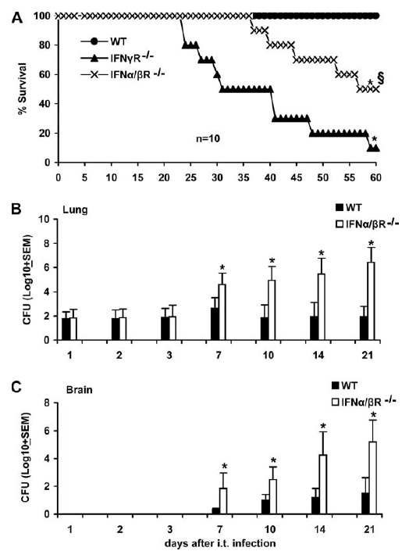
-ve control
“treatment” group
FIGURE 1.
Effect of type I and II IFN signaling on the outcome of infection following intratracheal challenge with C. neoformans. A, Survival of WT (129Sv/Ev), IFN-α /βR–/–, and IFN-γ R–/– mice (10 per group) after intratracheal challenge with 1 x 10³ CFU of C. neoformans strain H99. Mice were observed until 90 days after challenge, but further deaths did not occur. Lung (B) and brain (C) colony counts at different times after a similar challenge are also shown. Log CFU were expressed as means ± SEM of five determinations, each conducted on a different animal, in the course of one experiment. The experiment was repeated on a different occasion with similar results. *, p < 0.05 vs WT mice; §, p < 0.05 vs IFN-γ R–/– mice.
Type 1
+ve control
-ve control
“treatment” group

Slide 6
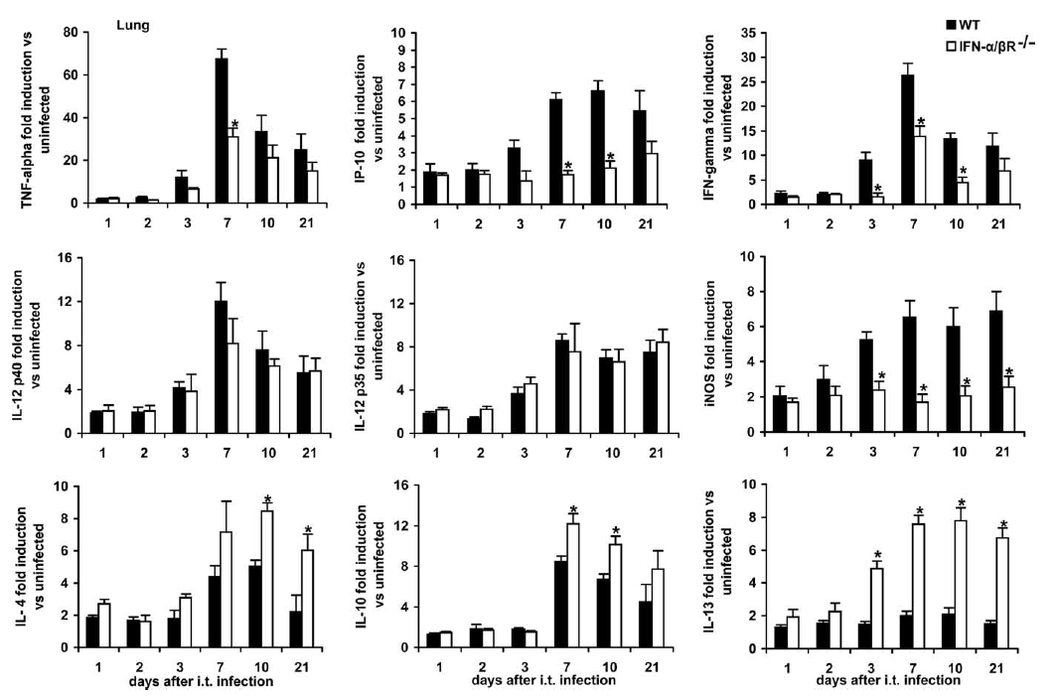
FIGURE 2. Kinetics of TNF-α , IFN-γ , IP-10, IL-12p40, IL-12p35, iNOS, IL-10, IL-4, and IL-13 mRNA expression in lung homogenates of WT and IFN- /βR-deficient mice infected as reported in Fig. 1. Total RNA was extracted from organ homogenates at the indicated times after intratracheal infection and expression of cytokines was evaluated by real-time RT-PCR. Data represent n-fold increases in mRNA expression relative to uninfected animals. Data are expressed as means ± SEM of four independent observations, each conducted on a different animal, in the course of one experiment. The experiment was repeated on a different occasion with similar results. *, p < 0.05 vs WT mice by one-way ANOVA and the Student-Keuls-Newman test.

Slide 7
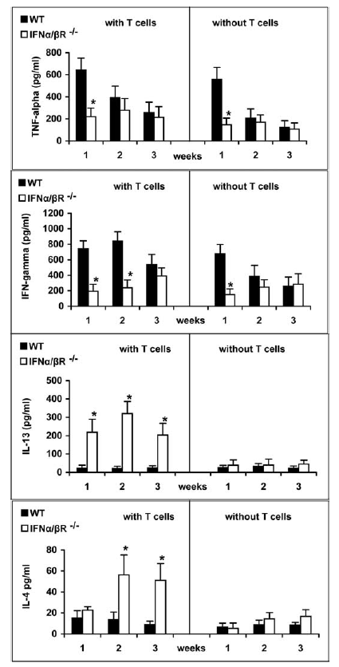
FIGURE 3. Effect of T cell depletion on cytokine responses by lung cells from infected mice. Lung cells were isolated from C. neoformans-infected IFN-α /βR^{+/+} and IFN- α/βR–/– mice at 1, 2, and 3 wk after challenge. T cells were removed and, after culturing for 24 h, supernatants were assayed for TNF-α , IFN-γ , IL-4, and IL-13 levels by ELISA. Data are expressed as means ± SEM of five independent and duplicate observations, each conducted on a different animal, in the course of one experiment. *, p < 0.05 vs WT mice by one-way ANOVA and the Student-Keuls-Newman test.

Slide 8
Timetable changes:
*
*
*
*
9:30 – 10:30

