Slide 1
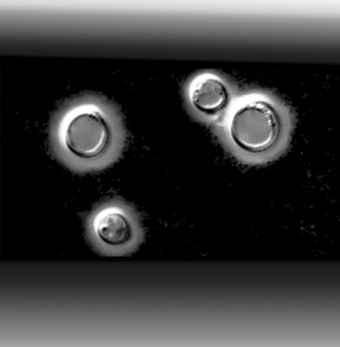
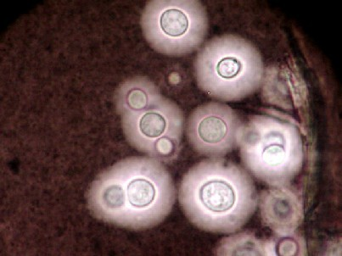
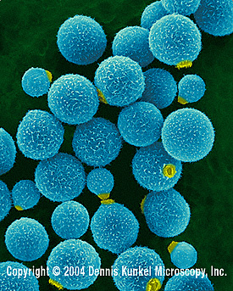


Cryptococcus: Host-Pathogen Interactions
Dr Elaine Bignell
Lecturer In Fungal Genetics and Pathogenicity
Cryptococcosis in the era of AIDS – 100 years after the discovery of Cryptococcus neoformans Mitchell and Perfect (1995) Clin. Microbiol. Rev. 8:515-548

Slide 2
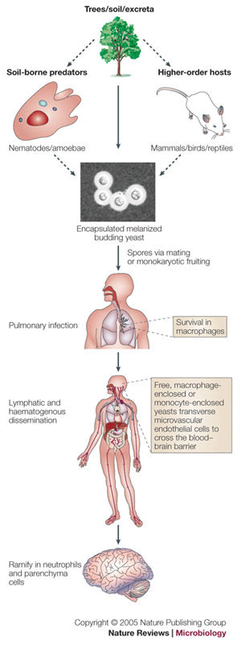
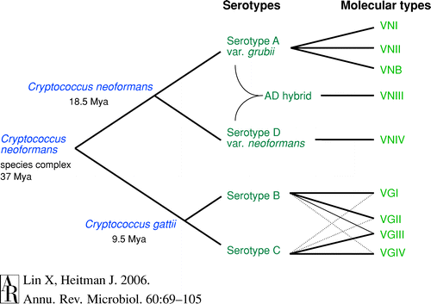
Serotypes and disease cycle
Cryptococcus: first described in 1894
Cryptococcosis: 300 cases reported up to 1955
Common worldwide opportunistic pathogen over last
two decades

Slide 3
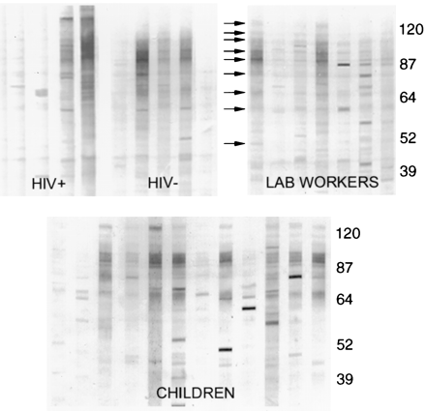
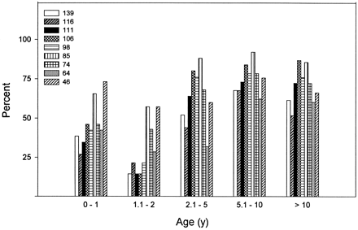
Evidence for Latency of cryptococcus infection
THERE IS CURRENTLY NO ESTABLISHED CLINICAL TEST TO DETECT LATENT CRYPTOCOCCOSIS
Serial isolates from AIDS patients exhibit no change in genotype – persistent infection is caused by relapse rather than reinfection
Cn genotypes from immigrant HIV+ are concordant with acquisition of infection several years prior
Fig 1. Immunoblots against C neoformans extracts.
Representative immunoblots of sera from: HIV patients with cryptococcosis, individuals
who work in a laboratory devoted to the study of C
neoformans, and children without a defined exposure
to C neoformans. Arrows point to bands that
were studied.
Most children residing in the Bronx are infected with C. neoformans after the second year of life
Serologic evidence for Cryptococcus neoformans infection in early childhood. Goldman et. al. (2001) Paediatrics 107:E66

Slide 4
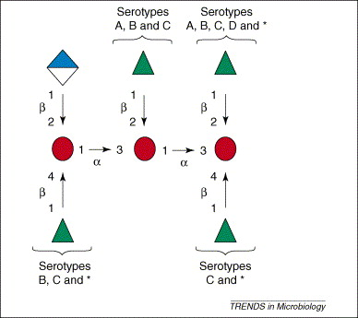
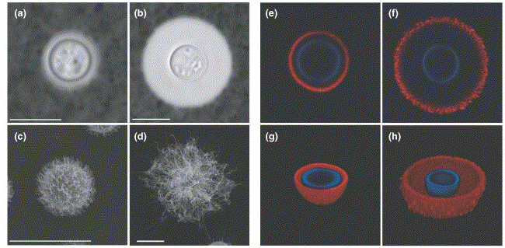
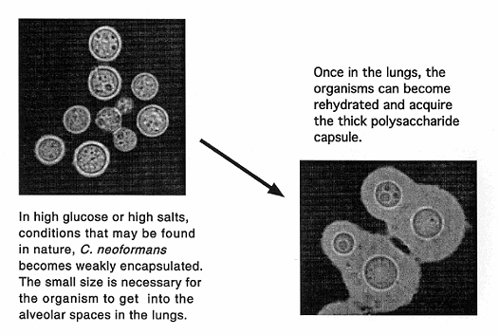
The Cryptococcus neoformans capsule
Capsule contains two major polysaccharides:
Glucuronoxylomannan (GXM)
A linear α(1,3)-mannan with a β(1,2) glucuronic
acid residue attached at every third mannose
(on average)
Galactoxylomannan GalXM
An α(1,6) galactan
Capsule composition
varies with
environmental conditions
Cryptococcus neoformans: A sugar-coated killer with designer jeans John Perfect
(2005) FEMS Immunol. And Medical Microbiol. 45:395-404

Slide 5
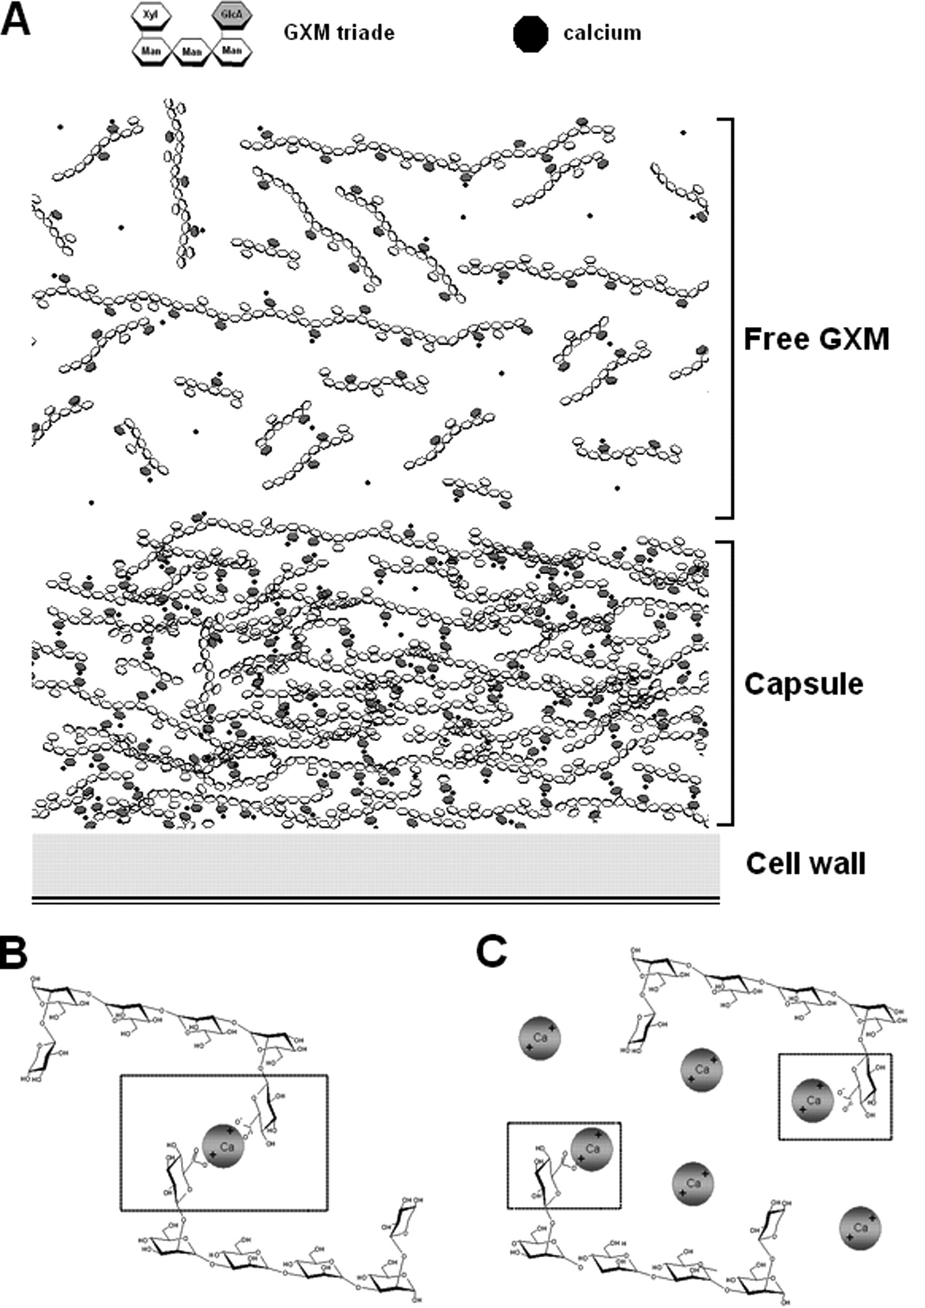
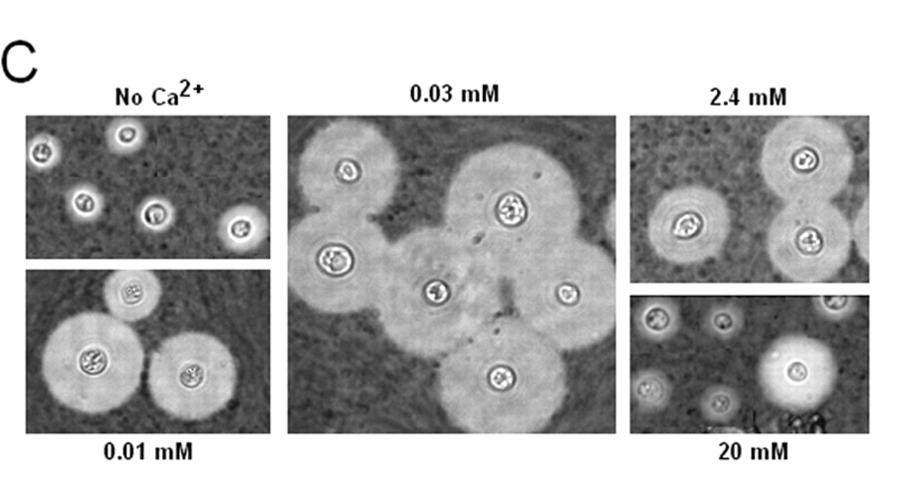
Proposed model for GXM assembly on fungal cell surface
Capsule expression/enlargement requires
the transport of polysaccharide to the
Extracellular environment in Golgi-body
Derived vesicles that traverse the cell wall
GXM polymers are first covalently
attached to the cell wall
2) Extracellular GXM chains (free GXM)
are then layered by metal-mediated
cross-linking
DEAD YEAST CELLS
Self-aggregation of Cryptococcus neoformans capsular glucuronoxylomannan
is dependent on divalent cations. Nimrichter et. al. (2007) Euk. Cell. 6:1400-1410

Slide 6
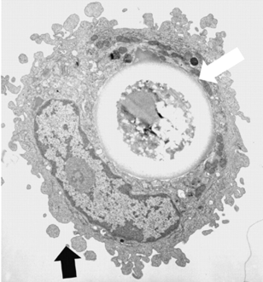
C. neoformans and macrophages
Alveolar macrophages are believed to be of central importance for the initial host response to
pulmonary cryptococcal infection
Alveolar macrophages phagocytose opsonised (either serum or antibody) Cryptococcus
Phagocytosis may be associated with killing but may also be accompanied by intracellular fungal replication in vivo and in vitro
An innate immune system cell is a major determinant of species-related susceptibility differences to fungal pneumonia
Shao et al., (2005) J. Immunol. 175:3244-3251

Slide 7
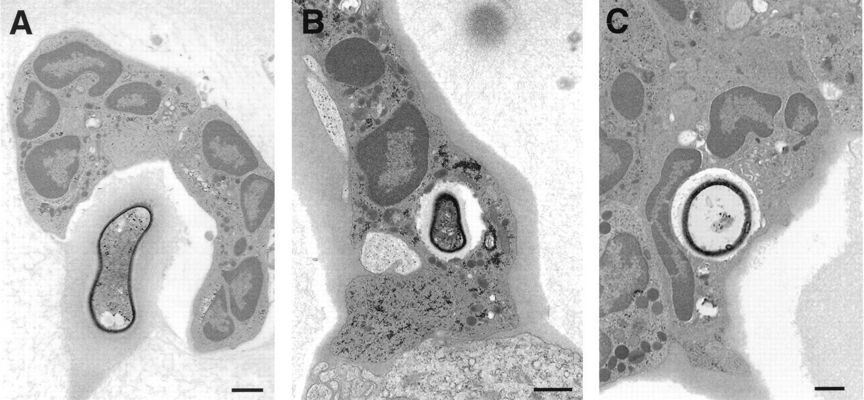
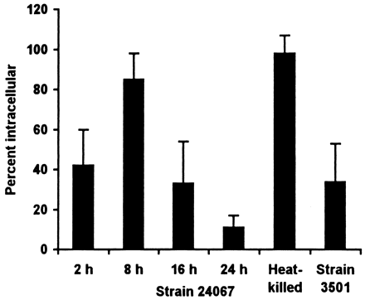
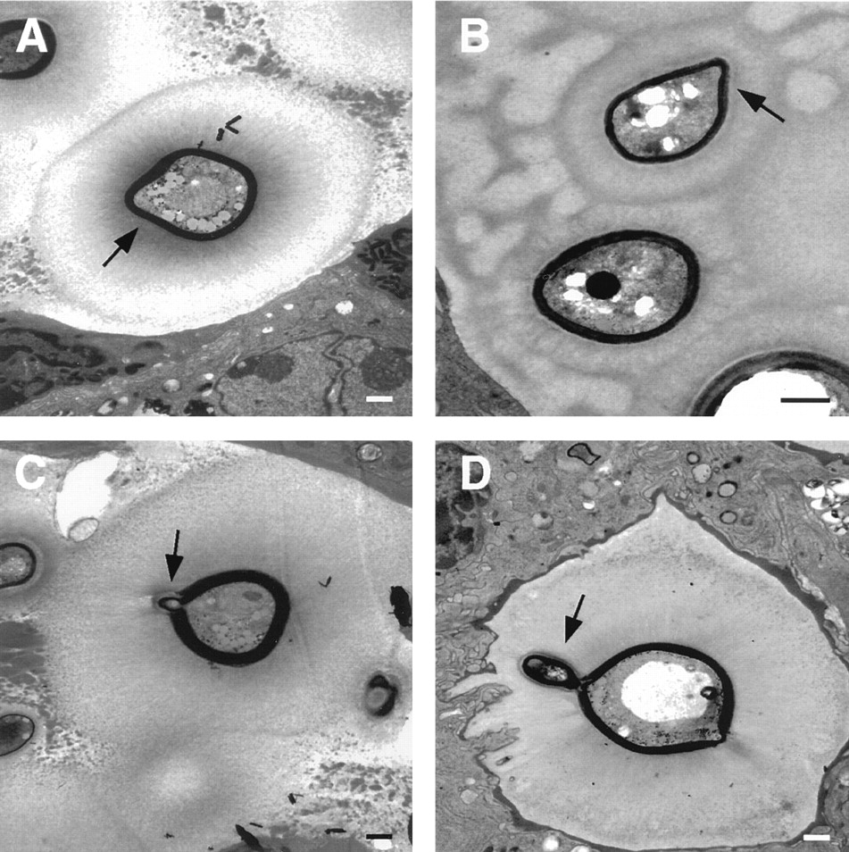
C. neoformans is a facultative intracellular pathogen
Cryptococcus neoformans
has adapted for persistence
in tissue but the mechanism
by which it resists immune
clearance is not known
48 hours
7 days
13 days
Extracellular yeast
Evidence of replication
Crytpococcus neoformans is a facultative intracellular pathogen in murine pulmonary Infection. Feldmesser et. al. (2000) Infect. Immun. 68:4225

Slide 8
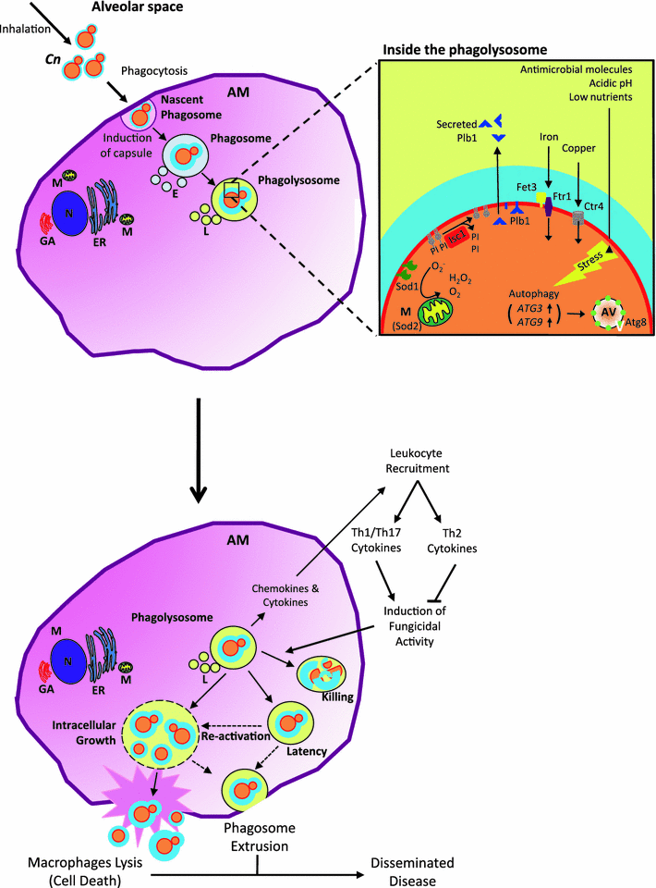
Roles of alveolar macrophages in the
host response to
Cryptococcus neoformans
Alveolar macrophages play an essential role in defence against cryptococcus infections
Internalisation by phagocytosis is an essential step which precedes chemokine and cytokine secretion, recruitment of other immune cells, killing of the pathogen and antigen presentation
A CD4+ Th1 response is essential for clearance of infecting fungal cells and suppression of invasive infection
Three possible outcomes of this interaction:
Clearance by collaborative innate and adaptive responses
Latency
Cn survival, CNS entry and infection
Paradoxical roles of alveolar macrophages in the host response
to C. neoformans J. Infect. Chemother. 2011

Slide 9
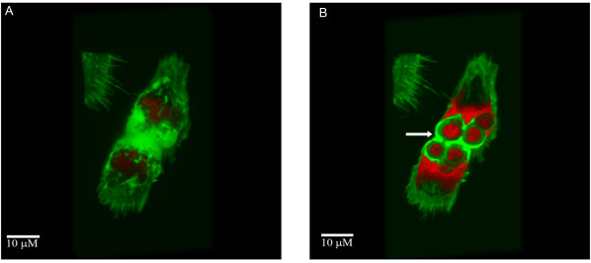
Cell-to-cell spread after Cryptococcus infection of
murine macrophages
Macrophages are known to fuse with each other and this process of cell-cell fusion has been implicated
in host viral spread with viruses such as HIV and vaccinia where host cell actin plays a crucial role
in mediating cell to cell transfer
Live imaging of Crytpococcus
neoformans interactions
with murine macrophages
reveals cell-to-cell spread
from infected donor cells to uninfected cells
All Cn strains were efficiently phagocytosed
by murine macrophages and replicated intracellularly
Macrophage fusion and cell to cell transfer of live Cryptococcus involves actin
Cell-to-cell spread and massive vacuole formation after Cryptococcus neoformans infection of murine macrophages. Alvarez and casadevall (2007) Bmc Immunol. 8: 16

Slide 10
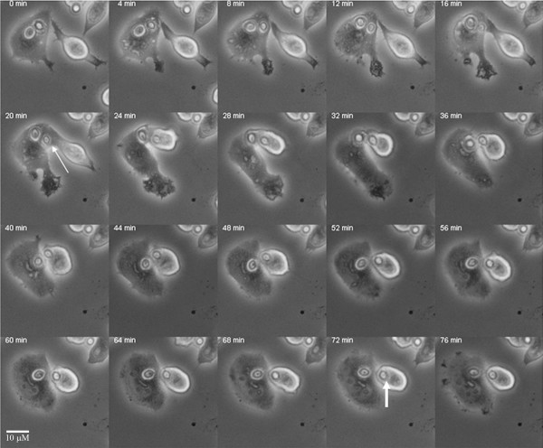
Cell-to-cell spread
http://www.pubmedcentral.nih.gov/articlerender.fcgi?artid=1988836

Slide 11
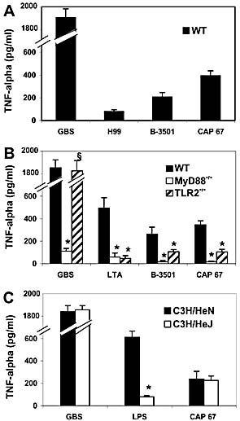
Involvement of Toll receptors in Cryptococcal recognition
AIM: To determine the requirement
For TLR2, TLR4 and MyD88
in recognition of Cryptoccus neoformans
METHOD: Incubate murine peritoneal
macrophages with different strains
of Cn and measure recognition using
TNF-α production by ELISA at 22 hours
RESULTS: TNFα was undetectable
In supernatents from unstimulated cells
(data not shown). All Cn isolates
produced detactable TNFα elevation
in cells from WT mice.
TLR-4
deficient
CONCLUSION: MyD88 and TLR2,
But not TLR4 are involved in in vitro
TNFα responses to cryptococci
MyD88 and TLR2, but not TLR4, are required for host defense against Cryptococcus neoformans. Biondo et. al., (2005)
Eur. J. Immunol. 35:870-878

Slide 12
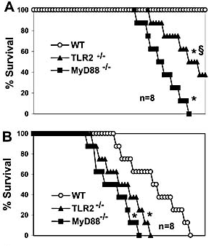
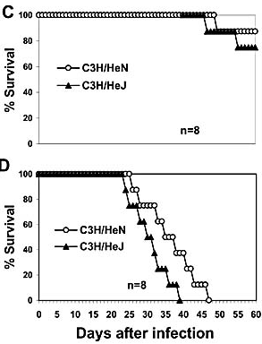
Involvement of Toll receptors in murine
Cryptococcal recognition
LOW
DOSE
HIGH
DOSE
Murine intraperitoneal injection of yeasts: TLR2 and MyD88, but not TLR4
required for murine defence against Cryptococcus neoformans

Slide 13
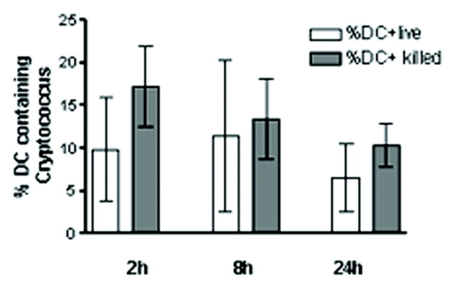
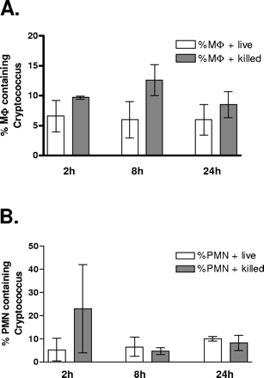
Dendritic cells and Cryptococcus neoformans
Dendritic cells phagocytose live and killed
Cn in vivo
METHOD: Label Cn with Oregon Green and then infect mice intranasally
At set timepoints following infection, sacrifice mice, Stain host cells for cell-specific markers. Flow cytometric
Cell sorting to separate cells depending upon flourescence characteristics
In vivo role of dendritic cells in a murine model of pulmonary cryptococcosis. (2006) Wozniak et. al. Infect. Immun. 74:3817-24

Slide 14
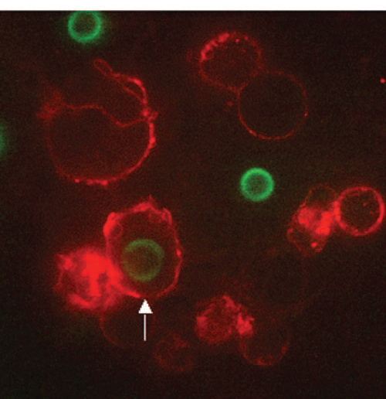
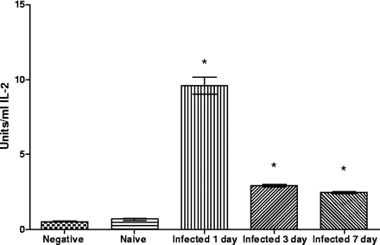
Dendritic cells and Cryptococcus neoformans
………Check by co-immunofluoresecence
microscopy
Dc rescue and incubation
with Cn-primed T cells
leads to T cell activation
as measured by IL-2
production
In vivo role of dendritic cells in a murine model of pulmonary cryptococcosis. (2006) Wozniak et. al. Infect. Immun. 74:3817-24

Slide 15
Summary
C. neoformans is the only encapsulated fungal pathogen
The capsule is the primary Cryptococcal virulence determinant and consists of two main polysaccharide polymers glucuronoxylomannan (GXM) and galactoxylomannan
The capsule size alters in reponse to physiological stimuli and chemical perturbation
Alveolar macrophages phagocytose opsonised Cn which can meet with 3 possible fates:
death, extrusion from the phagolysosome, transfer to other macrophages – as evidenced from
studies in murine peritoneal macrophages in vitro.
C. neoformans is, therefore, an intracellular facultative pathogen.
Cell-to-cell spread is mediated by host cell actin in an as yet uncharacterised manner
Cytokine production by murine macrophages in vitro imply that TLR 2 and MyD88 mediate Cn recognition, these findings are substantiated within a physiological context using TLR and Myd88-
deficient mice.
Dendritic cells, macrophages and neutrophils phagocytose Cn during the early stages of murine infection and ex vivo co-incubation of Dcs and Cn-specific T cells leads to T cell stimulation as measured by IL2 induction.

Slide 16
Virulence determinants of Cryptococcus
Classical virulence phenotypes under genetic control:
Capsule production
Melanin formation
Thermotolerance
Phenotypic switching
Why this fungal pathogen favours the CNS is an interesting but unresolved
question.
At least three possible hypotheses:
Specific neuronal substrates supporting C. neoformans growth in the CNS
2) CNS is a refuge for C. neoformans from host immune responses
3) Specific receptors present on neuronal cells attract Cryptococcal cells

Slide 17
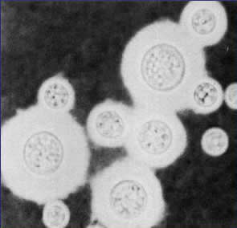
Virulence determinants of Cryptococcus
The capsule is a key virulence factor
Antiphagocytosis
Complement depletion
Antibody unresponsiveness
Inhibition of leukocyte migration
Dysregulation of cytokine secretion
L-selectin and TNF receptor loss
All capsule-deficient strains have been found
to be less virulent than parental isolates
Genetic manipulation of the capsular structure
by either a change in its structure or increased
formation of capsule can make strains hypervirulent

Slide 18
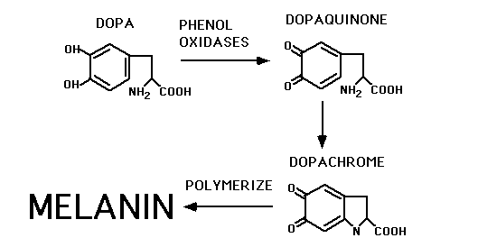
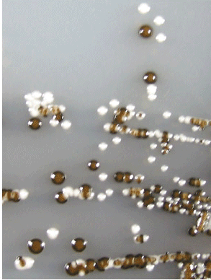
Melanin
Melanogenesis in various biological systems begins with the oxidation of tyrosine to dihydroxyphenylalanine (DOPA)
In this process an enzyme is needed only for the oxidations of tyrosine and DOPA. The other reactions in melanogenesis are likely to be extremely fast and non-enzymatic
Melanogenesis is affected by many chemical factors. No known enzyme that can hydrolyze melanin
nor are there antibodies that can recognise the dopachrome polymers. Melanin is regarded as a protective shield against microbial and enzymatic degradation, and in particular to protection against
oxidative stress which may afford survival in macrophages.

Slide 19
Relative contributions of melanin and capsule to
virulence
Cap-Mel⁻
Cap⁺Mel⁻
WT/Reconst
Immunocompetent mice
Tail vein infection
Encapsulation and melanin formation as indicators of virulence in Cryptococcus neoformans
Kwon-Chung and Rhodes (1986) Infect. Immun. 51:218-223

Slide 20
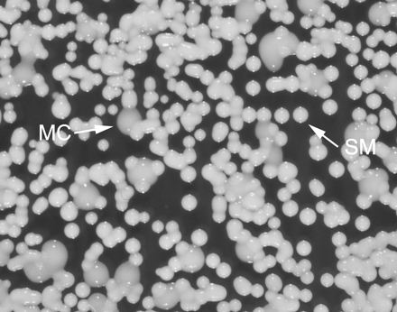
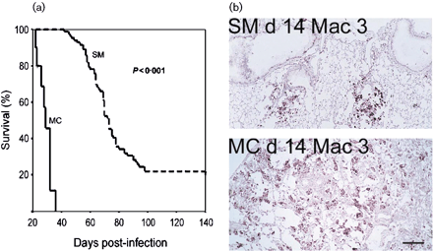
Phenotypic switching
Crypto exhibits an extraordinary ability to undergo
microevolution and phenotypic variation after
in vitro or in vivo passage
In Cryptococcal infection phenotypic switching
from a smooth to a mucoid variant can occur
in vivo and affect the outcome of infection
Phenotypic switching has been described in serotyoe A and D strains of Crytpococcus neoformans.
It occurs in vivo during chronic infection and is associated with differential gene expression in virulence.
Ultimately it is the immune response of the host that determines which of the switch variants are selected and maintained.

Slide 21
Summary
C. neoformans exhibits three well-characterised virulence determinants
capsule production, melanin production and thermotolerance
The capsule renders C neoformans resistant to macrophage killing and phagocytosis
Capsule-deficient isolates are unable to induce experimental infection
Melanin is thought to promote resistance to oxidative reactive intermediates and may promote
Intracellular survival of the organism and therefore immune evasion
Phenotypic switching occurs at a high frequency in human and animal infections

