Slide 1
Cellular immune responses to HIV

Slide 2
Goals of this lecture
An understanding of the basic biology of the HIV virus in the context of the immune response
An appreciation of the role and effector cells of the immune response
How HIV destroys the immune system
How the immune response tries to control HIV infection

Slide 3
HIV Biology

Slide 4
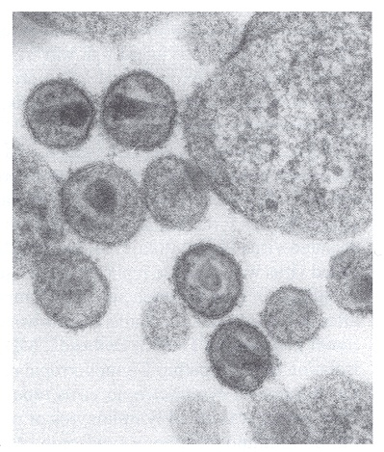
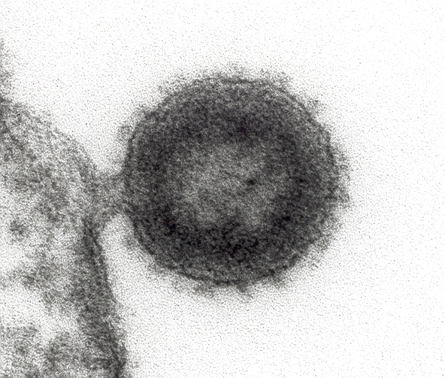
HIV morphology (EM)

Slide 5
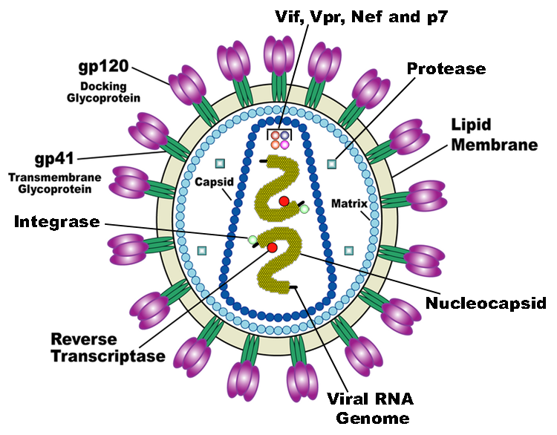

Slide 6
HIV Biology
RNA virus
Reverse transcriptase highly error prone
Homogeneous virus primary infection
Highly divergent quasi-species of viruses over time
Attaches via CD4 fuses to gain entry via chemokine (CCR5/CXCR4) receptors

Slide 7
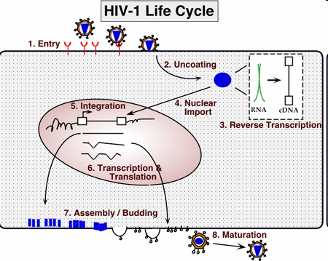

Slide 8
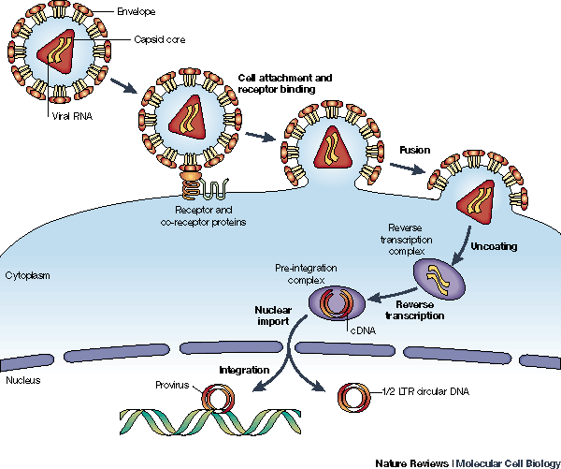
Early steps in HIV infection

Slide 9
The role of the immune system
Recognise danger
Respond to pathogen and destroy
Preserve self
Generate memory

Slide 10
Cells of the immune system

Slide 11
Organs of the immune system

Slide 12
http://www.youtube.com/watch?v=1tBOmG0QMbA

Slide 13
Effectors of the immune system
Innate; non antigen-specific
Utilises proteins for recognition of invader
First-line fast
Non-pathogen specific
No memory
Acquired; antigen specific
Complex highly variable recognition of intra and extra cellular invaders
Slower
clonal selection Ag-specific receptors
memory

Slide 14
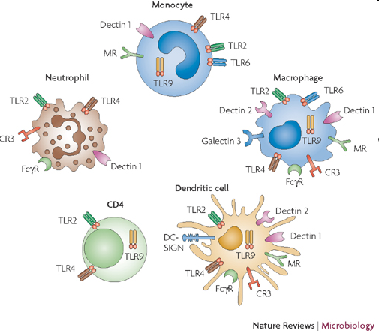
Innate cellular immune responses
NK, NK T-cells, DC, monocytes, neutrophils
Rapid action, non-specific

Slide 15
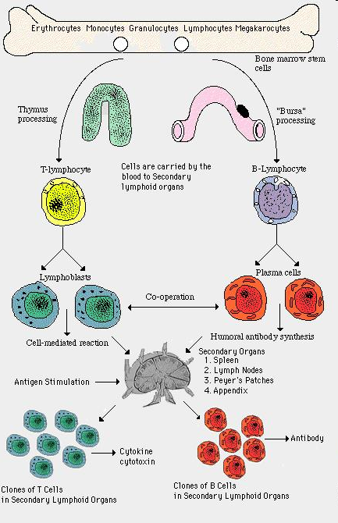
T-cells generally fight viral and
Parasitic infections
B-cells/antibodies generally fight
Bacterial infections
T-helper CD4 cells stimulate other
Cells of the immune system

Slide 16
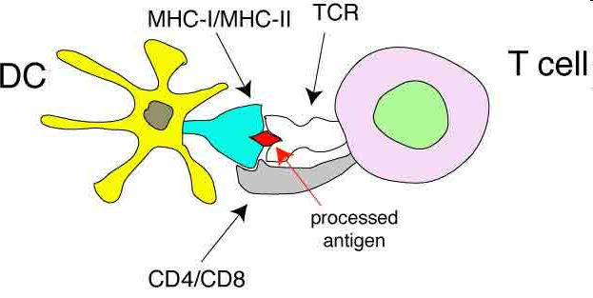
Priming a T-cell response
Antigen specific
Activation threshold
Effector responses
Memory
See antigen bound to self MHC by TcR
Require cross linking of a minimum number of TcR-MHC-Ag complexes

Slide 17
B-cell response to HIV
Generation of sterilising immunity via ‘Neutralising antibody’
‘mop’ up virus as immune complexes
Block viral entry therefore target gp120-CD4-CCR5 interaction
Can find Nab in all patients infected but fails to clear virus

Slide 18
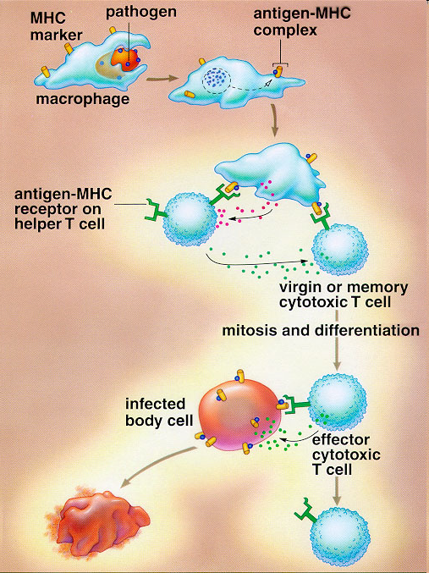

Slide 19
What happens after exposure to HIV-1?

Slide 20
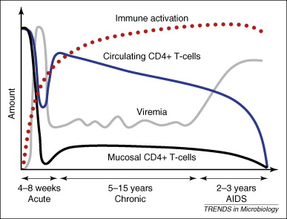

Slide 21
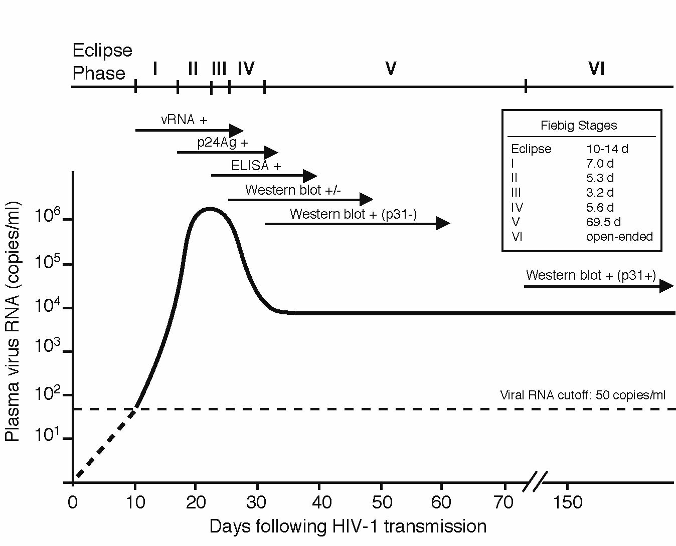
Fiebig Laboratory Staging of Acute HIV Infection
Fiebig I (5 days)
Fiebig II (10 days) Fiebig III (13 days)
Fiebig IV (19 days)
Fiebig EW, AIDS 2003

Slide 22
Transit of HIV through the body
Target cells CD4+ dendritic cells in genital tract mucosa
Traffic to regional lymph nodes day 3
Disseminate throughout body by 10 days
Will infect and lie ‘dormant/latent’ for life span of that infected cell any CD4 bearing cell

Slide 23
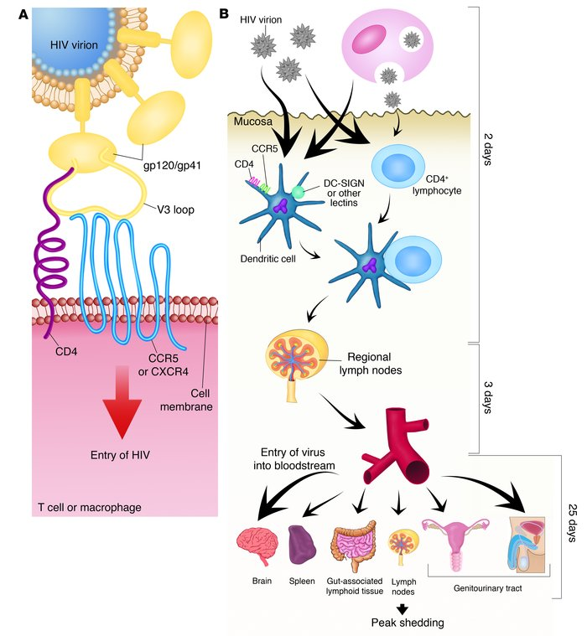

Slide 24
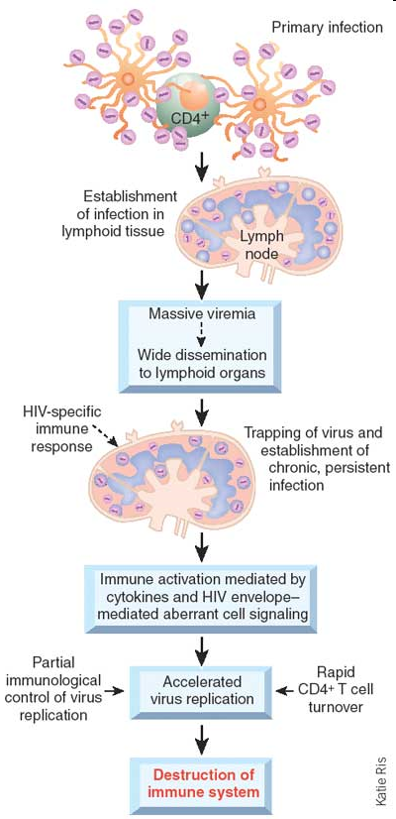

Slide 25
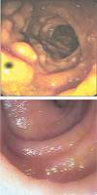
Gut
HIV negative
60-80% loss memory CD4+ T cells
Primary HIV
Brenchley, Douek et al., J Ex Med Volume 200 (6), 2004 749–759

Slide 26
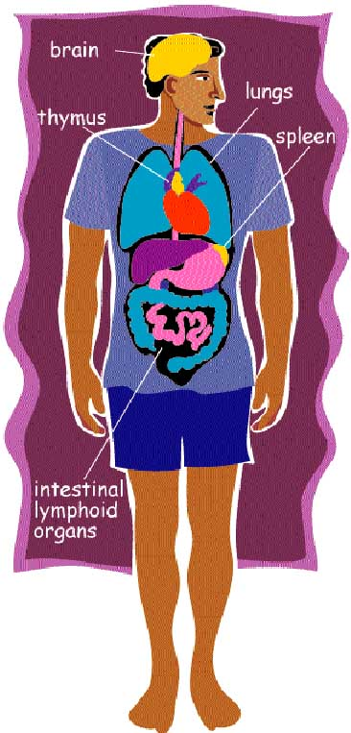
HIV remains “latent” it infects cells incorporates
Its genome into host cell DNA and remains
Persistent within those cells until they become
activated
This is referred to as the latent reservoir
accessing infected cells within the latent
reservoir is very difficult with current drugs and
explains why it is not possible to eradicate or
cure HIV at present

Slide 28
Outcome of exposure to HIV
Majority fail to control viral replication and get progressive depletion of CD4 T-cells with eventual immunological collapse
Small number ~10% generate a potent HIV-specific immune response and hold viral replication under control (LTNP)
Very small numbers prevent the establishment of infection despite exposure

Slide 29
Lymph Nodes
Uncontrolled viral replication leads to lymph nodes architecture destruction (Panteleo 1993)
Prevents immune priming
Site of viral transmission from DC loaded with virus onto trafficking CD4 T-cells

Slide 30
Immune destruction
CD4 cells provide help to all other arms of the acquired immune system
Serious CD4 T-cell functional deficit even when T-cell counts remain normal clerici & Shearer 1992
Antigen presenting cell dysfunction
CD4 T-cell death
Ultimate complete immune failure CD4<100 (normal range 500-1000)

Slide 31
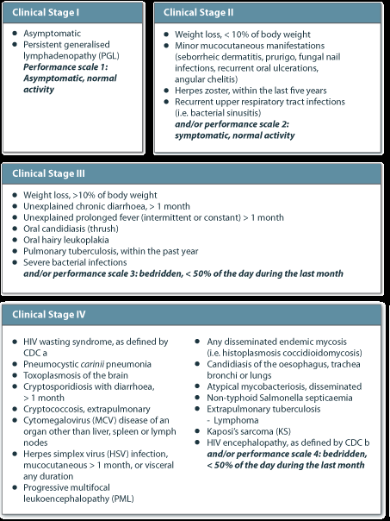
WHO staging of HIV

Slide 32
Can the immune system control HIV?

Slide 33
How is HIV controlled by the immune system?
HIV infects the CD4 helper cells that co-ordinate or Help the immune system ultimately destroying it.
HIV-specific responses can control viral replication certain individuals have enhanced control largely a result of genetic predetermined immune systems

Slide 34
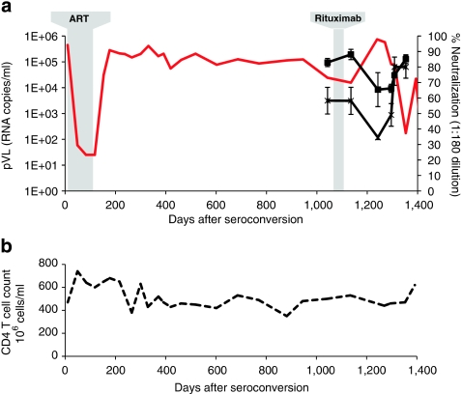
B-cell depletion reveals a role for antibodies in the control of chronic HIV-1 infection.
Nat Commun. 2010 Oct 19;1:102

Slide 35
How does CTL mediate viral destruction
Secretion of cytokines e.g.
CCR5/MIP-1a,b/Rantes/a,1,2,3 defensin
Direct killing of infected CD4 +cells (also therefore mediate CD4 destruction)

Slide 36
Evidence to support the role of HIV specific CTL in HIV control
Long-term non-progressors (LTNP) have replication competent virus and strong CTL Clerici et al 1996
Inverse relationship between pVL and CTLs McMichael 2001
Control of pVL at seroconversion correlates with CTL Koup et al 1994 Musey 1997 Panteleo 1997 Rosenberg 2000 Borrow 1994
Presence of CTL in cord blood associated with viral clearance in infant Bryson
Primate models support role CD4 and CD8 depletion in primates infected with SIV rapidly die

Slide 37
HIV specific CD4 responses
Effectors as well as targets
High level CD4 responses are also associated with good viral control at seroconversion in humans Rosenberg 2000 and primate models Kahn 1998
Th1 type response associated with good outcome

Slide 38
How do HIV-specific CD4 responses kill virus
Secrete cytokine that control other arms of immune response esp. CTL
Secrete beta chemokines
Cytolytic function

Slide 39
Immune escape
Virus evolves that are not recognised by HIV-specific CTLPhillips 1991, Price 1997
Adds support to the role played by CTL since if they exert a significant survival advantage for the virus to ‘escape’ they must be suppressing viral replication

Slide 40
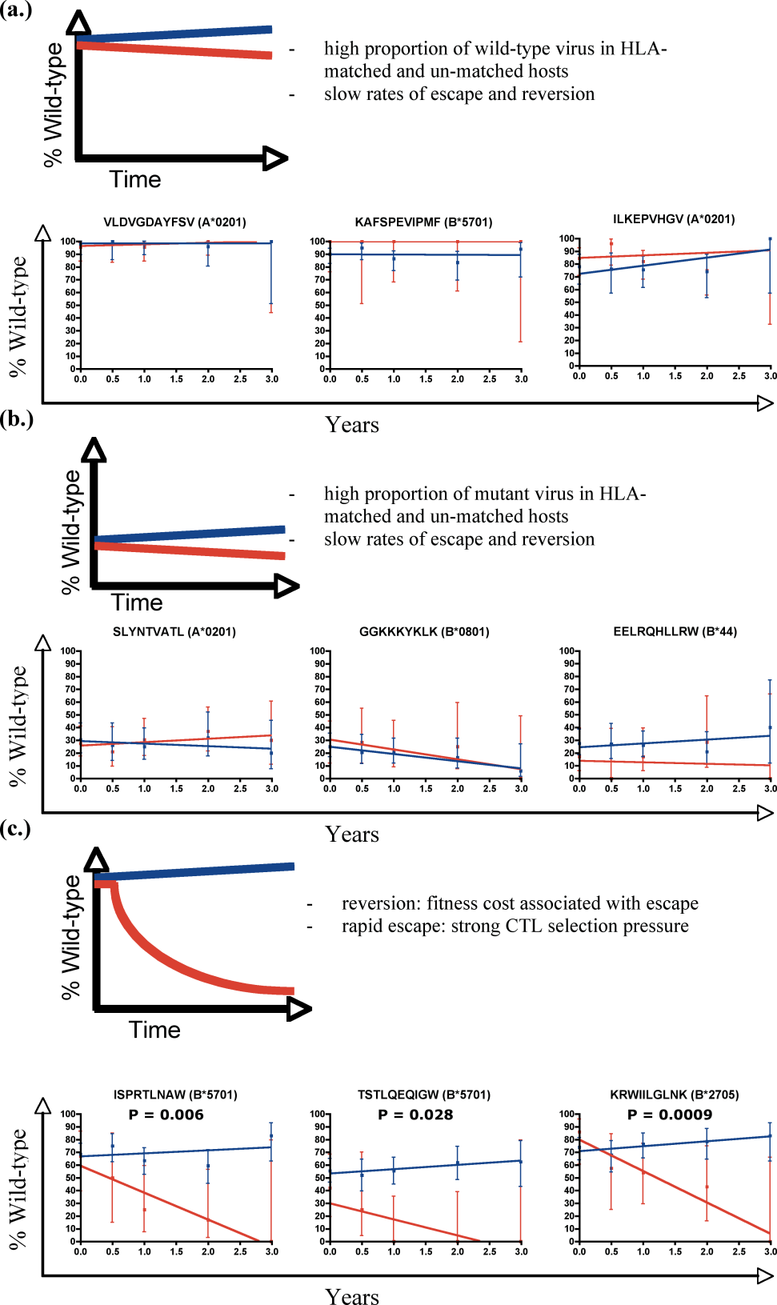
Rates of escape:
3 models:
Very little happens
A lot happens but its not very interesting
Rapid escape in HLA matched, paired with reversion in HLA-ve controls

Slide 41
Factors associated with good viral control
Genetic
Virological
Immunological
Therapeutic
CCR5d32 HLA alleles
Low dose nef deletions
CTL vs gag CD4 Th1 responses esp. vs env neutralising antibody
ART
Younger age with residual thymic function

Slide 42
Elite controllers
People who following infection maintain good HIV-specific immune responses control viral replication spontaneously and sustain a normal CD4 count >10 years after infection
Correlates with good immune responses esp CTL gag and HLA types CCR5d32 heterozygotes

Slide 43
Post treatment controllers (PTC)
Individuals who have taken a period of ART usually at acute infection then stopped therapy and spontaneously controlled viral replication

Slide 44
Immune restoration
ART removes on-going CD4 cell destruction allowing immune reconstitution but relates to nadir CD4 count
Lymph node architecture can redevelop depending on degree of damage
Immune responses can re-develop

Slide 45
Early ART may Modify HIV Disease Course
Elite controllers
Post-ART controllers
0.5%
HLA B27, B57
overrepresentation
High frequencies of HIV-specific CD8+ T cells
Up to 15.6%
No HLA B27, B57
overrepresentation
Low frequencies of HIV-specific CD8+ T cells
Low HIV DNA
Reservoir distribution in short-lived memory CD4+ T cells
Low immune activation
High CD4+ T cell count
Seng R, JAIDS 2008; Hocqueloux L, AIDS 2010; McMichael AJ, Nat Rev Immunol 2010;
Goujard C, Antiviral 2012, Bacchus C, 2012 IAS HIV Cure workshop

Slide 46
Time to starting ART from HIV infection vs CD8 responses at acqusition

Slide 47
Enhancement of HIV specific immunity
Therapeutic vaccines
Use ART to reduce viral replication, allow for immune reconstitution
Direct immune responses towards known ‘protective epitopes’
Little clinical success at eradicating virus but may have potential to enable simplification of ART

Slide 48
Why can’t ART cure HIV?
Viral latent pool- ‘reservoir’
HIV integrated into host cell genome no antigen expression therefore immunologically silent
V limited viral turnover therefore ART no effect
Sanctuary sites away from drug penetration

Slide 49
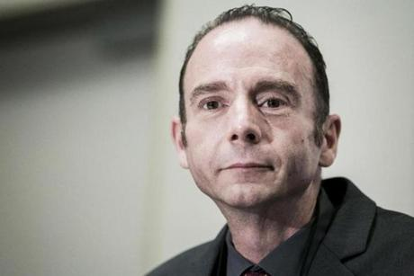
Is there a chance of finding a cure?
One man has been cured of HIV infection
He had years of ART, 2 bone marrow transplants, 2 courses of total body radiation and chemotherapy

Slide 50
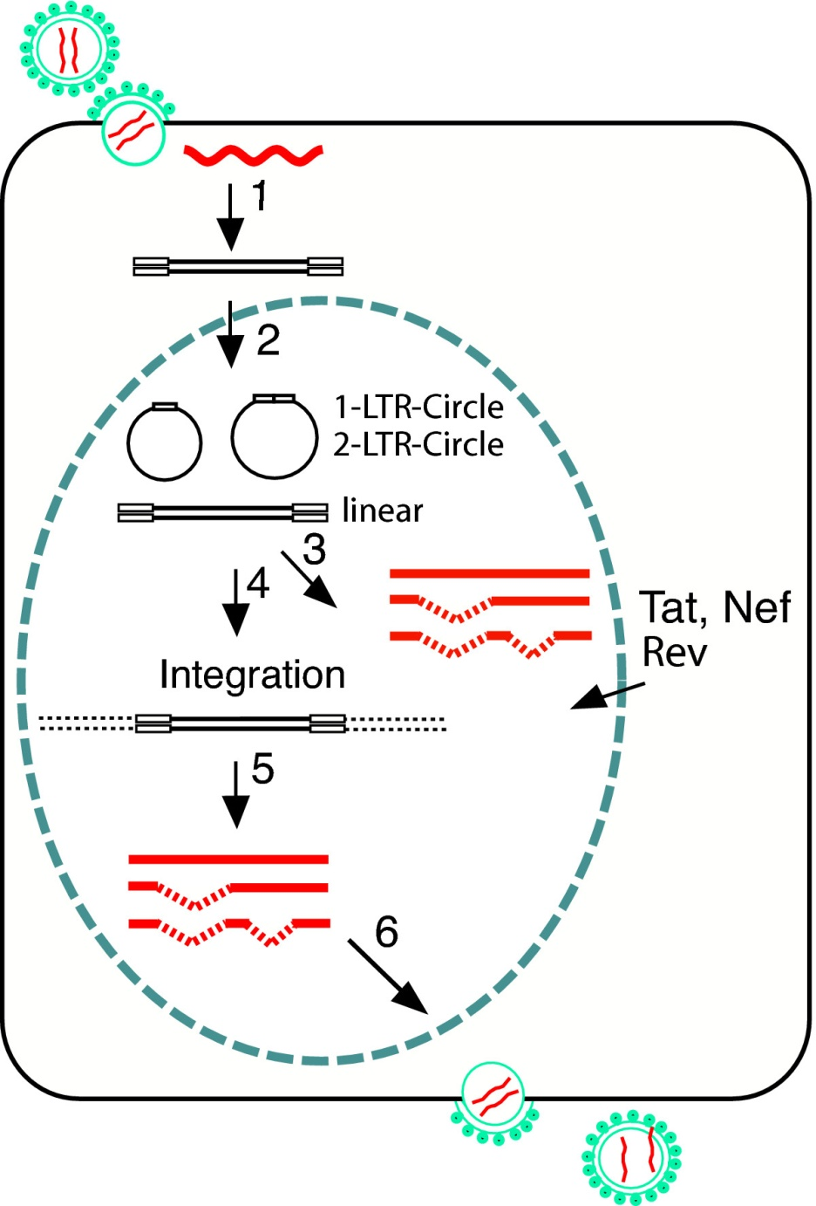
Which ‘reservoir’ to measure?

Slide 51
What interventions could confer a cure?
Force expression of HIV integrated DNA from latently infected cells
Enhance HIV specific immune responses- esp CTL
Convert individuals into EC?

Slide 52
Immune therapy approaches to HIV ‘Cure’

Slide 53
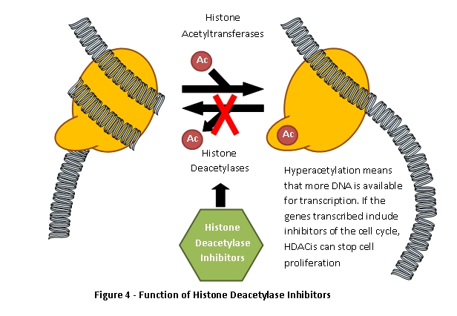

Slide 56
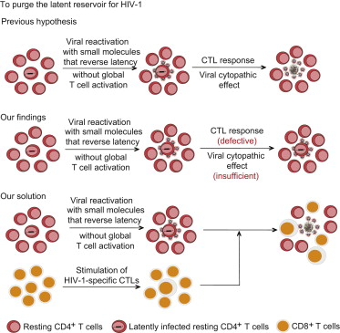
Stimulation of HIV-1-Specific Cytolytic T Lymphocytes Facilitates Elimination of Latent Viral Reservoir after Virus Reactivation
Liang Shan , Kai Deng , Neeta?S. Shroff , Christine?M. Durand , S.?Alireza. Rabi , Hung-Chih Yang , Hao Zhang , J...
Immunity Volume 36, Issue 3 2012 491 - 501

Slide 57
In vitro data did not show increased viral transcription with VOR +ART
Purging the latent reservoir for HIV-1 requires reactivation of latent virus and then elimination of infected host cells
Resting CD4⁺ T cells latently infected with HIV-1 do not die after virus reactivation
Viral CPEs or patient CTLs do not cause death of HIV-1-infected resting CD4⁺ T cells
Stimulated patient CTLs kill infected resting CD4⁺ T cells after reversal of latency
Autologous viruses recovered from latent reservoir do not escape from patient CTLs

Slide 58
S. Deeks Nature Volume: 487, Pages: 439–440
If used HDACi in earlier stages of infection with relative
immune preservation and smaller
size of reservoir would this be more effective?

Slide 59
Conclusions
The question is not ‘why does the immune system do too little’, but ‘can we make it do enough?’
CD4 and CD8 T cell responses contribute to outcome, but the effect is not large
Parameters of T cell function need further understanding to understand truly effective responses
The virus matters – eg fitness, but…
Escape is widespread, and maybe not a major factor in cure strategies

