Slide 1

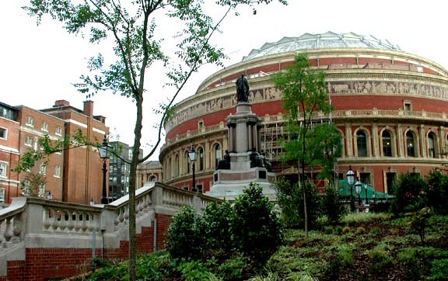

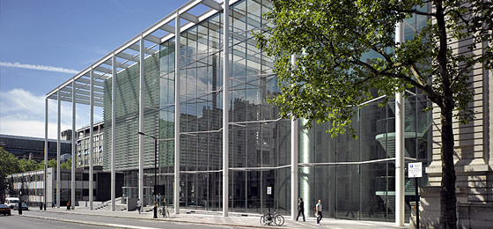






Molecular basis of Aspergillus host-pathogen interactions
Elaine Bignell
Section of Microbiology, Imperial College London

Slide 2
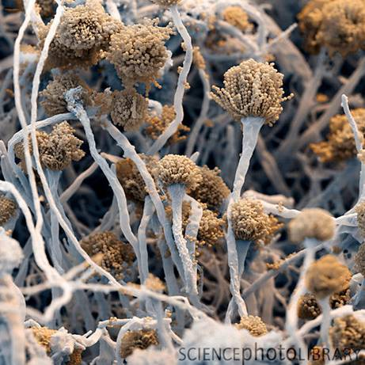
Aims of our work:
New insight into the molecular basis of A. fumigatus virulence
Identify and develop novel interventative strategies

Slide 3
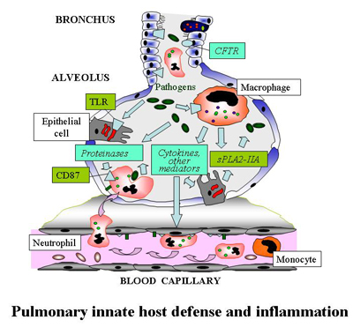
Overview
A damage-response continuum to describe infectious disease
Recognition of Aspergilli by host phagocytic cells
Macrophages
Neutrophils
Dendritic cells
Fungus-mediated host damage
Binding to extracellular matrix proteins
Epithelial cell damage
Cytoskeletal cell damage
Toxins
Fungal gene expression
Immune evasion?

Slide 4
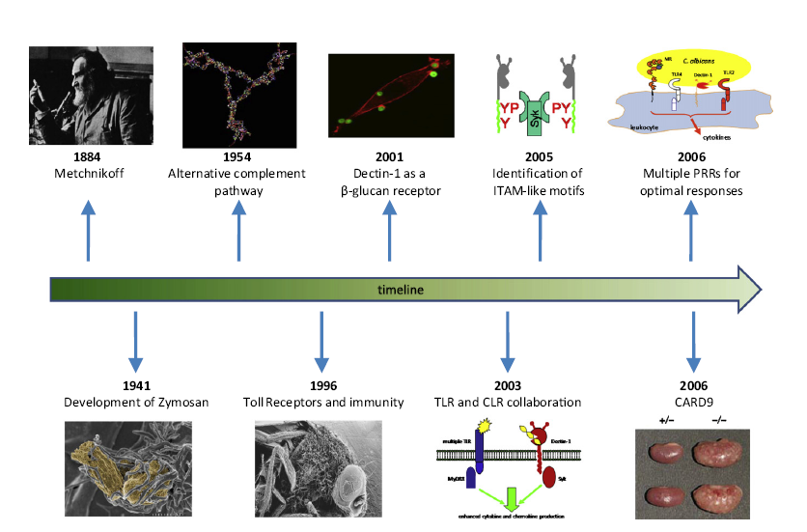
Fungi and the understanding of mammalian immunology
How fungi have shaped our understanding of mammalian immunology
Gordon D brown (2010) Cell Host and Microbe Vol. 7:9-11

Slide 5
A damage-response continuum to define microbial
pathogenesis
With respect to disease pathogenesis the host-pathogen interaction has
two outcomes
DAMAGE TO THE HOST NO DAMAGE TO THE HOST
Disease occurs when the host sustains sufficient damage to perturb homeostasis
Damage at the cellular level: Damage at the organ and tissue damage level:
Necrosis Granulomatous inflammation
Apoptosis Fibrosis from chronic inflammation
Malignant transformation Tumour
DAMAGE CAN BE MEDIATED BY EITHER THE PATHOGEN OR THE HOST
Damage in hosts that mount very weak responses is primarily pathogen mediated
Damage in hosts which mount strong immune responses is primarily host-mediated
Casadevall and Pirofski (1999) Host-Pathogen Interactions: Redefining the basic concepts of virulence and pathogenicity Infect. Immun. 67:3703-3713

Slide 6
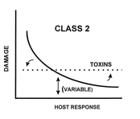
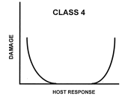
A damage-response continuum to define fungal
pathogenesis
Class 2
Pathogens that cause damage either in hosts
with weak immune responses or in the setting of
normal host responses
Cause damage by both host- and pathogen-
mediated mechanisms.
The capacity of class 2 organisms to mediate damage in
individuals with apparently normal immunity is indicative
of expression of microbial characteristics which promote
their ability to evade normal host defenses.
e.g. Candida albicans and Cryptococcus neoformans
Class 4
Pathogens that cause damage primarily at the extremes
of both weak and strong immune responses
Host damage is pathogen mediated in invasive aspergillosis
and results from necrosis and tissue infarction as a result of
tissue invasion and elaboration of hydrolytic enzymes
e.g. Asperillus fumigatus

Slide 7

Interaction of Aspergillus with the host
A unique microbial-host interaction
Acute IA
ABPA
Allergic sinusitis
Subacute IA
Frequency of aspergillosis
Frequency of aspergillosis
Tracheobronchitis
Aspergilloma
Chronic cavitary
Chronic fibrosing
Immune dysfunction
Normal immune function
Immune hyperactivity
.

Slide 8
Disease as an outcome of the
Aspergillus interaction with the host

Slide 9
Dynamic nature of the Aspergillus host-pathogen interaction
Innate immune mechanisms provide an
essential defence against Aspergillus infection
Macrophages: Engulf and kill spores, cytokine release
Neutrophils: ROS and NETs kill enlarged spores and hyphae, cytokine release
Presentation of fungal antigens by dendritic cells and other APCs prompts subsequent adaptive response, the identity of which is a potent detrminant of infectious outcome.
Luigina Romani

Slide 10
Dynamic nature of the Aspergillus host-pathogen interaction
Sensitive to:
Rate of change of fungal morphology
PAMPS
Fungus-derived chemical deterrants
and proteases
Dynamic antigen profile
Changes in the physiological environment
Such as pH, hypoxia
Degree, or nature of immunosuppression
Luigina Romani

Slide 11
Dynamic nature of the Aspergillus host-pathogen interaction
Virulence factors?
Prominence of A. fumigatus as a
Pathogen
No specific virulence factors
Fungus-derived proteins and
small molecules can influence the
host response
No intracellular phase of the
infection cycle
Luigina Romani

Slide 12
Dynamic nature of the Aspergillus host-pathogen interaction
Predictions:
Events which shape the initiation of infection might dictate outcome of disease in the whole animal host
Modulation of host or pathogen properties will be curative or exacerbatory
The same fungal entity can cause different diseases dependent upon host immunotype
Luigina Romani

Slide 13
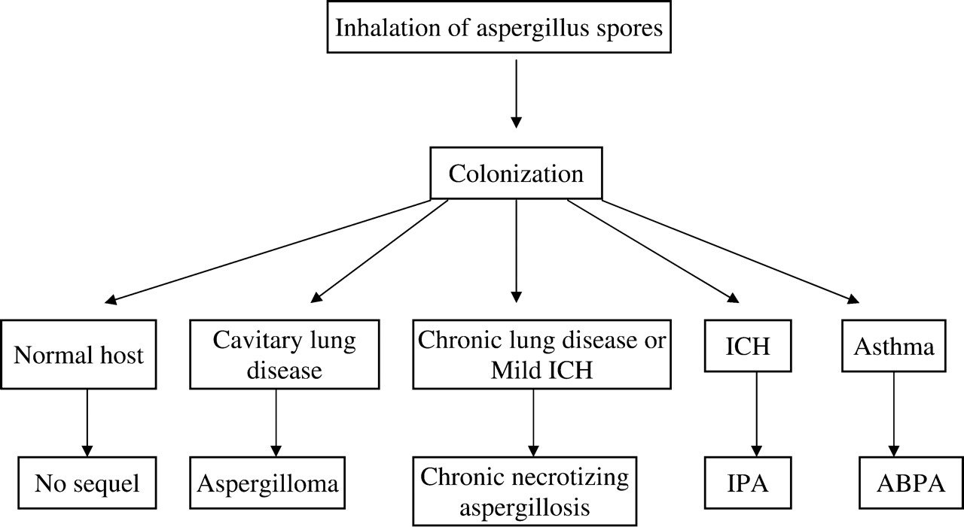
The clinical spectrum of aspergillus disease
Aspergillus species cause a range of diseases
Dependent upon:
the immune status of the host
- the presence of underlying lung
disease.
‘Fungus ball’
Pre-existing lung cavity
Non-invasive
Severe
immunocompromise
Hypersensitivity to
Aspergillus antigens
Asthmatics, cystic fibrosis
Healthy humans
suffer no consequences
following spore inhalation,
a daily occuurrence
for all of us
Secondary to local tissue invasion
Seen in chronic lung disease, previous tuberculosis,
Mild immunocompromise
Pulmonary aspergillosis: a clinical update Zmeili, O.S. et al. QJM 2007 100:317-334

Slide 14
The role of innate immunity
in defence against Aspergillus infection

Slide 15
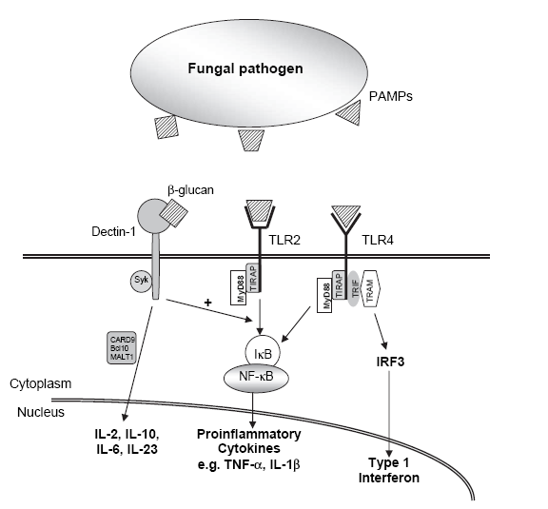
Dichotomous roles of innate immune recognition
and surveillance
Direct role = antimicrobial activity and fungal killing
2) Facilitative role = production of proinflammatory cytokines and chemokines
and antigen presentation

Slide 16
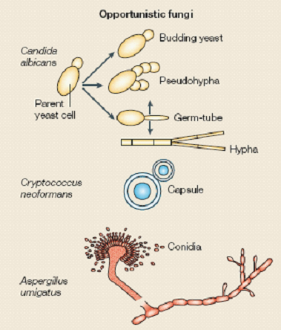
General features of immunity to fungal infection
Fungi have complex and unusual relationships with the vertebrate immune system
Key features include the abundance of morphotypes involved, including ability to switch between them (in some instances reversibly).
Immune evasion strategies for long term survival in the host
The strategies used by the host to limit the negative impacts of infection are necessarily distinct
f

Slide 17
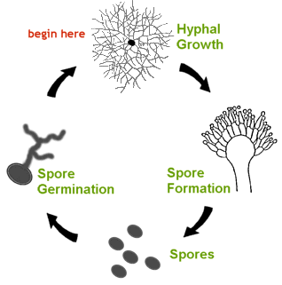
Spores, hyphae and mycelia
Spores are sometimes referred to as conidia
(singular = conidium)
From a spore, following germination, hyphae
are formed (singular = hypha)
A branched network of hyphae is caused a
mycelium

Slide 18
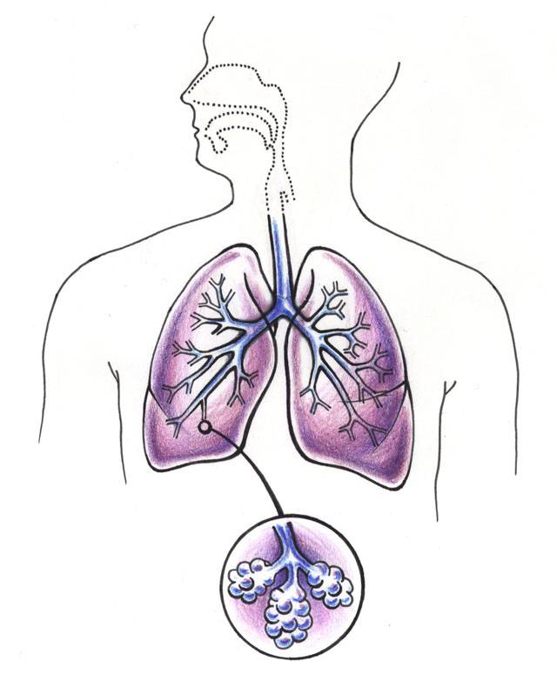
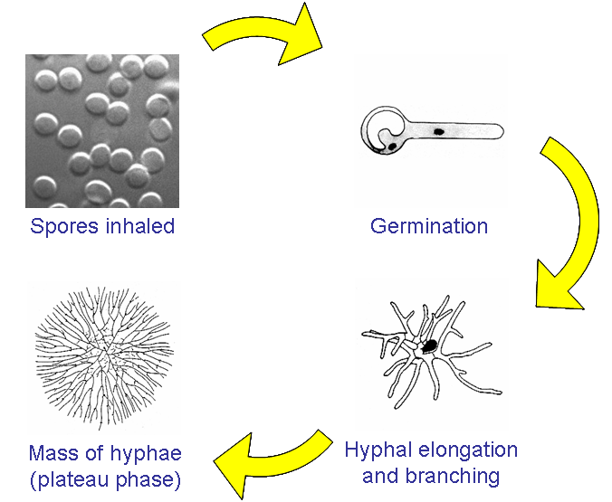
Modelling aspergillosis, in a physiologically
relevant manner

Slide 19
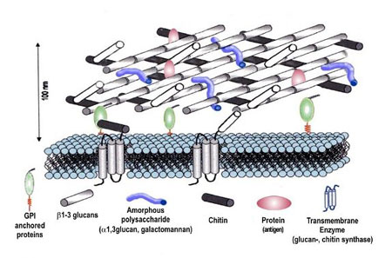
The A. fumigatus cell wall
The cell wall of A. fumigatus hyphae
contains 3 major carbohydrate polymers: chitin, galactomannan,
and linear beta 1-3 glucans
In contrast conidia have
morphologically distinct features
including a proteinaceous layer
and an inner cell wall which
becomes exposed during swelling
The complex composition of both forms remains incompletely defined

Slide 20
Modelling infection
(whole animal models)

Slide 21
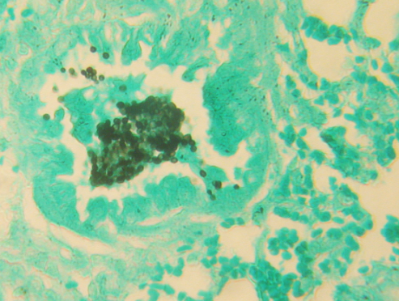
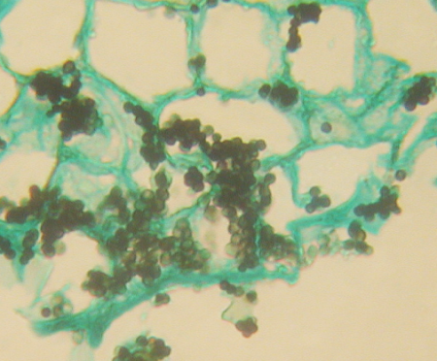
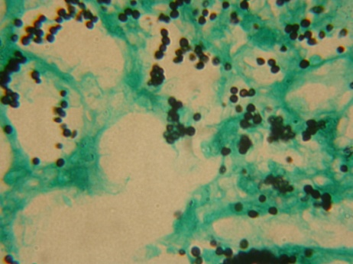
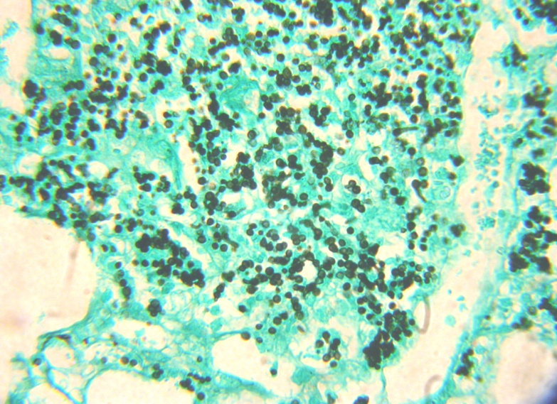
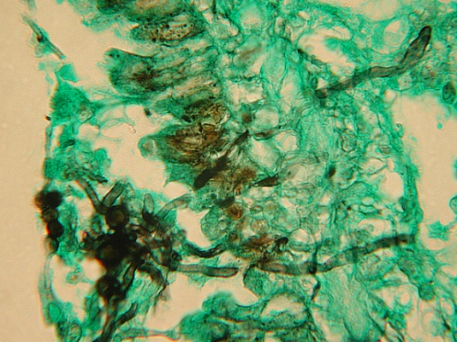
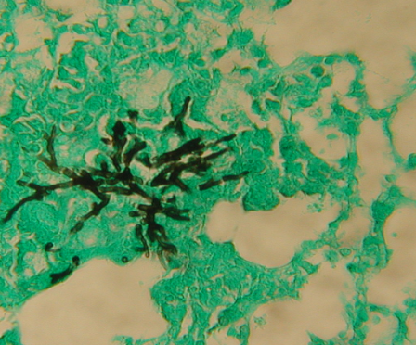
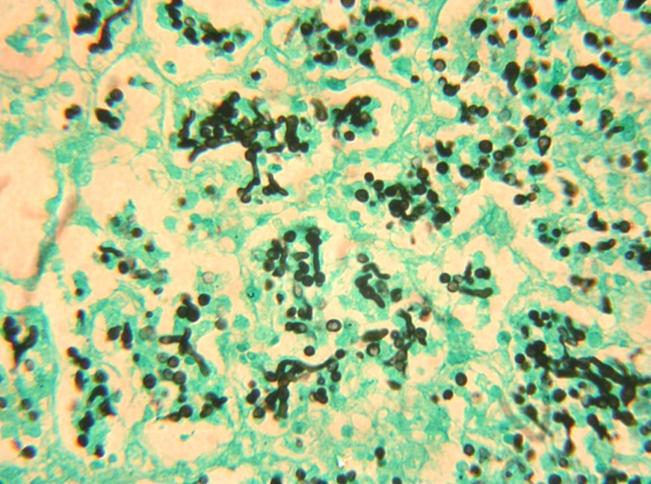
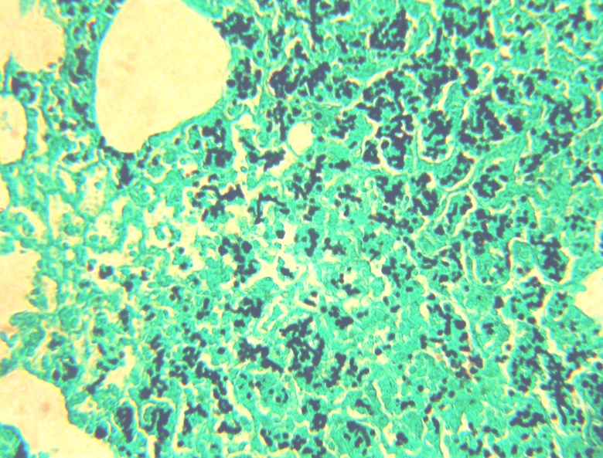
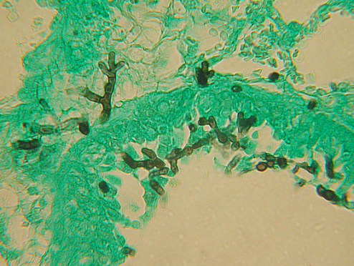
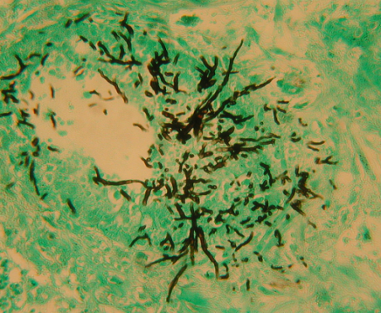
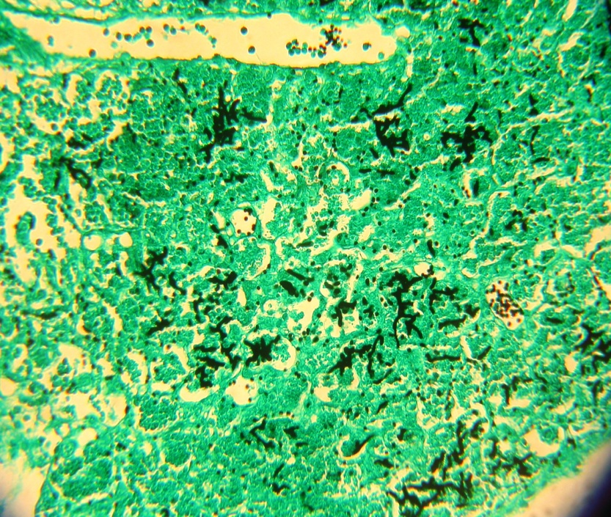
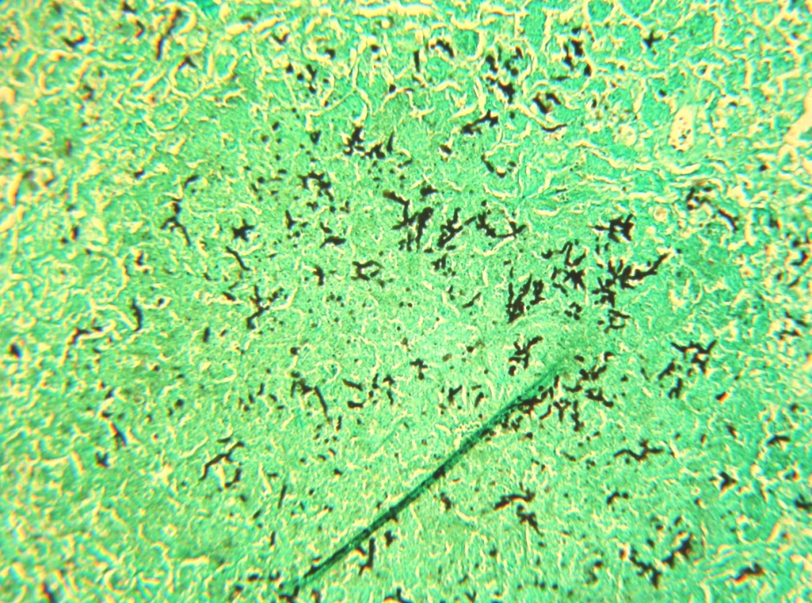
Pulmonary aspergillosis in mice
Neutrophil depletion
Corticosteroid treatment
4
8
4
8
14
24
14
24
48
72
48
72
The host environment governs the growth rate and morphology of the invading fungus

Slide 22
Macrophages

Slide 23
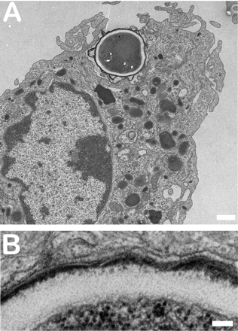
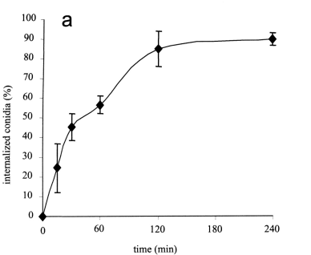
Fungal killing: macrophages and A. fumigatus
AIM: To test the physiological relevance of macrophage-mediated killing of Aspergillus spores.
HOW: Infect immunocompetent mice, harvest macrophages at set time-points post-infection, electron microscopy.
RESULT: Macrophages from immunocompetent mice phagocytose A. fumigatus spores within 90 minutes of infection

Slide 24
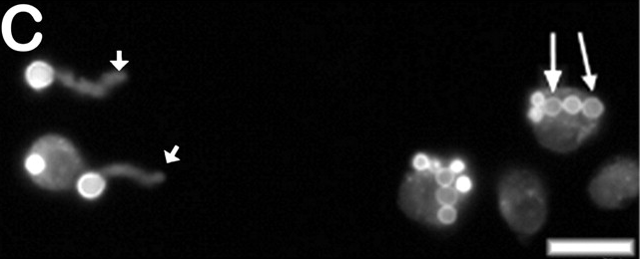
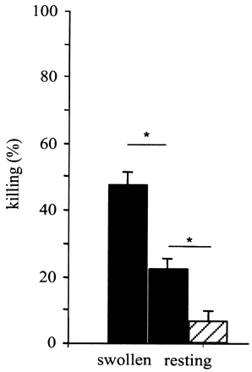
Fungal killing: macrophages and A. fumigatus
Differential fluorescence used to distinguish phagocytosed from internalised spores.
By 6 hours post-infection, no internalised spores germinated. Extracellular spores display germ tubes.
In the setting of steroid therapy macrophage function is sufficiently disabled to permit conidial germination and formation of invasive hyphae.

Slide 25
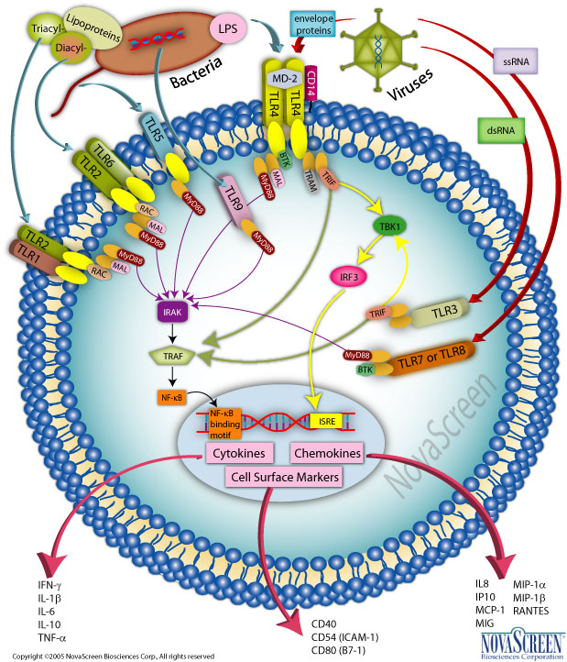
Microbial recognition by the host
Multiple receptors on host immune cells can recognise microbial structures/ molecules pathogen associated molecular patterns PAMPs.
These receptors mediate initial responses in innate
immunity and are required for the development of
the adaptive immune response
The Toll family of class I transmembrane receptors
recognizes and responds to diverse structures associated with pathogenic microbes.
Structure and function of Toll receptors and their ligands. Gay and Gangloff (2007) Ann. Rev. Biochem. 76:141-65

Slide 26
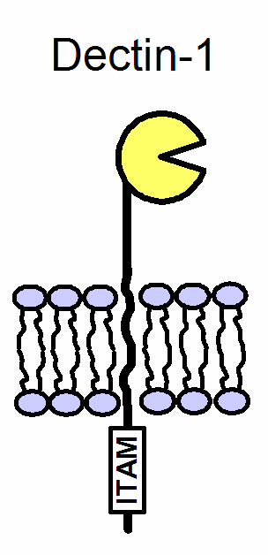
Recognition: Dectin 1
Non TLRs are also important in innate recognition of A. fumigatus
Dectin-1 (Dendritic cell associated lectin-1) is a lectin-like receptor
It is a type II membrane molecule with an N-terminal carbohydrate
recognition domain separated from the membrane by a short stalk
region
Dectin 1 is a specific receptor for beta-glucans with 1,3 and 1,6 linkages
In mice it is predominantly expressed by macrophages, monocytes,
neutrophils and some dendritic cells
Also expressed by a subset of T cells
It is a major receptor on macrophages for the non-opsonic recognition of
fungi
IMMUNORECEPTOR TYROSINE-BASED
ACTIVATION MOTIF
The beta-glucan receptor dectin-1 recognizes specific morphologies of Aspergillus fumigatus. Steele et. al. (2005) PLoS Pathogens 1:e42

Slide 27
Recognition: Dectin 1
Beta-glucan and the dectin-1 receptor co-localise in co-immunofluorescence
microscopy using swollen conidia

Slide 28
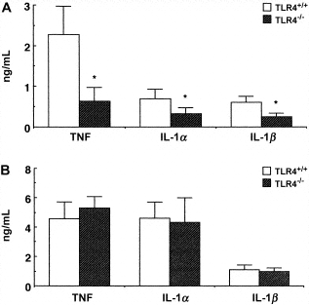
Recognition: Toll-like receptors (TLRs)
Murine macrophages produce cytokines when stimulated with A. fumigatus
AIM: To assess the role that TLR4 plays in the stimulation of cytokines in macrophages by A. fumigatus
METHOD: Stimulate peritoneal macrophages from TLR4-deficient mice with heat-killed Aspergillus condia and hyphae and measure the production of proinflammatory cytokines
RESULT: The synthesis of proinflammatory cytokines in response
to Aspergillus conidia is significantly lower
In TLR4^{-/-} macrophages thanin TLR4^{+/+} macrophages. In contrast Aspergillus hyphae stimulated comparable production of cytokines in macrophages of either origin
CONCLUSION: TLR4 plays an important role in in the stimulation of cytokines by A. fumigatus conidia and this function is lost during germination to hyphae
CONIDIA
HYPHAE
A. fumigatus evades immune recognition during germination through loss of Toll-like Receptor-4-mediated signal transduction Netea et. al. (2003) J. Infect. Dis. 188:320-326

Slide 29
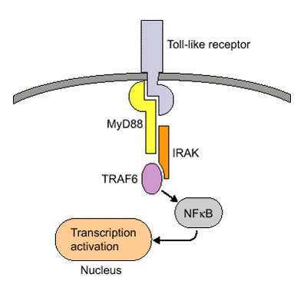
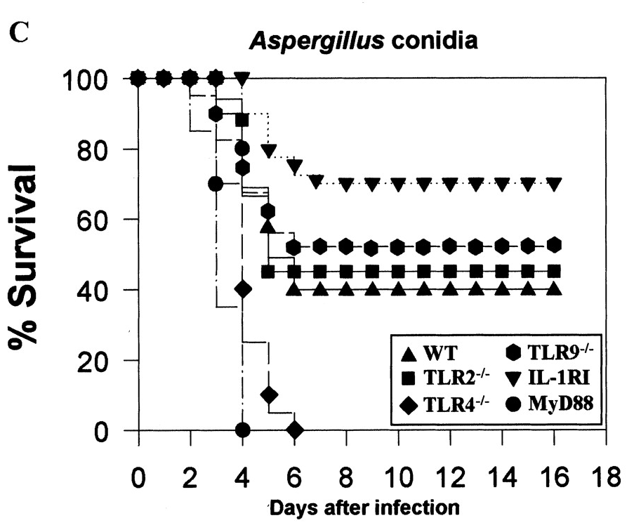
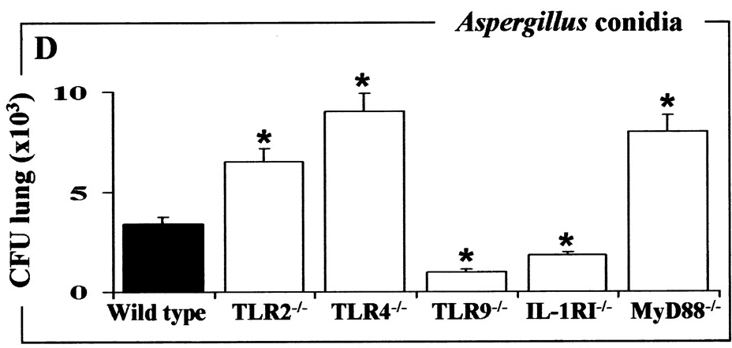
Cellular receptors and A. fumigatus in vivo
The complexity of TLR activation and function including cooperative action in some instances and sharing of signal transduction pathways mean that in vitro studies may not be sufficient to predict the impact of the total repertoire on infections in vivo.
Fungal burden in lungs of TLR9 and IL-R1 deficient mice was decreased, fungal burden in TLR2, 4 and MyD88 deficent mice was increased
Survival of TLR4 and MyD88 deficient mice reduced in experimental infection
S. Bellocchio, C. Montagnoli and S. Bozza et al., The contribution of the Toll-like/IL-1 receptor superfamily to innate and adaptive immunity to fungal pathogens in vivo, J. Immunol. 172 (2004), pp. 3059–3069.

Slide 30
Neutrophils

Slide 31
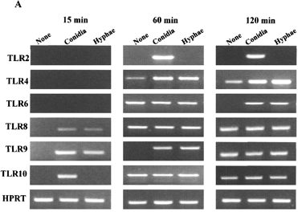
Neutrophils and Aspergillus recognition
AIM: To assess the
expression of TLR mRNA in response
to exposure to A. fumigatus conidia or
hyphae
METHOD: Expose human
neutrophils from peripheral blood
to Aspergillus and measure TLR
messenger RNA levels by reverse
transcription and PCR
RESULTS: Some TLR receptors
(8, 9, 10) were induced within
15 minutes of exposure. At 60
minutes post-exposure TLR 2, 4
and 9 were increased. Among
multiple donors the latter result was
the most consistent.
CONCLUSION: Human neutrophils increase TLR 2, 4 and 9 gene
expression in response to Aspergillus
TLRs govern neutrophil activity in Aspergillosis. Bellocchio et. al. (2004) J. Immunol. 173:7406-7415

Slide 32
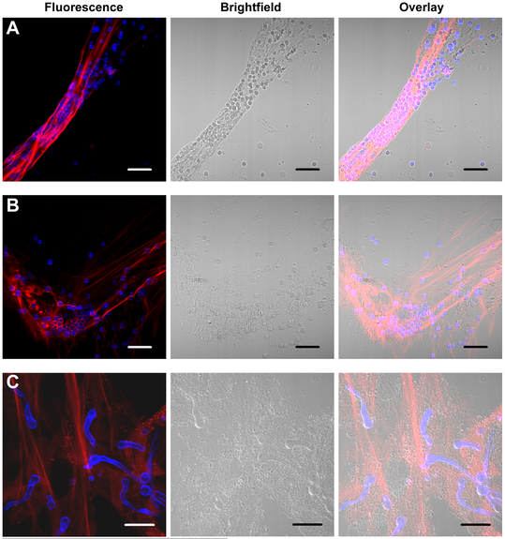
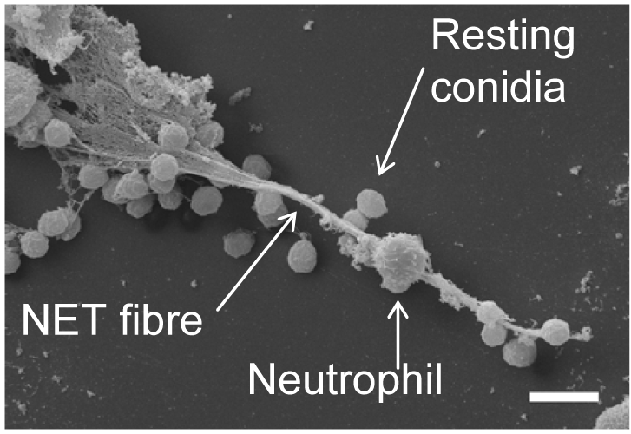
Neutrophil extracellular traps (NETs)
NETs are extracellular fibres, derived from chromatin and coated with granule proteins.
Bruns et. al. (2010) Production of neutrophil extracellular traps against A. fumigatus
http://www.ncbi.nlm.nih.gov/pmc/articles/PMC2861696/

Slide 33
Dendritic cells

Slide 34
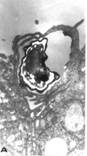
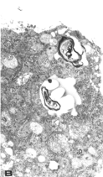
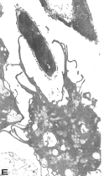
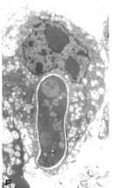
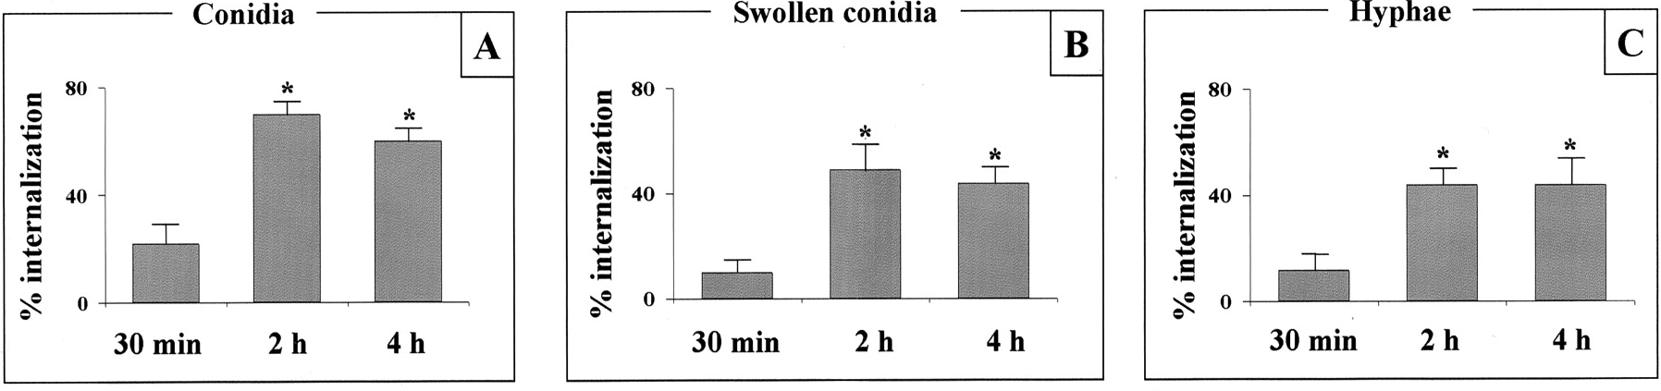
Dendritic cells (DC) have a primary role in surveillance for pathogens at the mucosal surfaces and are recognized as the initiators of immune responses to them.
DCs phagocytose and internalise both conidia and hyphae, mounting distinct cytokine responses to them, demonstrating remarkable functional plasticity.
Dendritic cells and Aspergillus
CONIDIA
HYPHAE
1 hour
3 hours
1 hour
3 hours
Immature myeloid immortalized DC were exposed to conidia (A), swollen conidia (B), and hyphae (C) at a DC-fungi ratio of 1:5 (for conidia and swollen conidia) and 1:1 (for hyphae) for different times before being evaluated for internalization, visualized by light microscopy.
Aspergillus-containing DCs migrate between
alveolar epithelial cells and traffic to the lymph nodes
Dendritic Cells Transport Conidia and Hyphae of Aspergillus fumigatus from the Airways to the Draining
Lymph Nodes and Initiate Disparate Th Responses to the Fungus Silvia Bozza et. al. (2002) The Journal of Immunology 168: 1362-1371.

Slide 35
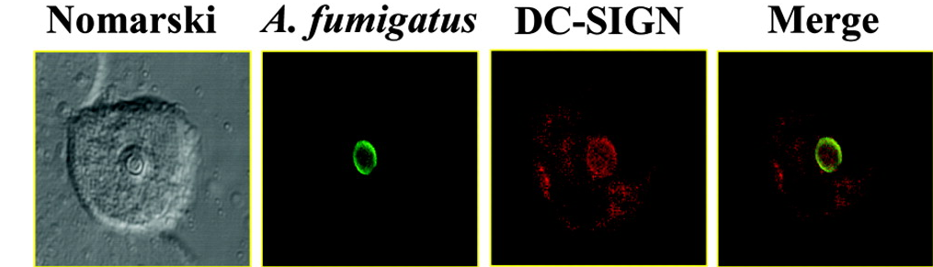
DC-SIGN mediated Aspergillus uptake in dendritic cells
Dendritic cell-specific ICAM-3 grabbing nonintegrin
is a type II C-type lectin that functions as an adhesin receptor and is used by bacterial and viral
bacterial pathogens to gain entry to human DCs
Binding and internalisation of A. fumigatus conidia correlates with DC-SIGN cell surface expression levels, this internalisation is abolished in the presence of A. fumigatus-derived galactomannans. Suggests a role for DC-sign in the initial stages of aspergillus infection and maybe spreading during IPA.
Dendritic Cell-Specific Intercellular Adhesion Molecule 3-Grabbing Nonintegrin Mediates Binding and internalization of Aspergillus fumigatus Conidia by Dendritic Cells and Macrophages
Diego Serrano-Gómez et. al. (2004) The Journal of Immunology 173: 5635-5643.

Slide 36
Summary
The host-pathogen interaction can be regarded as a continuum within which either host or pathogen
(or both) can inflict host damage
Toll like receptors play an important role in Aspergillus recognition as evidenced by in vitro and
in vivo infection studies
TLR4 is required for recognition of conidia (i.e. fungal spores) in macrophages.
TLR 2 recognises both conidia and hyphae.
TLR gene expression is induced in neutrophils during stimulation with A. fumigatus conidia and
hyphae
Dectin-1 recognises Aspergillus in a growth phase dependent manner in human macrophages
Dendritic cells phagocytose and internalise both conidia and hyphae in a DC-SIGN dependent manner

Slide 37
Aspergillus virulence factors
and host damage

Slide 38
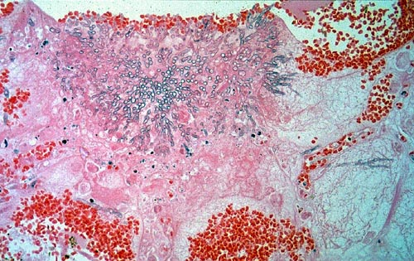
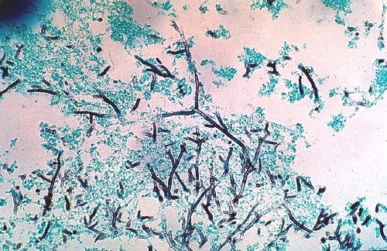
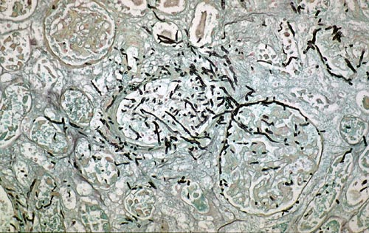
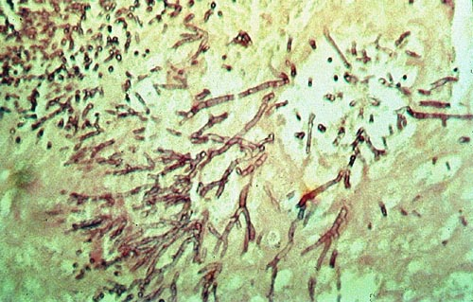
Fungus-mediated host damage
Lung
Brain
Kidney
Heart
Aspergillus species cause damage to human cells at many levels.
Aspergillus attributes which potentiate virulence are multiple and are poorly characterised
Immune evasion (hydrophobin)
Adhesion
Tissue damage
Toxin-mediated immunosuppression

Slide 39
The A. fumigatus genome
Size 29.4 Mb
Nº genes 9,926
Genes of
unknown
function 3,288
Mean gene
Length 1,431 bp
Mean intergenic
Region 1,226 bp

Slide 40
Pulmonary aspergillosis in mice
Neutrophil depletion
Corticosteroid treatment
4
8
4
8
14
24
14
24
48
72
48
72
The host environment governs the growth rate and morphology of the invading fungus

Slide 41
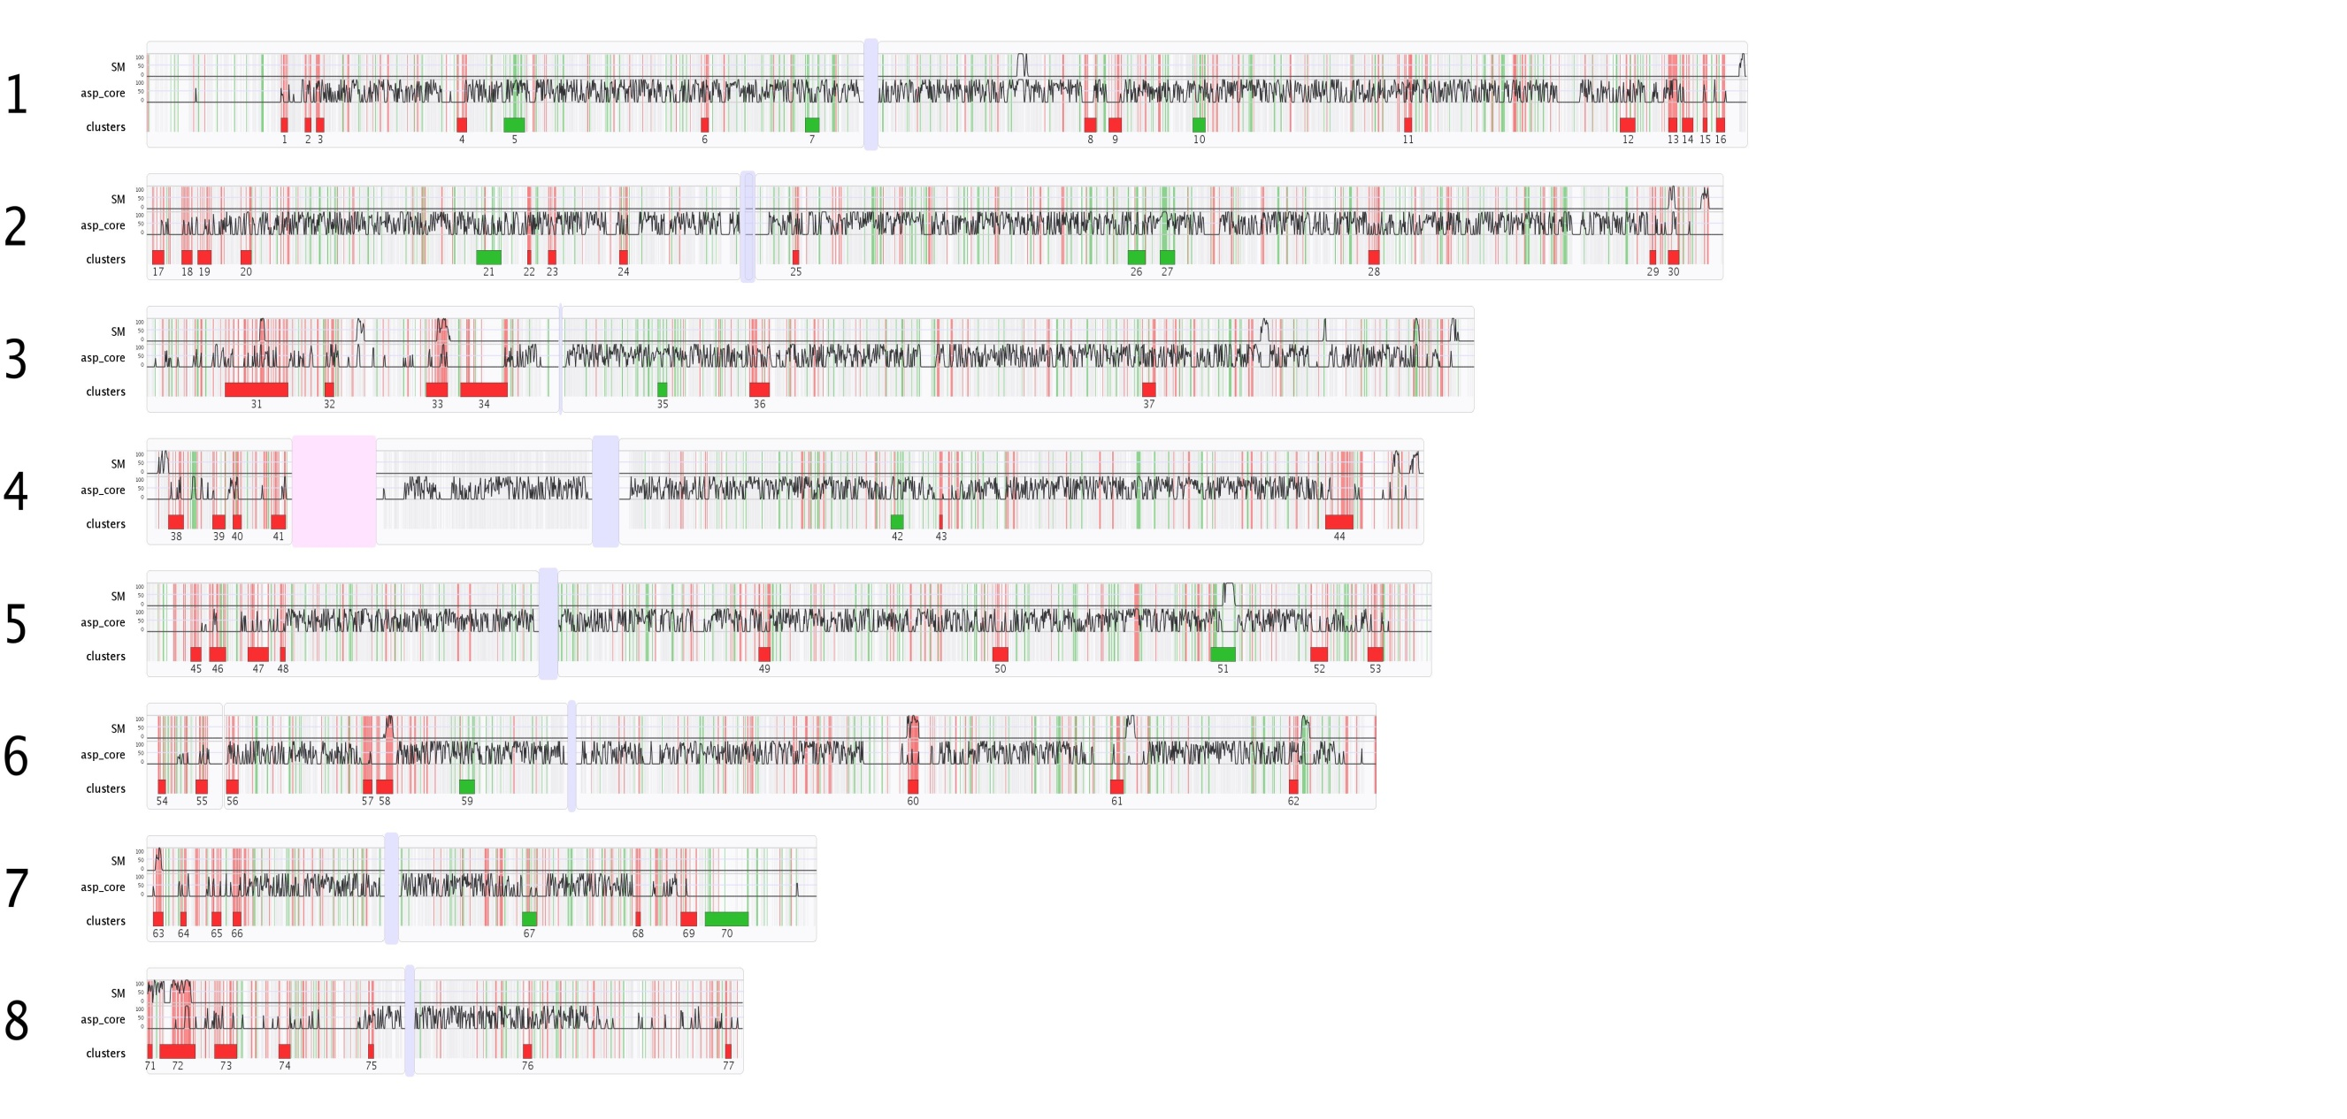
A transcriptional snapshot of A. fumigatus gene expression during
initaition of murine infection

Slide 42


Outer layer
Hydrophobins
Pigments
Cell wall
Β 1-3 glucan
Chitin
Galactomannan
Galactofuranose
Β 1-3 glucan synthase (Fks1p)
Glucanosyltransferases (Gel1, Gel 2, Gel3)
Β 1-3 endoglucanase (Eng1)
Α 1-3 glucan synthase
Afmp1, Afmp2
Chitin synthases ChsE, ChsG
Conidium
Host defence
DHN melanin
Polyketide synthase
Hydrophobins
CatA
MnSOD/AspF6
CuZnSOD
Toxins
Fumiclavine C
Gliotoxin
LaeA
Secreted cell wall molecules
Β 1-3 glucan
Afmp1, Afmp2
Galactomannan
Host defence
Cat1/CatB
Cat2
Immune evasion
Allergen production
Invasive hypha
Cell wall
Β 1-3 glucan
Chitin
Galactomannan
Galactofuranose
Β 1-3 glucan synthase (Fks1p)
Glucanosyltransferases (Gel1, Gel 2, Gel3)
Β 1-3 endoglucanase (Eng1)
Α 1-3 glucan synthase
Afmp1, Afmp2
Chitin synthases ChsE, ChsG
Iron acquisition
TAFC
Ferricrocin
Toxins
LaeA
Gliotoxin
Helvolic acid
Fumagillin
Ribotoxin/restrictocin/mitogillin/AspF1
Asp-hemolysin
Nutrient acquisition
p-aminobenzoic acid
Pyrimidine biosynthesis
Environmental adaptation
Alkaline adaptation
Calcium-mediated signalling
(CrzA/CnaA,B).
Notes:
42

Slide 43



Hydrophobic spore coating as immunoprotective cloak
Airborne fungal spores do not continuously activate host innate immune cells.............RodA is a
fungal hydrophobin which coats the surface of spores.............and provides immunoprotection.
RodA does not induce DC maturation (relative to negative control).
Spore hydrofluoric acid extracts, SDS PAGE and mass spec.

Slide 44

Hydrophobic spore coating as immunoprotective cloak
Human dendritic cells (a) and murine alveolar macrophages (b) were incubated with wild-type naive (WT DOC) or hydrofluoric acid-treated dormant conidia (WT DOC-HF), ΔrodA dormant conidia, RodA and germinated conidia (WT GC). Concentrations (mean ± s.e.m.) of secreted tumour necrosis factor α (TNF-α), IL-6, IL-10 and IL-1β are shown. Statistical significance (*P < 0.05) determined by Mann–Whitney test (a; n = 4) and paired t-test (b; n = 3) compared to unstimulated cells (Ctr) is shown.

Slide 45


Epithelial cells and A. fumigatus
1
Aspergillus fumigatus hyphae can bind to
human alveolar epithelial cells
2) Culture supernatents diminish the adhesive
properties of human alveolar macrophages
3) And prompt apoptosis as evidenced by
degradation of DNA
2
3
Culture filtrates of A. fumigatus induce different modes of cell death in human
cancer cell lines Daley et. al. (1999) Mycopathologica 146:67-74

Slide 46

fumigatus culture supernatents destroy the actin
cytoskeleton
Soluble components of A fumigatus cell culture supernatents destroy actin cytoskeletal structures in human alveolar macrophages as evidenced by immunofluorescence microscopy
Using F-actin specific, fluorescently conjugated antibodies
Plasma membrane blebbing is also observed (arrow)
The observed damage can be abrogated with infection using
serine protease inhibitors suggesting that secreted fungal proteases
are responsible
Involvement of Secreted Aspergillus fumigatus Proteases in Disruption of the Actin Fiber
Cytoskeleton and Loss of Focal Adhesion Sites in Infected A549 Lung Pneumocytes
Kogan et al (2004) The Journal of Infectious Diseases 189:1965–1973
Notes:
Epithelial cells

Slide 47

Fungal secondary metabolites from biochemistry to genomics
Secondary metabolites are low molecular weight
Metabolites with potent physiological activities
e.g. penicillin, cephalosporin, the statins.
Dispensable to the cell
Restricted taxonomic distirbution
Recent advances in comparative genomics reveals that
Genes encoding secondary metabolites are clustered and
often located near telomeres.
Closely related species produce different profiles of metabolites,
fumigatus gliotoxin is an important immunotoxic secondary
Metabolite implicated in disease
Exquisitely tailored gene expression dependent upon
Environmental factors and growth stage
Keller et al., 2005. Nature Reviews Microbiology 3 937 - 947

Slide 48





Gliotoxin differentially impacts virulence in a host-dependent manner
Neutropenic
Gliotoxin biosynthetic gene cluster
Corticosteroid
Immunotoxic properties in vitro
Detectable in infected human and murine tissues
Not required for virulence in a neutropenic host
Required for virulence in corticosteroid treated host
Corticosteroid Bak^{-/-}
Bok JW et. al. (2006) Infect Immun 74: 6761–6768
Cramer RA Jr (2006) Eukaryot Cell 5:972–980
Pardo J. et. al. (2006) J Cell Biol 174: 509–519.

Slide 49



LaeA : A global regulator of Aspergillus secondary
metabolism
Keller et. al. (2007) Transcriptional Regulation of Chemical Diversity in Aspergillus fumigatus by LaeA. PLoS Pathog. 2007 April; 3(4): e50.

Slide 50
Summary
Aspergillus fumigatus inflicts damage upon the host in multiple ways
Components of the spore surface, such as pigments, can suppress the host inflammatory response
Aspergillus hyphae adhere to human alveolar epithelial cells and Aspergillus cell culture
supernatents abrogate adherence and induce apoptosis
Damaging effect of A. fumigatus cell culture supernatents results in part from destruction of
the actin cytoskeleton and can be blocked by protease inhibitors
A. fumigatus conidia bind specifically to the human extracellular matrix protein fibrinogen,
and the basement membrane protein laminin which may facilitate tissue invasion once
the process of tissue damage has initiated
A. fumigatus synthesises immunotoxigenic secondary metabolites during initiation of invasive
Infection. Global control of secondary metabolite biosynthesis in A. fumigatus is under the control
of a global regulator encoded by the laeA gene
At the genomic level coding tandem repeats generate diversity in A. fumigatus cell wall associated
proteins, a mechanism which may serve to promote antigenic variation

