Slide 1
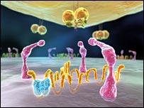
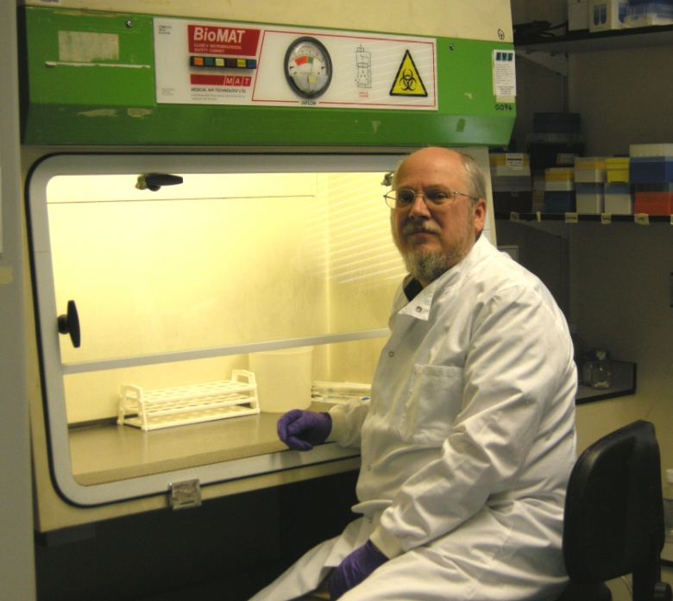
HIV envelope - cellular interactions
Dr Simon A.Jeffs
Infectious Diseases Section,
Division of Medicine,
Jefferiss Research Trust Labs,
4th Floor Wright-Fleming Institute
020 7594 3918
simon.jeffs@imperial.ac.uk

Slide 2

LEARNING OBJECTIVES:-
a.) The functional outcomes of viral ligand:cellular receptor interactions:-
VIRAL ENTRY
VIRAL TROPISM
SIGNALLING/MEMBRANE DYNAMICS
b.) The structural features of the ligands and receptors that facilitate this
c.) How knowledge of these structures and interactions can be used in intervention therapies
AFTER THIS LECTURE,
YOU SHOULD UNDERSTAND:-

Slide 3
THE OUTCOMES OF LIGAND:RECEPTOR INTERACTIONS IN VIRAL INFECTION

Slide 4


KEY STATEMENTS
1. VIRUSES CO-OPT
CELL SURFACE
RECEPTORS TO
GAIN ENTRY
2. IMPLIES
CO-EVOLUTION
OF VIRUS AND HOST
3. VIRAL TROPISM OCCURS
BYSPECIFIC VIRAL LIGAND:
HOST CELL RECEPTOR
INTERACTIONS
UNDERSTAND
INTERACTIONS-
INTERVENTION
THERAPY

Slide 5
OUTCOMES OF HIV LIGAND:CELLULAR RECEPTOR INTERACTIONS
SIGNALLING/
MEMBRANE DYNAMICS
INFECTION
VIRUS ENTERS CELL:
REPLICATES
(“CIS” INFECTION)
DOES NOT REPLICATE
(“TRANS” INFECTION)
IMMUNE RESPONSES
(CHEMOKINE/CYTOKINE PRODUCTION),
RECEPTOR CLUSTERING
(VIRAL SYNAPSE),
CELLULAR RESPONSES
(APOPTOSIS)

Slide 6
THE VIRAL LIGANDS gp120 gp41

Slide 7
THE HIV ENVELOPE COMPLEX IS TRIMERIC
gp120
ED
gp41
TM
Viral
membrane
CD
Assembled as gp160 in golgi: glycosylated/trimerises in ER
Transported to surface membrane as trimer
7-20 trimers per virion
Fragile – gp120 tend to be shed

Slide 8
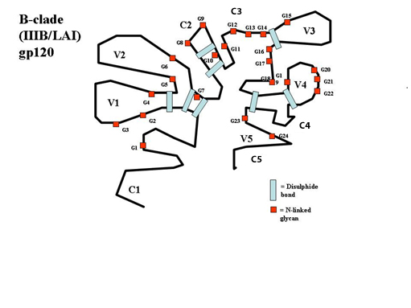
gp120: 2D STRUCTURE
env gene is most pleiomorphic of HIV-1 genome, possibly in nature
Highly glycosylated (50% of mass) structure, with 23-25 N-linked oligosaccharide chains of high mannose, complex or hybrid structures
9 S-S bonds divide gp120 into domains, comprising hypervariable LOOPS (V1-V5) and CONSERVED REGIONS (C1-C5)
gp41 noncovalently bound to gp120 to form heterodimer; oligomerisation determinants in gp41

Slide 9
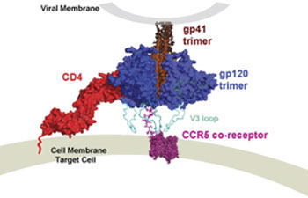
gp120 is MULTIFUNCTIONAL
Enables INFECTION (receptor binding) - Ability to contact MULTIPLE RECEPTORS SEQUENTIALLY (CD4, PDI, CR, gp41) is UNIQUE
Receptor interaction both through protein (CD4, CR) and carbohydrate (DC-SIGN, LANGERIN, MMR)
Evades HOST IMMUNE RESPONSE (multiple mechanisms)
Determines CELLULAR TROPISM (coreceptor binding)
Assists VIRAL DISSEMINATION (APC receptor binding and induction of APOPTOSIS)

Slide 10
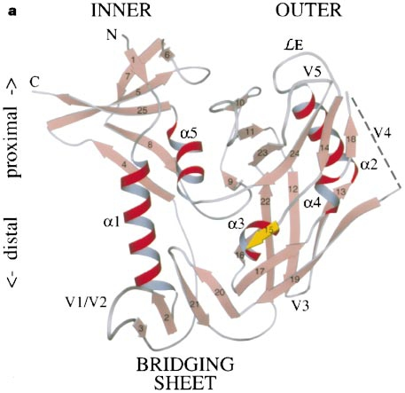
gp120 – 3-D STRUCTURE EXPLAINS FUNCTION:1
3-dimensional structure is GLOBULAR
25 β- and 5 α-helical loops –
Hypervariable loops on SURFACE of protein
Conserved regions form a CENTRAL CORE
FOLDING of gp120 gives INNER DOMAIN – faces TRIMER axis
OUTER DOMAIN – exposed on surface
BRIDGING DOMAIN linking the two

Slide 11
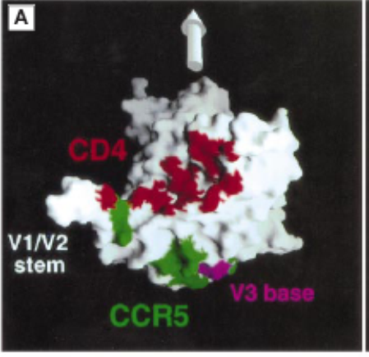
gp120 – 3-D STRUCTURE EXPLAINS FUNCTION:2
gp41 TM domain
gp41 ectodomain + gp120
Mao et al., 2012

Slide 12
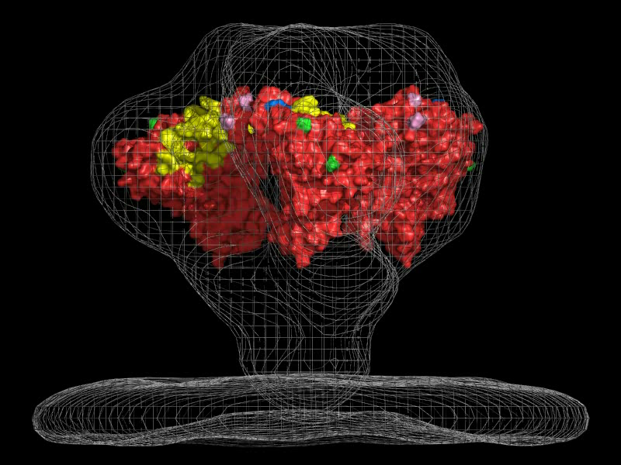
THE GLYCOSYLATED TRIMER

Slide 13
gp41
THREE regions: cytoplasmic – transmembrane – external domain
External domain contains (N to C) N-terminal hydrophobic fusion peptide, two alpha-helical regions separated by an immunodominant “hinge” region with a disulphide loop
Like gp120, multifunctional:
Enables INFECTION (conformational change); Evades HOST IMMUNE RESPONSE (various); Permits OLIGOMERISATION; Extensive CELL SIGNALLING (via cytoplasmic region)
SEE: Zwick (2005)

Slide 14
THE CELLULAR RECEPTORS
ANTIGEN PRESENTING CELL (APC) RECEPTORS – DC-SIGN, LANGERIN, MMR (DENDRITIC CELLS/MACROPHAGES)
CD4 – THE PRIMARY LYMPHOCYTE RECEPTOR
CHEMOKINE RECEPTORS (CCR5, CXCR4) – THE CO-RECEPTORS
NATURAL KILLER CELL RECEPTORS – KIR etc
OTHER RECEPTORS – INTEGRINS, α₄β₇

Slide 15

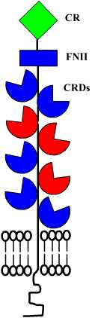
FIRST CONTACT – THE APC RECEPTORS
LANGERIN
DC-SIGN
MACROPHAGE MANNOSE RECEPTOR

Slide 16
GETTING PAST THE BARRIERS – THE INNATE MUCOSAL DEFENCE SYSTEM
Overall efficiency of HIV transmission during unprotected heterosexual sex LOW – c. 1%
Genital tract inhospitable, virus is fragile, low number of target cells in mucosa
Women: Target cells are CD4+/CCR5+ lymphocytes/monocytes in mucosa; immature dendritic cells (DC) – mostly in cervix (monolayer); Langerhans cells in vaginal epithelia (stratified); macrophages
Target cell numbers fluctuate with menstrual cycle – CCR5 upregulated in cervix; coitus recruits CD4+ T-cells and macrophages – semen immunostimulatory
Men: Similar populations of target cells in penile mucosa and foreskin; rectal epithelia
ALL STIs/genital infections increase likelihood of HIV transmission – trauma, immunostimulation (more CD4+ T-cells, DCs) – HSV2/CMV “work” with HIV
See: Kaul et al (2008)

Slide 17
THE KEY ROLE OF DENDRITIC CELLS
TWO main types: MYELOID (“Conventional” - cDC) AND PLASMACYTOID DCs (pDC)
cDCs subdivide into LANGERHANS CELLS (epidermis, mucosa, gut lumen); DERMAL DCs (dermis); Blood DCs (blood, lymphoid organs)
Depending on location and differentiation state, DCs express a number of TOLL-LIKE RECEPTORS and C-TYPE LECTINS to respond to REPEAT MOTIFS (Pattern Recognition Molecules) on pathogens
4 C-type lectin receptors bind gp120: DC-SIGN, Langerin, Macrophage Mannose receptor, DEC205 – ALL act as endocytic/phagocytic receptors
APCs act as “Bridge”
between Innate and
Adaptive immune systems
See: Wu &
KuwelRamani (2006)

Slide 18
MECHANISMS OF
DC-MEDIATED
HIV TRANSMISSION
TRANS
(a) – Trans infection via viral
Synapse mediated by DC-SIGN
(b) – Trans infection by
“exosome” – HIV targeted
To endosomal MV body –
Exosome fuses with target cell
Membrane
(c ) – Cis infection – virus
Replicates, buds from DC,
Infects target cell via CD4/CR
Trans infection – 1st 24h
(INITIAL INNOCULA - low
levels of virus)
Cis infection – 24h-72h (high
levels of virus ESTABLISHED
INFECTION)
CIS
TRANS
See: Wu & Kuwelrmani (2006)

Slide 19
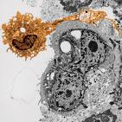
HIV AND LANGERIN - 1
LCs reside in vagina, ectocervix, glans penis, foreskin (NOT in endocervix, rectum)
Express CD1a, LANGERIN and Birbeck granules (cell organelles)
<1% of epithelial cells, but LONG DENDRITES form a CONTINUOUS NETWORK and extend into lumen
FIRST POINTOF CONTACT WITH HIV-1 IN INTACT MUCOSA
IF epithelial layer DAMAGED (trauma, ucleration by STIs) – HIV-1 accesses DCs with DC-SIGN in SUBEPITHELIAL LAYER
In RECTUM, columnar epithelium has NO LCs – DC-SIGN+ DCs infected INSTEAD
See: de Witt et al. 2007

Slide 20
HIV AND LANGERIN - 2
LANGERIN = Langerhans cell-specific C-type lectin (CD207)
Found on IMMATURE LCs
At LOW LEVELS of HIV-1 – Langerin CAPTURES HIV-1, conveys to BIRBECK GRANULES for DEGRADATION (and presentation to TCR)
Thus acts as ANTIVIRAL RECEPTOR
At HIGH LEVELS of HIV-1or Langerin INHIBITION (by TNFalpha or TLR-2 agonists) – HIV-1 NOT degraded, replicates, presented to T-cells
See: van der Vlist & Geijtenbeek (2010)

Slide 21
DC-SIGN: “DENDRITIC CELL SPECIFIC ICAM-3 GRABBING NON-INTEGRIN” (CD209)
DC-SIGN = C-type lectin Type II Transmembrane Protein; Tetrameric + α-helical stalk (amplified specificity for multiple glycans)
Binds a variety of HIGH MANNOSE STRUCTURES on cell surface INTEGRINS and PATHOGENS (viral, bacterial, yeast, parasites) using its C-type lectin binding site
Once activated, migrates to regional lymph nodes – DC-SIGN acts as ADHESION RECEPTOR to ICAM-2 on endothelial cells
Mediates interaction between DENDRITIC CELLS and RESTING T-CELLS by binding ICAM-3 on T-cells – very potent T-cell stimulator

Slide 22
THE MACROPHAGE MANNOSE RECEPTOR (MMR – CD206)
Found on macrophages, monocyte-derived DCs, skin DCs and hepatic endothelial cells as DIMER
Level of MMR expression HIGH – 100000 per cell – projects out of cell surface – ideal site of attachment
>60% of initial association with macrophages or DCs LACKING DC-SIGN is via MMR
Carbohydrate specificity of MMR and DC-SIGN DIFFER
Like Langerin and DC-SIGN, MMR is an endocytic/phagocytic receptor
MMR-bound HIV is internalised BUT NOT DEGRADED – presented to T-cells via immune synapse
SEE: van Kooyk, Y. & Geijtenbeek, T. (2003)

Slide 23
CELL-CELL TRANSFER: THE VIRAL SYNAPSE
When an APC (DC or macrophage) contacts target (T) cell, virions relocate to point of contact (3-18min) – In HTLV-1 model, virions use microtubule cytoskeleton to travel to synapse; adhesion molecule LFA-1 concentrates there
T-cell concentrates CD4, CXCR4, CCR5 receptors to point of contact- possibly due to movement of receptors in lipid rafts
Recruitment of virus and receptors to region of contact = VIRAL SYNAPSE – ENHANCES likelihood of productive infection – evidence this occurs in post-binding fusion/entry steps in HIV infection
Formation of viral synapses MAY explain productive infection of cells with LOW surface density of CD4
Utilisation of DCs allow HIV to infect T-cells when number of viral particles would normally be too low
Thus, the antigen capture ability of APCs has been co-opted as a weak point by viral, bacterial and parasitic infections – sentinel becomes Trojan Horse!
SEE: Igakura et al., 2003

Slide 24
THE PRIMARY RECEPTOR – CD4
INTO THE T-CELL
THE CO-RECEPTORS – CCR5/CXCR4

Slide 25
CD4: STRUCTURE AND LOCATION
gp120
120 A
58Kda Ig supergene family
Found on developing THYMOCYTES, CLASS II MHC-RESTRICTED T-LYMPHOCYTES,
PLASMACYTOID DENDRITIC CELLS (pDC), MACROPHAGES/MONOCYTES
PRESENCE DEFINES HIV-1 PRODUCTIVE INFECTION
PRIMARY CELL SURFACE RECEPTOR FOR HIV AND SIV
HIGH LEVELS on T-CELLS, LOW LEVELS on MACROPHAGES, pDC

Slide 26
CD4: gp120 INTERACTIONS
INITIAL work by mutagenesis studies
– defined regions of Gp120 (C2, C4, V4)
and CD4 (D1) that interacted
STRUCTURAL STUDIES show that CD4 interacts at interface of
INNER and OUTER domains of gp120
CD4 makes extensive contacts over about 800A of gp120
Binds to a 10A RECESSED CAVITY in gp120, occupied by Phe 43 of
CD4 – Phe 43 ESSENTIAL for gp120 binding
BLOCKING of the Phe43 cavity is POTENTIAL INTERVENTION
THERAPY
See: Huang et al (2005)

Slide 27
THE CORECEPTORS

Slide 28
THE CORECEPTORS: HISTORY
Early evidence that CD4 allows viral BINDING but not ENTRY
TWO distinct phenotypes of HIV isolates:-
Slow/Low (replication in PBMCs); NSI (non-syncitium inducing);M-trophic (macrophage trophic) – found at all stages of disease
Rapid/High; SI; T-trophic (T-cell trophic) – found in later stages of disease (associated with progression to AIDS)
Consistent with TWO virus groups using DIFFERENT CO-RECEPTORS

Slide 29
THE CORECEPTORS ARE CHEMOKINE RECEPTORS – CCR5/CXCR4
Soluble factors produced by CD8+ CTLs inhibit HIV entry
Found to be CHEMOKINES
Identification of chemokines inhibiting entry of T-trophic (SDF-1) and M-trophic (MIP-1^{α}, MIP-1β, RANTES) HIV-1
Led to identification of T-trophic receptor CXCR4, and M-trophic receptor CCR5
Both are 7—transmembrane G-protein coupled receptors (GPCRs)
Act as co-receptors for HIV-1, HIV-2 and SIV
INTERVENTION THERAPIES using chemokine derivatives and small molecule inhibitors/antibodies

Slide 30
HIV-1 CORECEPTOR USAGE
In vivo, major coreceptors are CXCR4 and CCR5
95% initial infection via CCR5 (R5) – R5 receptors on APCs (macrophages, dendritic cells)
∆32CCR5 Mutation – STOPS R5-Trophic HIV-1 infection
Stem cell treatment to introduce ∆32CCR5 restored T-cell function
Later in infection, dual-trophic (R5X4) and CXCR4-trophic (X4) strains predominate – associated with severe DECREASE in CD4 count and MORE RAPID progression to disease
Determinants of tropism related to CHANGE in V3 loop (plus other, minor changes elsewhere)
Coreceptor usage more diverse in HIV-2 and HIV-1 in CNS (CCR2b, CCR3, APj)
CD4-independent HIV-1 infection but NOT CR-independent. CR use older?
See: Alkhatib (2009)

Slide 31
VIRAL ENTRY

Slide 32
CD4-DEPENDENT INFECTION - 1
Docking
receptors
CRbs
V1/2
Mediated by SPECIFIC viral ligand/host cell receptor (CD4) interactions: Mechanisms WELL UNDERSTOOD
Essentially FIVE stages:-
Trimeric envelope attaches via DOCKING RECEPTOR MOLECULES
Viral ligand LOOSELY engages CD4 – gp120 MIGRATES to surface-located PDI
PDI reduces 2 disulphide bonds in gp120 – CD4 binding stabilised – gp120 conformation CHANGES – CR bs (on V3 loop) EXPOSED

Slide 33
CD4-DEPENDENT INFECTION - 2
4. PDI-induced conformational change in CD4-bound gp120 brings envelope coreceptor binding sites into contact with CCR5/CXCR4
5. Fusion reaction then occurs – MEDIATED BY conformational changes in gp41 – allows viral and cell membranes to fuse
MEMBRANE DYNAMICS (viral synapses, lipid rafts) ALSO INVOLVED – may explain SOME examples of CD4-independent infection

Slide 34
CD4- INDEPENDENT INFECTION
In general, mechanisms POORLY UNDERSTOOD
Multiple viral pathways, often NOT used by T-cells, but by macrophages, dendritic cells (DCs), brain macrophages and microglia:-
Internalised – replicates (usually at lower levels than in T-cells) – presented to T-cells or other cells (particularly DCs) DC-SIGN
Internalised – does NOT replicate – retains infectivity – presented to T-cells DC-SIGN, MMR
Binds to surface – retains infectivity – presented to T-cells GLYCOSAMINOGLYCANS (SYNDECAN)

Slide 35
THE FUSION REACTION

Slide 36
THE ENV-MEDIATED FUSION REACTION - I:
“THE VIRAL MOUSETRAP” MODEL
Lipid-enveloped viruses require fusion of viral and host cell membranes for entry
HIV envelope is a “Type I fusion protein” (like flu HA) – has α-helixes cleaved to form heterotrimers (gp120+gp41), is anchored in membrane (gp41 TM region) and has N-terminal fusion peptide (gp41 FP)
Fusion peptide of gp41 is BURIED in cavity in gp120
Pre-fusion gp41 conformation like an UNSPRUNG MOUSETRAP: N- and C-helical peptide fragments are two halves (separated by S-S “hinge”) of trap, with fusion peptide as a barbed hook – energy associated with this

Slide 37
THE ENV-MEDIATED FUSION REACTION - II
FUSION PEPTIDE
In presence of co-receptor, gp120 BINDS and STRUCTURAL CHANGES in gp41 TRIGGERED (“Fusion activation”)
These changes cause the gp41 MOUSETRAP TO SPRING – FUSION PEPTIDE PENETRATES TARGET CELL - forms PRE-HAIRPIN INTERMEDIATE structure (relatively long-lived (minutes) and vulnerable to C-PEPTIDE INHIBITION
Gp41 next relaxes into STABLE post-fusion conformation (HAIRPIN) as N- and C-peptides adopt a helcal conformation bringing TM and fusion peptide domains of gp41 together
Viral and cell membranes COALESCE, leading to membrane fusion (exact mechanism unknown) and forming a FUSION PORE
4. POST FUSION structure of gp41 unknown, as are whereabouts of gp120 and receptors
1
2
3
4
SEE THE ANIMATION OF THIS!!

Slide 38
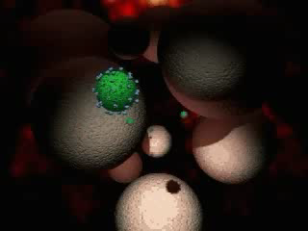
Cell entry animation

Slide 39
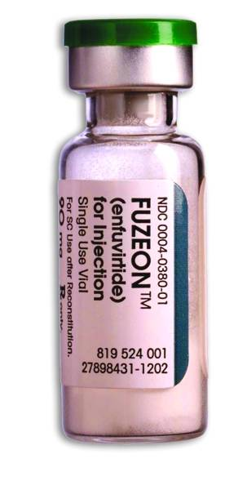
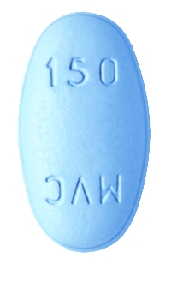
THERAPIES TARGETTED AT HIV ENTRY
ENTRY INHIBITORS
FUSION INHIBITORS

Slide 40
THERAPEUTIC INTERVENTIONS DURING THE FOUR STEPS OF VIRAL ENTRY
STEP 1 – HIV-1 ATTACHMENT – PREVENTING VIRAL ATTACHMENT
STEP 2 – CD4 BINDING – BLOCKING CD4 RECEPTORS OR gp120:CD4 INTERACTION
STEP 3 – CORECEPTOR BINDING – BLOCKING gp120:CR INTERACTIONS
STEP 4 – MEMBRANE FUSION – PREVENTING gp41 ACTIVITY
SEE: Cooley, L. & Lewin, S. (2003), Kuritzkes (2009), Choi & An (2011)

Slide 41
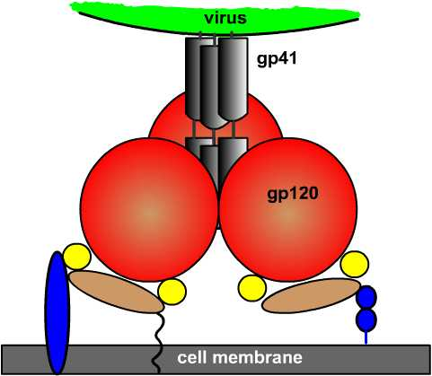
STEP 1 – INHIBITORS OF HIV ATTACHMENT
Sulphated polysaccharides – prevent blood clots; also block formation of HIV syncitia in vitro
LOTS OF THESE - Dextran sulphate blocks gp120/CD4 interaction in vitro BUT causes thrombocytopenia (platelet shortage) – WITHDRAWN
Dextrin-2-Sulphate, infused i.p, REDUCES viraemia – Phase II trials inconclusive
Many tried as MICROBICIDES - Cellulose sulphate (“Ushercell”) in Phase III trial – NO BENEFIT DEMONSTRATED (July 2007)

Slide 42
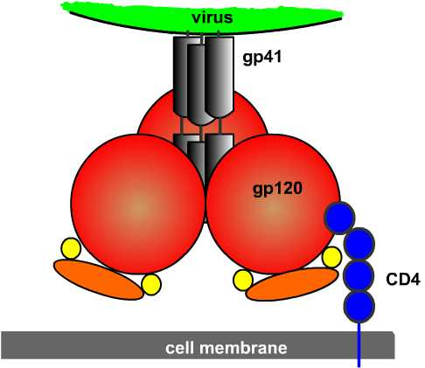
STEP 2 – INHIBITORS OF CD4:gp120 BINDING: Soluble CD4 and mimetics
Long line of soluble CD4-based drugs
Soluble CD4 inhibits TCLA HIV-1 isolates, but NOT PI HIV-1 in vitro: Ineffective in vivo
Many derivatives of CD4 mimetics + IgG – effective in vitro but poor in vivo
Mostly superceded by HAART

Slide 43
STEP 2 – INHIBITORS OF CD4:gp120 BINDING: anti-CD4 antibodies
ANTI-IDIOTYPE approaches (inject artificial MAb that RESEMBLES anti-CD4 MAb – body produces Ab to artificial Ab that resembles CD4 receptor- binds to gp120, prevents infection) = IO4Ta (Immunotech)
In Phase II trials (1996), No side FX, delays onset of clinical or immunological disease progression. NO CURRENT TRIALS
TNX-355 “Ibalizumab” (Novartis) – anti-CD4 Mab
Given by i.v infusion
Phase I/II trials showed reduction in viral load– only needs 2 injections/month - safe
Works by reducing CD4 flexibility
92% viruses neut. @ IC50 – mean is 0.03µg/ml (lower than PG9/VRC01)
Pace et al. (2012)

Slide 44
STEP 2 – INHIBITORS OF CD4:gp120 BINDING: BMS 488043
Agents to block phenyl ring of F43 on CD4 that inserts into Phe 43 cavity on gp120 such as BMS-488043 (Bristol-Myers-Squibb “043”)
Acts against X4 and R5 viruses – safe in HIV+ve and –ve people
Shows about 10-fold reduction in viral load/ stabilised CD4 cell count BUT needs large doses given with a high-fat meal (800mg/Kg)
Still under development – several Phase I trials

Slide 45
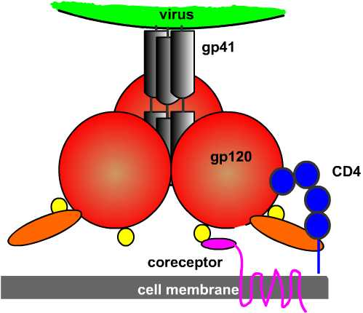
STEP 3 – INHIBITORS OF CORECEPTORS BINDING
R5-using HIV-1 isolates can be blocked by chemokines RANTES, MIP-1α, MIP-1β; X4 by SDF-1 - BUT too inflammatory and toxic for in vivo use – CORECEPTOR ANALOGUES must be used instead
CORECEPTOR ANTAGONISTS (small molecules, peptides, chemokine derivatives, MAbs) developed
SEE: Cooley & Lewin (2003); Maeda et al. (2006)

Slide 46

STEP 3 – INHIBITORS OF CCR5 CORECEPTOR – “ENTRY INHIBITOR” DRUGS - MARAVIROC
SMALL MOLECULE INHIBITORS OF CCR5 – 4 developed
APLAVIROC (GSK); MARAVIROC (Pfizer); VICRIVIROC (Schering); INCB009471(“-viroc” = “viral receptor occupancy”)
MARAVIROC – showed promising potency and tolerability – now LICENSED AS “SELZENTRY/CELSENTRI”
Blocks MIP-1-α and RANTES-mediated signalling at nm range
Fully-approved for use Nov. 2008
Does NOT favour emergence of CXCR4-trophic virus – no resistance noted to date
See: Kuritzkes (2009)

Slide 47
STEP 3 – INHIBITORS OF CCR5 CORECEPTOR – “ENTRY INHIBITOR” DRUGS - OTHERS
VICRIVIROC MALEATE – showed early promise with good viral reduction BUT early viral-rebound seen in Phase II trials and poor results in Phase III trials –MERCK stopped ALL development July 2010
APLAVIROC – Like MV, reduces viral load and now in Phase I/II trirals with other drugs BUT concerns over liver toxicity. NOW WITHDRAWN
PRO-140 (humanized αCCR5 Mab that blocks CCR5/gp120 interactions): 1-2 log VL reduction
Phase IIb trials successful- fast-tracked by FDA 2008
See: Kuritzkes (2009); Jacobson et al. (2010)

Slide 48
STEP 3 – INHIBITORS OF CXCR4 CORECEPTOR
CXCR4 Inhibitors
PURE X4 populations RARE
X4 -/- mice DIE
Peptide/organic compounds unrelated to chemokines (ie: AMD3100, ALX40-4C, T22) suggest efficacy
BUT most are toxic (Leukocytosis and liver toxicology)
Natural chemokine ligands based on vMIP-II under development
See: Kuritzkes (2009), Choi & An (2011)

Slide 49
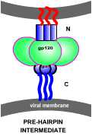
STEP 4 – INHIBITORS OF MEMBRANE FUSION
Aims to block CONFORMATIONAL CHANGES in gp41 that lead to FUSION – target PRE-HAIRPIN INTERMEDIATE (PHI), HAIRPIN FUSION CONFORMATION or FUSION INTERMEDIATE STRUCTURE (FIS)
Attempts to make FIS by fixation of gp140 and CD4 unsuccessful to date
However, PEPTIDE analogues based on leucine zipper domain or α-helix of gp41 targetting PHI MORE SUCCESSFUL
One peptide, T20, based on TM-proximal α-helix is EFFECTIVE in vivo – first of new class of HIV drugs – FUSION INHIBITORS
Now licensed as ENFUVIRITIDE (Fuzeon) – must be used in combination, or resistance rapidly develops
Must be given s.c and causes painful reactions at injection site
See: Makinson & Reynes (2009)

Slide 50
SUMMARY
HIV co-opts cellular receptors to gain entry
Cellular tropism enabled by gp120:CR interactions
Initial interaction between virus and APC – APC presents
intact virus to T-cells
On T-cells, primary receptor is CD4
Co-receptors are CCR5/CXCR4
Complex infection process – knowledge of this PLUS
structural information of viral ligands and cellular
receptors allows design of intervention therapies
NEW therapies based on entry inhibition (MARAVIROC);
fusion inhibition (FUZEON)
Antibody therapies also show promise (PRO-140,
IBALIZUMAB)

Slide 51
FURTHER READING
Van kooyk & Geijtenbeek (2003) Nature Reviews Immunology, 3, 697-709
Sattentau, Q. (1998). Structure, 6, 945-949
Zwick (2005). AIDS, 19, 1725-1737
Cooley & Lewin (2003). J. Clin.Virol., 26, 121-132
Huang et al. (2005). Science, 310, 1025-8
Maeda et al. (2006). J.Biol.Chem., 281, 112688-12698
Arthos et al. (2008). Nature Immunology, 9, 301-309
Fortin et al. (1998). J.Virol. 72, 2105-2112
Kaul et al. (2008) J.Reprod.Immunol. 77, 32-40
Wu & KuwelRamani (2006). Nature Reviews Immunology, 6, 859-868
De Witt et al. (2007). Trends in Mol. Med. 14, 12-19
Alkhatib (2009). Curr. Opp. HIV AIDS 4, 96-103
Kuritzkes (2009). Curr. Opp. HIV AIDS 4, 82-87
Makinson & Reynes (2009). Curr. Opp. HIV AIDS 4, 150-8
Wu et al. (2010). Science 330, 1066-1071
Altfeld et al. (2011). Nature Reviews Immunology, 11, 176-186
Choi & An (2011). Exp. Biol. Med., 236, 637-647
Jacobson et al. (2010). J. Inf. Dis., 201, 1481-1487
Mao et al (2012). Nature Struct. Mol. Biol.,19, 893-900
See also http://www.aidsmap.com for recent info on drug therapies
Pace et al. (2012) J. AIDS Sep 2012 (ePub)

