Slide 1
The immunological synapse
Dr Paul F McKay
Section of Infectious Diseases
Department of Medicine
St. Mary’s Campus, Imperial College
p.mckay@imperial.ac.uk
15 October 2012

Slide 2
Stages of Antigen Presentation
Activation of the APC
Formation of MHC/peptide complexes (antigen processing)
Formation of the ‘immunological synapse’ with T cells
Functional effects
Termination of signalling

Slide 3
Primary Function of the IS
Sustained TCR signalling is required for full T cell activation.
Low number of MHC:peptide complexes on the APC: need to increase signalling efficiency
Effector functions: cellular communication and target cell killing
Termination of signalling/TCR internalisation

Slide 4
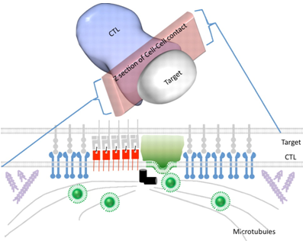
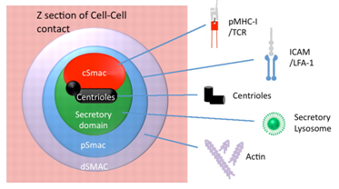
Formation of the ‘Immunological Synapse’ (IS)
What is it?
Specialised junction between T lymphocytes and antigen presenting cells. Consists of a central cluster of T cell receptors surrounded by a ring of adhesion molecules (Supramolecular activation cluster - SMAC).
Griffiths G M et al. J Cell Biol 189:399-406 (2010)

Slide 5
IS formation
There is a physical or steric barrier to cell – cell interaction
Very large molecules - CD43 and CD45 (length 50-100 nm)
TCR: MHC-Peptide (distance: 15 nm)
The negatively charged glycocalyx (a glycoprotein / glycolipid matrix surrounding each cell)

Slide 6
CD43
CD45
CD28
LFA-1
TCR
CD2
T cell
APC

Slide 7
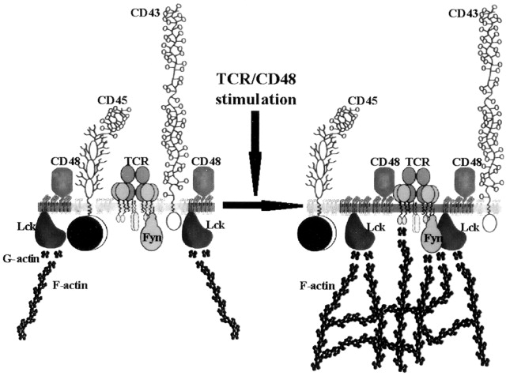
Moran and Miceli. Immunity 9: 787 - 796

Slide 8
Membrane rafts
Membrane domains rich in cholesterol and gangliosides like GM1
Called DIGs: detergent-insoluble domains (can be isolated with TRITON X100)
Rich in signalling molecules
Many on memory T cell surface, while in naïve T cells they are mainly intracellular

Slide 9
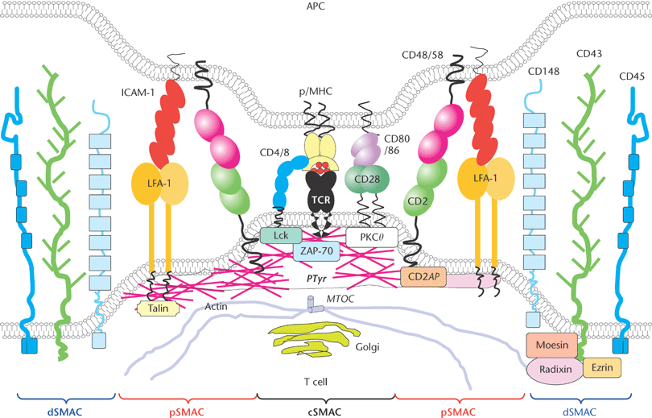
Valitutti, S. and Espagnolle, N. 2006. Immunological Synapse. eLS.

Slide 10
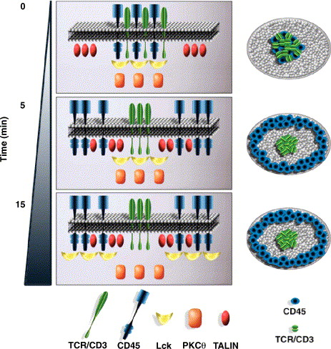

Slide 11
What initiates the formation of the IS?
Activation signals
MHC : Peptide Scanning – TCR engagement
Co-Stimulation
Chemokines

Slide 12
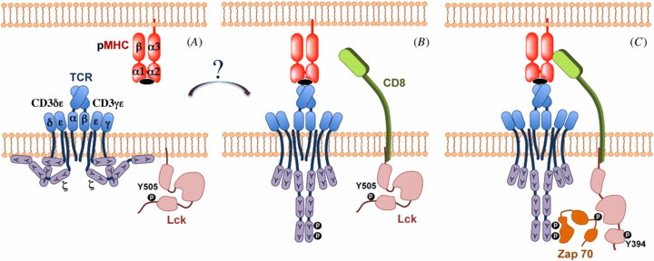
MHC : Peptide Scanning – TCR engagement
Zarnitsyna and Zhu. Phys Biol. 9 No4

Slide 13
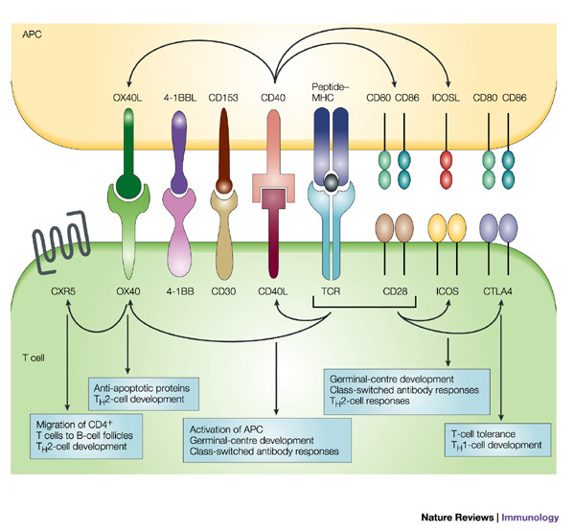
T Cell Co-Stimulation
Acuto and Michel. Nature Reviews Immunology 3: 939 - 951

Slide 14
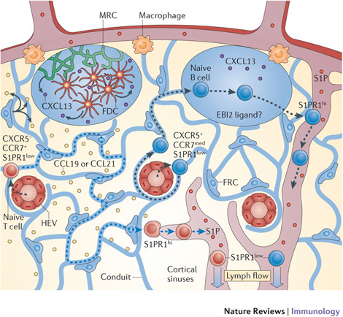
During trafficking through the lymph nodes, T cells are exposed to chemokines
Girard et al., Nature Reviews Immunology doi:10.1038/nri3298

Slide 15
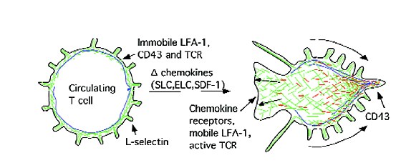
T cell polarisation

Slide 16
Exposure to chemokines during
migration to the inflammatory site
Polarisation
(redistribution of
surface molecules)
Integrin activation
Adhesion to the APC
(DC in the lymph node)

Slide 17
Specific stages of IS formation
1. Initial adhesion
2. TCR triggering
3. Organization
4. Stabilization

Slide 18
1. Adhesion
Resting T cells : uniform distribution of surface molecules and domains. Adhesion molecules non-activated
L-sel
TCR
CD2
CD43
LFA-1
During migration in the inflammatory sites, they are exposed to chemokines: this induces polarisation prior to contact with the APC

Slide 19
Polarization allows the establishment of a sensory contact with APC
CD43
LFA-1
CD2
‘Active’ TCR

Slide 20
Junction formation
T Cell
LFA-1
TCR
MHC:P
1
2
APC
1. LFA-1 ‘anchoring’ (also CD2, DC-sign-ICAM-3)
2. Leads to initial TCR triggering

Slide 21
2. TCR triggering
Adhesion allows initial TCR triggering
This event is crucial to the
organization of the IS

Slide 22
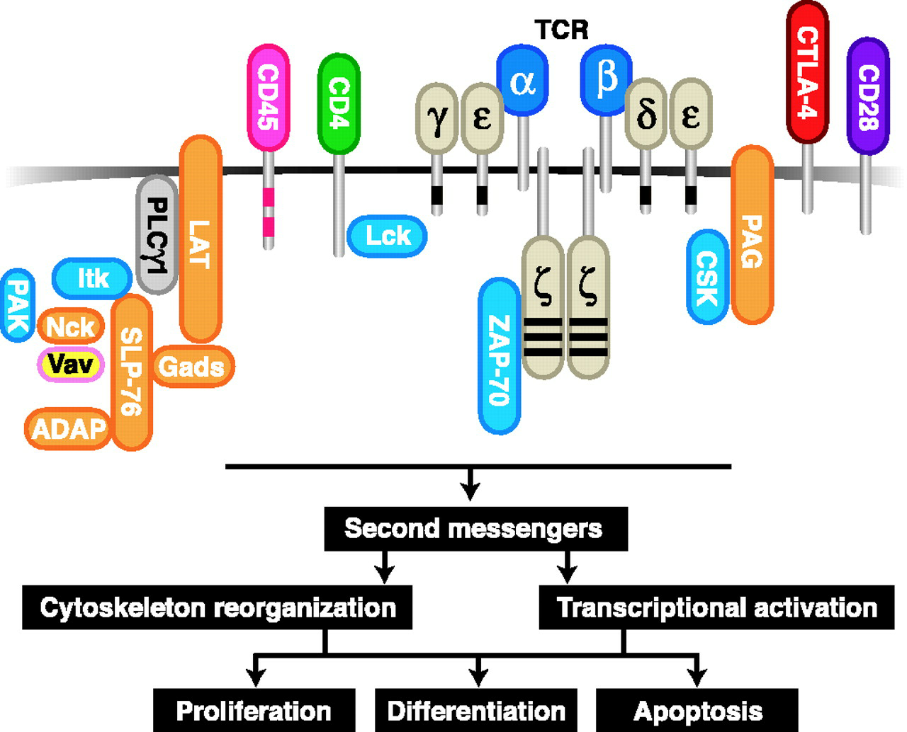
Early events in TCR signalling
1. Lck-mediated ITAMs (immunoreceptor tyrosine-based activation motifs) phosphorylation
2. ZAP-70 activation
3. Recruitment of LAT and SLP-76
4. Vav and WASP activation - cytoskeleton reorganization

Slide 23
Initial TCR triggering induces further cytoskeletal rearrangements:
This leads to the recruitment of other TCRs and rafts and to synapse organization

Slide 24
3. Synapse organization
TCR:MHC:peptide complexes are transported in the centre of the synapse
LFA-1
TCR
MHC:Peptide
ICAM-1
mediated by cytoskeletal rearrangements, takes 5-10 minutes
Other molecules are “pushed” out: CD45, CD43

Slide 25
SupraMolecular Activation Complexes:
SMAC c:
TCR, CD28, CD4 (short molecules)
RAFT microdomains (LAT, LCK)
SMAC p:
CD2, LFA1,
CD43/CD45

Slide 26
Molecular interactions in the synapse
TCR, CD28: cSMAC
LFA-1, CD2: pSMAC
CD4: excluded after organisation
CD45: excluded initially, some in the mature synapse’ cSMAC

Slide 27
The synapse from the APC side

Slide 28
4. Stabilization
TCR
LFA-1
MHC:Peptide
ICAM-1
mechanism unknown and it lasts for hours, allowing sustained TCR activation
(parallel activation of 60 TCR)
Allows TCR internalisation and termination of signalling

Slide 29
IS and Signalling
Membrane domains rich in signalling molecules continue to be transported to the centre of the synapse: This allows sustained TCR signalling (role of PKCθ in T cell activation)
At the same time, inhibitory molecules (SHP and CD45) continue to be excluded.

Slide 30
Summary: Synapse formation and Stabilisation
1. Initial adhesion: polarization and integrin activation by chemokines
2. TCR triggering: initiates cytoskeletal rearrangements (signalling pathways)
3. Organization: recruitment of new TCRs and transport to the centre of the synapse
4. Stabilisation: allows sustained signalling, mechanism unknown

Slide 31
Altered or abortive synapse formation
The size/organization of synapses determines modes and degree of T cell activation (i.e. memory vs naïve T cells)
Functional consequences
Altered synapse formation/organisation can lead to T cell inactivation
Anergy Deletion Immune deviation

Slide 32
Other types of cell – cell synapses
CD8 Cytotoxic T cells
B cells
NK Cells
Viral Synapse

Slide 33
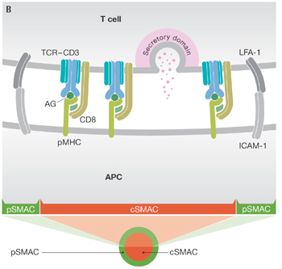
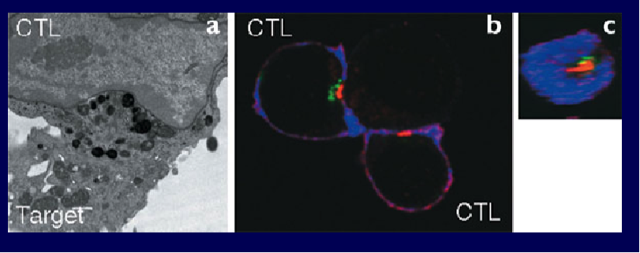
CD8 Cytotoxic T cells
The ‘secretory’ synapse: a mechanism of target killing by CTLs

Slide 34
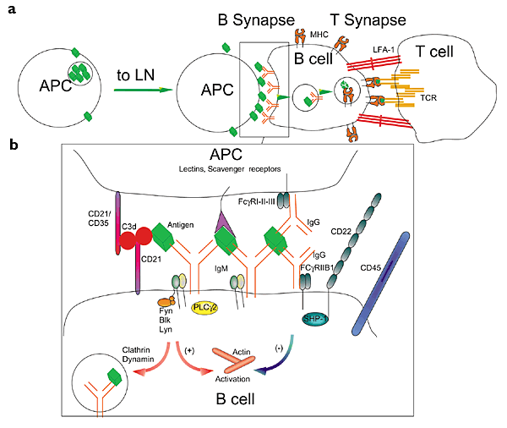
B cell Synapses

Slide 35
NK cell Synapses
‘Inverted Synapses’ are formed by inhibitory receptors

Slide 36
The Viral or Infectious Synapse
The viral synapse allows cell to cell viral spreading
NB Viral synapse formation is independent of TCR signalling, but it is induced by viral proteins

Slide 37
Summary
Sustained TCR signalling: recruitment of rafts into the synapse
Altered synapse formation as a mechanism of T cell inactivation
CD8 T cell secretory synapse
B cell synapses
NK cell synapses
Viral Synapse

Slide 38
Controversy and Current Research Efforts
A number of reserachers have postulated that the main role of the synapse is to terminate TCR signaling by internalisation
That the IS is not absolutely necessary to activate the T cells
Strength of secondary signal

Slide 39
References
Griffiths GM, Tsun A and Stinchcombe JC. 2010. The immunological synapse: a focal point for endocytosis and exocytosis. J Cell Biol. 189: 399 - 406.
Bromley et al., Annu. Rev. Immunol. 2001. 19: 375 – 396.
Dustin, M.L., and J.A. Cooper. 2000. The immunological synapse and the actin cytoskeleton: molecular hardware for T cell signaling. Nature Immunol. 1: 23 - 29.
Friedl P, den Boer AT and Gunzer M. 2005. Tuning immune responses: diversity and adaptation of the immunological synapse. Nat Rev Immunol. 5: 532 – 545.
Girard JP, Moussion C and Förster R. 2012. HEVs, lymphatics and homeostatic immune cell trafficking in lymph nodes. Nat Rev Immunol. doi: 10.1038/nri3298.

