Slide 1
25 October 2012
Immunological memory
Sophie Rutschmann
Molecular Immunology
s.rutschmann@imperial.ac.uk

Slide 2
Immunological Memory
“Immunological memory is the ability of the immune system to respond with greater vigour upon re-encounter with the same pathogen and constitutes the basis for vaccination”
Immune response activity
0
8
Secondary infection
Time (days)
Innate
Adaptive
Memory
F. Sallusto et al., Immunity, 2010

Slide 3
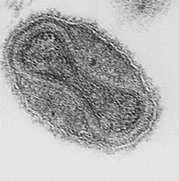
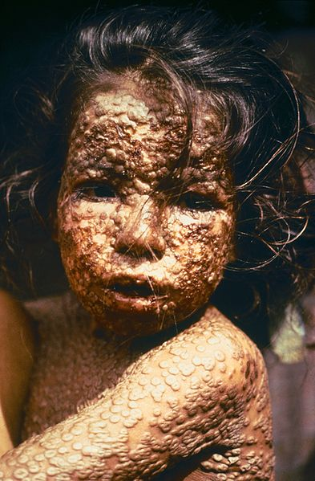
Smallpox (variola)
Poxvirus: double stranded DNA
20-60% of infected people and up to 80% of children would die from viral infection
4 forms of disease: patients died from organ failure, haemorrhage, uncontrolled immune response, pulmonary oedema
WHO: eradicated in 1979

Slide 4
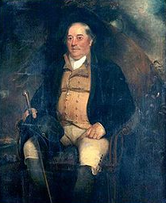
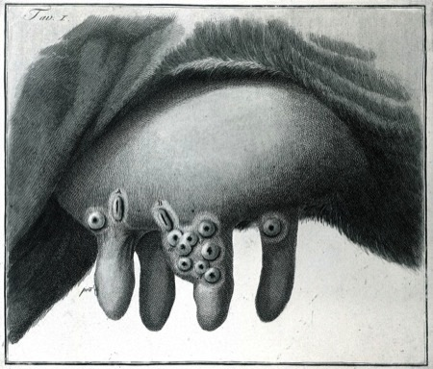
Benjamin Jesty (1736-1816)
1774: decided to inoculate his sons and wife with cowpox to protect them from a smallpox epidemic

Slide 5
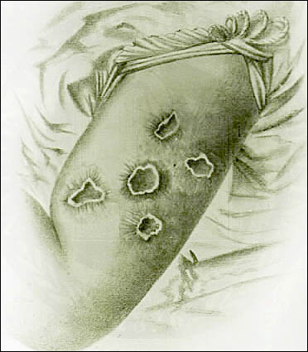
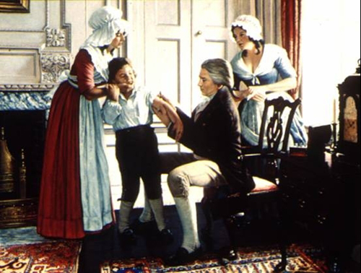
Edward Jenner (1749-1823)
1796: inoculated James Phipps with pus scraped from Sarah Nelmes cowpox (vaccinia) blisters

Slide 6
Vaccines today
General success against acute infections with invariant pathogens (diphtera, tetanus, polio, MMR, …)
Lack of vaccines against variable or persistent infections (HIV, M. tuberculosis (BCG vaccine confers variable efficacy for 10-15 years only), HCV, …)

Slide 7
Basics
Memory: relies mainly on T and B lymphocytes
B cells: produce antibodies to deal with microbes itself: free virus particles, bacteria, parasites
T cells: deal with infected cells (virus, intracellular bacteria)
Ideal vaccine against difficult pathogens: induce neutralizing antibodies and highly effective T cell immunity
Two lines of defence: mucosal and systemic
F. Sallusto et al., Immunity, 2010

Slide 8
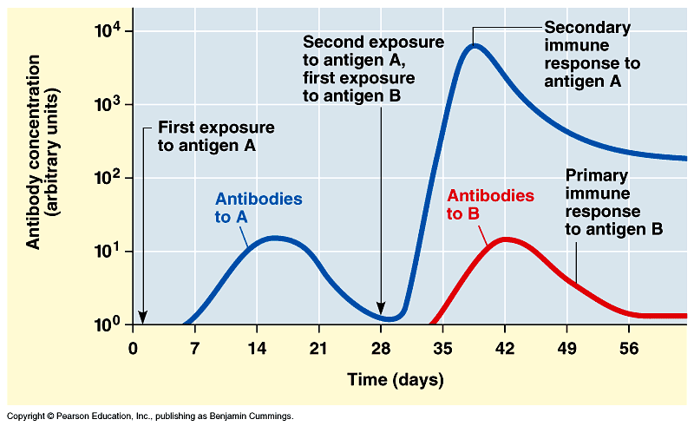
Memory B cells
Antibodies are produced by plasma cells: non-dividing immobile terminally differentiated cells of the B lineage. Their precursors are called plasmablasts.
Switch from expression of membrane-bound antibody (receptor) to antibody production marks the terminal differentiation of B cells into plasmablasts

Slide 9
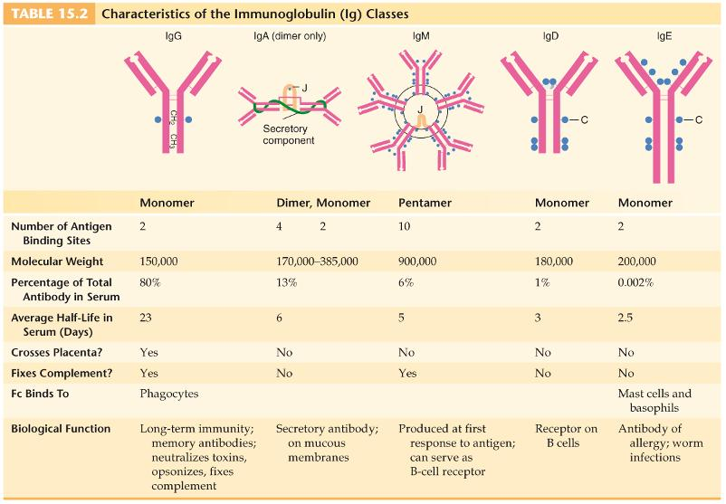
Antibodies

Slide 10
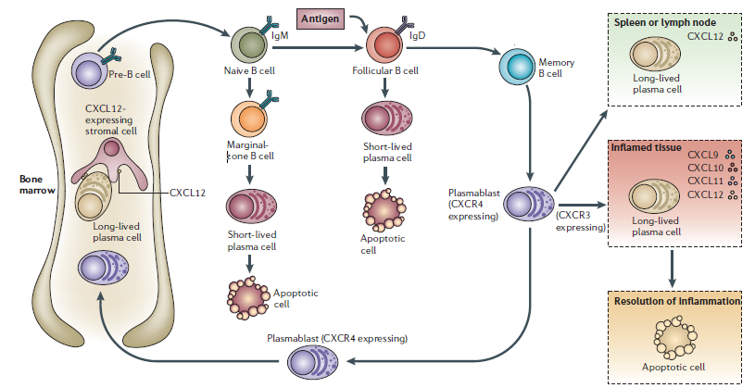
Generation of memory B cells
T help
Long-lived, switched class high affinity
Plasmablast
(Ab secretion)
Ab secretion
Survival niches
Immobile plasma cells
Humoral Immunity
IFNg
CXCL12
Termination of survival niches
Destruction of resident plasma cells
Peak of immune response
A. Radbruch et al., Nat. Rev. Immunol., 2006

Slide 11
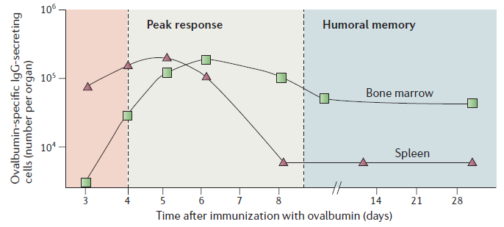
Peak and humoral memory B cells
Spleen:
Blasts migrate to tissue
Survive in niches
Successful IR terminates niche
Plasma cells cannot relocate and die
Bone marrow:
Blasts invade BM and compete for niches
Become long-lived plasma cells
Dislocated plasma cells die
Memory fades due to competition
Secondary immunisation of Balb/c mice with ovalbumine
A. Radbruch et al., Nat. Rev. Immunol., 2006

Slide 12
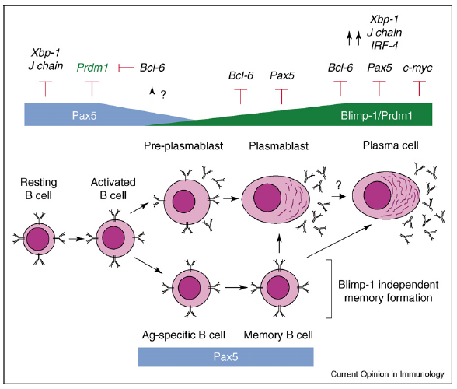
Genes regulating plasma and memory differentiation
A. Kallies and S.L. Nutt, Current Opinion Immuno., 2007

Slide 13
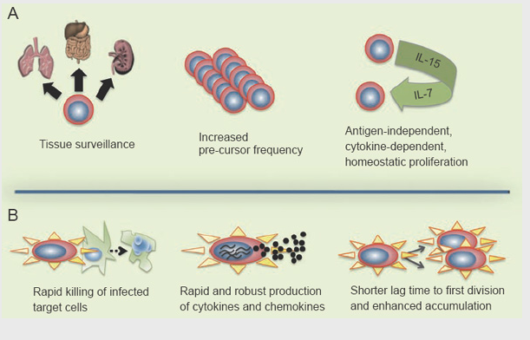
Memory T cells

Slide 14
CD8⁺ T cell response
# Ag-specific CD8⁺ T lymphocytes
3
2
4
1
Time
Infection #2
Mature APC
Infection #1
Ag specific T cell
T cell
Dying T cell
1: Activation
3: Contraction, programmed cell death
2: Clonal burst
4: Memory
(x1000 in frequency of Ag-CD8)

Slide 15
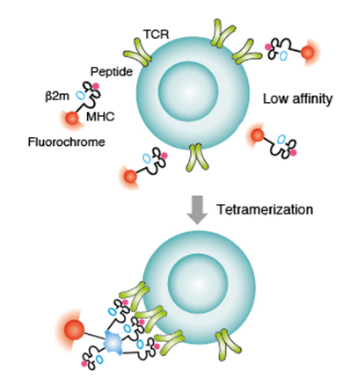
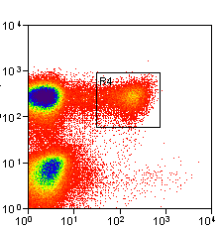
Visualizing antigen-specific T cells
LCMV glycoprotein 33-specific CD8 T-cells
(gp33⁺CD8⁺ T-cells)
CD8
gp33
tetramer
Tetramerization (biotin/streptavidin) increases the avidity of the TCR-MHC/peptide interaction
CD8
K. Murali-Krishna et al., Immunity, 1998

Slide 16
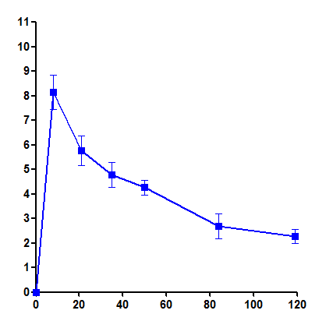
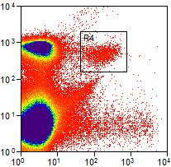
Primary CD8⁺ T cell response
gp33⁺CD8⁺ T-cells
Day 8
Day 69
% gp33⁺CD8⁺ T-cells (PBL)
CD8
CD8
gp33
gp33
Time (days)

Slide 17
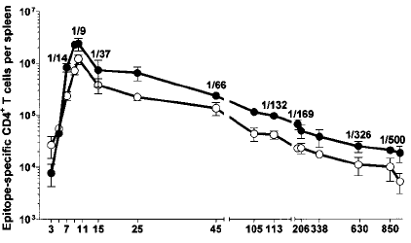
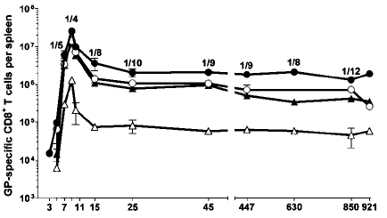
Antigen-specific CD4⁺ T cell response
Ag-CD4⁺ T-cells
Ag-CD8⁺ T-cells
D. Homann et al., Nature Immunology, 2001

Slide 18
Secondary (recall) CD8⁺ T cell response
Primary Influenza
Tetramer
Secondary Influenza
(8 months later)
CD8
K.J. Flynn et al., Immunity, 1998

Slide 19
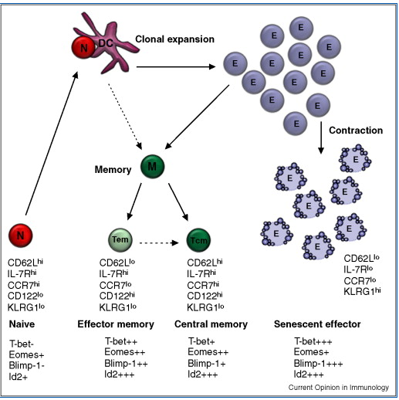
Memory and effector subtypes

Slide 20
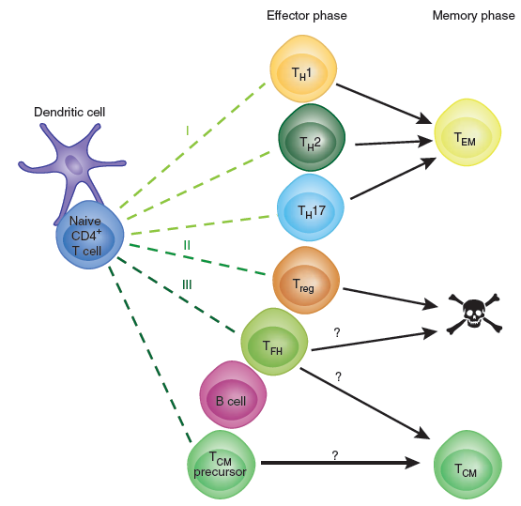
CD4⁺ memory and effector subtypes
M. Pepper et al., Nature Immunology, 2011

Slide 21
Tem and Tcm
Effector memory T cells (Tem)
Lack LN homing molecules CCR7 and CD62L
Present in and circulate through peripheral tissues
Exhibit immediate effector function upon antigen recognition
Central memory T cells (Tcm)
Circulate between secondary lymphoid organs
Express the LN homing molecules CCR7 and CD62L
Do not exhibit immediate effector functions (cytokines/cytotoxicity)
Undergo significant recall proliferation upon antigen re-encounter
With time, the memory pool gradually changes from Tem to stable and long-lived Tcm

Slide 22
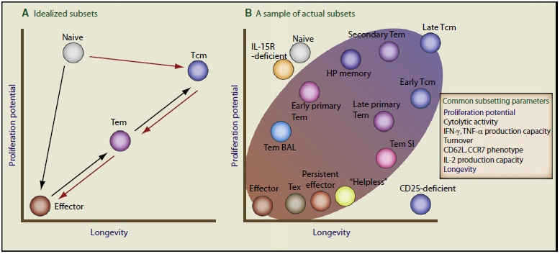
Is it that simple?
F.C. Jameson and D. Masopust, Immunity, 2009

Slide 23
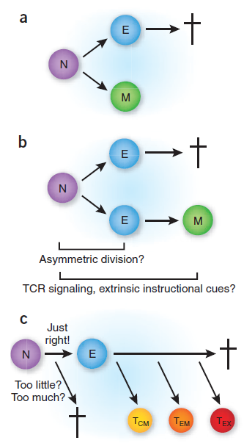
Memory development models
a: asymmetric division
two daughter cells with polarized cell-fate
b: effector lineages
two effector daughters with effector and memory potential
L. Lefrancois and D. Masopust, Nat. Immunol., 2009

Slide 24
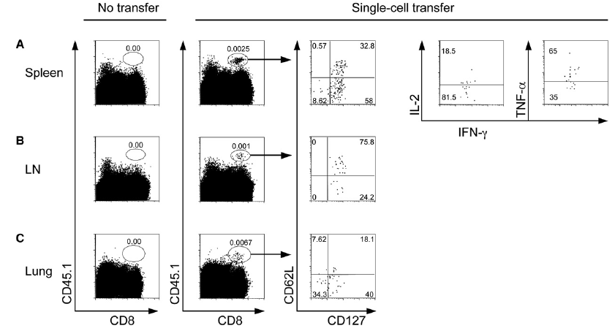
No innate fate
One single naïve CD45.1⁺CD8⁺ cell transferred to CD45.2⁺ recipients, infected with Listeria, analysed 5 weeks later.
Tcm: IL7R⁺CD62L⁺
Tem: IL7R⁺CD62L⁻
C. Stemberger et al., Immunity 2007

Slide 25
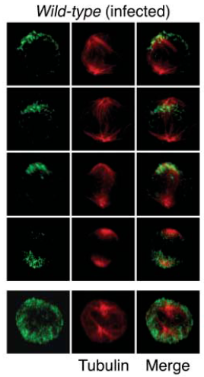
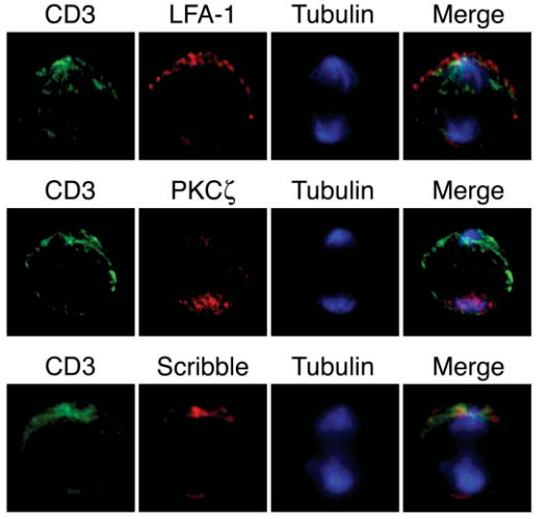
Asymmetric cell division
J.T. Chang et al., Science 2007

Slide 26
Memory development models
a: asymmetric division
two daughter cells with polarized cell-fate
b: effector lineages
two effector daughters with effector and memory potential
c: pluripotent effector cells
stochastic or environmental control of memory development
L. Lefrancois and D. Masopust, Nat. Immunol., 2009

Slide 27
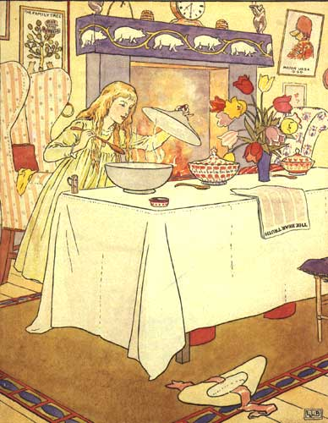
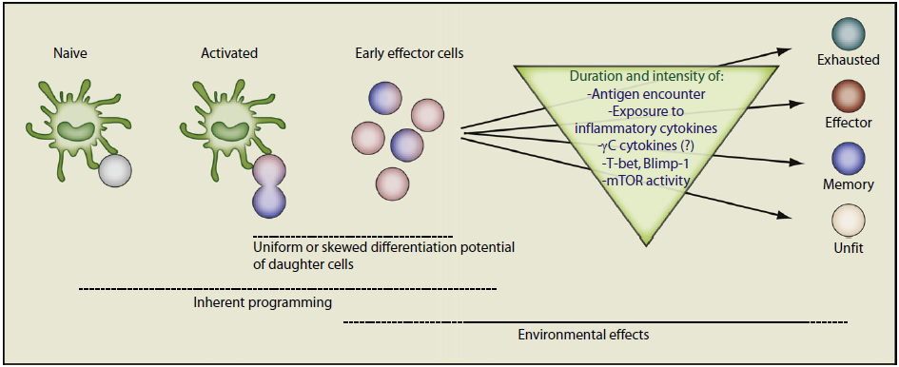
The Goldilocks “just right” situation
F.C. Jameson and D. Masopust, Immunity, 2009

Slide 28
“Just right” examples
Antigen encounter:
A. Scholer et al., Immunity 2008
Inflammatory cytokines:
N.S. Joshi et al. Immunity 2007
mTOR: metabolic conditions
K. Araki et al., Nature 2009
F.C. Jameson and D. Masopust, Immunity, 2009

Slide 29
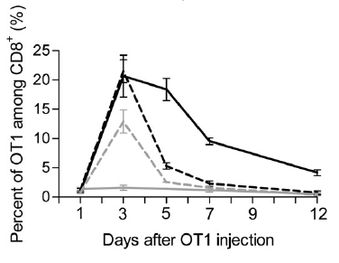
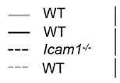
Antigen encounter
Ovalbumin-specific T cells (OT1) are injected into wt or ICAM^{-/-} recipients (ICAM=DC/T cell interaction) and OVA is injected to recipients.
Absence of DC/T cells long-lasting interactions does not affect effector development but impairs memory formation
Effector cells
No antigen
OVA + costimulation
OVA
Memory precursors
A. Scholer et al., Immunity, 2008

Slide 30
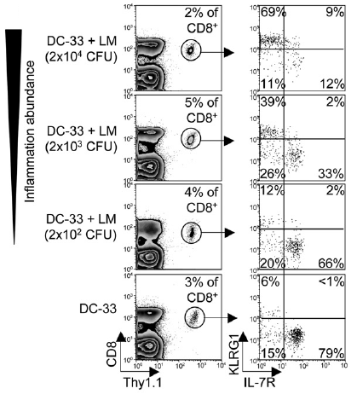
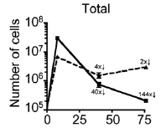
Pro-inflammatory conditions
Memory cells: KLRG1⁻IL7R⁺
Effector senescent cells: KLRG1⁺IL7R⁻
WT mice infected with peptide loaded DC with or without Listeria.
Inflammation influences towards effector populations (gradient of T-bet)
N.S. Joshi et al., Immunity, 2007

Slide 31
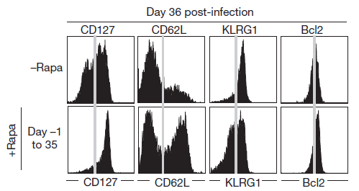
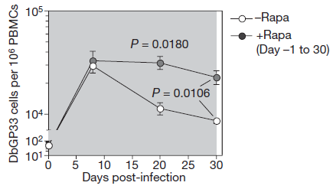
mTOR activity, metabolic conditions
WT mice infected with LCMV and treated with Rapamycin, an mTOR inhibitor. mTOR is a transcription factor regulating complex pathways involved in cell proliferation, cell growth, …
Inhibition of mTOR promotes memory formation and maintenance.
Memory cells escape cell-death by up-regulating anti-apoptotic genes (Bcl-2, BcL-X_{L}) and receptors for/secretion of pro-survival cytokines mediating homeostatic self-renewal (IL-15, IL-7)
K. Araki et al., Nature, 2009

Slide 32
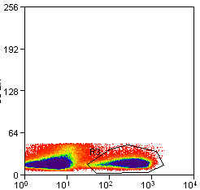
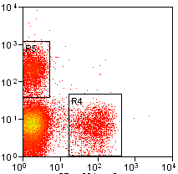
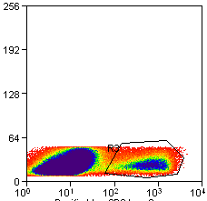
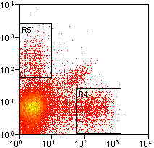
Exhaustion during some viral infections
LCMV Armstrong
UNSTIM
STIM
UNSTIM
STIM
CD107a
IL-2
np396
11.6
4.7
CD8
IFN-γ
TNF-α
gp33
LCMV CL13
UNSTIM
STIM
UNSTIM
STIM
1.3
CD107a
IL-2
np396
4.7
IFN-γ
TNF-α
CD8
gp33
In humans: HIV, HCV, HBV, …
Consequence of type of infection, lack of CD4 help, cellular tropism, inflammation level, Ag presentation, decrease in CD122/CD127 expression, increase in inhibitory signals (PD1, IL10, …)
I. Okoye and S. Rutschmann, unpublished data

Slide 33
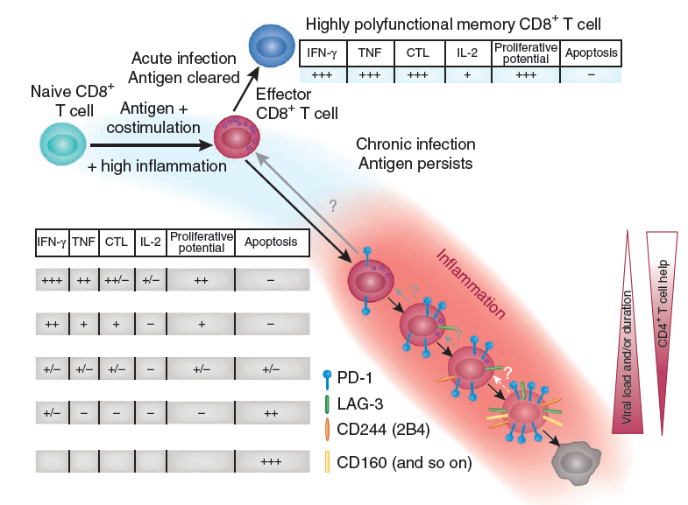
Memory exhaustion
E.J. Wherry, Nature Immunol. 2011

Slide 34
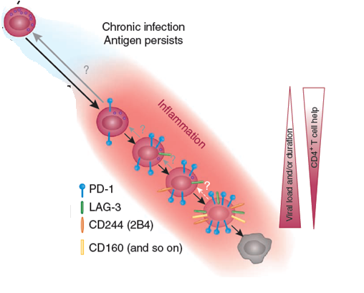
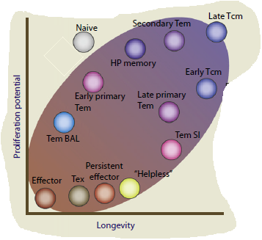
Summary

Slide 35
Literature
Focus on Immunological Memory
Nature Immunology, June 2011, Volume 12 No 6
From vaccine to memory and back
F. Sallusto et al., Immunity, 2010
Competence and competition: the challenge of becoming a
long-lived plasma cell
A. Radbruch et al., Nature Review in Immunology, 2006
Diversity in T Cell Memory: An Embarrassment of Riches
S.C. Jameson et al., Immunity, 2009

