Slide 1
Cytotoxic T cell effector functions
Abigail Culshaw
Hammersmith Hospital
Imperial College London

Slide 2
Cytotoxic T cells see peptide from an endogenous origin
CD4+ Helper T cell
CD8+ Killer T cell
MHC class II molecule
CD8
CD4
T cell receptor
peptide
MHC class I molecule
Exogenous protein
Endogenous protein

Slide 3
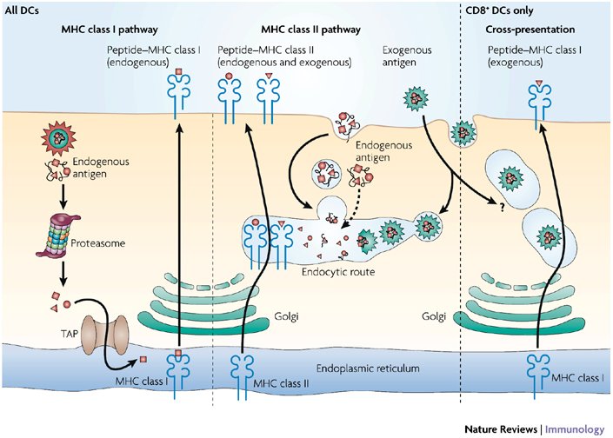
Antigen processing pathways

Slide 4
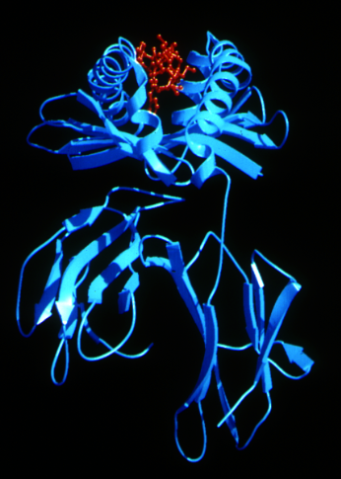
T cells recognise peptide epitopes bound to MHC
*

Slide 5
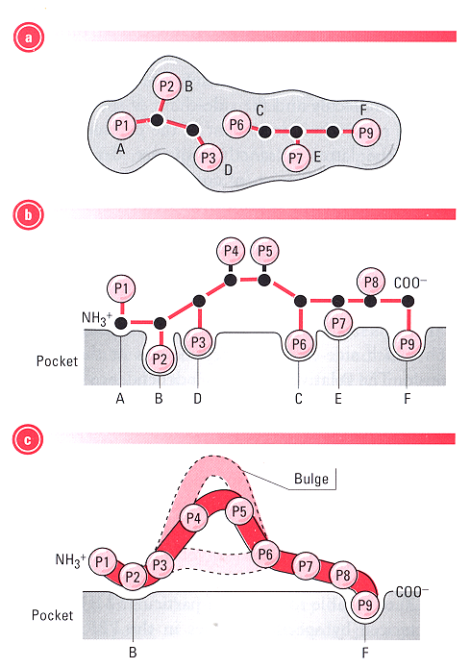
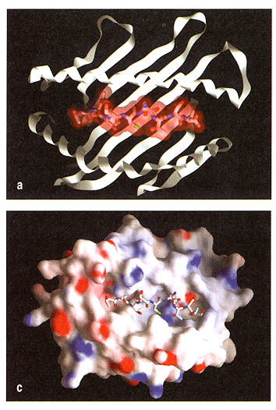
Peptides make contact with the MHC groove and have
characteristic anchor residues

Slide 6
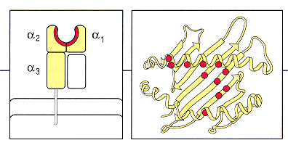
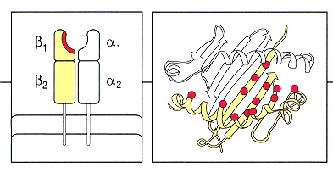
Sites of allelic variation in MHC I and MHC II
MHC I
MHC II

Slide 7
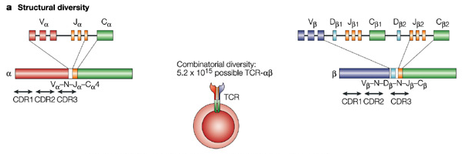
TCR are formed by rearranging non-continuous gene segments

Slide 8
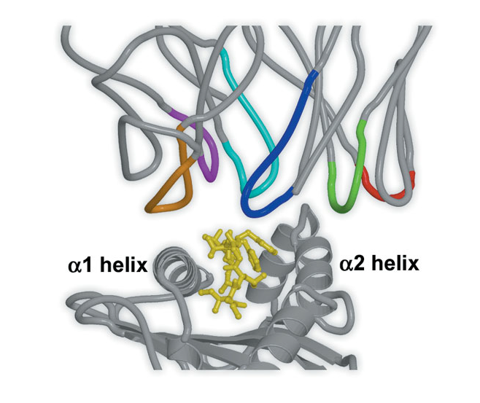
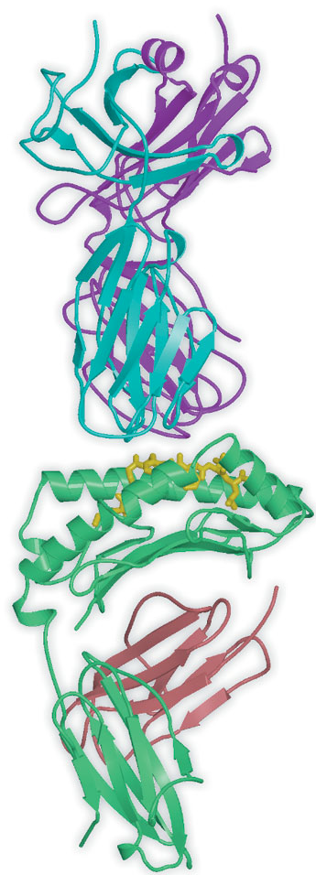
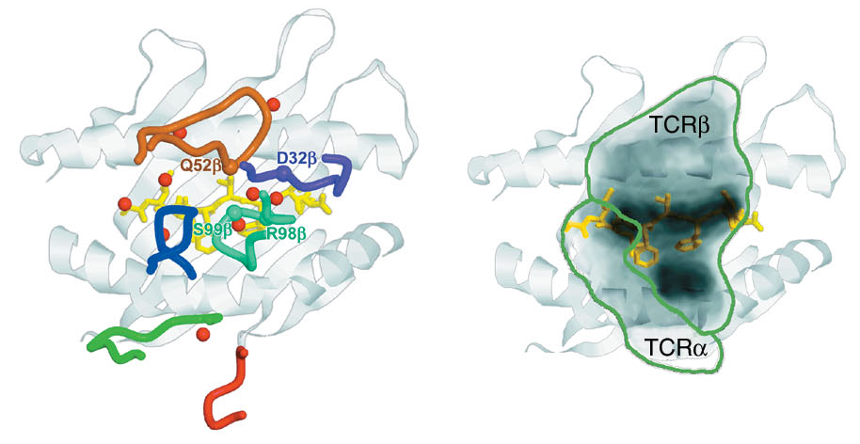
MHC restriction - the TCR contacts both MHC and peptide

Slide 9
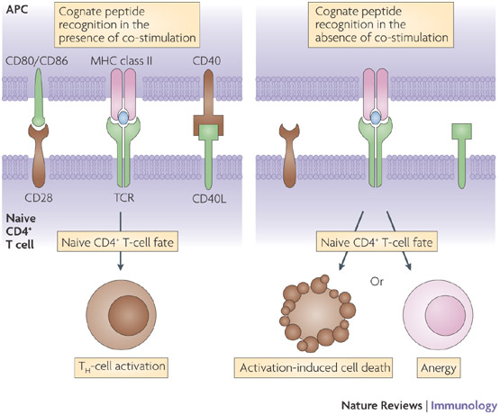
T cells require co-stimulation to become activated

Slide 10
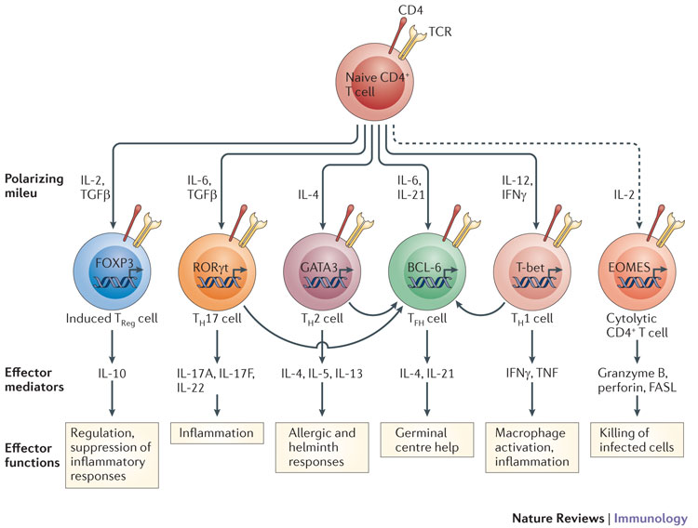
Cytokines provide a 3rd signal that polarises T cells

Slide 11
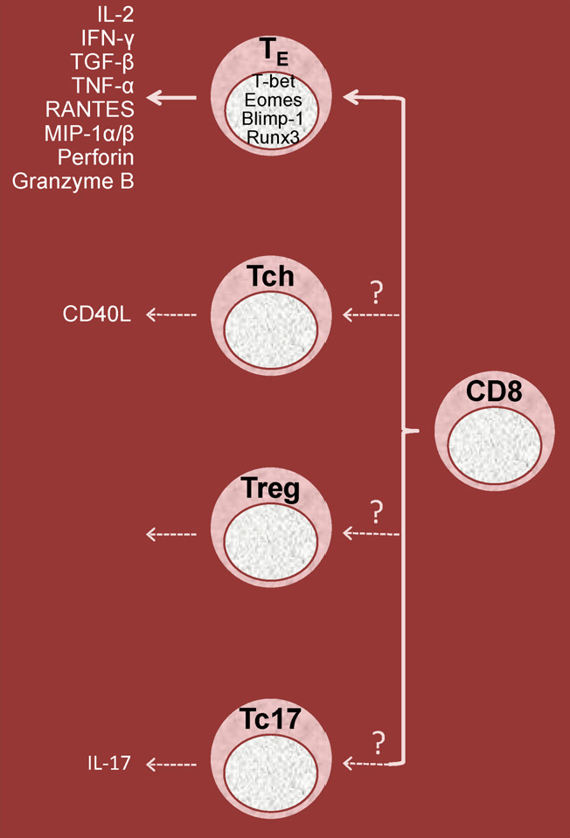
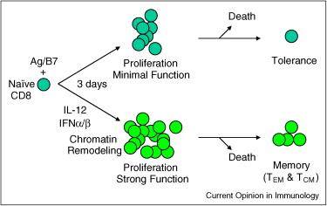
CD8+ T cells also require signal 3

Slide 12
Antigen presenting cells
Dendritic cell
Macrophage
B cell
Professional antigen presenting cells
Most potent stimulator of naïve T cells
Present antigen from ingested pathogens that have failed to be destroyed
Take up soluble antigen
Do not constitutively express co-receptors

Slide 13
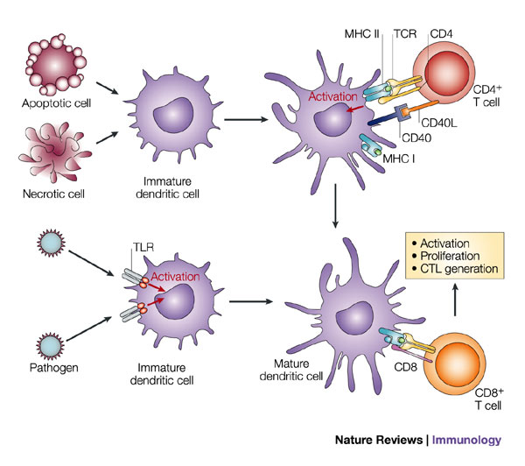
Initiation of a CD8+ T cell response

Slide 14
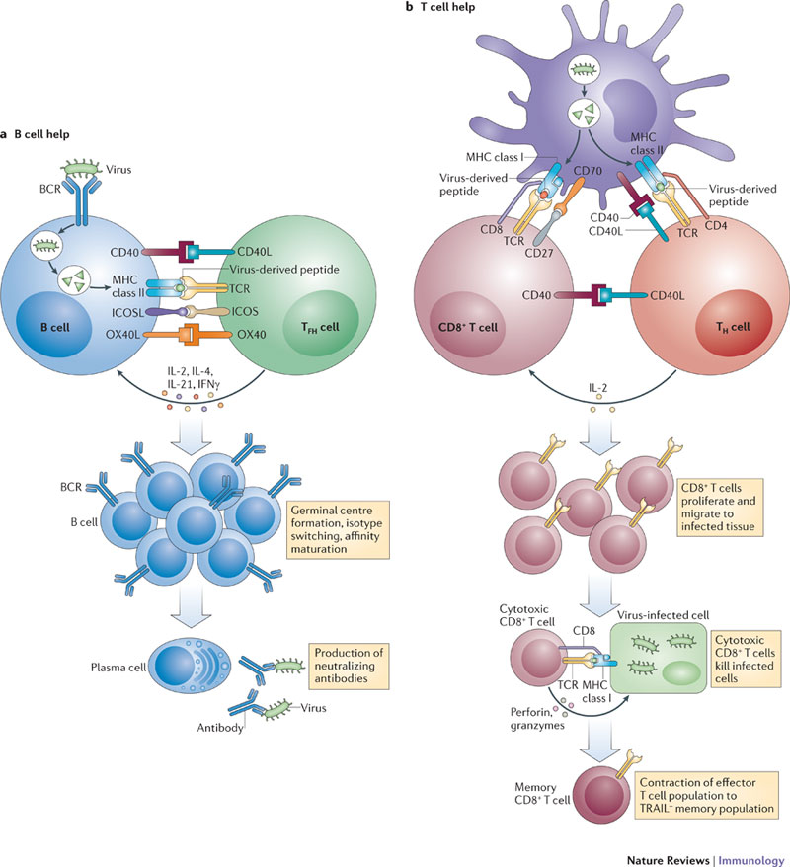
Initiation of a CD8+ T cell response

Slide 15
Effector functions of CD8+ T cells
Expansion
CD8+ Killer T cell
Activation
Killing of infected cells
Release of cytokines and chemokines

Slide 16
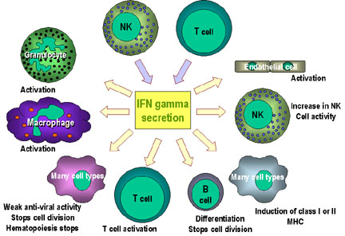
Cytokine secretion by CD8+ T cells

Slide 17
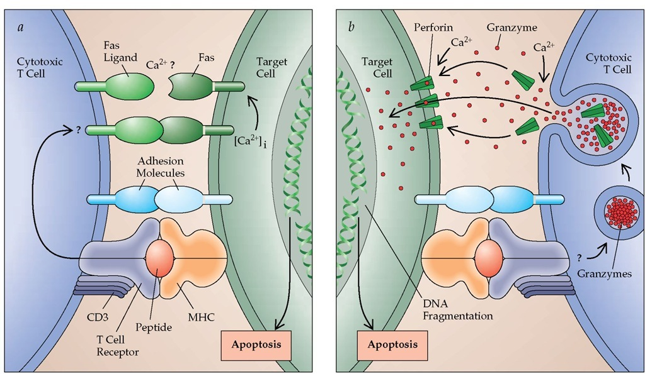
Mechanisms of cell lysis

Slide 18
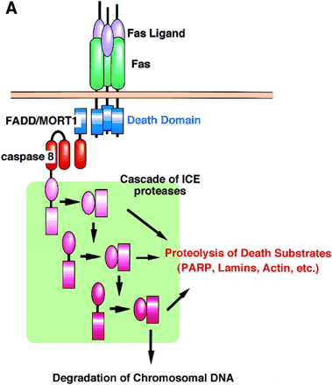
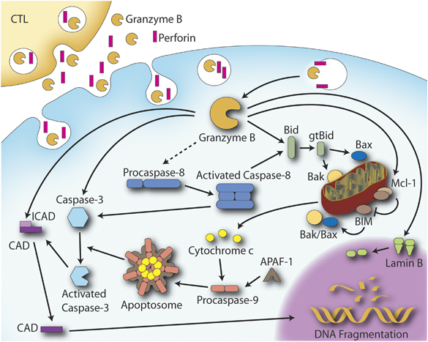
A complex series of protein-protein interactions
transduces the death signal

Slide 19
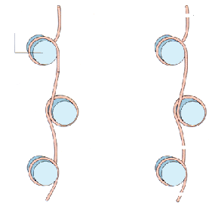

DNA is cleaved into regularly sized fragments during
apoptosis to form the “DNA ladder”
Nucleosome
Nuclease
attack
2
1

Slide 20
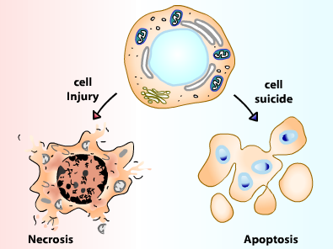
Cell death can occur by 2 main pathways:
Necrosis and Apoptosis

Slide 21
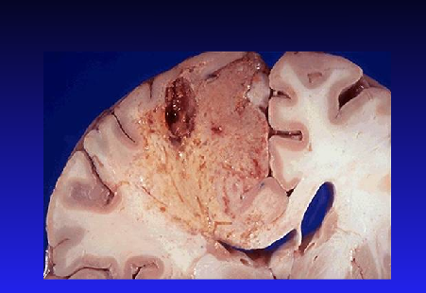
Necrosis is inflammatory and can be damaging

Slide 22
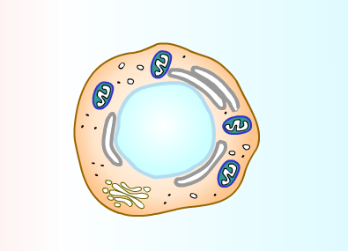
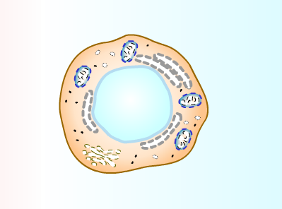
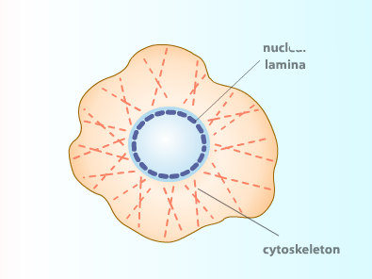
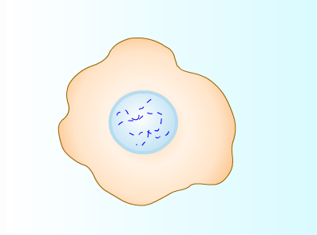
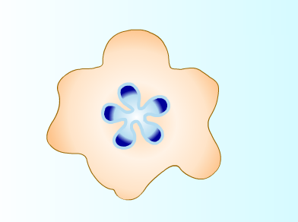
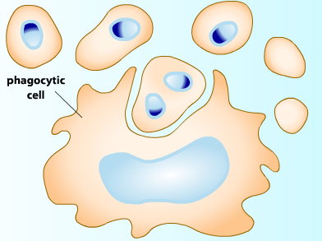
Apoptosis is an ordered program, cellular contents
are not released and inflammation is minimised
1
2
3
6
4
5

Slide 23
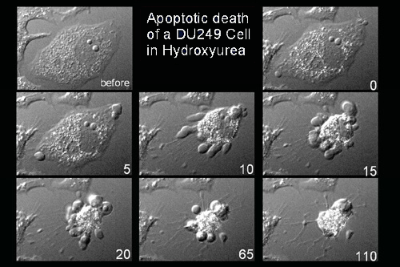
Blebbing of the
cell membrane is
a characteristic of
apoptotic cells

Slide 24
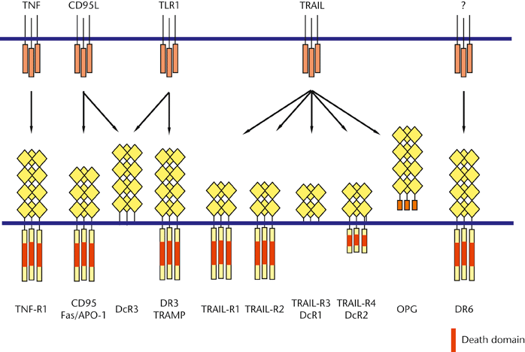
Families of death inducing ligands and their receptors
FasL

Slide 25
Lymphocytes need to die after they have done their job
CTL
Infection
Immune Response
Early
intermediate
late

Slide 26
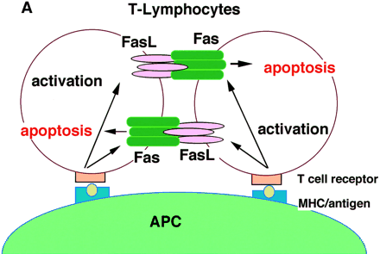
A double edged sword - lymphocytes also use
Fas to kill each other

Slide 27
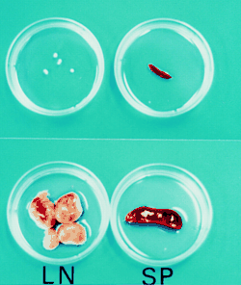
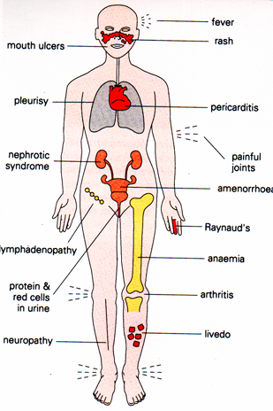
What happens if lymphocytes fail to die?
lymphoproliferation
Autoimmunity

Slide 28
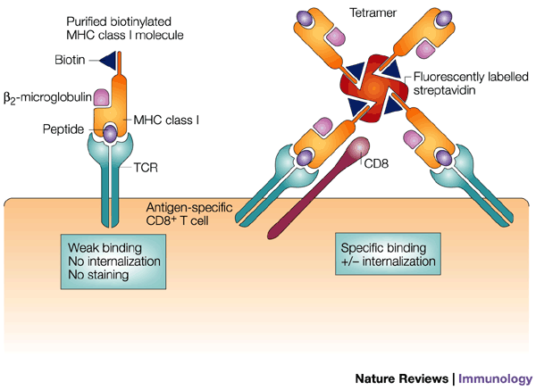
Quantifying specific T cells – MHC tetramers

Slide 29
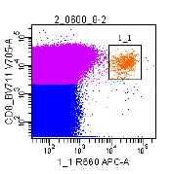
Tetramer staining of peripheral blood mononuclear cells
CD8
Tetramer

Slide 30
Measuring T cell-mediated killing
Label target cells with radioactive molecule - ⁵¹Cr
Wash off excess ⁵¹Cr
Incubate target cells with cytotoxic T cells
Remove supernatant and measure amount of ⁵¹Cr

Slide 31
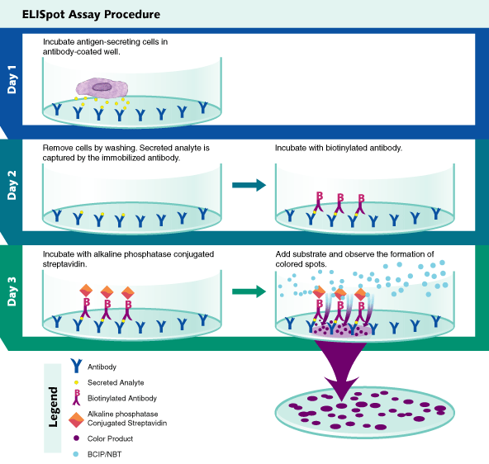
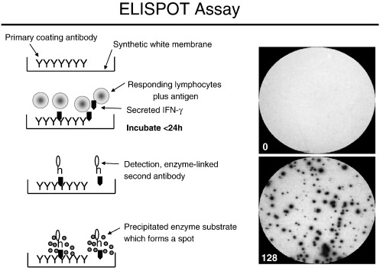
Measuring T cell-mediated cytokine secretion

