Slide 1

BSc Immunity and Infection Module - 1
Complement
Matthew Pickering
matthew.pickering@imperial.ac.uk
Wellcome Trust Senior Fellow in Clinical Science
Consultant Rheumatologist

Slide 2
Overview
Complement biology
  Activation
  Regulation
  Function
Complement deficiency states
  Activation protein deficiency
    ‘too little complement’
  Regulatory protein deficiency
    ‘too much complement’
Complement therapy
  Antibody-mediated inhibition of complement C5

Slide 3
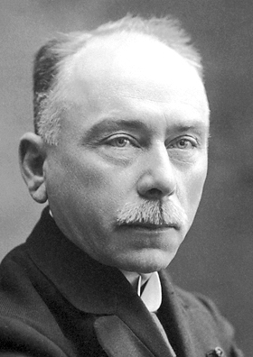
Where did it all start?
Jules Bordet - 1895
destruction of bacteria required the presence of antibody and a heat-sensitive substance in blood which Bordet called alexin (‘to ward off’)
alexin
antibodies
bacteria
http://nobelprize.org

Slide 4
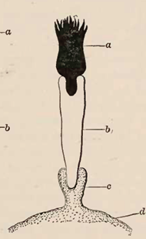
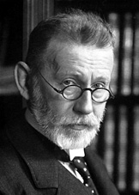
Where did it all start?
Paul Ehrlich – 1899
renamed Bordet’s ‘alexin’: complement
complement
antibodies
bacteria
http://nobelprize.org

Slide 5
Complement function
‘safe’ disposal of immune
complexes and apoptotic cells
classical pathway
lectin pathway
alternative pathway
C3
C5a
C4b2a
C3bBb
C5 activation
anaphylatoxin
C3b
Factor B
Factor D
MAC
C3b
C3b
C3b
C3b
opsonization
leucocyte activation
augment antibody
response
FOREIGN SURFACE
Membrane damage
Cell lysis

Slide 6
Complement function
Killing of microorganisms
  Opsonisation (C3b, C4b), activation of leucocytes (C5a), target cell lysis (MAC)
Bridging adaptive and innate immunity
  Lowers threshold for antibody response
    Natural adjuvant
    C3d binding to CD21 on the B cell CD21/CD19 complex
    Targeting of antigen coated with iC3b to follicular dendritic cells expressing complement receptors (CR1[CD35] and CR2[CD21])
Immune complex processing
  Immune complexes coated with C3b
  C3b binds to complement receptors on red blood cells (CR1 [CD35])
  Enables removal by phagocytes
  Physiological removal of apoptotic cells
    Especially important is C1q

Slide 7
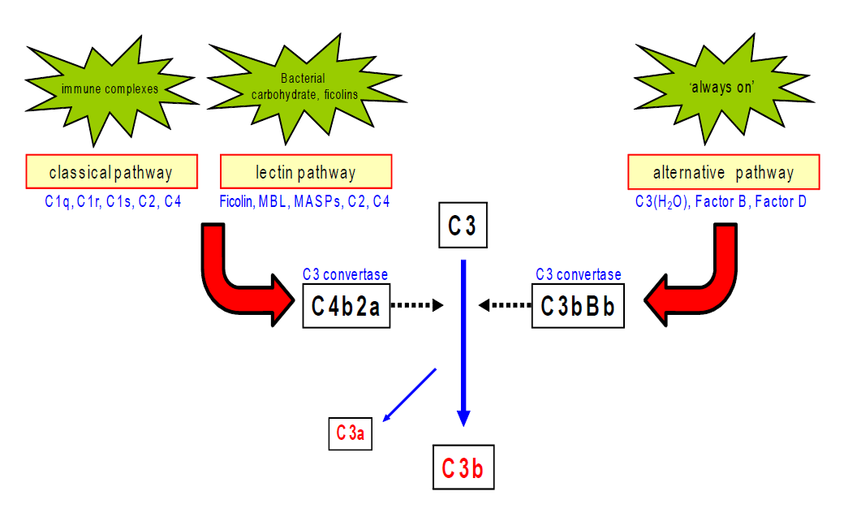
Complement activation

Slide 8
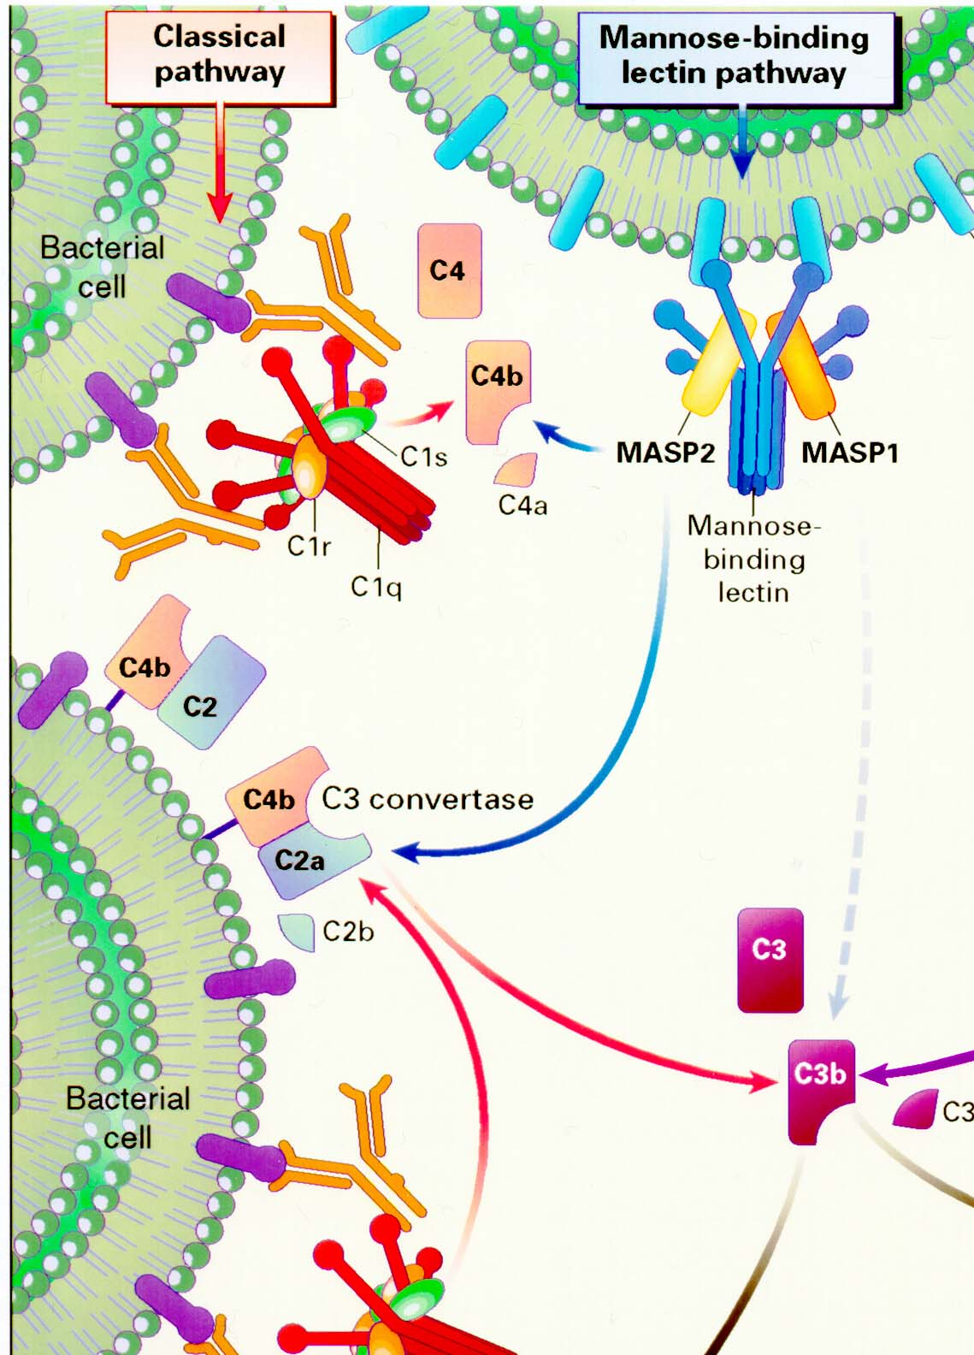
Classical pathway
Classical pathway activation
  Triggered by binding of C1q to Fc potions of IgG and IgM
    CH2 domain of Fc of IgG3 > 1 > 2
    Does not bind IgG4
    CH3 domain of IgM
Sequence of events:
  Binding of C1q to complexed IgG or IgM results in conformational change in C1 complex
  Activation of C1r then C1s (serine esterase)
  C1s cleaves C4 to:
    C4b and C4a
  C4b binds to C2 and is then cleaved by C1s generating classical pathway C3 convertase
    C4b2a

Slide 9
Lectin pathway
Lectin pathway activation
  Binding of mannose-binding lectin or ficolins to bacterial carbohydrate moieties
    MBL bind to mannose groups on bacteria
    Ficolins bind to e.g. N-acetyl glucosamine
  The bound MBL then activates proteases (analogous to C1s, C1r) termed:
    Mannose-binding lectin-associated proteases (MASPs)
  Cleavage of C4 and C2 then proceeds analogous to that of the classical pathway

Slide 10
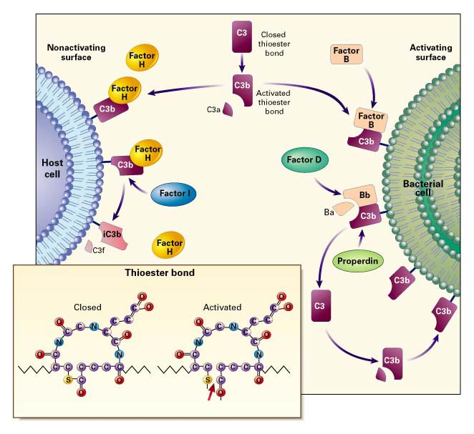
Alternative pathway
Alternative pathway activation
  Spontaneous activation of C3
    antibody-independent means of activating C3
  C3 is hydrolysed in plasma
    C3(H2O)
  C3(H2O) interacts with factor B
    C3(H2O)B
  C3(H2O)B is cleaved by factor D
    C3(H2O)Bb = C3 convertase
Also works for C3b:
  C3b generated by any of the pathways
  C3b interacts with factor B
    C3bB
  C3bB is cleaved by factor D
    C3bBb = C3 convertase

Slide 11
What happens to C3b?
Triggers C5 activation
  TERMINAL PATHWAY
  Generates anaphlatoxin C5a and membrane attack complex
Interacts together with its fragments with cellular complement receptors
  Immune complex transport
  Phagocytosis
  Immune stimulation
Triggers more C3b formation
  Positive feedback loop = C3b amplification loop
    Uses alternative pathway components so also ‘alternative pathway amplification loop’

Slide 12
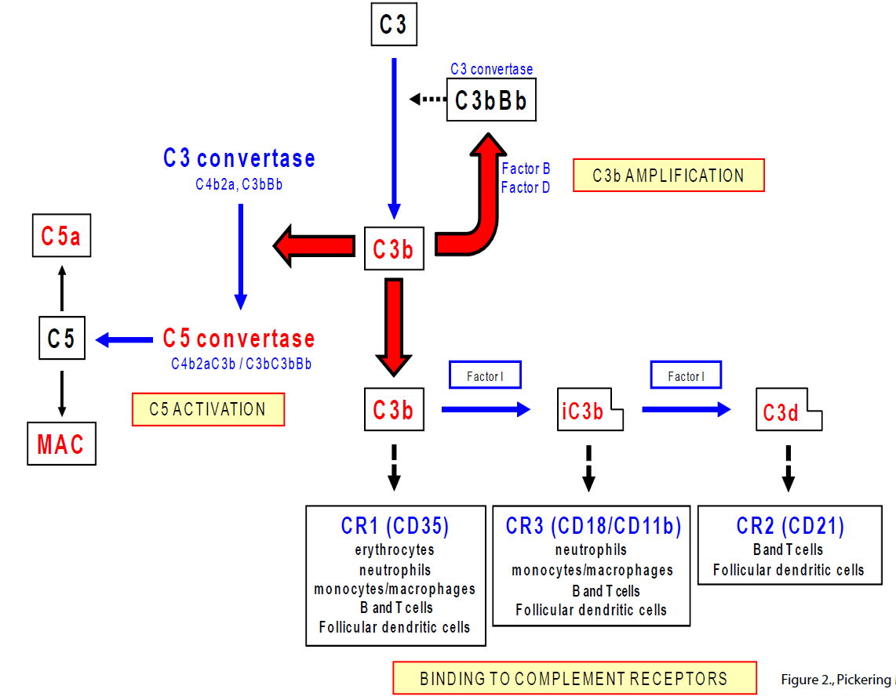

Slide 13
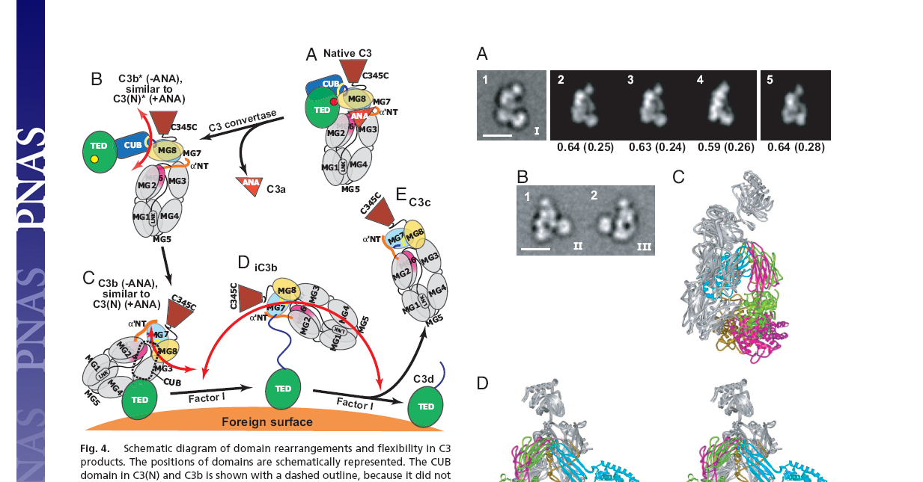
C3 fragments and complement receptors
Binds to CR1 [CD35] on RBCs
(immune complex transport) and
monocyte/macrophages (phagocytosis)
C3b

Slide 14
C3 fragments and complement receptors
Factor I cleaves C3b

Slide 15
C3 fragments and complement receptors
Binds to CR3 [CD18/11b]
on monocyte/macrophages
mediating phagocytosis
iC3b

Slide 16
C3 fragments and complement receptors
Binds to CR2 [CD21]
on B cells, follicular
dendritic cells
C3d

Slide 17
Complement regulation
Regulation of complement activation
  Important to limit damage to host tissues and prevent complement depletion
  Especially important for the alternative pathway which is ‘always on’ and C3b amplification loop
  Built in safety is the inherent instability of the active convertases
    E.g. C3bBb unstable unless binds to properdin
Host regulators are on surface (e.g. CD59) or in plasma (e.g. factor H)
  Examples of actions:
    decay acceleration
      e.g. C3bBb → C3b and Bb mediated by DAF (CD55)
    cofactors for enzymes to degrade convertases
      e.g. C3b cleaved by factor I only in presence of factor H or CR1 or MCP (CD46)
    Prevent formation of active component
      e.g CD59 binds to C5b-8 complex preventing addition of C9 and therefore MAC assembly
Key regulators (INHIBITORS)
  Alternative pathway and C3b amplification loop = factors H and I
  Membrane attack complex = CD59

Slide 18
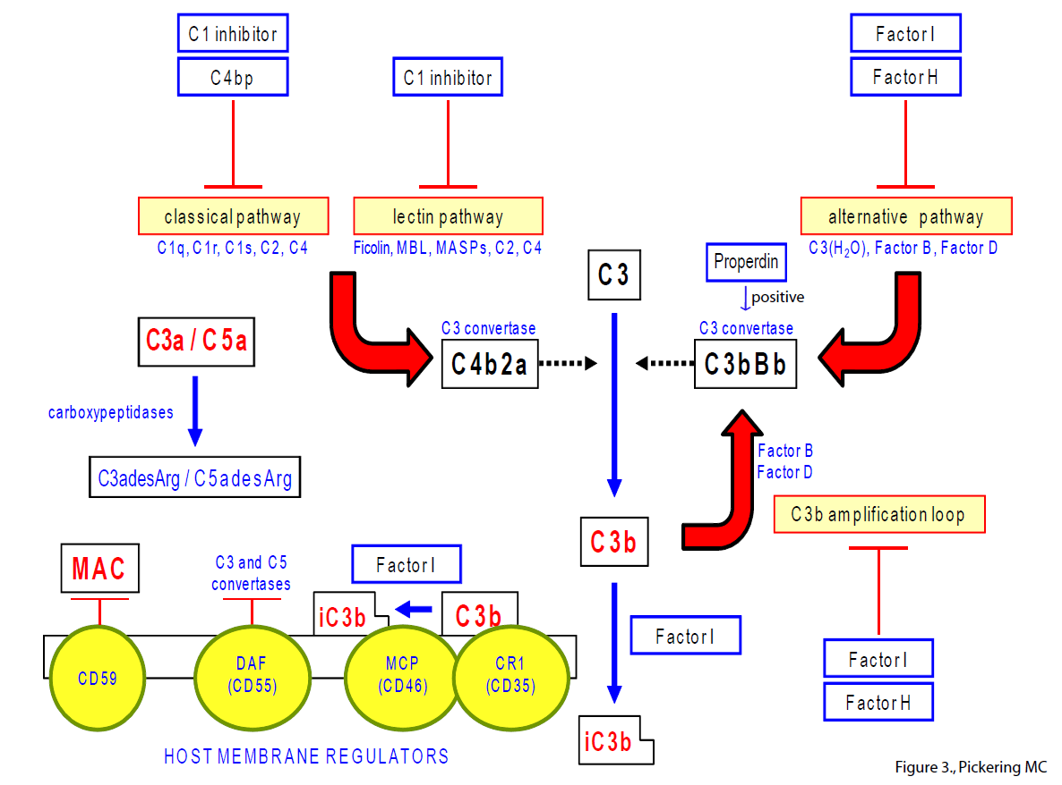
Complement regulation

Slide 19
Disorders of complement
‘too little’ complement
Tell us what might happen if we therapeutically inhibit complement
Activation protein deficiency
‘too much’ complement’
Provide diseases in which complement inhibiting therapies ought to be effective
Regulatory protein deficiency

Slide 20
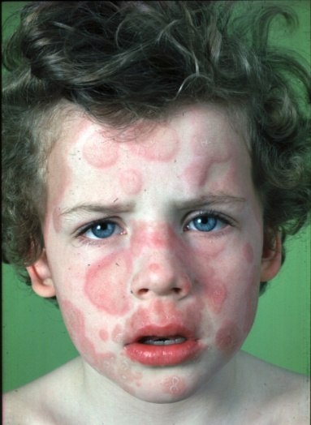
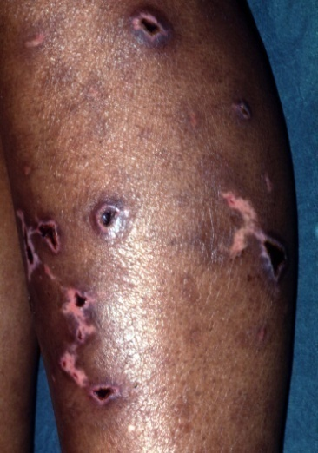
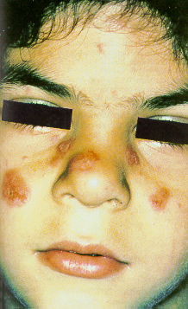
Complement activation protein deficiency
Classical pathway
C3
Terminal pathway
Infection
Recurrent infection with encapsulated bacteria e.g. pneumococci, Haemophilus influenzae
Recurrent Neisseria infections
SLE-like illness

Slide 21
Complement activation protein deficiency
Very rare e.g. C1q deficiency < 50 cases
Except:
  Homozygous C2 deficiency
    1:10,000-20,000
    associated with SLE in 10% cases
  Homozygous C9 deficiency in Japan
    1/1000
      Compare C5, C6, C7, C8 deficiency = <100 cases
      risk of Neisseria infection increased but less so compared to C5-C8 deficiency
    C9 deficiency extremely rare in Caucasoid populations
  Mannose-binding lectin (MBL) deficiency
    2-7% completely deficient in MBL in Caucasoid populations
    increased susceptibility to infection
    increases morbidity in cystic fibrosis, common variable immunodeficiency states

Slide 22
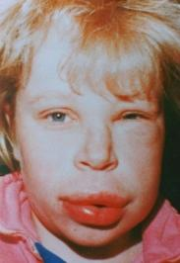
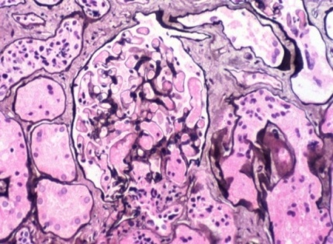
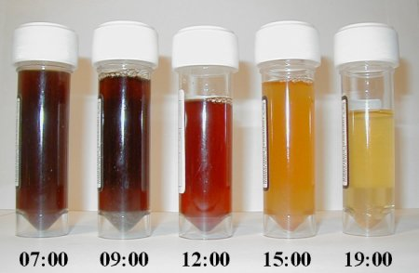
Complement dysregulation
C1 inhibitor deficiency
[classical pathway dysregulation]
Terminal pathway dysregulation
Alternative pathway dysregulation
renal thrombotic microangiopathy
Atypical haemolytic uraemic syndrome
Hereditary angioedema
Paroxysmal nocturnal haemoglobinuria
C3 glomerulopathy

Slide 23
C1 inhibitor deficiency
C1 inhibitor deficiency
2 – 10 cases per 100,000
Hereditary
  Autosomal dominant
  Type I (80%) – inadequate production
  Type II (20%) – dysfunctional protein
Acquired
  Due to antibodies inhibiting C1 inhibitor function
Localised sub-mucosal or subcutaneous oedema
  Upper airways – laryngeal oedema
  Gastrointestinal tract – ‘acute abdominal pain’
  Skin swellings
Hereditary angioedema

Slide 24
C1 inhibitor deficiency
Function of C1 inhibitor
  Serine protease inhibitor (serpin) – SERPING1
  Involved in multiple processes:
    inhibits C1r and C1s of the complement classical pathway
    inhibits serine proteases of the lectin pathway
    tissue plasminogen activator and plasmin in the fibrinolytic system
    Factor XII and kallikrein on the contact system
    Factor XI and thrombin in the coagulation system
LOW COMPLEMENT C4 LEVEL
ELEVATED KININ LEVELS
during attack
continuous

Slide 25
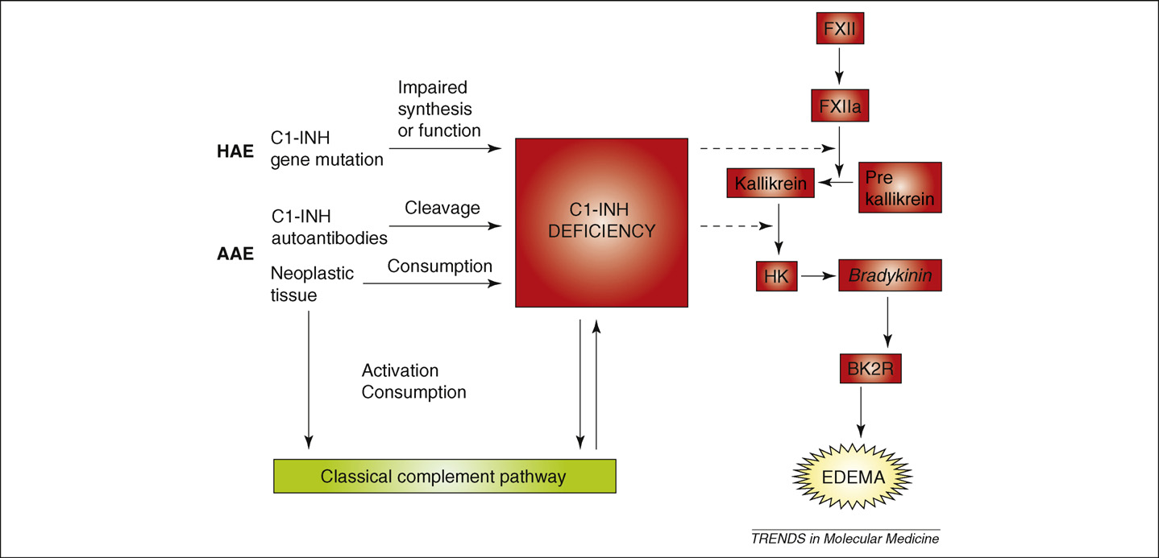
C1 inhibitor deficiency
Pathogenesis relates to excessive bradykinin production
Gain-of function mutations in factor XII are associated with hereditary angioedema (type III)
Marco Cicardi and colleagues, Trends in Molecular Medicine 2009, vol. 15, pp69-78.

Slide 26
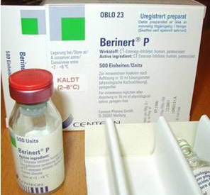
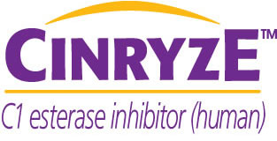
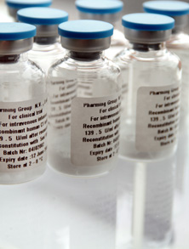
C1 inhibitor deficiency
Treatment of acute attacks
  Replacement of C1INH using purified or recombinant preparations
  Very effective
New approaches based on pathogenesis
  Bradykinin 2 antagonist – Icatibant™ (peptide)
  Recombinant kallikrein inhibitor – ecallantide (peptide)
Rhucin™
Pharming
Viro Pharma
Berinert™
CSL Behring
C1 inhibitor concentrates
Recombinant C1 inhibitor

Slide 27
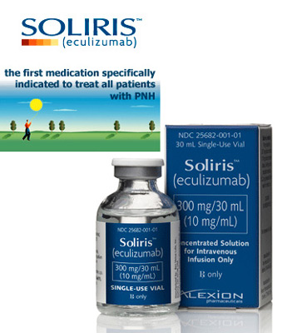
Paroxysmal nocturnal haemoglobinuria
Humanised anti-C5 antibody
Terminal pathway dysregulation
Paroxysmal nocturnal haemoglobinuria
Eculizumab - Soliris™
Alexion Pharmaceuticals

Slide 28
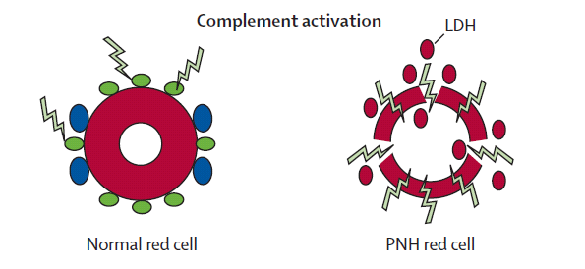
Paroxysmal nocturnal haemoglobinuria
Pathology
  Clonal expansion of haemopoietic stem cells that cannot synthesis glycosylphosphatidylinositol (GPI) anchors
    somatic mutation in phosphatidylinositol glycan class A gene
    AFFECTED erythrocytes deficient in all GPI-linked proteins
  Affected proteins include complement regulators:
    Decay-accelerating factor (DAF, CD55)
      inactivates membrane C3 convertase
    CD59
      prevents assembly of membrane attack complex
    PNH erythrocytes vulnerable to complement-mediated lysis
CD59
DAF
Charles Parker, Lancet, 2009, vol. 373, pp759-67.

Slide 29
Paroxysmal nocturnal haemoglobinuria
‘always on’
  Humanised monoclonal antibody against complement C5
eculizumab
alternative pathway
C3
C5a
C3bBb
C5 activation
C3b
Factor B
Factor D
MAC
C3b
C3b
C3b
C3b
‘Alternative pathway C3
amplification loop’
PNH-RED CELL SURFACE

Slide 30
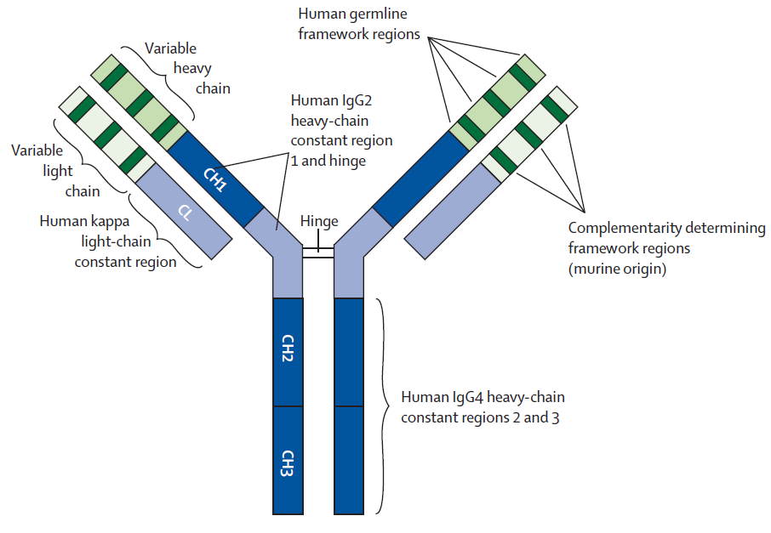
Paroxysmal nocturnal haemoglobinuria
Eculizumab
  Humanised monoclonal antibody against complement C5
  Prevents C5 activation
  Blocks formation of both the anaphylatoxin C5a and the membrane attack complex
  Stops red cell lysis in PNH
    Reduces need for blood transfusion
  Side-effects:
    Increased risk of Neisserial infections
Humanised anti-C5 antibody
Eculizumab - Soliris™
Alexion Pharmaceuticals

Slide 31
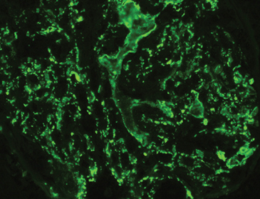

Kidney diseases and complement dysregulation
C3 glomerulopathy
Atypical haemolytic uraemic syndrome

Slide 32
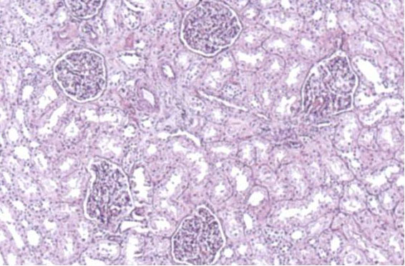
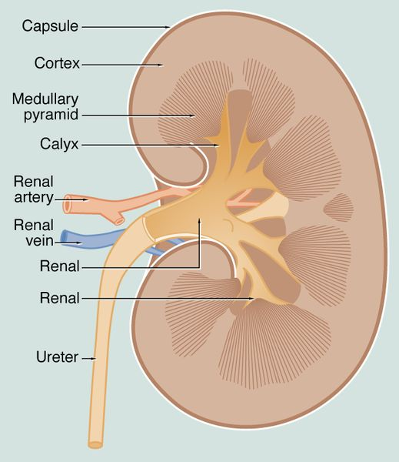
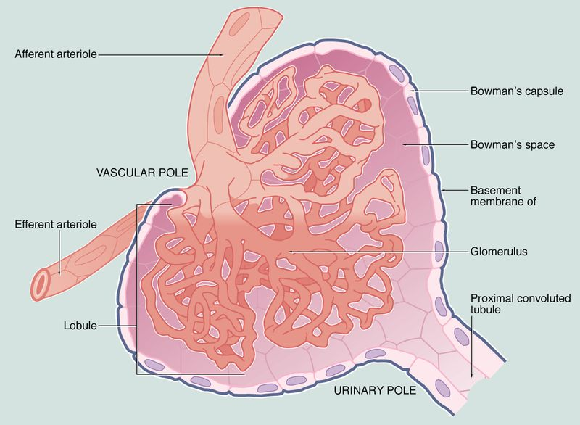
Glomerulus

Slide 33
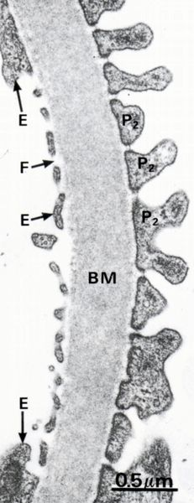
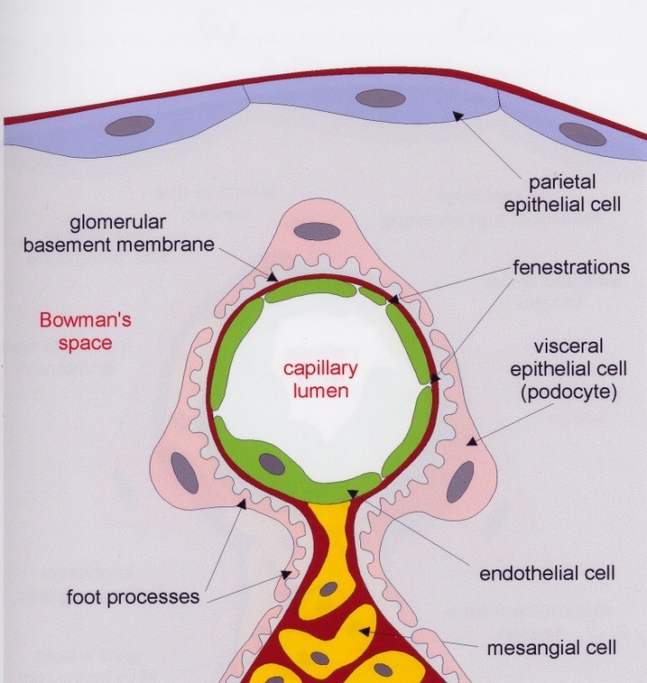
Glomerulus

Slide 34
Kidney diseases and complement dysregulation
C3
staining
in
glomerulus
C3 glomerulopathy
Atypical haemolytic uraemic syndrome
C3 accumulates along
glomerular basement membrane
(GBM)
Glomerular thrombosis
‘thrombotic microangiopathy’
pathology
mechanism
C3 mediated damage to GBM
GBM barrier compromised ‘protein leak’
inflammation ‘glomerulonephritis’
C5 mediated damage to
the renal endothelium
thrombosis
treatment
Inhibit C3
NOT YET POSSIBLE
Inhibit C5
ECULIZUMAB

Slide 35
Atypical haemolytic uraemic syndrome
‘always on’
  Humanised monoclonal antibody against complement C5
eculizumab
alternative pathway
C3
C5a
C3bBb
C5 activation
C3b
Factor B
Factor D
MAC
C3b
C3b
C3b
C3b
‘Alternative pathway C3
amplification loop’
RENAL ENDOTHELIUM

Slide 36
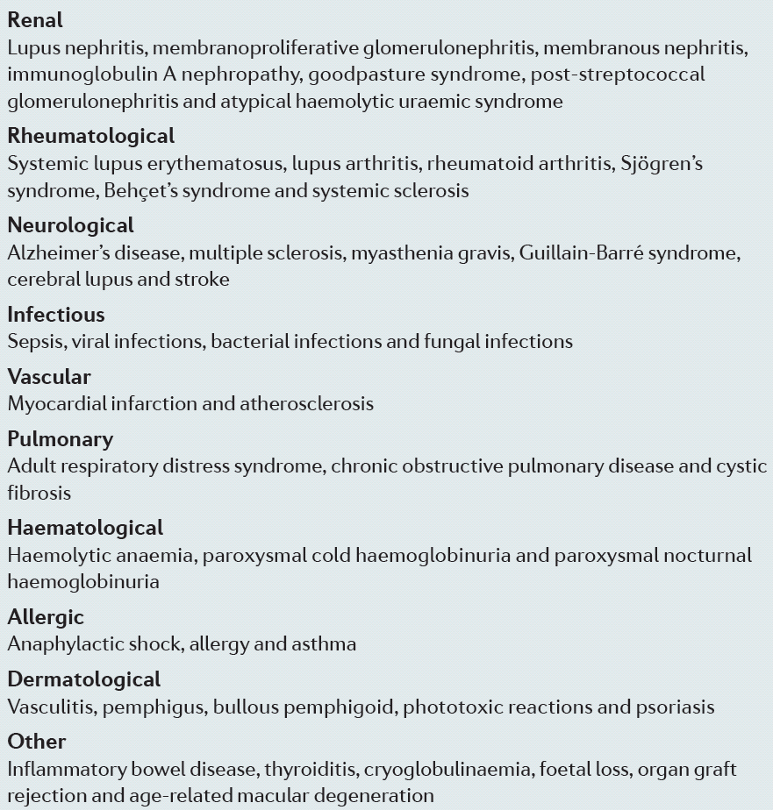
Complement therapeutics – the future
Pathologies in which complement is activated

Slide 37
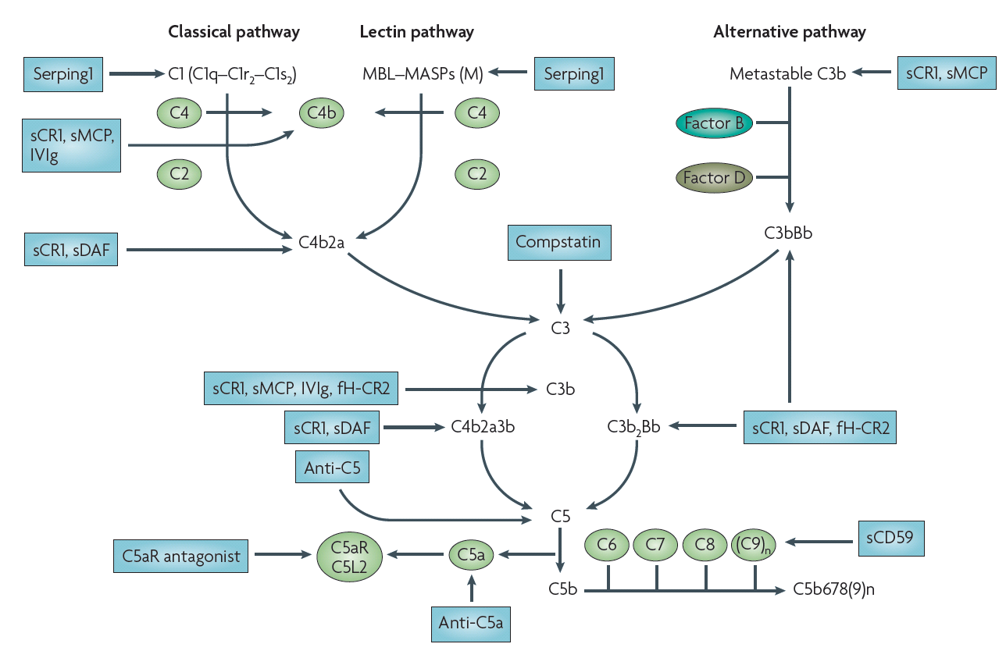
Complement therapeutics – the future
Examples of the many complement inhibitors in development
Eric Wagner and Michael Frank Nature Reviews 2010, vol. 9, 43-56.

Slide 38
Learning points:
Briefly outline,
  Complement activation and regulation
  Complement function
  two diseases associated with complement activation protein deficiency.
  two diseases associated with complement regulator deficiency.

