Slide 1
B cell effector functions
Liliane Fossati-Jimack

Slide 2
B cell function
Antibody
Structure
Function
Antigen-presentation
Cytokine production

Slide 3
WHAT IS AN ANTIBODY?
AN ANTIBODY IS A PROTEIN THAT IS PRODUCED IN RESPONSE TO A FOREIGN MOLECULE (ANTIGEN), AND HAS THE PROPERTY OF BINDING SPECIFICALLY TO THAT ANTIGEN
ANTIBODIES FORM THE CLASS OF PROTEINS KNOWN AS IMMUNOGLOBULINS, AND ARE A LARGE FAMILY OF SOLUBLE GLYCOPROTEINS
ANTIBODIES ARE PRODUCED BY B LYMPHOCYTES

Slide 4
ANTIBODIES
EACH INDIVIDUAL HAS A LARGE NUMBER (>10⁷) OF DIFFERENT ANTIBODIES
ANTIBODY DEFICIENCY IS LIFE-THREATENING
AFTER BINDING ANTIGEN, ANTIBODIES INITIATE SECONDARY EFFECTOR FUNCTIONS
COMPLEMENT ACTIVATION
OPSONISATION (PROMOTION OF PHAGOCYTOSIS)
CELL ACTIVATION VIA SPECIFIC ANTIBODY-BINDING RECEPTORS (Fc receptors)

Slide 5
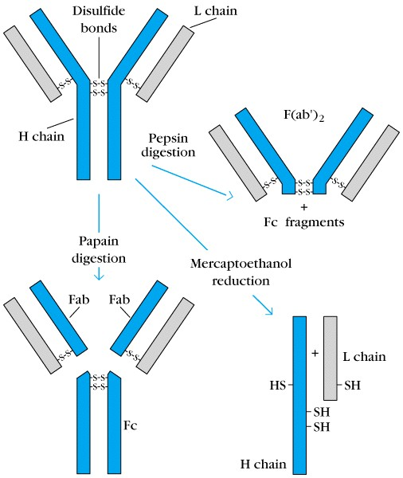
2
1
3

Slide 6
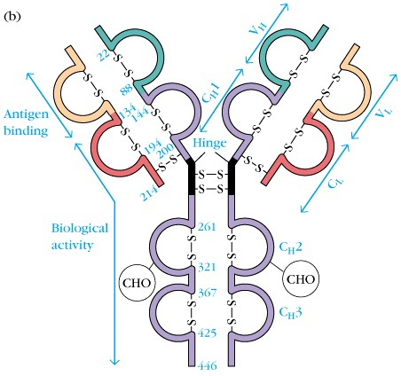

Slide 7
THE ANTIGEN-BINDING SITE
WHERE IT IS
SIZE
FORCES INVOLVED IN BINDING
AFFINITY / AVIDITY
CROSS-REACTIVITY

Slide 8
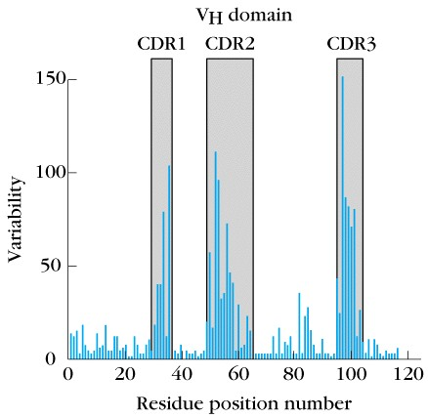
3 HYPERVARIABLE REGIONS
COMPLEMENTARITY DETERMINING REGIONS (CDR’s)

Slide 9
H=blue, L=yellow
Contact =red
Green=lysozyme

Slide 10
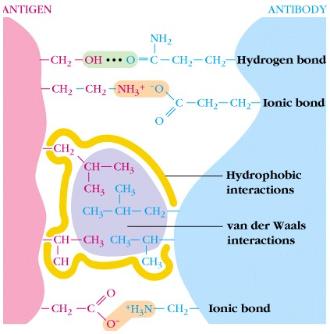
FORCES INVOLVED IN ANTIBODY/ANTIGEN BINDING
NON-COVALENT

Slide 11
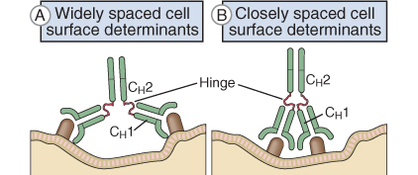
FLEXIBILITY OF ANTIBODY MOLECULES

Slide 12
ANTIBODY AFFINITY
Defined as the strength of the total non-covalent
interactions between a single antigen binding site
and a single epitope on the antigen
Ab + Ag Ab-Ag
[ Ab-Ag ]
[ Free Ab ] [ Free Ag ]
K =
Association constant K varies from 10⁴ to 10¹¹ L/mol

Slide 13
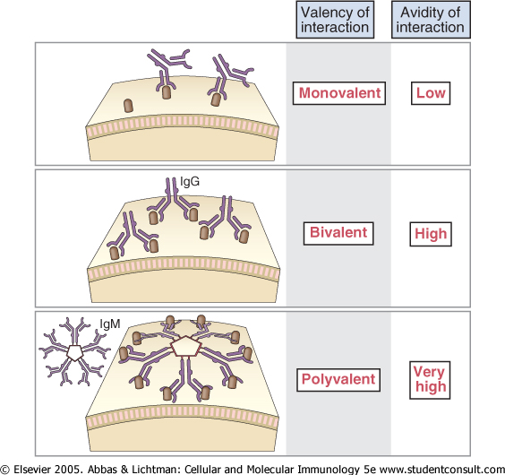
ANTIBODY AVIDITY
Defined as the overall strength of multiple interactions between an antibody with multiple binding sites and a complex antigen with multiple epitopes:
Better measure of binding capacity in biological systems

Slide 14
ANTIBODY CROSS-REACTIVITY
Antibody elicited in response to one antigen can also
recognise a different antigen:
1. Vaccination with cowpox induces antibodies which are
able to recognise smallpox
2. ABO blood-group antigens (glycoproteins on r.b.c.)
Antibodies made against microbial antigens on common intestinal bacteria may cross-react with carbohydrates on r.b.c.

Slide 15
The constant region of the immunoglobulin

Slide 16
Antibody Isotypes
The constant regions of antibodies vary between different isotypes
light chain: kappa & lambda
heavy chain: classes (μ,δ,γ,α,ε), subclasses (γ1,γ2,γ3,γ4; α1,α2)
These variations confer different properties
recruitment of different effectors
polymerisation
secretion onto mucous membranes

Slide 17
IgM ANTIBODY
μ heavy chain
large pentameric molecule
5 monomers joined by J chain (10 x Fab)
mainly confined to blood (80%)
first Ig synthesised after exposure to antigen
primary antibody response
multiple binding sites compensate for low affinity
efficient at agglutination
activates complement
surface IgM (monomeric form) as part of the B cell receptor

Slide 18
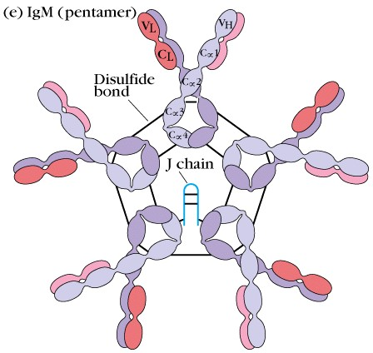
IgM
Y
Y
Y
U
Y
Y
J CHAIN

Slide 19
IgD ANTIBODY
δ heavy chain
extremely low serum concentrations
least well characterised immunoglobulin
surface IgD expressed early in B cell development
involved in B cell development and activation

Slide 20
IgA Antibody
α heavy chain
Second most abundant immunoglobulin after IgG
Occurs as a monomer (blood) and as a dimer (secretions)
Major secretory immunoglobulin
Protects mucosal surfaces from bacteria, viruses and protozoa
Mainly produced by B cells in the mucosal tissue

Slide 21
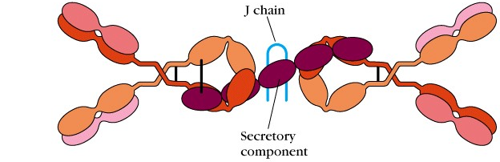
SECRETORY IgA
Y
Y
J 15,000Da
SC 70,000
U

Slide 22
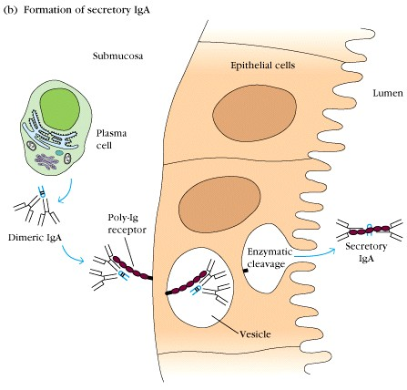
FORMATION OF SECRETORY IgA

Slide 23
IgE ANTIBODY
ε heavy chain
present at extremely low levels
produced in response to parasitic infections and in allergic diseases
binds to high affinity Fc receptors of mast cells and basophils
cross-linking by antigen triggers mast cell activation and histamine release

Slide 24
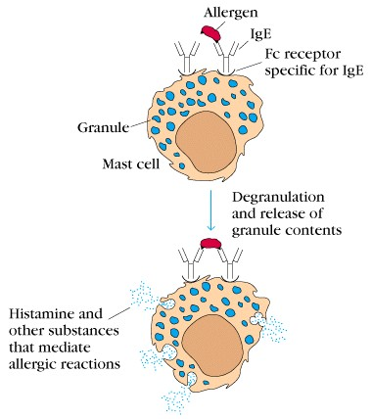

Slide 25
IgG Antibody
γ heavy chain
Most abundant immunoglobulin
Occurs as a monomer, but 4 subclasses
variability mainly located in hinge region and effector function domains
Actively transported across the placenta
Blood and extracellular fluids
Major activator of classical complement pathway (mainly IgG1 and IgG3)
Bind to FcγR on macrophages (phagocytosis) and neutrophils (release of ROS)

Slide 26
IgG Subclasses

Slide 27
Functions of Antibodies
Blocking/neutralising
Complement activation
Fc receptor binding
B lymphocyte surface receptor for antigen

Slide 28
Effect of polyvalency
Multivalent antibodies can bind to an antigen with more than one ‘arm’
This increases the strength of the interaction (affinity) to a multivalent antigen, as it is more difficult for the antibody to fall off
This increase in functional affinity is known as avidity
It is particularly important for IgM

Slide 29
Circulating antibody
Circulating antigen
IMMUNE COMPLEXES

Slide 30
Blocking/neutralising
Pathologic effect (cell necrosis)
Toxin
Cell surface Receptor for toxin
Ab blocks binding to cellular Receptor
i.e.: Tetanus Toxin bind to R of Neuromuscular junction: paralysis
anti-toxin Ab

Slide 31
Blocking/neutralising
infected cell
Virus
Cell surface Receptor to protein on the viral envelope
Entry of the virus into the cell
Ab blocks binding of the virus and infection of the cell
i.e.: Haemaglutinin on the envelope of the influenza virus binds to respiratory epithelial cells

Slide 32
Complement
Preformed plasma proteins
5-10% of all serum proteins
Arranged in cascade such that activation of one component activates next component
3 major pathways
Classical
Alternative
Lectin
Form the C3 convertase, lead eventually to the MAC formation
Classical pathway is activated by antibodies
Numerous effects of complement activation

Slide 33
Biological Functions of Complement
Cell surface bound components
opsonisation
Soluble mediators
chemotactic agents
anaphylatoxins
Solubilisation of immune complexes
Membrane attack complex
cytolysis

Slide 34
Complement Classical pathway
Only certain Igs can activate complement
IgM
IgG3 and IgG1 (in humans)
C1q needs to bind to at least two Fc portion to be activated
IgM can bind more than 1 C1q: more efficient than IgG to activate complement
free IgM:
planar
bound IgM:
staple form
C1q bind to at least two IgG molecules
C1q bind
Binding of C1q activates C1r, cleaves C1s, activate C4, C2 to create the C3 convertase.
Immunobiology, Janeway

Slide 35
Binding of antigen and recruitment of effectors
MAC
C5a
lyse cell
attract inflammatory cells
C3b
binding to complement receptor
C3a
Complement
antigen
antibody

Slide 36
Complement Receptors to C3 fragments
CR1 = CD35
bind C3b,C4b; high affinity
phagocytosis, transport of Immune Complexes, microbicidial activity (in conjunction with the FcγR)
phagocytes, neutrophils, RBC, B and T cells
CR2 = CD21
Bind C3d
Coreceptor for B cell activation, trapping of Antigen, Receptor for EBV
B cells, FDC
CR3 = Mac-1 = CD11b/CD18
bind iC3b, ICAM, other ligands
phagocytosis, leukocyte adhesion to endothelium
Phagocytes, neutrophils, NK cells
CR4= CD11c/CD18
bind iC3b
Phagocytosis
Dendritic Cells (phenotypic marker), phagocytes, NK cells
CRIg
Bind C3b, iC3b
Clearance of opsonized microbes
Kupfer cells (phagocytes of the liver)

Slide 37
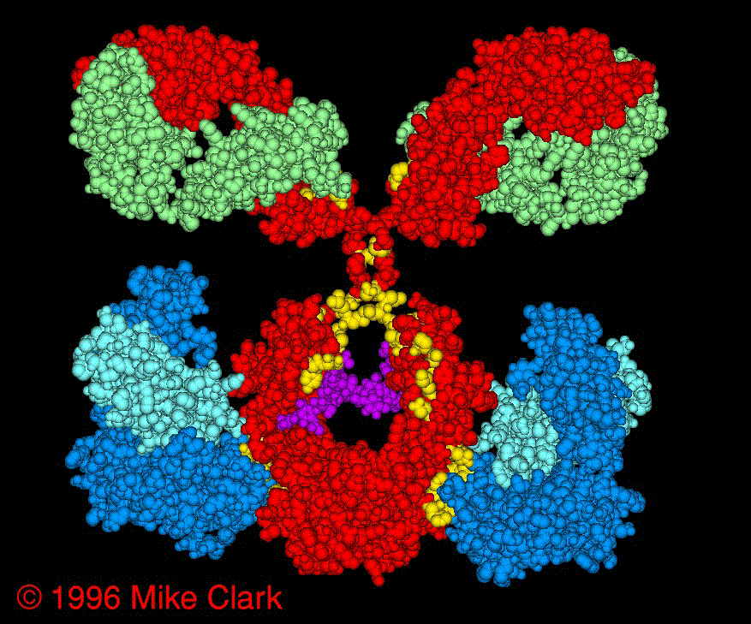
Interaction of Ig with FcR

Slide 38
Human Fcγ receptors
Name
CD
Distribution
Affinity
Specificity
Fc
γ
RI
CD64
monocytes,
macrophages
neutrophils
eosinophils,
dendritic cells
High
IgG1=IgG3>IgG4
Fc
γ
RII
CD32
monocytes,
*Low
IgG1=IgG3>IgG2,
(different isoforms: a bI, bII)
neutrophils,
IgG4
eosinophils,
platelets, B cells
Fc
γ
RIII
CD16
neutrophils,
*Low
IgG1=IgG3
eosinophils,
macrophages,
NK cells
*: do not bind monomeric IgG, only Immune Complexes or surface bound IgG

Slide 39
There are receptors for other isotypes
FcεRI: high affinity
mast cells, basophils, eosinophils
FcεRII: low affinity
some T and B cells, eosinophils, macrophages/monocytes, platelets
FcαRI (CD89): monocytes, neutrophils,eosinophils
FcRn: transport maternal IgG across the placenta and from the gut of the newborn into the plasma
in adults, protects plasma IgG from catabolism
polyIgR: transport IgA into intestinal lumen, transport IgM as well

Slide 40
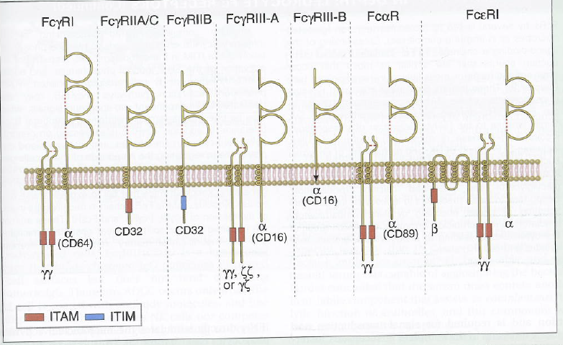
Fc Receptors (human)
Cellular and molecular immunology, Abbas
α-chain: extracellular domain which bind the Ig, associated with the γ-chain which transduce the signal, except the FcγRII
ITAM: activation signal
ITIM: inhibition signal

Slide 41
Consequences of FcR-Ig interactions
Opsonisation and phagocytosis
Antibody-Dependent Cellular Cytotoxicity (ADCC)
Clearance via reticuloendothelial system
Release mediators
Signalling

Slide 42
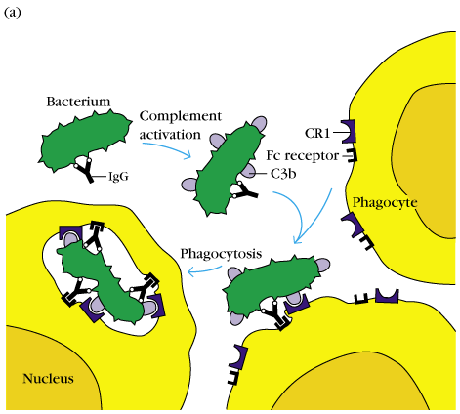
FcR-Ig - Phagocytosis
macrophages, neutrophils
IgG binding on the surface
complement activation, C3b deposition
engagment of Fcγ receptor and CR
ingestion of particle
phagosome fuse with lysosome
production of RO
killing of microbe

Slide 43
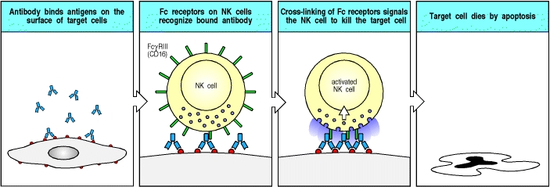
FcR-Ig - Antibody Dependent Cellular Cytotoxicity

Slide 44
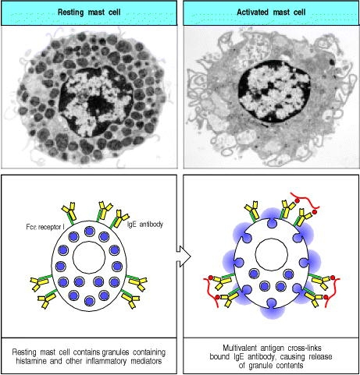
pathogens via Fc receptors
FcR-Ig - Release of mediators
Resting mast cell
Activated mast cell
Neutrophils Respiratory burst
Fcε RI
IgE
Mast cells contains granules full of inflammatory mediator. FcεRI covered with “empty” IgE.
Cross-link of FcεRI, release of histamine and other inflammatory mediators

Slide 45
FcR-Ig - Signalling
FcγRI
(CD64)
FcγRII-b2
(CD32)
FcγRII-b1
(CD32)
Uptake
Stimulation
Respiratory burst
Induction of killing
(macrophages, …)
Uptake
Inhibition of stimulation
(macrophages, …)
No uptake
Inhibition of stimulation
(B cells, …)
NB: FcγRII-b is the only FcγR expressed on B cells

Slide 46
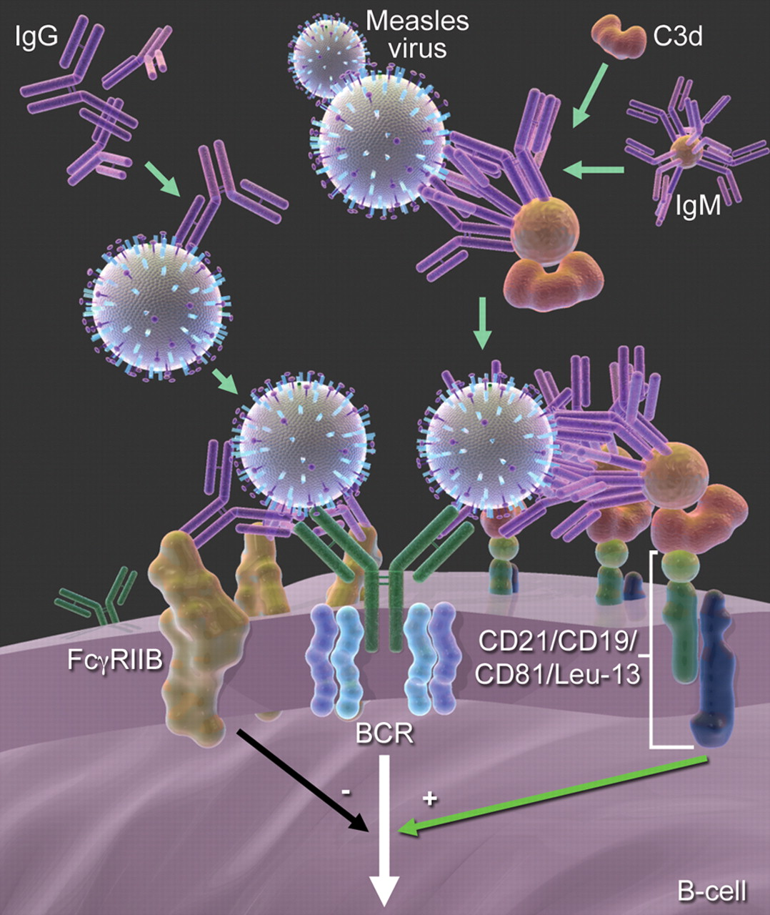
Model of B-cell inhibition by IgG and B-cell stimulation through IgM.
Kim D et al. Blood 2011;117:6143-6151

Slide 47
Antibody as surface receptor
binds to antigen on surface of B cell
signals to the B cell that antigen has been engaged
signalling due to cross linking and involves other molecules associated with the immunoglobulin
signalling causes proliferation and differentiation of B cell clone

Slide 48
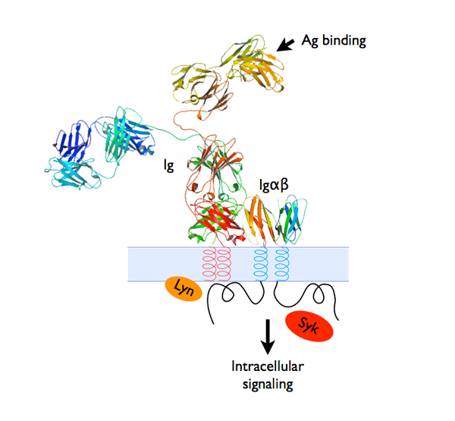
B cell receptor

Slide 49
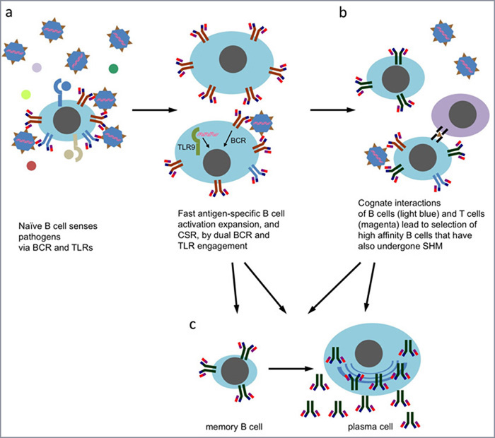
Cross-link of specific BCR by pathogens
- processing of the Ag
presentation on MHC
interaction with T cell
somatic mutation
isotype switch
Fast Ag-specific B cell activation and expansion
plasma cell
memory B cell

Slide 50
B cell as an antigen-presenting cell
antigen is captured by the BCR, internalized and processed
Antigenic peptides are presented on B cell MHC class II to CD4 T cells
Occur during the humoral response
essential for receiving T cell help
can be much more efficient than macrophage
high affinity receptor for an epitope
need concentrations thousands of times smaller than a macrophage

Slide 52
B cell as an immunomodulator
Ag presented on MHC
Cross-talk between B and T cell
Cytokines secreted by B and T cell according to the different stimuli
Modulate the type of response of the T and the B cells

Slide 53
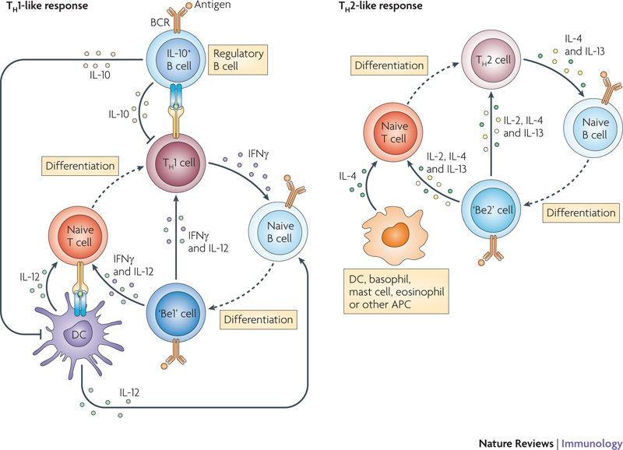

Slide 54
B cell immunodeficiencies
Reduced serum Ig levels
Increased susceptibility to pyogenic bacteria (pneumonia, meningitis..), enteric bacteria and viruses, some parasites
Primary B cell defect or secondary to T cell defects
Developmental block
Absence of so-stimulation by T cells
ex: Hyper IgM syndrome sometimes link to a CD40-CD40L defect, no isotype switch
Congenital or acquired
ex: RAG deficiency
ex: removal of spleen, increased susceptibility to bacteria, cf defective Ab response resulting from the absence of marginal zone B cells

Slide 55
Diseases caused by antibodies
Allergy
IgE -> release of mediators form the mast cells
Ab agaisnt cell surface
Autoimmune hemolytic Anemia
Ab against RBC -> opsonization, phagocytosis RBC
ANCA Vasculitis
Ab against granules protein -> neutrophil degranulation and inflammation
Myasthenia gravis
Ab against Acetylcholine R -> muscle weakness, paralysis
Immune complexes
SLE
Ab against DNA, nucleoproteins -> nephritis, arthritis, vasculitis

Slide 56
Concluding Remarks
Although the main characteristic of a B cell is to produce antibodies, it is also a potent antigen presenting cell and an immunomodulator via the cytokines released while sensing the environment via the BCR and other molecules such as the Toll receptors

