Slide 1
MHC class I and antigen processing
Professor Julian Dyson
Section of Immunobiology
Imperial College London

Slide 2
MHC class I and antigen processing
-overview
-MHC class I
-peptide generation
-transport into ER
-assembly with MHC class I
-presentation of exogenous antigen

Slide 3
Function of MHC class I

Slide 4
B and T cell epitopes
viral protein
antigen
Antibody epitope
conformational
shape is recognised
H N
2
COOH
T cell epitope - internal linear produced by antigen processing
MHC class II
presentation
of T cell epitope
MHC class II
presentation
of T cell epitope
Expressed on cell surface

Slide 5
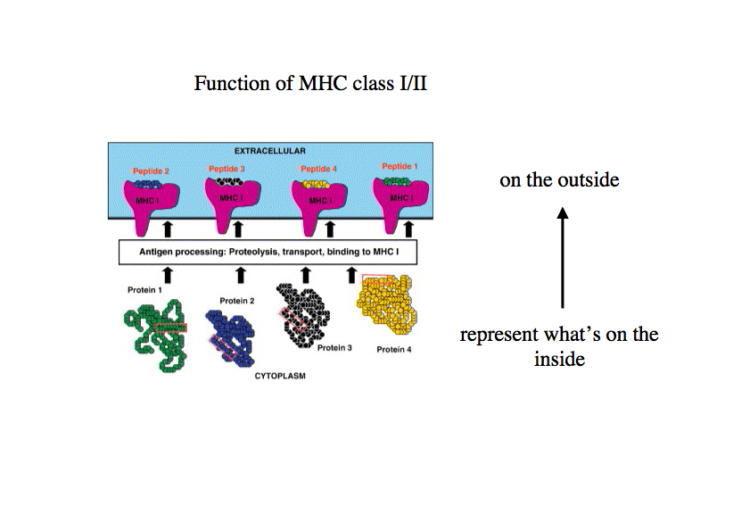

Slide 6
CD8 T cell sensitivity
Human cell enlarged 100,000x
20,000 MHC I/peptide
complexes each ~2mm
CD8 T cell can scan hundreds of cells/hr and be activated by ~5-10 antigenic complexes distributed over the surface
3M

Slide 7
Overview

Slide 8
MHC class I and antigen processing
-overview
-MHC class I
-peptide generation
-transport into ER
-assembly with MHC class I
-presentation of exogenous antigen

Slide 9
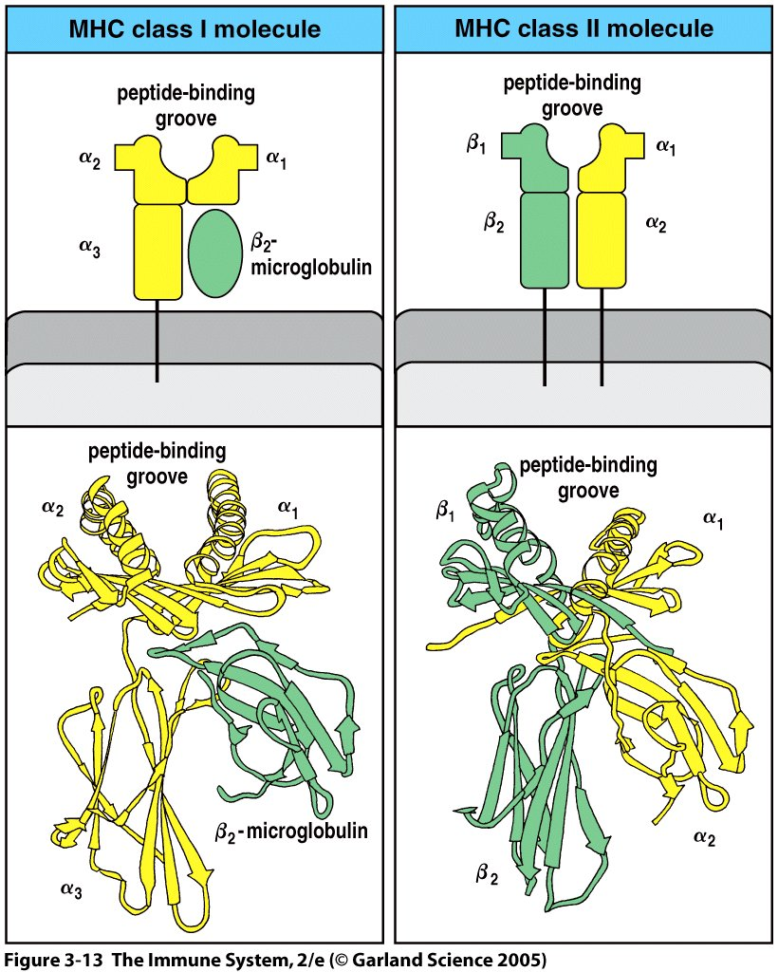
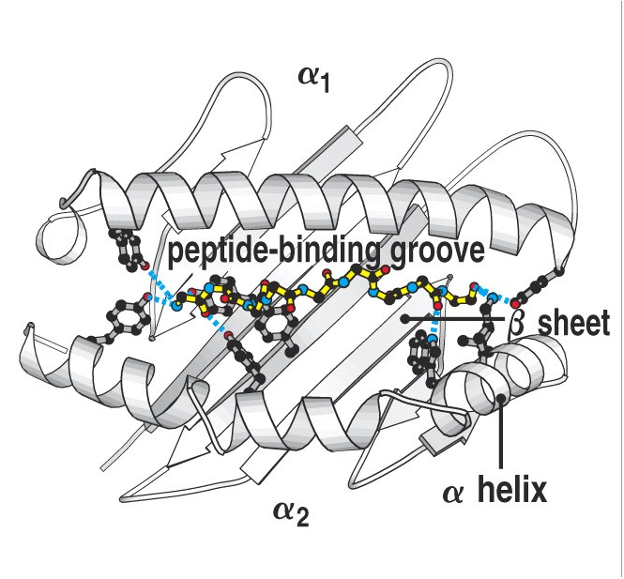
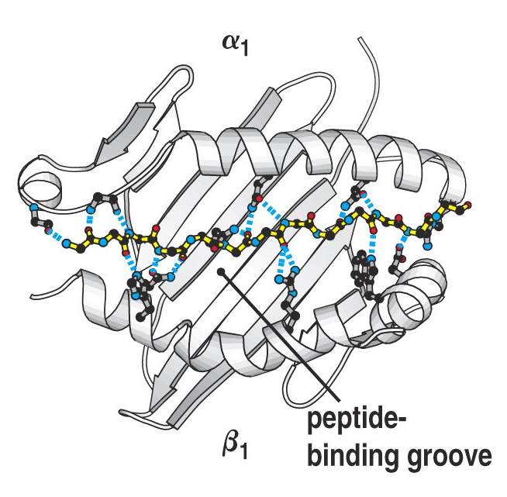
TCR recognises peptide antigen in the context of
MHC (Major Histocompatibility Complex)
α chain/β2 microglobulin
α chain/β chain
Ig domain
Transmembrane segment

Slide 10
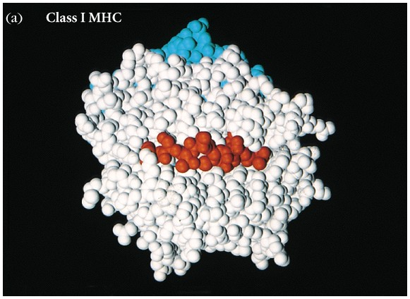
class I molecule
MHC class I
Peptide
-pathogen-derived
-self peptide

Slide 11
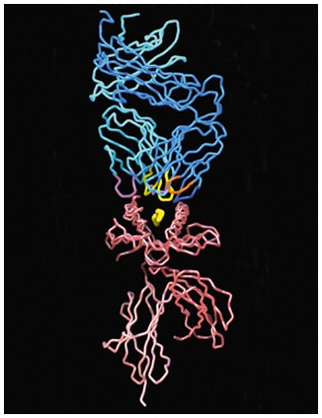
TCR and MHC-peptide
←TCR
← peptide
← MHC

Slide 12
MHC class I and antigen processing
-overview
-MHC class I
-peptide generation
-transport into ER
-assembly with MHC class I
-presentation of exogenous antigen

Slide 13
Class I MHC presents peptides from proteins
synthesized within the cell.
translation
AAAAAAA
mRNA
protein
ubiquitin
ubiquitin
76-amino acid protein
C
NH
O
Lys
Ubiquitin-protein conjugate
Proteins undergo turnover.
Ubiquitinated proteins are degraded.

Slide 14
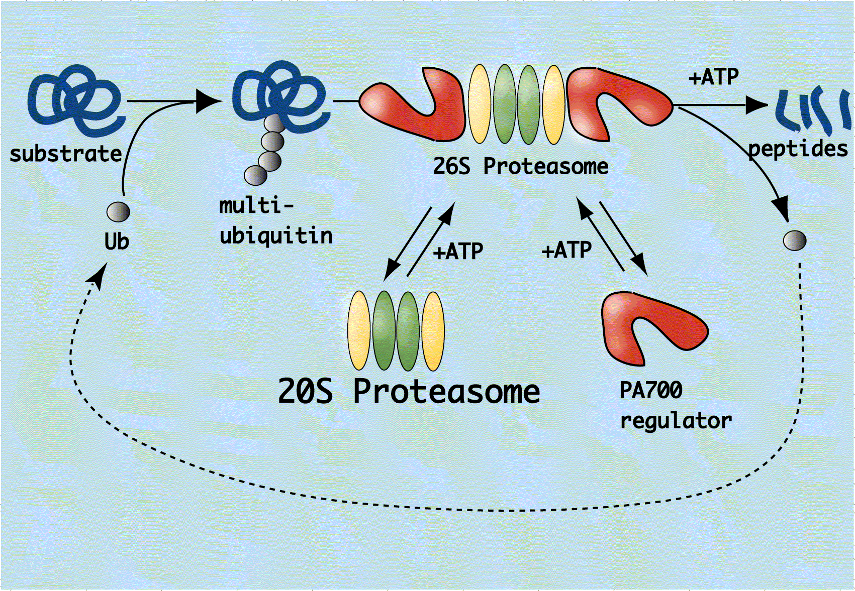
In the cytosol, proteins are degraded into peptides by proteasomes
The Ubiquitin-Proteasome Pathway
Proteasomes are multicatalytic protease complexes made of ~28 subunits

Slide 15
Proteasome
α subunits
β subunits
no proteolytic activity
important for proteasome assembly
binding site for regulatory subunits
threonine proteases
3 active units
4 inactive precursor units
chymotrypsin-like (after hydrophobic residues)
trypsin-like (after basic residues)
Acidic protease activity (after acidic residues)

Slide 16
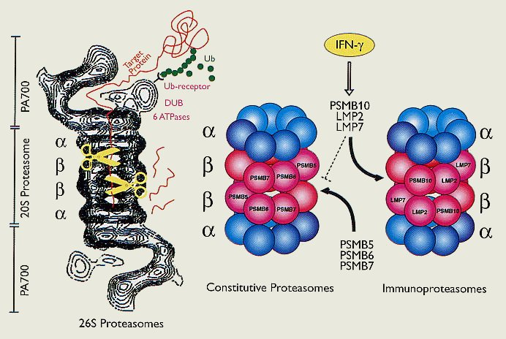
Gamma interferon, produced during immune response,
induces expression of alternative beta subunits
Immunoproteasome

Slide 17
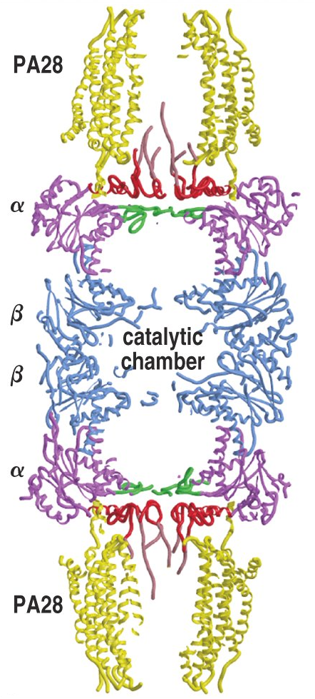
Proteasome degrades ubiquitinated proteins
Ubiquitinated proteins
cap
The proteasome for antigen processing contains
interferon γ induced LMP2, LMP7, and LMP10.
4 heptamer
rings
Such proteasome preferentially cleaves
peptide bonds after hydrophobic or basic residues
preferred by MHC class I for binding.
Proteasome activating molecule (PA28), is inducible by gamma interferon, increases the release of cleaved peptides.
cap
peptides

Slide 18
Gamma interferon induces expression of alternative
beta subunits. Immunoproteasome

Slide 19
MHC class I/peptide complexes recognised
by CD8⁺ cytotoxic T cells
-Require rapid response to virus infection
-Virus infection cycles can be short ~4hrs
-T cell has to identify and kill infected cell before
virus release

Slide 20
DRiPs: Defective ribosomal products
Translation is imperfect
Protein folding is imperfect
Non-functional proteins
Newly synthesised protein
Rapidly degraded by the proteasome
Nature. 2000 Apr 13;404(6779):770-4.

Slide 21
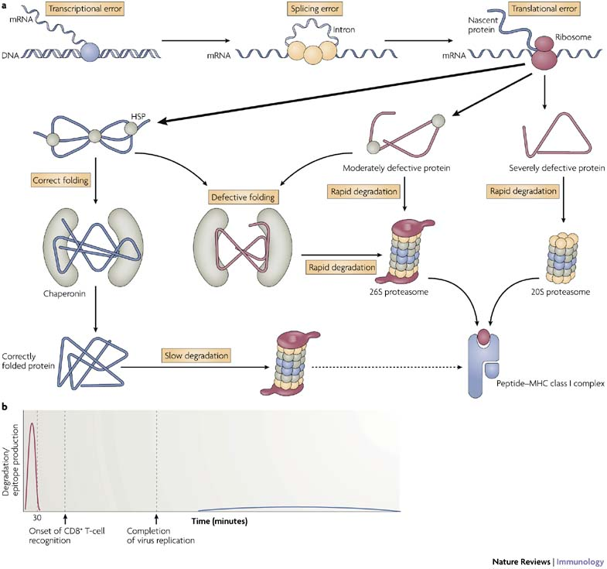
DRiPs

Slide 22
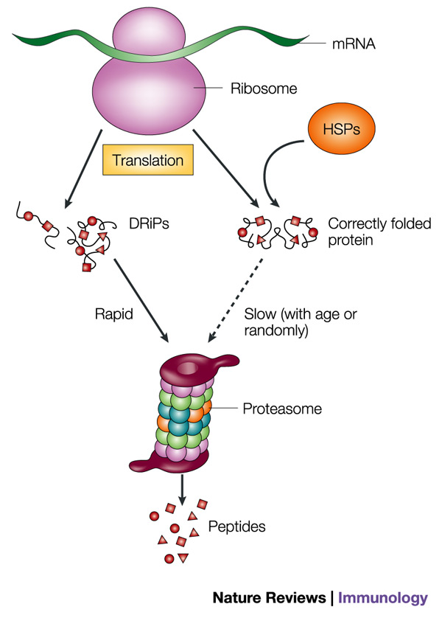
Two sources protein for degradation

Slide 23
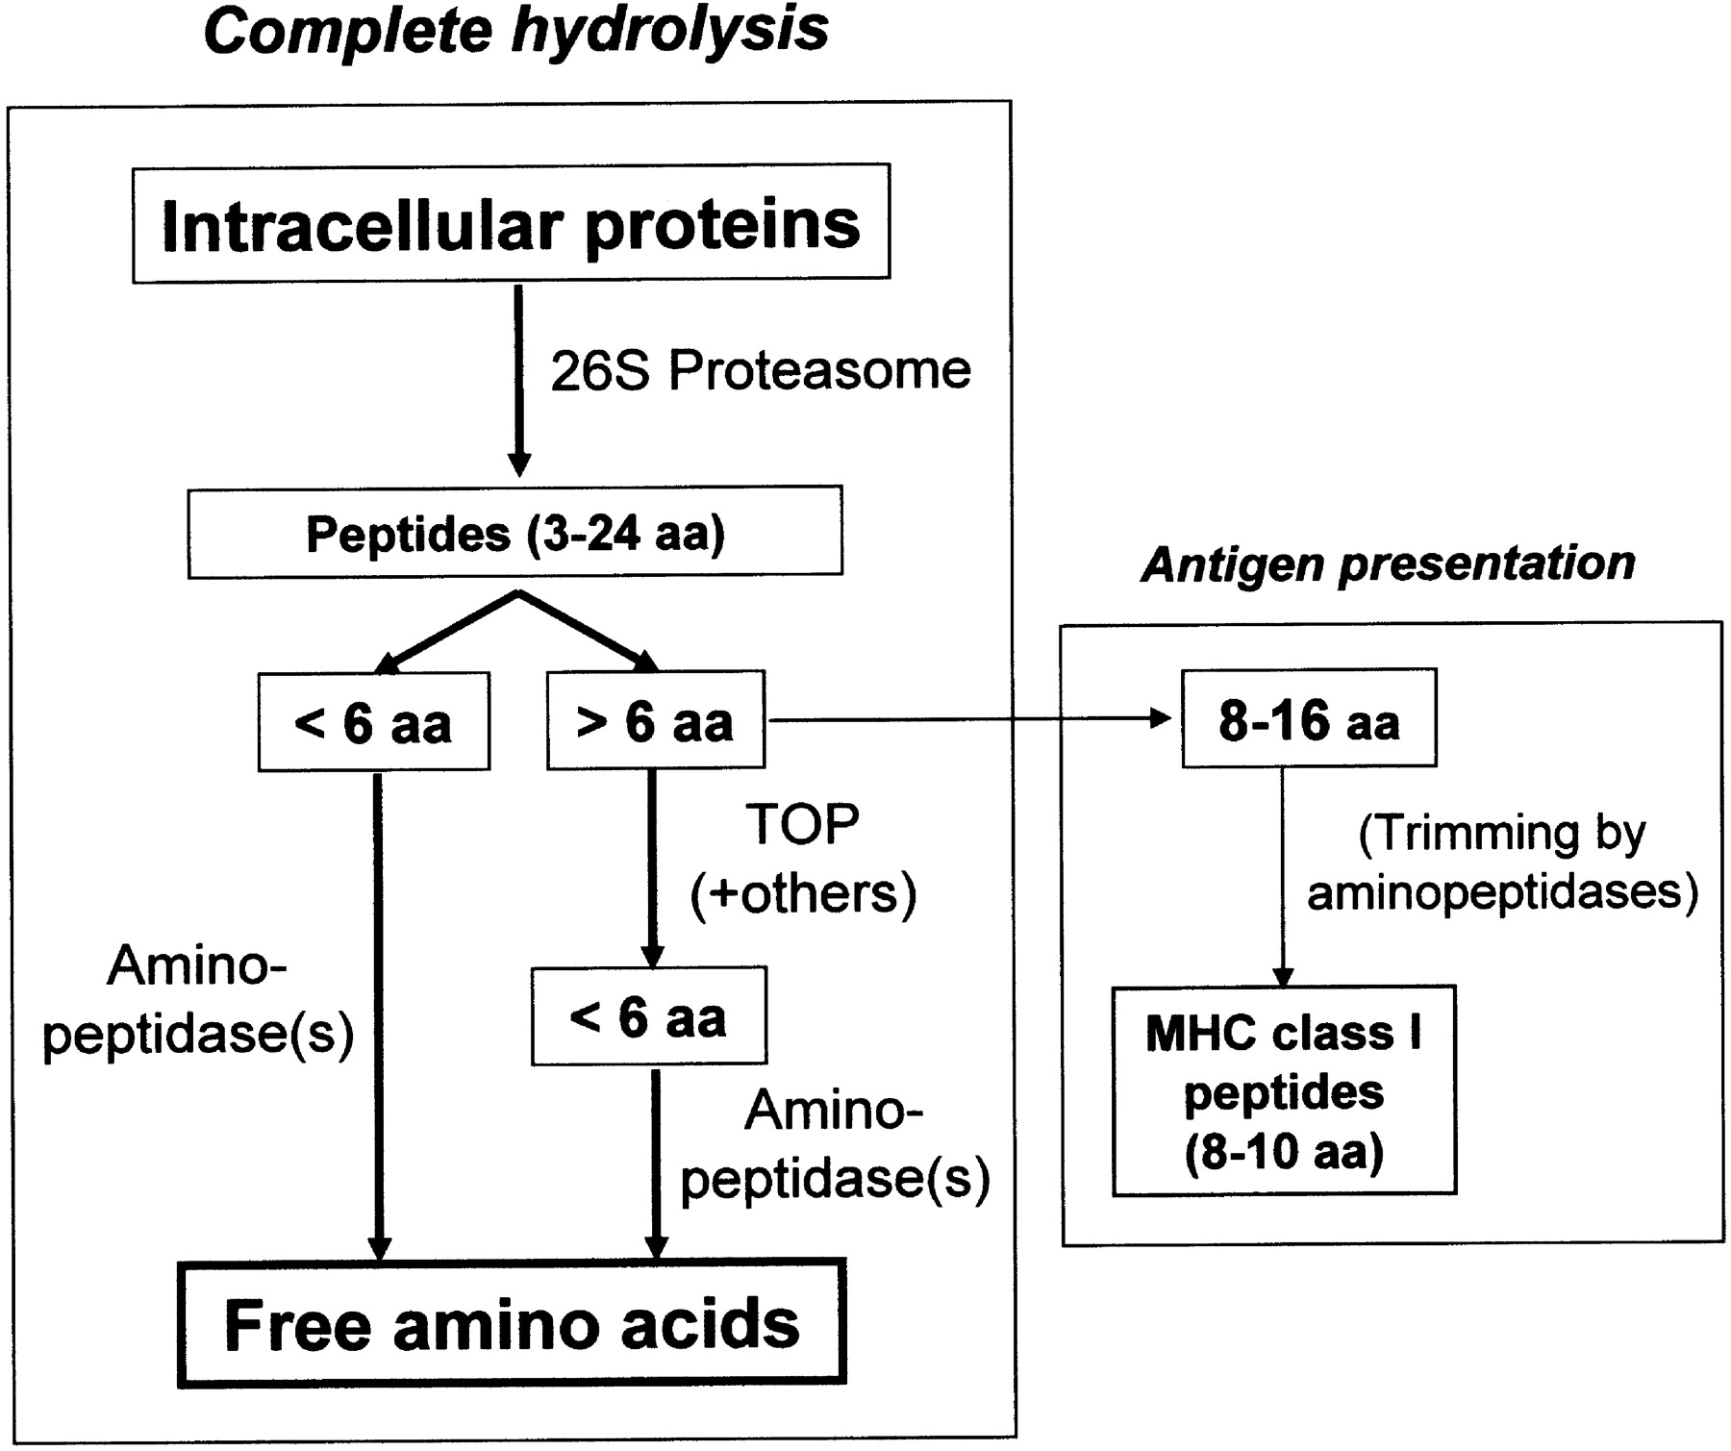
Products of proteasomal degradation range from 6-24aa
thimet oligopeptidase (TOP)

Slide 24
MHC class I and antigen processing
-overview
-MHC class I
-peptide generation
-transport into ER
-assembly with MHC class I
-presentation of exogenous antigen

Slide 25
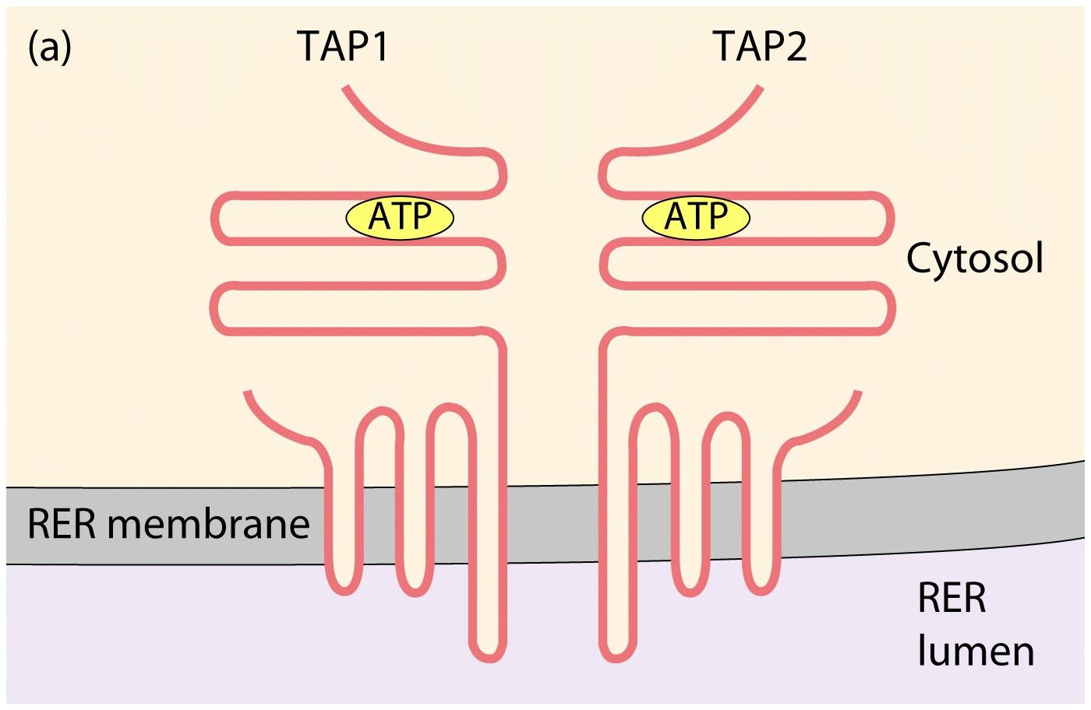
TAP: Transporter associated with antigen processing
ATP binding cassette (ABC family of transporters)
ATP hydrolysis provides the energy for transport.
TAP prefers peptides that are:
8-10 amino acids long
Carboxyl-terminal amino acids are hydrophobic
or basic. Preferred by MHC class I

Slide 26
TAP peptide transporter: model for peptide transport
high low
affinity peptide binding site

Slide 27
MHC class I and antigen processing
-overview
-MHC class I
-peptide generation
-transport into ER
-assembly with MHC class I
-presentation of exogenous antigen

Slide 28
Peptide binding by MHC class I
-A given allelic MHC molecule can bind numerous different peptides
-Each MHC allele binds a different set of peptides

Slide 29
Polymorphism of
class I (and class II) molecules
-MHC class I is highly polymorphic. One of the most
polymorphic gene sets in the human genome.
HLA-A 1200 alleles
HLA-B 1800 alleles
HLA-C 830 alleles
-Each individual’s complement of MHC class I/II genes
is close to unique. Hence difficulty in tissue matching
HLA-A -B -C (HLA -DR -DQ -DP)
-The diversity of MHC I, II within a species helps protect from new pathogens

Slide 30
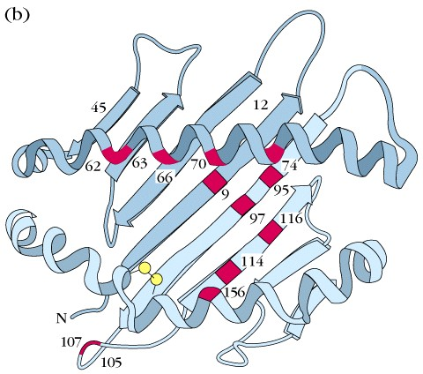
Location of polymorphic amino acid residues
Most polymorphic residues are located in the peptide binding cleft

Slide 31
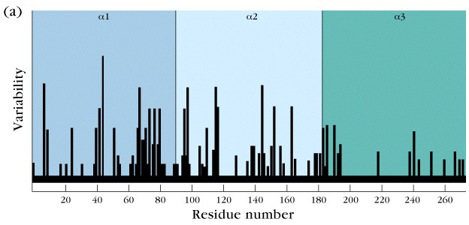
Polymorphism in the amino acid sequence of allelic class I MHC molecules

Slide 32
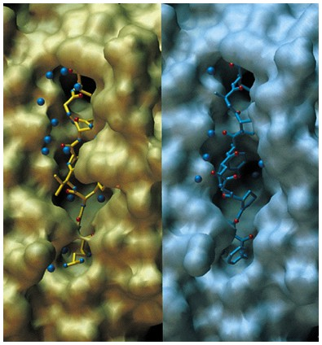
Many peptides bind to the
same MHC molecule
Deep pockets accommodate ‘anchor’ residues
Vesicular stomatitis Sendai virus
virus (VSV-8) peptide nuclear protein

Slide 33
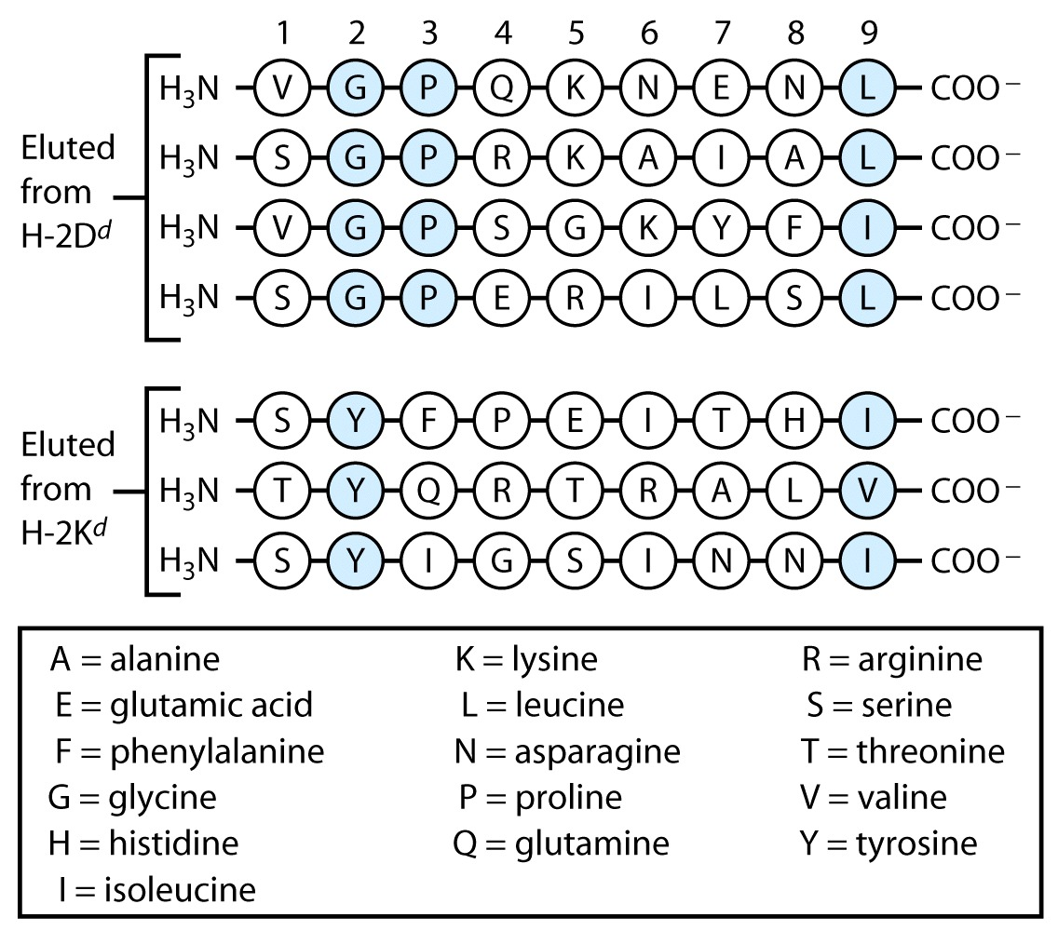
Class I MHC binds peptides through anchor residues.
Anchor residues at other positions
Vary with the type of MHC
The most conserved anchor residue
Hydrophobic (basic occasionally)

Slide 34
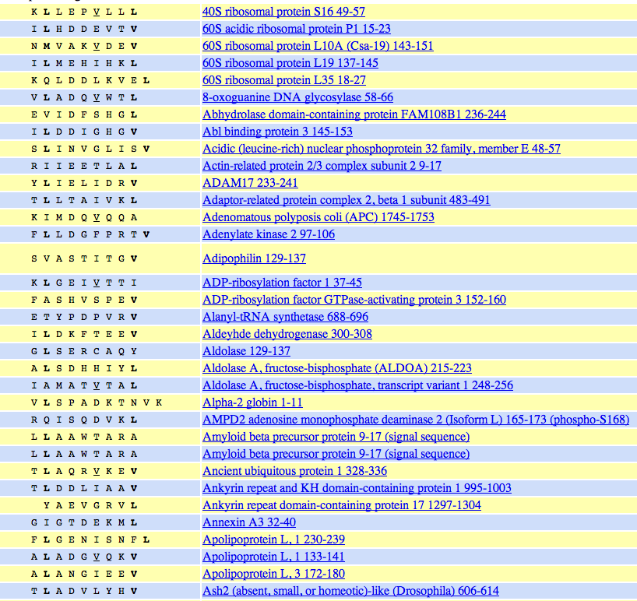
Class I MHC binds peptides through anchor residues
Selection of HLA-A2 binding peptides

Slide 35
Peptide loading is aided by chaperones
Chapman DC, Williams DB.Semin Cell Dev Biol. 2010 21:512

Slide 36
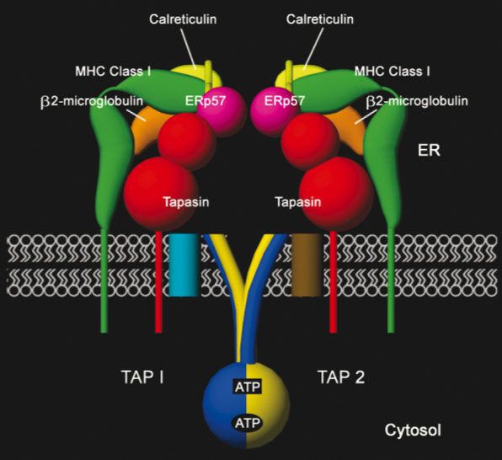
Components of the peptide-loading
complex in the endoplasmic reticulum
Raghaveb et al (2008) Trends in Immunology 29:436

Slide 37
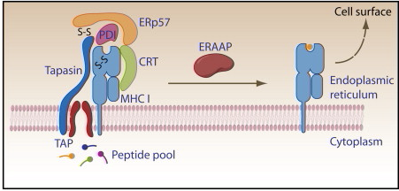
Peptide trimming in the ER
Amino peptidase ERAP

Slide 38
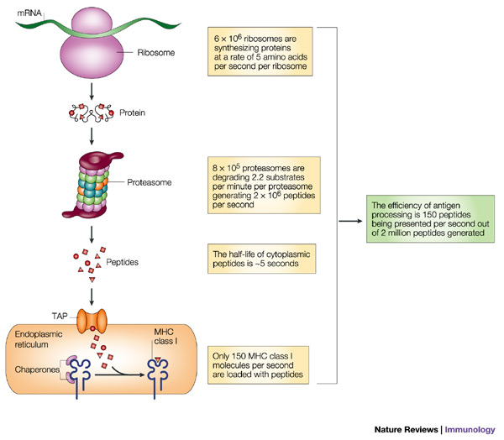
Few peptides make it to the cell surface

Slide 39
MHC class I and antigen processing
-overview
-MHC class I
-peptide generation
-transport into ER
-assembly with MHC class I
-presentation of exogenous antigen

Slide 40
Cross-Presentation
-Loading of “exogenous” ligands onto MHC Class I on APCs
-Essential for priming naïve CD8 T cells
-Pathways:
particulate antigens
soluble antigens
direct inter-cellular transfer

Slide 41
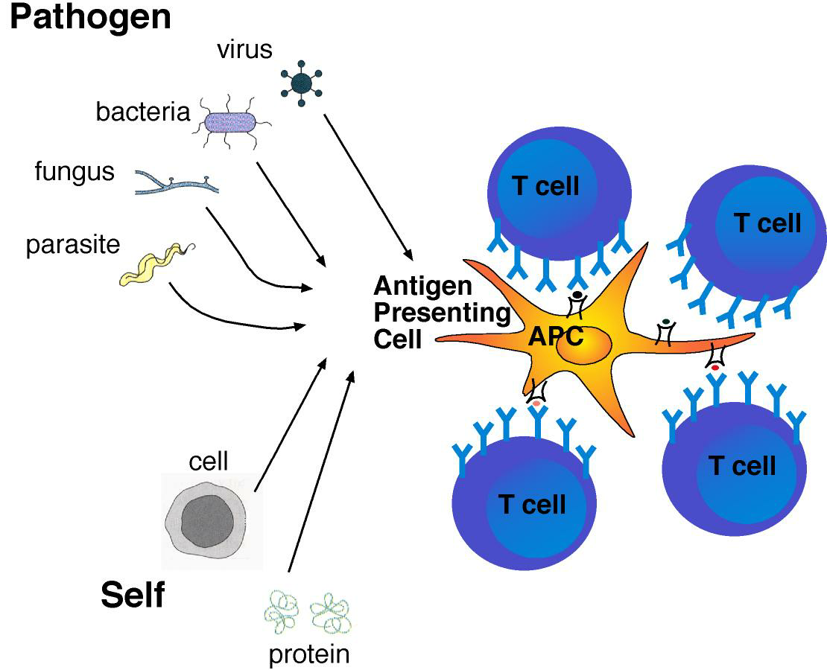

Slide 42
Cross presentation of exogenous antigen
(Alternative pathway of MHC class I antigen presentation)
Blanchard N, Shastri N.Ann N Y Acad Sci. 2010 1183:237-50

Slide 43
References
-Web
For MHC class I structures: http://imgt.cines.fr/3Dstructure-DB/
For peptide binding motifs etc: http://www.syfpeithi.de/
Reviews: *most useful
*Antoniou AN, Powis SJ. Pathogen evasion strategies for the major histocompatibility complex class I assembly pathway. Immunology. 2008 May;124(1):1-12.
*Rethinking peptide supply to MHC class I molecules.
Eisenlohr LC, Huang L, Golovina TN. Nat Rev Immunol. 2007 May;7(5):403-10. Review
*Major histocompatibility complex class I binding predictions as a tool in epitope discovery. Lundegaard C, Lund O, Buus S, Nielsen M.
Immunology. 2010 Jul;130(3):309-18. Epub 2010 May 26. Review
*ABC proteins in antigen translocation and viral inhibition.
Parcej D, Tampé R. Nat Chem Biol. 2010 Aug;6(8):572-80. Review
Proteasome and peptidase function in MHC-class-I-mediated antigen presentation.
Kloetzel PM, Ossendorp F. Curr Opin Immunol. 2004 Feb;16(1):76-81. Review

