Slide 1

PCR and Congenics
Wednesday 26 September 2012
Mick Jones

Slide 2
Aims and Objectives
Explain the concept of PCR and how to perform a PCR
The practical: Use PCR to identify different genetically modified strains.
Using PCR to answer a biologically relevant question

Slide 3
5 minute challenge!
Write a list of reagents you need for a PCR
Describe a typical PCR
Describe how you would analyse PCR results

Slide 4
5 minute challenge! Answers.
Write a list of reagents you need for a PCR
Template DNA!
Primers – forward and reverse
dNTPs
DNA Polymerase
MgCl₂ (Enzyme co-factor)
Enzyme Buffer

Slide 5
PCR Cycle
Denaturation (94 - 96˚C) to
disrupt double stranded DNA
Annealing (primer dependent)
allows synthetic primers to bind
to target sites on template
DNA polymerase extension to
duplicate target sequence

Slide 6
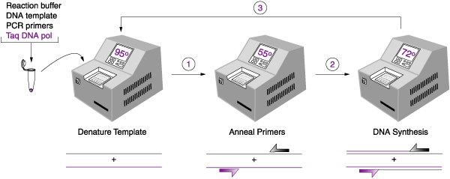
PCR Cycling

Slide 7
PCR – Gene Amplification in vitro

Slide 10
The first 4 cycles in detail

Slide 11
Exponential Increase
Cycle 3 - 2 copies
Cycle 4 - 8 copies
Cycle 5 - 20 copies
Cycle 6 - 44 copies
Cycle 7 - 88 copies
Cycle 20 - 262,304
Cycle 22 - 1,049,216
Cycle 30 - 134,299,648
Cycle 35 - ~1,000,000,000

Slide 12
1.2% agarose 1x TBE gel analysis
Lane: M = 100 bp marker ladder
1 to 5 = positive DNA samples
6 = negative control DNA sample

Slide 13
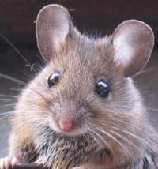
Use PCR data to identify different genetically modified strains.
Transgenic:
Knock-out:
Knock-in:
Inbred:
Recombinant Inbred:
Consomic: A single chromosome from one inbred strain is transferred
onto the genetic background of a second strain.
Chromosome substitution.
Congenic: An interval (1 - 99%) of a single chromosome from one inbred strain is transferred onto the genetic background of a
second strain.

Slide 14
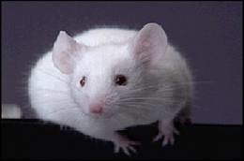
The Practical
The biological question:
Which genes are responsible for SLE?
Animal model of SLE : BXSB mice
Breeding has narrowed down the genes responsible for disease
Some genes linked to disease are on Chr 1.

Slide 15
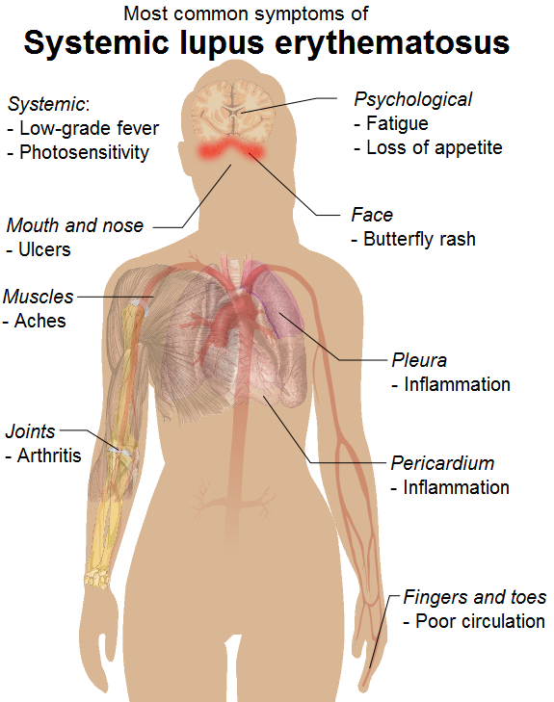

Slide 16
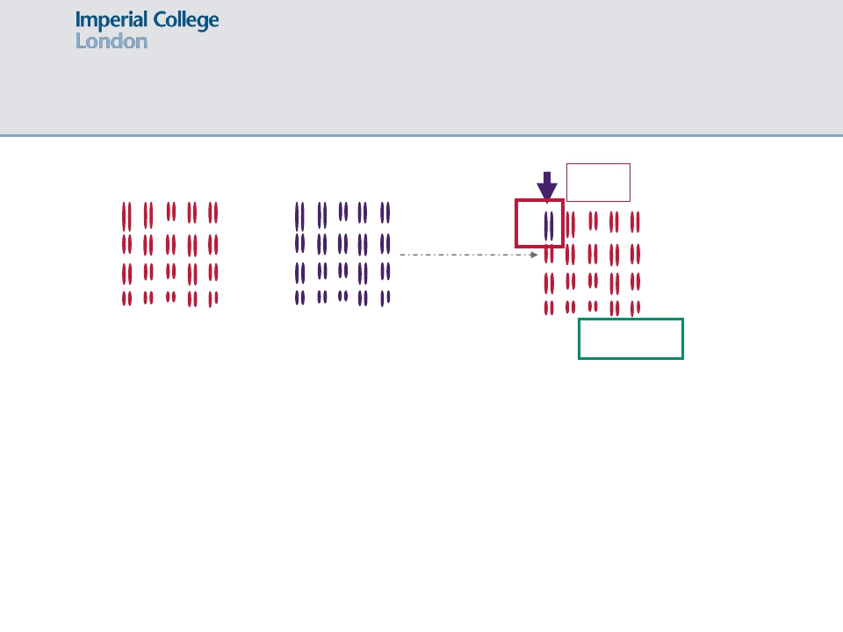
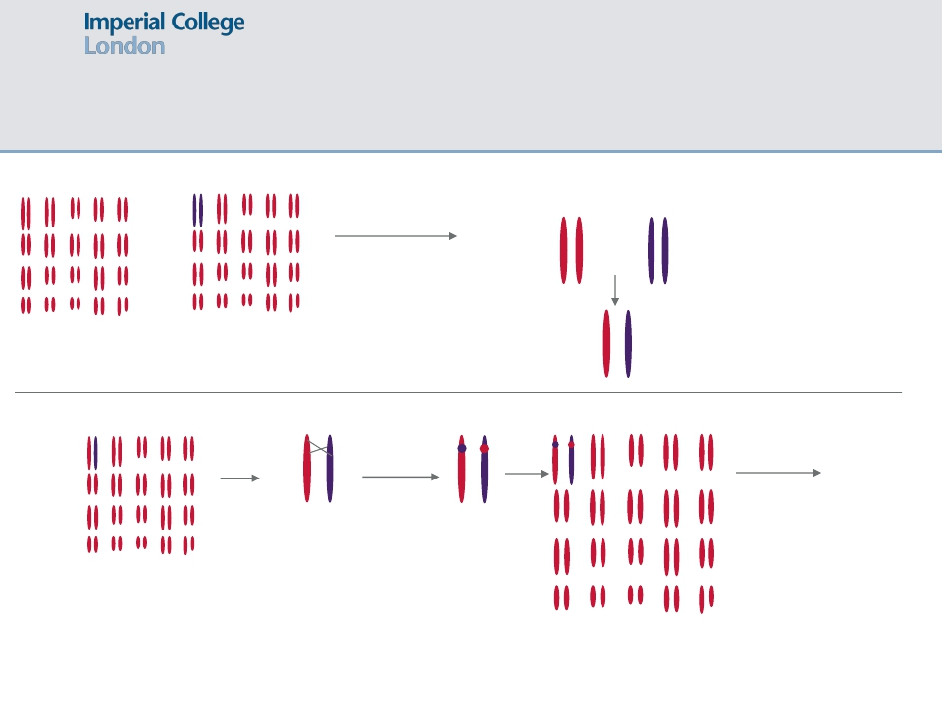
The Practical
Healthy
SLE
SLE
X
B10 Control
BXSB
BXSB Consomic
20 chromosomes
(40 in diploid cells!)

Slide 17
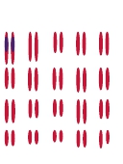
The Practical
Recombination
during meiosis
X
B10
BXSB Consomic
BXSB Congenic
How do we know if and where recombination has occurred?
Answer: Microsatellites

Slide 18
Sequence Analysis - Microsatellites
What are microsatellites?
Short sequence repeats (2 - 4 bp repeats)
Found in most genomes
Exceptional variability in humans and mice
Bordered by unique DNA sequence
Can be examined using PCR
Strain 1 5’- TGAGCTAGGACTCTCTCTCT(CT)₅₀GGATCCGAGC-3’
CT microsatellite repeat 110 bp
Strain 2 5’- TGAGCTAGGACTCTCTCTCT(CT)₁₀₀GGATCCGAGC-3’
CT microsatellite repeat 210 bp

Slide 19
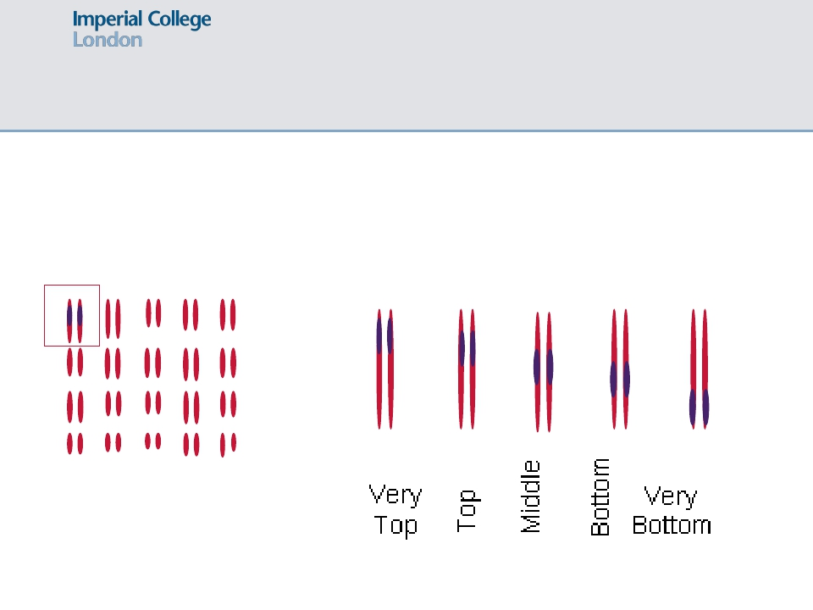
The Practical
Using microsatellite analysis to identify different BXSB congenic mice
Very
Top
Very
Bottom
Top
Middle
Bottom
BXSB Congenic Mouse

Slide 20
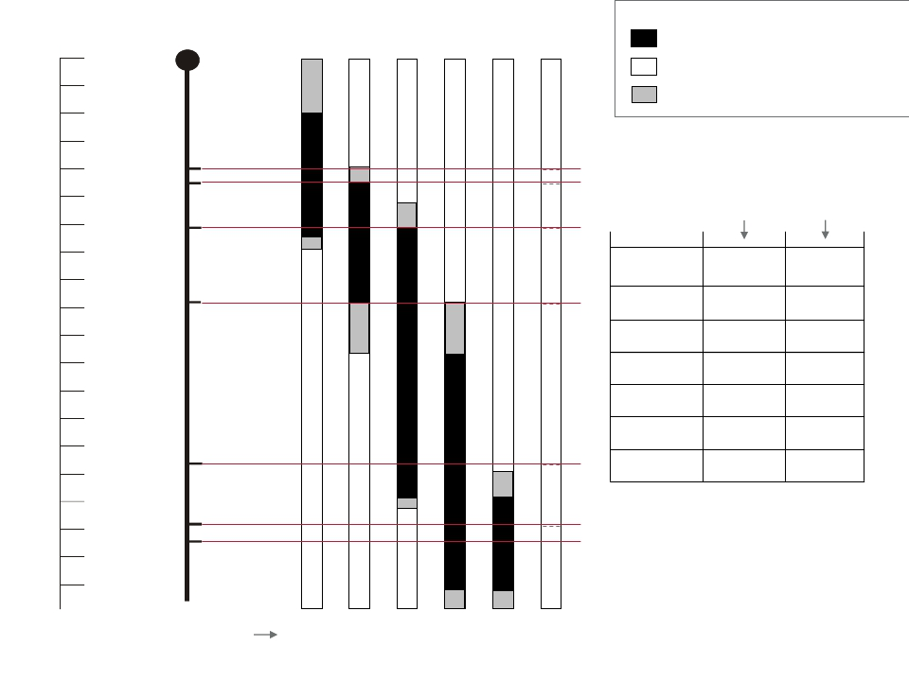
Position of
Microsatellites (MS)
on Chromosome 1
Chromosome 1 in the
Congenic mice
Key:
Scale
0 Mb
10
20
BXSB-derived
B10-derived
Derivation unconfirmed
30
40
50
60
70
Size
in
B10
Size
in
BXSB
MS 1
MS 2
MS 3
MS
80
MS 1
140 bp 185 bp
90
100
110
120
130
140
150
MS 4
MS 5
MS 2
MS 3
MS 4
MS 5
MS 6
MS 7
150 bp 135 bp
137 bp 125 bp
146 bp 128 bp
112 bp 122 bp
160 bp 184 bp
150 bp 124 bp
160
170
180
190
MS 6
MS 7
Names of congenics
Very
Top
Top
Middle
Bottom
Very Unknown
Bottom

Slide 21
The Practical: Congenics and Microsatellites
What size would the PCR products be in the following experiments?
1. If you were given:
Primers that amplify MS 1
DNA from mouse strain Very Top
2. If you were given:
Primers that amplify MS4
DNA from mouse strain Very bottom
3. If you were given:
Primers that amplify MS 7
DNA from an F1 mouse (BXSB x B10)

Slide 22
Position of
Microsatellites (MS)
on Chromosome 1
Chromosome 1 in the
Congenic mice
Key:
Scale
0 Mb
10
20
BXSB-derived
B10-derived
Derivation unconfirmed
30
40
50
60
70
Size
in
B10
Size
in
BXSB
MS 1
MS 2
MS 3
MS
80
MS 1
140 bp 185 bp
90
100
110
120
130
140
150
MS 4
MS 5
MS 2
MS 3
MS 4
MS 5
MS 6
MS 7
150 bp 135 bp
137 bp 125 bp
146 bp 128 bp
112 bp 122 bp
160 bp 184 bp
150 bp 124 bp
160
170
180
190
MS 6
MS 7
Names of congenics
Very
Top
Top
Middle
Bottom
Very Unknown
Bottom

Slide 23
Position of
Microsatellites (MS)
on Chromosome 1
Chromosome 1 in the
Congenic mice
Key:
Scale
0 Mb
10
20
BXSB-derived
B10-derived
Derivation unconfirmed
30
40
50
60
70
Size
in
B10
Size
in
BXSB
MS 1
MS 2
MS 3
MS
80
MS 1
140 bp 185 bp
90
100
110
120
130
140
150
MS 4
MS 5
MS 2
MS 3
MS 4
MS 5
MS 6
MS 7
150 bp 135 bp
137 bp 125 bp
146 bp 128 bp
112 bp 122 bp
160 bp 184 bp
150 bp 124 bp
160
170
180
190
MS 6
MS 7
Names of congenics
Very
Top
Top
Middle
Bottom
Very Unknown
Bottom

Slide 24
The Practical: Congenics and Microsatellites
What size would the PCR products be in the following experiments?
1. If you were given:
Primers that amplify MS 1
DNA from mouse strain Very Top
2. If you were given:
Primers that amplify MS4
DNA from mouse strain Very bottom
3. If you were given:
Primers that amplify MS 7
DNA from an F1 mouse (BXSB x B10)

Slide 25
Position of
Microsatellites (MS)
on Chromosome 1
Chromosome 1 in the
Congenic mice
Key:
Scale
0 Mb
10
20
BXSB-derived
B10-derived
Derivation unconfirmed
30
40
50
60
70
Size
in
B10
Size
in
BXSB
MS 1
MS 2
MS 3
MS
80
MS 1
140 bp 185 bp
90
100
110
120
130
140
150
MS 4
MS 5
MS 2
MS 3
MS 4
MS 5
MS 6
MS 7
150 bp 135 bp
137 bp 125 bp
146 bp 128 bp
112 bp 122 bp
160 bp 184 bp
150 bp 124 bp
160
170
180
190
MS 6
MS 7
Names of congenics
Very
Top
Top
Middle
Bottom
Very Unknown
Bottom

Slide 26
Position of
Microsatellites (MS)
on Chromosome 1
Chromosome 1 in the
Congenic mice
Key:
Scale
0 Mb
10
20
BXSB-derived
B10-derived
Derivation unconfirmed
30
40
50
60
70
Size
in
B10
Size
in
BXSB
MS 1
MS 2
MS 3
MS
80
MS 1
140 bp 185 bp
90
100
110
120
130
140
150
MS 4
MS 5
MS 2
MS 3
MS 4
MS 5
MS 6
MS 7
150 bp 135 bp
137 bp 125 bp
146 bp 128 bp
112 bp 122 bp
160 bp 184 bp
150 bp 124 bp
160
170
180
190
MS 6
MS 7
Names of congenics
Very
Top
Top
Middle
Bottom
Very Unknown
Bottom

Slide 27
The Practical: Congenics and Microsatellites
What size would the PCR products be in the following experiments?
1. If you were given:
Primers that amplify MS 1
DNA from mouse strain Very Top
2. If you were given:
Primers that amplify MS4
DNA from mouse strain Very bottom
3. If you were given:
Primers that amplify MS 7
DNA from an F1 mouse (BXSB x B10)

Slide 28
Position of
Microsatellites (MS)
on Chromosome 1
Chromosome 1 in the
Congenic mice
Key:
Scale
0 Mb
10
20
BXSB-derived
B10-derived
Derivation unconfirmed
30
40
50
60
70
Size
in
B10
Size
in
BXSB
MS 1
MS 2
MS 3
MS
80
MS 1
140 bp 185 bp
90
100
110
120
130
140
150
MS 4
MS 5
MS 2
MS 3
MS 4
MS 5
MS 6
MS 7
150 bp 135 bp
137 bp 125 bp
146 bp 128 bp
112 bp 122 bp
160 bp 184 bp
150 bp 124 bp
160
170
180
190
MS 6
MS 7
Very
Top
Top
BXSB
Middle
B10
Very
Bottom
Bottom

Slide 29
The Practical: Congenics and Microsatellites
For this practical, you will be provided with two DNA samples that were
taken from the mice during the generation and characterization of the
congenics. Consequently, the samples may be from any of the following:
The parental control strain BXSB or B10
F1 breeding crosses
1 of the 5 congenics
Primers for the Microsatellites
Controls – DNA from parental strains B10 and BXSB
PCR reagents
Agarose gel electrophoresis

Slide 30
How do you make a congenic
X
F1
B10
Consomic
Mouse
Recombination
during meiosis
(production of gametes)
F1 Consomic
Mouse
F1 Consomic Mouse
with a recombination event

Slide 31
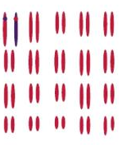
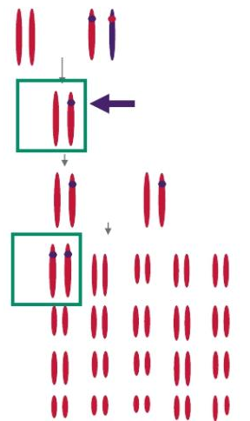
How do you make a congenic
X
B10
F1 Consomic Mouse
with a recombination event

