Slide 1

Psychological dimensions in sickle cell disease and thalassaemia
Dr Kofi A Anie

Slide 2
Background
Sickle Cell Disease & Thalassaemia cause much distress to patients & families
Both pose significant challenges
Psychosocial problems may be present
Result from impact of symptoms on daily lives patients & families

Slide 3
Cognitive Challenge
Family must learn about illness
cause
prognosis
complications
Family must revise expectations for child
daily life
present & future

Slide 4
Emotional Challenge
Coming to terms with the illness
uncertainties
disease process
Thoughts & feelings about outcome
fears & anxieties
hoping & praying

Slide 5
Behavioural Challenge
Changes in family life
treatment
hospital visits
Preservation of family function
daily roles & limitations
other members – eg. siblings
income

Slide 6
Individual Challenges
Identity & Role
active able independent to passive dependent
Social Support
Isolation from family & friends
Future
career or family plans

Slide 7
Model of Care
Medical
Nursing
Hospital & Community
Age Appropriate
Evidence Based
Psychosocial

Slide 8
Paediatric Issues
Cognitive Impairment
strokes, silent strokes
attention, executive function, learning
Educational Problems
loss of schooling
academic achievement
Nutrition & Growth
body image
puberty

Slide 9
Adolescent Issues
Personal
severity & chronicity of illness, limitations
coping strategies, skills
Interpersonal
family & peer relationships
attitudes to health services & professionals
Adherence
treatment & healthcare
health beliefs & illness perceptions

Slide 10
Adolescent Needs – UK & US
(Anie, Telfair & Transition Study Group, 2005)
Transition in Care
paediatric to adult
readiness to transfer
Competence for Self-Management
adequate knowledge
self-efficacy
Independence Maturity & Responsibility
confidence with age
parents relinquish care

Slide 11
Challenges in Intervention
Shift from hospital to community focussed care
Shift from dependence to more independence
Self-management & self-efficacy
Palliative type care & home support
Improvement in quality of life

Slide 12
Child/Adolescent Interventions - I
Psycho-Education
groupwork
patient education
coping skills
creative arts eg. artwork, music
Problem Solving
solution focussed
parents, family eg. siblings

Slide 13
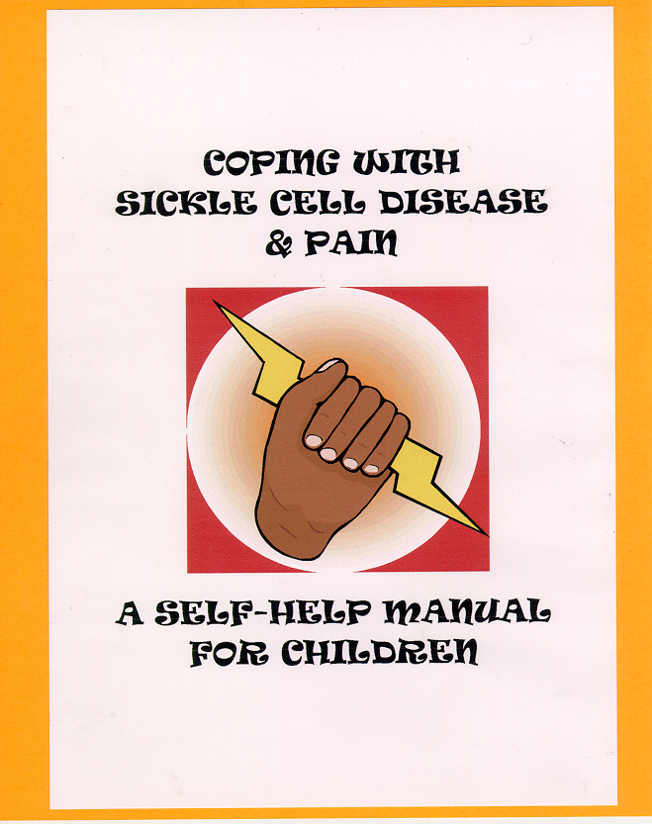
Child/Adolescent Interventions - II
Cognitive Behavioural Therapy
coping skills
emotional support
self-help materials –
manual, video

Slide 14

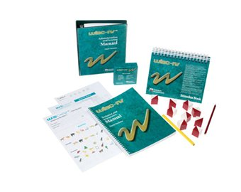
Child/Adolescent Interventions - III
Neuro-Educational
neuropsychological assessments
school support & extra tuition
special programmes

Slide 15
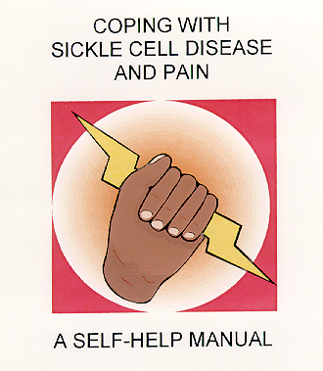
Adult Interventions - I
Cognitive Behavioural Therapy
long-term coping skills
behaviour modification
emotional distress
self-help materials – manual, video

Slide 16
Adult Interventions - II
Patient Education
pain & symptom management
Expert Patient Programme
DoH initiative
self-management of chronic illness

Slide 17
Way Forward
Incorporate Psychological Interventions into Clinical Management Protocols

