Slide 1
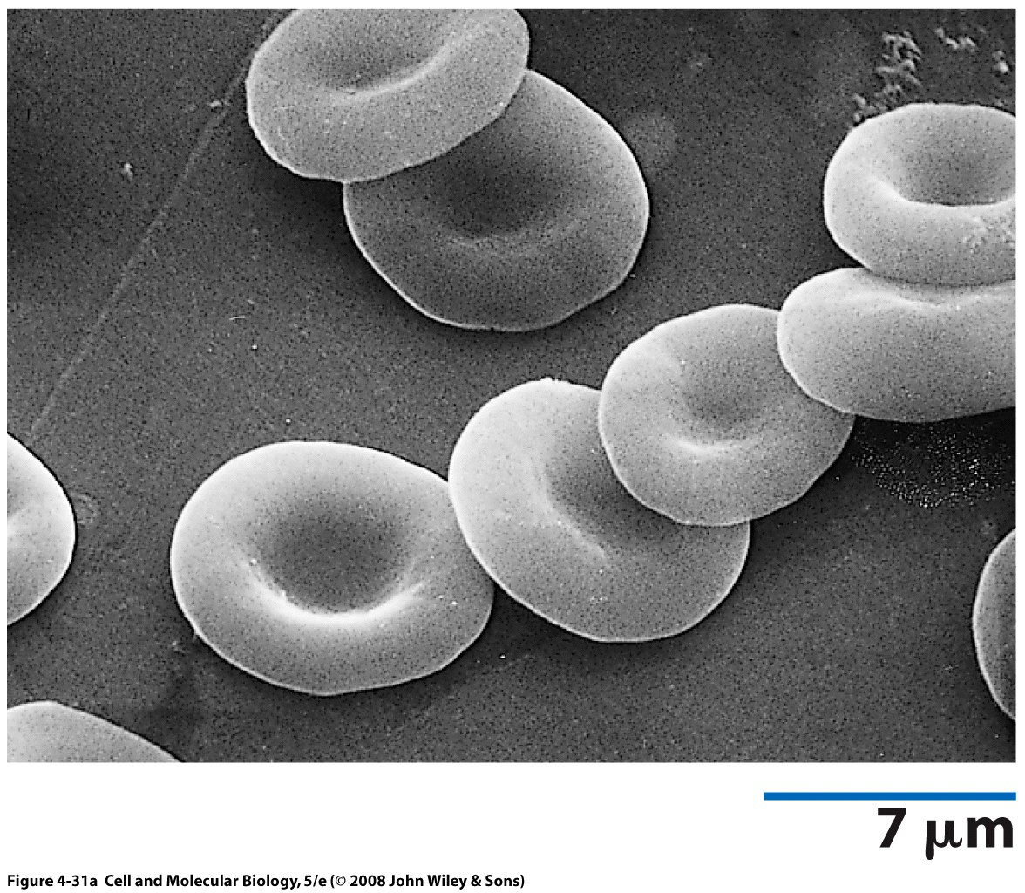
The red cell membrane and its defects
Subarna Chakravorty

Slide 2
Aims of this talk
Outline the structure and function of the red cell membrane
Discuss the molecular defects underlying some of the well-known red cell membrane defects in humans
Discuss the clinical features of such membranopathies

Slide 3
Objectives
By the end of this talk we will:
Understand the structure of the RBC membrane and its role in RBC rheology
Correlate the structure and function of individual components of the RBC membrane
Understand how the membrane defects correlate to clinical effects in RBC membrane disorders

Slide 4
The RBC membrane
The plasma membrane of the RBC is its only structural component and accounts for all of its diverse antigenic, transport, and mechanical characteristics
The RBC membrane is composed of a lipid bilayer along with a 2D protein network running beneath the inner surface of the bilayer (RBC membrane skeleton)
The lipid bilayer is studded with transmembrane proteins

Slide 5
RBC membrane deformability
Reticulocyte
Normal
discoid RBC
An RBC squeezing
through a
splenic cord
RBC shape in an
in vitro
flow chamber
Mohandas and Gallagher, Blood 2008

Slide 6
Structural organisation of a normal RBC membrane
It is highly elastic (100-fold softer than a latex membrane of comparable thickness)
rapidly responds to applied fluid stresses (time constants in the range of 100 milliseconds)
stronger than steel in terms of structural resistance.
While a normal red cell can deform with linear extensions of up to approximately 250%, a 3% to 4% increase in surface area results in cell lysis.

Slide 7
Membrane lipids
The lipid bilayer is composed of equal proportions by weight of cholesterol and phospholipids
Phosphatidylcholine and sphingomyelin are predominantly located in the outer monolayer, while most phosphatidylethanolamine and all phosphatidylserine (PS), together with the minor phosphoinositide constituents are confined to the inner monolayer

Slide 8
Phospholipid bilayer

Slide 9
Maintaining the phospholipid dysequlibrium
Flippase
Floppase
Scramblase
Avoid PS exposure in outer layer to prevent phagocytosis by macrophages and inhibit adhesion of RBC membrane to endothelium
By interactions with skeletal proteins, spectrin, and protein 4.1R, both PS and phosphatidylinositol-4,5-bisphosphate (PIP2) can regulate membrane mechanical function

Slide 10
RBC membrane proteins
At least 50 proteins have been described
blood group antigens (25)
transport proteins
adhesion proteins involved in interactions of red cells with other blood cells and endothelial cells
signaling receptors
other still undefined activities

Slide 11
Membrane transport proteins
Band 3 (anion transporter)
Aquaporin 1 (water transporter)
Glut1 (glucose and L-dehydroascorbic acid transporter)
Kidd antigen protein (urea transporter)
RhAG (gas transporter, probably of carbon
dioxide),
Na-K-ATPase, Ca ATPase, Na-K-2Cl cotransporter,
Na-Cl cotransporter, Na-K cotransporter, K-Cl
cotransporter, and Gardos Channel.

Slide 12
Membrane adhesion proteins
ICAM4 (interacts with integrins)
Lu (laminin binding protein)

Slide 13
Macromolecular membrane protein complexes
Mohandas and Gallagher, Blood 2008

Slide 14
Macromolecular membrane protein complexes
Mohandas and Gallagher, Blood 2008

Slide 15
Macromolecular membrane protein complexes
Mohandas and Gallagher, Blood 2008

Slide 16
Skeletal proteins
α spectrin
β spectrin
Actin
Protein 4.1
Adducin
Dematin
Tropomysin
Tropomodulin

Slide 17
Spectrin
Long and filamentous
Triple helical repeats of 106 amino acids
20 repeats in α spectrin
16 repeats in β spectrin

Slide 18
Horizontal linkages of spectrin at transmembrane protein interaction site
Mohandas and Gallagher, Blood 2008

Slide 19
Other skeletal proteins
Actin- polymers made of 16-20 monomers, numbers are tightly regulated in the red cell membrane
The spectrin dimer-dimer interaction and the spectrin actin- protein 4.1R junctional complex are key regulators of membrane mechanical stability
play a critical role in preventing deformation-induced membrane fragmentation as the cell encounters high fluid shear stresses in circulation.

Slide 20
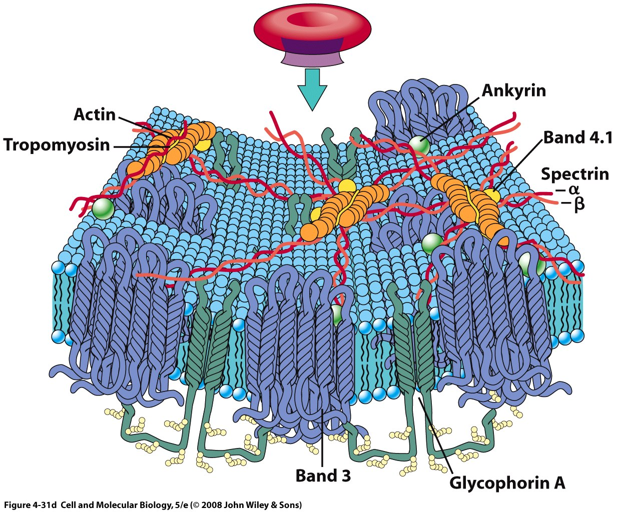

Slide 21
Structure-function relationship of the RBC membrane
Geometry of the RBC
Cytoplasmic viscosity
Membrane deformability

Slide 22
Cell shape: bi-concave discs
Average volume 90fl , average SA 140μm²
40% more surface area compared to a sphere of the same volume
Strong cohesion between lipid bilayer and skeletal proteins stops membrane vesciculation (vertical linkage between bilayer and membrane skeleton)
Membrane integrity is maintained by strong interactions within the skeletal proteins (spectrin dimers and proteins in the junctional complex ) and with membrane phospholipids
Careful cation regulation maintains RBC volume

Slide 23
Macromolecular membrane protein complexes
Mohandas and Gallagher, Blood 2008

Slide 24
Cytoplasmic viscocity
Rapid RBC shape change is governed by its cytoplasmic viscocity, which in turn is determined by the Haemoglobin concentration within the cell (MCH)
Average MCH 33 g/dl (27-37)
Viscosity rises steeply if MCH > 37
increased cytoplasmic viscosity will hamper the cells ability to squeeze through microcirculation and affect tissue oxygen delivery ( but not cell survival)

Slide 25
Membrane deformability
Spectrin repeats behave as independent folding and unfolding units, affecting membrane elasticity

Slide 26
Red cell membrane defect in disease
Membrane or skeletal protein mutations causing altered membrane function
Hereditary Spherocytosis (HS)
Hereditary Elliptocytosis (HE)
Hereditary Stomatocytosis
Hereditary Ovalocytosis
Secondary effect on membrane function due to altered globin content in RBC

Slide 27
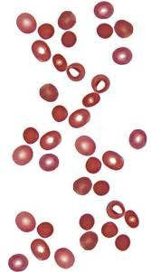
Hereditary spherocytosis
Autosomal dominant
Common in Caucasians (1:3000)
Clinical features:
Anaemia
Jaundice
Reticulocytosis
Splenomegaly
Gallstones
Spherocytes in blood smears

Slide 28
Hereditary spherocytosis
Clinical heterogeneity
Loss of RBC membrane surface area, causing cell shape change to spherocytes
Destroyed in splenic cords
Membrane surface area loss occurs due to reduction in loss of cohesion of the membrane components due to mutations in the so –called ‘Vertical linkage’ proteins

Slide 29
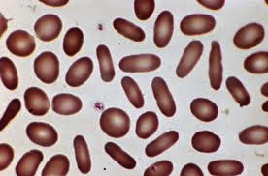
Hereditary elliptocytosis
Autosomal dominant
Worldwide distribution (more in malarial endemic areas)
10% are symptomatic
Elliptical cells on smears

Slide 30
Hereditary elliptocytosis
Reduction in membrane surface area
Gradual deformation of cell shape to elliptical
Occurs as a result of mutation in membrane skeletal proteins responsible for ‘horizontal linkage’ – spectrins, protein 4.1, etc

Slide 31
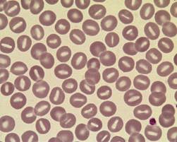
Overhydrated heredtary stomatocytosis (OHS)
Autosomal dominant
Marked increase in cation content
Stomatocytes on smear
Molecular basis not known

Slide 32
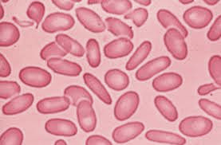
Reduced membrane deformability
SE asian ovalocytosis
Marked reduction in cell membrane deformability
Single mutation in band 3
Ovalocytes on smear

Slide 33
When to suspect RBC membranopathy
Haemolytic anaemia
Jaundice
No evidence of immune haemolysis
Reticulocytosis
Family History
Peripheral smear

Slide 34
Specialist tests
EMA binding assay
SDS PAGE Electrophoresis

Slide 35
Spectrin electrophoresis

