Slide 1
Indications and contraindications for transfusion in inherited red cell disorders
Dr Stephen Field
Welsh Blood Service

Slide 2
The Inherited Red Cell Disorders
The haemoglobinopathies
  Sickle cell disease
  The Thalassaemias
    Alpha thalassaemia
      Silent carrier (1 gene deletion)
      Trait (2 gene deletion cis or trans)
      HbH diseases (3 gene deletion)
      Hb Barts (4 gene deletions- incompatible with life)
    Beta thalassaemia
      Minor
      Intermedia (β⁺⁾
      Major ( βº)
Transfusion often required but is variable from episodic crisis management to life time support
No Transfusion support needed
Transfusion generally not required but transient episodes of anaemia may require transfusion support
No Transfusion support needed
Transfusion generally not required but transient episodes of anaemia may require transfusion support
Lifetime transfusion support required

Slide 3
  Combinations Sickle /Thalassaemia
    Hb Sβ⁺ thalassaemia
    Hb Sβ⁰ thalassaemia
  Other Haemoglobinopathies
    Hb Constant Spring (non deletion HbH diseases)
    Hb E
Transfusion generally not required but transient episodes of anaemia may require transfusion support
Lifetime transfusion support required
Lifetime transfusion support required
Transfusion often required but is variable from episodic crisis management to life time support

Slide 4
The Inherited Red Cell Disorders
Congenital Dyserythropoietic Anaemia
Red cell membrane disorders
  Inherited spherocytosis
  Inherited elliptocytosis
Enzymopathies
  G6PD deficiency
  Pyruvate kinase deficiency
Present as a broad clinical spectrum- severe forms may require transfusion support
These conditions apart from some acute episodes of haemolysis generally do not require transfusion support

Slide 5
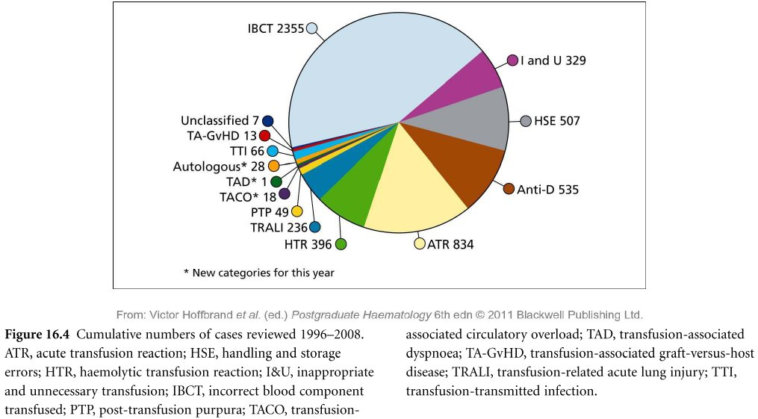
Transfusion – General principles
Good Transfusion Practice
  Right blood to right patient
    Correct identification at pre transfusion sampling
    Correct labelling of blood for transfusion
    Correct identification of patient at time of transfusion

Slide 6
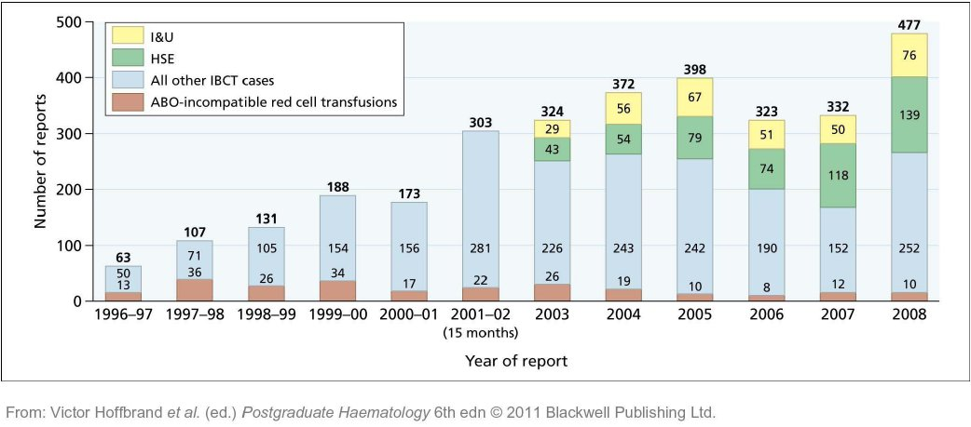

Slide 7
Safe Sample Labelling
The patient must be identified BEFORE taking the blood sample by asking their name and date of birth & checking their wristband
The blood transfusion sample MUST be correctly labelled (including the signature of the person taking the sample) or it will be REFUSED and discarded
No addressograph labels may be used on the sample bottle
The sample must be labelled by the person taking the blood and sample bottles must not be pre-labelled
Errors can not be altered once the sample has been sent to the laboratory and the patient will have to be re-bled

Slide 8
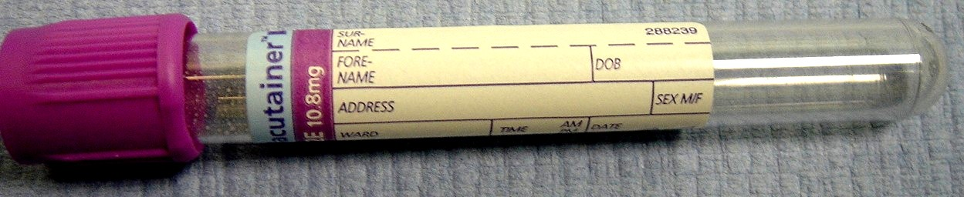
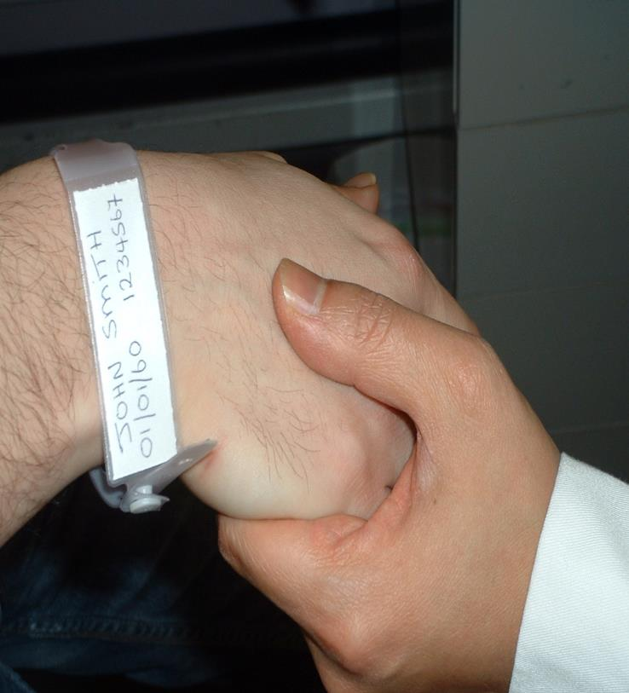
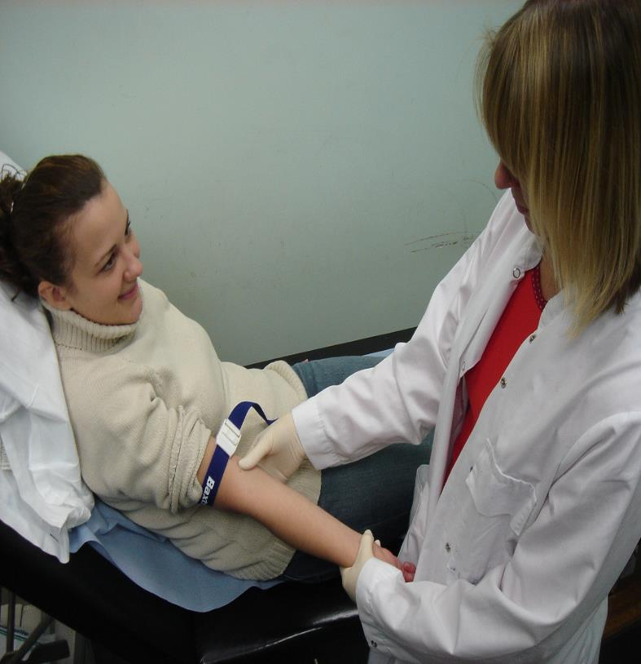
DO NOT PRE-LABEL SAMPLE BOTTLE
Identify patient using wristband
Ask them to state their name and date of birth

Slide 9
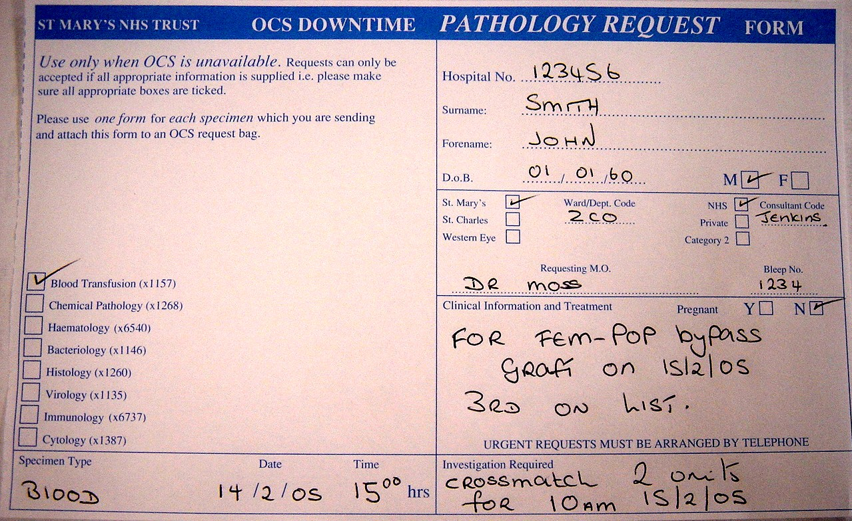
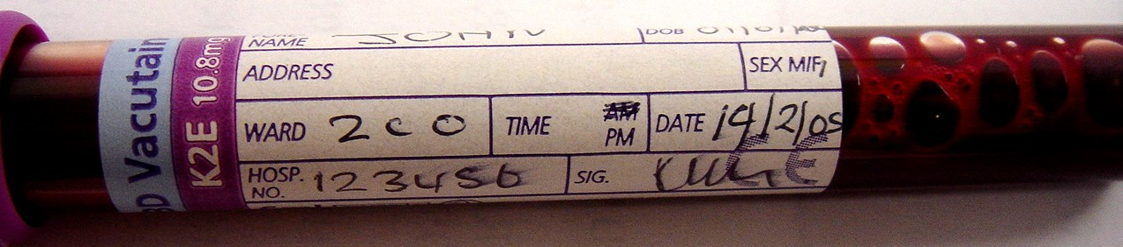
Correct patient details
Ward, Consultant & name of requesting MO
Relevant clinical details & indication
Units required & time needed
Correctly labelled & signed sample
Insufficient clinical information will result in sample not being processed

Slide 10
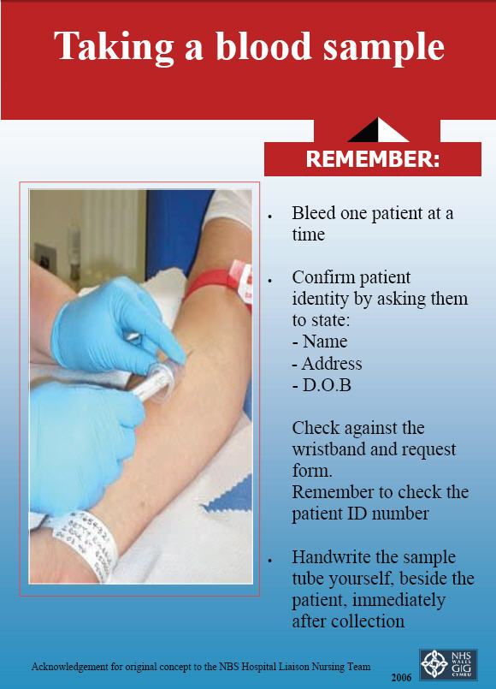
Printed labels not allowed
3 points of Identification
Name, Unique Hospital No DOB

Slide 11
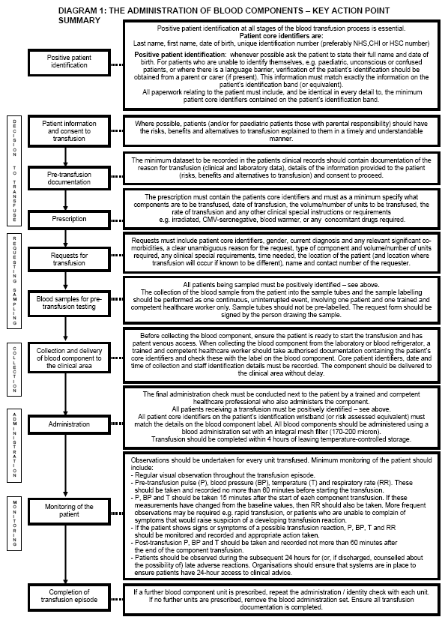
http://www.bcshguidelines.com/4_HAEMATOLOGY_GUIDELINES.html?dpage=0&dtype=Transfusion&sspage=0&ipage=0

Slide 12
Transfusion – General principles
Transfusion only when benefit outweighs the risk
  Transmission of infectious agents – HIV,HCV,HBV Bacteria CJD etc.
  Haemolytic transfusion reaction
  Immunological reactions –
  Transfusion associated lung injury (TRALI)
  Transfusion associated Graft v Host disease (TA-GvHD) (Rare)
  Post transfusion Purpura (PTP)
  Anaphylaxis
  Allergic reactions
  Febrile reactions

Slide 13
Transfusion – General principles
Good Transfusion Practice
  Right blood to right patient
    Correct identification at pre transfusion sampling
    Correct labelling of blood for transfusion
    Correct identification of patient at time of transfusion

Slide 14
Transfusion – General principles
Transfuse the right amount
  Transfusion associated circulatory overload (TACO)

Slide 15
Objects of transfusion in Thalassaemia & Sickle Cell Disease
Providing the oxygen carrying capacity by increasing the total haemoglobin level
Suppression of ineffective erythropoiesis/ sickling at the same time minimising iron overload
Maintenance of red cells in circulation with normal red cell lifespan. ( i.e. increase the erythrocyte half life)
Maintain Haemoglobin between 9 and 10,5 g/dl
  although adjustment upwards (11-12 g/dl) to compensate for patients with heart disease who do not adequately supress bone marrow activity at the lower level.

Slide 16
Iron Overload
Consequence of hyper transfusion regimens particularly in β⁰ Thalassaemia and to a lesser extent in Sickle cell disease.
  each unit of transfused red cells introduces 200 to 250 mg of elemental iron into the body.
  Since iron cannot be actively excreted, and is utilized poorly in patients with ineffective erythropoiesis
  the excess iron is deposited in macrophages of the reticuloendothelial system.
  When this iron burden overwhelms the ability of reticuloendothelial cells to sequester the iron, parenchymal iron overload develops, leading to end-organ dysfunction, especially in the liver, myocardium, and endocrine organs.
Can arise as a result of anaemia due to ineffective erythropoiesis

Slide 17
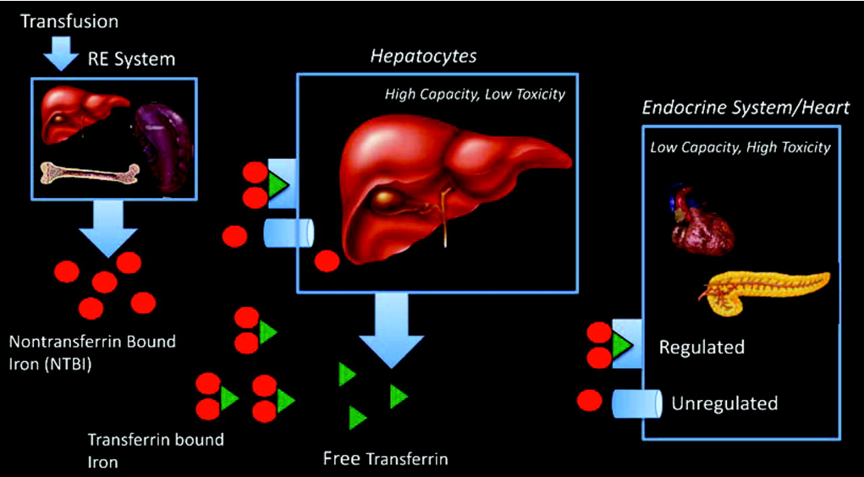
Schematic depicting organs responsible for iron cycling and iron uptake in thalassemia major patients
Impact of Iron Assessment by MRI John C. Wood
ASH Education Book December 10, 2011 vol. 2011 no. 1 443-450

Slide 18
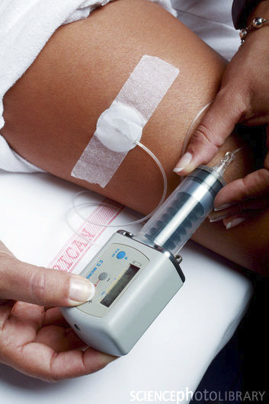
Iron Chelation Therapy
The discovery of the iron chelator DEFEROXAMINE in the 1960s revolutionised the management of β⁰ Thalassaemia.
Transfusion regimens alone without chelation extended life expectancy to 2nd decade. Chelation has extended this considerably.
Deferoxamine is usually administered as a slow, subcutaneous infusion through a portable pump.
Dose 20-60mg/Kg/day over 8-24 hours
It is freely soluble in water.
Approximately 8 mg of iron is bound by 100 mg of deferoxamine.

Slide 19
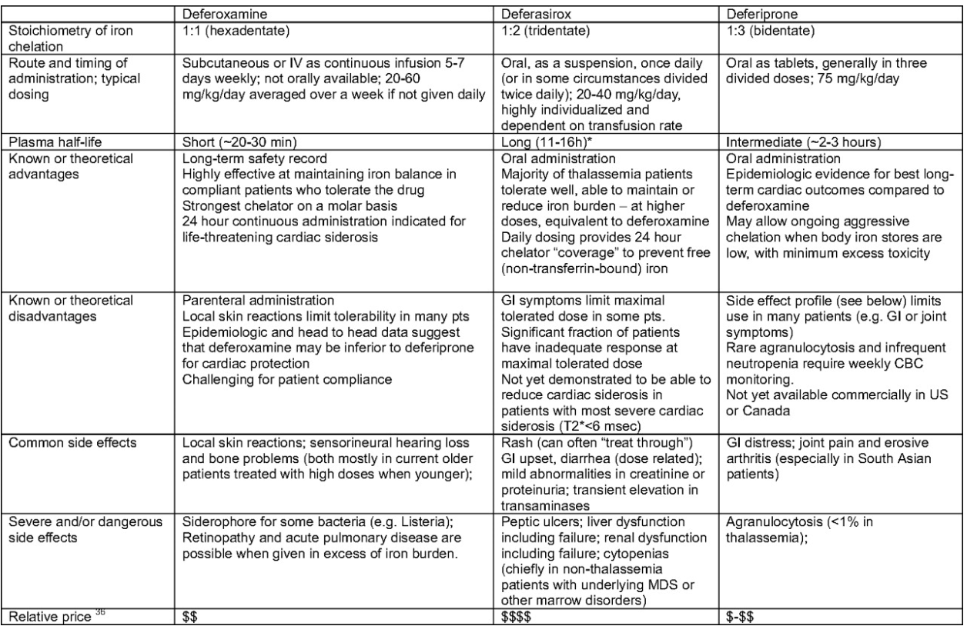
Comparison of 3 Iron Chelators
Update on Iron Chelators in Thalassemia Ellis J. Neufeld
ASH Education Book December 4, 2010 vol. 2010 no. 1 451-455

Slide 20

Oral Iron Chelators
Deferasirox (Exjade®)
  Dose: Adult and over 2 years initially 10–30 mg/kg once daily according to serum-ferritin concentration and amount of transfused blood (consult product literature); maintenance, adjust dose every 3–6 months in steps of 5–10 mg/kg according to serum-ferritin concentration; usual max. 30 mg/kg daily, but may be increased to max. 40 mg/kg daily and reduced in steps of 5–10 mg/kg once control achieved
  Side-effects: gastro-intestinal disturbances (including ulceration and fatal haemorrhage); headache; proteinuria; pruritus, rash; less commonly hepatitis, cholelithiasis, oedema, fatigue, anxiety, sleep disorder, dizziness, pyrexia, pharyngitis, glucosuria, renal tubulopathy, disturbances of hearing and vision (including lens opacity and maculopathy), and skin pigmentation; hepatic failure, acute renal failure, blood disorders (including agranulocytosis, neutropenia, pancytopenia, and thrombocytopenia), hypersensitivity reactions (including anaphylaxis and angioedema), alopecia also reported
Deferiprone (Ferriprox®)
  Dose: Adult and over 6 years 25 mg/kg 3 times daily (max. 100 mg/kg daily)
  Contra-indications : history of agranulocytosis or recurrent neutropenia
  Side-effects: gastro-intestinal disturbances (reducing dose and increasing gradually may improve tolerance), increased appetite; headache; red-brown urine discoloration; neutropenia, agranulocytosis; zinc deficiency; arthropathy

Slide 21
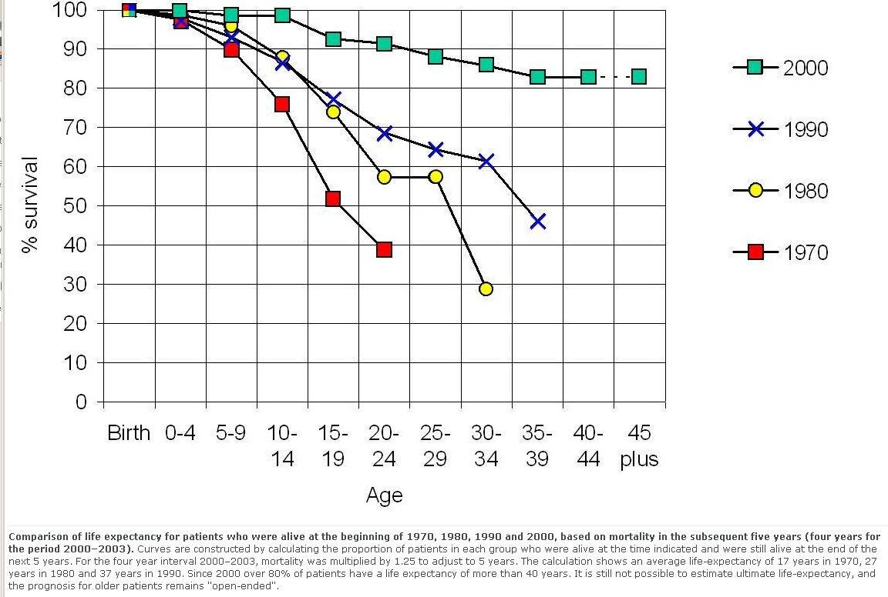
LIFE EXPECTANCY IN THALASSAEMIA PATIENTS

Slide 22
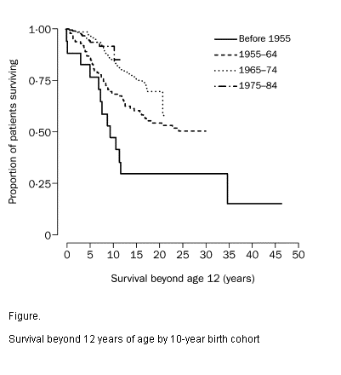
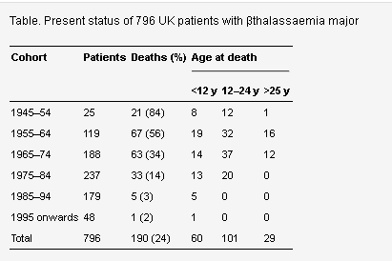
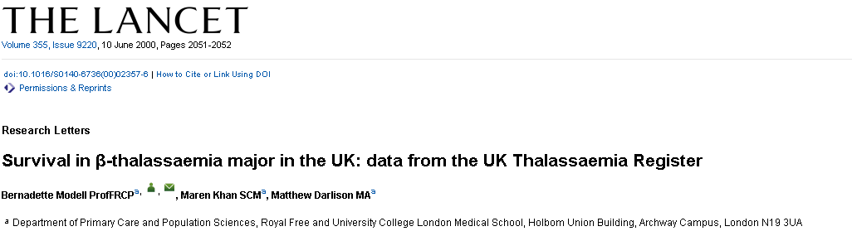
Improved survival in Thalassaemia patients

Slide 23
Transfusion in Sickle cell disease
Three approaches to transfusion depending on the particular indication
    Simple or intermittent transfusion
      This is a simple transfusion of red blood cells to alleviate acutely worsening symptomatic anaemia.
    Hyper-transfusion or chronic regimens
      Regular transfusions designed to maintain haemoglobin levels at a level that suppresses erythropoiesis.
    Exchange transfusion
      Isovolaemic exchange of blood using an apheresis machine or manual technique.

Slide 24
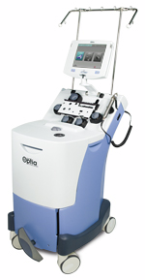
Apheresis
Exchange transfusion is done by a process of Apheresis
  Apheresis- Greek to take away
  The COBE Optia Apheresis System sets the standard of care for many procedures:
    TPE: Therapeutic plasma exchange
    RBCX: Red blood cell exchange and depletions
    Depletions: Platelet and white blood cell depletions
    Can be used in Paediatric applications

Slide 25
Aplastic crisis
  Usually caused by Parvovirus B19 and is usually transient not usually requiring transfusion
  Transfusion indicated if evidence of cardio-respiratory compromise or a haemoglobin of less than 5 g/dl with reticulocytopenia

Slide 26
Splenic sequestration
  This crisis occurs in infants and young children and is characterised by sudden massive pooling of red cells in the spleen. This is due to sickled red cells becoming trapped in the sinusoids of the spleen.
  Defined
    as an acute fall in haemoglobin level to < 6 g/dl or
    fall of haemoglobin >3 g/dl compared to the baseline value
  The haemoglobin increment after transfusion is often higher than expected in such cases.
    This is due to the spleen and loading red cells back into the circulation a process known as autotransfusion.
    Initial transfusions should be at half the expected dosage in order to observe any autotransfusion effect.
  Caution Over transfusion may result in increasing the viscosity which in itself has adverse effects on the patient.

Slide 27
Hepatic sequestration
    Occurs in adults and is characterised by rapid enlargement of the liver due to obstruction of sinusoids by masses of sickled erythrocytes
    This is a RARE complication of vaso-occlusive crisis in sickle cell disease and needs to be differentiated from other conditions such as cholestasis which is relatively common
    Are often managed with simple transfusion - the auto transfusion phenomenon may occur and care needs to be taken to avoid a hyper viscosity syndrome
    Some centres recommend exchange transfusion in this setting

Slide 28
Acute Stroke
Major indication is prevention of recurrent stroke in children
  Trans cranial Doppler (TCD) screening of with SCD to identify susceptible children
  Approximately 5% of children with sickle cell disease and will experience a cerebral-vascular incident.
  70% of those that have a first/will develop a recurrent stroke within two to three years.
Chronic transfusion of red cells is critical in reducing recurrent stroke (reduction by up to 90%- STOP I trial NEJM 339: p5, 1998)
Recommended guideline is to give a simple transfusion every three to four weeks
  Hb AS-level lower than 30% and haematocrit level of 30% or lower. (This can be achieved using exchange transfusion)
STOP II trial showed that chronic transfusions should not be stopped after a period of 30 months as the risk returned to the same level as prior to the commencement of the chronic transfusion regimen.

Slide 29
ACUTE CHEST SYNDROME
Defined and a new pulmonary infiltrate on chest x-ray accompanied by respiratory symptoms, chest pain, or fever.
Approximately 30 paper 30% of patients with sickle cell disease will develop acute chest syndrome at least once in their lifetime. Half of these will have one or more recurrent episodes.
Red cell transfusion early in the course of acute chest syndrome has been shown to improve the condition it instituted within 48 hours of the diagnosis.
In this survey patient a simple transfusion is adequate that in those with progressive decline in pO₂ (less than 60 mmHg in adults and less than 70 mmHg and children)
In rapid clinical deterioration therapeutic exchange transfusion is recommended

Slide 30
Acute multi organ system failure
Multi organ system failure may occur as a result of multiple infarctive episodes secondary to vascular occlusion of the small vessels although the exact aetiology is unknown
Multi organ system failure may occur after several episodes of severe pain crisis.
Therapeutic intermittent simple or exchange transfusions are recommended during acute organ failure and had been shown to rapidly reverse organ dysfunction and improve clinical syndromes

Slide 31
Severe infection
Patients with sickle cell disease are more susceptible to infections as a result of functional asplenia.
Complications from infections may lead to increased morbidity and mortality.
Infection alone is not an indication of transfusion however patients that become symptomatically anaemic would benefit from intermittent simple transfusion.

Slide 32
Perioperative transfusion management in SCD
Patients with sickle cell disease undergoing general anaesthesia are at higher risk of developing intra vascular sickling with its associated morbidity and mortality.
Prospective studies have shown that patients with sickle cell disease undergoing cholecystectomy had increased rate of perioperative sickle cell related complications if they had not been transfused. – A conservative simple transfusion was recommended (Blood 89: 1543, 1997)
A study comparing conservative and aggressive transfusion regimens showed that there was no difference in the number of postoperative days occlusive complications between either group. (NEJM 333: 206, 1995)
UK guidelines state that transfusion is not routinely indicated for patients with sickle cell disease when the haemoglobin is >7 g per dl and it is suggested that such patients are treated in consultation with the specialist centres .

Slide 33
Eye surgery
In many instances eye surgery is done under local anaesthesia and therefore the potential complications of a general anaesthetic do not arise.
However in eye surgery the microvasculature may be compromised if there is excessive settling and this could result in permanent damage.
Therefore the patient should be prepared according to guidelines for those receiving general anaesthesia.

Slide 34
Complicated pregnancy
Transfusion in pregnancy should be directed at specific clearly identifiable medical and obstetric complications such as hypoxaemia progressive persistent symptomatic anaemia acute chest syndrome splenic sequestration or pre-eclampsia

Slide 35
Controversial indications of a transfusion in sickle cell disease

Slide 36
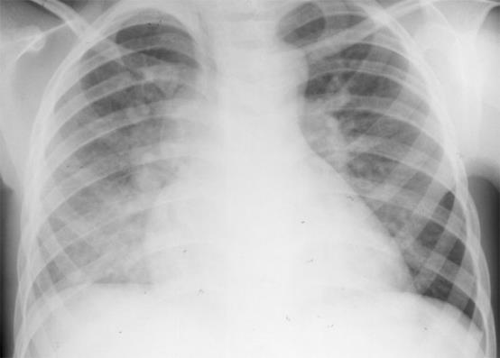
Prevention or pulmonary hypertension/cor pulmonale
Pulmonary hypertension and its related complications is probably one of the most common causes of mortality in patients with sickle cell disease
Doppler echocardiography should be screened to detect early stages of this condition
Some anecdotal evidence in early studies suggested transfusion therapy a be beneficial not only reducing the progression of pulmonary hypertension that could possibly reversing early disease.
Additional data is required before routine transfusion can be recommended for patients with tricuspid regurgitant velocity of > 2.5 m/s

Slide 37
Priapism
Priapism is based manage with adequate hydration and pain control.
Exchange or simple transfusion have been advocated in the past but to date no randomised controlled trial has shown this to be any better than hydration and pain control alone.

Slide 38
ASPEN Syndrome
Associated with sickle cell disease priapism and exchange transfusion is a condition known as ASPEN* syndrome.
In this condition patients with priapism receiving partial exchange transfusions develop neurological complications.
  Range from seizure activity to a reduced level of alertness or consciousness requiring ventilatory support
  Proposed pathophysiology of these neurological events is related to cerebral ischemia after an acute increase in per cent total haemoglobin, concomitant decrease in % haemoglobin S and subsequent release of vasoactive substances during penile detumescence
*Eponym for Association of Sickle cell disease, Priapism, Exchange transfusion and Neurological events

Slide 39
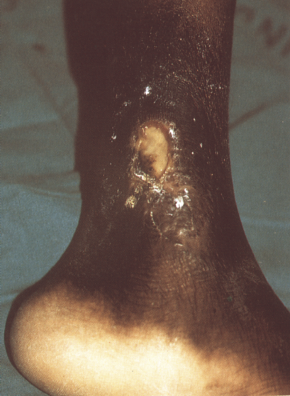
Leg ulcers
Studies in patients with sickle cell disease develop leg ulcers show no improvement having been transfused as compared to those that haven’t received transfusion
Platelet derived growth factor which can be applied by applying platelets (fresh or desiccated) directly to the ulcer surface will promote angiogenesis and tissue growth resulting in accelerated healing (personal observation)
Need to be a licensed blood establishment and autologous platelet to do this in UK so products not available

Slide 40
Problems/adverse effects in transfusion in sickle cell disease
Venous access
  Poor venous access is almost a universal problem.
  Simple diagnostic phlebotomy difficult.
  Transfusion becomes more difficult as venous cut down procedures and central vein canalisation became a necessity

Slide 41
Alloimmunisation and availability of suitable donors
Red-cell at the immunisation is a very common problem in sickle cell disease in the United Kingdom.
This is because of poor phenotypic compatibility between the recipient who is of Afro-Caribbean origin and most of the donors who are Caucasian. There are significant differences in the antigen frequencies in E,C,Kell Fy^{a,},Fy^{b} and Jk^{b}
Matching for Rh in Kell antigens and reduces the possibility of an immunisation in approximately half of patients
A further extension to include S, Fyª and Jk^{b} would prevent alloimmunisation in approximately 70%.
This would exclude most of the available donors since only 0.6% of Caucasian donors would match this phenotype.
Extensive campaigns have been launched by the blood transfusion services to encourage voluntary donation by ethnic minority groups

Slide 42
Delayed transfusion reactions
Delayed haemolytic transfusion reaction is a consequence of the high rates of alloimmunisation
occur 7 to 10 days post-transfusion
Laboratory and clinical evidence of haemolysis
Positive direct antiglobulin test
Identification of new and antibodies
Decreased survival of transfused red cells

Slide 43
Hyperhaemolysis syndrome
Characterised by
    severe haemolysis after blood transfusion
    significant decrease in reticulocytes count from the patient steady-state value
    hyperbilirubinaemia and
    Haemoglobinuria
    Post-transfusion haemoglobin level is lower than pretransfusion level.
    Both patient and transfused red cells are haemolysed
    Direct antiglobulin test usually negative although some patients may have multiple alloantibodies and some have autoantibodies
    Further transfusion may exacerbate this condition and may even cause death.
    Aetiology unknown

