Slide 1
Haemoglobinopathies: a molecular investigation
Letizia Foroni, MD PhD
Haematology/Cellular Pathology department
Hammersmith Hospital campus l.foroni@imperial.ac.uk contact tel: 020 8383 2167

Slide 2
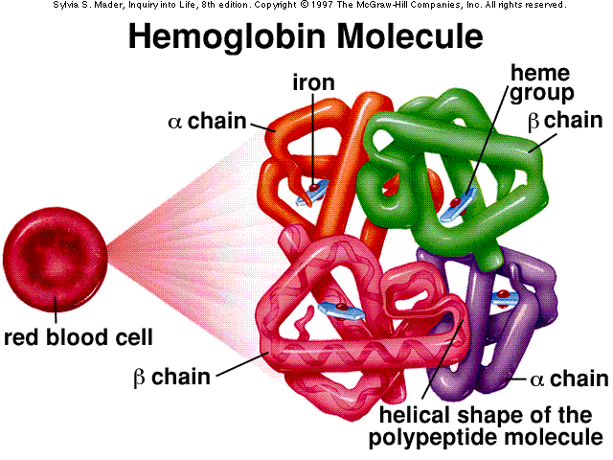
The Haemoglobin protein: structure
Haemoglobin A: HBA
Haemoglobin B: HBB

Slide 3
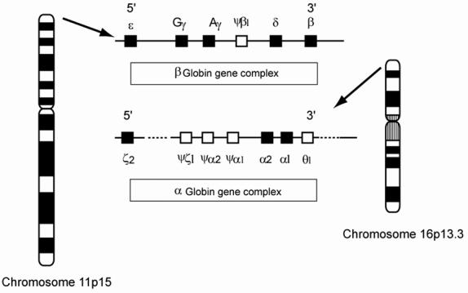
Human globin Genes: location
HBB
HBB
http://old.aacb.asn.au/pubs/cbr05ci.htm

Slide 4
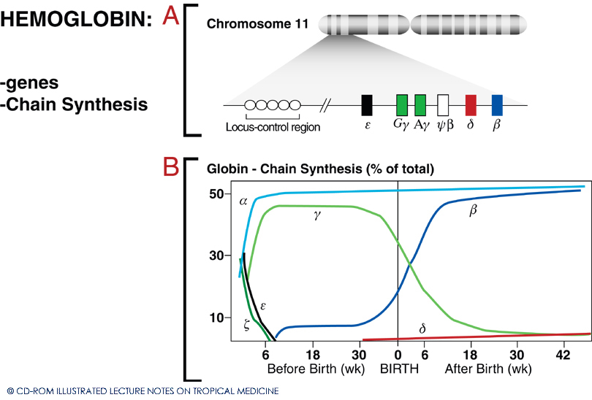
Foetal and adult globin gene production

Slide 5
Most Common Genetic defects
Mutations (99%)
Deletions (95%)
Mutations (5%)
http://old.aacb.asn.au/pubs/cbr05ci.htm

Slide 6

lpha thalassemias: pathophysiology and geographical distribution
▲β chain production
in adults
abnormal
oxygen
dissociation
curves
α Thal
▼α chain production
▲γ chain production
in foetal life

Slide 7
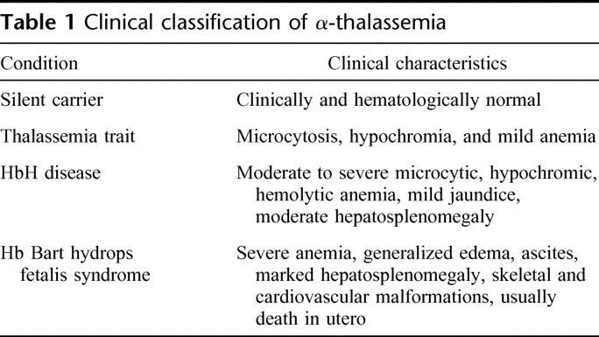
Clinical classification of α-thalassemias

Slide 8
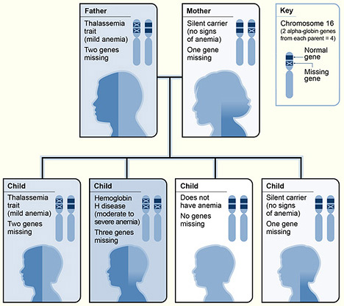
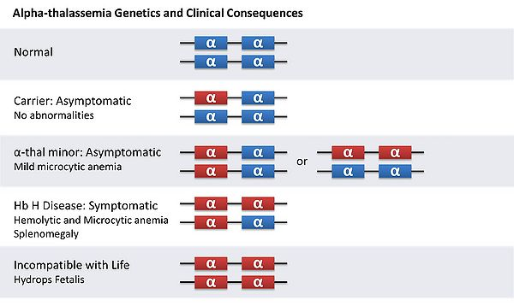
Alpha thalassemias: deletions (95%)
M’
P’
M’
P’
Thalassaemia trait
M’
P’
M’
P’
Affected
M’
P’
Fatal
α1 α2

Slide 9
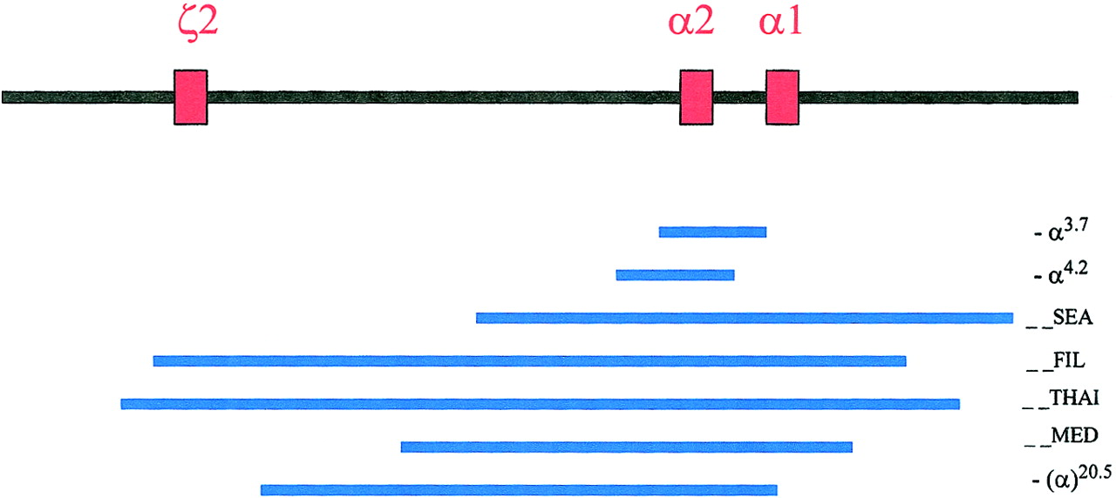
Most common α-Thalassaemia deletions
Common deletions in the ζ-α-globin gene cluster.The 3 red boxes represent the 3 active globin genes, the one embryonic ζ2-globin gene, and the α2- and α1-globin genes.
Chui D H K et al. Blood 2003;101:791-800
©2003 by American Society of Hematology
Notes:
Common deletions in the ζ-α-globin gene cluster.The 3 red boxes represent the 3 active globin genes, the one embryonic ζ2-globin gene, and the α2- and α1-globin genes. They span approximately 26 Kb in length from ζ2 to α1 globin genes. The blue lines represent the common α-thalassemia deletions. Figure adapted with permission from Cambridge University Press2 andBlood.5

Slide 10
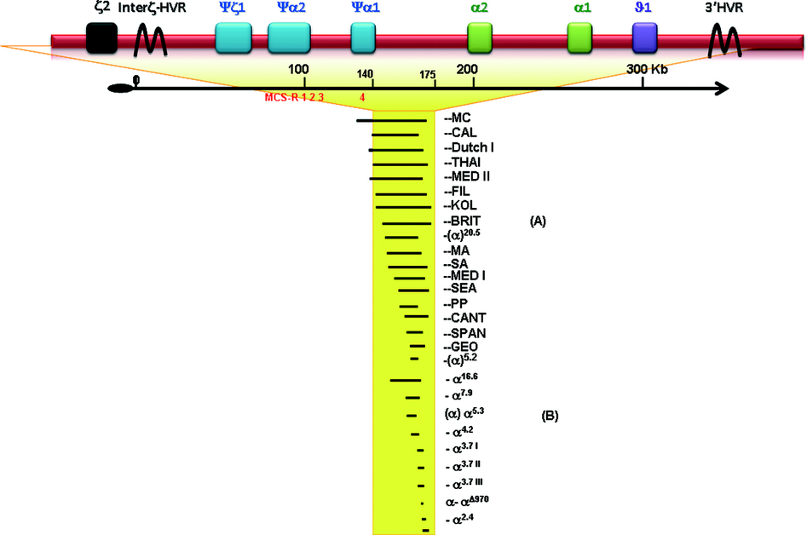
Other common α gene deletions

Slide 11
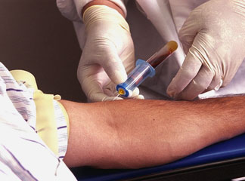
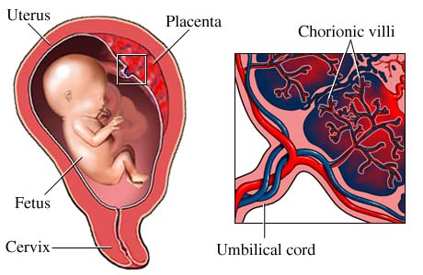
Genetic testing: procedures
DNA can be analysed from
1. patients' white blood cells,
2. prenatal (fetal) testing: amniocytes or chorionic tissue obtained by
-transabdominal or
- transvaginal sampling.

Slide 12
Genetic testing: methodologies
1. Southern Blotting analysis
2. Sequencing
3. Polymerase chain reaction:
GAP-PCR (amplification using oligos flanking deletion breakpoints)
ARMS (amplification refractory mutation system)
RFLP (restriction fragment length polymorphism)
4. ASO detection system
5. Denaturing gradient gel electrophoresis (DGGE)

Slide 13
Polymerase chain reaction
Courtesy Dr T. Vulliamy

Slide 14
GAP-PCR
a large deletion brings together primers that do not give rise to a product from the normal gene.
used in the identification of alpha globin gene deletions.
A
Normal: A and B give a product; A and C are too far apart.
B
C
A
Deleted: A and C now give a product, which is different in size to the product of A and B
C

Slide 15
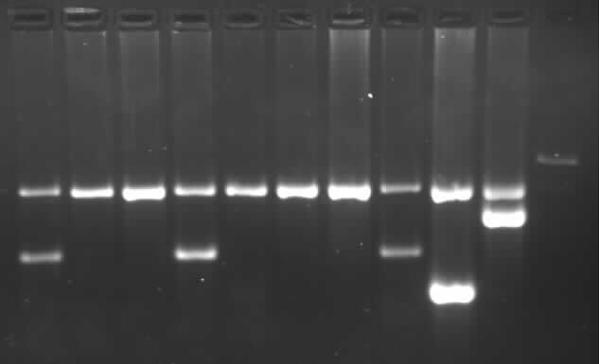
Multiplex PCR detection of αº thalassaemia
FIL^{F}
20.5^{F}
MED^{F}
SEA^{F}
α^{R}
20.5^{R}
MED^{R}
FIL^{R}
SEA^{R}
ζ2
α2
α1
SEA
MED
-20.5
FIL
1
2
3
4
5
6
7
SEA
FIL
MED
-20.5

Slide 16
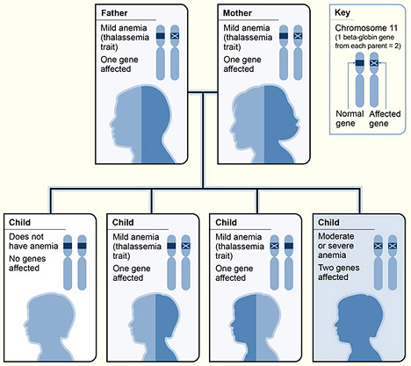
Beta thalassaemias

Slide 17
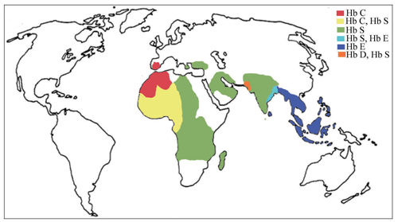
HBB Variant haemoglobinopathies
HBB-S: AA6 GAG>GTG
Glutamic acid > Valine
Heterozyg: Sickle trait
Homozyg: Sickle disease
West Africa and Hispanic and
Mediterranean descendents
HBB-C: AA6 GAG>AAG
Glutamic acid > Lysine
West Africa (Burkino Faso, Cote d'Ivoire
and Ghana; 40-50% affected)
HBB-D: AA121 GAA>CAA
Glutamic acid > Glycine
Northwest India, Pakistan and Iran
HBB 0-Arab: AA121 GAA>AAA
Glutamic acid > Glutamine
HBB-E: AA26 GAG>AAG
Glutamic acid > Lysine
South East Asia

Slide 18
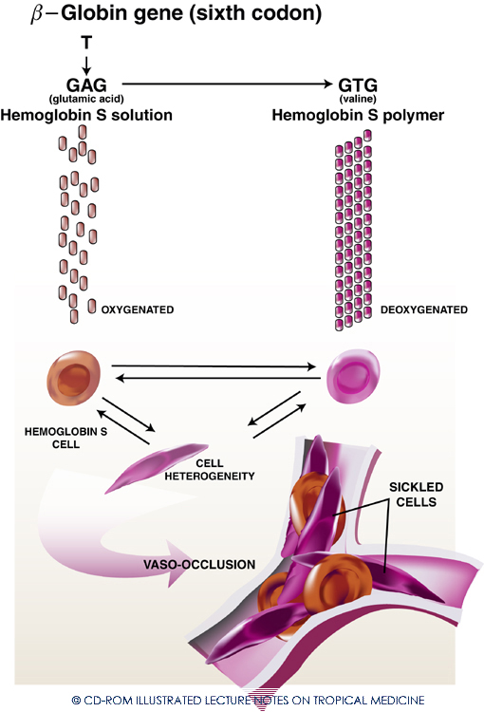
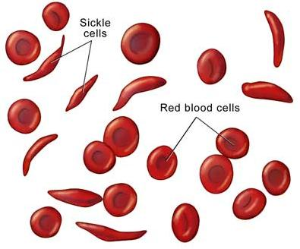
Homozygous HbSS (Sickle cell anaemia)

Slide 19
Methodologies
1. Southern Blotting analysis
2. Sequencing
3. Polymerase chain reaction:
ARMS (Amplification refractory mutation system)
ACRE (Amplification created restriction enzyme)
GAP-PCR
4. ASO detection system
5. Denaturing gradient gel electrophoresis (DGGE)

Slide 20
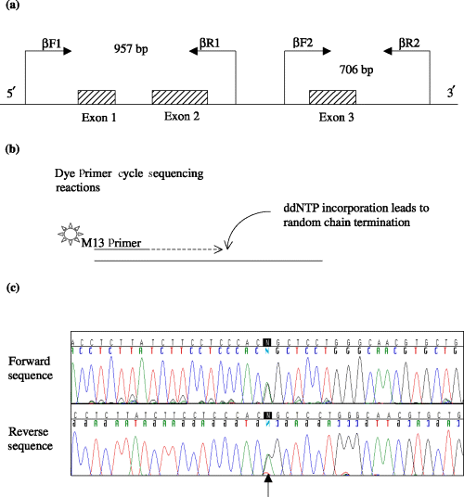
Sequencing of PCR amplified fragments

Slide 21
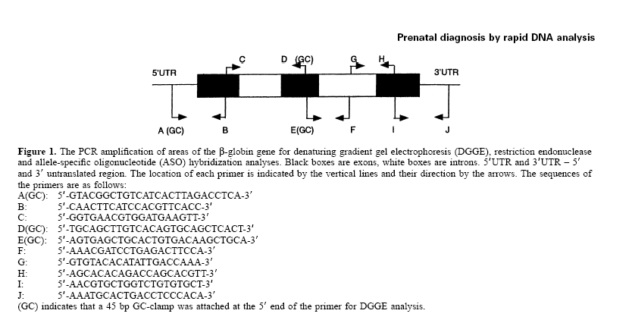
HBB gene disorders

Slide 22
Restriction Fragment Length Polymorphism
T>C
Hind III
Hind III
WT: GAGAGGGATATCGTCGGAAGTTTAT
Wild type allele
Mutated: GAGAGGGATATCGTCGGAAGCTTAT
Mutated allele
Hind III
Hind III
Hind III
Hind III
Wild type allele
Mutated allele

Slide 23
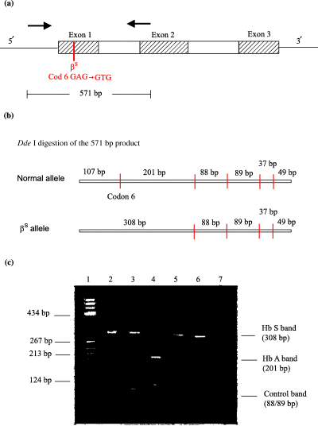
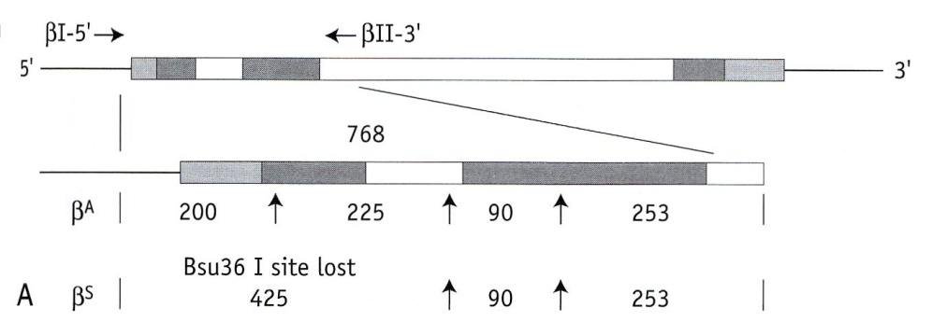
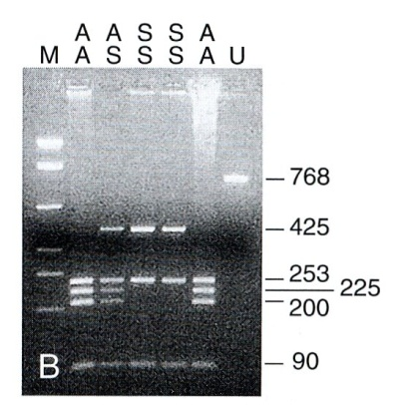
Restriction Fragment Length Polymorphism
(RFLP) examples
From Practical Haematology, 10th Edn.

Slide 24
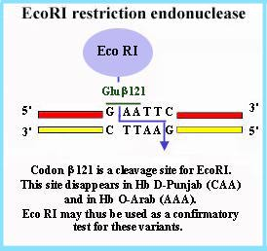
Restriction Fragment Length Polymorphism
RFLP
HBB-D: AA121 GAA>CAA
Glutamic acid-> Glycine
Northwest India, Pakistan and Iran
HBB 0-Arab: AA121 AA121 GAA>AAA
Glutamic acid -> Glutamine
GAA>CAA
GAA>AAA

Slide 25
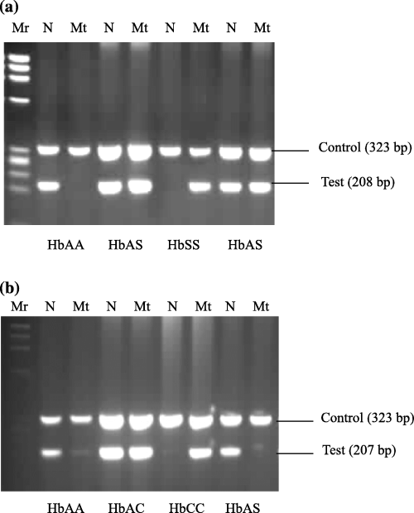
Amplification Refractory Mutation System
(ARMS)
N=WT primer
Mt: Mutated primer
T>C
C’ 323 bp
WT: GAGAGGGATATCGTCGGAAGT
T
Mutated: GAGAGGGATATCGTCGGAAGC
C
Conventional ARMS-PCR performed in 2 separate reactions using a common primer and primers specific for the mutated or WT sequence. A control amplification is carried out to check for the amount of loaded DNA

Slide 26
The High Performance Liquid Chromatography
• Heteroduplex detection by denaturing HPLC
Homo-duplexes
DNA with a heterozygous A>C point mutation
A
5’
3’
3’
T
5’
A
Amplify,
denature
and cool
slowly
5’
C
3’
5’
3’
3’
G
5’
3’
T
5’
5’
C
3’
A
5’
3’
3’
G
5’
3’
5’
G
C
5’
3’
Difference in migration!
3’
T
5’
Hetero-duplexes

Slide 27
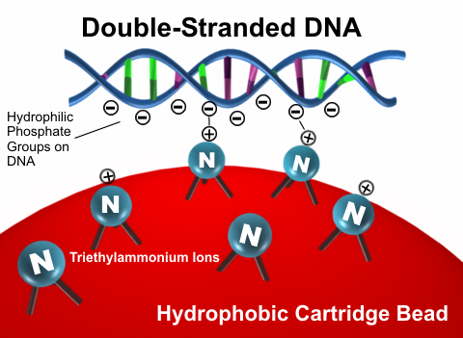

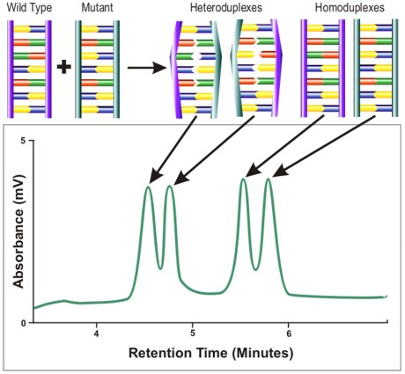
The High Performance Liquid Chromatography

Slide 28
Summary
A-Thal: deletions
  Methodology: Gap PCR and Multiplex PCR
B-Thal: mutations
  Sanger sequencing
  RFLP
  HPLC

Slide 29
Other Red cell disorders
G6PD deficiency
Pyruvate Kinase deficiency
Diamond Blackfan Anaemia

Slide 30
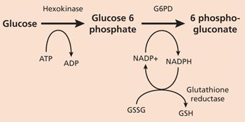
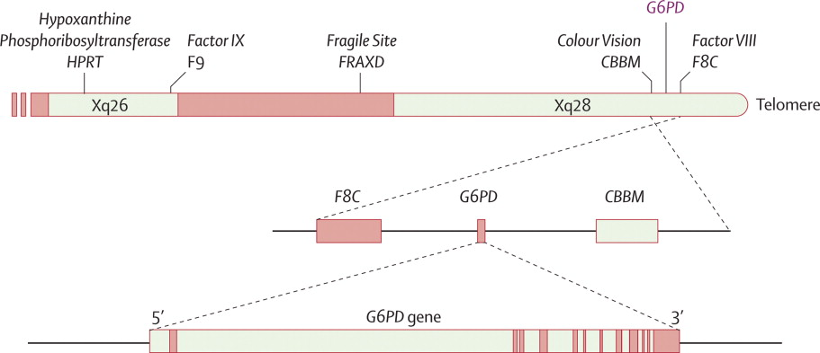
G6PD deficiency and its genetics

Slide 31
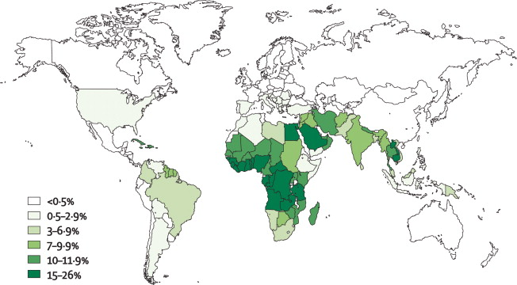
G6PD deficiency: geographical distribution

Slide 32
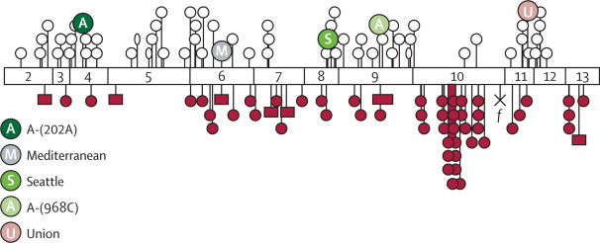
G6PD: genetic defects

Slide 33
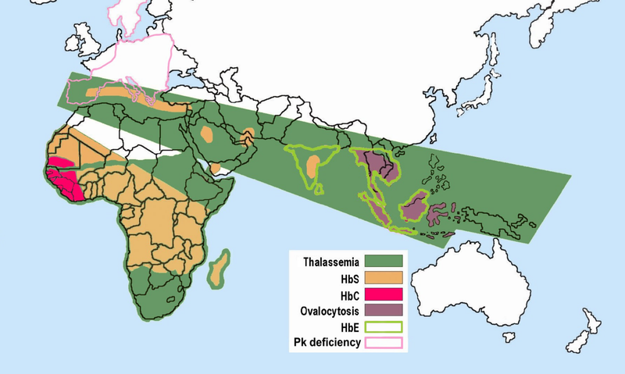
Pyruvate kinase deficiency

Slide 34
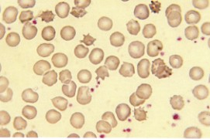
Pyruvate Kinase deficiency
acanthocytes
Pyruvate kinase is a rate-controlling glycolytic enzyme that catalyses
the irreversible conversion of phosphoenolpyruvate (PEP) to pyruvate,
coupled to the synthesis of one molecule of ATP.

Slide 35
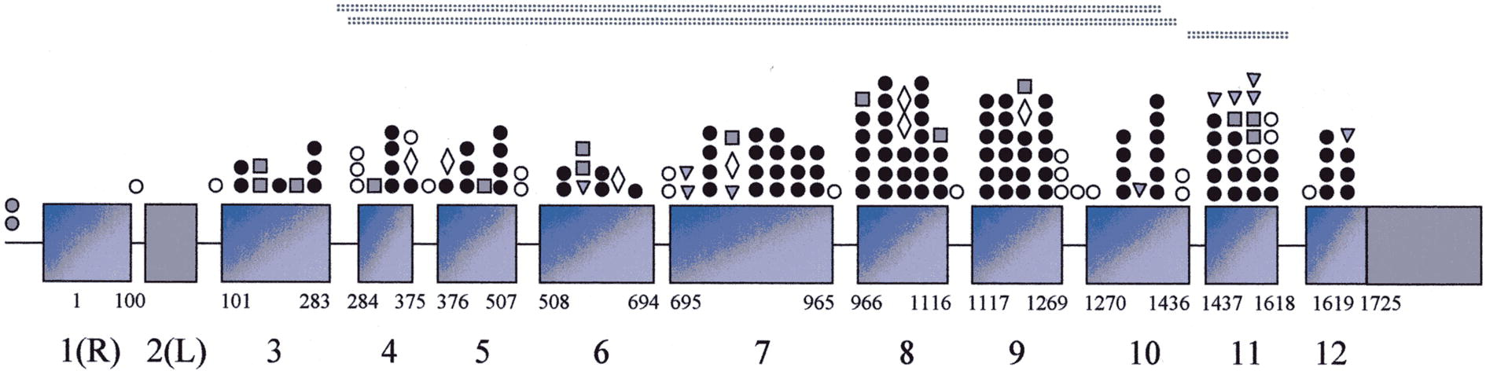
Pyruvate Kinase genetic defect
Figure 2 Schematic representation of PK-LR gene and distribution of mutations associated with PK deficiency. Nucleotides are numbered starting from the ATG in red blood cell-specific exon 1.
Missense mutations
Spice sites
Stop codons
In frame insertions/deletions
Mutations
Alberto Zanella , Elisa Fermo , Paola Bianchi , Laurent Roberto Chiarelli , Giovanna Valentini. Pyruvate kinase deficiency: The genotype-phenotype association; Blood Reviews Volume 21, Issue 4 2007 217 – 231. http://dx.doi.org/10.1016/j.blre.2007.01.001
GenBank accession numbers D10326 and D90465); for the genomic DNA and the putative promoter region GenBank accession numbers are U47654 and D13232 respectively.

Slide 36
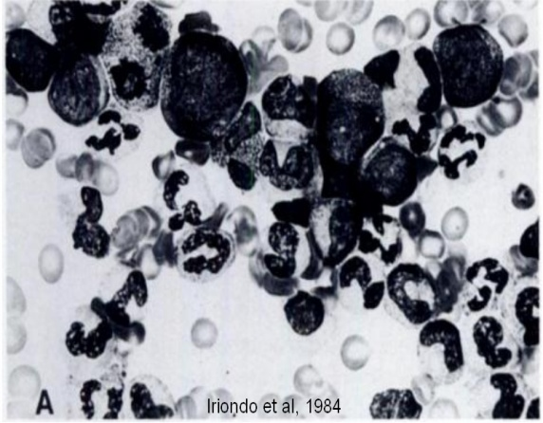
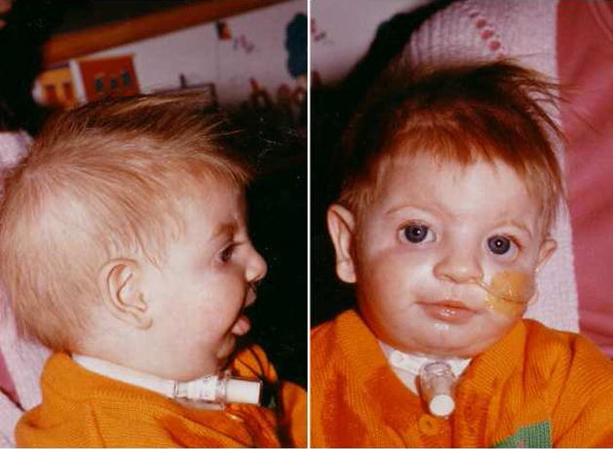
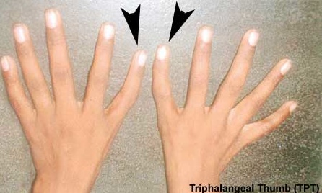
Diamond Blackfan Anaemia (DBA)
Rare, genetically & clinically heterogeneous red cell aplasia
May be inherited or sporadic
Affects about 7 per 1,000,000 live births and usually presents during the first year of life
~50% of DBA patients also have physical anomalies, eg craniofacial (cleft palate), urogenital, upper limb (thumb) and cardiac

Slide 37
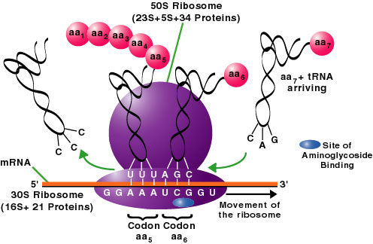
The ribosomes
50S (L) unit:
5S RNA,
28S RNA,
5.8S RNA +
~49 proteins
30S (S) unit:
18S RNA +
33 proteins
A protein knitting machine that uses mRNA as the pattern, amino acids as the wool and tRNA as the needles…

Slide 38



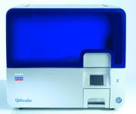
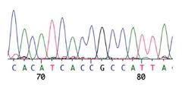
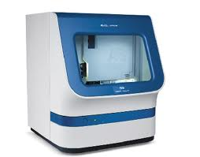
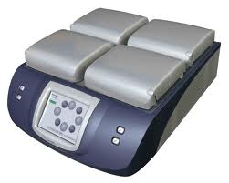
Current DBA Screening Pipeline
Measure & QC
Peripheral Blood
Extract DNA
RPS19
RPL5
RPL11
RPS24
RPS17
RPL35a
RPS7
Sanger Sequence
PCR target gene exons

Slide 39



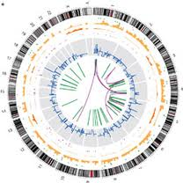
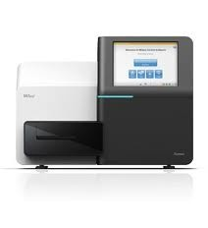
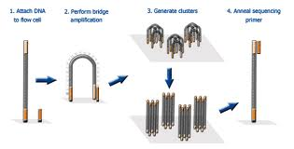
Next Generation Sequencing Workflow
Target Enrichment
Hybridise and capture Ribosomal Protein Gene DNA
including exons, introns, & regulatory regions
Genomic DNA
10 patient-parent pairs
Fragment DNA
High-throughput Sequencing
Library quant, pool, clean up and cluster generation
Data analysis
Sanger seq validation

Slide 40
Results – Mutation Type
Gene
n= (17)
%
Type
RPL5
5
29.4%
3(2) SG/2 FSD
RPS26
3
17.6%
SG/FSD/SL
RPL11
2
11.8%
FSD/FSI
RPS7
1
5.9%
SSD
RPS10
1
5.9%
SG
RPS24
1
5.9%
SG
RPS19
0
0.0%
No Muts
3
23.5%
SG= Stop Gain SNV (Nonsense); FSD= Frame-shift Deletion; FSI= Frame-shift Insertion;
SL= Start Loss SNV (Missense); SSD= Splice Site Defect

Slide 41
Summary
►α-Thal: deletions
  Methodology: Gap PCR and Multiplex PCR
►β-Thal: mutations
  Sanger sequencing
  RFLP
  HPLC
►Others disorders
- Next Generation Sequencing (NGS)
in particular for multi-gene disorders

