Slide 1

Challenges of Blood Transfusion Practice in Africa South of the Sahara
Dr SP Field
Inaugural conference of the African Society for Blood Transfusion ECOWAS March 2011

Slide 2
Why is there a need for organised blood services in Sub Sahara Africa?
Maternal mortality
Child (under 5 mortality)
Safe Blood supply and distribution
  Rural and Urban
  Adequacy and sustainability
Pooled resources –
  component production
  Testing –quality and continuity
Quality Standards
Regulation

Slide 3


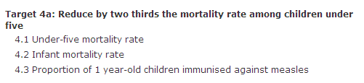
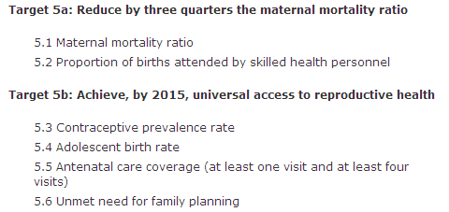

Slide 4
Maternal Haemorrhage
528 000 women worldwide die from complications of pregnancy and childbirth each year
Haemorrhage during labour, delivery and postpartum accounts for 34% of maternal deaths in Africa
Haemorrhage leads to death can occur in around 2 hours (Coagulopathies develop rapidly)
Rapid access to adequate and safe supplies of blood for transfusion is therefore absolutely critical to prevent deaths due to obstetric haemorrhage
Complicated by a starting anaemia in pregnancy (no reserve)
BATES, I., CHAPOTERA, G. K., MCKEW, S. & VAN DEN BROEK, N. 2008. Maternal mortality in sub-Saharan Africa: the contribution of ineffective blood transfusion services. BJOG : an international journal of obstetrics and gynaecology, 115, 1331-9.

Slide 5
Maternal Mortality Ratio, Adjusted (Per 100,000 Live Births) 2005
Transfusion an adjunct to good obstetric care.
Blood must be available within 2 hours in both rural and urban locations.
Good antenatal care should include ABO Rh and antibody screen.
If reliable records available group specific blood can be given in emergency without crossmatch.(caution- this is usually done when a good laboratory computer system is in use.
KHAN, K. S., WOJDYLA, D., SAY, L., GÜLMEZOGLU, A. M. & VAN LOOK, P. F. A. 2006. WHO analysis of causes of maternal death: a systematic review. The Lancet, 367, 1066-1074.

Slide 6
Audit of causes of Maternal death in 5 Senegalese hospitals
The cause of death was assessed in 84% of the cases.
The main causes of death found by the audit committees were:
  haemorrhage,
  pre-eclampsia/eclampsia and
  uterine rupture.
Some 48% of deaths were considered avoidable according to national standards of care;
25% were considered as probably avoidable.
recommendations were
  improve initial management of critical patients at admission time;
  improve the availability of blood for transfusion;
  improve patient monitoring during the postpartum period.
Dumont A, Tourigny C, Fournier P..Improving obstetric care in low-resource settings: implementation of facility-based maternal death reviews in five pilot hospitals in Senegal. Hum Resour Health. 2009 Jul 23;7:61

Slide 7
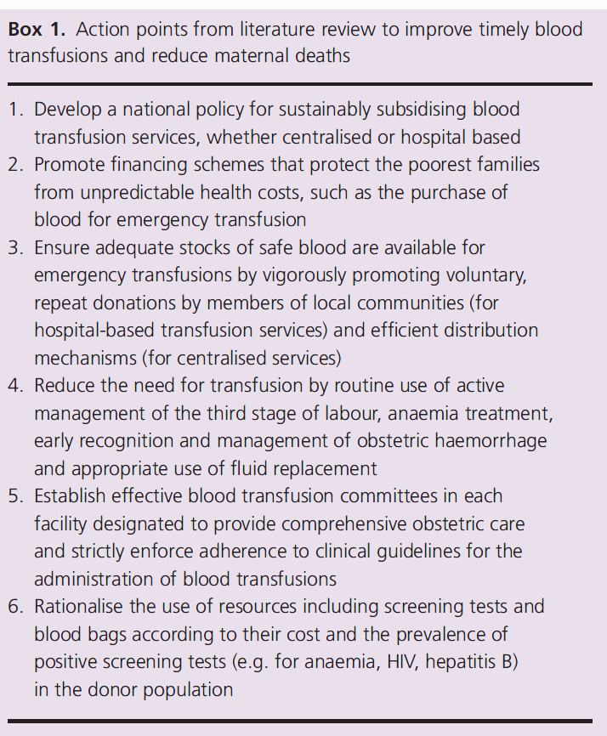
Bates et al, from literature review suggest the following actions to improve timely blood transfusions and reduce maternal deaths
BATES, I., CHAPOTERA, G. K., MCKEW, S. & VAN DEN BROEK, N. 2008. Maternal mortality in sub-Saharan Africa: the contribution of ineffective blood transfusion services. BJOG : an international journal of obstetrics and gynaecology, 115, 1331-9.

Slide 8
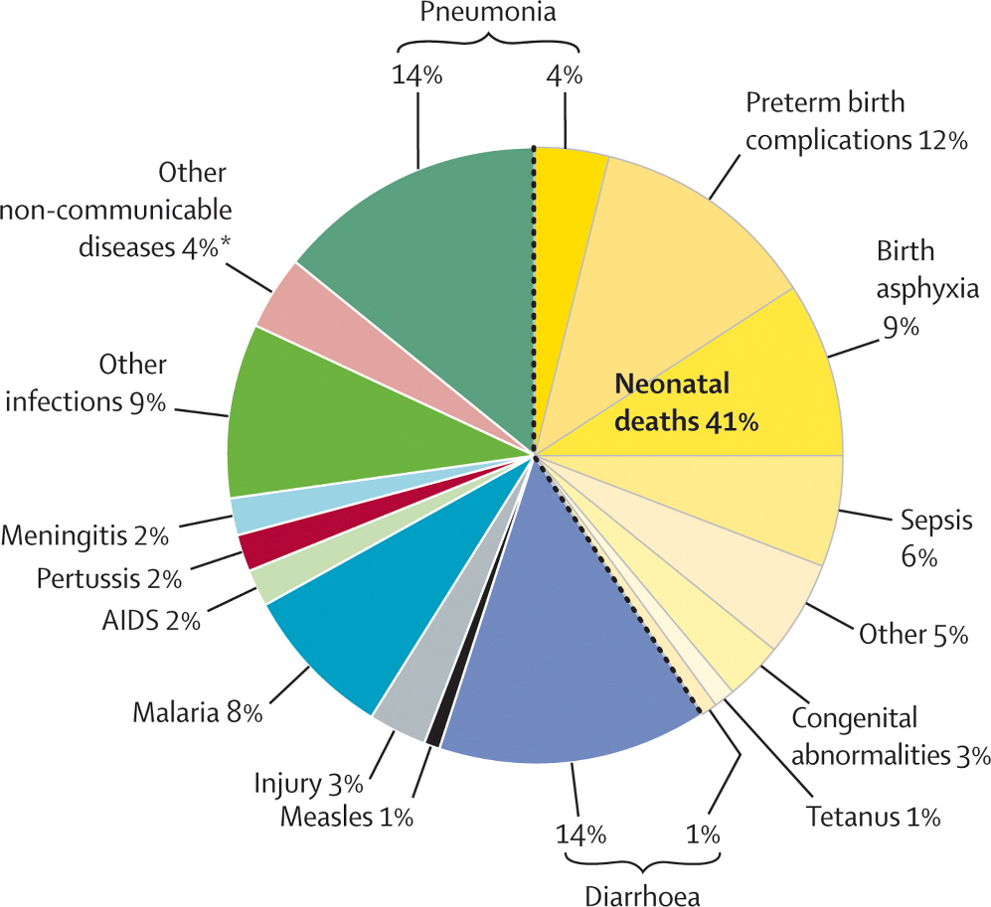
Under-Five Mortality Rate (Probability of Dying Under Age Five per 1,000 Live Births)
Malaria management requires transfusion support
Public health and sanitation improvement are the major requirements to reduce child mortality
Other factors in West Africa include sickle cell anaemia which may also require transfusion support.

Slide 9
Challenges
Donor selection and retention
National/Regional vs. Hospital based
Testing
Components
Regulation and Quality
Funding and economic reality
Sustainability

Slide 10
External Financial Aid to Blood Transfusion Services in
Sub-Saharan Africa: A Need for Reflection

Slide 11
What a transfusion service does
Hospital
Blood Banks
Independent entity

Slide 12
Where do the donors come from?
New Voluntary non remunerated Donor (VNRD)-
  Community based- driven by altruism
    Schools and Universities (Club 25)
    Factories
    Walk in to donor centres
    Businesses etc
  Disease risk similar to general population (although some high risk individuals screened out by donor selection criteria/questionnaires)
Repeat VNRD-
  as the new VNRD with infections have been removed from the active donor base the infection rate is much lower in the repeat group
  However a positive result in this group represents a seroconversion and this would prompt the need for a lookback of the recipients of the previous donation (i.e. was the previous donation in the window period)
Family replacement Donors (FRD)
  Considered to be high risk by some as they may be surrogate family members (ie commercial donors paid by family member)
Commercial Donors (CD)
  no altruism and financial gain motive may prevent disclosure of risk

Slide 13
Source of donors
How safe are these donors?

Slide 14
Commercial donors
Reports in most countries in Sub-Saharan Africa have indicated a high prevalence of TTIs among commercially remunerated blood donors
Commercially remunerated donors
  often come from the poorest sectors of the economy, may be poor in health,
  are more likely to give blood more often than recommended,
  and are also at a higher risk of being undernourished and having a TTI from high-risk behaviours such as maintenance of multiple sex partners, intravenous drug abuse, and unprotected sexual intercourse.
Erhabor, O. & Adias, T.C. (2011) The challenges of meeting the blood transfusion requirements in sub-Saharan Africa: the need for the development of alternatives to allogeneic blood. J Blood Medicine, 2: 7-21.

Slide 15
The debate: is the FRD safe?
WHO strong advocates of VNRD
  “Safe blood donors are the cornerstone of a safe and adequate supply of blood and blood products. The safest blood donors are voluntary, non-remunerated blood donors from low-risk populations. Despite this, family/replacement and paid donors, which are associated with a significantly higher prevalence of transfusion-transmissible infections (TTIs) including HIV, hepatitis B, hepatitis C, syphilis and Chagas disease, still provide more than 50% of the blood collected in developing countries WHO advocates and recommends to its Member States to develop national blood transfusion services based on voluntary non-remunerated regular blood donation in accordance with World Health Assembly resolution 28.72, which was adopted in 1975. “
  From http://www.who.int/bloodsafety/voluntary_donation/en/index.html

Slide 16
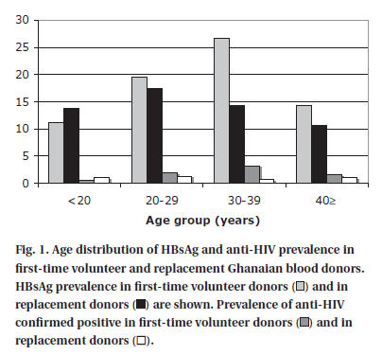
The evidence
First time VRND and FRD in Kumasi Ghana compared.
For each type of donor, pre donation clotted venous samples were taken and rapid tests done for
  HBsAg
  anti-HIV
  anti-HCV
All reactive donors were not accepted for a full donation.
Reactive tests were confirmed in the laboratory using EIA techniques.
In 6640 first-time volunteer and 4360 replacement donors, the prevalence of anti-HIV and HBsAg (1.03 and 13.8% vs. 1.1 and 14.9%, respectively) was not significantly different
ALLAIN, J. P., SARKODIE, F., ASENSO-MENSAH, K. & OWUSU-OFORI, S. 2010. Relative safety of first-time volunteer and replacement donors in West Africa. Transfusion, 50, 340-3

Slide 17
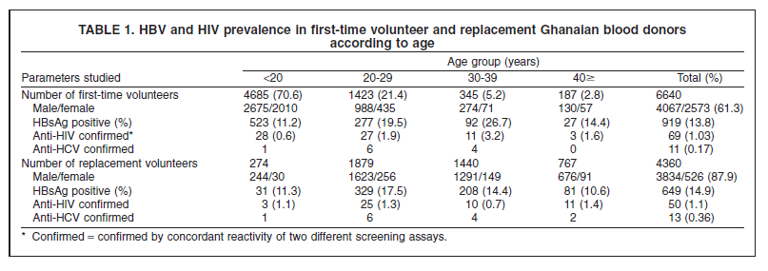
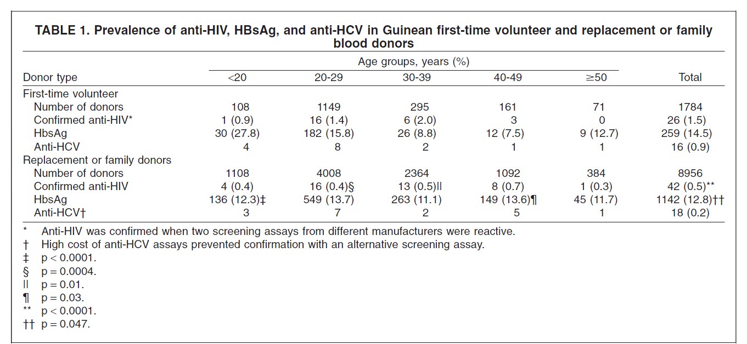
And corroborated in Guinea
LOUA, A. & NZE NKOURE, G. 2010. Relative safety of first-time volunteer and replacement donors in Guinea. Transfusion, 50, 1850-1; author reply 1851-2.

Slide 18
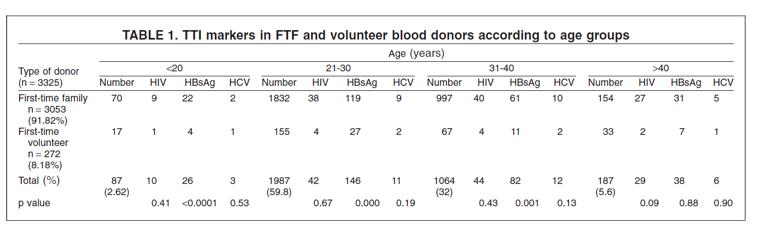
And in Cameroon
MBANYA, D. N., FEUNOU, F. & TAYOU, T. C. 2010. Volunteer or family/replacement donations: are the tides changing? Transfusion, 50, 1849-50; author reply 1851-2.

Slide 19
The Future?

Slide 20
Why not just collect enough blood from VNRD in the community and stop demanding blood from family members?

Slide 21
More new donors recruited
50% become regular donors
new voluntary non remunerated donors
20%
Pos for
TTI
Successful return of a proportion of donors
<0.1% Pos for TTI
Panel of regular donors grow
Initiation of Donor Service
Notes:
21

Slide 22
Equilibrium
Die
Recruit and retain donors
Loose interest
Panel
of regular donors
donating
3 to 4 times a year
Become TTI Positive
New donors
Medical conditions exclude
Donors IN
Have High risk lifestyle
Donor Pool
Move away
Donors Out

Slide 23
Crisis is in recruitment of suitable donors
  Expectation of reward
  Fear of getting an adverse HIV sero-status report
  Fear of others knowing sero-status
  Fear of occult practice with blood
  No sense of altruism in a society that does not appear benevolent
  Bureaucracy
  Lack of education
  Blood donated free but cost recovery fee charged to patient from hospitals.
Notes:
23

Slide 24
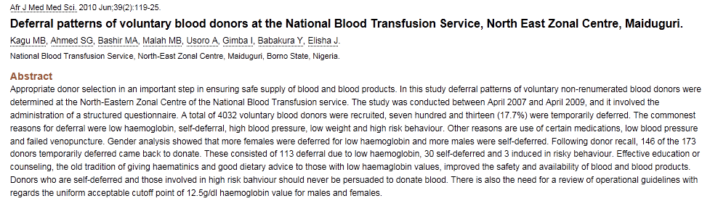

Slide 26
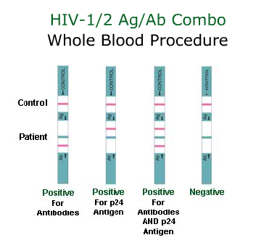
Pre Donation testing and the use of rapid tests
Better than no test at all
Can be done on whole blood (with chaser buffer) plasma (EDTA) or serum.
Can be used as a pre donation screen to avoid wastage of blood bags
Problem of counselling and referral of donors whilst on session.
Quality control- has the test worked properly (internal controls)
Screen only- reactive results require confirmation with EIA techniques

Slide 27
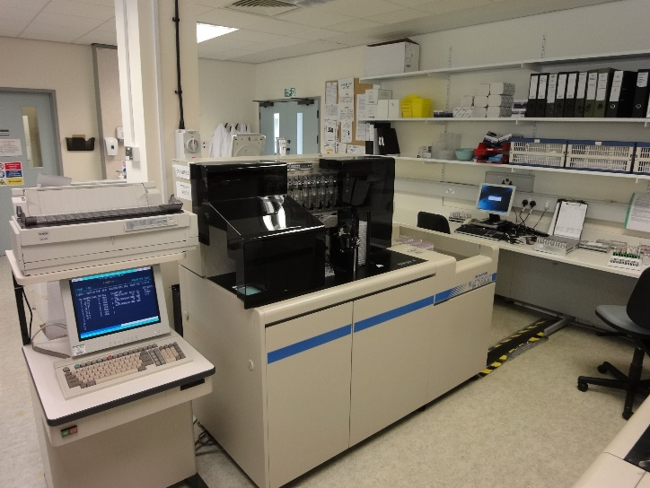
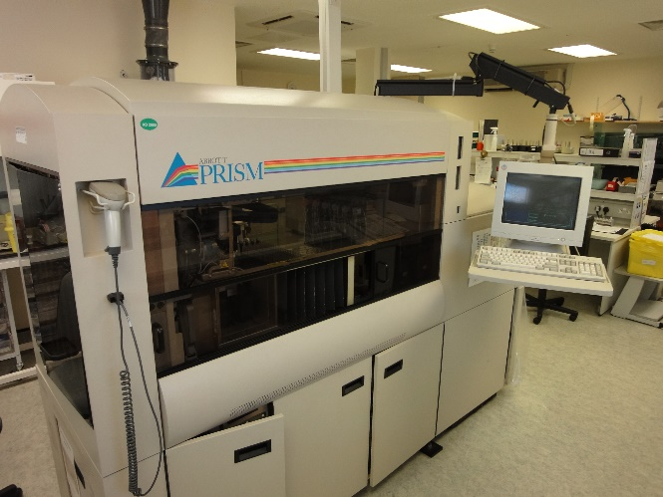
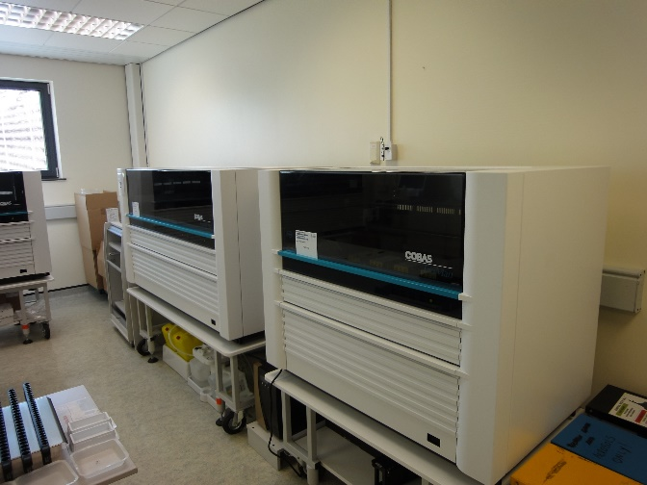
Testing

Slide 28
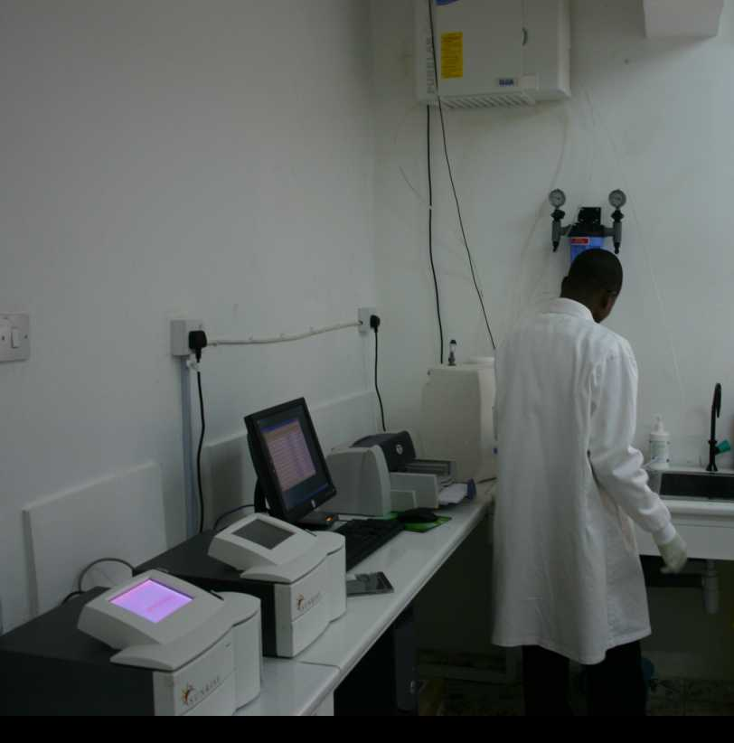

Slide 29
What do we test for?

Slide 30
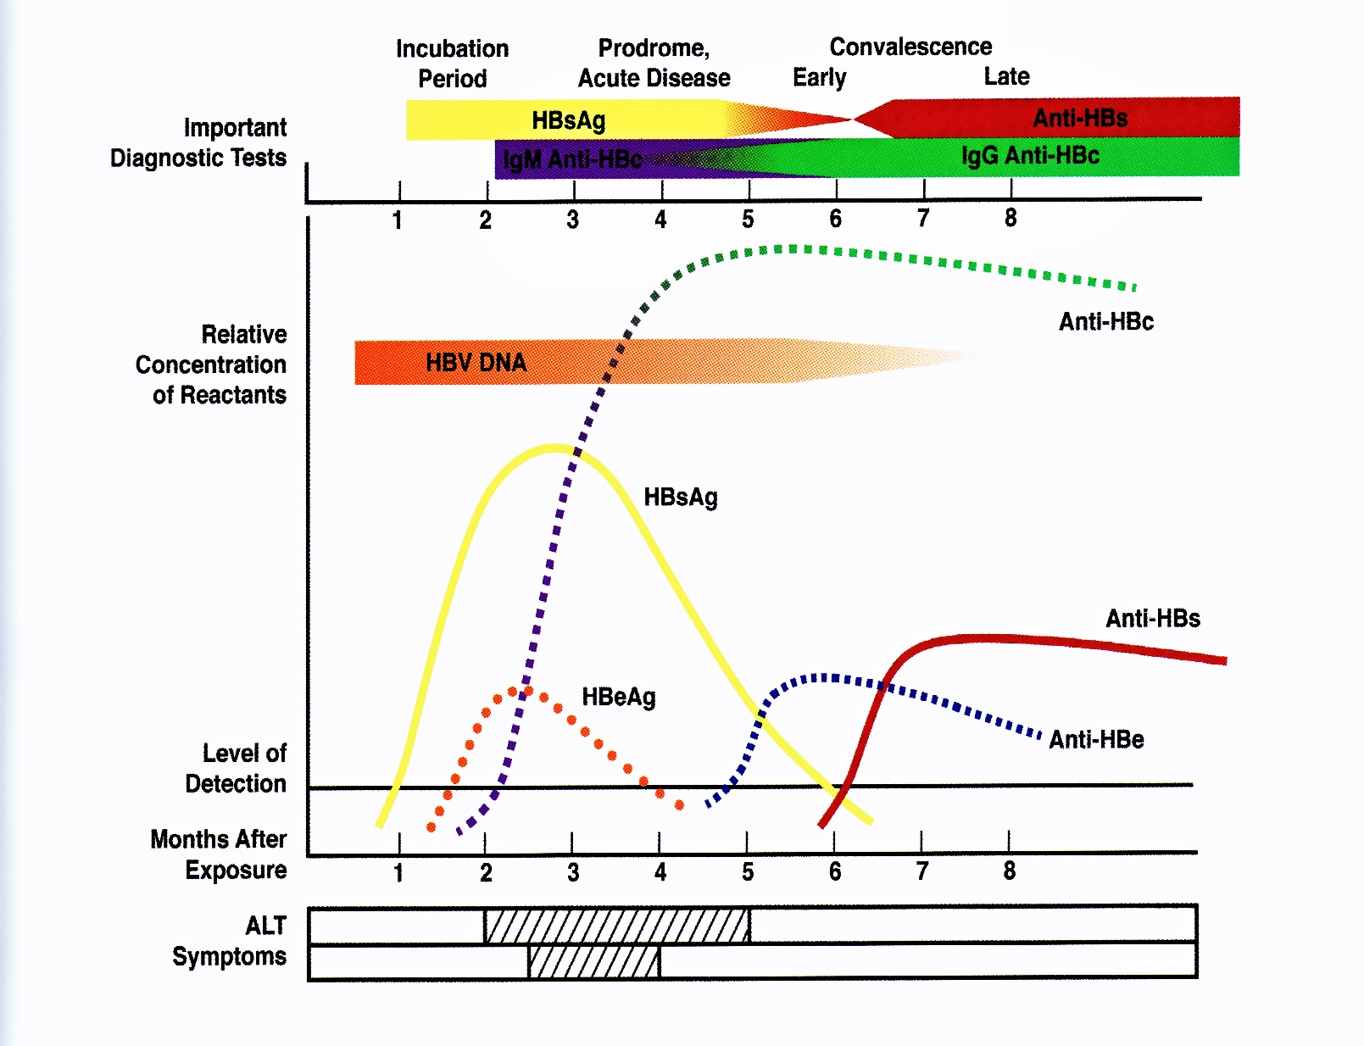
Exposure to risk
Donor suspended
120 days
Donor unit taken with
sample for Anti HBc
up to 12 months post exposure

Slide 31
Quality of Kit
WHO or some other body (eg UK KEG) tested and validated kits
Centralisation – power of buying kits in bulk
Proficiency testing schemes (UK NEQAS)

Slide 32
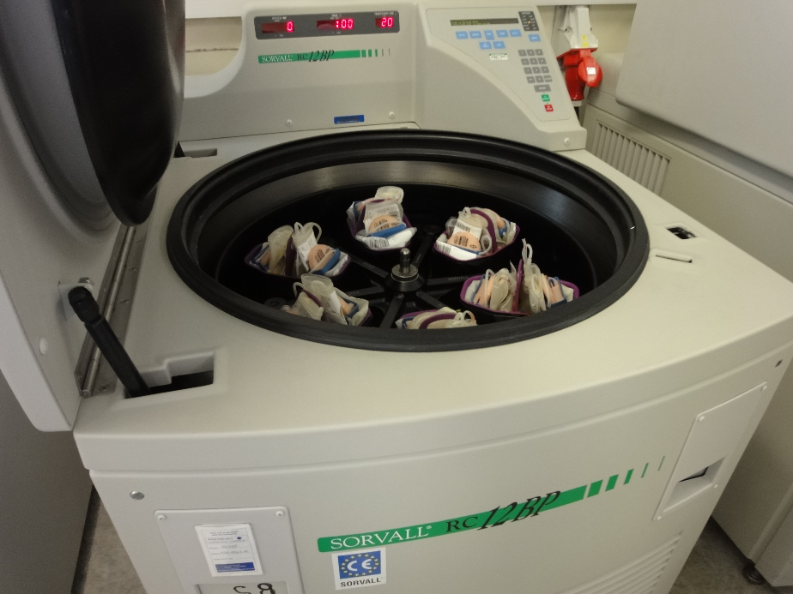
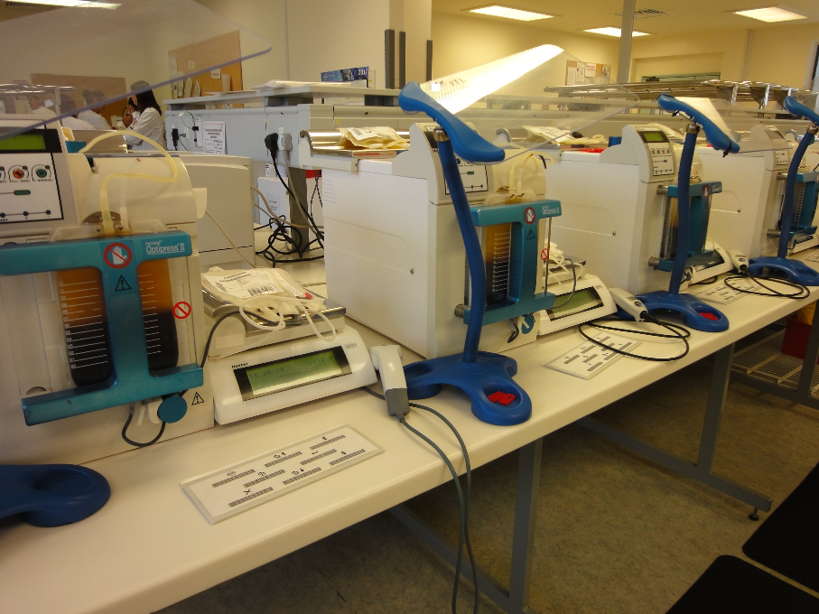
Component separation
Do we need to make components?

Slide 33
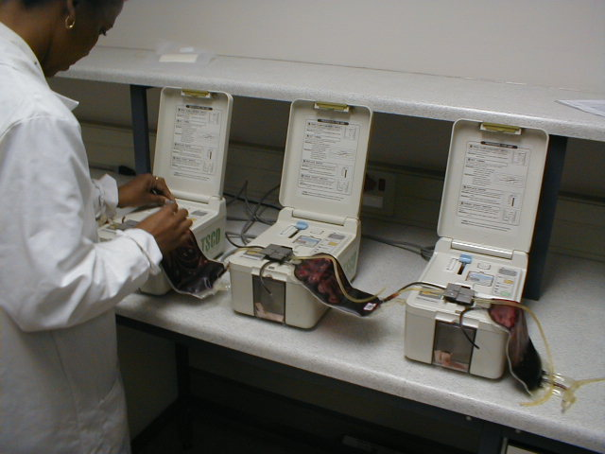
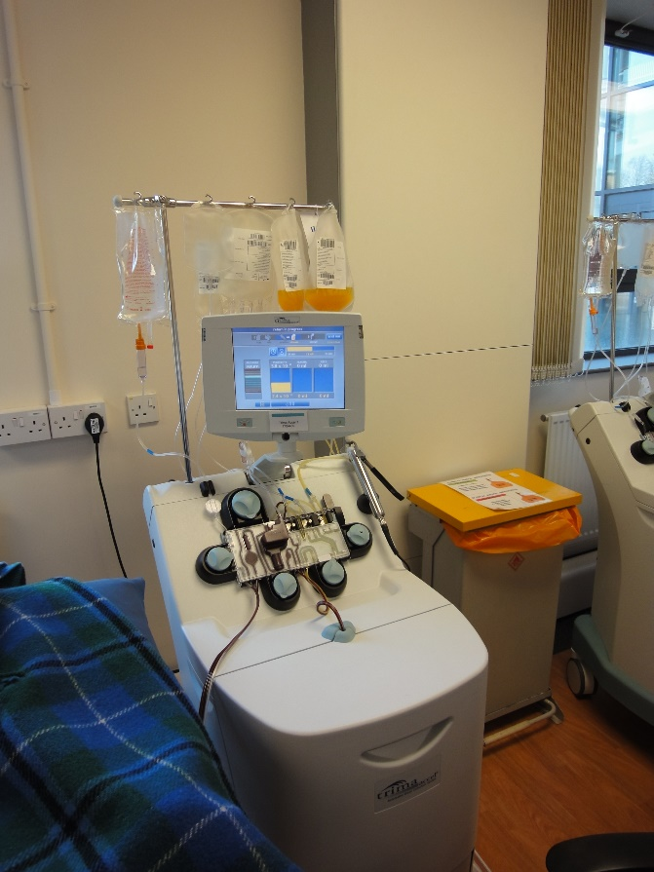
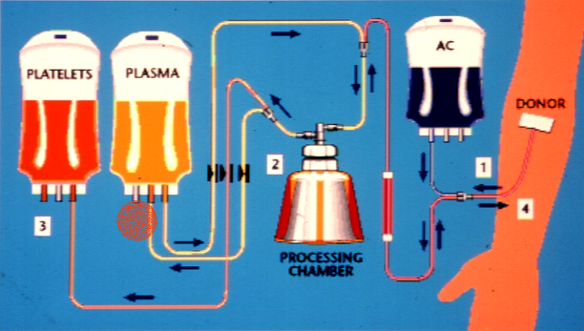
Platelets by buffy coat or Apheresis?

Slide 34
Donor records/ database
The need for a integrated IT system
One of the tenants of a safe blood supply is the retention of regular donors.
  Database of contact details
  Donation history (maintenance of donation intervals)
  Medical information that may have bearing on donation fitness.
  The identification of donors that have tested positive ( a permanent deferral process).
Control of testing and component processing
  Download results from instrumentation
  Bar code control
  Final issue labelling (Impossible to label infected unit etc)
  GMP control
Quality system recording all transactions from donor to recipient (traceability)

Slide 35
IT support of Blood Transfusion Service

Slide 36
Economics of blood transfusion service
LARA, A. M., KANDULU, J., CHISUWO, L., KASHOTI, A., MUNDY, C. & BATES, I. 2007. Laboratory costs of a hospital-based blood transfusion service in Malawi. Journal of clinical pathology, 60, 1117-20.
The cost of recruiting blood at centralised blood service includes recruiting
As FRD do not have a recruiting cost Hospital based collection sites are less expensive (Lara et al)
However if every hospital were to have a full EIA testing system and centrifuges for making components then the cost of running hospital service increases as there is no economy of scale. (both capital and recurrent costs)
If the combined cost of each hospital operating a mini-blood service is calculated then a true comparison of relative costs can be made.
Staff can be better resourced in a regional centre.
Money allocated to blood service operation is dedicated to transfusion whereas in hospital centres competes with other pathology disciplines for resources.
Quality and GMP processing easier to control in centralised system.

Slide 37
Regulation
South Africa
  Accreditation body oversees quality
  Licensing by department of health
UK
  Regulated by Medicines and Healthcare products Regulatory Agency (MHRA)
  both hospitals and blood services.
  EU blood directive as incorporated into UK law by The Blood Safety and Quality Regulations 2005 No. 50
    Directive 2002/98/EC – setting standards of quality and safety for the collection, testing, processing, storage and distribution of human blood and blood components
    Directive 2004/33/EC – regarding certain technical requirements for blood and blood component.
    Directive 2005/61/EC regarding traceability requirements and notification of serious adverse reactions and events
    Directive 2005/62/EC regarding Community standards and specifications relating to a quality system for blood establishments.
  Based on Pharmaceutical GMP standards

Slide 38
MHRA
As of 8 November 2005, blood establishments are required to:
  submit an application for a blood establishment authorisation
  maintain a quality system based on the principles of good practice
  notify the competent authority of any serious adverse events and serious adverse reactions (haemovigilance /SABRE)
  ensure that all prospective donors of blood and blood components comply with the Regulations
  maintain records to ensure full traceability from donation to the point of delivery for no less than 30 years
  be subject to an inspection from the competent authority at least once every two years.
Hospital blood banks are required to:
  if they collect autologous blood and blood components submit an application for a blood establishment authorisation
  if they perform secondary processing of blood component (for example, irradiation, washing, splitting etc.) submit an application for a blood establishment authorisation
  maintain a quality system based on the requirements of Directive 2005/62/EC
  notify the competent authority of any serious adverse events and serious adverse reactions (haemovigilance /SABRE)
  confirm compliance with the requirements of the directives by submitting an annual compliance report to the competent authority
  maintain records to ensure full traceability from donation to the point of delivery for not less than 30 years.

Slide 39
USA
  Food and Drugs administration
  The Center for Biologics Evaluation and Research (CBER) regulates the collection of blood and blood components used for transfusion or for the manufacture of pharmaceuticals derived from blood and blood components, such as clotting factors, and establishes standards for the products themselves.
  CBER also regulates related products such as cell separation devices, blood collection containers and HIV screening tests that are used to prepare blood products or to ensure the safety of the blood supply.
  CBER develops and enforces quality standards, inspects blood establishments and monitors reports of errors, accidents and adverse clinical events.

Slide 40
Centralised vs. Hospital Transfusion Services
A pragmatic approach is required, with both systems operating until resources are suitably utilised, to ensure sustainability of centrally organised blood services.
FIELD, S. P. & ALLAIN, J. P. 2007. Transfusion in sub-Saharan Africa: does a Western model fit? Journal of clinical pathology, 60, 1073-5.

Slide 41
Nigeria

Slide 42
Nigeria Background
Nigeria is a Federation of 36 semi-autonomous states and a Federal Capital Territory.
Population is estimated at 130-40 million, most populous country in Africa.
Notes:
42

Slide 43
Nigerian military junta of 1966-1979
Civilian democracy 1979- 83
Nigerian military junta 1983-1998
Civilian democracy 1999- present

Slide 44
Nigerian Federation – Six Geopolitical Zones
Katsina
Jigawa
Zamfara
Yobe
Borno
Kano
Kebbi
Sokoto
Kaduna
Bauchi
Gombe
Niger
Adamawa
Plateau
Kwara
FCT
Oyo
Nasarawa
Taraba
Ekiti
Kogi
Osun
Benue
Key
Ogun
Ondo
Lagos
Edo
Enugu
Anambra
Ebonyi
North West
North East
North Central
South West
South South
South East
Cross
River
Delta
Imo
Abia
Rivers
Akwa
Ibom
Bayelsa
Notes:
44

Slide 45
Nigeria Transfusion History
Blood transfusion is fragmented and hospital based.
Blood is sourced from family replacement and commercial donors ~90-95%.
A few states have local legislation restricting blood transfusion to licensed facilities (e.g. Lagos State).
The blood supply in Nigeria is totally inadequate.
Notes:
45

Slide 46
Nigeria transfusion History 2
Transfusion associated HIV is unquantifiable because of inadequate data but MoH estimates that 10% of HIV in Nigeria is due to unsafe blood.
Study by DFID in 2000 indicated that approx. 14% of HIV in Nigeria due to blood transfusion
National blood policy has remained unchanged since the 1960’s until recently.

Slide 47
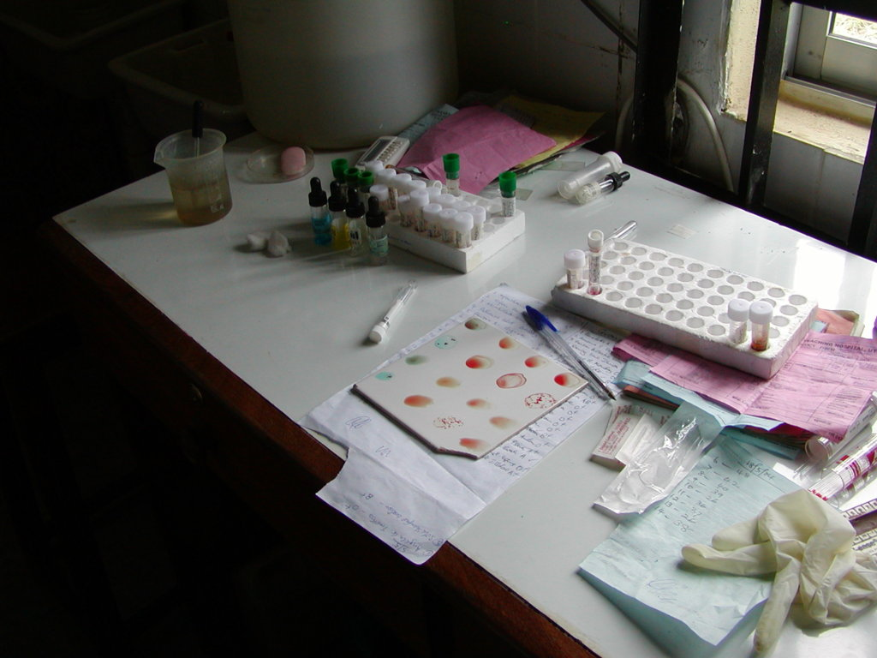

Slide 48
Nigeria Background Health Indicators (1)
HIV Prevalence (2003) 15-49 year olds 5.4%
  In Nigeria's AIDS hot spots, mainly in the urban centres, the prevalence rates range from 15 percent among the adult population to 20 percent in pregnant women (Dr. Chinua Akukwe, the former Vice-Chairman of the National Council for International Health (NCIH) Washington, DC)
Notes:
48

Slide 49
Nigeria Background health indicators (2)
Nigeria is a malaria pandemic country
Prevalence of sickle cell anaemia is 20 per 1000
24% population carry sickle cell gene

Slide 50
Mortality rates Children and Women Nigeria
Neonatal Mortality 48 per 1000 live births
Infant mortality 100 per 1000 live births
Under 5 mortality 210 per 1000 live births
    30% Malaria
    20% diarrhoeal diseases
    Malnutrition a contributory factor in 52% of deaths
Maternal mortality 800 per 100000 births
    25-30% Maternal haemorrhage
Notes:
50

Slide 51
Most transfusion from hospital based family replacement systems
Commercial donors
Voluntary non remunerated donor programme
Notes:
51

Slide 52
Crises is in recruitment of suitable donors
  Expectation of reward
  Fear of getting an adverse HIV serostatus report
  Fear of others knowing sero status
  Fear of occult practice with blood
  No sense of altruism in a society that does not appear benevolent
  Bureaucracy
  Lack of education
  Blood donated free but cost recovery fee charged to patient from hospitals.
  Hospitals crossmatch fee
Notes:
52

Slide 53
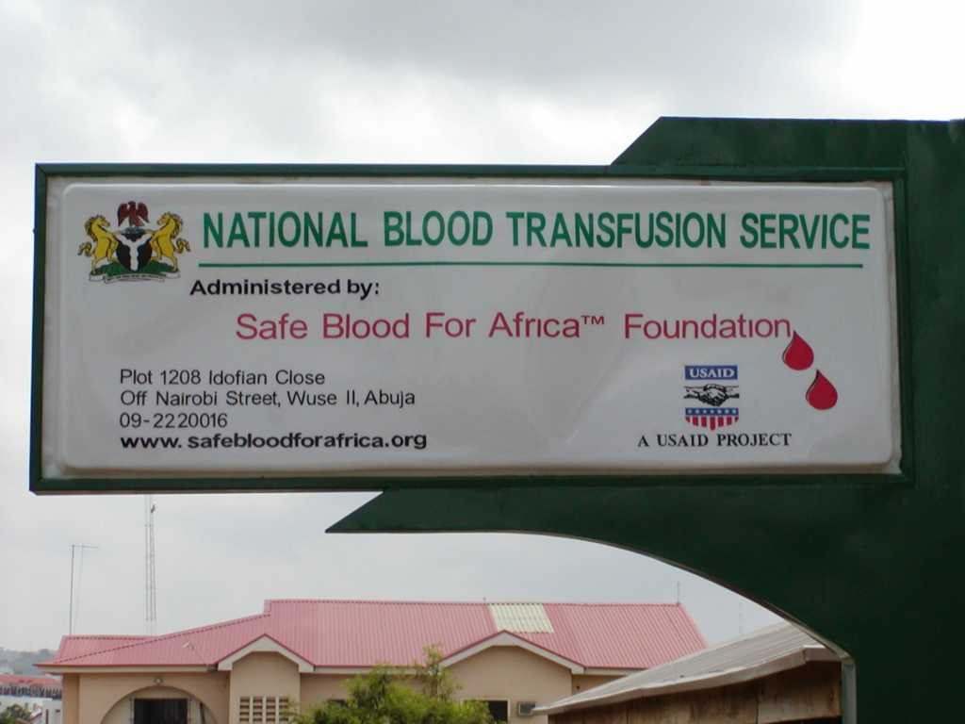
The Abuja Project

Slide 54
Club 25 is a concept whereby school leavers are encouraged to continue donating by pledging a safe lifestyle and 20 donations before the age of 25 years.
Notes:
54

Slide 55
 | HIV |  | HBS |  | HCV |  | Syphilis |  | Total
Status | Num | Prev | Num | Prev | Num | Prev | Num | Prev
New | 14 | 3.3% | 41 | 9.8% | 13 | 3.1% | 2 | 0.5% | 420
Repeat | 1 | 1.8% | 0 | 0.0% | 0 | 0.0% | 0 | 0.0% | 57
 | 15 | 3.1% | 41 | 8.6% | 13 | 2.7% | 2 | 0.4% | 477

Slide 56
Sero prevalence of transfusion transmissible diseases
 | HIV |  | HBS |  | HCV |  | Syphilis |  | Total
Age Cat | Num | Prev | Num | Prev | Num | Prev | Num | Prev
16-20 |  | 0.0% | 3 | 5.3% |  | 0.0% |  | 0.0% | 57
21-25 | 7 | 4.7% | 15 | 10.1% | 6 | 4.1% | 1 | 0.7% | 148
26-30 | 5 | 3.8% | 16 | 12.1% | 5 | 3.8% |  | 0.0% | 132
31-35 |  | 0.0% | 3 | 5.2% | 2 | 3.4% | 1 | 1.7% | 58
36-40 | 2 | 3.9% | 3 | 5.9% |  | 0.0% |  | 0.0% | 51
41-45 |  | 0.0% |  | 0.0% |  | 0.0% |  | 0.0% | 20
46-50 | 1 | 14.3% | 1 | 14.3% |  | 0.0% |  | 0.0% | 7
51-55 |  | 0.0% |  | 0.0% |  | 0.0% |  | 0.0% | 2
> 55 |  | 0.0% |  | 0.0% |  | 0.0% |  | 0.0% | 2
Total | 15 | 3.1% | 41 | 8.6% | 13 | 2.7% | 2 | 0.4% | 477

Slide 57
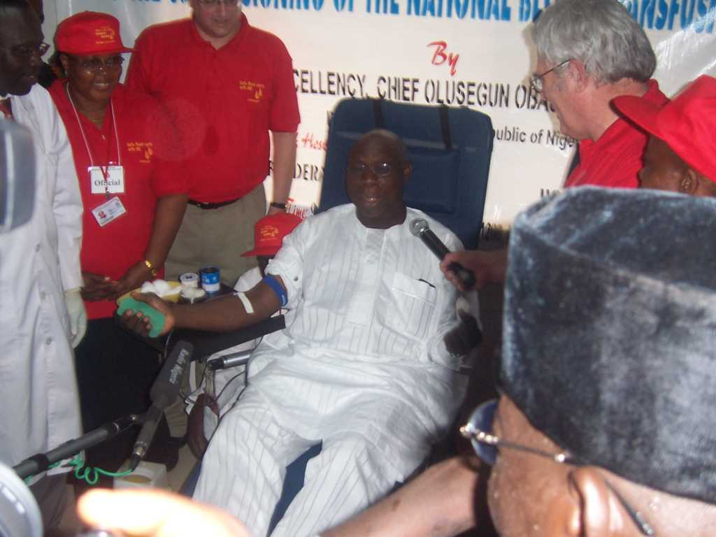

Slide 58
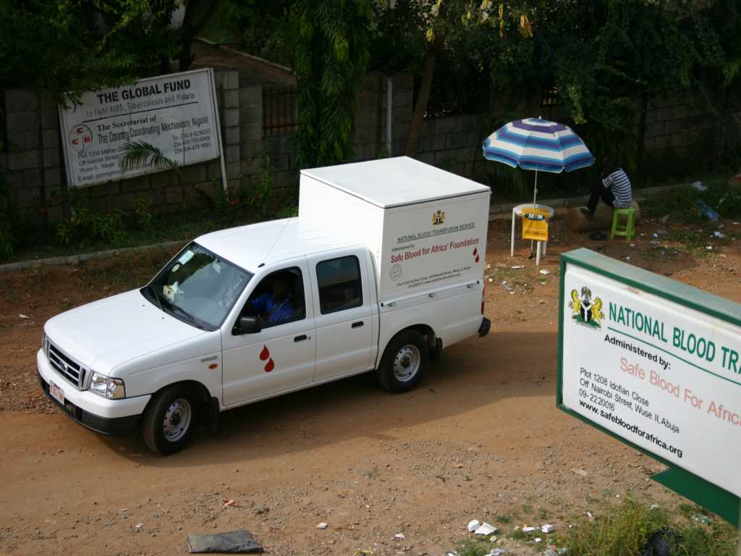

Slide 59
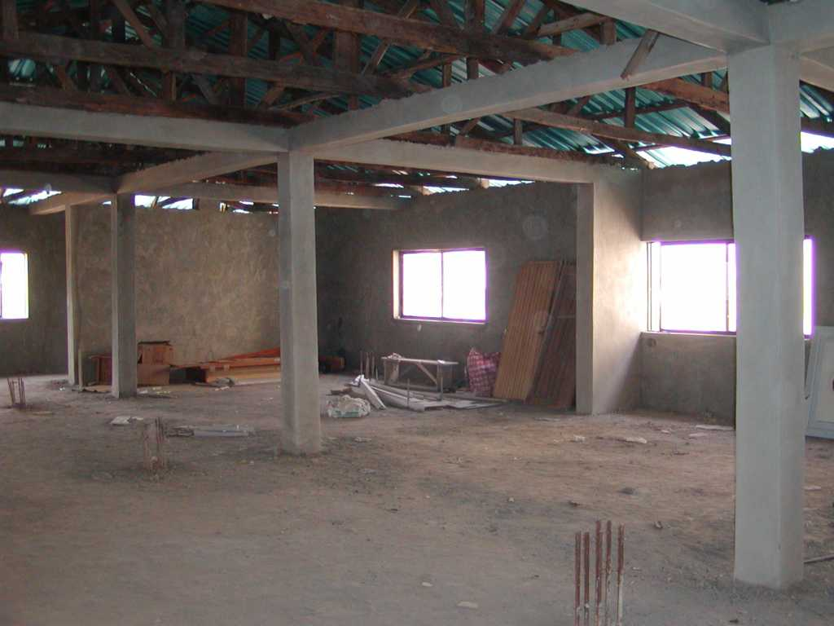

Slide 60


Slide 61
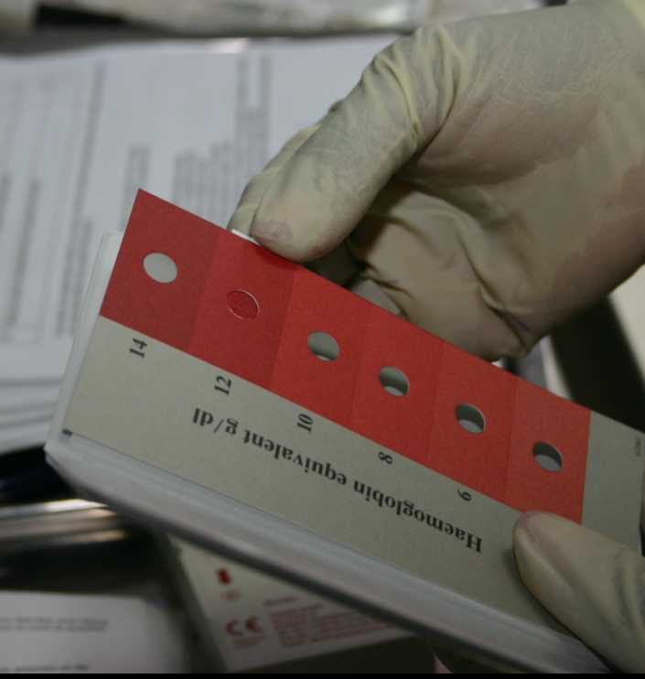

Slide 62
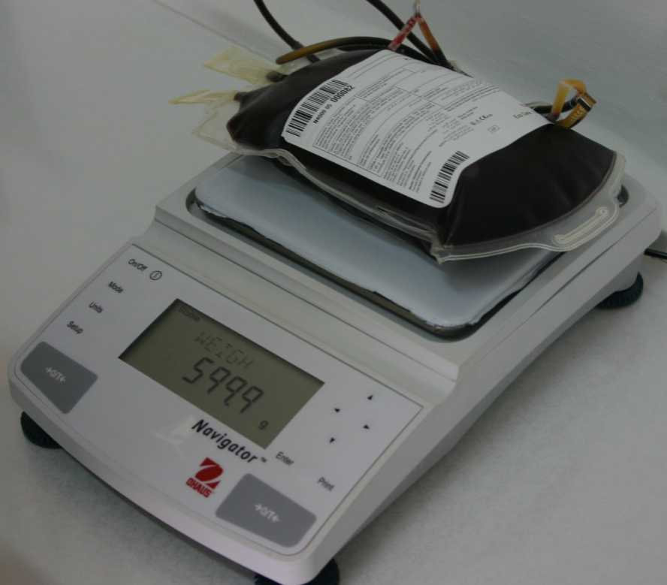

Slide 64
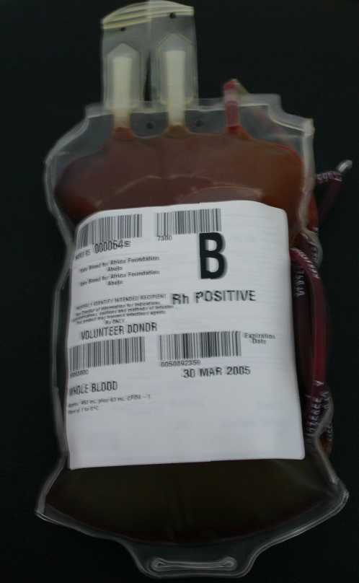

Slide 65
UniAbuja

Slide 66
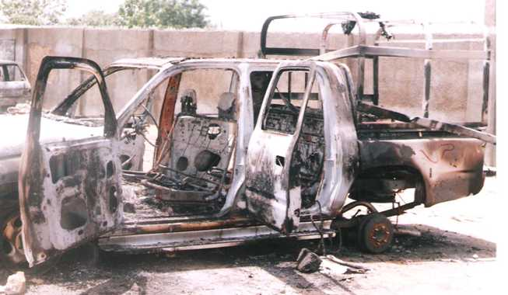

Slide 67
Training
  In the last year (October 2004 through September 2005):
    25 training session provided by Safe Blood for Africa
    49 total training days provided
    1,512 students trained
    Major course topics
      Clinical Use of Blood products (9)
      Laboratory techniques in Blood transfusion (6)
      Core Knowledge in Transfusion Medicine (3)
      Donor Management (3)
      Donor Recruitment (3)
      Quality Management (1)
Notes:
67

Slide 68
Nigerian Federation – Six Zonal Blood Centers
Sokoto
Kaduna
PEPFAR CDC
Abuja
PEPFAR USAID
Maiduguri
FMoH
Ibadan
FMoH
Jos
FMoH
North West
North East
North Central
South West
South South
South East
Owerri
PEPFAR CDC
Lagos
Lagos State Gov
USAID PEPFAR
Port Harcourt
FMoH
Notes:
68

Slide 69
Laboratory standards
  Slide grouping
  No reverse groups
  Cross match AHG/albumin
  Recycled tubes
  Accreditation and training

Slide 70
Lagos State
Legislation
State Government
Voluntary donors at a premium
Records- paper

Slide 71
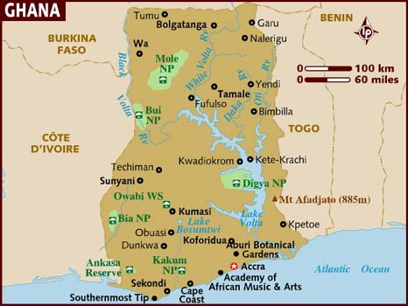
Ghana

Slide 72

