Slide 1
Auto Immune Haemolytic Anaemia (AIHA)
Paroxysmal Cold
Haemoglobinuria (PCH) &
Cold Haemagglutinin Disease (CHAD)
Dr Stephen Field
Medical Director
Welsh Blood Service

Slide 2
Reading
Lechner, K. and U. Jager (2010). "How I treat autoimmune hemolytic anemias in adults." Blood 116(11): 1831-1838.
Gertz, M. A. (2006). "Cold hemolytic syndrome." Hematology Am Soc Hematol Educ Program: 19-23.

Slide 3
Acquired haemolytic anaemia
Divided into two main categories depending on the mechanism by which there is premature destruction of red cells
  Immune
    Warm autoimmune haemolytic anaemia (WAIHA)
    Cold immune syndromes
      Cold Haemagglutination disease (CHAD)
      Paroxysmal Cold haemoglobinuria (PCH)
  Non Immune
    Infections
    Haemophagocytic syndrome
    Fragmentation (mechanical)
    Chemical and physical causes

Slide 4
Antibodies in immune haemolytic anaemia
Antibody mediated haemolysis is an important cause of acquired haemolytic anaemia.
Antibodies may be
  autoantibodies produced by the patient’s immune system against epitopes on their own red cells.
    These may be warm, cold or mixed autoantibodies
  Alloantibodies may be produced by the patient and directed against antigens not present on the person’s own red cells
    that act against foreign red cells ( from transfusion) or
    that are secondarily acquired by the patient’s red cells ( i.e. drug induced haemolysis)
  Some alloantibodies may be acquired from outside the example from the mother transferred across the centre in haemolytic disease of the newborn.

Slide 5
Warm Auto immune Haemolytic Anaemia
Incidence approximately 1 in 75000 per year
WAIHA accounts to 60 to 70% of autoimmune haemolytic anaemia
Approximately 50% of all cases have no associated disease (i.e. idiopathic or primary WAIHA)
The remainder may be secondary to
  underlying lymphoproliferative diseases (e.g. CLL)
  immunodeficiency states
  solid tumours
  connective tissue diseases or
  infectious diseases

Slide 6
Clinical features of WAIHA
Severe signs and symptoms or seen in patients with rapid onset of brisk haemolysis.
  Fatigue, weakness, malaise, dizziness, fever back pain, dyspnoea on exertion and angina can be presenting complaints in severe haemolysis.
  jaundice, pallor and discoloured urine (haemoglobinuria)
  the rapid fall in haemoglobin can constitute a medical emergency
  hepatosplenomegaly is found in more than 50% of cases
Conversely if haemolysis is at a lower level the symptoms are less severe and there is a more indolent course.
  Low Hb may be better tolerated in patients in whom compensation has occurred and is no cardiopulmonary disease

Slide 7
Laboratory diagnosis of WAIHA
Laboratory findings indicative of shortened red cell survival
Serologic evidence of auto antibodies directed against red cell antigens optimally reacted at 37°C
Moderate to severe anaemia with reticulocytosis
Occasionally thrombocytopenia is found and this combination with autoimmune haemolytic anaemia is known as Evans syndrome. The thrombocytopenia is also an auto immune mediated disorder.

Slide 8
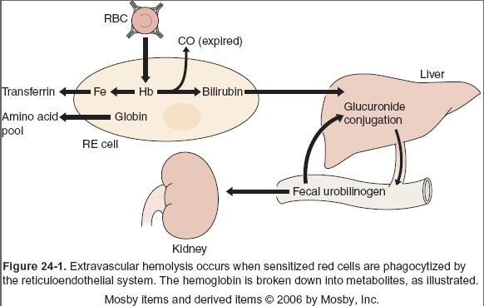
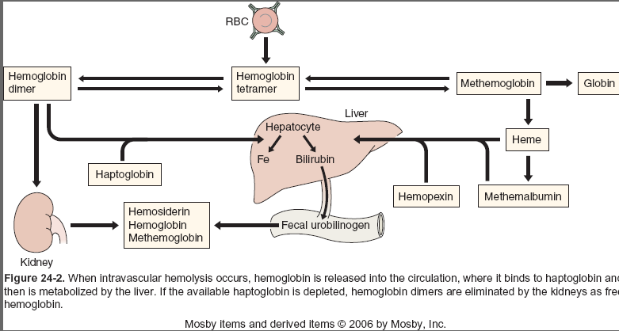
Evidence of haemolysis
Increased red cell breakdown
  ⬆ urine urobilinogen
  ⬆serum bilirubin unconjugated
    (acholuric jaundice)
  If intravascular - Absent/low serum haptoglobins
  haemoglobinuria
Increased red cell production
  Reticulocytosis
  Erythroid hyperplasia in bone marrow
Red cell morphology
  Spheroctosis
  Polychromasia (reticulocytes)
    May be nucleated red cells in peripheral blood

Slide 9
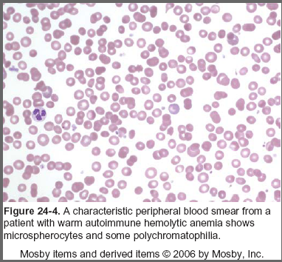
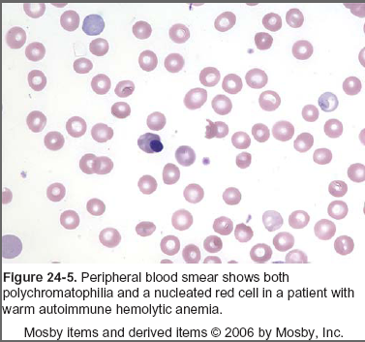
Spherocytosis
Red cells coated by antibody are taken up by the reticulo-endothelial system
      Passage through spleen removes part of the coated membrane resulting in the cell becoming progressively more spherical
      The resultant spherocytes are prematurely removed from circulation

Slide 10
Serology of WAIHA
Direct antiglobulin test
  using anti-IgG and anti-C3d

Slide 11
Direct antiglobulin (Coombs) Test
1
2
3
4
Add red cells
to be tested
Wash off
serum
keeping red cells
Add anti human
globulin
Centrifuge gently
Examine
for
Agglutination

Slide 12
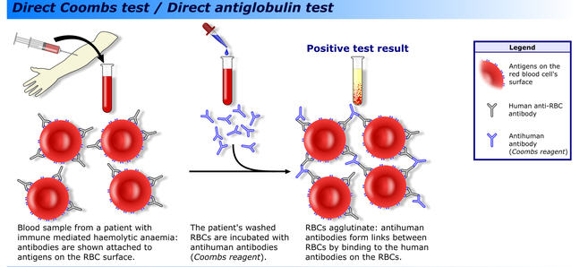
Direct antiglobulin test
Source: A. Rad. GNU Free Documentation License. Wikipedia.

Slide 13
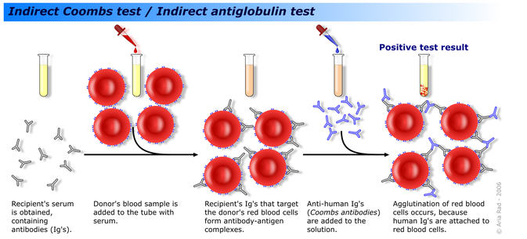
Indirect antiglobulin test

Slide 14
Serology of WAIHA
Direct antiglobulin tests may show
  IgG only (approximately two thirds of patients)
  Both IgG and C3d
  C3d only
Studies on elution taken from the antiglobulin positive red cells of demonstrate the presence of IgG antibodies
  Tests against standard red cell panels often show a pan agglutinating antibody (which can also be demonstrated in the serum) .
  occasionally a specific auto antibody is identified often with an broad anti-Rh (i.e. reacting against the whole or a large part of the Rh antigen complex.
  Alloantibodies can be mixed in with the auto antibody

Slide 15
Management
Corticosteroids are used in the initial therapy
  Prednisolone 60 to 100 mg/day one to three weeks
  Improvement may be seen in several days of approximately 80% of patients having a good initial response
  After an initial response the dose can be incrementally reduced over several weeks
  To reduce side effects of chronic steroids maintenance should be on alternate days schedule
  If relapse occurs in the dose would need to be increased again
  A maintenance dose of greater than 15 mg prednisolone daily should be considered as a therapeutic failure.
  Approximately 20 to 35% of patients will go into permanent commission on corticosteroids alone

Slide 16
Splenectomy
About 50% of patients will have a completed initial response splenectomy although some may require maintenance on low-dose prednisolone
Danger of post-splenectomy sepsis syndrome
  Encapsulated bacteria such as pneumococcal as
  Pneumococcal and meningococcal vaccines
  Prophylactic antibiotic regimens are controversial (penicillin or trimethoprim sulphamethoxazole have been used)

Slide 17
Other immunosuppressive therapy
Several immunosuppressive agents have been reported to be successful in treating WAIHA
Paucity of randomised therapeutic trials
Considered when conventional therapy has failed or cannot be tolerated or relapses after splenectomy.
  Azothtioprine, cyclophosphamide and other single agents have been used successfully but side-effects may be considered unacceptable
  If the WAIHA is secondary to a lymphoproliferative disorder the drugs used to treat the primary disease may be successful in eradicating haemolytic anaemia.
  Cyclosporine and other antirejection drugs had been tried successfully but side-effects may be unacceptable

Slide 18
Rituximab
Engineered chimeric Murine/human monoclonal anti-CD 20 antibody which is targets B-cell precursors and mature B cells.
  Been shown to be effective in both primary and idiopathic forms of the disease including refractory disease in children.
  Dose is 375 mg per m² once a week at two to four weeks
Bussone G, Ribeiro E, Dechartres A, Viallard JF, Bonnotte B, Fain O, et al. Efficacy and safety of rituximab in adults' warm antibody autoimmune haemolytic anemia: retrospective analysis of 27 cases. Am J Hematol 2009;84(3):153-7.

Slide 19
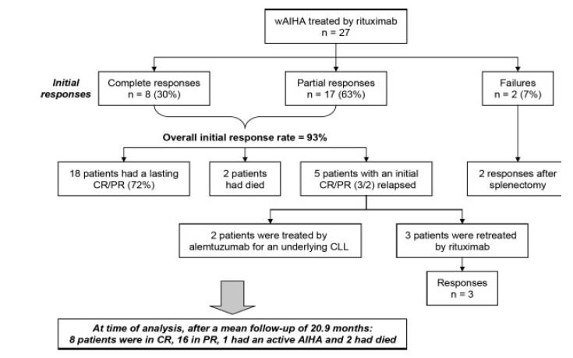
Bussone G, Ribeiro E, Dechartres A, Viallard JF, Bonnotte B, Fain O, et al. Efficacy and safety of rituximab in adults' warm antibody autoimmune haemolytic anemia: retrospective analysis of 27 cases. Am J Hematol 2009;84(3):153-7.

Slide 20
Other treatment
Intravenous immunoglobulin – variable results reported in the literature
Plasmapheresis may have temporising value in reducing antibody level that is not practical to long-term management.
Solubilised Haemoglobin oxygen carriers. (HBOC)
  oxygen bridge
  Nitrous oxide scavenger – vasoconstriction and hypertension
  These are generally falling out of favour- side effects

Slide 21
Cold Haemagglutin Disease (CHAD)
Many people have low titre cold agglutinins in vitro. These are not clinically significant.
CHAD is less frequent 15 to 25% of all autoimmune haemolytic anaemia
In CHAD the antibody (IgM) binds the red cell at cold temperatures (0-4°C).
  The exposure to these low temperatures occurs at the periphery (fingers, toes, ears, tip of nose etc.)
On warming the antibody dissociates but the complement has been bound to the red cell surface and once activated causes haemolysis.
This complement activation occurs optimally at 37°C

Slide 22
CHAD
Acute or chronic
Acute often secondary to lymphoproliferative syndrome of all atypical pneumonia (Mycoplasma pneumoniae infection
Primary disease seen in elderly patients and is very rare in children

Slide 23
Types of Cold haemaggutinin
Disease

Slide 24
Clinical features
Progressive chronic anaemia
Indolent
Thermal amplitude of the antibody – more clinically severe if antibody reactive at high temperature
Exacerbated in winter
Acute haemolytic crisis can be accompanied by frank haemoglobinuria

Slide 25
Signs
Pallor and anaemia
Acrocyanosis involving tip of nose, fingers, toes and ears results on warming
No hepatosplenomegaly usually

Slide 26
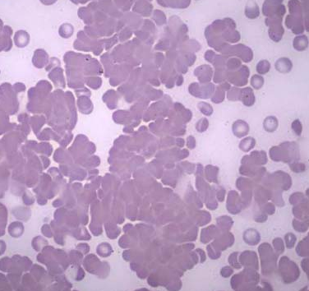
Blood picture

Slide 27
Serology
Cold reactive by IgM autoantibody
The rate antiglobulin test shows complement coating of the red cells
Elution study is not indicated
Serum evaluation should include cold agglutinin titre and thermal amplitude measurements
Titres >1/1000 is clinically significant ( normal or benign cold antibodies are titres lower than this)
Specificity of antibody is usually anti I which is present on all post neonatal red cells
An exception is in patients with infectious mononucleosis and antibody may be anti i (found on cord blood cells)
Very rarely other antigen specificities are found

Slide 28
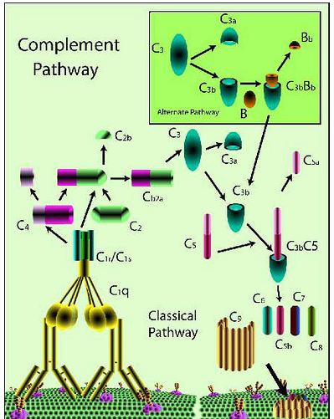
The complement system
A series of proteins in inactive form which are triggered (for the classical pathway) by an antigen binding to a complement fixing antibody.
Result is the binding of activated complement (C5b-9-Membrane attack Complex ) to cell surface and subsequent instability of the cell membranes and leakage of contents (haemolysis)
Also prepares target cell ready for phagocytosis via Complement receptors (C3b) on phagocyte.
http://www.youtube.com/watch?feature=player_detailpage&v=tJJAyPWQ3fk

Slide 29
Management
Avoidance of exposure to cold.
Transfusion is rarely need.
Corticosteroids of little value
Patients with underlying lymphoproliferative disorder may benefit from the chemotherapy or rituximab (studies have indicated that although remission occurs in approximately half patients this is not a durable and lapses durable within a year
Plasmapheresis – temporising measure of care must be taken to warm replacement fluids
long indolent course
A surgical procedures such as cardiac bypass that require reduction in core body temperature may evoke a cold agglutinin episode of acute haemolysis.

Slide 30

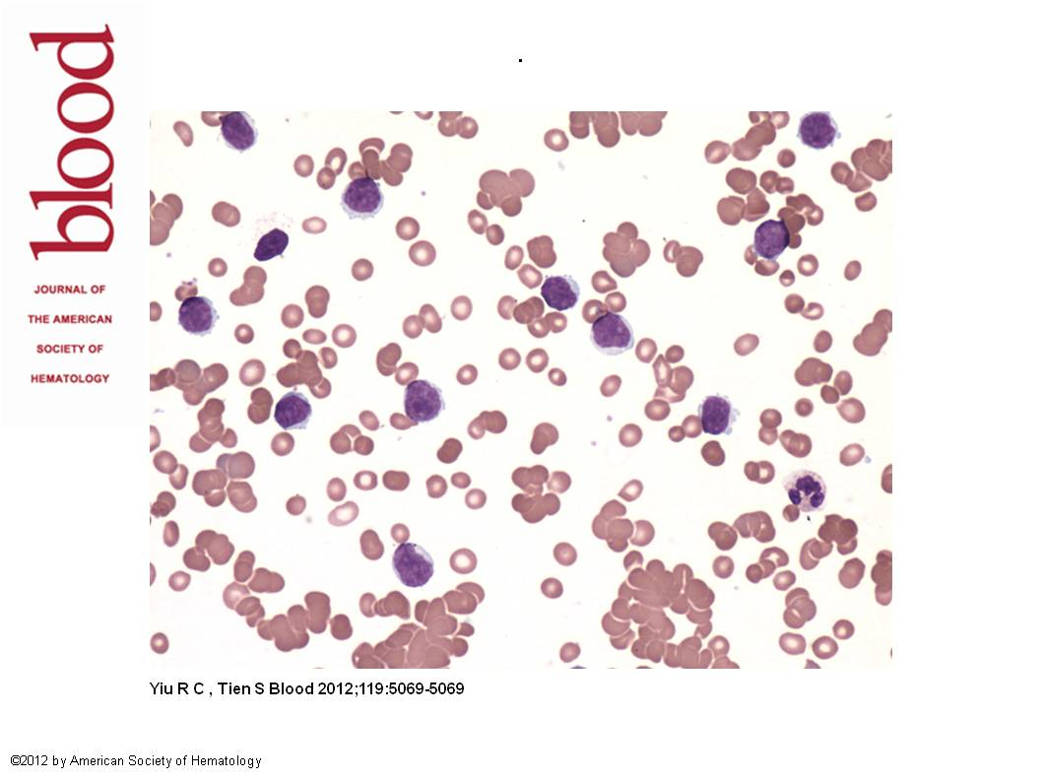
Cold agglutinin disease with PLL
Blood Work Richard Cheung Yiu and Sim-Leng Tien, ASH Image Bank 2012; 2012-12539
Copyright © 2012 American Society of Hematology. Copyright restrictions may apply.
Notes:
A46-year-old man presented with 2 weeks of lethargy and exertional dyspnea. Clinically he was jaundiced and had an enlarged spleen
with its edge palpable at 5 cm below the left costal margin. Complete blood count showed hemoglobin of 7.2 g/dL, white cell count of
42.8 _ 109/L, 60% of which were prolymphocytes, and platelet count of 150 x 109/L. Aside from the numerous prolymphocytes detected onnblood smear, there was marked red cell agglutination (see figure). Hemolysis was evident with elevated reticulocyte count (5.2%), raised serum bilirubin , low serum haptoglobin, and high serum lactate dehydrogenase. Direct Coombs test was strongly positive for C3d.
Cold agglutinin was detected to a titer of 1:1024 with anti-I specificity. The serum IgM level was elevated (10.24 g/L) with normal serum IgGnand IgA levels; however, a serum electrophoresis was not performed. These findings were consistent with cold agglutinin hemolytic anemia.
Bone marrow revealed 50% prolymphocytes. Immunophenotyping positivity for CD5, CD19, CD23, CD79b, and FMC7 with moderate SmIg expression and light chain restriction was consistent with B-cell prolymphocytic leukemia. After combination chemotherapy of rituximab, fludarabine, and cyclophosphamide, the white cell count normalized with a disappearance of prolymphocytes and hemoglobin level that became normal. The peripheral smear no longer showed agglutination, and tests of hemolysis including the Coombs test became negative. This case illustrates the recognition of cold agglutinin hemolytic anemia by a review of the peripheral smear. While cold agglutinin hemolytic anemia is well recognized with chronic lymphoid malignancies, its association to prolymphocytic leukemia is rare.

Slide 31
Paroxysmal cold haemoglobinglobinuria
Rare disease
Similar to CHD in mechanism of complement fixation and activation with antibody binding in the cold (biphasic haemolysin).
Antibody is IgG and complement fixing
Antibodies may bind at different temperatures (often <20°C but may be higher).
On warming the antibody dissociates but the complement has been bound to the red cell surface and once activated causes haemolysis.
Complement activation occurs optimally at 37°C (Biphasic Antibody)

Slide 32
Causes severe episodes of Intravascular haemolysis.
No agglutination of cells at low temperature (as it is IgG).
Associated with syphilis ,chicken pox, influenza, adenovirus.
Antibody specificity is anti P

Slide 33
Antibody and complement activity at range of temperature
Overlap
Area of in vivo
haemolysis
Range of
antibody activity
Range of
complement
activity

Slide 34
Donath-Lansteiner test
0°C
37°C
2 clotted
blood specimens
incubated at 0 and 37°C respectively for 30 minutes
Incubate both
samples at 37°
for further 30 minutes
Centrifuge
both sample
Examine for haemolysis

Slide 35
Management
Majority of cases of post infectious and self limited requiring supportive care only
Some patients however have severe intravascular haemolysis which can be life-threatening and urgent transfusion are required
Corticosteroids are often given but is unproven benefit.

Slide 36
Serological Characteristics of Autoimmune Haemolytic Anaemia

Slide 37
Clinical Characteristics of Autoimmune Haemolytic Anaemia's

Slide 38
Other autoimmune haemolytic anaemia
Occasionally patients may not fit into three categories described previously
  Mixed type autoimmune haemolytic anaemia in which there is both a warm and cold component to the auto-antibodies
  Maybe mixed IgM and IgG
  Respond well to corticosteroids (unlike CHAD)
IgM-only warm autoimmune haemolytic anaemia
  Very rare
  Activate complement causing an intravascular haemolysis
  Agglutinate remarkable red cells at 37° resulted in poor organ perfusion and tissue necrosis
  Whole blood exchange, immunosuppressive drugs and cytotoxic agents usually unsuccessful in treating this and prognosis is very poor

Slide 39
Drug induced autoimmune haemolytic anaemia
Acquired haemolytic anaemia can develop in association with various medications
Mostly prescription drugs but can occasionally occur with over-the-counter medications
Cephalosporin are the most often implicated
4 different mechanisms

Slide 40
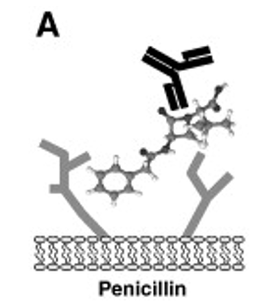
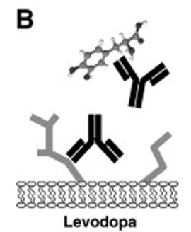
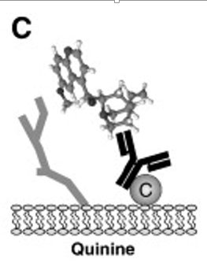
Major subtypes of drug-associated haemolytic antibodies.
A. Classical, hapten related autoantibody of the penicillin type depending on a low affinity attachment of the drug to the RBC surface allowing warm reactive IgG fixation with consecutive Fc opsonisation.
B. Drug-independent haemolytic mechanism (e.g. levodopa) associated with the random occurrence of a drug-specific antibody that cross reacts RBC membrane components.
C. Immune complex autoimmunohemolytic mechanism related to the non-specific
Jean-Francois Lambert , Urs E. Nydegger
Geoepidemiology of autoimmune hemolytic anemia
Autoimmunity Reviews Volume 9, Issue 5 2010 A350 - A354

Slide 41
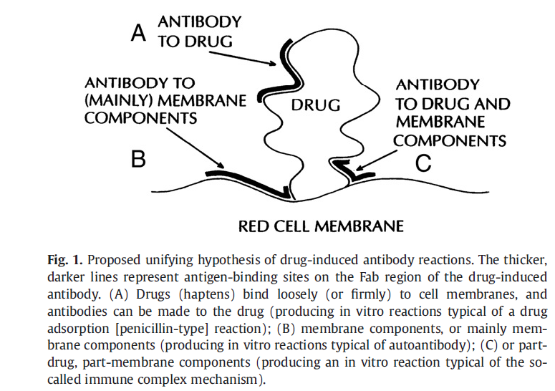
George Garratty
Immune hemolytic anemia associated with drug therapy
Blood Reviews 24 (2010) 143–150

Slide 42
