Slide 1
Designed drugs: targeted therapeutics
Dr Gareth Gerrard
Imperial Molecular Pathology,
Centre for Haematology,
Faculty of Medicine,
Imperial College London,
Hammersmith Hospital
g.gerrard@imperial.ac.uk

Slide 2
Targeted therapy, a definition…..
“A drug with a focused mechanism that specifically acts on a well defined target or biological pathway that when inactivated, causes regression or destruction of the malignant process.”

Slide 3
…in other words
Targeted therapy:
blocks the growth of tumour cells by interfering with specific targeted molecules needed for oncogenesis and growth,
rather than by simply interfering with all rapidly dividing cells (e.g. traditional chemotherapy).

Slide 4
Cancer as a Target
Characterised by extensive genomic abnormalities:
Tumour specific mutations, copy number aberrations, translocations & epigenetic changes
Dysregulated apoptosis/cell death, altered cell adhesion/migration, angiogenesis, and cell proliferation
Knowledge of oncogenic pathways has lead to Rational Drug Design

Slide 5
Categories of Targets
Cell surface markers & receptors
Secreted proteins
Intracellular kinases
Gene fusion products
Other targets, eg. Proteasome

Slide 6
1 .Cell Surface Receptor and 2. Secreted Protein Targets
Protein – Receptor interaction leads to signal transduction
Involved in intercellular communication (FLT3)
Accessible targets to therapeutic monoclonal antibodies (CD20)
Typically signal for survival, proliferation & angiogenesis (VEGF)

Slide 7
3. Protein Kinases
Pivotal players in signal transduction
Provide assayable enzymatic activities for screening small molecule inhibitors
Can be:
Receptor kinases on cell membrane (FLT3)
Intracellular (BCR-ABL1)
Phosphorylate key amino acid residues:
Tyrosine kinases (BCR-ABL1 / SRC-family)
Serine/threonine kinases (Aurora)

Slide 8
4. Gene Fusion Products
BCR-ABL1 - t(9;22)
Also a TK
Other BCR-TK fusion partners
PML-RARα - t(15;17)
Dysregulated / aberrant gene product
Unique to tumour cell

Slide 9
5. 26S Proteasome
Intracellular protein degradation machinery
Ubiquitination: tags proteins to be broken down
2 sub-units:
20S core particle (x1)
19S regulatory caps (x2)
Essential component in many cellular functions

Slide 10
Catagories of Targeted Therapies
Antibodies:
‘Naked’
Conjugated
Small molecule inhibitors:
Kinase Inhibitors
Differentiation Agents
Proteosome Inhibitors

Slide 11
1.Antibodies
High affinity binding
Create anti-tumour effect by:
Cell-mediated cytotoxicity & complement activation - naked antibodies
Focused delivery radiation/cellular toxin - conjugated antibody
Other intracellular mechanisms, currently not clearly understood (anti-CD52)

Slide 12
1.1 ‘Naked’ Antibodies
Rituximab (Rituxan, MabThera)
Chimeric monoclonal IgG1 antibody
Induces apoptosis, antibody dependant & compliment mediated cell cytotoxicity
Most commercially successful anticancer therapeutic
Target: CD20 surface receptor, common to many B cell non-Hodgkin lymphoma subtypes and B cell leukaemias

Slide 13
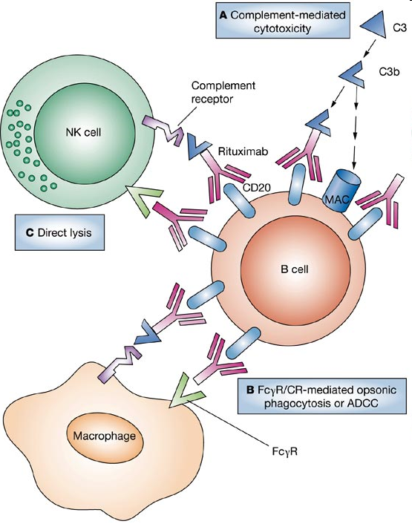
Rituximab Mode of Action
Effective for use in:
Haematological Malignancies
B cell leukaemia & lymphoma
Autoimmune Disease
rheumatoid arthritis
Anti-rejection post transplant
- Kidney transplant
Taylor and Lindorfer. Nature Clinical Practice Rheumatology (2007) 3, 86-95

Slide 14
1.2 Toxin Conjugated Ab
Gemtuzumab ozogamicin (Mylotarg)
Anti-CD33 monoclonal antibody
Conjugated to calicheamicin cytotoxin (ozogamicin)
Both CD33 & Ab internalised
Approved for use in elderly relapsed AML
Withdrawn from some protocols due to adverse side effects
Often used as adjuvant
VOD/SOS possibly due to CD33 expression on Kupffer cells
Target: High expression of CD33 on AML tumour cells
Notes:
Hepatic veno-occlusive disease or veno-occlusive disease (VOD) is a condition in which some of the small veins in the liver are blocked. It is a complication of high-dose chemotherapy given before a bone marrow transplant and is marked by weight gain due to fluid retention, increased liver size, and raised levels of bilirubin in the blood.[1] The name sinuosoidal obstruction syndrome is now preferred if VOD happens as a result of chemotherapy or bone marrow transplantation.[1][2]

Slide 15
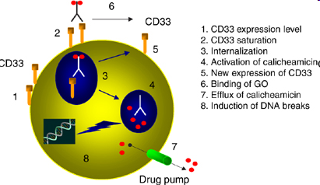
Gemtuzumab mode of action
Pagano et al. Oncogene (2007) 26, 3679–3690
Notes:
The calicheamicins are a class of enediyne antibiotics derived from the bacterium Micromonospora echinospora, with calicheamicin γ1 being the most notable.^{[1]} It was isolated originally in the mid-1980's from the chalky soil, or "calichi pits", located in Kerrville, Texas. The sample was collected by a scientist working for Lederle Labs. ^{[2]} It is extremely toxic to all cells and in the year 2000, a CD33 antigen-targeted immunoconjugate N-acetyl dimethyl hydrazide calichiamicin was developed and marketed as targeted therapy against the non-solid tumor cancer acute myeloid leukemia (AML).^{[3]} Calicheamicin γ1 and the related enediyne esperamicin are the two of the most potent antitumor agents known.^{[4]}

Slide 16
2.1 Anti-secreted Protein Antibody
Bevacizumab (Avastin):
Targets Vascular Endothelial Growth Factor
Anti-VEGF monoclonal antibody
Angiogenesis inhibitor
For use in colorectal cancer, also breast & lung cancer
VEGF is an extracellular protein signal that stimulates the growth of new blood vessels
Avastin binds to VEGF and blocks interaction with receptor on vascular endothelium
Inhibits tumour growth by blocking the formation of new blood vessels
Target: Growth factor involved in tumour progression

Slide 17
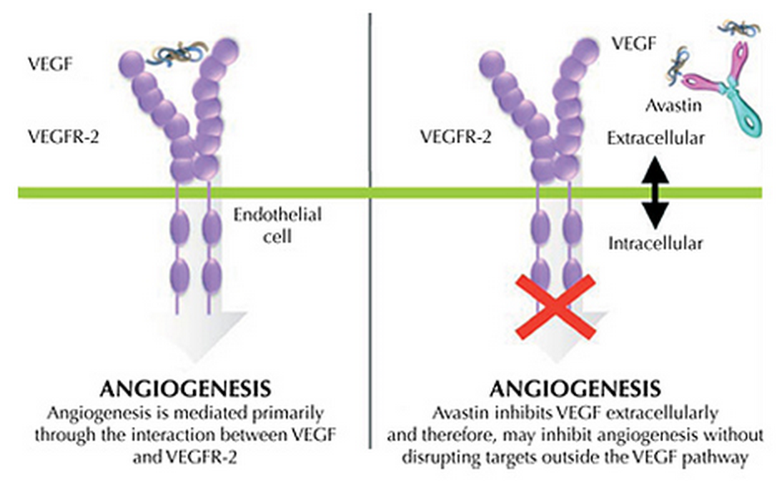
Avastin – Mode of Action
http://www.avastin.net/portal

Slide 18
3. Small Molecule Inhibitors
All-Trans Retinoic acid (ATRA)
Imatinib Mesylate (Glivec)
Flt3 targeted therapies
Bortezomib (Velcade)

Slide 19
3.1 All Trans Retinoic Acid
ATRA (Vesanoid)
Specifically for the treatment of acute promyelocytic leukaemia-APL (AML M3)
Acid form of Vitamin A
PML-RARα reciprocal translocation t(15;17)
Fusion gene product
Disruption of RARα leads to maturation arrest
ATRA overcomes this disruption and induces differentiation
Target: aberrant transcription complex caused by tumour specific fusion gene product

Slide 20
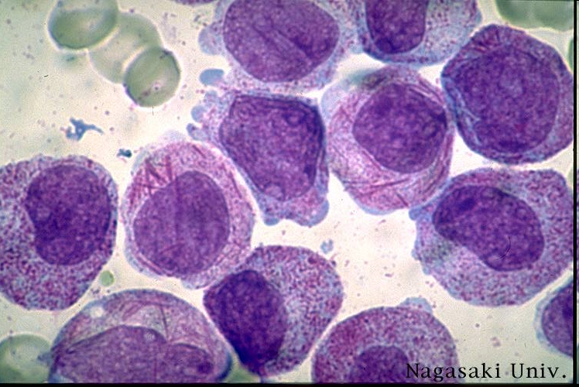
APL – BM

Slide 21
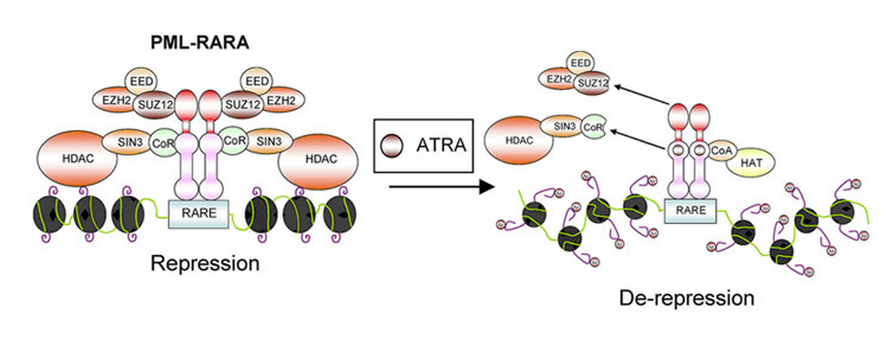
ATRA Mode of Action
RARα
RXR
Brown et al, 2009, Frontiers in Bioscience 14, 1684-1707

Slide 22
3.2 BCR-ABL1
Chronic myelogenous leukemia (CML) t(9;22)(q34;q11) translocation (Philadelphia chromosome):
BCR-ABL1
Also found in Ph+ALL and AML
ATP dependant tyrosine kinase
Multiple downstream targets:
Up-regulation of proliferation
Down-regulation of apoptosis
Alteration of adehesion

Slide 25
3.2 Imatinib Mesylate
Glivec (STI571; Gleevec)
“First molecularly targeted therapy”
Potent Tyrosine Kinase inhibitor (TKI)
Blocks proliferation
Induces apoptosis
Low toxicity
Selectively Inhibits TK ATP binding site:
ABL1; c-kit; PDGFR_{α/β}; BCR-ABL1
Use in Ph⁺CML, ALL & other TK malignancies
Target: Tumour associated fusion gene product

Slide 26
Imatinib Mode of Action

Slide 27
Bcr-Abl1 Signalling
bcr-abll
P
P
bcr-abl
ATP
ATP
Oligomerization and autophosphorylation
MAPK
PI3K
STAT
Akt
Nucleus
Altered adhesion
Proliferation
Genomic instability
Inhibition of apoptosis
Adapted from Deininger MWN et al. Blood. 2000;96:3343-3356; Smith KM et al. Mol Cell. 2003;12:27-37; Johnson FM et al. Clin Cancer Res. 2005;11:6924-6932; and Walz C, Sattler M. Crit Rev Oncol Hematol. 2006;57:145-164.
Notes:
Constitutive activation of bcr-abl induces signaling through multiple downstream pathways leading to transformation.
bcr-abl becomes active through dimerization-induced intermolecular autophosphorylation.¹
bcr-abl constitutively activates signaling pathways, including the PI3K, STAT and Ras pathways that have been shown to be critical for transformation.^{2,3}
Mechanisms that have been implicated in the malignant transformation by bcr-abl include altered adhesion to stroma cells and extracellular matrix, constitutively active mitogenic signaling, genomic instability, and reduced apoptosis.³
It has long been known that the activity of Src tyrosine kinase is elevated in the presence of the bcr-abl oncoprotein.²
MAPK=mitogen-activated protein kinase; PI3K=phosphatidylinositol 3 kinase;
STAT=signal transducer and activator of transcription.
References
1. Smith KM, Yacobi R, Van Etten RA. Autoinhibition of Bcr-Abl through its Sh3 domain. Mol Cell. 2003;12:27-37.
2. Walz C, Sattler M. Novel targeted therapies to overcome imatinib mesylate resistance in chronic myeloid leukemia (CML). Crit Rev Oncol Hematol. 2006;57:145-164.
3. Deininger MWN, Goldman JM, Melo JV. The molecular biology of chronic myeloid leukemia. Blood. 2000;96:3343-3356.

Slide 28
TKI Therapy
Imatinib
IM
IM
P
P
bcr-abll
bcr-abl
ATP
ATP
X
X
X
MAPK
PI3K
STAT
Akt
Nucleus
Altered adhesion
Proliferation
Genomic instability
Inhibition of apoptosis
Apoptosis
Adapted from Deininger MWN et al. Blood. 2000;96:3343-3356; Smith KM et al. Mol Cell. 2003;12:27-37; Johnson FM et al. Clin Cancer Res. 2005;11:6924-6932; and Walz C, Sattler M. Crit Rev Oncol Hematol. 2006;57:145-164.
Notes:
Constitutive activation of bcr-abl induces signaling through multiple downstream pathways leading to transformation.
bcr-abl becomes active through dimerization-induced intermolecular autophosphorylation.¹
bcr-abl constitutively activates signaling pathways, including the PI3K, STAT and Ras pathways that have been shown to be critical for transformation.^{2,3}
Mechanisms that have been implicated in the malignant transformation by bcr-abl include altered adhesion to stroma cells and extracellular matrix, constitutively active mitogenic signaling, genomic instability, and reduced apoptosis.³
It has long been known that the activity of Src tyrosine kinase is elevated in the presence of the bcr-abl oncoprotein.²
MAPK=mitogen-activated protein kinase; PI3K=phosphatidylinositol 3 kinase;
STAT=signal transducer and activator of transcription.
References
1. Smith KM, Yacobi R, Van Etten RA. Autoinhibition of Bcr-Abl through its Sh3 domain. Mol Cell. 2003;12:27-37.
2. Walz C, Sattler M. Novel targeted therapies to overcome imatinib mesylate resistance in chronic myeloid leukemia (CML). Crit Rev Oncol Hematol. 2006;57:145-164.
3. Deininger MWN, Goldman JM, Melo JV. The molecular biology of chronic myeloid leukemia. Blood. 2000;96:3343-3356.

Slide 29
Response with First-Line Imatinib at 60 m.
96%
98%
100
92%
90
85%
84%
87%
80%
80
70
69%
% Responding
60
CHR
50
MCR
40
CCR
30
CCR IM = 68%
Ifn/Ara-c = 7%
20
10
0
0
6
12
18
24
30
36
42
48
54
60
66
Months since randomization to imatinib mesylate
CCR = complete cytogenetic response.
Druker. NEJM 355: 2408, 2006
Notes:
29
Core
In the Phase III IRIS trial comparing interferon alfa with imatinib mesylate, patient responses to imatinib continued to improve with prolonged time on imatinib.
This is most clearly seen in complete cytogenetic responses (CCRs), which increased from 69% at 12 months to 87% at 60 months.
CP: chronic phase; CHR: complete hematologic response; MCR: major cytogenetic response; CCR: complete cytogenetic response
REFERENCES:
Druker BJ, Guilhot F, O’Brien SG, et al for the IRIS Investigators. Five-year follow-up of patients receiving imatinib for chronic myeloid leukemia. N Engl J Med 2006;355:2408-2417.
Druker BJ, Guilhot F, O'Brien S, et al. Long-term benefits of imatinib (IM) for patients newly diagnosed with chronic myelogenous leukemia in chronic phase (CML-CP): The 5-year update from the IRIS study. In: Program/proceedings of the 42nd Annual Meeting of the American Society of Clinical Oncology; June 2-6, 2006; Atlanta, Ga. Abstract 6506.

Slide 30
BCR-ABL1 TK domain mutations
Point mutations can develop in the kinase domain
Imatinib resistance due to steric distortion of drug binding pocket
Occurs in 40-90% of patients, especially during progression to AP/BC
50+ different mutations identified
Most clinically relevant is the T315I mutation
cytosine to thymine (C -> T) substitution at base position 944
resulting in Threonine being substituted by Isoleucine (aa315)

Slide 31
Second generation TKIs
Nilotinib – AMN107/Tasigna (Novartis)
Dasatinib – BMS354825/Sprycel (BMS)
Bosutinib - SKI-606 (Pfizer)
Significantly improved activity in IM resistant patients, (except for T315I)
Dasatinib binds ABL1 with greater affinity than other agents (and like Bosutinib) is also a multi-kinase inhibitor, notably effecting the SRC family kinases
All are currently in use as 2nd & 3rd line treatments and under investigation for 1st line.

Slide 32
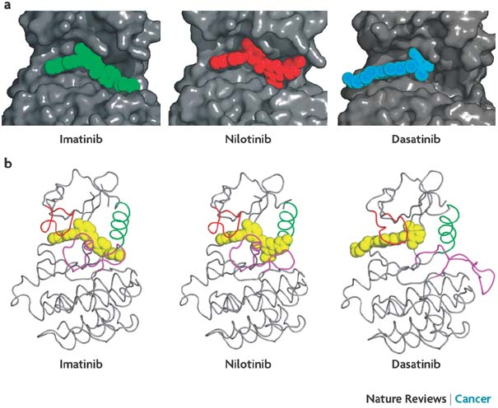
TKIs in ATP Binding Pocket
Weisberg et al. Nat Rev Cancer. 2007;7:345.

Slide 33
3rd Generation TKIs
Ponatinib – (Ariad)
DCC-2036 – (Deciphera)
DCC-2157 – (Deciphera)
All are effective against BCR-ABL1 T315I mutations and show higher activity than imatinib against other TK mutations
Notes:
http://www.ncbi.nlm.nih.gov/pmc/articles/PMC2804470/?tool=pmcentrez

Slide 34
3.3 FLT 3 targeted inhibitors
FLT3 Expressed on 90% of AML (and B-ALL):
30% associated with an Internal Tandem Duplication (ITD) and/or a point mutation
Tyrosine Kinase autophosphorylation
Associated with more aggressive disease
High level of expression makes it a potential target
Three novel small compounds, all TKIs, are now in developmental stages:
Tandutinib (MLN518)
Lestaurtinib (CEP-701)
Midostaurin (PKC412)
Target: highly expressed receptor TK
Notes:
FLT3, a member of the receptor tyrosine kinase (RTK) class III, is preferentially expressed on the surface of a high proportion of acute myeloid leukemia (AML) and B-lineage acute lymphocytic leukemia (ALL) cells in addition to hematopoietic stem cells, brain, placenta and liver. An interaction of FLT3 and its ligand has been shown to play an important role in the survival, proliferation and differentiation of not only normal hematopoetic cells but also leukemia cells. Mutations of the FLT3 gene was first reported as an internal tandem duplication (ITD) of the juxtamembrane (JM) domain-coding sequence, subsequently as a missense mutation of D835 within a kinase domain. ITD- and D835-mutations are essentially found in AML and their frequencies are approximately 20 and 6% of adults with AML, respectively. Thus, mutation of the FLT3 gene is so far the most frequent genetic alteration reported to be involved in AML. Several large-scale studies in well-documented patients published to date have demonstrated that ITD-mutation is strongly associated with leukocytosis and a poor prognosis

Slide 35
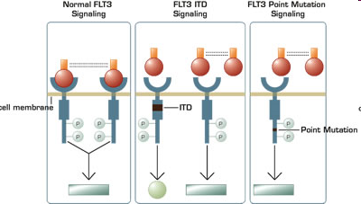
FLT3 Mutations
Mead et al. Blood. 2007;110:1262-1270.

Slide 36
3.4 Proteasome Inhibitor
Bortezomib (Velcade)
Novel, potent and specific inhibitor of 26S proteasome
Boron-based di-peptide
Currently in use for MM and MCL
Therapeutic effect via blockade of NF-κB activation
Blocks ubiquitin-signalled degredation of IκB
Inactive NF-κB unable to perform pro-proliferative and anti-apoptotic function
Target: cellular component needed by tumour cell

Slide 37
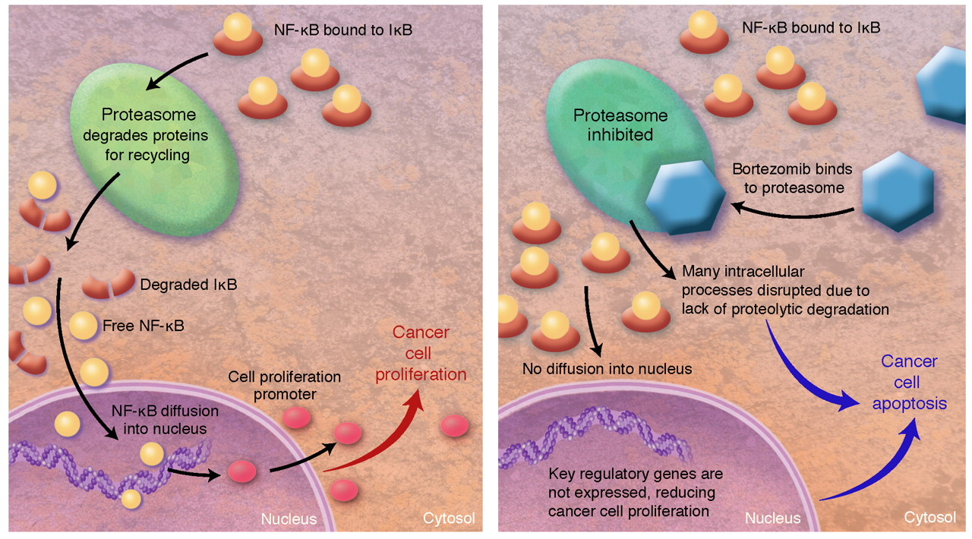
Bortezomib Mode of Action
Am J Health Syst Pharm. 2008 Jul 1;65(13):1221-31.
Notes:
The left panel illustrates the nuclear factor kappa B (NF-kB) functioning in a cancer cell. NF-kB is primarily bound to inhibitor of
kappa B (IkB) in the cytosol. As IkB is degraded by the proteasome, NF-kB is freed and diffused into the cell nucleus. In the nucleus, NF-kB
promotes the expression of key proliferative compounds that promote cancer cell survival and proliferation. The right panel illustrates
how bortezomib disrupts the action of NF-kB. Illustration by Taina Litwak, CMI.

Slide 38
Conclusions
Targeted therapies allow for reduced toxicity and higher levels of treatment success
Therapeutic agents designed to act upon specific malignant targets
Monoclonal antibodies – often target tumour specific antigens
Small molecule inhibitors – often target tyrosine kinases
Many 2nd & 3rd generation targeted therapies currently being investigated

Slide 39
References
J.S Ross et al Targeted Therapies for Cancer Am J Clin Pathol 122:598-609 (2004)
Desany & Zhang Bioinformatics and cancer target discovery DDT Vol9, No18 (2004)
J Apperley Mechanism of resistance to Imatinib in CML. Lancet Oncol vol 8:1018-29 (2007)
Thomas et al Ph+ ALL a new era of challenges Blood ASH edition (2007)
Quintas-Cardama et al Flying under the radar: The new wave of BCR-ABL inhibitors Nature reviews vol 6:834-848 (2007)
Utecht & Kolesar. Am J Health Syst Pharm. 2008 Jul 1;65(13):1221-31.
Estey E. New drugs in acute myeloid leukemia. Semin Oncol. 2008 Aug;35(4):439-48

