Slide 1
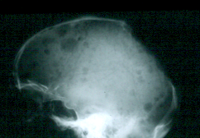
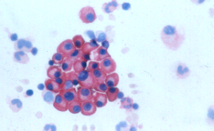
The pathobiology of multiple myeloma
Dr Saad Abdalla
BSc Module 2 2012

Slide 2
Purpose of lecture
To explain the various aspects of plasma cell tumours including:
    The origin and phenotype of the myeloma cell and the cell compartment in which oncogenic events develop:
    The genetic events that lead to clonal selection: Chromosomal and gene translocations
    The emerging role of cyclin D activation in MM
    Myeloma growth : the role of stroma, cytokines and adhesion molecules
    The multistep evolution of this group of disorders from asymptomatic conditions to symptomatic but treatment responsive disease to ultimate stromal independence and drug resistance

Slide 3
Other topics discussed elsewhere
Bone disease
Neoangiogenesis and implications (to be more fully discussed with treatment)

Slide 4
Basic biological characteristics of myeloma cells
Myeloma cells have a very low labelling index with a small compartment of dividing cells
There are two compartments, the end stage cell (plasma cell) and a feeder cell (plasmablasts)
PC are dependant on mutual interaction with BM stroma for survival and proliferation and other functions and therefore not normally found in the circulation
The cytogenetics of MM is complex
  Numerous abnormalities found
  Some translocations are cryptic
  Primary versus secondary abnormalities

Slide 5
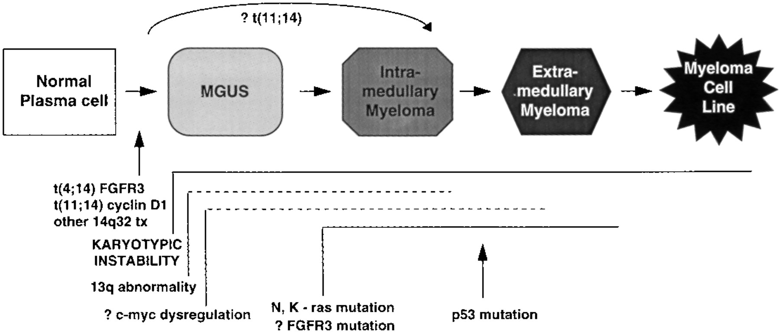
Myeloma as a multistep disease

Slide 6

Normal plasma cell development
Short lived plasma cells
Switched non switched
Lymphoplasmacyte
IgM
Plasmablast
Somatic
hypermutation
Antigen selection
Lymph node
IgG
IgA
Productive antigen
interaction
IgH class switch recombination
Germinal centre
Blood
Virgin B cell
Bone
Marrow
Long-lived
plasma cell
Pre B cell
Functional V(D)J rearrangement
Genetic modifications that generate double stranded DNA breaks

Slide 7
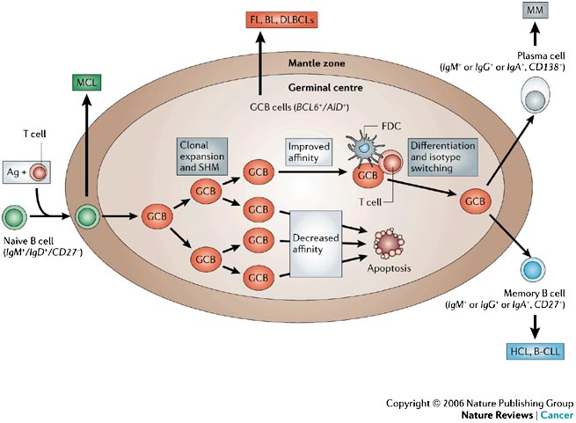

Slide 8
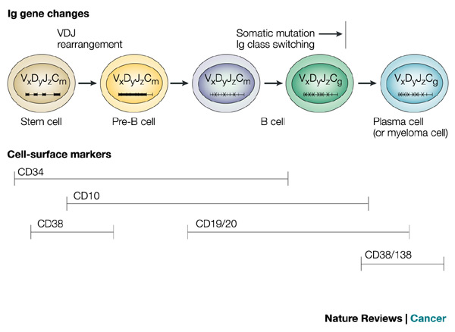
DNA rearrangements during B lymphoid cell development
These events lead to double stranded DNA breaks and give rise to the possibility of illegitimate recombinations
Early in B cell developement
    In germinal centres

Slide 9
Characteristics of Plasma cells in MM
Post switch, somatically hypermutated with invariate immunoglobulin idiotype corresponding to long lived plasma cells
Low labelling index and relatively inefficient Ig production
Presence of pre-switch idiotypically identical cells in circulation of some patients with MM suggestive of an earlier feeder compartment
Cell of origin in which critical event leads to immortalisation is the long lived plasma cells or plasmablasts

Slide 10
Membrane markers of myeloma cells: 1. universal markers of plasma cells
High level CD 38 expression
  (Type II integral membrane glycoprotein no significant homology to known molecules, Plasma cells, thymocytes, activated T-cells).
Syndican-1 CD138 expression
  An adhesion molecule of the heparan sulphate family

Slide 11
2. Markers associated with malignant phenotype
Aberrant expression of
  CD 56 Adhesion molecule( : N-CAM
    Lost in PCL and extramedulary plasmacytomas
    Interacts with osteoblasts
  CD 28: T-cell specific marker (48%)
    Not associated with growth or survival
    Chemokine release
    Increased expression with relapses

Slide 12
3. Markers present in normal PC but absent in MM cells
  B cell : CD 19 weakly expressed in normal PC but not expressed in majority of MM cells
  Cd27: memory marker, found in most normal PC but lost in about 50% of MM. Expression associated wit better prognosis. Also lost with disease progression

Slide 13
4. Markers associated with poor prognosis: under-expression of CD45 and over-expression of CD221 (IGF-1R)
CD45 pan leucocyte marker (tyrosine phosphatase)
  Absent in mature PC
  Strong expression associated with IL-6 dependant growth
  Expressed strongly on proliferating cells but not mature plasma cells
  Impairs activation of AKT pathway by IGF-1

Slide 14
CD45- cells usually over-express CD221
Unimpeded activation of AKT pathway by IGF-1/IGF-1R
Associated with increased PC proliferation and worse prognosis
Associated with t(4;14) see later

Slide 15
Membrane markers, morphology and cytogenetic correlations
CD20+ (14%), CD19+ (2.5%) mutually exclusive in MM associated with
  lymphoplasmacytic or small plasma cell morphology
  Good prognosis
  Diploid with t(11;14)
CD19-CD20-CD27-
  Associated with blastic morphology
  Poor prognosis
  Associated with t(4;14) or (14;16)
CD117+ associated with indolent myeloma and favourable prognosis

Slide 16
Myeloma cytogenetics
Difficulties because the majority of plasma cells have a slow turnover
Exclude abnormalities associated with MDS
Conventional metaphase cytogenetics yield lower rates of positivity
Interphase FISH higher rates of detection but needs to be targeted

Slide 17
Tumour cell-associated genetic abnormalities in MM and MGUS: conventional karyotyping
Abnormal karyotype found in 30-50% of cases and increases with stage.
Numeric changes: hyperdiploidy (60%), pseudodiploidy and hypodiploidy(15-20%)
Complex karyotypes frequent and increase in advanced disease: Karyotypic instability
Most common numeric changes: monosomy 13, trisomy 3,5,7,9,11,15,19.
Also found in MGUS to lesser extent
Better detection rates using FISH and other more sensitive techniques

Slide 18
Cytogenetic abnormalities in MM
Diploid: usually IgH locus involved or hyperdiploid
Primary
  Early
  B cell specific
  switch or J region
  Ig locus
  Present in MGUS
  Simple abnormality
Secondary
  Late
  Not B cell specific
  Not usual
  Less often
  Rare
  Complex

Slide 19
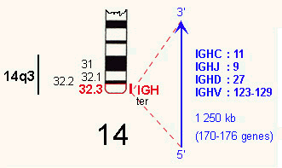
The 14q32 locus
Switch
VDJ recombinase

Slide 20
Illegitimate recombination at the 14q32 locus in PCDs (After Avet-Loiseau IFM)
Juxtaposition of IgH chain promoter locus to a proto-oncogene
Leads to dysregulation of partner proto-oncogene
Found in 48% MGUS, 73% of all MM and 84% PCL,
4 categories :
  t(11;14)(q13;q32) 15-20% Bcl -1 Cyclin D1
  t(4;14)(p16.3;q32) 12% FGFR-1 and MMSET
  t(14;16)(q32;q23) 5-10% c-maf
  t(6;14)(p21;q32) 5% Cyclin D3
Other partner chromosomes sporadic and less common
No demonstrable rearrangement (25%)
In cases cloned, translocations mainly in switch region, whereas translocation in VDJH region in Mantle Cell Lymphoma
Lambda locus on chromosome 22 in approx 5% Kappa rare.

Slide 21
Translocations involving 14q32: t(11;14)(q13;q32)
30% of translocations involving 14q32 (15-20% of all MM)
partner is 11q13 : Bcl-1 which encodes for cyclin D1
Associated with over expression of cyclin D1
Protein which plays a critical role in regulating the cell cycle.
Highest percentage in light chain myeloma (31%)
Although same translocation as in MCL the breakpoint is different in both chromosomes suggesting different mechanisms.
Expression of CD20 and lymphoplasmacytic morphology
Associated with best overall survival
Garand et al. Leukaemia 2003 71:2032

Slide 22
T(4:14)(p16;q32)
Occurs in 12% of MM and represents 20% of patients with involvement of 14q32
Cryptic not visible by banding
Involves two target genes: FGFR3 on der (14)(Fibroblast Growth Factor Receptor 3) and MMSET on der (4).
FGFR3 not overexpressed in 30 % of those with translocation
  Tyrosine kinase receptor implicated in tumourgenesis and angiogenesis
MMSET overexpressed in MM cell with translocation
  Thought to be an oncogene
  Homology to MLL1 and ALL1.
More common in IgA MM
Poorer prognosis even with high dose therapy

Slide 23
t(14;16)(q32;q23 t(6;14)(6p21;q32)
Incidence 2-10%
Up-regulation of basic leucine zipper transcription factor c-maf
Little data on prognostic value
Incidence 4%
Encodes for Cyclin D3

Slide 24
Other translocations in IgH locus
8q24 (c-myc) less than 5% (the same translocation as found in mouse plasmacytomas and Burkitt’s, thought to be secondary
18q21(bcl-2)
11q23 (MLL-1)
20q12 (MAFB)
rest partner unknown
Less commonly λ light chain locus involved

Slide 25
Chromosome 13 abnormalities
Monosomy 13 or del13q
In 40-50% of patients with MM and some - MGUS
90% are monosomy 13 others 13q⁻
More common in non-hyperdiploid tumours
Cytogenetic del 13: (15%) worse prognosis
  advanced disease
  more common in PCL
Does not appear to be related to retinoblastoma gene loss as other allele active

Slide 26
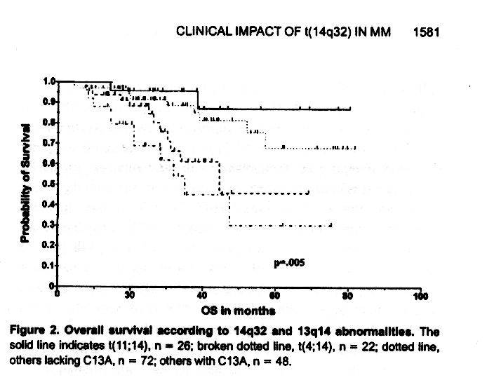
T(11;14)
T(4;14)
No C13A
C 13 A
Moreau et al Blood 2003 volume 100

Slide 27
Proposed model
Hyperdiploid
No IgH translocations
Primary
IgH translocations
Non-hyperdiploid
Non recurrent translocatoins
Variable ploidy

Slide 28
Secondary genetic events in MM
Become commoner with more advanced disease
Other IgH translocation:
  Numerous non-recurrent mutations involving different partner chromosomes
  MYC oncogene (c-myc 8q24)
Lambda light chain locus
Kappa locus involvement rare.
Rb gene deletion
P18
RAS

Slide 29
Cyclin D dyregulation in PCD
Important in cell cycle progression from G₀ to G₁
Cyclins D1, D2 and D3
Interact with Cyclin Dependant Kinases CDK4 and 6 leading to phosphorylation of Rb protein and disinhibition of E2F a transcription factor that initiates the cell cycle.
All proliferating cells express Cyclin D1 but not normally lymphoid tumours except MM, MCL and exceptionally others
Most MM cells express cyclins
MAF and MAFB transcription factors that lead to increase in many factors including cyclin D2 mainly
Trisomy 11 may contribute to increase in Cyclin D1 in hyperdiploid tumours

Slide 30
RNA expression profiling of MM cells Bergsagel et al Blood 2005 Vol 106
8 groups according to cyclin D expression are identified 1-4 IgH, 5-8 hyperdiploid
1. 4p16 FGFR-MMSET Cyclin-D2. 2. MAF 16q23 and 20q21. 3.6p21 Cyclin D3 4. 11q13 Cyclin D1
5. D1 overexpression. 6. D1+2. 7. No overexpression. 8. D2
16q23

Slide 31
Proposed model of cyclin dysregulation in MM:
1. Direct gene dysregulation solid arrows
2. Indirect unknown mechanism: dotted arrow
From Hideshima et al 2004 Blood vol 104
Other genes targetted usually in secondary mutations include P16 and 18 which are inhibitors of CDK, and the Rb gene.
Cyclins interact with Cyclin D kinases to phosphorylate Rb gene, a tumour suppressor gene bound to E2F a transcription factor important in transition from G1 to S phase in the cell cycle.

Slide 32
Possible relevance of Cyclin D classification of MM

Slide 33
Role of BM stroma in MM
Normal plasma cell development is dependant on interactions through
  adhesion molecules,
  Receptors
  cytokines
Interactions between PC and stromal cells regulate
  proliferation,
  Growth
  differentiation
  apoptosis
These factors are also essential in supporting the growth of myeloma cells and prevention of apoptosis in a dysregulated cell with an oncogenic translocation

Slide 34
Myeloma cell growth and inhibitory factors
Growth factors
  Il-6
  IGF-1
  VEGF
  SDF-1a: Stromal Cell
  derived factor 1a
  TNFa
  IL-21
Inhibitory factors
  Interferon-γ
  IFN-α and β
  TGF-1β and TNF-α also inhibit IL-6 effects

Slide 35
IL-6 and MM
Growth and survival effects:
  IL-6 can induce growth of MM cells in vitro
  Anti-IL-6 inhibits growth of myeloma cell lines
  Serum IL-6 levels correlate with disease
  Some patients respond to anti-IL-6
  Myeloma cells can express IL-6 and IL-6R
Prevention of apoptosis

Slide 36
Source of IL-6 in MM
BM stroma cultures from MM patients produce a lot of IL-6
MM cells induce IL-6 production on contact with SC probably through IL-1 secretion by MM cells

Slide 37
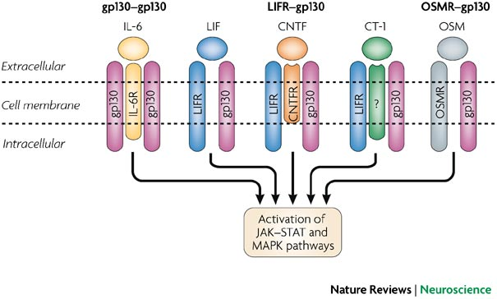
The IL-6 family and their receptor complex
IL-6 receptor made up of two subunits:
  80 kDa IL-6 binding protein IL-6Rα specific to IL-6, found on cells but also in a soluble form
  gp 130 : 130 kDa glycoprotein which acts in signal transduction and is found on cells
gp 130 is also a receptor for other cytokines, each with their own α subunit. The two units are needed one to specifically bind to cytokine and then dimerise with gp 130 which then mediates signal transduction
Other cytokines are: IL-11, OSM, LIF, CNTF, CT-1
gp 130 belongs to Ig superfamily and has close similarities to G-CSF receptor
FIGURE 1 | Neuropoietic cytokine receptor complexes.
From the following article:
The neuropoietic cytokine family in development, plasticity, disease and injury
Sylvian Bauer, Bradley J. Kerr & Paul H. Patterson
Nature Reviews Neuroscience 8, 221-232 (March 2007)

Slide 38
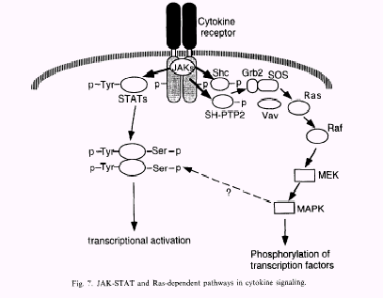

Slide 39
Adhesion Molecules
Intercellular adhesion molecules (I-CAMs) are important in homing and cell-cell interactions leading to cytokine production in both normal B cell development as well as in MM.
β1 integrins: VLA-1,-4,-5. β2 integrins: LFA-1. NCAM (CD56). ICAM-1 (CD54),-2 (CD 102), -3 (CD 50). CD 44.
Adhesion between MM cells and stroma leads to IL-6 secretion
Aberrant expression of LFA-3 and NCAM
  LFA-3 interaction with T-cells
  CD 56 NCAM not normally expressed on PC

Slide 40
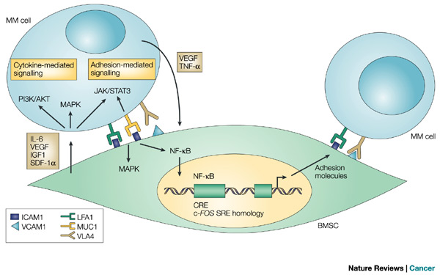

Slide 41
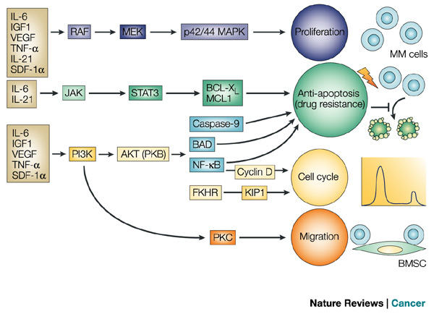

Slide 42
Progression: acquisition of karyotypic instability and further chromosomal abnormalities
ras mutations correlate with disease stage: rare in MGUS, 9-30% in newly diagnosed MM and 63-70% in PCL
ras usually activated by IL-6 but ras mutations lead to reduced reliance on or independence from IL-6 in experimental system
Hypothetically ras mutations may therefore lead to progression
Other oncogenes: bcl-2: p53,retinoblastoma gene, MDR gene and others

Slide 44
Further reading
Tricot CJ New insights into role of microenvironment in multiple myeloma.
Int J Hematol. 2002 Aug;76 Suppl 1:334-6.
Moreau P, Facon T, Leleu X, Morineau N, Huyghe P, Harousseau JL, Bataille R, Avet-Loiseau H. Recurrent 14q32 translocations determine the prognosis of multiple myeloma, especially in patients receiving intensive chemotherapy. Blood. 2002 Sep 1;100(5):1579-83. 2:
Avet-Loiseau H, Minvielle S, Mellerin MP, Magrangeas F, Bataille R. 14q32 chromosomal translocations: a hallmark of plasma cell dyscrasias? Hematol J. 2000;1(5):292-4.
Avet-Loiseau H, Facon T, Grosbois B, Magrangeas F, Rapp MJ, Harousseau JL, Minvielle S, Bataille R. Oncogenesis of multiple myeloma: 14q32 and 13q chromosomal abnormalities are not randomly distributed, but correlate with natural history, immunological features, and clinical presentation
Sezer O, Heider U, Zavrski I et al. RANK ligand and osteoprotegerin in myeloma bone disease. Blood. 2002 Nov 7 [epub ahead of print]
Gonzales et al (2007) Immunoglobubulin gene rearrangement and the pathogenesis of multiple myeloma. Blood 110; 3112-3121

Slide 45
Further references
Hideshima and anderson 2002. Molecular mechanisms of novel therapeutic approaches to Multiple Myeloma. Nature Reviews Cancer 2;927-937
Liebisch P, Dohner H. Cytogenetics and molecular cytogenetics in multiple myeloma. Eur J Cancer. 2006 Jul;42(11):1520-9. Epub 2006 Jun 16. Review.
Kuehl WM, Bergsagel PL. Early genetic events provide the basis for a clinical classification of multiple myeloma. Hematology Am Soc Hematol Educ Program. 2005;:346-52.
Hideshima T, Bergsagel PL, Kuehl WM, Anderson KC. Advances in biology of multiple myeloma: clinical applications. Blood. 2004 Aug 1;104(3):607-18. Epub 2004 Apr 15.
Fonseca R, Barlogie B, Bataille R, Bastard C, Bergsagel PL, Chesi M, Davies FE, Drach J, Greipp PR, Kirsch IR, Kuehl WM, Hernandez JM, Minvielle S, Pilarski LM, Shaughnessy JD Jr, Stewart AK, Avet-Loiseau H. Genetics and cytogenetics of multiple myeloma: a workshop report. Cancer Res. 2004 Feb 15;64(4):1546-58.
Bergsagel et al: Cyclin D dysregulation: an early and unifying pathogenic event in multiple myeloma Blood volume 106, 2005

