Slide 1


Biology and management of bone disease in patients with multiple myeloma
BSc Module in Haematology,
St Mary’s Hospital, 13/12/2012
Imperial College London
Evangelos Terpos, MD, PhD
Assistant Professor of Haematology, Department of Clinical Therapeutics, University of Athens School of Medicine, Athens, Greece & Hon. Senior Lecturer, Faculty of Medicine Imperial College London, London, UK

Slide 2
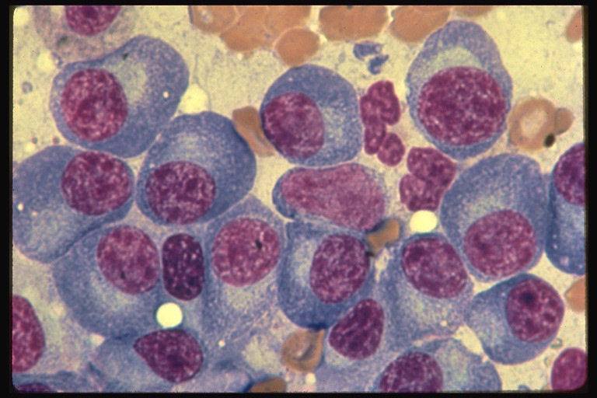
Introduction (I)
Multiple myeloma is a B-cell malignancy characterized by a monoclonal expansion and accumulation of abnormal plasma cells in the bone marrow compartment.

Slide 3
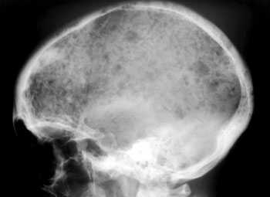
Introduction (II)
Most frequent presentation of the disease (70%)
Osteolytic lesions (60%), diffuse osteopenia (10-15%),
very rarely increased bone formation (POEMS syndrome)

Slide 4
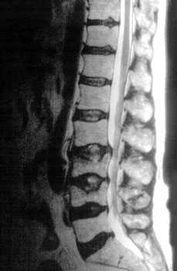
Bone Disease in Multiple Myeloma
Characterized by osteolytic bone lesions secondary to increased bone resorption and impaired bone formation
Sequelae
  Pathological fractures
  Osteoporosis
  Hypercalcemia
  Bone pain
  Spinal cord compression
Kyle. Mayo Clin Proc 1975;50:29-40

Slide 5
Cells of The Bone
Walsh et al. Annu Rev Immunol 2006;24:2.1

Slide 6
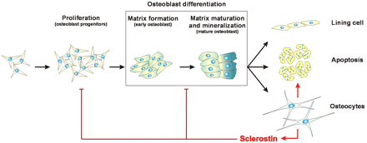
Bone Metabolism: A Balance Between Osteoblasts and Osteoclasts
Seeman & Delmas. N Engl J Med 2006;354:2250-61

Slide 7
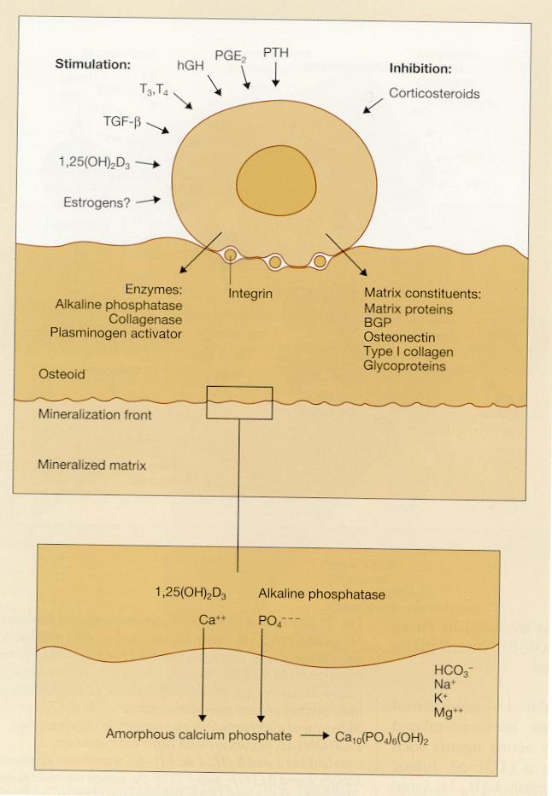
Osteoblasts
OBs initially produce an osteoid matrix that is calcified extracellularly.
The major structural protein of bone is type I collagen, which provides bone with a resistance to fracture in a way that is similar to the effect of reinforcing bars in modern reinforced concrete buildings.
The mineral crystal of bone is hydroxyapetite, which is a calcium-phosphate salt, containing hydroxyl ions.
Terpos et al. Blood Rev 2005;19:125

Slide 8
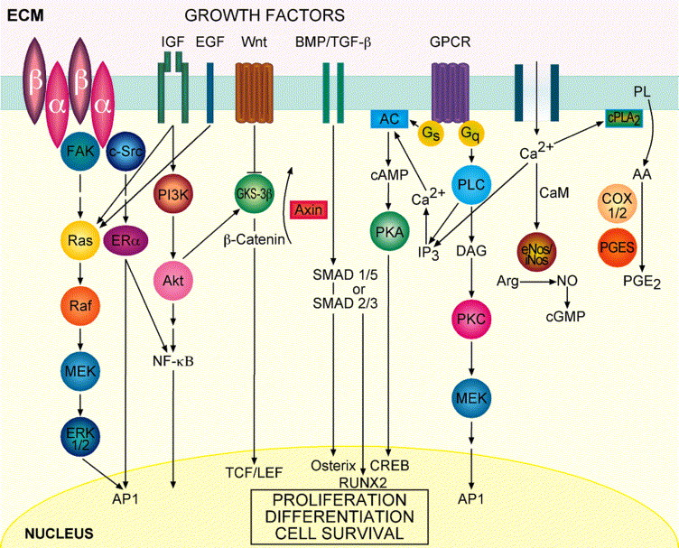
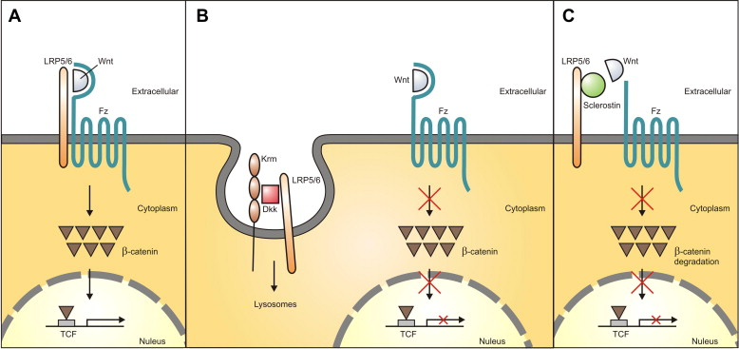
Regulation of Osteoblast Function
Peters E, et al. Arch Biochem Biophys. 2008;473(2):112-116.
Marie PJ. Arch Biochem Biophys. 2008;473(2):98-105.

Slide 9
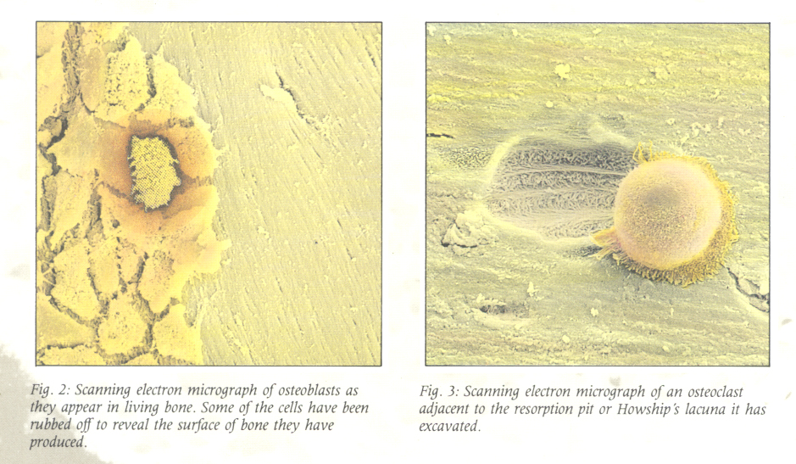
Osteoclasts

Slide 10
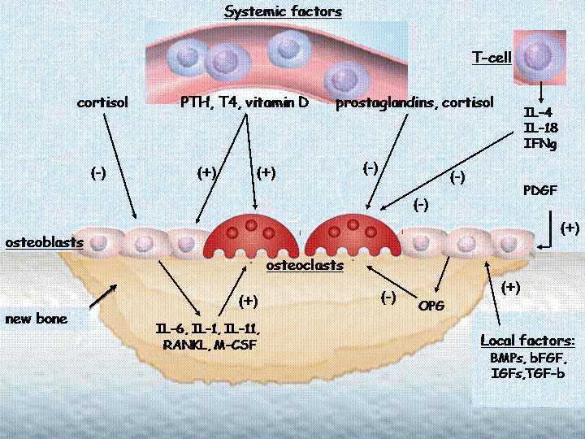
Bone Metabolism Unit
Voskaridou & Terpos. Br J Hematol 2004;127:127-39

Slide 11
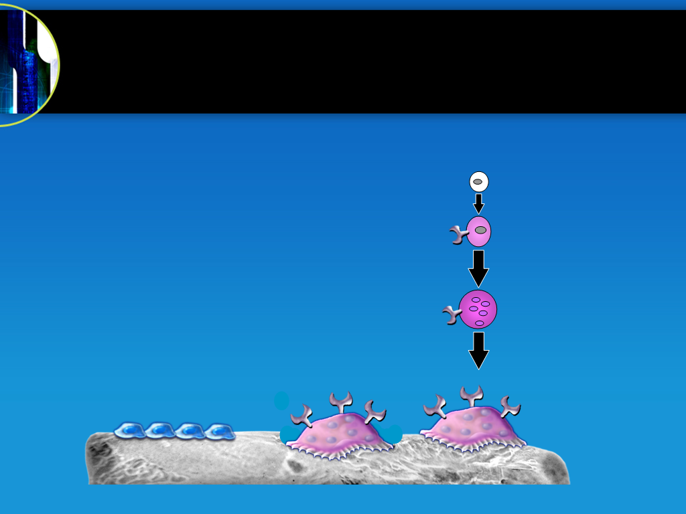

Bone Resorption Is Dependent on
RANK Ligand, An Essential Mediator of Osteoclasts
RANKL
CFU-M
RANK
Pre-Fusion
Osteoclast
Growth Factors Hormones
Cytokines
Multinucleated
Osteoclast
Mature
Osteoclast
Osteoblast
Lineage
CFU-M = colony forming unit macrophage
Bone
Boyle et al. Nature 2003;423:337-42

Slide 12
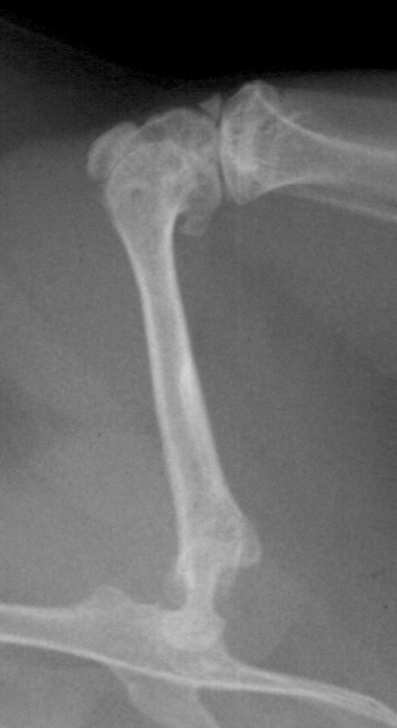
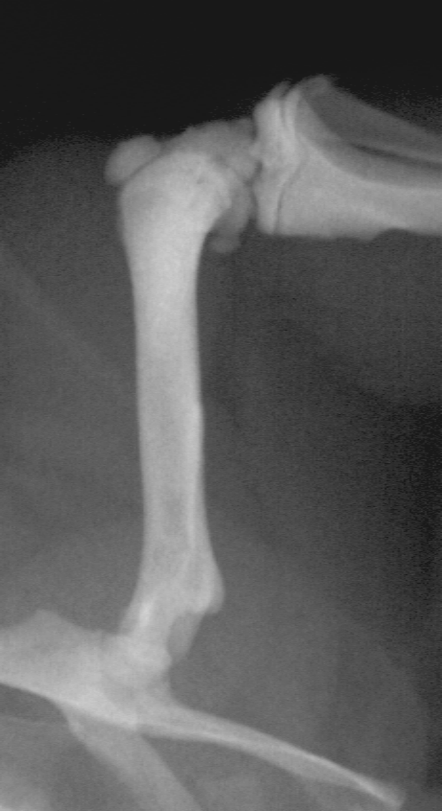
Increased Bone Density Associated With Absence of RANKL
Preclinical Experiments
Normal
RANKL knockout
Li et al. PNAS 2000;97:1566-71

Slide 13





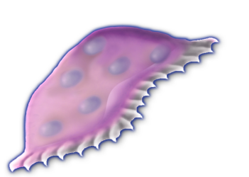
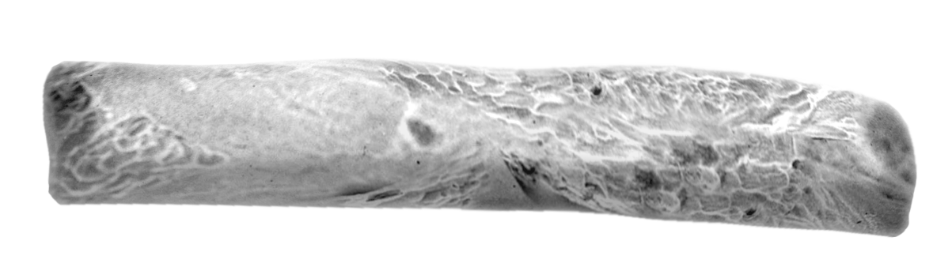

Osteoprotegerin (OPG): the Decoy Receptor of RANKL
Osteoclast Formation, Function, and Survival Inhibited by OPG
RANKL
CFU-M
RANK
OPG
Pre-Fusion
Osteoclast
Growth Factors Hormones
Cytokines
Multinucleated
Osteoclast
Inactive
Osteoclast
Osteoblast
Lineage
CFU-M = colony forming unit macrophage
Bone
Boyle et al. Nature 2003;423:337-42

Slide 14
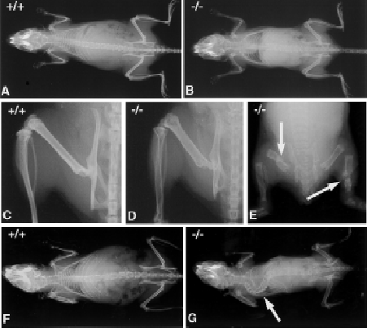
Reduced Bone Density Associated With Absence of OPG
BV%TV
50
40
30
20
10
0
-10
K
*
*
OPG +/+
OPG +/-
OPG -/-
Bucay et al. Genes Dev 1998;12:1260-8

Slide 15
RANKL/OPG Balance Drives Osteoclast Activity
Alterations of the RANK Ligand / OPG ratio are critical in the pathogenesis of bone diseases that result from increased bone resorption¹⁻³
OPG
RANK Ligand
Promotes
OC activation
Prevents
OC activation
Osteoclast Activity
OC = osteoclast
¹Hofbauer et al. JAMA 2004;292:490-5
²Lacey et al. Cell 1998;93:165-76
³Boyle et al. Nature 2003;423:337-42

Slide 16
MM Bone Disease: Pathogenesis
Skeletal destruction results from increased osteoclastic activity, which is not accompanied by a comparable increase in bone formation
LYTIC LESIONS

Slide 17
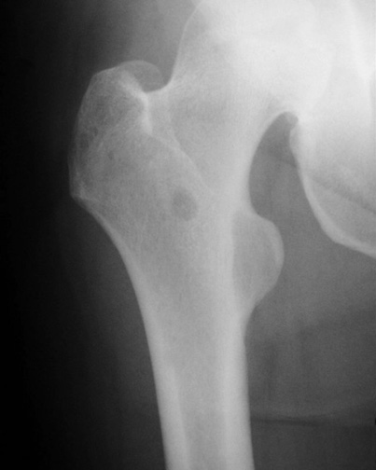
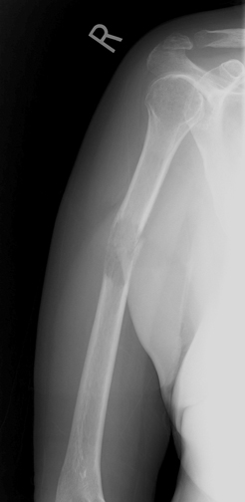

Slide 18
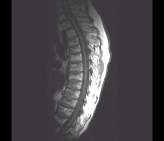
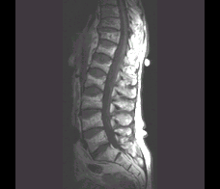
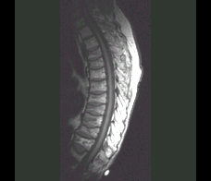
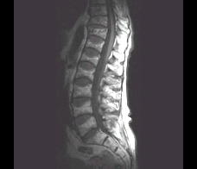

Slide 19

Myeloma Microenvironment and Bone Disease
Osteoblasts
↓ bALP,
↓ osteocalcin
OPG
Myeloma cells
(-)
RANKL
CD138
Dkk-1, sFRP-2
sclerostin, activin-A
IL-6, IGF-1
BAFF, APRIL
α4β1 integrin
RANKL
RANKL
VCAM-1
VCAM-1
BMSCs
RANKL
(-)
IL-11, IL-1β, bFGF
TNFα, M-CSF
OPG
RANK
IL-6
MIP-1α, MIP-1β,
SDF-1α, IL-3,
HGF, OPN
Osteoclast
precursor
Activated osteoclasts
TRACP-5b
Collagen type-1
degradation products:
NTX, ICTP, CTX
Bone resorption
Bone matrix
Terpos & Dimopoulos. Ann Oncol. 2005;16:1223.
Notes:
Curatio Fact-Check:
Taken directly from Terpos, figure 1, pg 1224
**PERMISSION REQUIRED FOR ENDURING WEB ACTIVITY---Author is presenter**

Slide 20
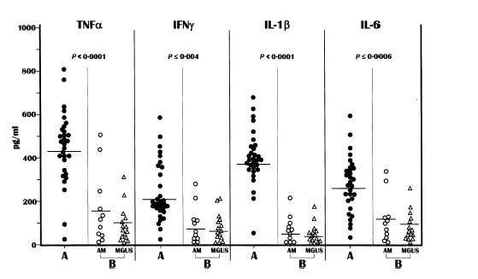
OAF cytokine production in myeloma
Silvestris et al. BJH 2004;126:475

Slide 21
Adherence of Myeloma Cells to BMSC:
Crucial for RANKL Production
**
1.40
1.20
1.00
0.80
RANKL mean levels (pM/L)
0.60
0.40
0.20
0.00
BMSC
BMSC+XG-1
XG-1
Giuliani et al. Haematologica 2004;89:1118-23

Slide 22
sRANKL/OPG Ratio in
Newly Diagnosed MM
2.0
P<0.0001
1.5
30
121
36
1.0
0.5
52
Log sRANKL/OPG
0.0
-0.5
134
68
-1.0
159
149
158
-1.5
n =
45
10
28
83
Control
A
B
C
Bone disease
Terpos et al. Blood 2003;102:1064-9

Slide 23
Prognostic Value of sRANKL/OPG in MM
sRANKL/OPG <1 (n=35)
100
89%
80
60
Probability of survival %
sRANKL/OPG 1-3 (n=54)
40
32%
20
sRANKL/OPG >3 (n=32)
20
0
12
24
36
48
60
Months post diagnosis
Terpos et al. Blood 2003;102:1064-9

Slide 24
RANKL Inhibition and Survival in Myeloma Mice
3.5
*P < 0.05
3.0
*
2.5
1.0
Paraprotein (g/dL)
P < 0.02
2.0
0.8
1.5
1.0
0.6
Control
Survival
90
0.4
OPG
85
0.2
*
80
0
% myeloma cells
0
5
10
15
20
25
30
35
40
75
Days
70
65
Control
5T33MM
+ Vehicle
5T33MM
+ OPG
Vanderkerken et al. Cancer Res 2003;63:287-9
Notes:
To evaluate the effect of reduced tumor burden on survival with RANK Ligand inhibition, 5T33MM-bearing mice were treated with OPG in separate experiments and the time to onset of morbidity were assessed.¹ 5T33MM cells are used as a murine model of multiple myeloma (MM). In this experiment, 24 mice were injected with 5T33MM cells and the development of MM was monitored by measuring serum paraprotein concentrations. On the day of injection of 5T33MM cells, mice were treated with OPG at 25 mg/kg/TIW or vehicle for 4 weeks. All of the animals that were given injections of 5T33MM cells developed MM. Twenty-eight days after injection of the MM cells, mice were sacrificed, bone marrow was isolated from the hind legs, and the proportion of tumor cells determined by staining the cells with an anti-5T33MM idiotype antibody and analysis by flow cytometry. To determine the effect of RANK Ligand on survival in the 5T33MM model, a similar experiment (as described above) was performed. Twenty-four mice were given injections of 5T33MM cells; 12 were treated with vehicle and 12 with OPG from the time of tumor injection. Treatment continued until each animal showed signs of morbidity, which included hind limb paralysis or cachexia, at which point they were sacrificed. Kaplan-Meier analysis demonstrated a significant delay in the onset of morbidity (7.8 days, 25% increase, P < 0.02, OPG treated group vs. vehicle). Day 1 was the first day of onset of morbidity (4 weeks after initiation of the experiment). RANK Ligand inhibition was observed to reduce tumor burden and improve survival in this murine model as measured by paraprotein levels and tumor cell numbers.¹
Vanderken K, et al. Recombinant Osteoprotegerin Decreases Tumor Burden and Increases Survival in a Murine Model of Multiple Myeloma. Cancer Research. 2003;63:287–9.

Slide 25
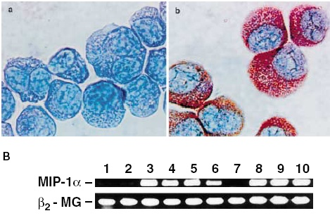
MIP-1α (CCL-3) and Bone Disease in MM
MIP-1α (CCL-3) is a member of the CC chemokine family and is primarily associated with cell adhesion and migration
is chemotactic for monocytes and monocyte-like cells, including osteoclast precursors
is produced by myeloma cells and directly stimulates osteoclast formation and differentiation in a dose dependent way
Uneda et al. Br J Haematol 2003;120:53-5

Slide 26
Serum MIP-1α in Myeloma Patients
3
p<0.01
86
85
2
1
0
5
Log MIP-1α
3
4
2
-1
N =
10
27
48
Group A
Group B
Group C
Bone Disease
Terpos et al. Br J Haematol 2003;123:106-9

Slide 27
CCL-3 (MIP-1a) in Trephine Biopsies and Bone Disease in MM
Roussou et al. Leukemia 2009; 23:2177-81

Slide 28
Predictive Value of Serum MIP-1α
Terpos et al. Br J Haematol 2003;123:106-9

Slide 29
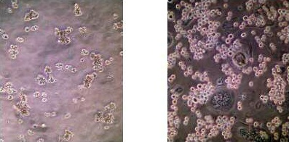
Osteoclast: Key Cell for Myeloma Cell Growth
without OC with OC
myeloma cell culture after 14 days
Abe et al. Blood 2004;104:2484-91

Slide 30
Osteoclasts–Osteoblasts: Antagonists of Myeloma Cell Growth?
P<0.002
P<0.04
MM
MM+OC
MM+OB
MM+OC+OB
7
P<0.0003
P<0.02
6
5
4
BrdU (%)
3
2
1
0
Yaccoby et al. Haematologica 2006;91:192-9

Slide 31
Osteoblast Function Is Reduced in MM
2.5
2.0
159
130
1.5
151
149
1.0
35
67
90
.5
122
p<0.001
116
Lg bALP
0.0
N =
45
40
35
86
Controls
MGUS
MM Stage1/2
MM Stage 3
GROUP
Politou et al. Br J Haematol 2004;126:686-9

Slide 32
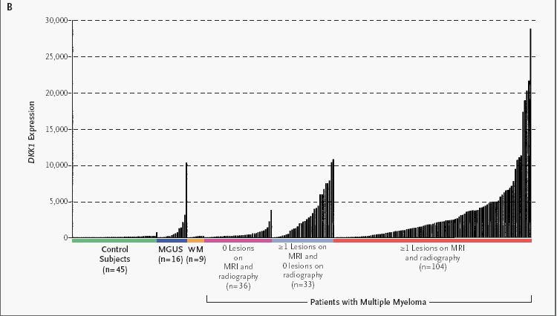
Dickkopf-1 Protein: An Osteoblast Inhibitor
Tian et al. N Engl J Med 2003;349:2483-94

Slide 33
Serum Dkk-1 in Myeloma Patients
2.6
p (MM vs. MGUS) = 0.006
p (MM vs. controls) = 0.02
2.4
2.2
2.0
1.8
1.6
1.4
1
1.2
-
LG Dkk
1.0
.8
N =
32
18
22
MM
MGUS
Controls
GROUP
Politou et al. Ιnt J Cancer 2006;119:1728-31

Slide 34
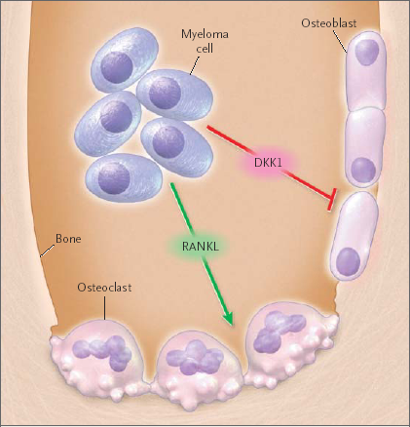
Tian et al. N Engl J Med 2003;349:2483-94

Slide 35
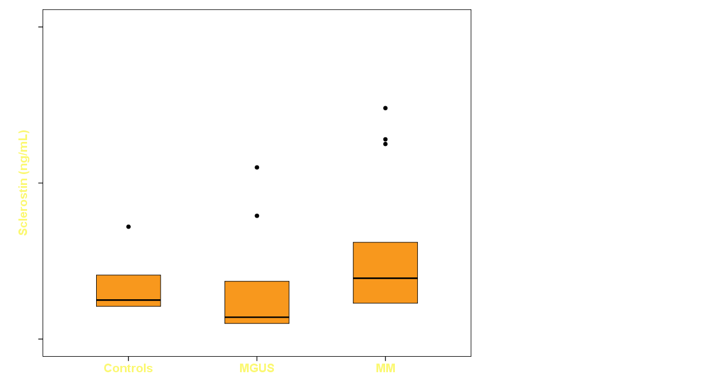
Sclerostin in Patients and Controls
mean±SD: 0.31±0.20 0.26±0.29 0.48±0.46
p=0.01
p=0.004
Terpos et al. Int J Cancer 2012;131:1466-71

Slide 36
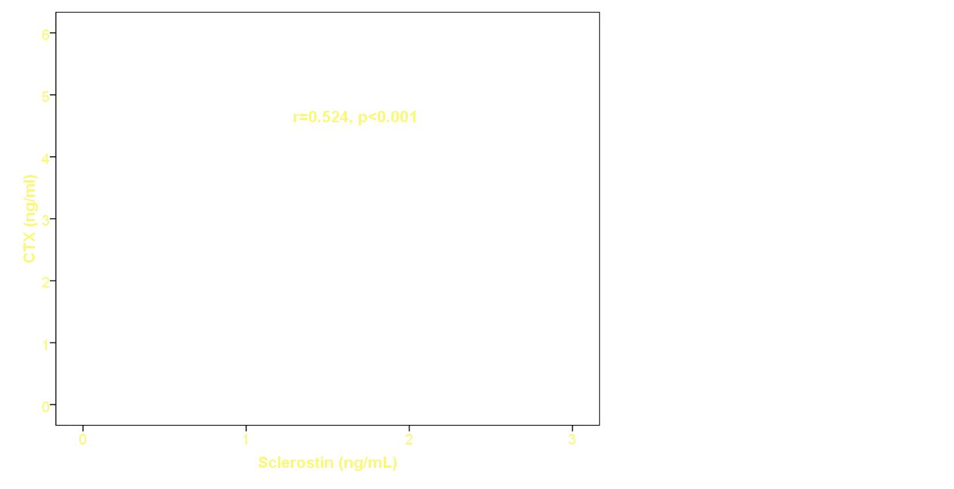
Sclerostin: Correlation with Bone Resorption
Terpos et al. Int J Cancer 2012;131:1466-71

Slide 37
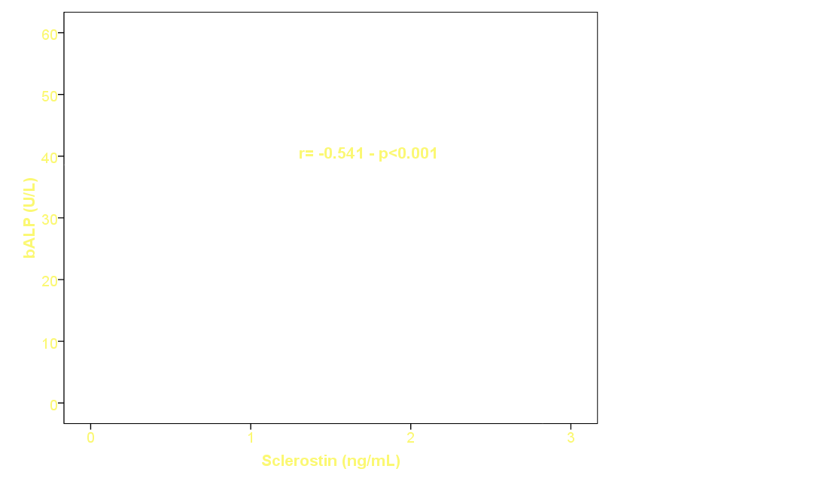
Sclerostin: Negative Correlation with Bone Formation (bALP)
Terpos et al. Int J Cancer 2012;131:1466-71

Slide 38
Activin A promotes multiple myeloma-induced osteolysis
Activin A levels are increased in bone marrow plasma of MM patients
Activin A is mainly produced by BMSCs and osteoclasts induced by MM cells via JNK pathway activation
NS
**
NS
3,500
150
**
*
*
3,000
100
2,500
Mean
1,884
Activin A (pg/mL)
*p < 0.05
2,000
Mean
1,300
**p < 0.01
50
Activin A (pg/mL)
1,500
Mean
299
0
1,000
MM
0–1 OL
MM
> 1 OL
Non-MM
Mean8.2
500
Average levels of activin A
MM 0–1 OL: 28.62 pg/mL
MM > 1 OL: 112.07 pg/mL
Non-MM: 30.6 pg/mL
0
OC
BMSC
OB
MM
BMSCs secreted high levels of activin A (average 1.8 ng/mL); activin A secretion by OC was variable over a wide range.
OL = osteolytic lesion;
OC = osteoclast; OB = osteoblast.
Vallet S, et al. Proc Natl Acad Sci. 2010;107:5124-9.

Slide 39
Circulating Activin-A in multiple myeloma
2500
p < 0.001
*
p < 0.001
*
2000
p = NS
*
1500
Activin-A (pg/ml)
p = NS
1000
*
500
0
Controls
(n = 17)
MGUS
(n = 10)
MM
asymptomatic
(n = 13)
MM
diagnosis
(n = 85)
MM
relapse
(n = 15)

Slide 40
Skeletal-Related Events
(SREs) In Myeloma Patients
Patients, %
n = 179
*21-month data (including osteolytic lesions) except for surgical intervention and spinal compression, for which only 9-month data are available from placebo arm of randomized study.
Berenson et al. J Clin Oncol 1998;16:593-602.

Slide 41
The Goal of Therapy for
Myeloma Bone Disease
Preserve patient’s functional independence
and QOL by
  Preventing skeletal-related events (SREs)
    Prevent the first SRE
    Delay the onset of the first SRE
    Prevent the recurrence of SRE
  Palliating and controlling bone pain
    Reduce the need for analgesics and palliative radiotherapy

Slide 42
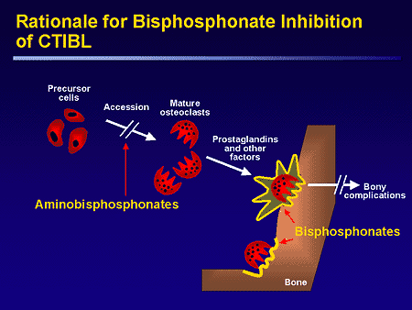
Bisphosphonates
Induce apoptosis
Inhibit migration

Slide 43
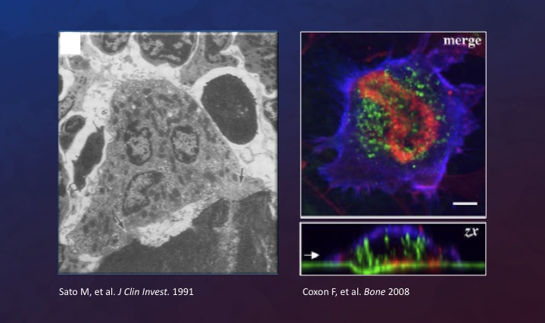
Targeting Osteoclasts With Bisphosphonates

Slide 44
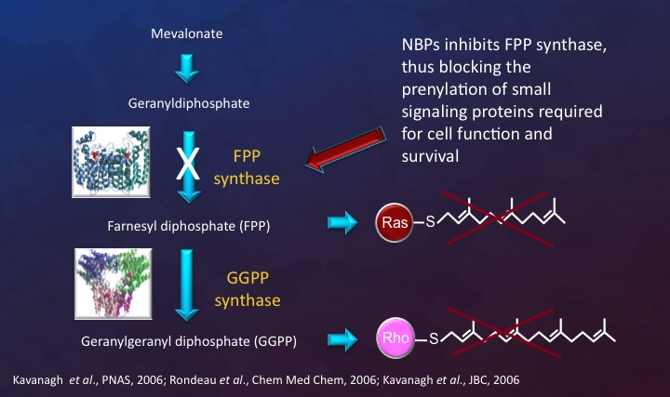
Molecular Mechanisms of Action of
Nitrogen-containing Bisphosphonates

Slide 45
Major Double-Blind, Placebo-Controlled, Trials On Bisphosphonates In MM
Authors/year | Type of BP | No pts | ↓ of pain | ↓ of SREs | Survival benefit
Belch et al, 1991 Daragon et al, ’93 Lahtinen et al, ’92 McCloskey et al 1998 & 2001 Brincker et al, ’98 Berenson et al, ’96 Menssen et al, ’02 Berenson et al, ’01 Rosen et al, ’01 & ’03 | Etidronate Etidronate Clodronate Clodronate Pamidronate Pamidronate Ibandronate Zoledronic acid Zoledronic acid | 173 94 350 530 300 392 198 108 513 | No No Yes Yes Yes Yes No Yes Yes | No No Yes Yes No Yes No Yes Yes | No No NE +/- No +/- No NE +?

Slide 46
Zoledronic Acid Was at Least as Efficacious as PAM in the Myeloma Stratum
Rosen et al. Cancer 2003;98:1735-44

Slide 47
MRC Myeloma IX: Trial Design
N=1,960
Intensive
Nonintensive
RANDOMIZATION
RANDOMIZATION
Clodronate
CVAD
Zoledronic acid
CVAD
Clodronate
C-TD
Zoledronic acid
C-TD
Clodronate
MP
Zoledronic acid
MP
Clodronate
C-TDa
Zoledronic acid
C-TDa
MEL-200
ASCT
Max
Response
RANDOMIZATION
RANDOMIZATION
–Thal
+Thal
–Thal
+Thal
Treatment continued until disease progression
Primary end points: PFS, OS, ORR
Secondary end points: Time to first SRE, SRE incidence, safety, and QoL
Zoledronic acid (4 mg IV q 3-4 wk); clodronate (1,600 mg/d PO)
Morgan G et al. Lancet 2010;376:1989-99.
Notes:
47
Curatio Fact-Check:
Per Dr Terpos (112610): Yes you have right. I have the presentations by Gareth Morgan who had the kindness to send them to me.
CVAD, cyclophosphamide (500 mg PO days 1, 5, and 15), vincristine (0.4 mg/d IV days 1-4), doxorubicin (9 mg/m2/d days 1-4), dexamethasone (40 mg/d PO days 1-4, 13-15 q 3 wk); C-TD, cyclophosphamide (500 mg PO days 1, 9, and 15), thalidomide (100-200 mg/d), dexamethasone (40 mg/d PO days 1-4, 12-15 q 3 wk); C-TDa is C-TD except thalidomide 50-200 mg/d, dexamethasone 20 mg/d days 1-4, 15-18 q 4 wk; MP, melphalan (7 mg/m2), prednisolone (40 mg) PO for 4 days; Thal, thalidomide (50 mg/d);
PFS, progression-free survival; ORR, overall response rate; OS, overall survival, SRE, skeletal-related event; QoL, quality of life.

Slide 48
MRC Myeloma IX: Analysis
Schematic for ZOL vs CLO
R
A
N
D
O
M
I
Z
A
T
I
O
N
Zoledronic acid (4 mg* IV q 3–4 wk) +
intensive or nonintensive chemotherapy
(n=981)
N=1,960
Patients with newly diagnosed MM
(stage I, II, III)
Treatment continued at least until disease progression
Clodronate (1600 mg/d PO) + intensive or nonintensive chemotherapy
(n=979)
End points (zoledronic acid vs clodronate)
  Primary: PFS, OS, and ORR
  Secondary: Time to first SRE, SRE incidence, and safety
*Dose-adjusted for patients with impaired renal function, per the prescribing information.
IV, intravenous; MM, multiple myeloma; ORR, overall
response rate; OS, overall survival, PFS, progression-free survival; PO, oral; SRE, skeletal-related event
Morgan G et al. Lancet 2010;376:1989-99.
Notes:
Curatio Fact-Check:
Randomization details OK per abstract; other details (endpts) not in abstract
Per Dr Terpos (112610): Yes you have right. I have the presentations by Gareth Morgan who had the kindness to send them to me.
48

Slide 49
MRC Myeloma IX—
ZOL ↓SREs vs. CLO Regardless of Bone Lesions at Baseline
Bone lesions at baseline
No lesions at baseline
0.5
HR=0.774; P=0.0038
CLO
0.5
HR=0.526; P=0.0068
0.4
0.4
0.3
ZOL
0.3
Cumulative incidence
function, SREs/patient
Cumulative incidence
function, SREs/patient
0.2
0.2
CLO
0.1
0.1
ZOL
0
0
0
6
12
18
24
30
36
42
48
54
60
66
72
0
6
12
18
24
30
36
42
48
54
60
66
72
Time From Randomization, months
Time From Randomization, months
Patients, n
Patients, n
ZOL
CLO
668
682
415
402
325
297
250
212
189
164
136
117
100
75
69
50
50
37
35
24
18
12
6
4
0
0
ZOL
CLO
302
276
241
212
185
159
135
118
92
91
63
56
38
37
28
24
18
18
11
12
8
7
5
4
0
0
Important to treat all patients regardless of lesions at presentation
Morgan G et al. Lancet 2010;376:1989-99.
Notes:
Curatio Fact-Check:
Cannot verify figures with Abstract; assuming data were rpesented at the time of ASCO.
Per Dr Terpos (112610): Yes you have right. I have the presentations by Gareth Morgan who had the kindness to send them to me.
49

Slide 50
MRC Myeloma IX: ZOL Significantly Improved OS vs CLO*
100
80
P=0.04
60
Survival, Patients (%)
40
Zoledronic acid
Clodronate
20
∆ 5.5 mo
*Kaplan-Meier analysis adjusted for treatment pathway (intensive vs not).
0
1
2
3
4
5
6
7
Number at risk:
Time, years
Zoledronic acid
981
806
675
418
222
79
3
Clodronate
979
776
642
399
208
69
0
Morgan G et al. Lancet 2010;376:1989-99.
Notes:
Curatio Fact-Check:
Cannot verify graph with cited abstract; assume information was presented at time of live meeting (ASCO).
Per Dr Terpos (112610): Yes you have right. I have the presentations by Gareth Morgan who had the kindness to send them to me.
Abbreviations: CLO, clodronate; ZOL, zoledronic acid.
*Log-rank, stratified by treatment pathway.
50

Slide 51
ZOL Significantly  OS vs CLO in Patients
With Bone Disease at Baseline (n = 1,350)
100
+ Censored
90
P = .0107
80
HR = 0.82 (95% CI = 0.70, 0.96)
70
60
Survival Distribution Function Estimate
OS, % patients
50
40
30
20
Clodronate (n = 682)
∆ ~10 mo
10
Zoledronic acid (n = 668)
0
0
1
2
3
4
5
6
Time Since Initial Randomisation, years
ZOL
668
544
447
292
165
64
3
CLO
682
534
437
271
143
53
0
Morgan G, et al. Blood. 2012; in press.

Slide 52
Bisphosphonates: Adverse Events
Oral
  GI intolerance (in up to 33% of pts)
    Especially esophagitis & esophageal ulcers
Intravenous (PAM or ZOL)
  Common adverse events
    Flu-like symptoms
    Fever/Myalgias/Arthralgias
  Uncommon adverse events
    Renal-function effects
    Osteonecrosis of the jaw
Conte & Guarneri. Oncologist 2004;9(Suppl 4):28-37

Slide 53
Bisphosphonates and Renal Insufficiency
IV bisphosphonates are cleared almost entirely by the kidneys
2007 ASCO Multiple Myeloma Guidelines
  In patients with pre-existing renal impairment (serum creatinine clearance 30-60 mL/min) should receive reduced dosage of zoledronic acid
  No change in infusion time or interval of zoledronic acid is required
Use of these bisphosphonates in patients with more severe renal dysfunction has been minimally assessed
Kyle et al. J Clin Oncol 2007;25:2464-72

Slide 54
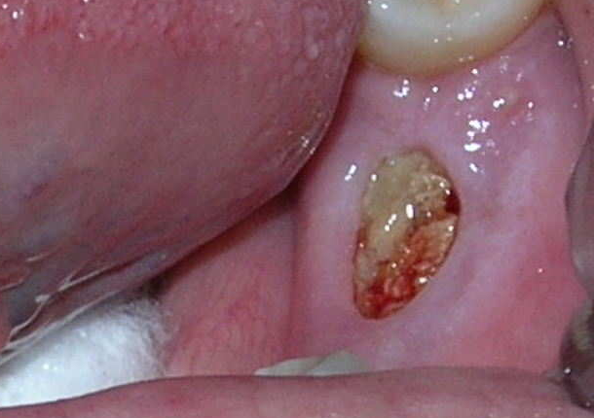
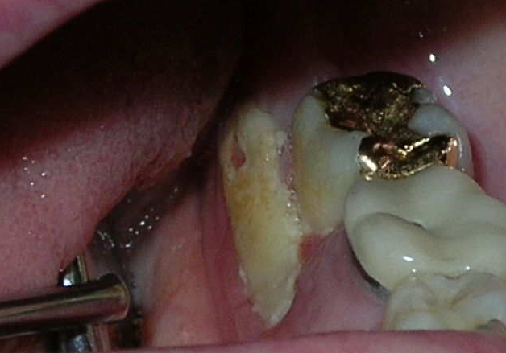
ONJ: Novel Complication of Bisphosphonates
Avascular osteonecrosis of the jaw (ONJ) is a recent complication that has been described in multiple myeloma and other cancer patients who receive potent bisphosphonates.
ONJ presents as an exposure of the mandible or maxilla that can be either painless or painful.

Slide 55
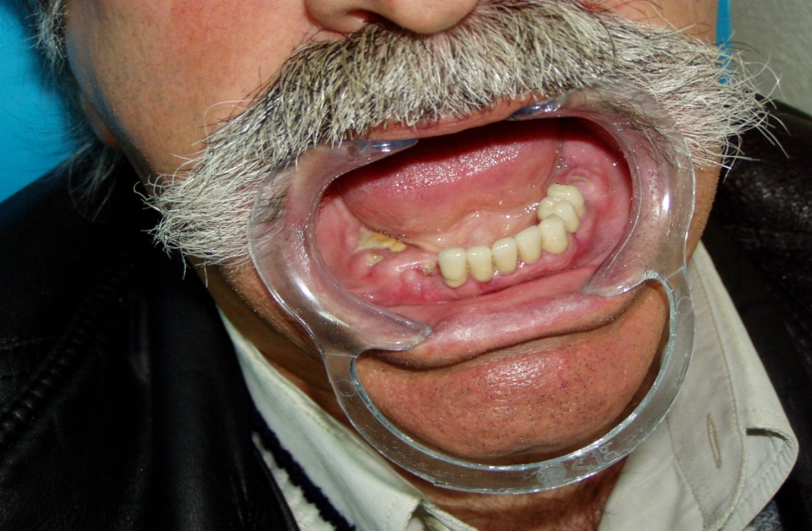
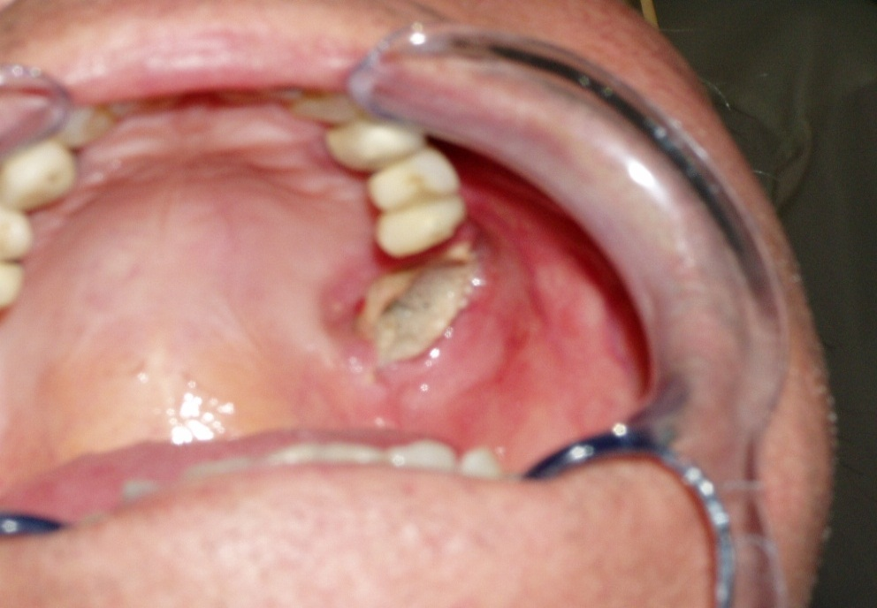
ONJ: characteristics
Symptoms
  • “heavy jaw”, a dull aching sensation
  • numbness/tingling of the jaw
  • tooth pain
  • undiagnosed oral pain
  Signs
• rough area on the jawbone
• soft tissue swelling, drainage or infection
• exposed bone in the oral cavity
• sudden change in the health of periodontal tissue
• failure of oral mucosa to heal
• loosening of teeth

Slide 56
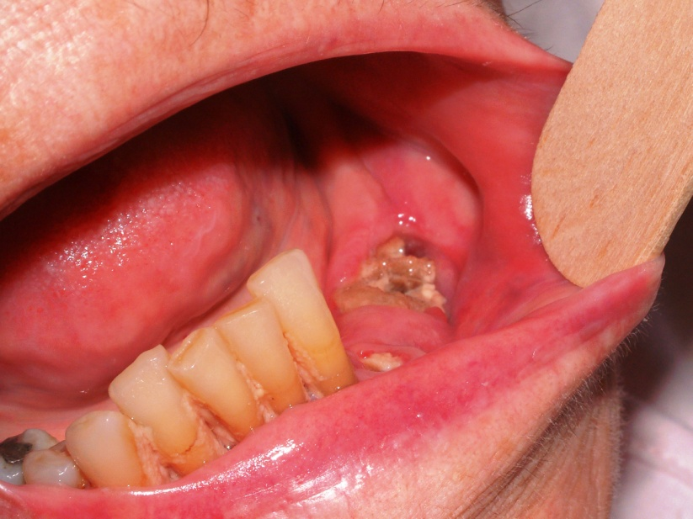
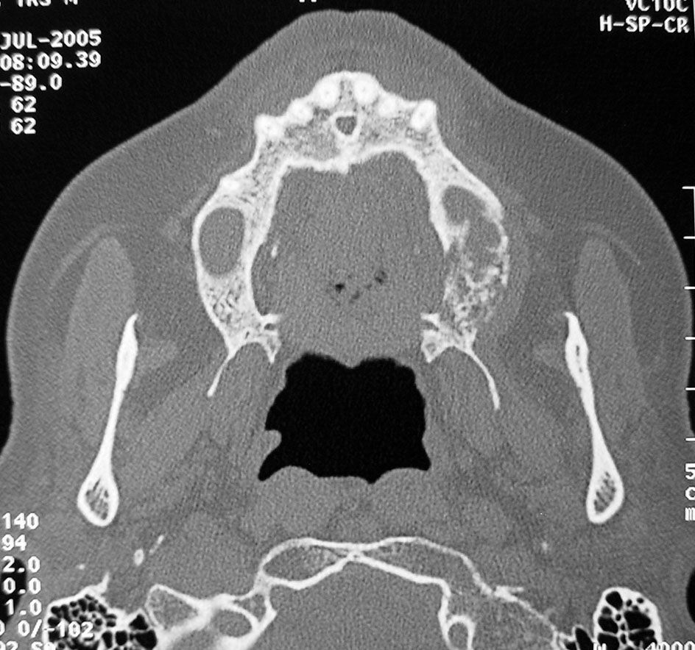
Clinical Presentation and Working Diagnosis of ONJ
Clinical features of suspected ONJ
Exposed bone in maxillofacial area that occurs in association with dental surgery or occurs spontaneously, with no evidence of healing
Working diagnosis of ONJ
No evidence of healing after
6 weeks of appropriate evaluation and dental care
No evidence of metastatic disease in the jaw or osteoradionecrosis
  Weitzman et al. Crit Rev Oncol Hematol 2007;62:148-152

Slide 57
MRC Myeloma IX: Adverse Events (Safety Population)
 | Patients, n (%)
 | Intensive Pathway |  |  | Non-Intensive Pathway |  |  | Overall
Adverse Event | ZOL (n = 555) | Clodronate (n = 556) | Pª | ZOL (n = 428) | Clodronate (n = 423) | Pª | Pª
Acute renal failure | 29 (5.2) | 33 (5.9) | .70 | 28 (6.5) | 27 (6.4) | 1.0 | .78
ONJ^{b} | 21 (3.8) | 2 (0.4) | < .0001 | 14 (3.3) | 1 (0.2) | .0009 | < .0001
Thromboembolic | 104 (18.7) | 82 (14.7) | .08 | 53 (12.4) | 35 (8.3) | .06 | .01
Any SAE | 327 (58.9) | 280 (50.4) | .0046 | 212 (49.5) | 198 (46.8) | .45 | < .0001
Not suspected to be related to the trial medications | 245 (44.1) | 214 (38.5) | .059 | 155 (36.2) | 161 (38.1) | .62 | .30
Any TESAE (suspected to be related to trial medications) | 158 (28.5) | 141 (25.4) | .42 | 90 (21.0) | 85 (20.1) | .80 | 0.27
ª Statistical significance determined by Fisher’s exact test.
^{b} ONJ cases were confirmed by an independent adjudication committee.
Abbreviations: ONJ, osteonecrosis of the jaw; SAE, serious adverse event; TESAE, treatment-emergent serious adverse event; ZOL, zoledronic acid.
Adapted from Morgan G, et al. Lancet. 2010;376(9757):1989-1999.

Slide 58
Recommendations by An Expert Panel on behalf of the EMN (1)
BPs should be given for 2 years; then at the physician’s discretion.
In patients in CR after 12 months the benefit of an additional 12 months of treatment is debatable.
BP therapy should be resumed upon relapse.
Comprehensive dental examination & education on dental hygiene. Existing dental conditions should be treated before initiating BPs.
After therapy initiation, unnecessary invasive dental procedures should be avoided and dental status should be monitored annually.
Terpos et al. Ann Oncol 2009;20:1303-17

Slide 59
Recommendations by An Expert Panel on behalf of the EMN (2)
Temporary BPs suspension if invasive dental procedures needed.
Initial ONJ therapy should include discontinuation of BP until healing.
The decision to restart BP should be individualized, until prospective long-term studies are available.
The physician has to take into consideration the advantages and disadvantages of BPs mainly in the relapsed/refractory setting.
Terpos et al. Ann Oncol 2009;20:1303-17

Slide 60
BSH Guidelines
Bisphosphonate therapy is recommended for all patients with symptomatic multiple myeloma, whether or not bone lesions are evident (grade A recommendation; level 1b evidence)
Zoledronic acid and pamidronate both show efficacy with respect to SRE prevention (grade A recommendation; level 1b evidence) but early data regarding prolongation of event-free survival (EFS) and OS in a large randomized trial suggest that zoledronic acid should be the bisphosphonate of choice
Sodium clodronate is less effective than zoledronic acid but has a significantly lower incidence of BONJ (grade A recommendation; level 1b evidence)
There is no consensus regarding the duration of bisphosphonate therapy.
Bird JM, et al. Br J Haematol 2011;154:32-75

Slide 61
Proteasome Inhibition and Bone Formation
r=0.94
10000
acLLL-epoxide
1000
MG115
ALLN
Inhibitory activity (nM-log ED₅₀)
Lactacystin
acNapthLLL-epoxide
MG132
Epoxomicin
MG262
100
PS1
achFLFL-epoxide
10
100
1000
10000
Bone formation activity (nM log ED₅₀)
Garrett et al. J Clin Invest 2003;111:1771-8

Slide 62
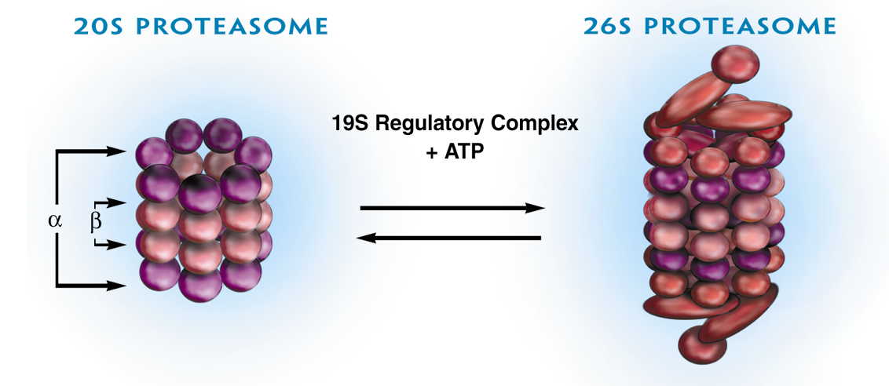
The Proteasome: Enzyme With Important
Impact on Multiple Regulatory Pathways
Is found in all eukaryotic cells, from yeast to man
Is present in the cytoplasm and nucleus
Degrades proteins
Represents approximately 1% of all cellular protein

Slide 63
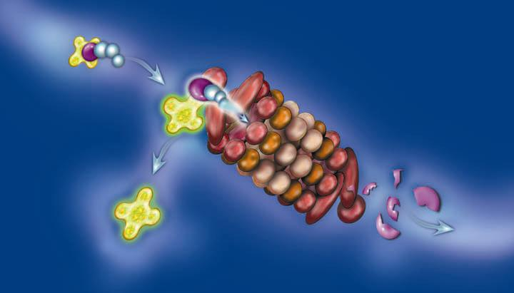
NF-κB Activation After IκB
Degradation by the Proteasome
NF-κB-IκB complex
Ubiquitin chain (blue)
NF-κB
IκB
(degraded)

Slide 64
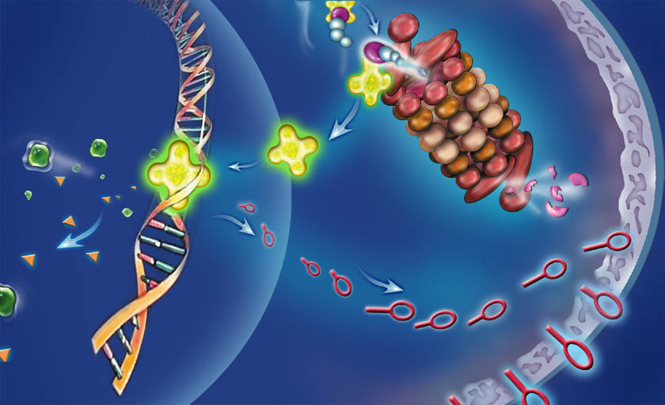
Effects of NF-κB Activation
Growth/angiogenic factors
NF-κB binds DNA,
induces transcription
Adhesion molecules

Slide 65
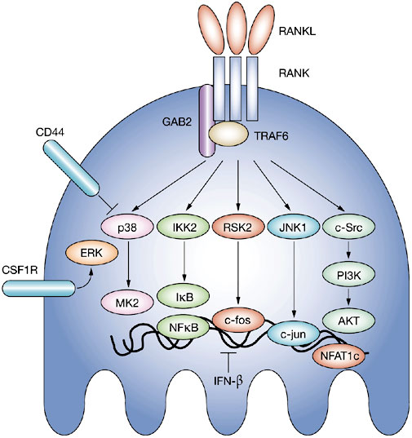
RANKL: Action Mainly Through NFκB & c-fos in Osteoclasts
Schett et al. Nat Clin Pract Rheumatol 2005;1:47-54

Slide 66
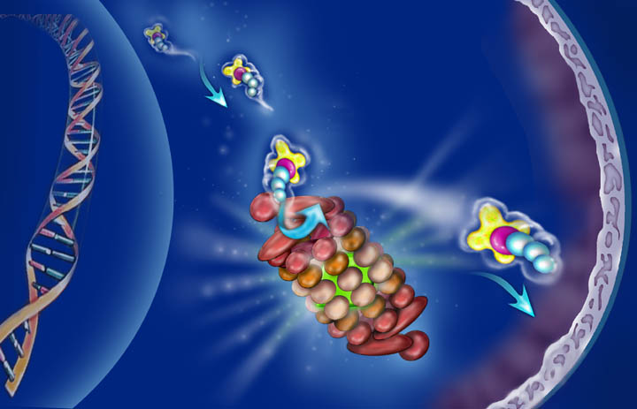
Effect of Proteasome Inhibition
2. Inhibition of proteasome prevents IκB degradation and NF-κB release
1. Bortezomib (green) binds chymotryptic site in core

Slide 67
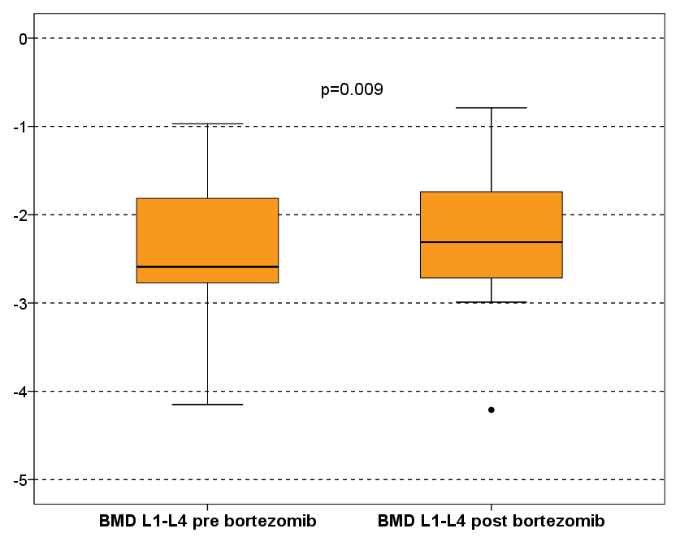
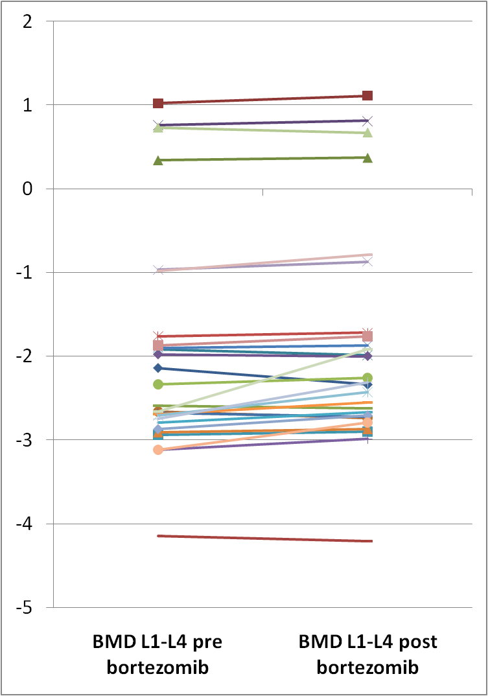
BMD: Pre- and Post-bortezomib
4/27 patients (14%) showed at least 10% of increase in L1-L4 BMD; all these patients had osteoporosis according to DXA, had responded to VD therapy (3 PR and one CR), and had received VD as second line treatment
Terpos et al; Ann Oncol. 2010;21:1561

Slide 68
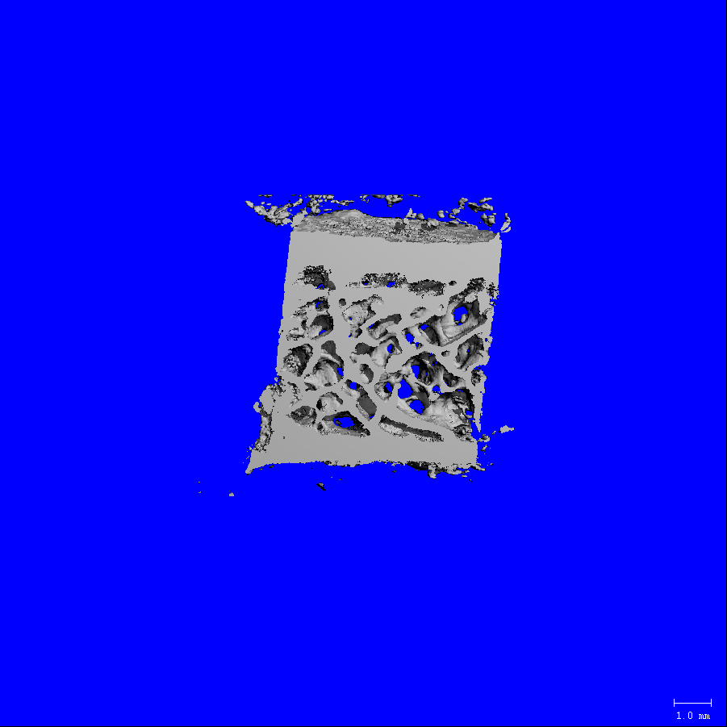
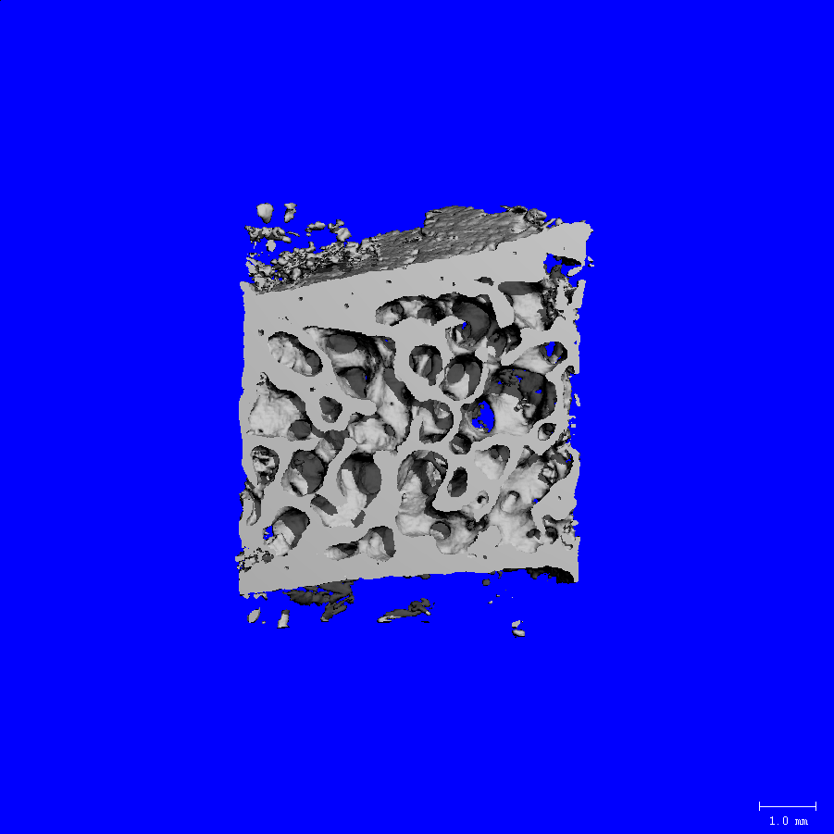
Pre-Bor
Post-Bor
BV/TV = 12.85%
Tb.Th = 0.1
Tb.Sp. = 0.7
Tb.N. = 1.5
BV/TV = 90%
Tb.Th = 0.7
Tb.Sp. = 0.2
Tb.N. = 2.8
Zangari et al. Haematologica 2011;96:333.

Slide 69
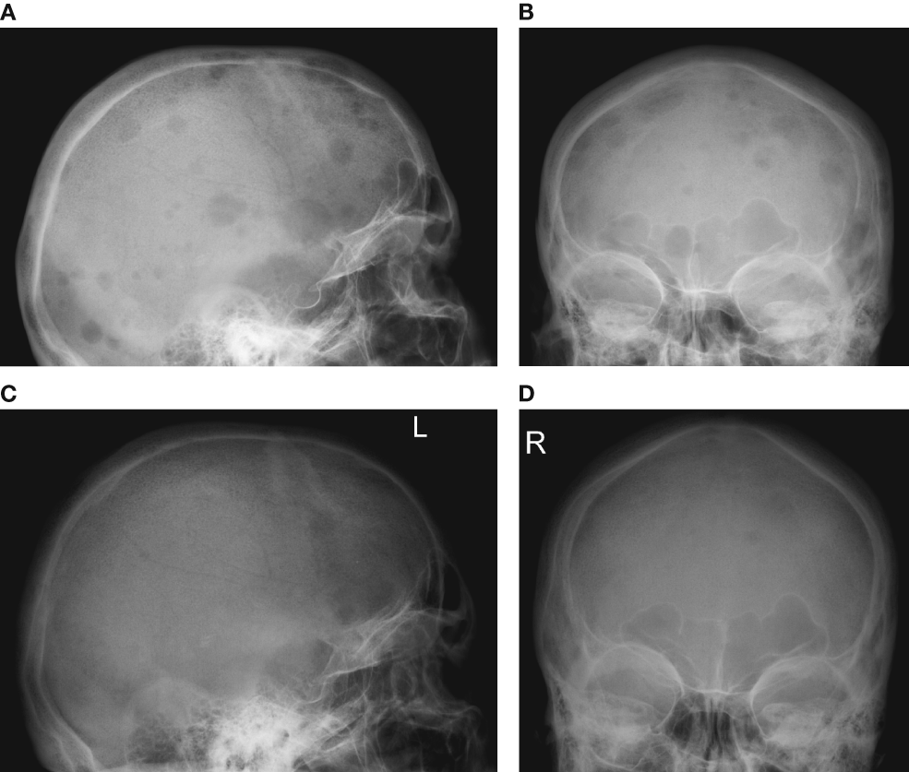
VMP: results in a patient after
9 cycles of therapy
Delforge et al. Eur J Haematol 2011; 86(5):372-84

Slide 70



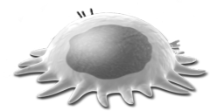




Denosumab in multiple myeloma
RANK Ligand
Denosumab
Myeloma cells
X
X
X
Growth factors
(PDGF, BMPs, TGF-β,
IGFs, FGFs)
Ca²⁺
Growth factors
(eg, PTHrP, IL-6, IL-8)
Osteoclast apoptosis
X
RANK Ligand ↑
X
Osteoblast
Bone resorption
Adapted from: Boyle et al. Nature 2003;423:337-42;
Roodman GD. N Engl J Med 2004;350:1655-64
Notes:
70

Slide 71
Denosumab (anti-RANKL): randomised, double-blind, active-controlled, phase 3 trial
Key Inclusion
Adults with solid tumours and bone metastases (excluding breast and prostate) or multiple myeloma
Key Exclusion
Current or prior intravenous bisphosphonate administration
N = 886 Denosumab 120 mg SC and Placebo IV* Q4W
Supplemental Calcium and Vitamin D
N = 890 Zoledronic acid 4 mg IV* and Placebo SC Q4W
1° Endpoint | Time to first on-study SRE (non-inferiority)
2° Endpoints | Time to first on-study SRE (superiority) Time to first-and-subsequent on-study SRE (superiority)
*IV product dose adjusted for baseline creatinine clearance and subsequent dose intervals determined
by serum creatinine (per zoledronic acid label)
Henry D, et al. J Clin Oncol 2011;29:1125-32
Notes:
A total of 1776 eligible adult subjects who were naïve to intravenous bisphosphonates were Randomised in a double-blind, double-dummy design to receive subcutaneous denosumab 120 mg or intravenous Zoledronic acid (ZA) 4 mg adjusted for creatinine clearance every 4 weeks
The key inclusion criterion was that there was evidence of bone metastasis based on x-ray, CT, or MRI
The key exclusion criterion was no prior IV bisphosphonate. Prior oral bisphosphonate use for osteoporosis was allowed
Zoledronic acid was administered per Zoledronic acid prescribing information. IV product dose which was either Zoledronic acid or placebo was calculated according to baseline creatinine clearance. Subsequent doses were withheld if there was elevation of the serum creatinine and the IV product was only reinstated once the serum creatinine had returned to within 10% of baseline levels. This dose and schedule is per the Zoledronic acid label. Subjects with creatinine clearance < 30 mL/min were excluded per the Zoledronic acid label
There was no modification of the SQ product which included denosumab or placebo either at baseline or on study
Subjects were stratified by Tumour type, previous SRE, and systemic anti-cancer therapy
All subjects were strongly recommended to take daily supplemental calcium (≥ 500 mg) and vitamin D (≥ 400 IU)
No crossover was allowed during the treatment phase
The median time on study was 7.3 months for both treatment arms
The median time on treatment was 6.7 months for both treatment arms
The study duration was approximately 34 months
The primary endpoint was time to first on-study SRE, defined as pathologic fracture, radiation therapy or surgery to bone, or spinal cord compression. Secondary endpoints included a superiority test for time to first and time to first-and-subsequent on-study SRE
Subject Disposition
Approximately 20% of subjects in the denosumab arm and 20% of subjects in the zoledronic arm remained on study through the primary data analysis cut-off date
The main reasons for study discontinuation were deaths, disease progression, and consent withdrawn
Reference
Henry D et al. European Journal of Cancer Supplements, Vol. 7, No 3, September 2009, Page 11. Abstract 20LBA and Oral Presentation.

Slide 72
Time to first-and-subsequent on-study SRE (multiple event analysis)
2° - Rate Ratio: 0.90 (95% CI: 0.77–1.04)
P = 0.14
Total # of SREs
Denosumab
392
Zoledronic
Acid
436
Henry D, et al. J Clin Oncol 2011;29(9):1125-32
Notes:
For the secondary endpoint of time to first-and-subsequent SRE, otherwise known as the multiple event analysis, denosumab reduced the risk of multiple events by 10% compared with Zoledronic acid in all patients (rate ratio: 0.90; 95% CI: 0.77–1.04; P=0.14). This difference did not reach statistical significance.
Reference
Henry D et al. European Journal of Cancer Supplements, Vol. 7, No 3, September 2009, Page 11. Abstract 20LBA and Oral Presentation.

Slide 73
Denosumab vs. ZOL in Patients With Multiple Myeloma
In a post hoc analysis of the MM subset (n = 180)
  Dmab  the risk of death by 2.3-fold vs ZOL (HR = 0.44; P < .05)¹
P value
2.26
Overall Survival
< .05
0.1
0.2
1
2
3
10
Hazard ratio (Dmab vs ZOL)
In favor of Dmab
In favor of ZOL
ªExcluding patients with breast or prostate cancer.
Abbreviations: CI, confidence interval; Dmab, denosumab; HR, hazard ratio; ST/MM, solid tumors or multiple myeloma; OS, overall survival; ZOL, zoledronic acid
.
Henry D, et al. Presented at ECCO/ESMO 2009. Abstract 20LBA.

Slide 74
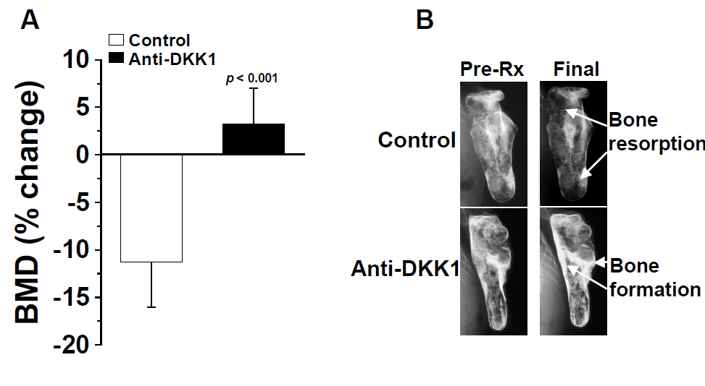

Anti-Dkk1 Antibodies in Myeloma Mice
Heath DJ, et al. J Bone Miner Res 2009;24:425-36.
Yaccoby S, et al. Blood 2007;109:2106-11.

Slide 75
Sotatercept in multiple myeloma
– phase 1/2 study
MPT | + | 4 cycles of sotatercept, g/kg
 | Placebo | 0.1 | 0.3 | 0.5
n | 6 | 8 | 8 | 8
4
7
Placebo
0.1 mg/kg
0.3 mg/kg
0.5 mg/kg
4
Placebo
0.1 mg/kg
0.3 mg/kg
0.5 mg/kg
Placebo
0.1 mg/kg
0.3 mg/kg
0.5 mg/kg
3
6
5
3
2
4
1
3
2
Lumbar BMD, maximum
change from baseline (%)
Lumbar BMD,
change from baseline (%)
Hip BMD,
change from baseline (%)
0
2
1
–1
1
0
0
–2
–1
–3
–2
–1
85
All patients
169/ET
With
bisphosphonates
85
Without
bisphosphonates
169/ET
Time from start of treatment (days)
Time from start of treatment (days)

Slide 76
CONCLUSIONS
Bisphosphonates (BPs) are useful and remain the cornerstone of the management of bone destruction in MM. Survival advantage of zoledronic acid.
However many questions have not been answered yet. What is the maximum duration for their use? What is the long-term safety profile? Be careful in renal dysfunction and be aware of ONJ.
Novel agents (bortezomib, denosumab) in combination with BPs and novel anabolic agents (BHQ-880, sotatercept) may help in the better management of myeloma bone disease in the near future.

Slide 77
Acknowledgments
Department of Clinical Therapeutics, Athens, GR
M.A. Dimopoulos,
E. Kastritis, M. Roussou,
E. Efstathiou, C. Matsouka,
M. Migkou, D. Christoulas,
M. Gavriatopoulou, M. Iakovaki
M. Gkotzamanidou
London, UK
A. Rahemtulla, J.F. Apperley
Sheffield: P. Croucher, D. Heath
Hersey: A. Lipton, K. Leitzel
Greek Myeloma Study Group
K. Zervas (Thessaloniki)
E. Katodritou (Thessaloniki)
A. Pouli (Athens)
E. Michalis (Athens)
S. Delimpasi (Athens)
E. Verrou (Thessaloniki)
K. Anargyrou (Athens)
M. C. Kyrtsonis (Athens)
P. Repoussis (Athens)
E. Vervessou (Athens)
A. Papatheodorou (Athens)
Hamburg: Orhan Sezer

