Slide 1
Morphology, immunophenotyping and cytogenetics in myeloid neoplasms
Data interpretation
BJ Bain

Slide 2
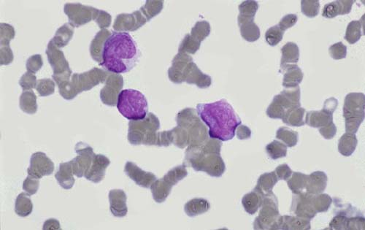
Case 1
Blood film – is it lymphoid or myeloid?
© Clinical Publishing, from Bain and Matutes, Myeloid Malignancies, 2012

Slide 3
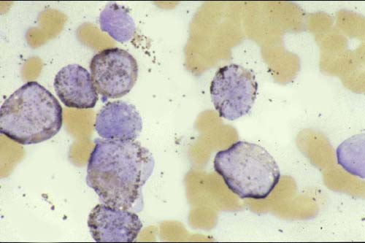
Case 1
Blood film, myeloperoxidase stain – is it lymphoid or myeloid?
© Clinical Publishing, from Bain and Matutes, Myeloid Malignancies, 2012

Slide 4
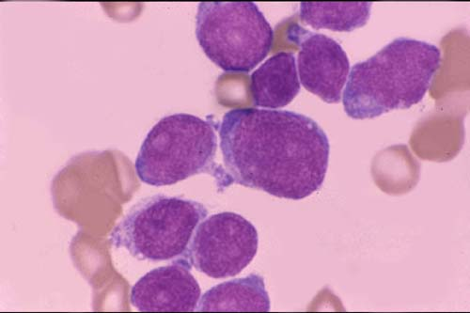
Case 2 (composite case)
Bone marrow film – is it lymphoid or myeloid?
© Clinical Publishing, from Bain and Matutes, Myeloid Malignancies, 2012

Slide 5
Case 2 (composite case)
Myeloperoxidase negative
Sudan black B negative
Non-specific esterase stain negative
Is it lymphoid or myeloid?
Are any other tests necessary?

Slide 6
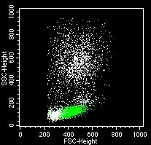
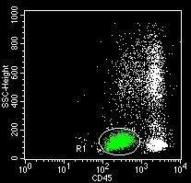
Case 2 (composite case)
Immunophenotyping on a similar case
© Clinical Publishing, from Bain and Matutes, Myeloid Malignancies, 2012

Slide 7
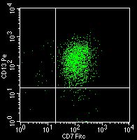
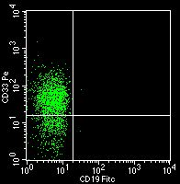
Case 2 (composite case)
Immunophenotyping on a similar case
© Clinical Publishing, from Bain and Matutes, Myeloid Malignancies, 2012

Slide 8
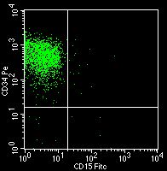
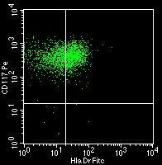
Case 2 (composite case)
CD15 is expressed on many monoblasts and some myeloblasts, and on maturing cells – you don’t need to learn about it
Immunophenotyping on a similar case
© Clinical Publishing, from Bain and Matutes, Myeloid Malignancies, 2012

Slide 9
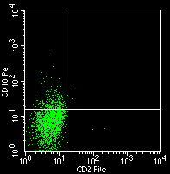
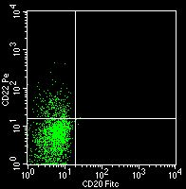
Case 2 (composite case)
Immunophenotyping on a similar case
© Clinical Publishing, from Bain and Matutes, Myeloid Malignancies, 2012

Slide 10
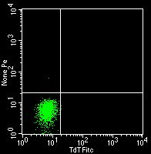
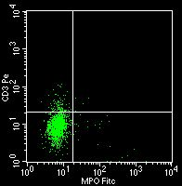
Case 2 (composite case)
Immunophenotyping on a similar case
© Clinical Publishing, from Bain and Matutes, Myeloid Malignancies, 2012

Slide 11
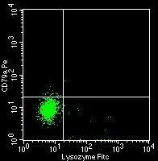
Case 2 (composite case)
Lysozyme is a myeloid marker – you don’t need to learn about it
Immunophenotyping on a similar case
© Clinical Publishing, from Bain and Matutes, Myeloid Malignancies, 2012

Slide 12
Case 2 (composite case)
What is your final diagnosis?

Slide 13
Case 3
A 62-year old fit man working full-time as a carpenter
He was a regular blood donor (6 monthly)
He had donated 66 units of blood
He failed the copper sulphate haemoglobin test and was deferred
Four months later he failed again
His doctor performed a blood count
With thanks to the late Dr David Swirsky, © the European Hematology Association

Slide 14
Case 3
FBC
Hb 126 g/l (130 – 180)
WBC 4.9 x 10⁹/l (3.6 – 11.0)
Platelets 228 x 10⁹/l (140 – 425)
RBC 3.50 x 10⁹/l (4.5 – 6.5)
MCV 106 fl (81 – 101)
HCT 0.350 l/l (0.40 – 0.54)
MCH 36.0 pg (27 – 32)
MCHC 360 g/l (320 – 370)
RDW 14.6 % (10.0 – 16.0)
With thanks to the late Dr David Swirsky, © the European Hematology Association

Slide 15
Case 3
Automated differential white cell count normal
Blood film
Mild macrocytosis
Platelet anisocytosis
Rare red cells showed basophilic stippling
Neutrophil morphology unremarkable
What tests would you do next?
With thanks to the late Dr David Swirsky, © the European Hematology Association

Slide 16
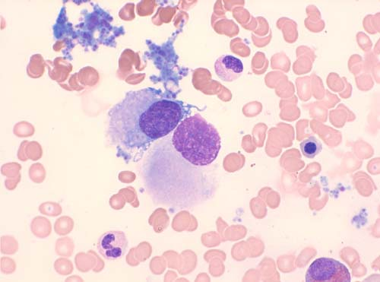
Case 3
Bone marrow film
With thanks to the late Dr David Swirsky, © the European Hematology Association

Slide 17
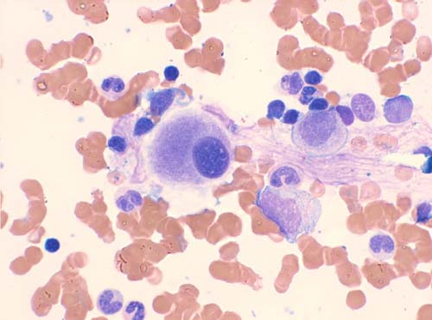
Case 3
Bone marrow film (blast cells were less than 5%; there were no ring sideroblasts)
With thanks to the late Dr David Swirsky, © the European Hematology Association

Slide 18
Case 3
Bone marrow blast cells were less than 5%
There were no ring sideroblasts
What is the most likely explanation of the mild macrocytic anaemia?
What other test would you do?
With thanks to the late Dr David Swirsky, © the European Hematology Association

Slide 19
Case 3
Karyogram – list the abnormalities
With thanks to the late Dr David Swirsky, © the European Hematology Association

Slide 20
Case 3
Karyogram
The karyotype was 46,XY,t(6;X),del(5q)
With thanks to the late Dr David Swirsky, © the European Hematology Association

Slide 21
Case 3
Using the WHO classification, what is your diagnosis?
22 months after diagnosis the Hb had fallen to 81 g/l
Erythropoietin was ineffective and he was commenced on regular transfusions
40 months after diagnosis he had splenomegaly and his FBC showed
Hb 69 g/l
WBC 13.8 x 10⁹/l
Platelets 35 x 10⁹/l
With thanks to the late Dr David Swirsky, © the European Hematology Association

Slide 22
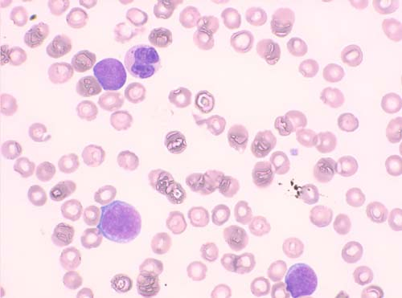
Case 3
Blood film
With thanks to the late Dr David Swirsky, © the European Hematology Association

Slide 23
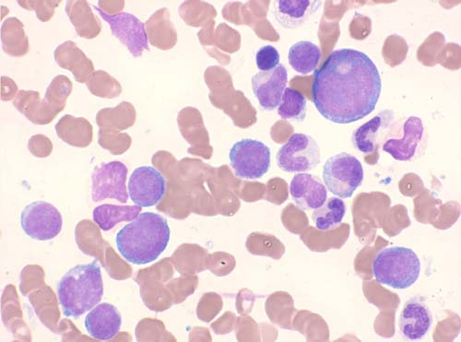
Case 3
Bone marrow
With thanks to the late Dr David Swirsky, © the European Hematology Association

Slide 24
Case 3
What has gone wrong?
Why does this happen?
There is one other very specific treatment that could have been used earlier in this patient – what is it?
With thanks to the late Dr David Swirsky, © the European Hematology Association

Slide 25
Case 4
A 56-year-old Caucasian woman
Non-specific symptoms including fatigue and intermittent paravertebral pain
Past history
Carcinoma of the breast
FBC
WBC 3.2 x 10⁹/l
Hb 109 g/l
MCV89 fl
Platelet count 122 x 10⁹/l
Neutrophil count 0.5 x 10⁹/l

Slide 26
Case 4
Breast cancer had been grade III invasive ductal breast carcinoma, which had presented exactly three years earlier
Treatment had been
Radical mastectomy
Chest wall radiotherapy
Anti-oestrogen
Chemotherapy (doxorubicin—total 240 mg/m², cyclophosphamide—total 2.4 g/m²)

Slide 27
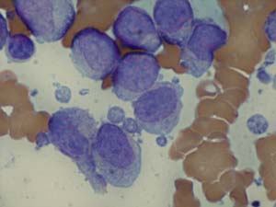
Case 4
Bone marrow

Slide 28
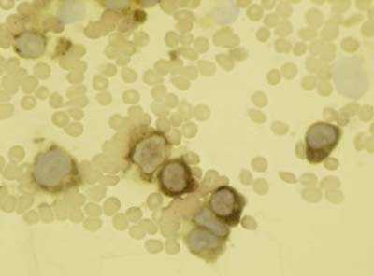
Case 4
Non-specific esterase
SBB and MPO were negative. What is the lineage?

Slide 29
Case 4
Immunophenotype
CD13 25% | CD33 99%
CD117 9% | CD15 74%
CD34 1% | HLA-DR 90%
CD45 99% | CD56 76%
What does it tell us?

Slide 30
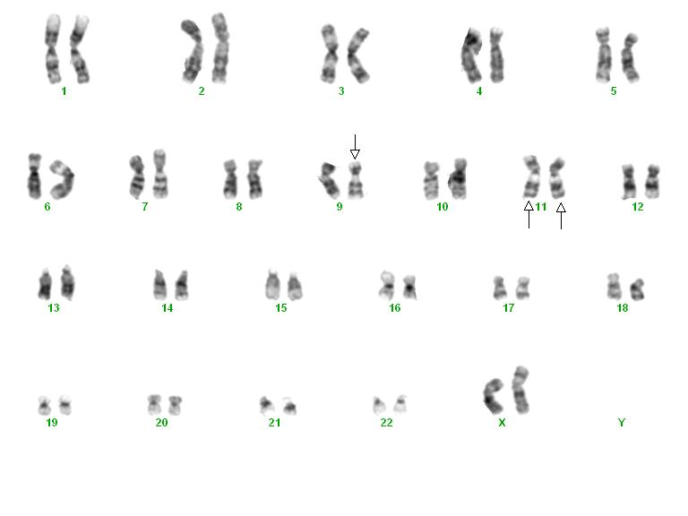
Case 4
CYTOGENETIC ANALYSIS
List the abnormalities shown

Slide 31
Case 4
Cytogenetic analysis
46,XX,t(9;11)(p22;q23), +der(11)t(9;11)(p22;q23) [5]/47,idem,+3 [5]
What is the WHO diagnosis?
Which gene do you think has been rearranged?

Slide 32
Case 4
Principle of MLL break-apart probe
With thanks to the Dr Wendy Erber and the European Hematology Association

Slide 33
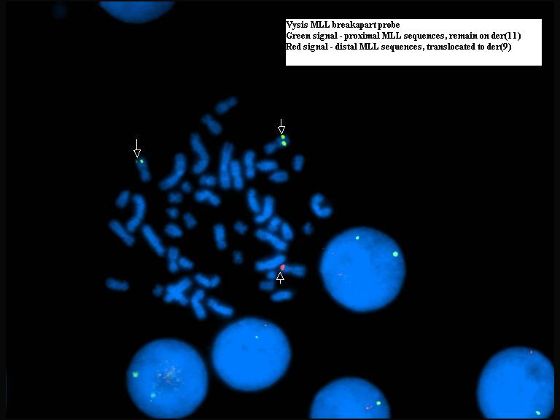
Case 4

Slide 34
Case 5 (composite case)
A 56-year-old woman with a 2-week history of fatigue, headache, easy bruising and visual changes
Past history
pulmonary tuberculosis in her twenties
hypertension
Physical examination
pallor
BP 135/80 mmHg
disseminated petechiae; epistaxis
retinal hemorrhages in left fundus
With thanks to Dr A Botelho de Sousa, © the European Haematology Association

Slide 35
Case 5 (composite case)
FBC
WBC 41.8 x 10⁹/l
Hb 103 g/l
Platelet count 14 x 10⁹/l
Coagulation tests
Prothrombin time 23.8 s (normal 10-13.0)
Activated partial thromboplastin time 30.3 s (normal 24-36)
Fibrinogen 1.16 g/l (normal 2.0-4.0)
D-dimer 5327 ng/ml (normal <230)
ctivated partial thromboplastin time23.8 sec (normal 10-13.0)
What are you suspecting?
With thanks to Dr A Botelho de Sousa, © the European Haematology Association

Slide 36
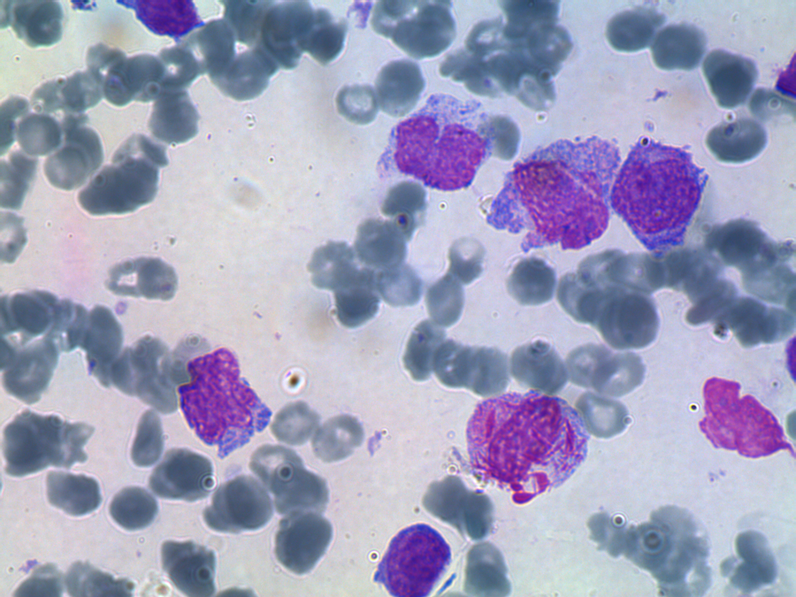
Case 5
Blood film
What are you suspecting?
With thanks to Dr A Botelho de Sousa, © the European Haematology Association

Slide 37
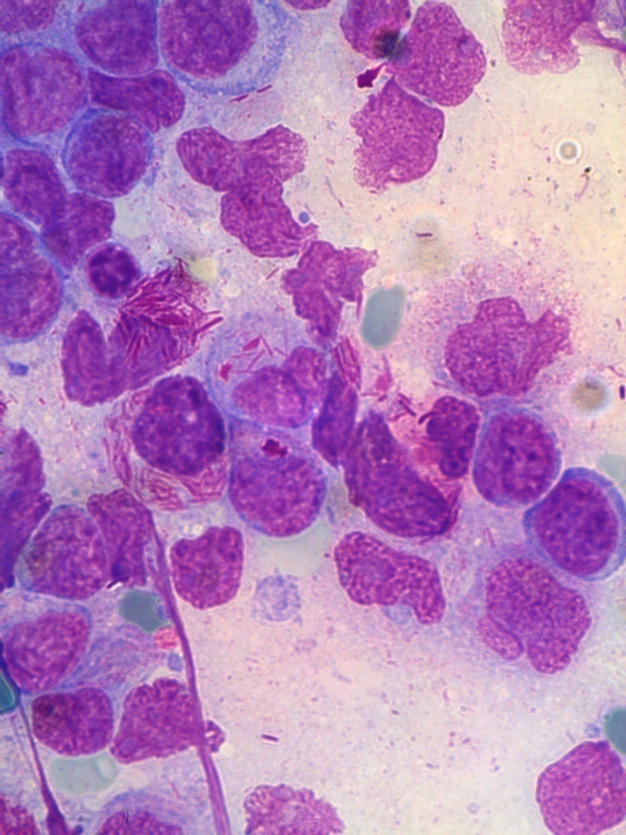
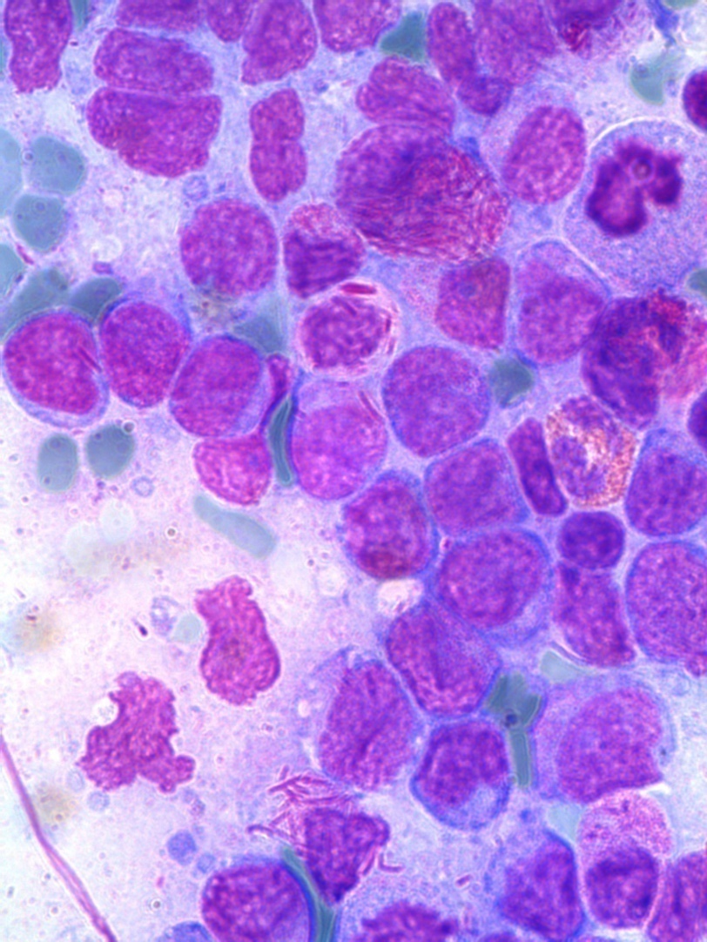
Case 5
Bone marrow could not be aspirated; imprints from trephine biopsy
What are you suspecting?
With thanks to Dr A Botelho de Sousa, © the European Haematology Association

Slide 38
Case 5
Is there any urgency?
Why?
What would the laboratory do?
Why might immunophenotyping be useful in this subtype of acute leukaemia?
What would the clinical haematologist do?

Slide 39
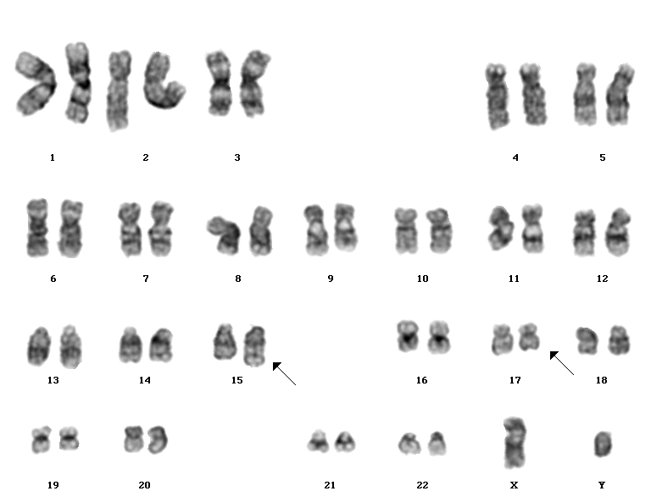
Case 5
Karyogram of another patient – is this what you expect?
© Clinical Publishing, from Bain and Matutes, Myeloid Malignancies, 2012

Slide 40
Case 5
Double-colour double-fusion FISH
normal
patient
patient
With thanks to Dr A Botelho de Sousa, © the European Haematology Association

Slide 41
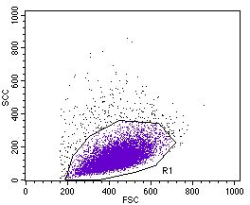
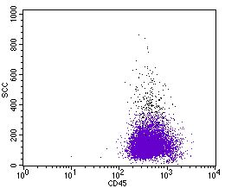
Case 5
Immunophenotyping from another patient
© Clinical Publishing, from Bain and Matutes, Myeloid Malignancies, 2012

Slide 42
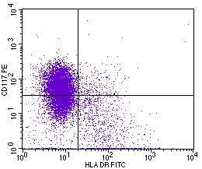
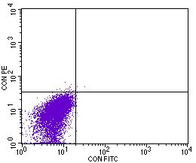
Case 5
Immunophenotyping from another patient
© Clinical Publishing, from Bain and Matutes, Myeloid Malignancies, 2012

Slide 43
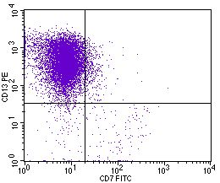
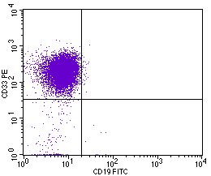
Case 5
Immunophenotyping from another patient
© Clinical Publishing, from Bain and Matutes, Myeloid Malignancies, 2012

Slide 44
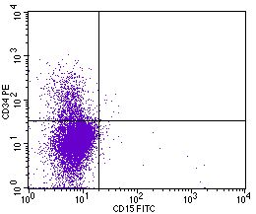
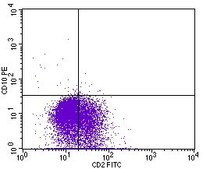
Case 5
Immunophenotyping from another patient
CD15 is expressed on many monoblasts and some myeloblasts, and on maturing cells – you don’t need to learn about it
© Clinical Publishing, from Bain and Matutes, Myeloid Malignancies, 2012

