Slide 1
Lymphoid neoplasms
Data interpretation
BJ Bain

Slide 2
Case 1 (composite case)

Slide 3
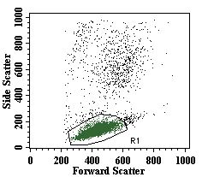
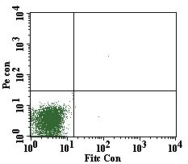
Case 1
Immunophenotyping
© Clinical Publishing, from Matutes and Bain, Lymphoid malignancies

Slide 4
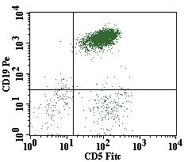
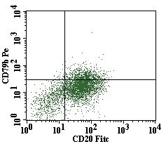
Case 1
Immunophenotyping
© Clinical Publishing, from Matutes and Bain, Lymphoid malignancies

Slide 5
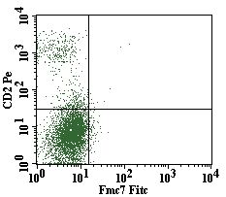
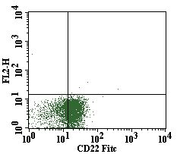
Case 1
Immunophenotyping
© Clinical Publishing, from Matutes and Bain, Lymphoid malignancies

Slide 6
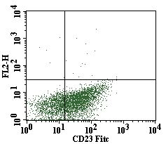
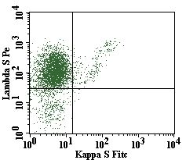
Case 1
Immunophenotyping
© Clinical Publishing, from Matutes and Bain, Lymphoid malignancies

Slide 7
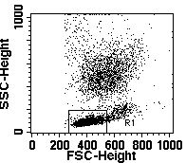
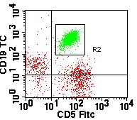
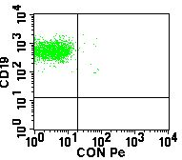
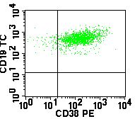
Case 1 – Supplementary
Immunophenotyping
© Clinical Publishing, from Matutes and Bain, Lymphoid malignancies

Slide 8
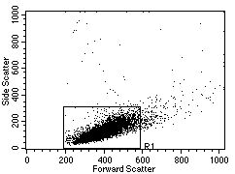
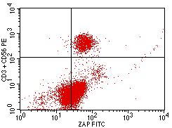
Case 1 – Supplementary
Immunophenotyping
© Clinical Publishing, from Matutes and Bain, Lymphoid malignancies

Slide 9
Case 2 (composite)
A 51-year-old female was admitted to the hospital showing:
Asthenia
Anorexia
10 Kg weight loss in the previous 3 months
No significant findings on physical examination
With thanks to Professor Alberto Orfao, © European Hematology Association

Slide 10
Case 2 (composite)
Parameter | Value
Hemoglobin (g/l) | 83
WBC (x 10⁹/l) | 6.5
Platelets (x 10⁹/l) | 245
With thanks to Professor Alberto Orfao, © European Hematology Association

Slide 11
Case 2 (composite)
Parameter | Value
ESR (mm/h) | 138
Immunoglobulins (g/L) IgG IgA IgM | 5.3 14.1 0.3
Creatinine (μmol/l) | 290
Calcium (mmol/l) | 2.5
BJ proteinemia | POS (LAMBDA)
With thanks to Professor Alberto Orfao, © European Hematology Association

Slide 12
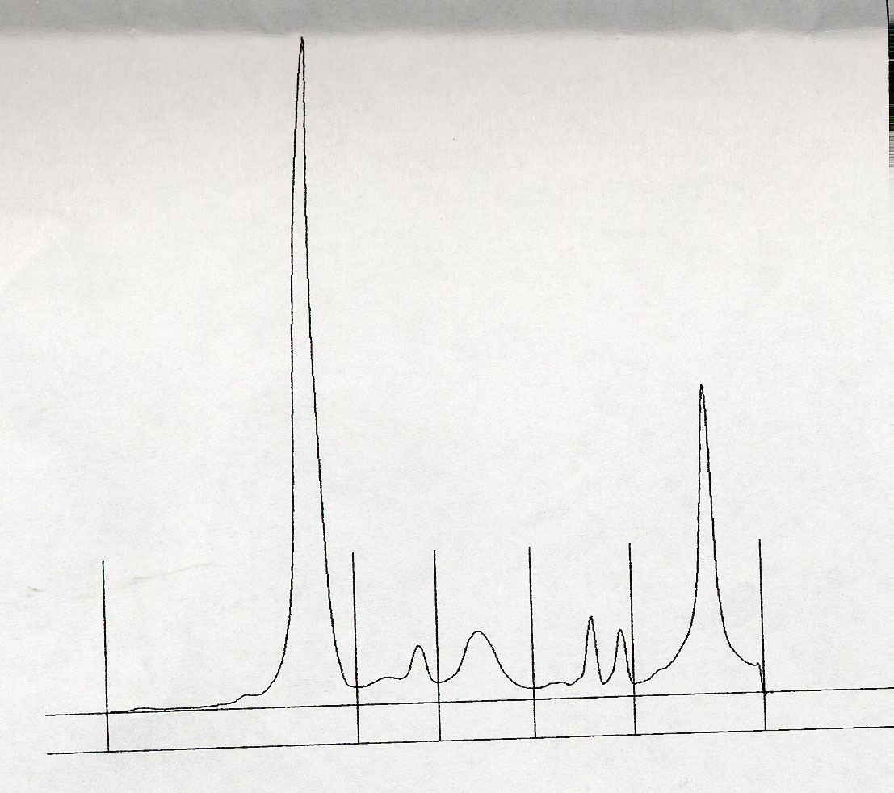
Case 2 (composite)
Serum protein electrophoresis
With thanks to Professor Alberto Orfao, © European Hematology Association

Slide 13
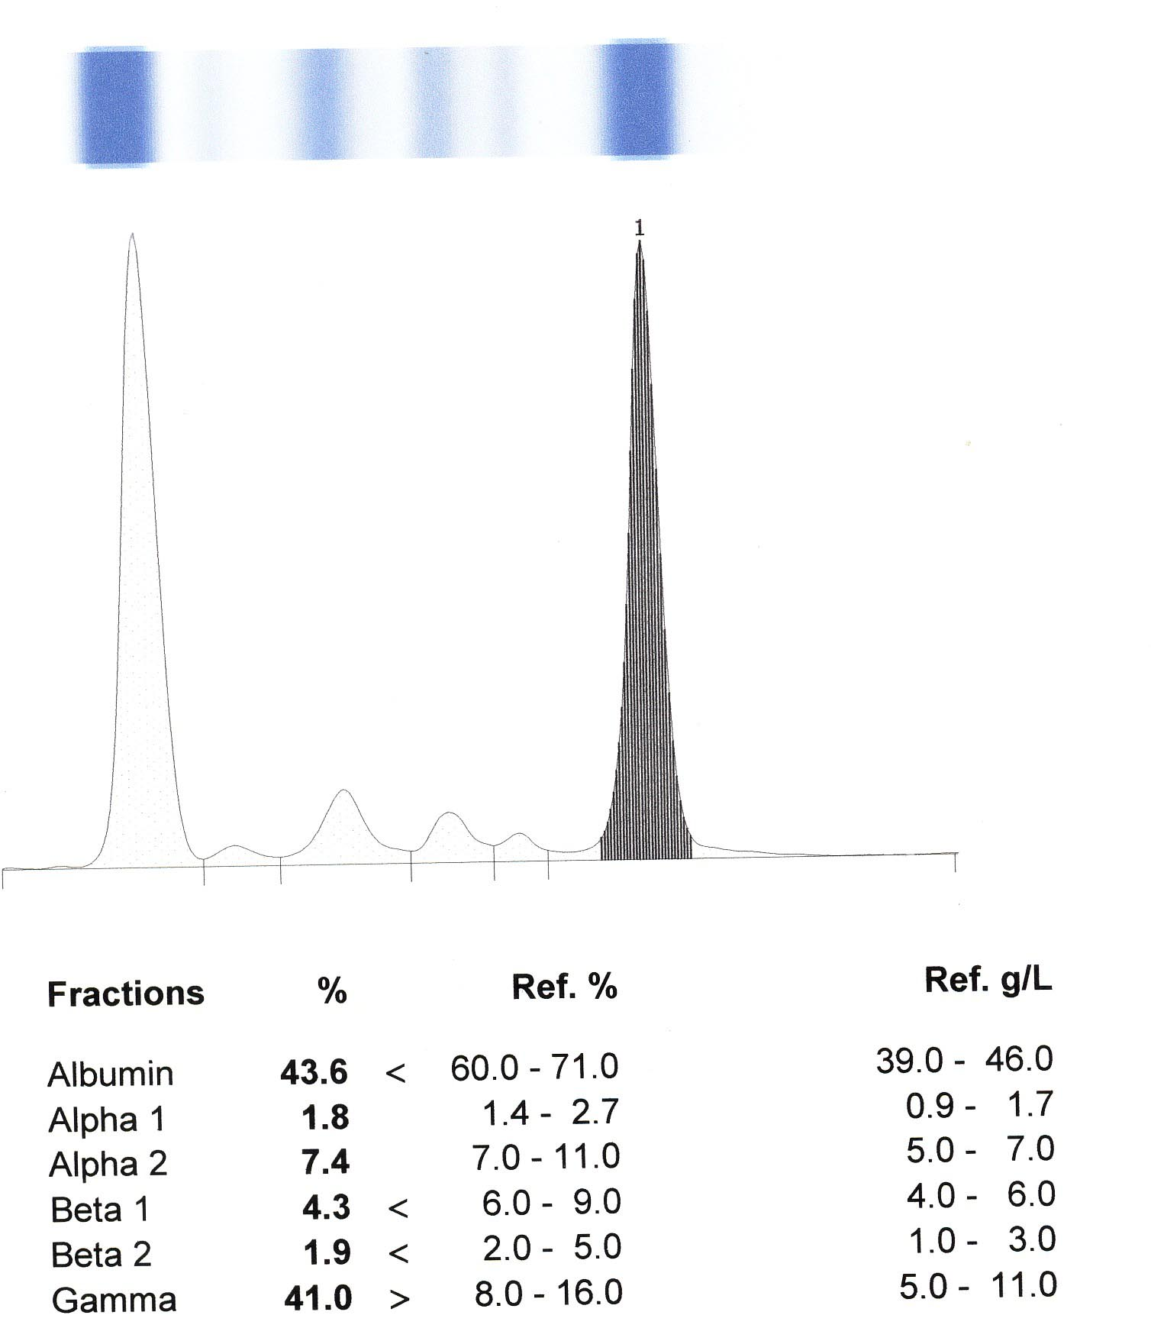
Case 2 (composite)
Serum protein electrophoresis from another patient

Slide 14
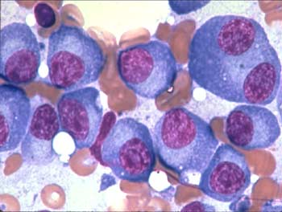
Case 2 (composite)
Bone marrow aspirate of a similar patient
www.personal.psu.edu

Slide 15
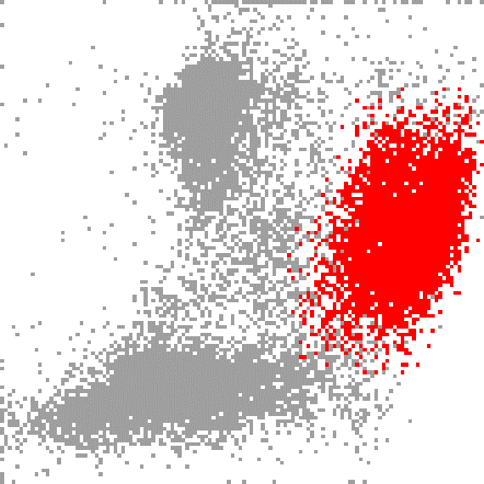
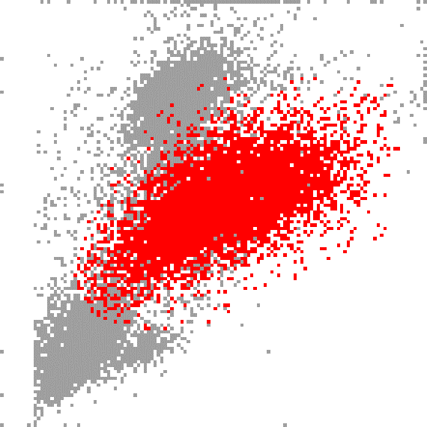
Case 2 (composite)
Immunophenotype
1024
1024
768
768
Transformed SSC ->
Transformed SSC ->
T-SSC
512
512
T-SSC
256
256
0
0
0
256
512
768
1024
FSC
10
0
10
1
10
2
10
3
10
4
FSC-Height ->
CD38-FITC
CD38 ->
With thanks to Professor Alberto Orfao, © European Hematology Association

Slide 16
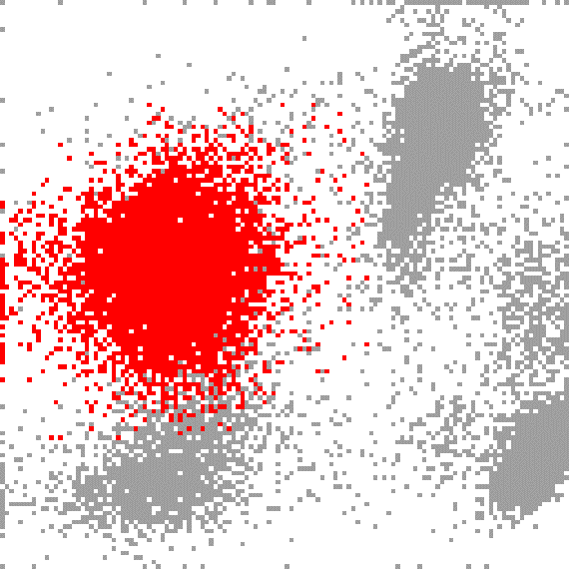
Case 2 (composite)
Immunophenotype
1024
10⁴
768
10³
Transformed SSC ->
512
10²
T-SSC
CD56-PE
10¹
256
CD56->
0
10⁰
10
0
10
1
10
2
10
3
10
4
10
0
10
1
10
2
10
3
10
4
CD45-APC
CD19-PCP/Cy5
CD45 ->
CD19 ->
With thanks to Professor Alberto Orfao, © European Hematology Association

Slide 17
Case 2 (composite)
Final diagnosis

Slide 18
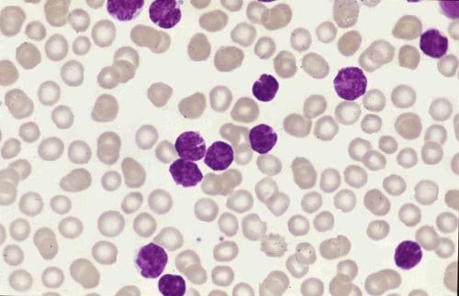
Case 3 (composite case)
Blood film
© Clinical Publishing, from Matutes and Bain, Lymphoid malignancies

Slide 19
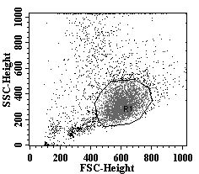
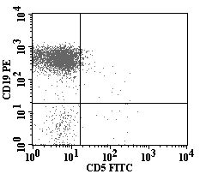
Case 3 (composite case)
Immunophenotyping
© Clinical Publishing, from Matutes and Bain, Lymphoid malignancies

Slide 20
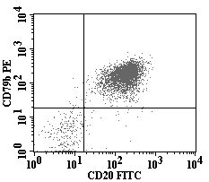
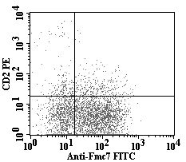
Case 3 (composite case)
Immunophenotyping
© Clinical Publishing, from Matutes and Bain, Lymphoid malignancies

Slide 21
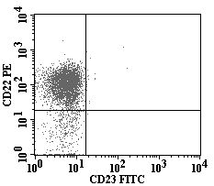
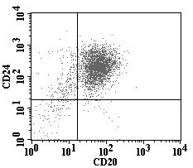
Case 3 (composite case)
Immunophenotyping
© Clinical Publishing, from Matutes and Bain, Lymphoid malignancies

Slide 22
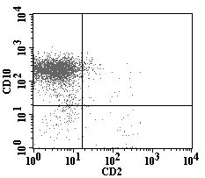
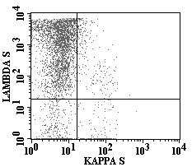
Case 3 (composite case)
Immunophenotyping
© Clinical Publishing, from Matutes and Bain, Lymphoid malignancies

Slide 23
Case 3 (composite case)
Karyogram
List all the abnormalities
Which is most significant?
© Clinical Publishing, from Matutes and Bain, Lymphoid malignancies

Slide 24
Case 3 (composite case)
What is your final diagnosis?
© Clinical Publishing, from Matutes and Bain, Lymphoid malignancies

Slide 25
Case 4
A38-year-old woman of Caribbean origin
A rash for several years duration
Her mother and sister had died of ‘leukaemia’

Slide 26
Case 4
Shortly before presentation she had developed marked cervical lymphadenopathy and hypercalcaemia
Her skin showed plaque-like infiltrates
Case Studies in Clinical Flow Cytometry. Di Giuseppe, JA CD4+/CD8+ adult T-cell leukemia/lymphoma presenting in lymphomatous transformation, www.flow-cases.org

Slide 27
Case 4
Flow cytometric data on cells from a cervical lymph node
Cervical lymph node specimen gated on CD3+ T cells. There is a predominant CD3dim+ population with extremely high right angle light scatter (yellow); these cells are also positive for CD2 and CD5, but show complete loss of CD7. Normal T cells are shown in blue.

Slide 28
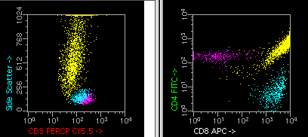
Case 4
Flow cytometric data on cells from a cervical lymph node
The CD7-ve T-cell population with high right angle light scatter - CD4 and CD8 (yellow). Normal T cells comprise a mixture of CD4+ (violet) and CD8+ (cyan) subsets. The neoplastic cells were also positive for CD25, CD71, and the T-cell receptor αβ.

Slide 29
Case 6
66-year-old woman
2-week history of fatigue and pallor
Full blood count showing pancytopenia
Unremarkable family history
No hepatosplenomegaly or lymphadenopathy
Abdominal US and CT: no hepatomegaly, mild splenomegaly (13 cm), no lymph nodes more than 1 cm
With thanks to Professor Robin Foa, © The European Haematology Association

Slide 30
Case 6
Peripheral blood count
Hb 98 g/l
WBC 4.0 x 10⁹/l (neutrophils 0.4 x 10⁹/l, lymphocytes 3.1 x 10⁹/l)
Platelets 16 x 10⁹/l
Peripheral blood film
Presence of immature granulocytes
Occasional circulating blasts
With thanks to Professor R. Foa and Dr F. Mancini, © The European Haematology Association

Slide 31
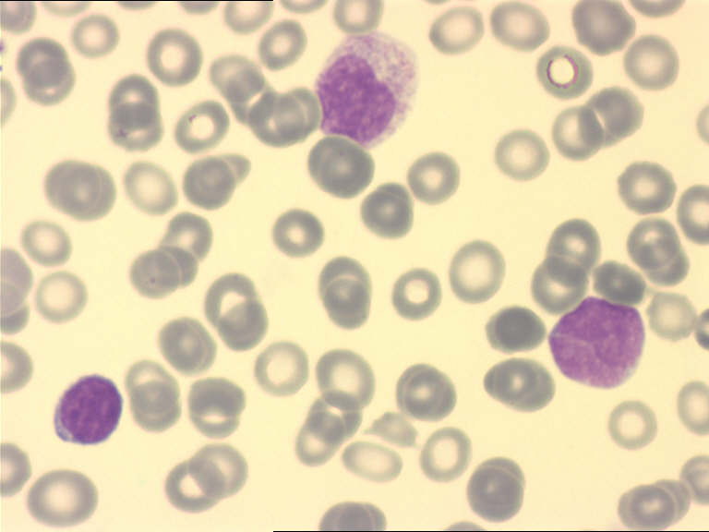
Case 6
Peripheral blood film
With thanks to Professor R. Foa and Dr F. Mancini, © The European Haematology Association

Slide 32
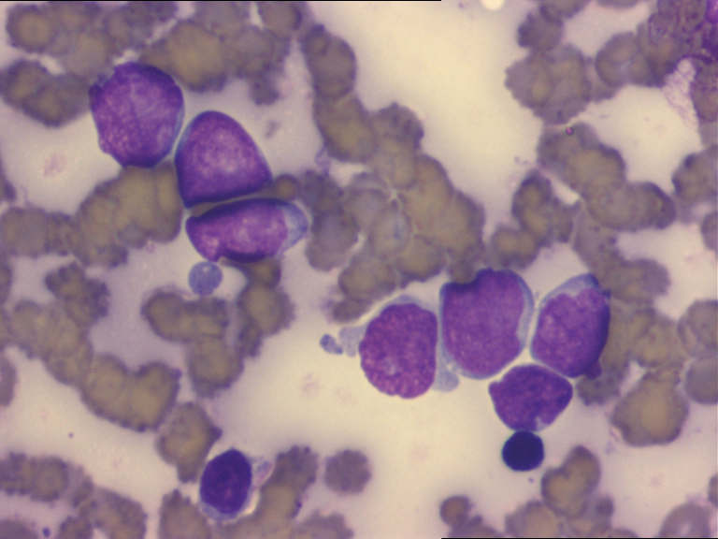
Case 6
Bone marrow aspirate
With thanks to Professor R. Foa and Dr F. Mancini, © The European Haematology Association

Slide 33
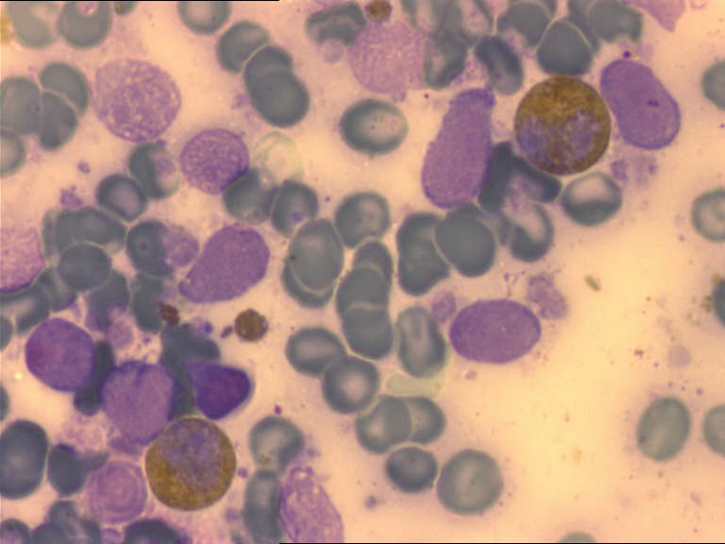
Case 6
Bone marrow aspirate myeloperoxidase
With thanks to Professor R. Foa and Dr F. Mancini, © The European Haematology Association

Slide 34
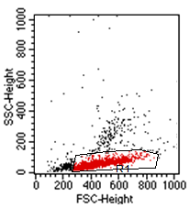
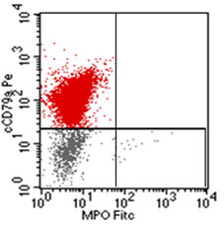
Case 6
Immunophenotype
With thanks to Professor R. Foa and M. S. De Propris, © The European Haematology Association

Slide 35
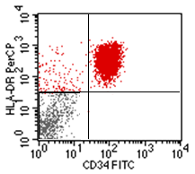
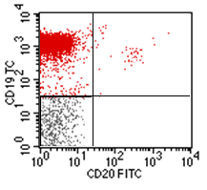
Case 6
Immunophenotype
With thanks to Professor R. Foa and M. S. De Propris, © The European Haematology Association

Slide 36
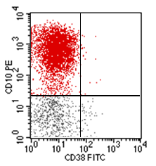
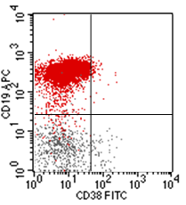
Case 6
Immunophenotype
CD38 is expressed on plasma cells and activated cells
With thanks to Professor R. Foa and M. S. De Propris, © The European Haematology Association

Slide 37
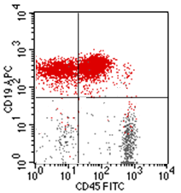
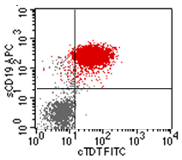
Case 6
Immunophenotype
With thanks to Professor R. Foa and M. S. De Propris, © The European Haematology Association

Slide 38
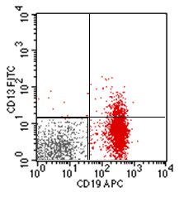
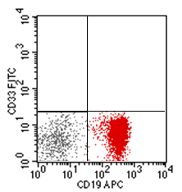
Case 6
Immunophenotype
With thanks to Professor R. Foa and M. S. De Propris, © The European Haematology Association

Slide 39
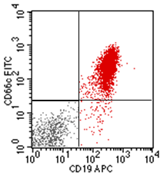
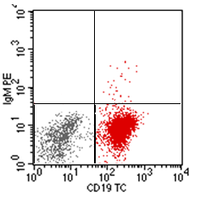
Case 6
Immunophenotype
CD66c is expressed on some B-ALL cells but not normal B-cell precursors – you don’t need to learn about it
With thanks to Professor R. Foa and M. S. De Propris, © The European Haematology Association

Slide 40
Case 6
Given the age of the patient and the immunophenotype, what is the most likely cytogenetic abnormality?

Slide 41
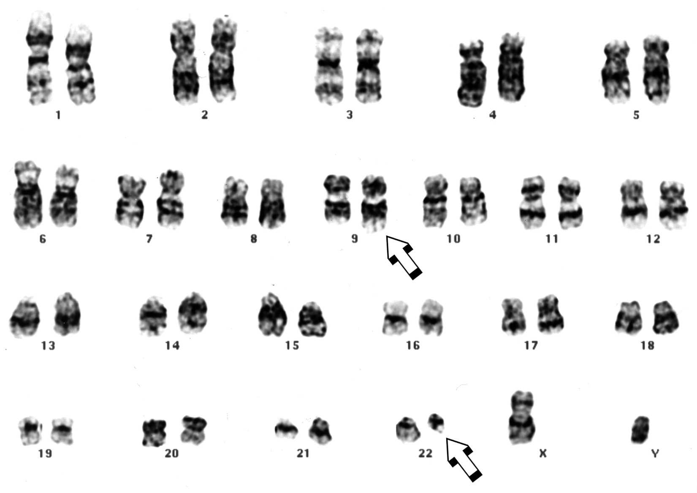
Case 6
Karyogram
With thanks to Professor R. Foa and M. S De Propris, © The European Haematology Association

Slide 42
Case 6
How does making a precise diagnosis influence management?
Note: CD66c is often expressed in Ph-positive ALL cells; expression can be used to monitor MRD
However, you don’t need to know this

