Slide 1
Immune complications of chronic lymphocytic leukaemia
Dr Andrew Innes with thanks to Dr Sasha Marks and Professor BJ Bain

Slide 2
Topics to be covered
Disease related
Therapy related
Autoimmune

Slide 3
Infections in CLL
50% of patients have recurrent infections
Multifactorial
Hypogammaglobulinaemia
Impaired cell mediated immunity
Neutropenia
Leukaemic infiltration of bone marrow
Therapy related
Incidence increased with
Advanced age
Disease progression
Repeated therapies

Slide 5
Hypogammaglobulinaemia
High incidence in CLL
Aetiology poorly understood,
defects in cellular immunity
functional abnormalities in T cells with resultant dysregulation of non-clonal B cells
Increased risk of infections with encapsulated organisms
Effect of treatment on levels unclear
Related to advancing disease

Slide 6
Cellular immunity
Qualitative and quantitative abnormalities of T lymphocytes described
May contribute to hypogammagloblulinaemia
Reduced CD4/CD8 ratio seen
Lack of response to skin testing to tuberculin
Increased risk of viral infections such as shingles
Newer treatment modalities contribute to defect in cellular immunity

Slide 7
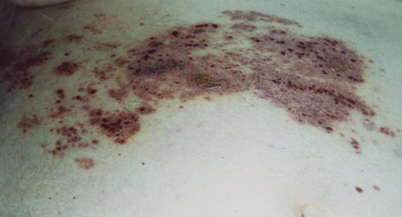
Impaired cellular immunity
Haemorrhagic herpes zoster in SLVL
www.mednet.gr/pim/h6.htm

Slide 8
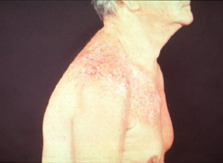
Impaired cellular immunity
Severe scarring following herpes zoster in CLL
© Wiley-Blackwell, from Bain, Interactive Haematology Imagebank, 2nd Edn, 2013

Slide 9
Neutropenia
More therapy-related than disease-related
Increased risk of bacterial and fungal infections
Pneumonia most common and severe
Bacteraemia with Gram-positive and Gram-negative organisms
S. pneumonia > S. aureus > H. influenzae > legionella > salmonella

Slide 10
Complement system
Abnormalities of complement system described
e.g. reduced opsonisation of bacteria by C3b in CLL
No alternative pathway abnormalities described

Slide 11
Therapy related
Steroids
Increased risk of bacterial infection due to defects in neutrophil chemotaxis
Lymphopenia or reduction of normal lymphocytes causing viral infections and opportunistic infections such as Pneumocystis jirovecii
Increased incidence of candida infection

Slide 12
Therapy related - Fludarabine
Purine analogue
Severe lymphopenia and myelosuppression
Bacteraemia & pneumonia
Viral: CMV, HSV, VZV
Pneumocystis jirovecii
Rarely other fungal and mycobacterial infections
Graft vs host disease
Those who are resistant to fludarabine are at highest risk

Slide 13
Therapy related - Alemtuzumab
CD52 monoclonal antibody
Profound lymphopenia
Neutropenia
Bacterial infections
Viral infection particularly CMV reactivation/HSV/VZV
Pneumocystis jirovecii and other fungal infections
Rarely mycobacterial
Graft vs host disease

Slide 14
Pneumocystis jirovecii
Fungus
Presentation
Tachypnoea, exertional dyspnoea and desaturation, dry cough, fever
Diagnosis
CXR – may be normal or diffuse bilateral alveolar shadows, sparing lower zones or ground glass
Induced sputum, broncho-alveolar lavage (BAL)
Treatment
High dose cotrimoxazle +/- steroids

Slide 15
Pneumocystis jirovecii
Chest X-ray in Pneumocystis jiroveci pneumonia
www.netmedicine.com

Slide 16
Pneumocystis jirovecii
Silver stain showing organisms
Erl.pathology.iupui.edu

Slide 17
Fungal Infections
Risk related to duration and severity of neutropenia
Majority of infections candida or aspergillus species
Fluconazole prophylaxis increases the incidence of non-albicans candida species
Difficult to diagnose as not easily cultured
Galactomannan in blood
Imaging of chest and sinuses
Often empirical treatment

Slide 18
CMV reactivation
Highest risk when CD4 count < 50
Presentations
Pyrexia of unknown origin (PUO)
Pneumonia
Colitis
Chorioretinitis
Hepatitis
Monitoring with PCR for CMV DNA

Slide 19
Mycobacterial infection
Mycobacterium fortuitum infection in a patient with CLL previously treated with chlorambucil and fludarabine
Robinson & Smith, 2004, Brit J Haematol, 127, 126

Slide 20
Mycobacterial infection
Mycobacterium fortuitum infection in a patient with CLL previously treated with chlorambucil and fludarabine
Robinson & Smith, 2004, Brit J Haematol, 127, 126

Slide 21
Opportunistic viral infection
Progressive multifocal leucoencephalopathy resulting from infection by the JC virus in a patient with CLL previously treated with chlorambucil, prednisolone, fludarabine and rituximab
Hasan & Taylor, 2005, Br J Haematol, 130, 808.

Slide 22
Graft vs Host disease
Lymphopenia from drugs and leads to the possibility of engraftment of donor lymphocytes and proliferation
Risk from transfusion although less now that products are leucodepleted
Irradiation of blood products for patients previously treated with purine analogues and alemtuzumab (?indefinitely)

Slide 23
Increased incidence of tumours in CLL
Skin cancer
Kaposi sarcoma
What is the cause of Kaposi sarcoma?
Why might it be more common in people with CLL?

Slide 24
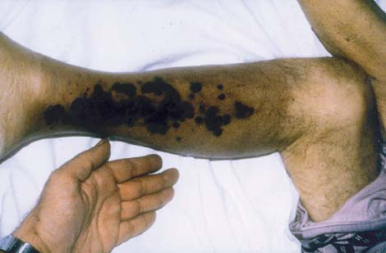
Kaposi sarcoma in CLL
Kaposi’s sarcoma in CLL (Athens Medical Society)
www.mednet.gr/pim/h3.htm

Slide 25
Autoimmune disease
Autoimmune haemolytic anaemia
Immune thrombocytopenic purpura
Pure red cell aplasia

Slide 26
Risk Factors for Auto-Immune Complications
Hodgson K et al. Haematologica 2011;96:752-761

Slide 27
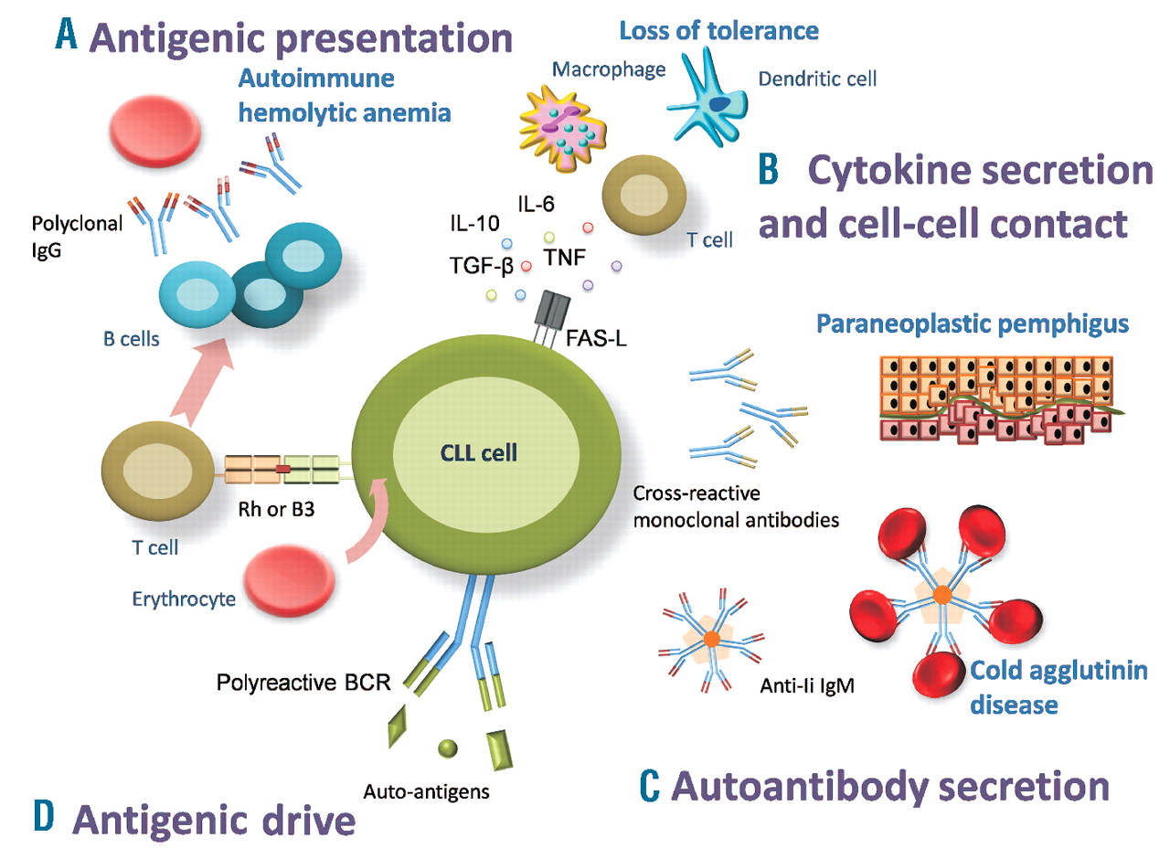
Hodgson K et al. Haematologica 2011;96:752-761
Notes:
Mechanisms of autoimmune disease in CLL.
CLL cells may process red blood cell antigens and act as antigen presenting cells, inducing a T-cell response and the formation of polyclonal antibodies by normal B cells, thus indirectly provoking autoimmune hemolytic anemia.
CLL cells express inhibitory cytokines that alter tolerance, which may facilitate the escape of self-reactive cells.
Rarely CLL cells are effector cells that secrete a pathological monoclonal autoantibody. Two such diseases are paraneoplastic pemphigus, where immunoglobulins are cross-reactive with epitopes located at the dermal-epidermal junction, and cold agglutinin disease, where IgMs have anti-red cell reactivity.
In turn, CLL cells may be stimulated through their polyreactive BCR that recognizes auto-antigens.
In AAE – mechanism uncertain.
Theory – clonal B cells produce an antibody that binds and neutralizes C1-INH
Theory – massive activation of complement pathway by neoplastic lymphoid tissue or by abnormal antibody – leads to depletion of C1-INH
Glomerulonephritis – may be direct deposition of immunoglobulins, rather than a actual autoimmune mechanism
Mechanisms of autoimmune disease in CLL.
CLL cells may process red blood cell antigens and act as antigen presenting cells, inducing a T-cell response and the formation of polyclonal antibodies by normal B cells, thus indirectly provoking autoimmune hemolytic anemia.
CLL cells express inhibitory cytokines that alter tolerance, which may facilitate the escape of self-reactive cells.
Rarely CLL cells are effector cells that secrete a pathological monoclonal autoantibody. Two such diseases are paraneoplastic pemphigus, where immunoglobulins are cross-reactive with epitopes located at the dermal-epidermal junction, and cold agglutinin disease, where IgMs have anti-red cell reactivity.
In turn, CLL cells may be stimulated through their polyreactive BCR that recognizes auto-antigens.
In AAE – mechanism uncertain.
Theory – clonal B cells produce an antibody that binds and neutralizes C1-INH
Theory – massive activation of complement pathway by neoplastic lymphoid tissue or by abnormal antibody – leads to depletion of C1-INH
Glomerulonephritis – may be direct deposition of immunoglobulins, rather than a actual autoimmune mechanism

Slide 28
Autoimmune haemolytic anaemia
Incidence 4-40%
Autoantibodies polyclonal, usually IgG
Secondary to immune dysregulation rather than antibody production by malignant clone
IgG coats red cells which are prematurely destroyed by the reticuloendothelial system (mainly spleen)

Slide 29
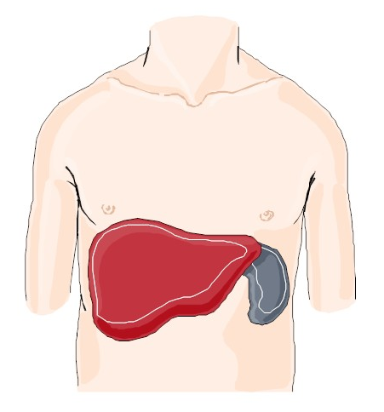
Auto-Immune Haemolysis

Slide 30
Autoimmune haemolytic anaemia
Clinical features
Anaemia
Jaundice
Splenomegaly
Laboratory features
Anaemia
Reticulocytosis
Raised bilirubin/lactate dehydrogenase (LDH)
Positive direct antiglobulin test (DAT) (often called a Coombs’ test)

Slide 31
Direct Antiglobulin Test
http://en.wikipedia.org/wiki/Coombs_test

Slide 32
Indirect Antiglobulin Test
http://en.wikipedia.org/wiki/Coombs_test

Slide 33
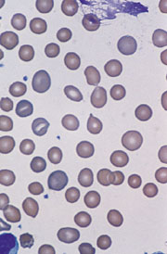
Autoimmune haemolytic anaemia
What are the features shown that suggest this diagnosis?
Is there a clue to the underlying cause?
© Wiley-Blackwell from Bain, Interactive Haematology Imagebank, 2nd Edn, 2013

Slide 34
Autoimmune haemolytic anaemia
Treatment
Immunosuppression with steroids
Treat the underlying disease
Rituximab (CD20)
May require transfusion
Dearden C, Hematology Am Soc Hematol Educ Program 2008:450-6

Slide 35
Autoimmune thrombocytopenic purpura ‘ITP’
Incidence 1-2%
Thrombocytopenia due to peripheral destruction
IgG antibodies directed against platelets
Premature destruction by the spleen
Bone marrow normal or increased megakaryocytes

Slide 36
Autoimmune thrombocytopenic purpura ‘ITP’
Treatment
Steroids
High dose intravenous immunoglobulin (IVIg)
Treat underlying disease

Slide 37
Pure red cell aplasia
Incidence <1%
Features
Normocytic or macrocytic anaemia,
Low reticulocyte count
Normocellular or hypercellular marrow with severe erythroid hypoplasia
Occurs early in disease
Treatment steroids and ciclosporin

Slide 38
Images 29: Immune complications of B-cell chronic lymphocytic leukaemia
Travers, J., Leach, M. & Jackson, R. Stobhill Hospital and Glasgow Royal Infirmary, Glasgow. Mike.leach@northglasgow.scot.nhs.uk edited by Barbara J. Bain
A 62-year-old man presented with Stage A chronic lymphocytic leukaemia. A full blood count showed haemoglobin concentration (Hb) 152 g/l, white cell count (WBC) 9.5 x 10⁹/l and platelet count 107 x 10⁹/l. Subsequently the platelet count fell to 55 x 10⁹/l. A marrow aspirate showed plentiful megakaryocytes. A prompt rise in the platelet count following a short course of prednisolone. Why was the patient thrombocytopenic?
From www.bloodmed.com

Slide 39
Images 29: Immune complications of B-cell chronic lymphocytic leukaemia
By three years and nine months from presentation, he had developed diffuse lymphadenopathy, night sweats and weight loss with Hb 130 g/l, WBC 99 x 10⁹/l and platelet count 62 x 10⁹/l. He was commenced on chlorambucil 6 mg daily and during chlorambucil therapy there was improvement in the lymphadenopathy, sweats and WBC but a progressive fall in Hb. Chlorambucil was stopped. One month later the Hb had fallen further to 86 g/l. A direct Coombs’ test was negative, reticulocyte count was 10 x 10⁹/l (normal range 50-150) and lactate dehydrogenase and haptoglobin levels were normal. There was no evidence of bleeding. He became transfusion-dependent.
What diagnosis is suggested by the reticulocyte count?
From www.bloodmed.com

Slide 40
Images 29: Immune complications of B-cell chronic lymphocytic leukaemia
A bone marrow trephine biopsy showed a cellularity of 70% with a prominent nodular and interstitial small lymphocytic infiltrate. Myeloid and megakaryocyte activity was reasonably well preserved. Erythroid precursors, however, were virtually absent in both an aspirate (Fig 1) and trephine biopsy sections. This was confirmed with a glycophorin C stain on the trephine biopsy specimen (Fig 2). What viral infection should be excluded as a cause?
From www.bloodmed.com

Slide 41
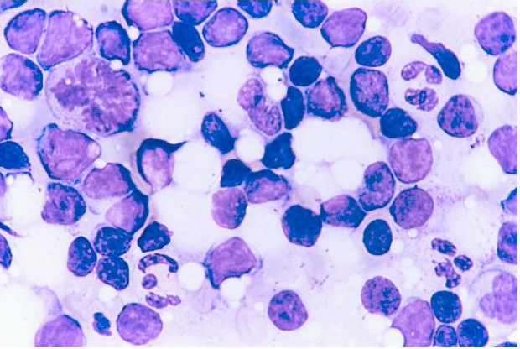
Images 29: Immune complications of B-cell chronic lymphocytic leukaemia
Bone marrow aspirate—no erythroblasts present
From www.bloodmed.com

Slide 42
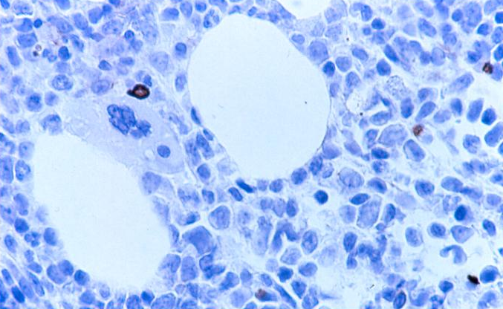
Images 29: Immune complications of B-cell chronic lymphocytic leukaemia
Bone marrow trephine biopsy section stained with an antiglycophorin antibody—only a single erythroblast is apparent
From www.bloodmed.com

Slide 43
Images 29: Immune complications of B-cell chronic lymphocytic leukaemia
A diagnosis of CLL-related pure red cell aplasia was made and ciclosporin therapy was commenced. Within 2 weeks there was a steady rise in Hb with an associated reticulocytosis (Fig 3). He has not required further transfusion and a current FBC shows Hb 126 g/l, WBC 29 x 10⁹/l and platelet count 120 x 10⁹/l.
From www.bloodmed.com

Slide 44
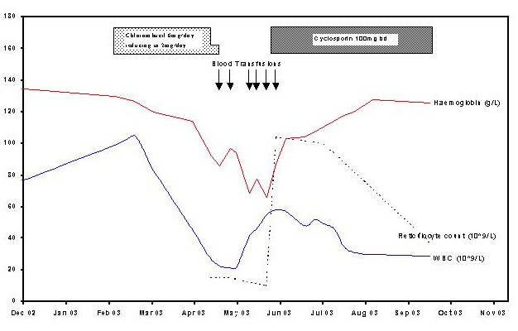
Images 29: Immune complications of B-cell chronic lymphocytic leukaemia
From www.bloodmed.com

Slide 45
Prevention of infection
IVIG
Significantly fewer bacterial infections
No effect on viral and fungal infections
No effect on overall survival
Septrin/cotrimoxazole for prevention of Pneumocystis jirovecii

Slide 46
Prevention of infection
Fluconazole for candida prophylaxis
GCSF for improving neutropenia
Irradiated blood products for prevention of GVHD

Slide 47
Prevention of infection
Immunization but suboptimal antibodies responses
Pneumococcus
Haemophilus influenzae
Influenza/swine flu
Prophylaxis
Penicillin for recurrent pneumococcal infection
Supportive care
Neutropenic diet
Mouth care

Slide 48
SUMMARY
Infective complications common cause of mortality and mortality
Accounts for 50% of all CLL-related deaths
Early recognition and supportive care important
Recognition of autoimmune complications important and managed differently
Therapy-related mortality/morbidity should not be underestimated

