Slide 1
Acute promyelocytic leukaemia:
A paradigm for molecularly targeted therapy
David Grimwade
Dept. of Medical & Molecular Genetics,
King’s College London School of Medicine

Slide 2
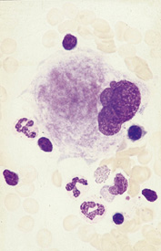
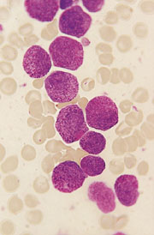
Diagnosis of acute myeloid leukaemia (AML)
~2000 cases per year in UK
Normal bone marrow
AML

Slide 3
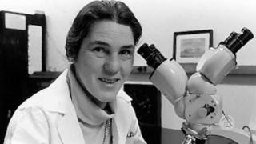
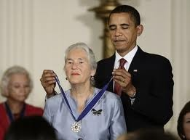
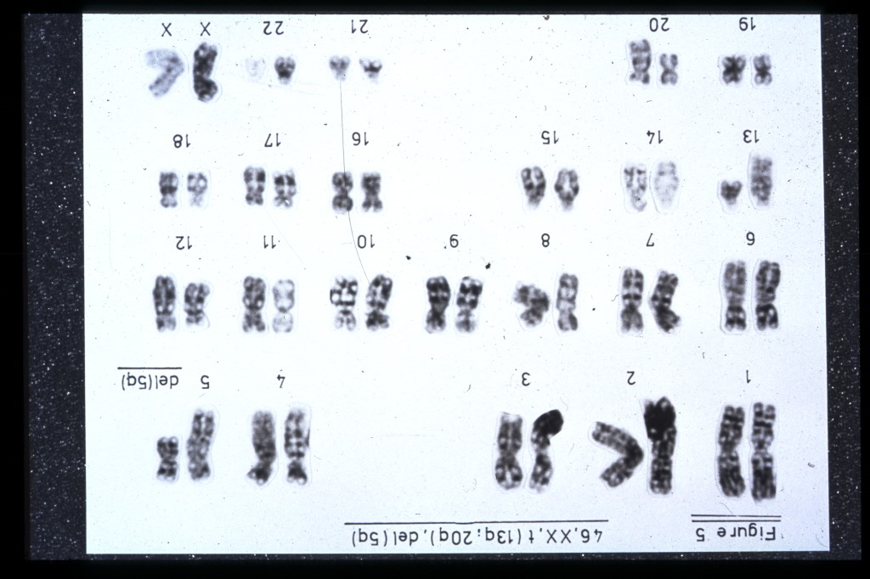
First steps to understanding the causes of AML
Janet Rowley
Univ of Chicago

Slide 4
Outcome of cytogenetic entities recognised in 2008 WHO classification
t(15;17)
t(8;21)
inv(16)
t(9;11)
t(6;9)
t(11q23)
t(9;22)
MDS-related
inv(3)
Grimwade et al. Blood. 2010;116: 354-365.
Analysis of 5,876 cases entered in MRC AML10, 12 & 15 trials

Slide 5
Disruption of normal haematopoeisis by leukaemia-associated mutations
T
CLP
B
AML
ST-HSC
Fusion
proteins
LT-HSC
LMPP
GMP
CMP
MkEP
Haematopoietic road map according to Adolfsson et al. Cell 2005; 121: 295-306

Slide 6
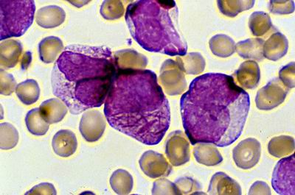
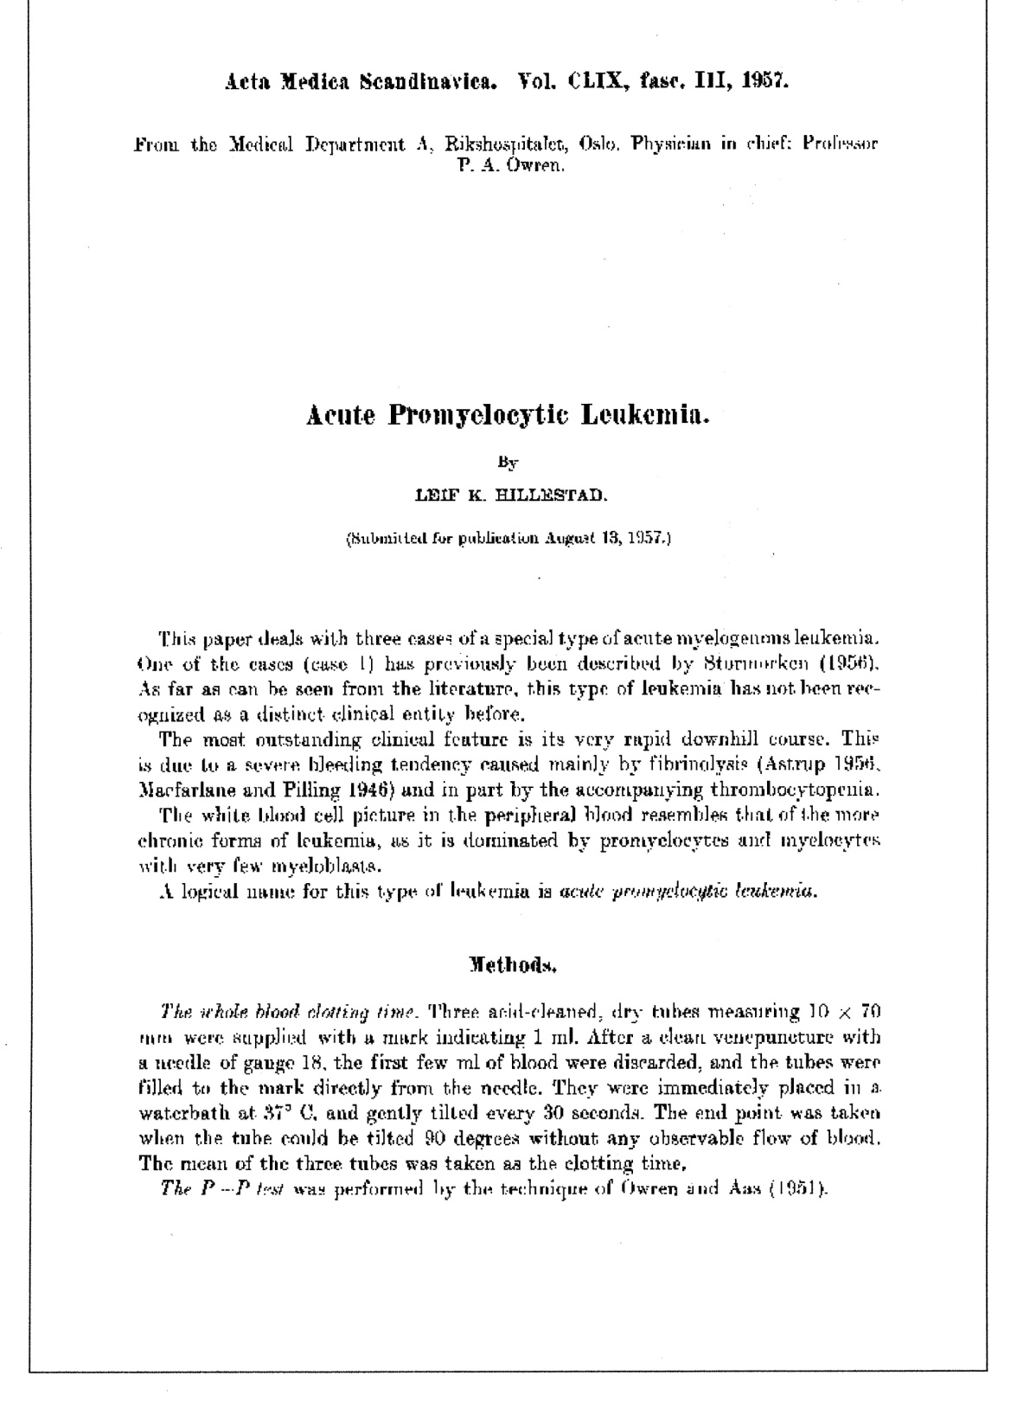
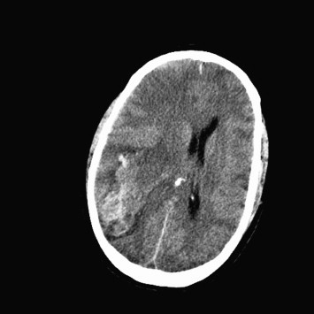
Acute promyelocytic leukaemia (APL) was first success for molecularly-targeted therapy

Slide 7
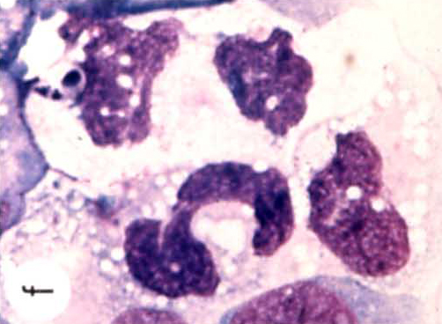
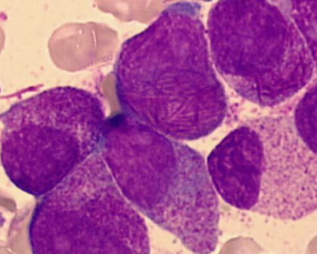
First success for molecularly targeted therapy:
Targeting of PML-RARα oncoprotein formed by t(15;17) in APL
15
17
PML-RARα
RA
RARA
PML
Borrow et al, Science 1990; 249: 1577-1580.
de Thé et al, Nature 1990; 347: 558-61.
Goddard et al, Science 1991; 254: 1371-1374.
APL

Slide 8
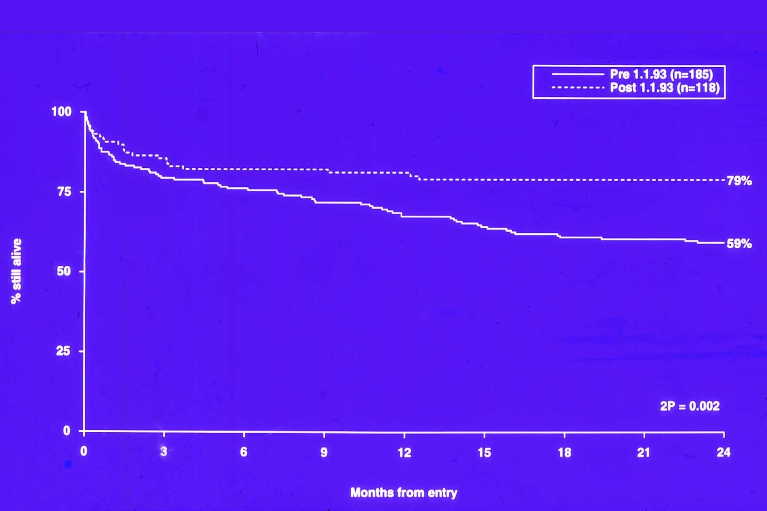
Impact of molecularly targeted therapy – all transretinoic acid (ATRA) on outcome in APL
Post-ATRA
Pre-ATRA

Slide 9
Development of ATRA to treat APL
Demonstration of benefit of addition
of ATRA to chemo in RCTs
(Fenaux 1993; Tallman 1997)
Cloning of the t(15;17)
(Borrow; de Thé 1990)
ATRA reported to induce
remission in APL patients
(Huang 1988)
ATRA found to
differentiate 1° APL cells
(Breitman 1981)
t(15;17) identified
(Rowley 1977)
ATRA as standard
of care in UK
First description of APL
(Hillestad 1957)
1950
1960
1970
1980
1990
2000
2010

Slide 10
Repression of target genes implicated in myeloid differentiation in acute promyelocytic leukaemia (APL)
Grimwade D, Mistry AR, Solomon E, Guidez F. Cancer Treat. Res. 2009

Slide 11
Molecularly targeted therapy in PML-RARA+ APL:
mechanisms of ATRA activity
Acetylases
coactivators
PML-RARα
PML-RARα
-
RARE
HDAC/
corepressors
HDAC/
corepressors
Terminal
Differentiation
Upregulation
Of TRAIL
Induction of
Apoptosis
Dnmt’s
M
Dnmt’s
PML-RARα
PML-RARα
PML-RARα
PML-RARα
RARE
Degradation of
PML-RARα
RARE
Acetylases
coactivators
RXRα
RARα
RARE
Reformation of PML NBs
Physiological RA
Pharmacological RA

Slide 12


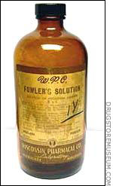
Arsenic: Evolution from poison to targeted therapy
Millais,
Ophelia (1851)
Elizabeth Siddal
Fowler’s Solution
(1786)
1% Potassium arsenite
First used to treat
leukaemia in 1845
Harbin, 1970’s
1% As₂O₃
Traces HgCl₂
32 APL pts treated
65% CR
See Degos L. Br J Haem 2003

Slide 13
Arsenic trioxide (ATO) induces degradation of the PML-RARα oncoprotein to induce remission of APL
Arsenic
-
Angiogenesis
endothelium
-
VEGF
AQP9
Induction of
Differentiation
GTP-binding
to monomeric
tubulin
ATR
ERK
CHK2O
HDAC/
SMRT
Telomerase
JNK
P
De-repression
tubulin-
polymerisation
PML-RARα
RARα
target genes
ROS
P53
Transition
pore
AP-1
BCL2
microtubule
assembly &
spindle formation
Tm
PML-RARα
H₂O₂
TRE
Casp10
Mitochondria
Daxx
Mitosis
cytochrome C
release
Degradation of PML-RARα in reformed PML nuclear bodies
caspase
cascade
Induction of
Apoptosis

Slide 14
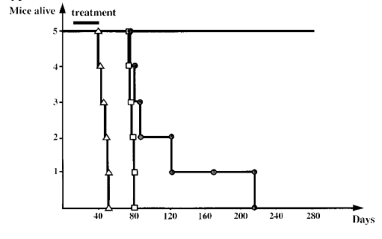
Utility to mouse models of leukaemia to develop novel treatment approaches
ATRA + Arsenic
ATRA
No
drug
Arsenic
Lallemand-Breitenbach et al, JEM 1999

Slide 15
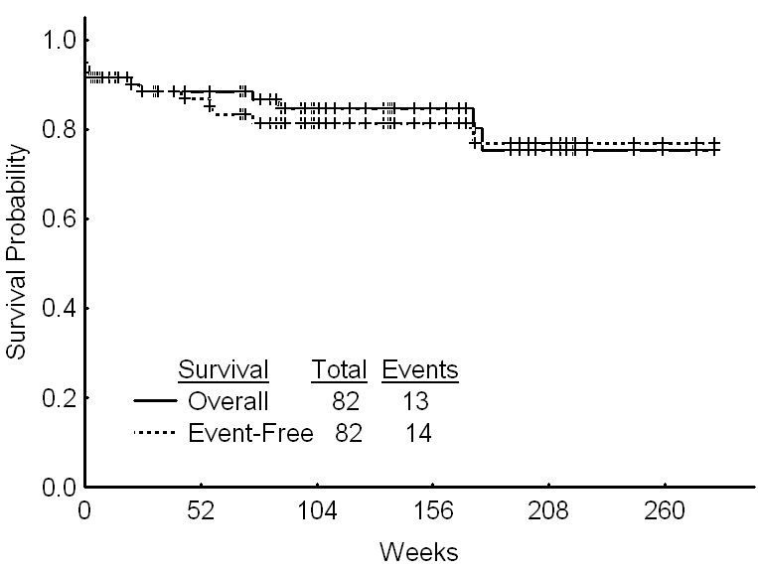
APL can be cured with molecularly-targeted therapy
(ATRA+ATO) without chemotherapy: MD Anderson experience
Ravandi, F. et al. J Clin Oncol; 27:504-510 2009

Slide 16
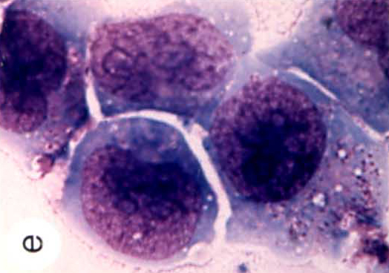
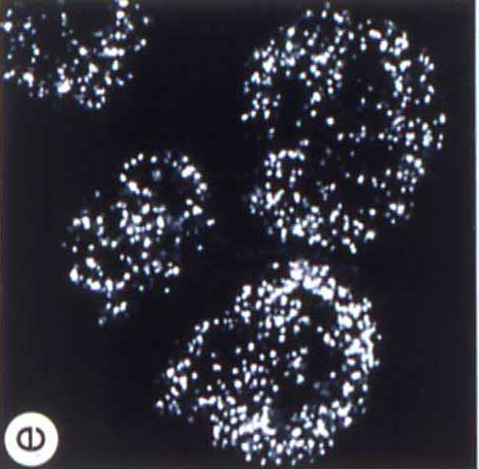
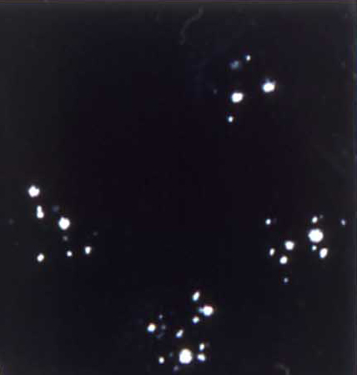
Impact of PML-RARα fusion protein on nuclear architecture and its reversal by targeted therapies
ATRA
ATO

Slide 17
Disruption of PML nuclear bodies in
t(15;17) associated APL
PML
BLM
PLZF
NBs implicated
in regulation of:
Apoptosis
Senescence
Growth suppression
Genomic stability
SUMO
p53
pRb
CBP
Normal
Sp100
tissues,
Daxx
RXR
Other
leukaemias
ATRA
Arsenic
PML RAR
α
Transcriptional
repression
Altered retinoid
signalling
Disruption of PML NBs
Loss of PML
growth suppressor &
pro-apoptotic effects
t(15;17) APL

Slide 18
Aetiology of acute promyelocytic leukaemia
Mechanisms underlying formation of tumour-associated chromosomal translocations poorly understood
Insights can potentially be gained from therapy-related leukaemias which have de novo counterparts
Therapy-related leukaemias are becoming an increasing healthcare problem as more patients survive their primary cancers
~10% of APL cases follow treatment with chemotherapeutic agents targeting DNA topoisomerase II (e.g. mitoxantrone, epirubicin)
Suggests a role for DNA topoisomerase II in forming chromosomal translocations, but mechanisms poorly defined

Slide 19
DNA topoisomerase II
Catalyses relaxation of supercoiled DNA
  DNA topoisomerase II homodimer introduces 4-base staggered nicks in DNA as each subunit covalently binds and cleaves one strand
  A second DNA double helix passes through the cleaved strands
  Cleaved strands are then re-ligated
Topoisomerase II-targeted drugs interfere with cleavage-re-ligation equilibrium → net increased cleavage → DNA damage → apoptosis
Notes:
DNA topoisomerase II catalyses the relaxation of supercoiled DNA by transiently cleaving and religating both strands of the double helix
The DNA topoisomerase II homodimer introduces 4-base staggered nicks in DNA as each subunit covalently binds and cleaves one strand
In presence of ATP, the DNA open gate allows passage of a second DNA double helix through the cleaved strands
Cleaved strands are then re-ligated, and after ATP hydrolysis, the enzyme homodimer attains its original conformational state to catalyse another cycle
Several anticancer drugs interfere with cleavage-re-ligation equilibrium → they increase the concentration of enzyme-DNA covalent cleavage complexes → net increased cleavage → DNA damage

Slide 20
Genomic cloning shows translocation breakpoint hotspot
in PML intron 6 in APL arising following mitoxantrone exposure
-1
+5
de novo n=35
mitoxantrone n=6
other t-APL n=7
p<0.0001 v. other t-APL
p<0.05 v. all de novo and t-APL
1482-1489
6
7a
0.1 kb
903
1958
Mistry et al, N Engl J Med 2005; 352: 1529-1538
Notes:
This slide shows the 4 t-APL cases following mitoxantrone indicated in red, which is clearly a DNA damage hotspot with a p value of less than 0.0001 when compared to the other bcr1 secondary cases in green, and a p value of less than 0.05 when compared to all bcr1 cases, including the de novo cases in blue.

Slide 21
PML breakpoint clustering in t-APL arising after mitoxantrone treatment of malignant and benign conditions
PML
bcr3
exon 3
4
S51489
273
1721
1482-9
bcr1
Mitoxantrone for breast cancer
exon 6
7a
S57791
903
1958
Mitoxantrone for multiple sclerosis
RARA
11569-71
14446-9
exon 2
3
17
16,902
AF088889
AJ297538
Hasan & Mays et al, Blood 2008;112:3383-90.

Slide 22
Model for formation of the t(15;17) chromosomal translocation in therapy-related t-APL
PML
RARA
AGGTTGCAGACCAGGTAGCAGT
CCGGAGTT
CCGGAGTTCCCCACACCTCCGG
AGGTTGCAGA
CCAGGTAGCAGT
CCCCACACCTCCGG
TCCAACGTCTGGTCCATCGTCA
GGCCTCAAGGGG
TCCAACGTCTGGTC
CATCGTCA
GGCCTCAAGGGGTGTGGAGGCC
TGTGGAGGCC
AGGTTGCAGA
CCCCACACCTCCGG
CCGGAGTT
CCAGGTAGCAGT
TCCAACGTCTGGTC
TGTGGAGGCC
GGCCTCAAGGGG
CATCGTCA
Exonucleolytic Digestion of Bases
AGGTTGCAGA
C
C
CCACACCTCCGG
TCCAACGTCTGG
T
C
TGTGGAGGCC
NHEJ/ alt-NHEJ
NHEJ/ alt-NHEJ
CCGGAGTT
CCAGGTAGCAGT
AGGTTGCAGA
CCACACCTCCGG
CCGGAGTT
CCAGGTAGCAGT
AGGTTGCAGA
CCACACCTCCGG
GGCCTCAAGGGG
CATCGTCA
TCCAACGTCTGG
GGCCTCAAGGGG
CATCGTCA
TCCAACGTCTGG
TGTGGAGGCC
TGTGGAGGCC
Ligation
Ligation, Gap Fill In
CCGGAGTT
CCAGGTAGCAGT
C
AGGTTGCAGA
CCACACCTCCGG
C
GGCCTCAAGGGG
CATCGTCA
T
TCCAACGTCTGG
TGTGGAGGCC
C
PML-RARA
RARA-PML
Ashley Mays

Slide 23
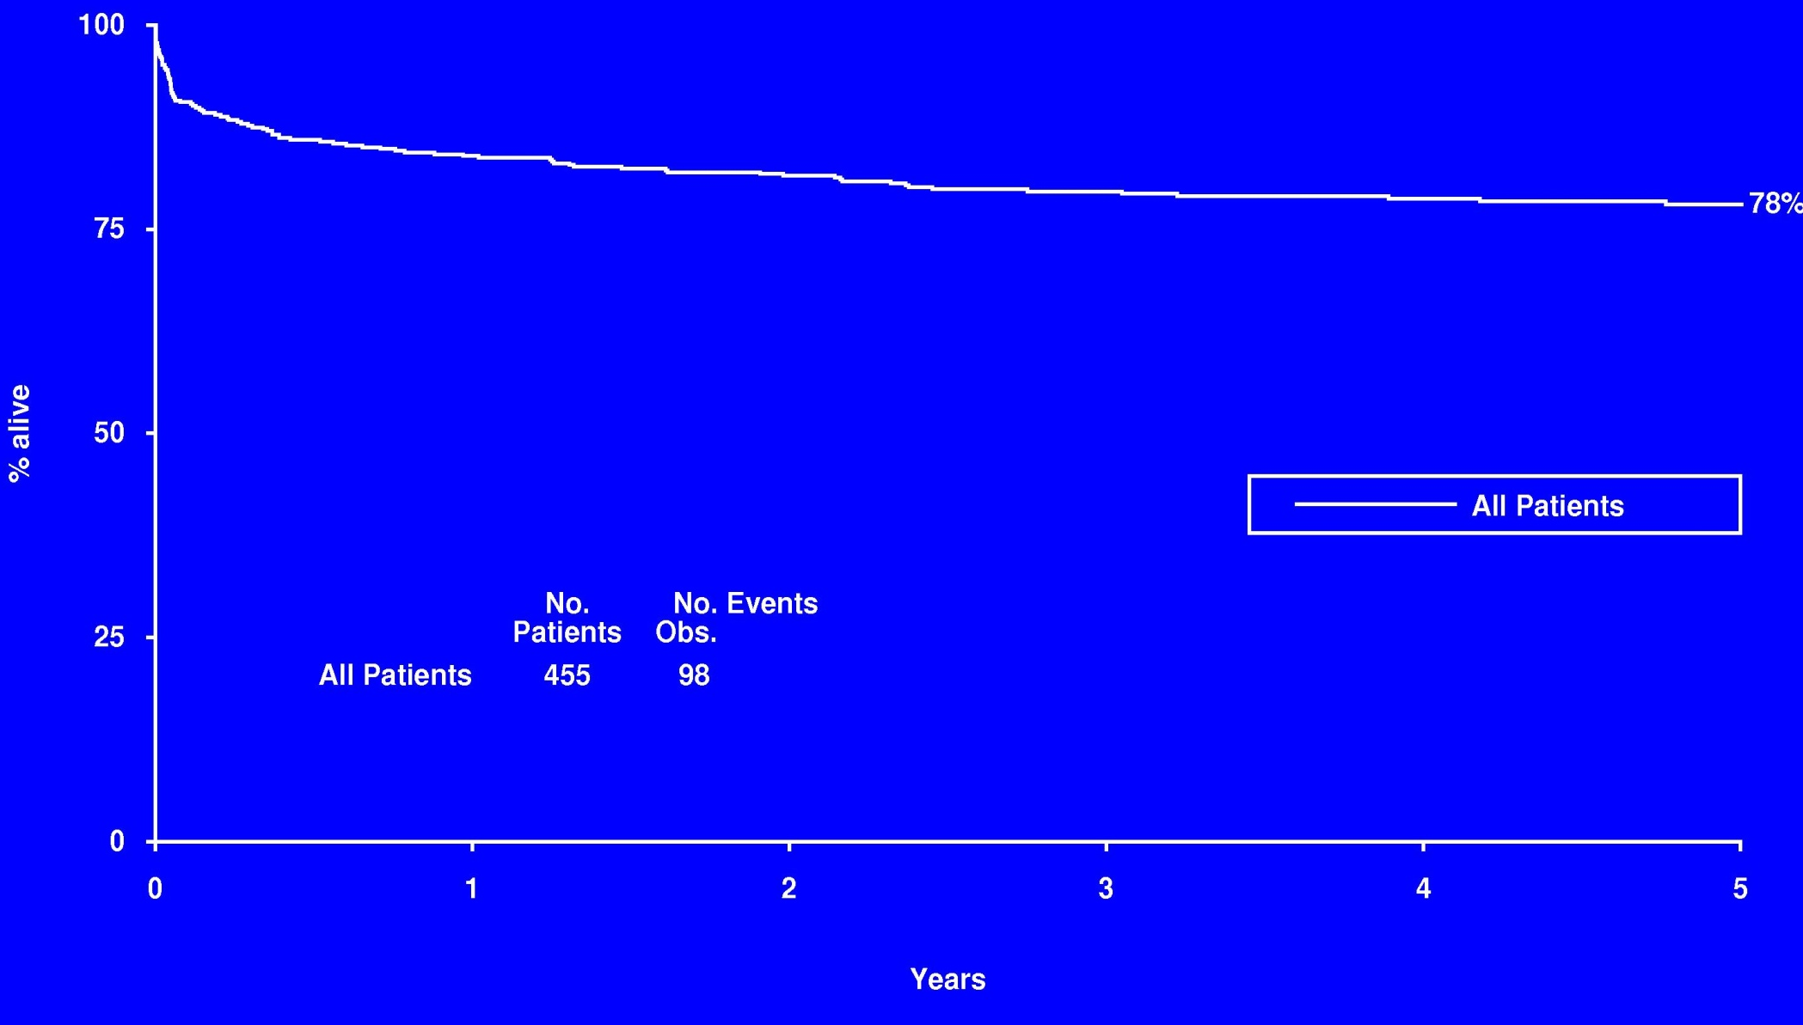
The APL challenge:
How to improve on outcome already achieved with ATRA & anthracycline-based chemotherapy?
MRC AML10 + 12

Slide 24
Real-time quantitative PCR (RT-qPCR) amplification of
APL fusion transcripts can detect submicroscopic levels of disease
PML-RARA
Grimwade et al, J Clin Oncol 2009; 27: 3650-8.

Slide 25
Use of sequential MRD monitoring to direct
pre-emptive therapy to prevent impending relapse
Leukaemic cell burden
>10¹²
Pre-emptive therapy
to prevent frank relapse
10¹⁰
Rapid
responders
Slow
responders
10⁸
10⁶
Undetectable range

Slide 26
Evaluation of MRD monitoring by standardised RT-qPCR
assay to direct treatment in patients with APL: MRC AML15 trial
281 patients, median age 42 yrs (16-69), median follow-up 26 months (0-56mo)
5,207 samples analysed
  Including 1,832 paired BM+PB samples, median of 18 samples analysed/pt (range, 1-50)

Slide 27
Serial monitoring of MRD by RT-qPCR to guide patient management
Case History:
9 month male infant
FBC: Hb 8g/dl, WBC 28.6 x 10⁹/l, Plt 12 x 10⁹/l
PML-RARA+ APL
Persistent disease
AlloSCT
ATO
ATO
Maint
ATO
ATRA
+
Chemo
Ongoing
Molecular CR

Slide 28
Evaluation of MRD monitoring & pre-emptive therapy to reduce rates of frank relapse in PML-RARA+ APL in MRC AML15 trial
P=0.02
Cost effectiveness of MRD monitoring
Assuming monitoring cost of £3,000/patient & life expectancy of 25y for patients successfully salvaged:
  WBC>10: 10% survival benefit at 5 years - £1,350/ quality adjusted life year (QALY)
  WBC<10: 1% survival benefit at 5 years - £14,300/QALY
Grimwade et al, J Clin Oncol 2009; 27:3650-8.

Slide 29
Causes of treatment failure & death in
PML-RARA+ APL in MRC AML15
Treatment Failure
Causes of death
4
36%
7
12
19
5
19
5
4
2
Treatment-related toxicity
~5% Death in CR/Molecular CR
~5% Treatment curtailment/amendment (~3% with significant cardiac toxicity)
~2% t-MDS/ t-AML

Slide 30

Deintensified MRD-directed therapy in paediatric APL: ICC APL Study 01
Relapse Protocol:
Arsenic trioxide
Molecular relapse
MRD monitoring
relapse
relapse
Standard Risk
2 yr Maintenance
6MP/MTX
ATRA
Molecular relapse
STOP
MRD-
MRD monitoring
Consolidation III
ATRA
IDARAC
IDA
2 yr Maintenance
6MP/MTX
ATRA
MRD+
STOP
MRD-
BM and PB for MRD
BM and PB for MRD
Consolidation III
ATRA
IDARAC
IDA
Relapse Protocol:
Arsenic trioxide
MRD+
High Risk
G. Kaspers, A-M Testi

Slide 31
Molecular monitoring can allow less toxic treatment protocols to be tested
Less intensive therapy + monitoring
3 deaths in remission
MRC AML12: Extended ATRA + MRC combination chemotherapy
Robert Hills, Brenda Gibson, Owen Smith & David Grimwade, unpublished

Slide 32


MRD monitoring to guide de-intensified treatment for PML-RARA+ APL in NCRI AML17 trial
CHEMO-FREE
PCR
GO (6 mg/m2 if WBC >10)
Week 1- 4
9 - 12
17- 20
25 - 28
ATO
3-monthly
BM for PCR
to 36mo from diagnosis
ATRA
d1 d60
Week1- 2
5-6
9-10
13-14
17-18
21-22
25-26
AIDA
PCR
Opened April 2009
192 patients recruited
Ida
Ida
Mitox
Ida
3-monthly
BM for PCR
to 36mo from diagnosis
ATRA

Slide 33
Favourable outcome of APL is maintained with less intensive therapy used in conjunction with sequential MRD monitoring

Slide 34
Can the APL success story be replicated in other types of AML?

Slide 35
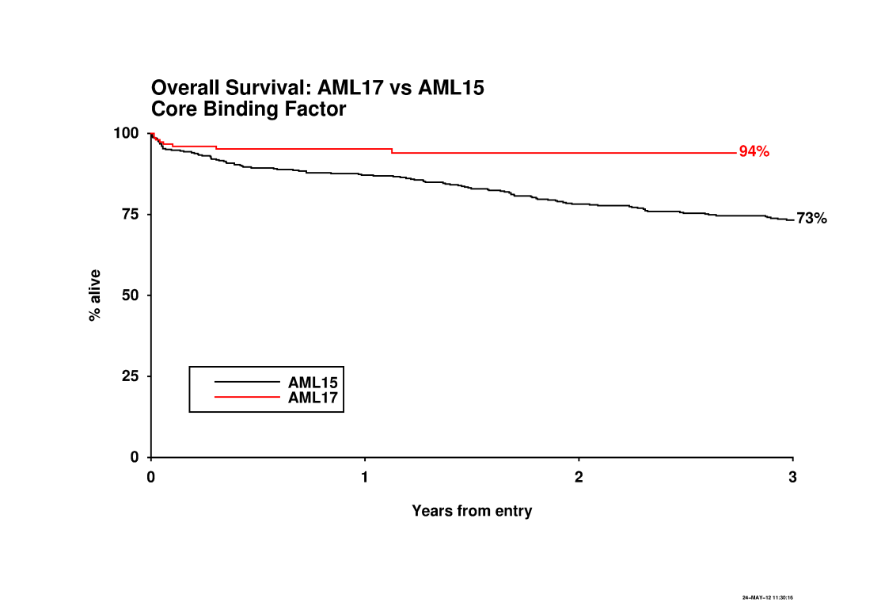
Impact of anti-CD33 targeted therapy (gemtuzumab ozogamicin) in CBF AML
Burnett AK et al, J Clin Oncol 2012

Slide 36

Molecular MRD detection in NCRI AML17 trial
19 patient-specific assays established
Commoner assays validated in European LeukemiaNet
All assays leukaemia-specific
1,768 samples analysed from 289 patients (median 6 samples/pt, range 1-22)
  PB (n=1,198), BM (n=570)
Neesa Bhudia & Adam Ivey

Slide 37

Sequential monitoring for leukaemia-specific transcripts to predict relapse
NCRI AML17 trial
NPM1 mutant AML
246 patients
1441 samples
Adam Ivey, Neesa Bhudia,
Mandy Gilkes, Rosemary Gale

Slide 38
Determining the clinical utility, cost-effectiveness & impact on quality of life of MRD monitoring in AML17
MRD monitoring
Monitor Disease
Report
Results
MRD Marker
2
Best AIDA
Best AIDA
Non
Best AIDA
Non
-
-
APL
APL
(Italian)
(Italian)
patients
(Italian)
R
patients
APL patients
R
1
MRD marker
No Monitoring
No MRD Marker
(Italian)
(Italian)
Chemo free
Chemo free
Chemo free
(ATRA/ATO)
(ATRA/ATO)
(ATRA/ATO)
R
DA (50mg) +GO
R
CBF
CBF
Chemo
I
I
Consol
DA (90mg)
Consol
ADE
S
S
K
K
DA (50mg) + CEP701
Chemo + CEP
Chemo + CEP
-
-
-
701
701
3v4 courses
3v4 courses
R
R
A
R
MACE
A
FLT3 +
FLT3 +
ve
ve
AraC 3g/m²
S
v
S
DA (50mg)
Chemo
Non
Chemo
Non
-
-
APL
APL
S
S
Targeted therapy
carried forward
R
MACE
patients
R
patients
E
E
Chemo +
+
MidAC
Chemo +
mTOR
mTOR
S
DA (50mg) + mTOR
S
R
R
Others
R
S
Others
S
M
M
DA (50mg)
Chemo
E
Chemo
E
Stem cell
transplant
– if appropriate
DA (60mg)
N
DA +GO
6
N
D Clofarabine
T
T
R
Poor risk
R
Poor risk
FLAG-Ida
-
-
Notes:
Another important question that needs to be asked is what effect does MRD monitoring have on patient outcome. We hope to answer this question in the next phase of the AML17 trial which is beginning this month. Each year approximately 400 patients are entered into the AML17 trial. Of these patients 50% are expected to have an MRD target suited for monitoring. Of these patients there will be a 2:1 ratio between those monitored and those not monitored. This should result in approximately 130 patients being monitored each year.
In combination with the treatment randomization protocol in the AML 17 trial, we will be able to assess the clinical significance of MRD monitoring on several different levels.

Slide 39
Potential of next generation sequencing approaches to track treatment response
DNMT3A mut
NPM1 mut
FLT3-ITD
Thol et al. Genes Chromosomes Cancer 2012.
Ivey A, Simpson MA, Burnett AK & Grimwade D, unpubl.

Slide 40
Conclusions
Characterisation of APL has provided significant insights into leukaemia biology
Molecularly-targeted therapies using ATRA & arsenic have transformed the management and outcome for patients with APL
Molecular diagnostics and monitoring allow a personalized medicine approach, serving as a model for other subsets of leukaemia

Slide 41

Acknowledgements
Rayne Institute,
King’s College London
Bernd Zeisig
Eric So
Cancer Genetics Lab,
King’s College London
Edwige Voisset
Eva Moravcsik
Adam Ivey
Melanie Joannides
Jelena Jovanovic
Andre Kűhnl
Richard Dillon
Ellen Solomon
GSTS Pathology
Yvonne Morgan
Khalid Tobal
Beverley Hunt

